Slide 1

SCHOOL MANAGEMENT PLATFORM
One operating system
for your entire school.
Admissions, student records, academics, fees, attendance, staff, parent communication and school operations run on one connected platform — not six that have to be reconciled.
Built for private schools, international schools, preschools and multi-campus groups.
Explore Today, Excel Tomorrow
Notes:
Open on the sentence, not on us. 'One operating system for your entire school' is the whole argument — everything after this slide is evidence for it.
Say who we built this for: private schools, international schools, preschools and multi-campus groups. Large enough that spreadsheets have started to hurt, small enough that enterprise software would be absurd. If they are outside that, say so now.
Do not read the sub-line aloud. Let them read it while you ask the first question: 'Before I show you anything — what does your office actually do on a Monday?'

Slide 2

THE PROBLEM
Most schools run something
critical on a spreadsheet.
The cost is not the licence fees. It is the hour a week each office spends reconciling — and the decisions made on figures nobody quite trusts.
Fee registers, admission enquiries, transport lists, sometimes attendance. It works until the person who maintains it is on leave.
Enquiries live in a notebook
Every system keeps its own student list
Outstanding fees are an exercise, not a screen
A name on a pad, a follow-up nobody owned, a family who visited twice and was never called back.
Somebody exports a spreadsheet on Friday to make them agree. By Monday they disagree again.
Reconciling collection, attendance and results at the end of a term takes the office most of a week.
The office answers the same three questions
The numbers are always a week old
Two screens, two answers
Was she marked present. What is the homework. How much is left to pay.
Reporting is an export somebody took last night, not the position as it stands this morning.
Confidence is lost the first time two systems disagree in front of a parent.
02
Notes:
This slide is where you stop presenting and start listening. Read two of the six, then ask which of them they recognise. Whichever they pick is the module you demo first.
The line that lands with owners is the last one: the cost is not the licence fee, it is the reconciliation hour and the mistrust. Nobody budgets for it, so nobody has ever priced what it costs them.
Do not argue with their current vendor by name. Describe the shape of the problem and let them place their own software inside it.

Slide 3
THE ARGUMENT
Seven integrations,
or one record.
SEPARATE SYSTEMS, JOINED AFTERWARDS
MYCAMPUSVIEW
SIS, admission CRM and school ERP on one database
An admissions tool, a fee package and an attendance app
One student record; every module reads it rather than copying it
Schools usually buy an SIS, an accounting package and a messaging tool, then spend the year reconciling them.
Each holding its own copy of the student list
A nightly sync that is really a person with a spreadsheet
A child admitted this morning is on this afternoon's register
A correction made in the office that three systems never hear about
A payment taken at 11:04 changes the outstanding figure at 11:04
Reporting assembled by hand, a week behind the school
Strength, attendance and collection read live, as they stand
Because there is nothing to synchronise, there is nothing to fall out of sync.
03
Notes:
The distinction to hold on to: integration is not the same as one system. Integrated products agree on a schedule. One database agrees continuously, because there is only one copy of the fact.
The 11:04 line is the one to say slowly. It is the whole difference, expressed as something an accounts clerk has actually experienced.
If they push back — 'our vendor says everything is integrated' — ask the diagnostic question: if you correct a student's name in the fee system, when does the register show it? The answer is usually 'tomorrow', or 'you have to change it in both'.

Slide 4
THE PRODUCT
One database,
not seven integrations.
CRM
Admissions & enrolment
Enquiries land on the system rather than in a counsellor's notebook, and an admitted child becomes a student record without being typed a second time.
SIS
Student Information System
MyCampusView is one application over one database that runs the whole school. The record admissions creates is the record fees invoices, the register marks, and the report card is built from.
One record per student, holding what the school knows about them — and the record every other module reads rather than keeping its own copy of.
ERP
School operations
Everyone signs into the same system and gets a different application. A parent reaches their own children. A teacher marks their own classes. An accountant sees the fee ledger and not the medical notes.
Fees defined once and collected at the counter, staff and leave, transport with live tracking, and a dashboard that reads today's figures.
04
Notes:
Three products, one record. Say the abbreviations out loud — CRM, SIS, ERP — because that is how a director has been taught to compare quotes, and it lets them see that three line items on their shortlist are one line item here.
The closing paragraph is the answer to 'is it safe to give teachers logins?'. Separation is enforced when data is read, not by hiding menu items: a link typed by hand returns nothing rather than someone else's record.
If the IT person is on the call, offer to walk them through the isolation tests directly.

Slide 5
WHAT YOU GET
Complete campus visibility.
And the control that comes with it.
One database, not an integration
There is no nightly sync between an SIS and an ERP, because there are not two systems.
Built for schools, not adapted from business software
Academic years, sections, terms and guardians are first-class. Nothing is a repurposed customer or invoice record.
Not a dashboard bolted onto a filing system. The figures are the records, read at the moment you ask for them.
Reporting from live figures
Strength, attendance, collection and outstanding are read from the records as they stand, not from an export taken last night.
50
1
11
100%
Your own domain and branding
The application, its documents and the school website carry your name, logo and colours on a domain you own.
Modules available today
Database behind all of them
Roles out of the box
Of queries scoped to one school
Plus custom roles, permission by permission, per school.
3 more in build, 8 planned — each labelled as such.
A fee, an absence and a result read the same student record.
Enforced in the data layer and covered by tests that fail the build.
05
Notes:
These four figures are deliberately modest and every one can be checked by opening the product. We publish no customer counts and no retention rates, because we will not put a number in front of a school that we cannot stand behind.
'100% of queries scoped to one school' is the one a group or a trust will care about. It means a staff member at one campus cannot reach another campus, and that this is enforced below the screens rather than remembered by each of them.
If they ask what is NOT built: 3 modules in build, 8 planned, all named on the website. Volunteering that is what makes the other 50 believable.

Slide 6
THE PLATFORM
Everything that is built today.
50 modules are available now, 3 are in build and 8 are planned. Only what works today is named here.
ACADEMICS
EXAMINATIONS
PEOPLE
ADMISSIONS
Classes & sections
Examinations
Student records
Enquiry capture
Subjects
Mark entry
Parents & guardians
Admission pipeline
Timetable
Grading schemes
Staff records
Follow-ups & call logs
Homework
Results
Student attendance
Conversion analytics
Classwork
Report cards
Attendance reports
Online enquiry form
Academic calendar
Certificates
Staff attendance
Front office & visitors
Syllabus
Leave
Enrol as a student
FINANCE
COMMUNICATION
OPERATIONS
ADMINISTRATION
Fee structures
Notices
Transport routes & stops
Administrator dashboard
Invoices
Messages
Buses & drivers
Roles & permissions
Fee collection
Email delivery
Live tracking
Branding
Payments ledger
Message templates
Library
Audit trail
Outstanding
Inventory
Custom domain
Concessions
Events
Progressive web app
Sports
Reports & analytics
School website
06
Notes:
Do not read this slide. Put it up, let them scan it, and ask which four matter to their office. Then demo those four properly instead of all fifty badly.
The sentence that earns trust here is the one about labelling. Our public module page carries a status on every module — available, in build, or planned — and nothing is described as available unless the screen exists. A school finds out what is missing in the first month either way; finding out now costs us some enquiries and saves both sides an implementation sold on something that did not exist.
If a module they need is planned, say so plainly and tell them which schools asking for what is how the build order gets decided.

Slide 7
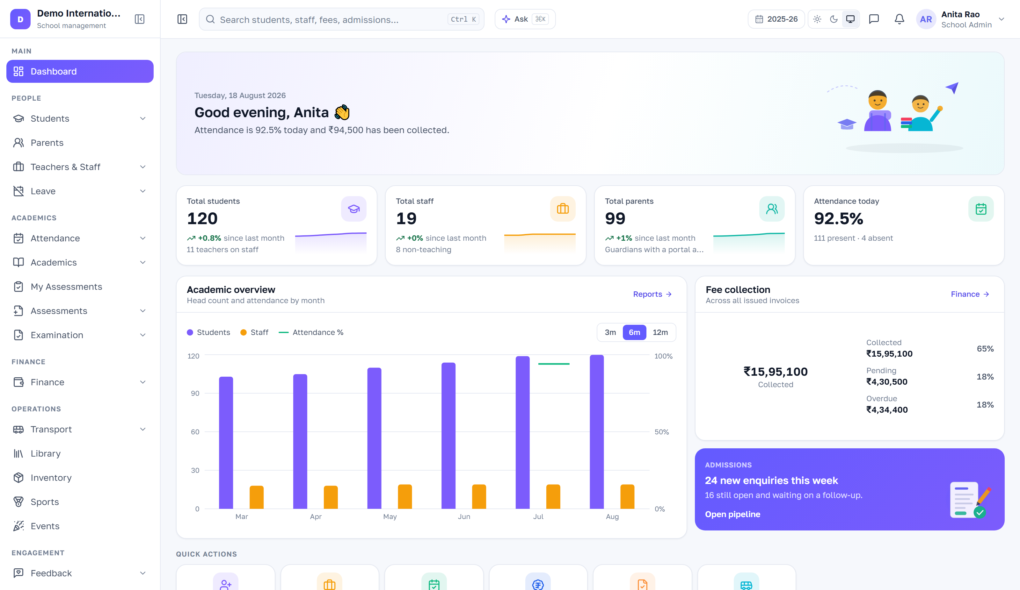
FOR THE PRINCIPAL AND THE MANAGEMENT
The whole school on one screen,
before your first meeting.
Ordered by the questions a head of school asks on the way in: how many children do we have, were they here, has the money arrived, and is anything on fire.
Strength, staff and guardians, with the movement since last month
Attendance today — present, absent, late, and which registers are still unsubmitted
Collected today and this month, against pending and overdue
Administrator dashboard. Live figures from a demonstration school of 120 students.
New enquiries this week and how many are still open
Needs attention: unmarked registers, invoices past due, leave to approve
07
Notes:
This is the slide a principal buys from. Everything on it is a live query, not a nightly rollup — the collection figure moves while you are looking at it.
Point at the 'needs attention' row specifically. It is the difference between a dashboard that reports and one that hands you today's work: registers nobody submitted, invoices past their date, leave sitting unapproved.
Principals and school admins get this. Students and parents get a fundamentally different page, not a cut-down version of this one — worth saying, because the first worry is always 'what will parents be able to see?'

Slide 8
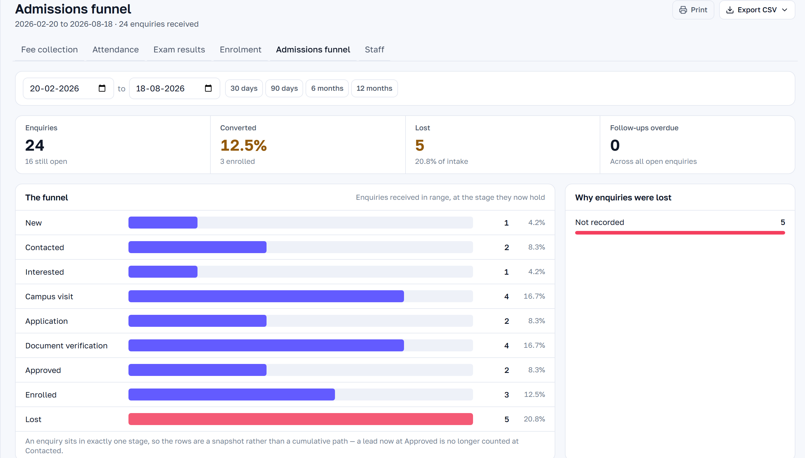
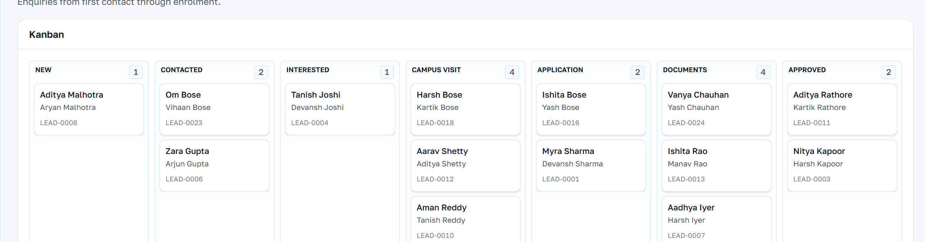
GROWTH
Every enquiry on the system
from the first phone call.
Admissions is where schools lose the most information and notice it the least. A school with three hundred enquiries a season and a two-point leak has lost six admissions, and no report will ever show it.
A pipeline, not a notebook
Follow-ups that have an owner and a date
New, contacted, interested, campus visit, application, documents, approved, enrolled — moved on a board the whole office can see.
One queue answering who to contact today and what is already overdue.
Where enquiries come from
Conversion by source, by stage and by counsellor
Walk-in, referral, website, call or campaign — recorded at capture, so spend can be judged against enrolments rather than guessed.
The funnel report shows where enquiries stall and why they were lost, exportable stage by stage and owner by owner.
Enrolment in one step
A public enquiry form on your own site
Admissions funnel report and the enquiry pipeline.
The student record, the enrolment and the guardian accounts are written together — and the fee structure for that class applies from the same moment.
Writes straight into the pipeline instead of into somebody's inbox.
08
Notes:
For an owner, this is the revenue slide. Everything else on the platform saves cost; admissions is the one that adds fee income, and it is usually the least instrumented part of the school.
Two questions worth asking here, in this order: how many enquiries did you take last season, and how many can you account for by name today? The gap between those answers is the business case, and they will work it out themselves.
'Conversion by owner' is the counsellor-performance conversation. Handle it carefully with the principal in the room — frame it as knowing which sources deserve more spend, not as monitoring staff.

Slide 9
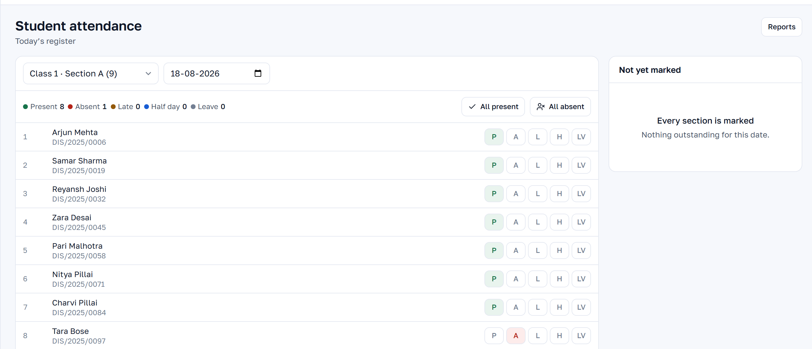
RECORDS
Six years of a child's school life,
on one record.
A student record is not a form. It is attendance, marks, fees, documents and correspondence — and it should still make sense when the child leaves.
The daily register.
THE STUDENT
THE CLASSROOM
ASSESSMENT
Admission details and guardians
Daily and period registers, marked where the class is
Examination schedules per class
Class and section history by year
Absent, late, half day and approved leave held apart
Marks entered against a known maximum, so an impossible score is refused
Siblings as real relationships in the data
Homework with due dates, visible to parents the same evening
Fees raised, paid and outstanding
Grading schemes applied centrally, not in each teacher's spreadsheet
Transport route and stop
Classwork, so a returning child can catch up
Timetable and academic calendar
Results computed, then held until an administrator publishes them
Messages exchanged with the family
Syllabus by chapter and topic
Report cards generated per student or per section
Bonafide, transfer and character certificates
09
Notes:
The point of this slide is that these are not six modules that happen to mention a student. They are six views of one row.
Two details that reliably land with an academic head: marks are validated against the paper's maximum at the point of entry, so an impossible score is refused rather than found at report-card time; and results are computed but withheld until somebody with the right permission publishes them.
For attendance, the thing to stress is that absent, late, half day and approved leave are distinct states, because a school treats them differently and a single present/absent flag forces the office to keep a second list.

Slide 10
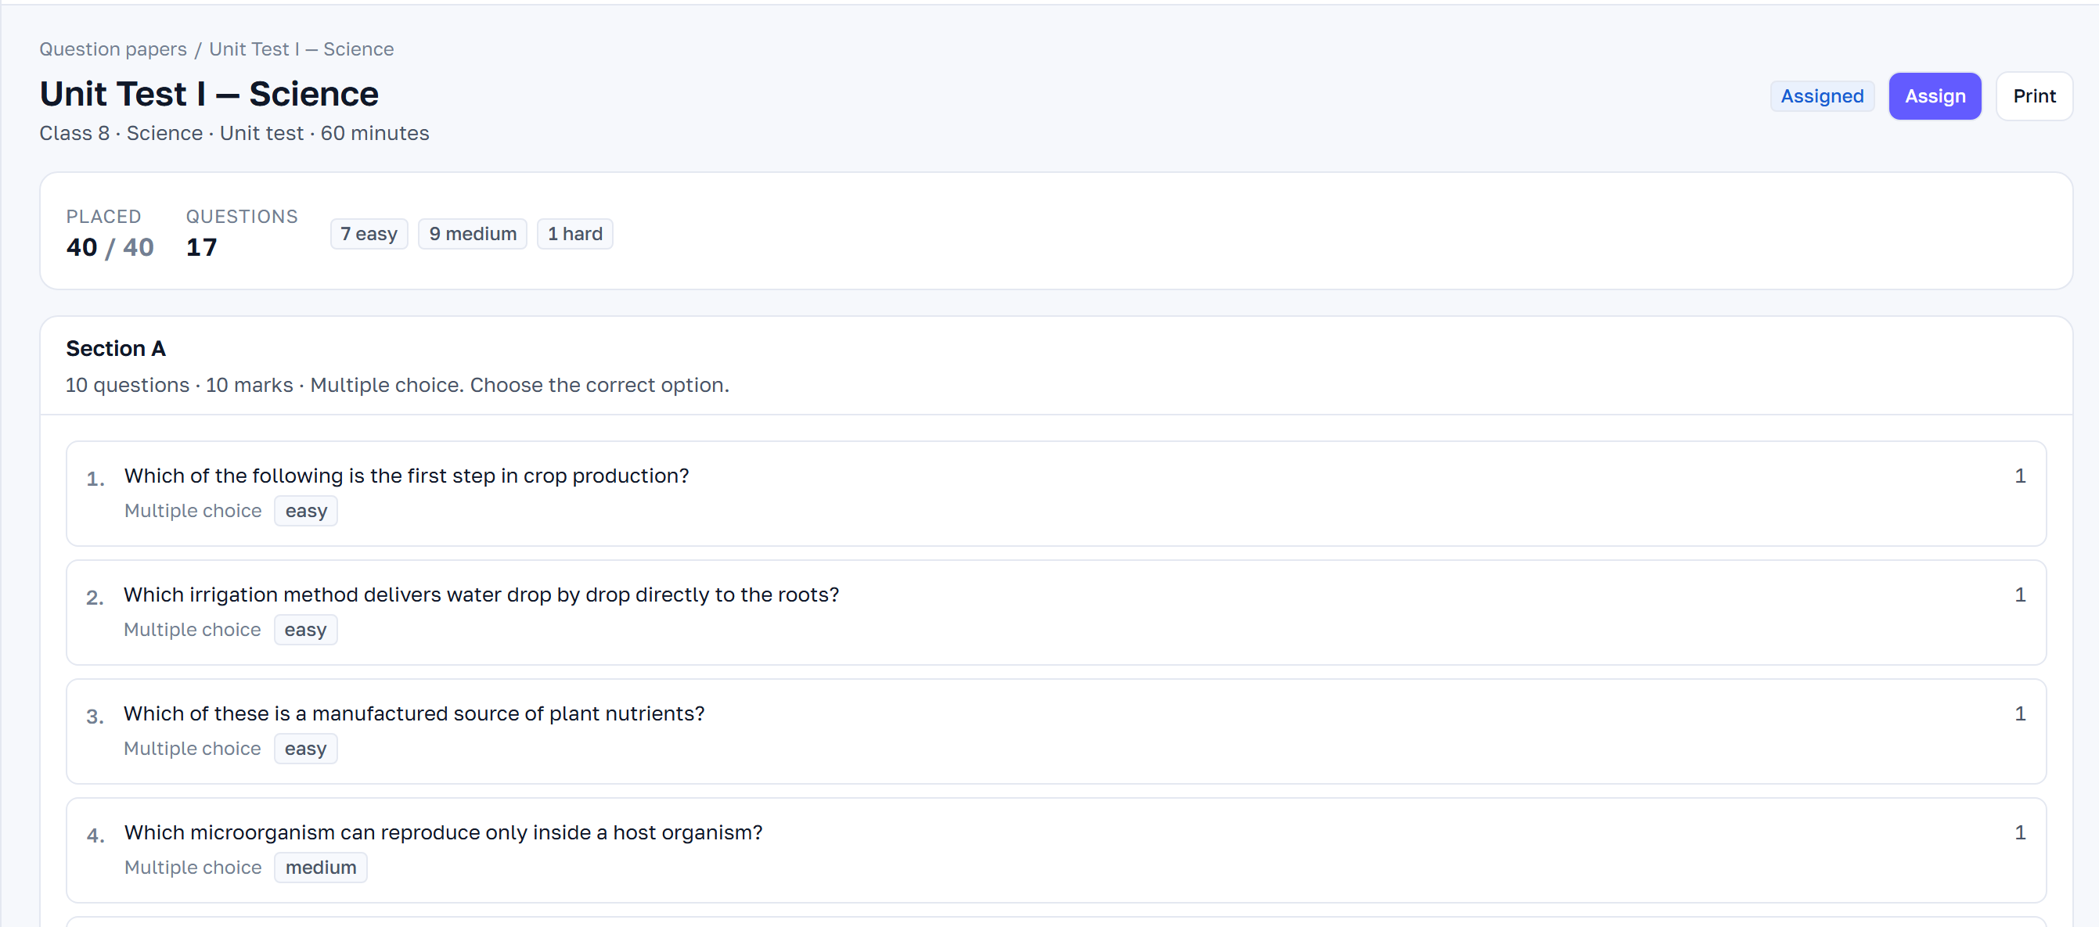
FOR TEACHERS
Give teachers back the evening.
Registers marked in the classroom, papers built from your own syllabus, marks entered once. Nothing collected on paper first and typed in later.
The paper builder: 40 of 40 marks placed, 17 questions, difficulty mix shown.
A question bank the school keeps
Papers built section by section
Drafts generated from your published syllabus
Questions by subject, chapter, type and difficulty, reviewed and approved once and reusable every year after.
Marks total as questions are placed, with the easy, medium and hard mix shown as you build. Fourteen test types, from a daily test to a pre-board.
Generated questions arrive as drafts against your own chapters and topics. They cannot reach a paper until a teacher approves them.
Set online or print it
Per-question analytics after the test
Their own classes, and nobody else's
Assign to a section with a window, or print the paper. Objective answers mark themselves; the rest get a marking sheet.
Which questions the class actually failed, before the next lesson is planned.
Registers, homework and marks are scoped to what each teacher teaches — enforced by the server, not by hiding a menu.
10
Notes:
Teacher adoption is what decides whether school software survives past month three, so this slide is about time, not features.
The strongest single line: a question written and approved this year is reusable every year after. Most schools rebuild the same unit test from scratch annually because it lives in a personal folder on a personal laptop.
On generated questions, be precise and be first to raise the limit: they are drafts, built from the school's own published syllabus rather than from the subject name, and nothing generated can reach a paper without a teacher approving it. Teachers relax when they hear the approval step before they think to ask for it. Question generation needs the AI module on the school's plan.

Slide 11
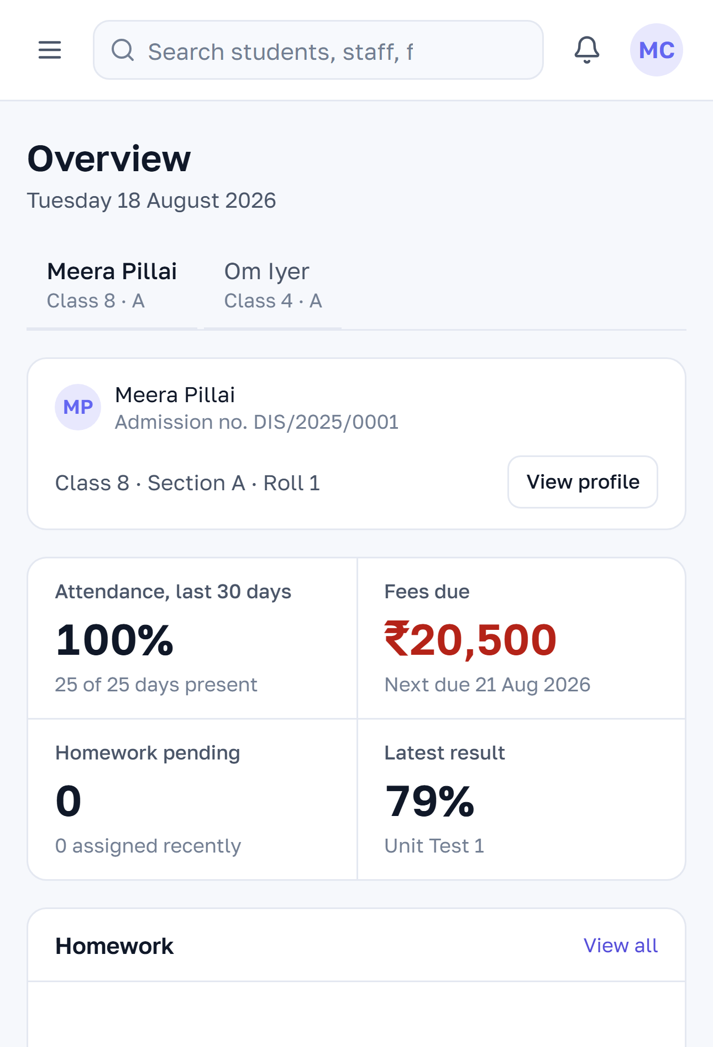
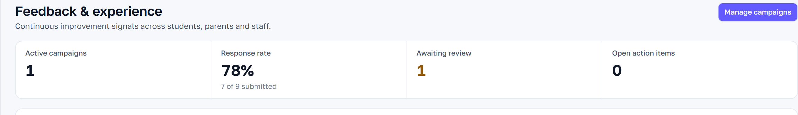
ENGAGEMENT
The office stops answering
the same three questions.
Was she marked present. What is the homework. How much is left to pay. Parents can see their own children and nothing else.
WHAT A PARENT OPENS ON THEIR PHONE
360° FEEDBACK, RUN AS A CYCLE
Attendance, day by day
Campaigns to students, parents or staff, on a schedule the school sets
Homework and classwork
Fee balance and receipts
Anonymous to the teacher, and withheld until a minimum number of responses
Results and report cards
Confidential concerns routed for review rather than into a public average
A parent’s own view of their own children, and the feedback cycle: campaigns, response rate, concerns and action items.
Notices from the school
Their child's bus, live, with the next stop
Action items with an owner, a priority and a due date
Teacher-to-student feedback with controlled visibility to the child or the parent
11
Notes:
Parent transparency is the part of this that a school markets. Feedback is the part that quietly changes the school.
The design detail that matters to teachers, and you should volunteer it: responses are anonymous to the teacher and are withheld entirely until a minimum number have come in, so one aggrieved child cannot become a teacher's rating. Say that before a teacher on the call has to ask.
For the principal: the value is not the score, it is the action item — a concern with an owner and a due date, which is the difference between collecting feedback and acting on it. Ask what they currently do with the PTM feedback forms they already collect.

Slide 12
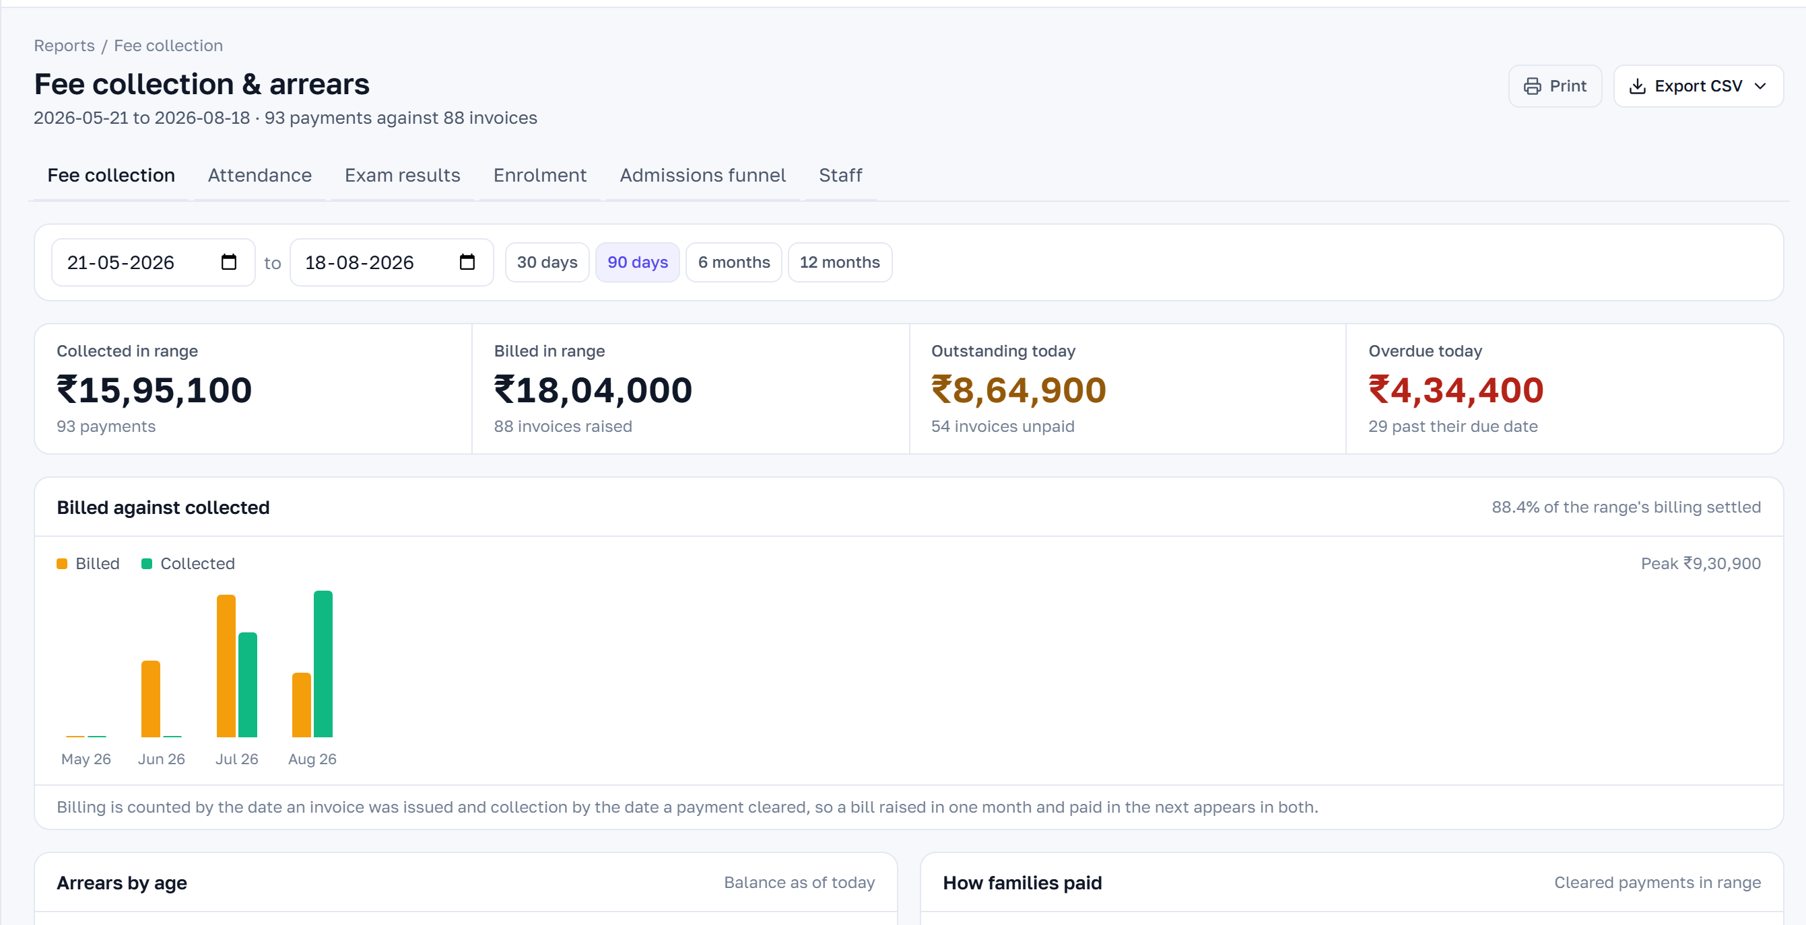
MONEY AND OPERATIONS
A payment taken at 11:04 changes
the outstanding figure at 11:04.
Fee structures are defined once per class and produce every invoice, receipt and outstanding report from the same figures.
Fee collection and arrears. Ageing measured from each invoice's due date.
FEES
VISIBILITY
THE REST OF THE OFFICE
Heads, instalments, due dates and late-fee rules per class
Outstanding by class and by family, as of today
Staff records, roles and permissions
Bulk invoice generation, previewed before it is committed
Arrears aged from each invoice's due date
Geofenced staff check-in, decided on the server
Counter collection in cash, cheque, card, UPI or transfer
Collection against billing, month by month
Leave applied for, approved and reconciled to the register
Numbered, branded receipts printed at the counter
How families paid, by mode
Transport: routes, stops, fleet papers and live tracking
Part payments allocated across invoices, oldest first
Every payment with the person who took it
Library, inventory, events, sports and the front desk
Sibling, staff and scholarship concessions on the record
Six reports, each exportable to CSV
Your school website, on your own domain
12
Notes:
Bring the accounts person into this one. They will test it in ten seconds with a part-payment question, so answer it before they ask: part payments are allocated across invoices oldest first, and every allocation is conserved to the paisa.
Concessions are applied to the record, not to the receipt. That sounds like a technical distinction and it is not — it is why a sibling concession still shows correctly in outstanding a year later.
Ask how long it currently takes to answer 'what is outstanding for Class 6, today'. Most schools answer in days. Then show them the arrears ageing screen.

Slide 13
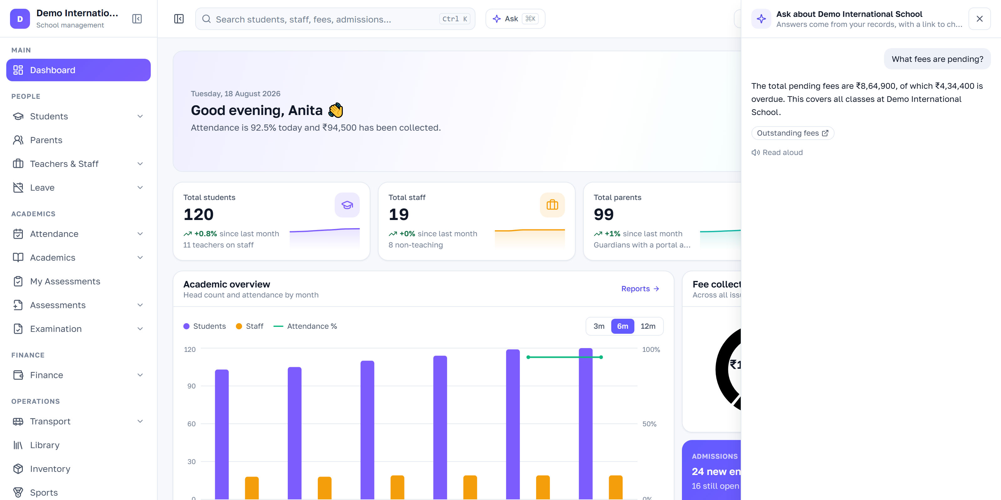
BUILT IN
Ask the school a question.
Get the number, not a report.
The fastest way for someone running a school to get a figure they would otherwise click through four screens to find.
What fees are pending?
Whose attendance is missing today?
The assistant answering from the demonstration school's own fee records.
How much did we collect this month?
Which students have attendance below 80%?
Every figure comes from your records
Each answer links to the screen it came from
It sees only what you may see
It drafts; you send
Fetched at the moment you ask. Nothing is estimated, and nothing is repeated from an earlier answer that may since have changed.
Your school, and your own permissions. There is no way to ask it about another school.
It can prepare a fee reminder or a notice for a class. Your approval performs the send — it never sends anything itself.
So the number can be checked rather than trusted.
13
Notes:
Demo this live if the connection allows. It is the moment that separates the deck from every other school-ERP deck a director has sat through.
Lead with the grounding rule, not the novelty. An assistant that guesses a fee balance is worse than no assistant, because a wrong number looks exactly as authoritative as a right one and a principal may repeat it to a parent. Ours cannot state a figure that did not come from a tool call against their records, and every answer carries a link to the record it came from.
Then the safety line: it drafts, you send. It has never sent a message on its own.
Commercially: the assistant is a module on the school's plan and is switched on per school. Do not promise it inside a starter quote.

Slide 14
FOR THE SCHOOL AS A BUSINESS
What changes for the people
who own the outcome.
FROM FIRST CALL TO LIVE
01
Discovery
Week 1
Half a day on how your school runs today, usually with the principal and the head of accounts.
02
Configuration
Weeks 1–2
THE BUSINESS CASE
Classes, sections, subjects, fee heads, grading schemes, roles and branding, as your school uses them.
Fewer enquiries quietly lost
Fee income arrives sooner
03
Data migration
Weeks 2–3
Every enquiry owned, with a follow-up that has a name and a date against it.
Outstanding is a screen, arrears are aged by family, and the follow-up call goes to the right people rather than the whole class.
Students, guardians, fee balances and staff, with totals reconciled against your office before anyone signs in.
04
Training
Weeks 3–4
Separate sessions for the office, for teachers and for your administrator. Recorded, so a new joiner can watch them.
Less manual work, not relocated work
Decisions on today's figures
Entered once. No reconciliation between an SIS, an accounting package and a messaging tool, because there are not three systems.
Strength, attendance, collection and results read live, so a board or trustee meeting is given the position rather than last week's.
05
Launch
Week 4
Attendance and fees go live at a term boundary. Parent sign-in opens once the office is comfortable.
06
Support
Ongoing
Less key-person risk
A brand parents recognise
A named contact for the first term. Every release is applied for you; there is nothing for your IT team to install.
The school's operations live in the system rather than in one person's spreadsheet and their memory of how it works.
Your name, logo and colours through the application, its receipts and report cards, and your website, on a domain you own.
14
Notes:
Left column is why they buy. Right column is why they believe they can survive the switch — and the second objection is usually the bigger one.
Most failed school software was not bad software. It was installed, never populated properly, and abandoned by the third month. Say that, then walk the six steps.
Two commitments worth making explicitly: migration reports every row that does not fit rather than quietly dropping it, and go-live is timed to a term boundary wherever possible so nobody is asked to switch fee systems mid-term.
The weeks are ranges, not promises. Do not tighten them in the room.

Slide 15
Ready to run your school
on one platform?
WHAT A DEMONSTRATION INVOLVES
Thirty to forty minutes, on a call, with your screen or ours
Tell us how your school runs today — what is on paper, what is in spreadsheets, what your current software does badly. The demonstration follows that rather than a script.
Whoever runs admissions, fees or the front office should be there
A written summary afterwards, and a straight note on anything we do not do yet
Book a demo
contact@mycampusview.com
No mailing list, no weekly chasing, and no pricing pressure on the first call
We will be straightforward about the modules that are not built yet. If MyCampusView is the wrong fit for your school, we would rather say so on the first call.
Explore Today, Excel Tomorrow
15
Notes:
Close on the ask, and make the ask small: a call, forty minutes, with the office staff present rather than only the director. They will spot in ten minutes what a director cannot.
The last line is the close, and it is not a flourish. A director who has been oversold twice before buys from the vendor who volunteers the gaps. We publish what is not built on our own feature page; say so.
Book the next call before you leave the room. Confirm who will be on it and which four modules they want to see.

