Slide 1
分布式机器学习
2018.3.19

Slide 2
目录
1.为什么要分布式？
数据量大
计算量大
2.如何设计分布式
数据并行
模型并行
3.怎样实施分布式
参数服务器架构
4.分布式需面对的问题
一致性问题
5.主流分布式框架
Tensorflow
MxNet

Slide 3
数据
Big data | Size of dataset
Clueweb 2012 web crawl | 700 million web pages as 27TB of text data
Flickr, Instagram and Facebook | 10s of billions of images
ImageNet | 14,197,122 images ≈27TB
Big models | Size of models
image recognition systems | 1~10 Billion model parameters
topic models | Up to 1 Trillion model parameters
matrix factorization | Over 1,000 billions parameters
数据来源：
http://www.lemurproject.org/clueweb12.php/
http://www.image-net.org/
https://aws.amazon.com/cn/datasets/

Slide 4
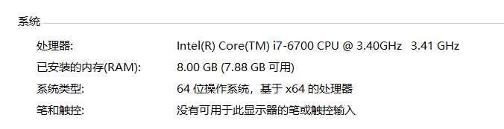
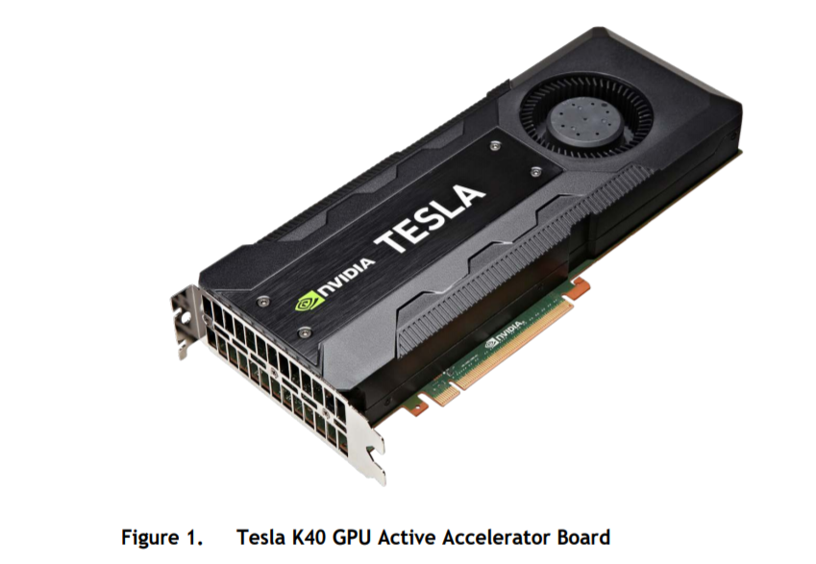
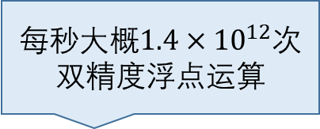
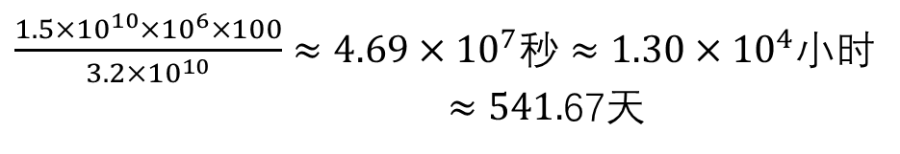
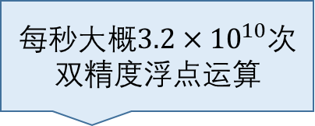
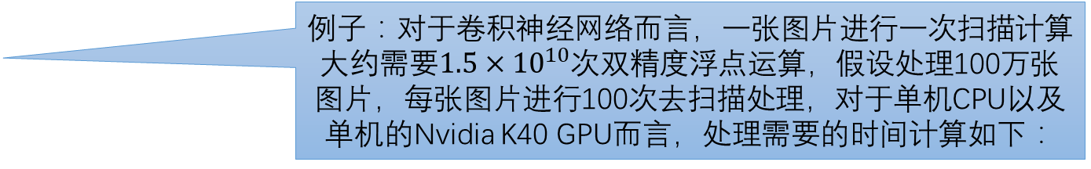
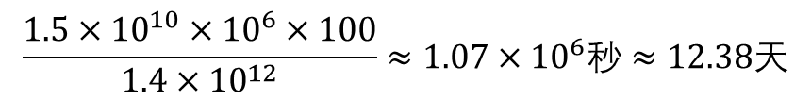
计算
例子：对于卷积神经网络而言，一张图片进行一次扫描计算大约需要$1.5×{10}^{10}$次双精度浮点运算，假设处理100万张图片，每张图片进行100次去扫描处理，对于单机CPU以及单机的Nvidia K40 GPU而言，处理需要的时间计算如下：
每秒大概$3.2×{10}^{10}$次双精度浮点运算
$\frac{1.5×{10}^{10}×{10}^{6}×100}{3.2×{10}^{10}}≈4.69×{10}^{7}秒≈1.30×{10}^{4}$小时
$≈541.$67天
每秒大概$1.4×{10}^{12}$次双精度浮点运算
$$\frac{1.5×{10}^{10}×{10}^{6}×100}{1.4×{10}^{12}}≈1.07×{10}^{6}秒≈12.38天$$
数据来源：
1. https://www.intel.com/content/www/us/en/products/processors/core/core-vpro/i7-6700.html
2. https://www.nvidia.com/zh-cn/data-center/tesla/

Slide 5
数据并行
Read/Write
D1
Δ₁ = Δ（A^{(t-1)} , D1）
D2
Δ₂ = Δ（A^{(t-1)} , D2）
D3
Δ₃ = Δ（A^{(t-1)} , D3）

Slide 6



模型并行
Read/Write
Read
$∆1=$ $∆ 1($S₁ $∈$ S，A^{(t-1)},D)
$∆2=$ $∆ 2($S₂ $∈$ S，A^{(t-1)},D)
$∆3=$ $∆ 3($S₃ $∈$ S，A^{(t-1)},D)

Slide 7
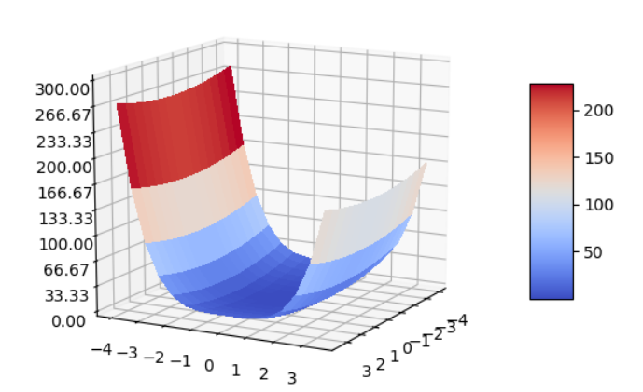
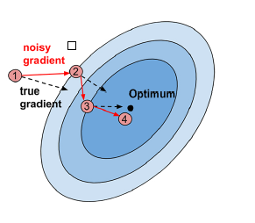
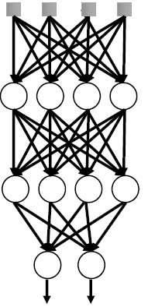
机器学习特点
迭代容错性：模型的更新并非一次完成，需要循环迭代多次，
即使在每个循环中产生一些错误，模型最终仍能收敛
结构（参数）性：在运行过程中参数是有依赖性的
参数收敛的非均匀性：有些参数几轮迭代就会收敛，而有的参数却需要上百轮迭代
（1）多次迭代找最优
（2）神经网络结构
(3)Z = X ^2 +Y^4在(0,2)点的梯度

Slide 8


工业上机器学习计算特点
1. 参数很大，超过单个机器的容纳能力（比如大型Logistic Regression和神经网络）
2. 训练数据巨大，需要分布式并行提速（大数据）
1.数据量大的时候驱动器节点存不下，会使用RDD存储
2.RDD存不下的时候会溢出到磁盘内，造成性能太低
3.由于RDD是只读的，对于每次迭代需要重新创建RDD存储更新的参数，引入大量额外开销。因此不适用与迭代性计算
1.过多的磁盘IO操作，造成性能下降
2.过多的通信以及必须完全同步造成的时间浪费

Slide 9
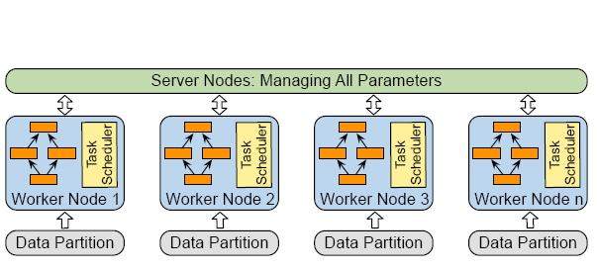
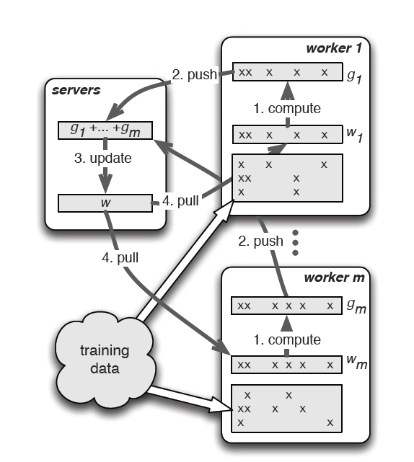
参数服务器——Parameter Server
PS端：收集参数梯度，执行参数更新
Worker端：从PS端获得参数，使用部分数据进行参数梯度计算
参数服务器架构
使用参数服务器计算随机梯度下降

Slide 10
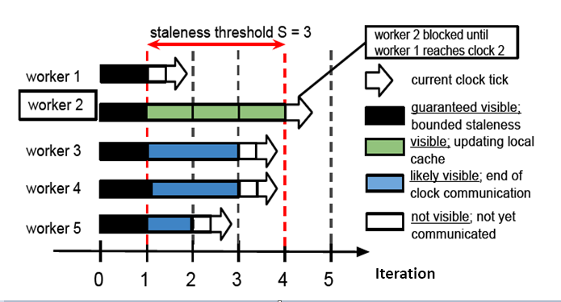
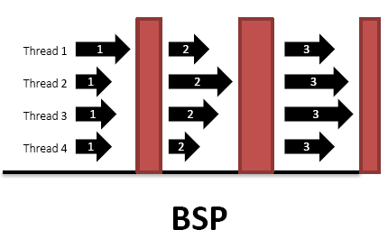
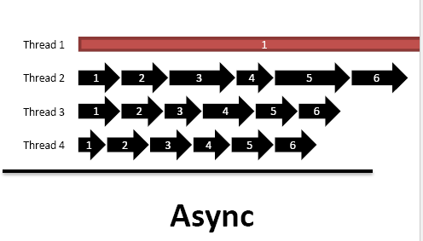
一致性模型
“partial” Synchronization
Stale Synchronous Parallel
1.纵坐标是并行计算节点worker，横坐标是迭代次数
2.设置一个阈值s，MaxIter – MinIter <= s
3.每个worker计算完后需上传更新的梯度，每隔s次迭代会下载更新的参数
4.当MaxIter – MinIter = s时，最快节点会去下载一次参数(相当于等最慢节点)
5.在s次迭代内使用的是陈旧的参数，为了去得到较好的并行化

Slide 11
Tensorflow
Predicition
Training Libraries
Inference Libraries
Softmax
Python Client
C++ Client
Operations
Master
Dataflow Executor
Add
b
Kernel Implementations
Matmul
Variable Tensor
Network Layer
Device Layer
W
x
Placeholder Tensor

Slide 12
Cluster
tf.train.ClusterSpec({
"worker": [
“10.128.201.107:2222",
"10.128.201.108:2222",
"10.128.201.109:2222"
],
"ps": [
“10.128.201.107:2223",
“10.128.201.108:2223"
]})
Ps Job
Job
Worker Job
Task
Master Service
Server
Worker Service
Client
tf.train.Server(cluster_spec,job_name=“ps”,task_index=0)
Notes:
A cluster can be divided into one or more "jobs", where each job contains one or more tasks.
Each task is associated with a TensorFlow "server", which contains a "master" that can be used to create sessions, and a "worker" that executes operations in the graph.
Create a tf.train.ClusterSpec that describes all of the tasks in the cluster. This should be the same for each task.
Create a tf.train.Server, passing the tf.train.ClusterSpec to the constructor, and identifying the local task with a job name and task index.
TensorFlow server: A process running a tf.train.Server instance, which is a member of a cluster, and exports a "master service" and "worker service".
Master service: An RPC service that provides remote access to a set of distributed devices, and acts as a session target. The master service implements the tensorflow::Session interface. All TensorFlow servers implement the master service.
prunes the graph to obtain the subgraph required to evaluate the nodes requested by the client
partitions the graph to obtain graph pieces for each participating device
caches these pieces so that they may be re-used in subsequent steps
Worker service(one for each task): An RPC service that executes parts of a TensorFlow graph using its local devices. A worker service implements worker_service.proto. All TensorFlow servers implement the worker service
handles requests from the master
schedules the execution of the kernels for the operations that comprise a local subgraph
mediates direct communication between tasks

Slide 13
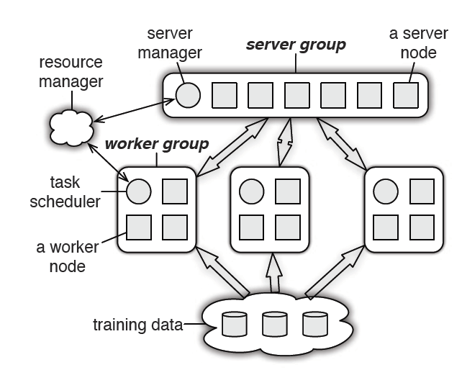
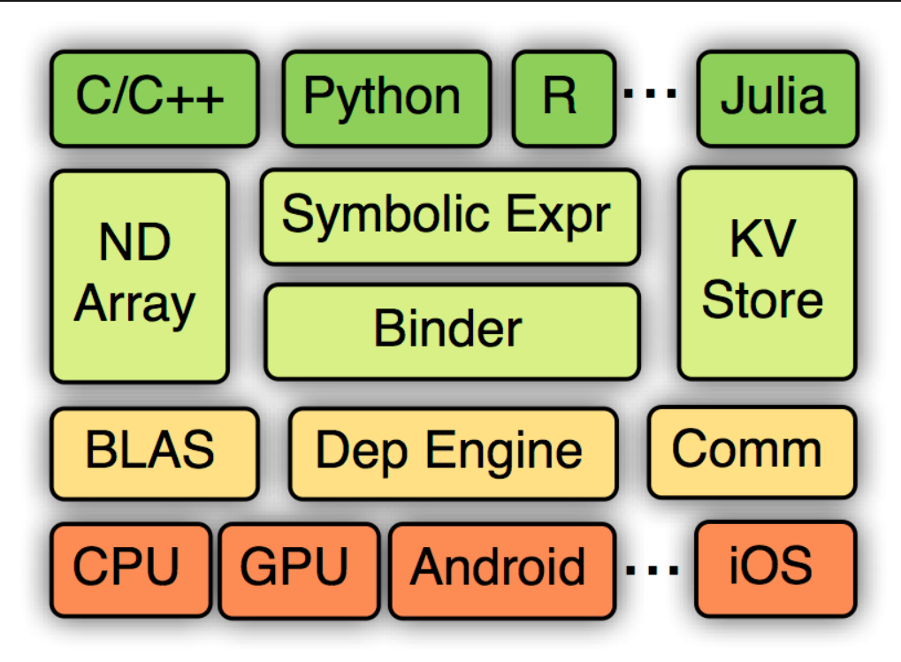
MXNet

