Slide 1
Recurrent Neural Network (RNN)
Notes:
（Recurrent）循环神经网络通过将长度不定的输入分割为等长度的小块，然后将其依次的输入到网络中，从而实现了神经网络对变长输入的处理。
（Recursive）递归神经网络处理树/图结构的的信息。

Slide 2

Example Application
Slot Filling
I would like to arrive Taipei on November 2nd.
ticket booking system
Destination:
Taipei
Slot
time of arrival:
November 2nd
Notes:
通过一个例子来分析一下RNN和普通DNN的区别，以及RNN适合处理于哪一类型的任务
订票系统，电脑客服
Slot Filling：语义解析中的工作，在某一特定话题下，句子中某些单词的含义，比较像分类。

Slide 3
Example Application
time of
arrival
dest
Solving slot filling by Feedforward network?
Input: a word
(Each word is represented as a vector)
Output:
Probability distribution that the input word belonging to the slots
Taipei
Notes:
Word Embedding: 将一个单词转换成固定长度的向量表示
网络：只包含一层全连接层
输入：词向量

Slide 4
Example Application
time of
arrival
dest
arrive Taipei on November 2nd
other
dest
other
time
time
Problem?
leave Taipei on November 2nd
place of departure
Neural network needs memory!
Taipei
Notes:
全连接层，卷积层的神经网络不适合处理序列数据，数据在序列中的位置对结果有很大的影响。因此，要对神经网络进行改造，使得神经网络有记忆功能。

Slide 5
Recurrent Neural Network(RNN)
The output of hidden layer are stored in the memory.
store
Memory can be considered as another input.

Slide 6
The same network is used again and again.
Probability of “arrive” in each slot
Probability of “Taipei” in each slot
Probability of “on” in each slot
y¹
y²
y³
store
store
a¹
a²
a³
RNN
a¹
RNN
a²
RNN
x¹
x²
x³
arrive Taipei on November 2nd
Notes:
General idea

Slide 7
Different
Prob of “leave” in each slot
Prob of “Taipei” in each slot
Prob of “arrive” in each slot
Prob of “Taipei” in each slot
y²
……
y²
……
y¹
y¹
store
store
a¹
a²
a¹
a²
a¹
……
a¹
……
RNN
RNN
RNN
RNN
x¹
x²
……
x¹
x²
……
leave
Taipei
arrive
Taipei
The values stored in the memory is different.
Notes:
Output y^{i} depends on x¹, x², …… x^{i}
The same input can have totoally different output.

Slide 8
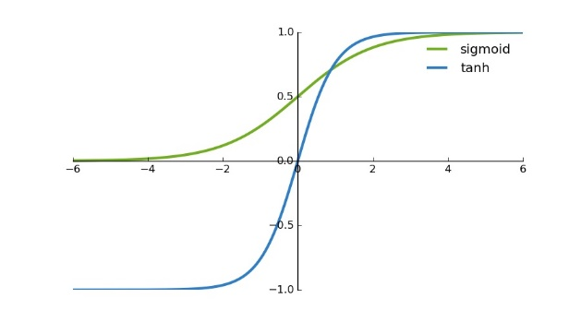



Naïve RNN
Given function f: $h^{′},y=f\left(h,x\right)$
y
h'
W^{h}
h
W^{i}
x
$$+$$
$$=tanh\left( \right)$$
h
f
h'
y
Wº
h'
$$=σ\left( \right)$$
x
softmax
Ignore bias here

Slide 9



Deep RNN
$$h^{′},y=f_{1}\left(h,x\right)$$
$$b^{′},c=f_{2}\left(b,y\right)$$
$$…$$
…
…
…
c¹
c²
c³
b⁰
f₂
b¹
f₂
b²
f₂
b³
……
y¹
y²
y³
h⁰
f₁
h¹
f₁
h²
f₁
h³
……
x¹
x²
x³

Slide 10
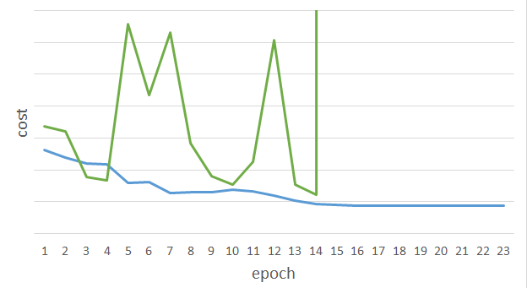
Unfortunately ……
RNN-based network is not always easy to learn
Real experiments on Language modeling
sometimes
Total Loss
Lucky
Epoch
Notes:
梯度爆炸：梯度值随着层的递进成指数级增长 （clipping技术）
梯度消失：梯度值随着层的递进越来越接近于零（改进网络结构：lstm)

Slide 11
Long Short-term Memory
y^{t}
LSTM
c^{t}
y^{t}
c^{t-1}
Naive
h^{t}
h^{t}
h^{t-1}
h^{t-1}
x^{t}
x^{t}
c change slowly
c^{t} is c^{t-1} added by something
h change faster
h^{t} and h^{t-1} can be very different

Slide 12
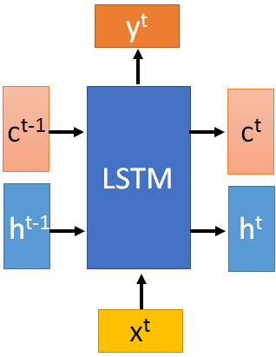




x^{t}
z
W
$$=tanh\left( \right)$$
h^{t-1}
c^{t-1}
x^{t}
z^{i}
W^{i}
$$=σ\left( \right)$$
h^{t-1}
x^{t}
z^{f}
W^{f}
$$=σ\left( \right)$$
h^{t-1}
z^{f}
z^{i}
z
zº
x^{t}
zº
Wº
$$=σ\left( \right)$$
h^{t-1}
x^{t}
h^{t-1}

Slide 13

x^{t}
z
W
h^{t-1}
$$=tanh\left( \right)$$
c^{t-1}
c^{t-1}
diagonal
“peephole”
zº
z^{f}
z^{i}
obtained by the same way
z^{f}
z^{i}
z
zº
h^{t-1}
x^{t}

Slide 14
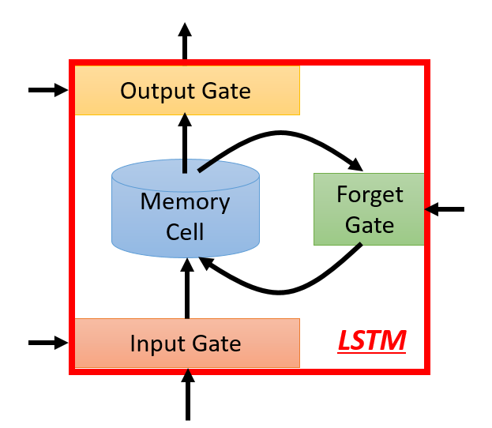








y^{t}
c^{t-1}
c^{t}
$$⨀$$
$$＋$$
$$⨀$$
tanh
$$c^{t}=z^{f}⨀c^{t−1}$$
$$+z^{i}⨀z$$
$$⨀$$
$$h^{t}=z^{o}⨀tanh\left(c^{t}\right)$$
z^{f}
z^{i}
z
zº
$$y^{t}=σ\left(W^{′}h^{t}\right)$$
h^{t-1}
x^{t}
h^{t}
Notes:
Zf：forget gate
Zi：input gate
Zo：output gate

Slide 15
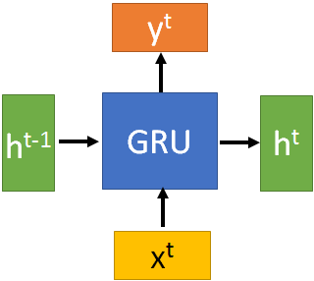
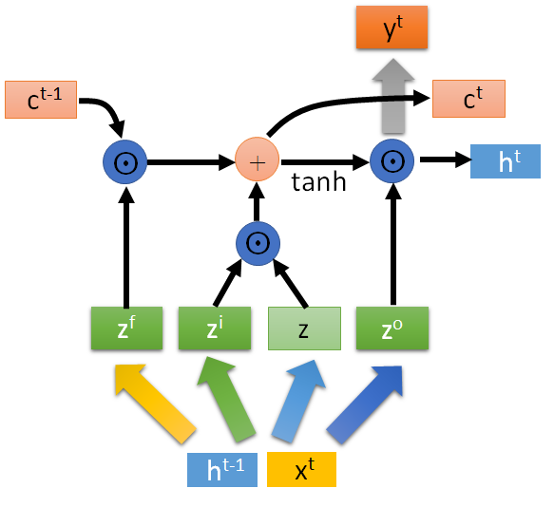





GRU
$$h^{t}=z⨀h^{t−1}+\left(1−z\right)⨀h^{′}$$
y^{t}
h^{t-1}
$$⨀$$
$$＋$$
$$⨀$$
1-
$$⨀$$
reset
update
r
z
h'
h^{t-1}
x^{t}
x^{t}

Slide 16
More Applications ……
Probability of “arrive” in each slot
Probability of “Taipei” in each slot
Probability of “on” in each slot
y¹
y²
y³
Input and output are both sequences with the same length
store
store
a¹
a²
a³
a¹
a²
RNN can do more than that!
x¹
x²
x³
arrive Taipei on November 2nd

Slide 17
Many to one
Input is a vector sequence, but output is only one vector
Sentiment Analysis
超好
好
看了這部電影覺得很高興 …….
這部電影太糟了
…….
這部電影很棒 …….
普
負
Positive (正)
Negative (負)
Positive (正)
超負
……
我
覺
得
……
太
糟
了

Slide 18
Many to Many (No Limitation)
Both input and output are both sequences with different lengths. → Sequence to sequence learning
E.g. Machine Translation (machine learning→機器學習)
Containing all information about input sequence
machine
learning
Notes:
Sequence to sequence model
一个RNN对源语言进行编码，将源语言编码到一个固定维度的中间向量，然后在使用一个RNN进行解码翻译到目标语言

Slide 19
Many to Many (No Limitation)
Both input and output are both sequences with different lengths. → Sequence to sequence learning
E.g. Machine Translation (machine learning→機器學習)
機
器
學
習
慣
性
……
……
machine
learning
Don’t know when to stop
Notes:
中翻英 英翻中 沒有哪一個一定比較長或比較短
RNN-based Encoder-Decoder

Slide 20
Many to Many (No Limitation)
Both input and output are both sequences with different lengths. → Sequence to sequence learning
E.g. Machine Translation (machine learning→機器學習)
機
器
學
習
===
machine
learning
Add a symbol “===“ (斷)
[Ilya Sutskever, NIPS’14][Dzmitry Bahdanau, arXiv’15]
Notes:
中翻英 英翻中 沒有哪一個一定比較長或比較短
More applications

Slide 21
Many to Many (No Limitation)
Both input and output are both sequences with different lengths. → Sequence to sequence learning
E.g. Machine translation / Chat-bot
machine
learning
. (period)
Information of the whole sentences
機
器
學
習
Encoder
Jointly Train
Decoder

Slide 22
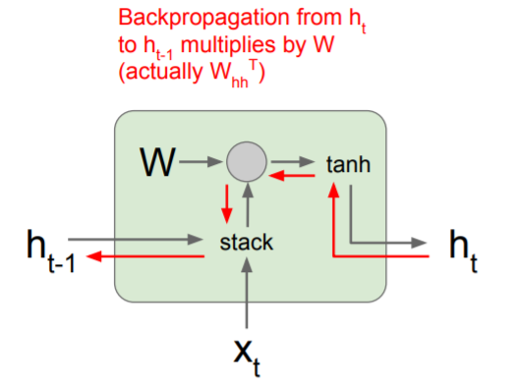
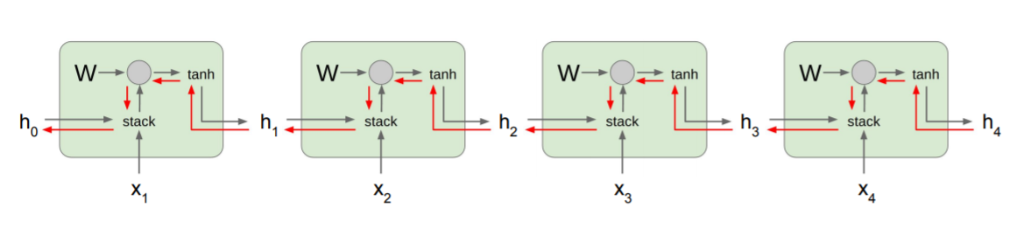
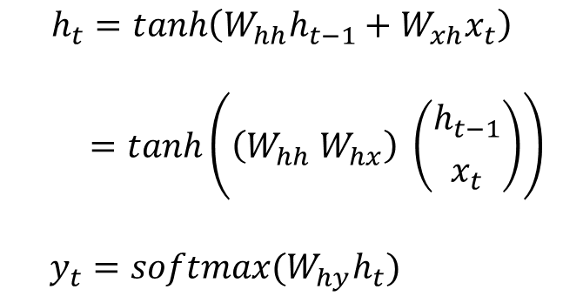
Back Propagation Trough Time
$$h_{t}=\tanh\left(W_{hh}h_{t−1}+W_{xh}x_{t}\right)$$
$$=tanh\left(\left(W_{hh} W_{hx}\right) \left({h_{t−1} \atop x_{t}}\right)\right)$$
$y_{t}=softmax(W_{hy}h_{t})$
Notes:
involve many factors of W and repeated tanh

