Slide 1
论文/项目报告 Present a Paper/Project
科学研究素养与实践
东南大学计算机学院
刘波副教授、单冯讲师
bliu@seu.edu.cn
shanfeng@seu.edu.cn

Slide 2
Content
How to design slides
Important tips
What to put in

Slide 3
How to Design Slides

Slide 4
Types of Presentations
Quick 1-minute “what I do” talk
25 minute conference paper presentation
Project presentation
Thesis defense
Job talk
Notes:
组会报告
课程报告
开题报告
论文答辩

Slide 5
What they have in common:
Never enough time to talk about everything
All of them reflect on you & need practice/polish
Focus on a clear goal and message.

Slide 6
Slide Structure – Good
Spend 1-2 minutes per slide of your presentation
Write in point form, not complete sentences
Include 4-5 points per slide
Avoid wordiness: use key words and phrases only

Slide 7
Slide Structure - Bad
This page contains too many words for a presentation slide. It is not written in point form, making it difficult both for your audience to read and for you to present each point. Although there are exactly the same number of points on this slide as the previous slide, it looks much more complicated. In short, your audience will spend too much time trying to read this paragraph instead of listening to you.

Slide 8
Slide Structure – Good
Show one point at a time:
Will help audience concentrate on what you are saying
Will prevent audience from reading ahead
Will help you keep your presentation focused

Slide 9
Slide Structure - Bad
Do not use distracting animation
Do not go overboard with the animation
Be consistent with the animation that you use

Slide 10
Moving Text
When text appears, we don’t want the audience to be watching the animation.
Use the
“Appear effect”
Not
“FANCY EFFECTS”
Notes:
I can tell that you all aren’t focusing on me but are totally fixed on what is on the screen.
If you want to use an effect to add a little animation to your text but keep it simple, use the APPEAR effect, which just makes the text appear and is the easiest for your audience to read.

Slide 11
Fonts - Good
Use at least an 24-point font
Use different size fonts for main points and secondary points
this font is 28-point, the main point font is 32-point, and the title font is 34-point
Use a standard font like Times New Roman
使用标准字体例如微软雅黑

Slide 12
Fonts - Bad
If you use a small font, your audience won’t be able to read what you have written, 14 pt
CAPITALIZE ONLY WHEN NECESSARY. IT IS DIFFICULT TO READ
Don’t use a complicated font
不要使用不常见的奇怪字体

Slide 13
Style Consistent - Good
Be consistent in your choice of
bullets,
font, and
colors.

Slide 14
Notes:
This is from a presentation at a conference I went to. The entire PowerPoint was like this and made it difficult to read.

Slide 15
Colour - Good
Use a colour of font that contrasts sharply with the background
Ex: blue font on white background
Use colour to reinforce the logic of your structure
Ex: light blue title and dark blue text
Use colour to emphasize a point
But only use this occasionally

Slide 16
Colour - Bad
Using a font colour that does not contrast with the background colour is hard to read
Using colour for decoration is distracting and annoying.
Using a different colour for each point is unnecessary
Using a different colour for secondary points is also unnecessary
Trying to be creative can also be bad

Slide 17
Background - Good
Use backgrounds such as this one that are attractive but simple
Use backgrounds which are light
Use the same background consistently throughout your presentation

Slide 18
Background – Bad
Avoid backgrounds that are distracting or difficult to read from
Always be consistent with the background that you use

Slide 19
Graphs - Good
Use graphs rather than just charts and words
Data in graphs is easier to comprehend & retain than is raw data
Trends are easier to visualize in graph form
Always title your graphs

Slide 20
Graphs - Bad

Slide 21
Graphs - Good

Slide 22
Graphs - Bad
Notes:
Minor gridlines are unnecessary
Font is too small
Colours are illogical
Title is missing
Shading is distracting

Slide 23
Graphs - Bad
Minor gridlines are unnecessary
Font is too small
Colours are illogical
Title is missing
Shading is distracting

Slide 24
Spelling and Grammar
Proof your slides for:
speling mistakes
the use of of repeated words
grammatical errors you might have make
If English is not your first language, please have someone else check your presentation!

Slide 25
Conclusion
Use an effective and strong closing
Your audience is likely to remember your last words
Use a conclusion slide to:
Summarize the main points of your presentation
Suggest future avenues of research

Slide 26
Questions??
End your presentation with a simple question slide to:
Invite your audience to ask questions
Provide a visual aid during question period
Avoid ending a presentation abruptly

Slide 27
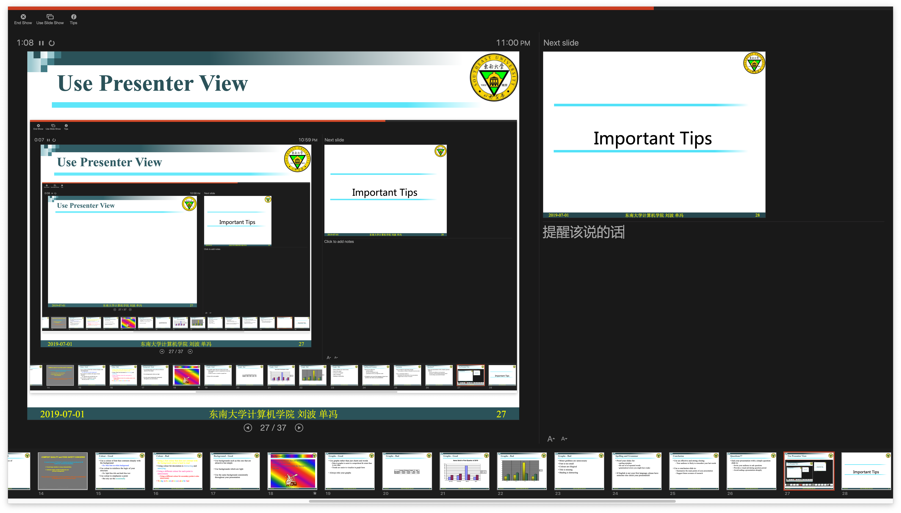
Use Presenter View
Notes:
提醒该说的话

Slide 28
Important Tips

Slide 29
To design your slides
Remember that you are the show
not the PowerPoint slideshow.
Notes:
Never allow the slides to draw attention away from you for long periods of time. Take charge. Be engaging yourself.

Slide 30
Show your Passion
Show your passion on what you are presenting
Your audience can feel it, and accept
Be convinced to convince your audience
Notes:
比如报告论文，你报告的论文必须

Slide 31
Focus on your Audience’s Needs
Bear in mind what the audience needs and wants to know, not what you can tell them.
Remain focused on your audience’s response, and react to that.
Notes:
要有中心思想

Slide 32
Keep it Simple
Concentrate on your Core Message
What is the key take-away key message?
Communicate that key message very briefly.
30-second ‘elevator summary’
keep your core message focused and brief.

Slide 33
Tell Stories
Human beings are programmed to respond to stories.
Think about what story you are trying to tell your audience, and create your presentation to tell it.

Slide 34
What to put in

Slide 35
A “Typical” Project Talk Outline
Who am I?
Title/author/affiliation (1 slide)
Forecast (1 slide)
Give gist of problem attacked
and insight found
Outline (1 slide)
Background
Motivation and Problem Statement (1-2 slides)
Related Work (0-1 slides)
Methods (1-3 slides)
Explain your approach
illustrate algorithm
What is the problem?
Why is it important?
What have others done?
What is my approach?

Slide 36
A “Typical” Project Talk Outline
Results (2-6 slides) Present key results and key insights. This is main body of the talk, but don’t try to show ALL results.
Summary (1 slide)
Future Work (0-1 slides) Backup Slides (0-3 slides) Optionally have a few slides ready to answer expected questions.

Slide 37
Other Things to Consider
Oral communication is different from written communication
Keep it simple and focus on a few key points
Repeat key insights
Be sensitive to your audience
The same talk may need to be adjusted for a different audience
Make the audience want to learn more
Handling Q&A is as important as the formal talk itself

