Slide 1
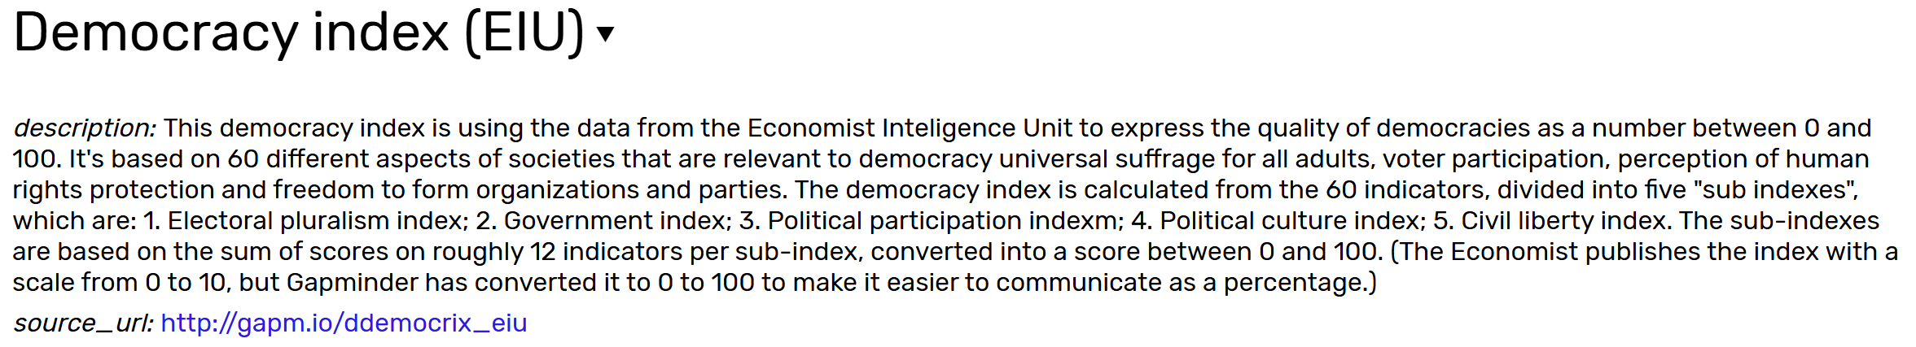
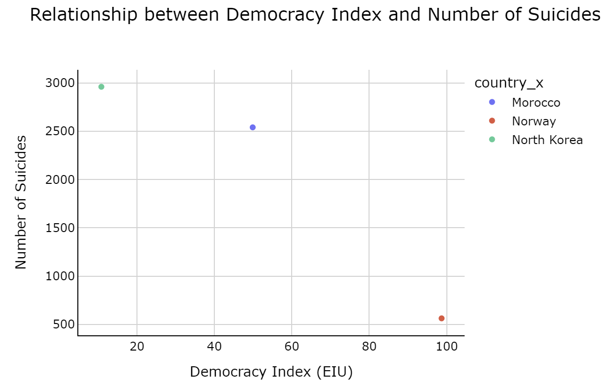
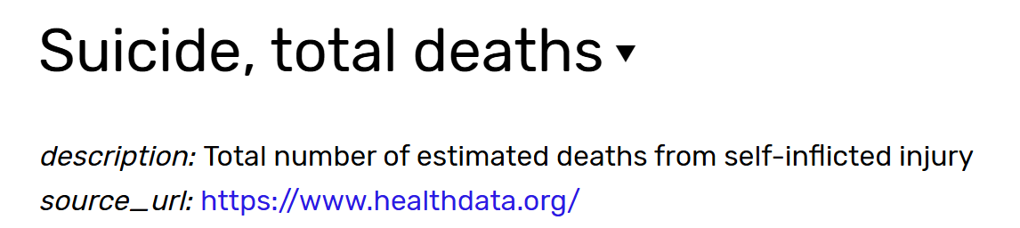
Final project proposal – Lea Adams
I want to look at the relationship between the democracy index of a country and the associated mental health of its citizens. Since the only data about mental health available on gapminder is data on suicides, I will use this data as a proxy for the mental health parameter (I know this may not be ideal, but it’s the best proxy I found).

