Slide 1
Logarithmic dynamic cuckoo filter
Lea Faber i Luka Mucko
Bioinformatika 1
2022/23.

Slide 2
Bloom filter
Cuckoo filter
Dynamic cuckoo filter
Logarithmic dynamic cuckoo filter

Slide 3
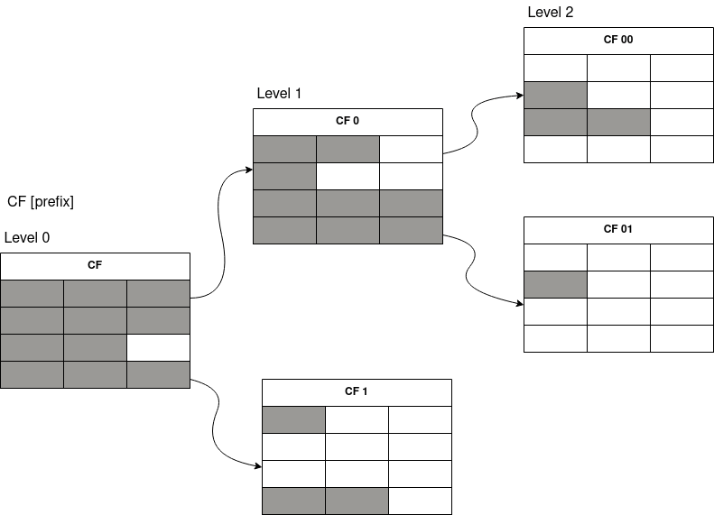
Primjer LDCF-a

Slide 4
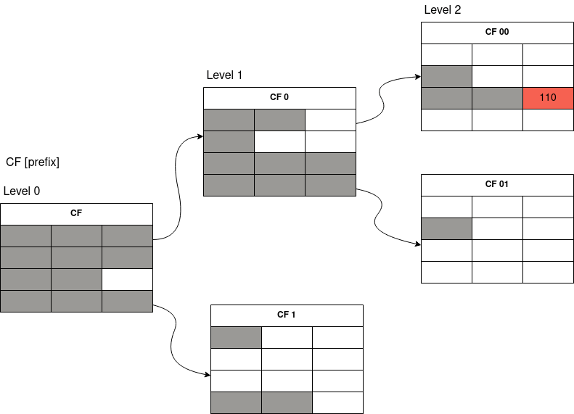
Umetanje 00110

Slide 5
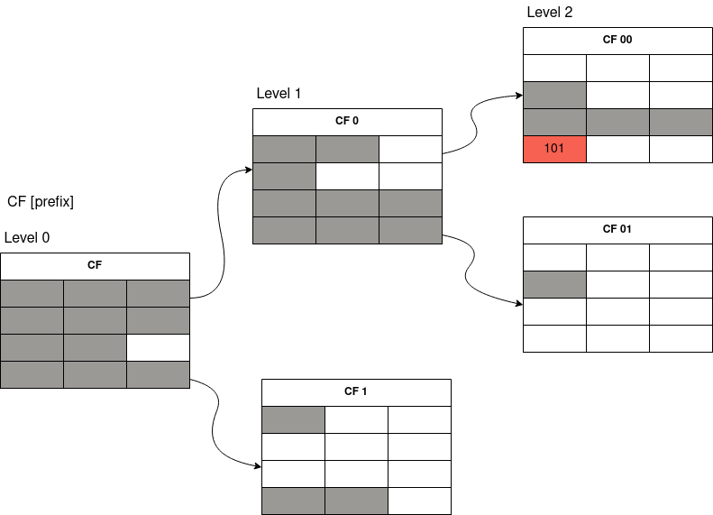
Slučaj: bucket je pun

Slide 6
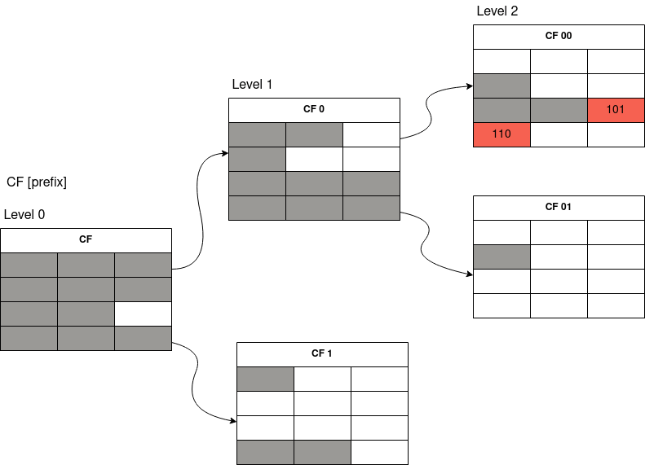
Slučaj: izbacivanje žrtve i umetanje 00101

Slide 7
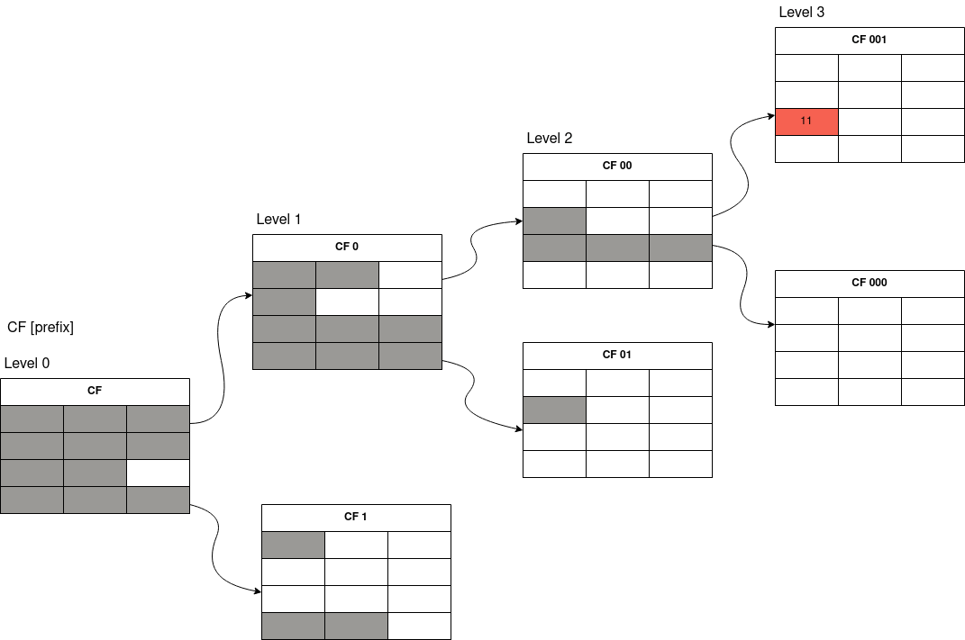
Ekspanzija LDCF-a

Slide 8
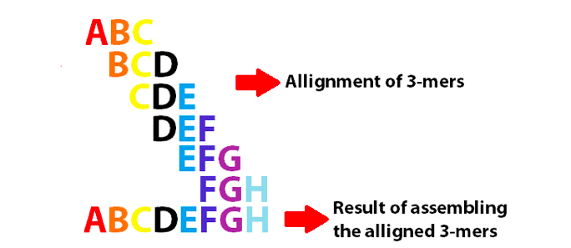

Slide 9
Točnost naše implementacije:
LDCF vs Jellyfish
K | LDCF | Jellyfish
10 | 927256 | 927256
20 | 5298013 | 5298013
50 | 5342621 | 5342621
100 | 5370269 | 5370269
200 | 5394027 | 5394027
500 | 5424848 | 5424848

Slide 10
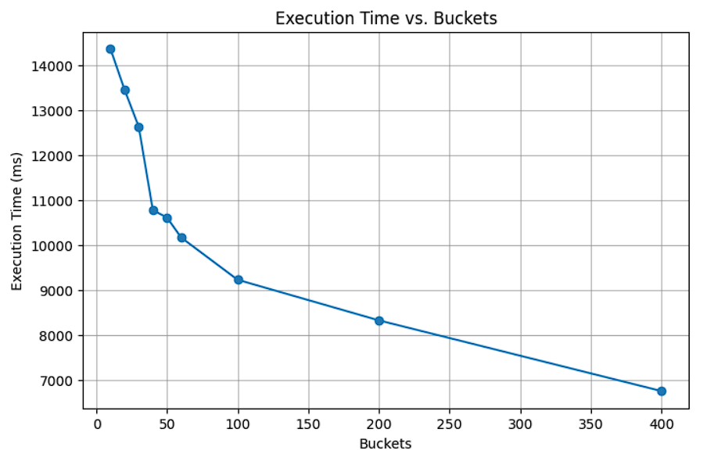

Slide 11
Utrošak memorije
l - nivoa #buckets * #entries * (fp + x₁(fp-1) + x₂(fp-2) + … + x_{l}(fp-l)) [b]
$$\text{4 ∗ 3 ∗ (}\text{fp}\text{ + 2 ∗ (}\text{fp}\text{−1) + 2 ∗ (}\text{fp}\text{−2)) [}\text{b}\text{]}$$

Slide 12
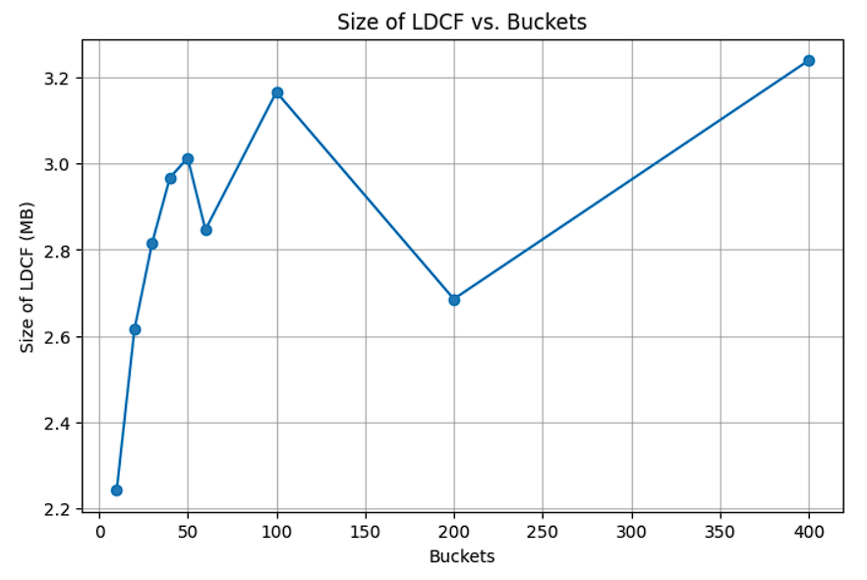

Slide 13
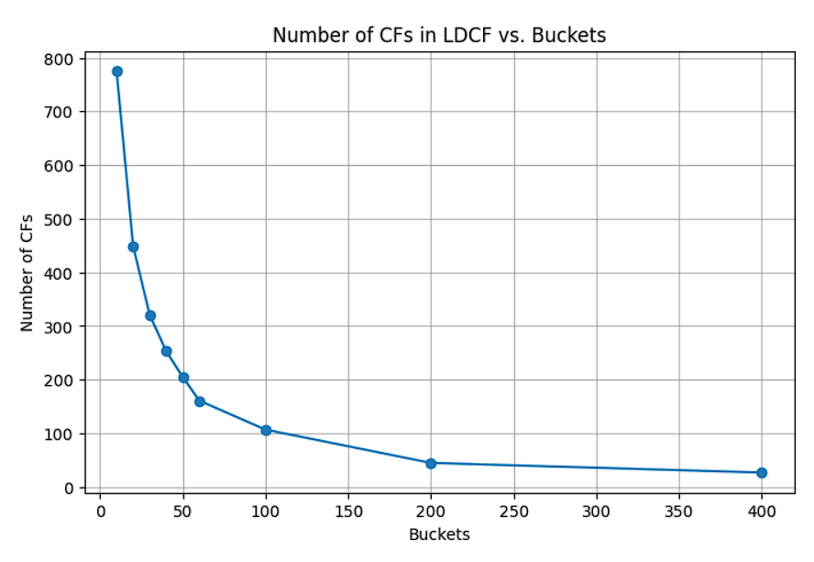

Slide 14
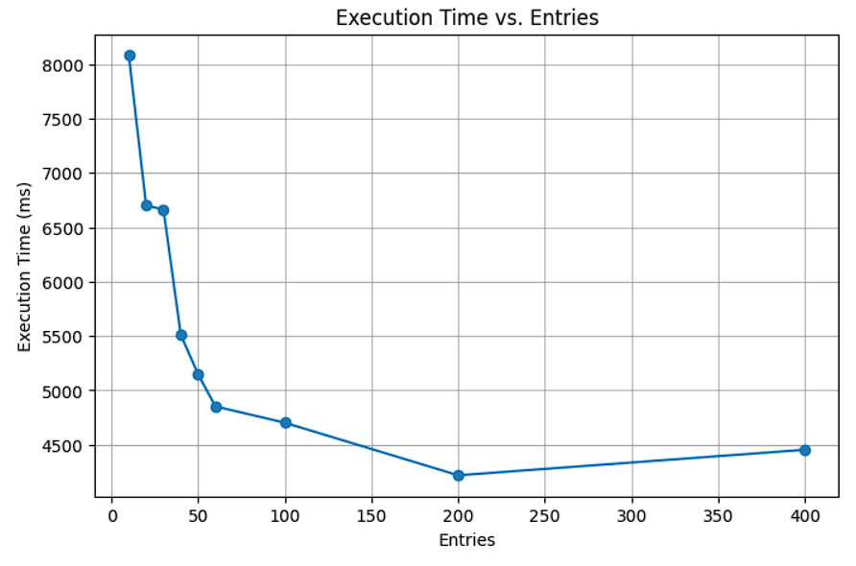

Slide 15
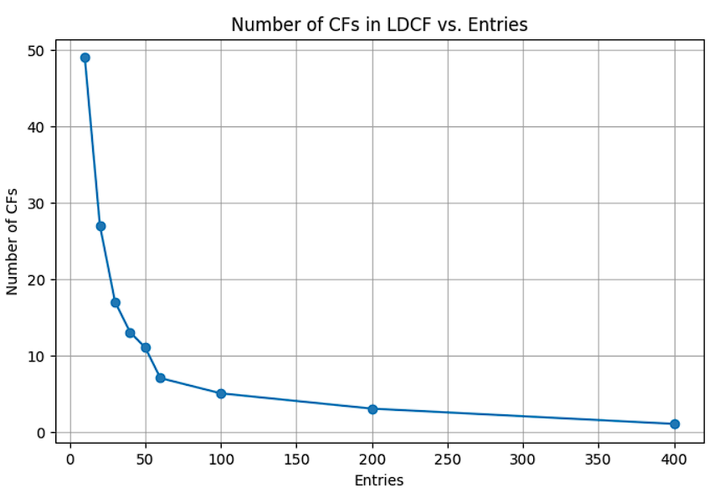

Slide 16
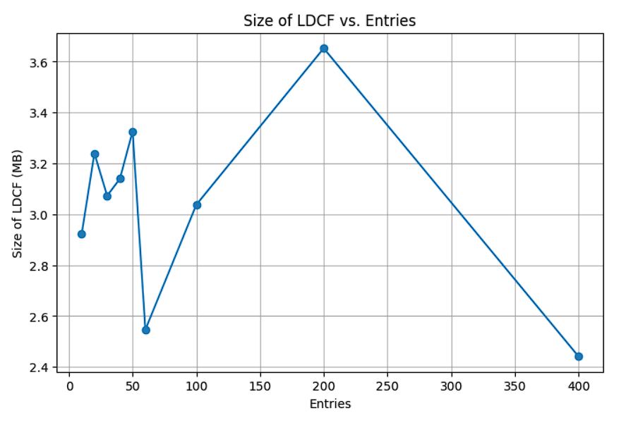

Slide 17
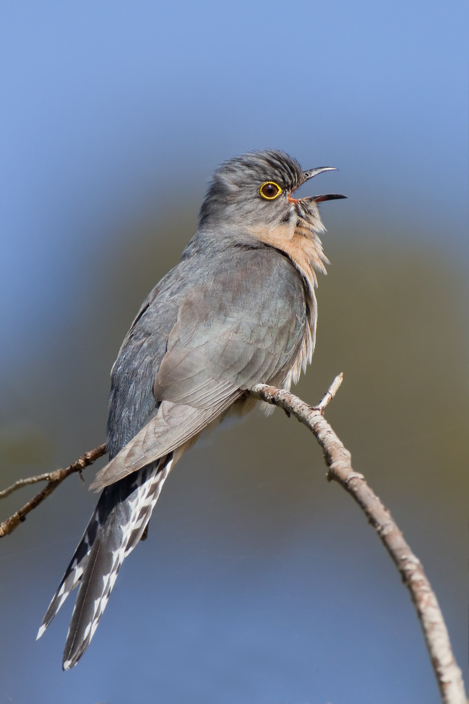
Hvala na pažnji!
Cuckoo

