Slide 1
Logarithmic dynamic cuckoo filter
Lea Faber i Luka Mucko
Bioinformatika 1
2022/23.

Slide 2
Bloom filter
Cuckoo filter
Dynamic cuckoo filter
Logarithmic dynamic cuckoo filter

Slide 3
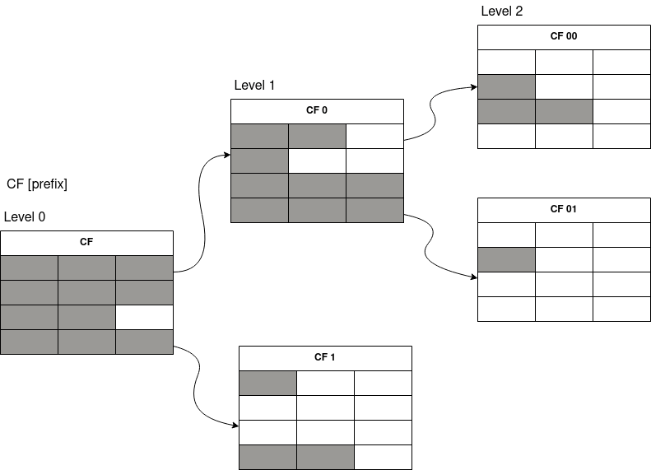
Primjer LDCF-a

Slide 4
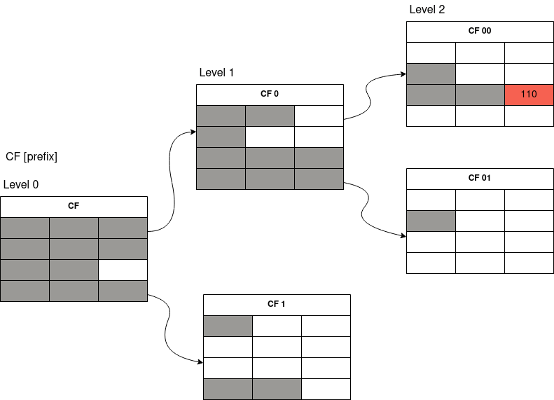
Umetanje 00110

Slide 5
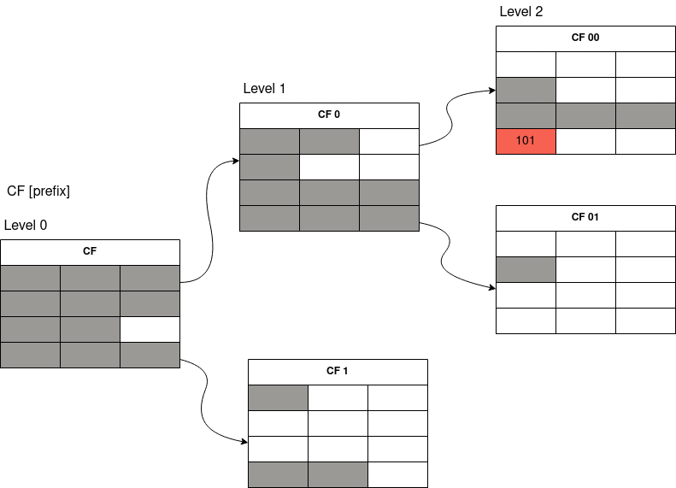
Slučaj: bucket je pun

Slide 6
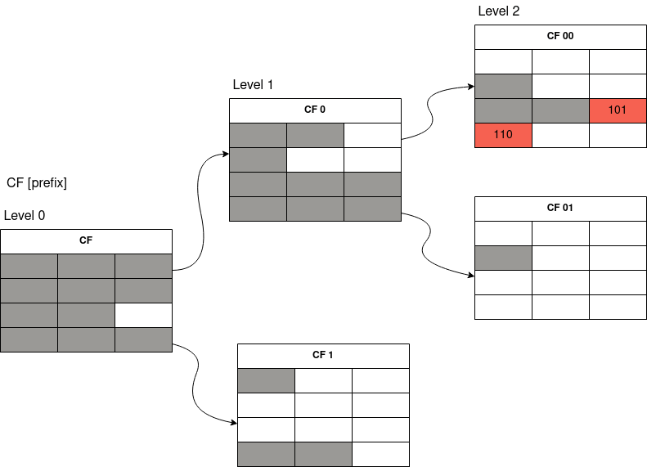
Slučaj: izbacivanje žrtve i umetanje 00101

Slide 7
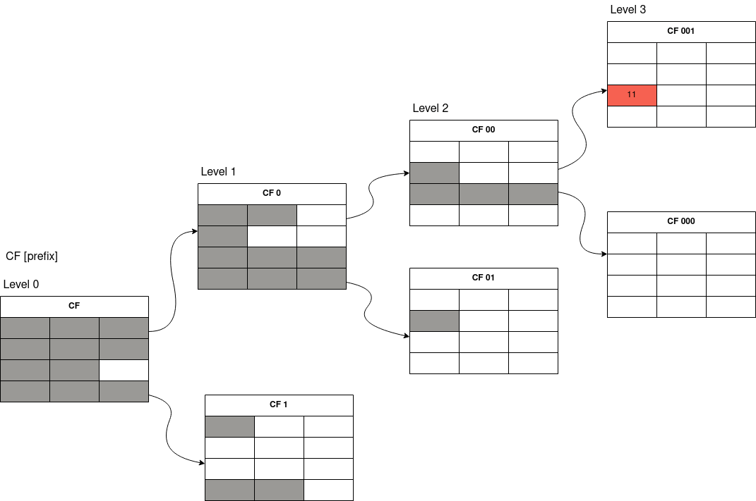
Ekspanzija LDCF-a

Slide 8
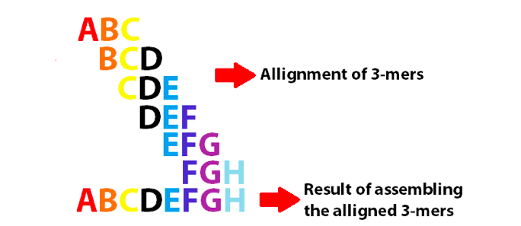

Slide 9
Točnost naše implementacije:
LDCF vs Jellyfish
K | LDCF | Jellyfish
10 | 927256 | 927256
20 | 5298013 | 5298013
50 | 5342621 | 5342621
100 | 5370269 | 5370269
200 | 5394027 | 5394027
500 | 5424848 | 5424848

Slide 10
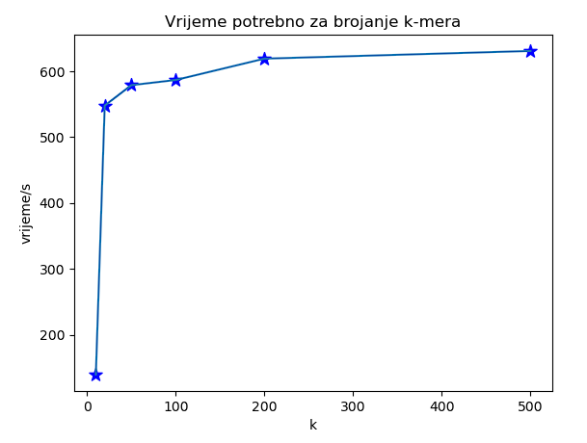
k | 10 | 20 | 50 | 100 | 200 | 500
Vrijeme/ms | 139426 | 547919 | 578915 | 586751 | 619190 | 630851

Slide 11
Utrošak memorije
l - nivoa #buckets * #entries * (fp + x₁(fp-1) + x₂(fp-2) + … + x_{l}(fp-l)) [b]
$$\text{4 * 3 * (}\text{fp}\text{ + 2 * (}\text{fp}\text{-1) + 2 * (}\text{fp}\text{-2)) [}\text{b}\text{]}$$

Slide 12
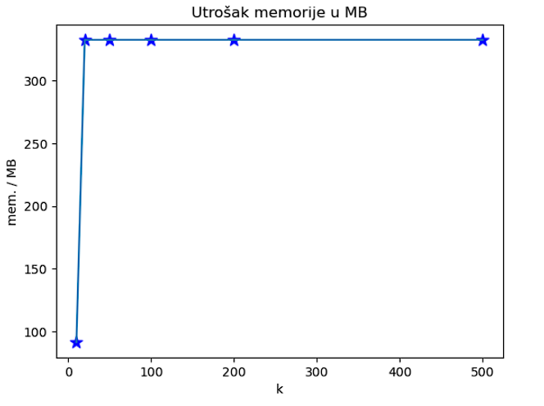
K | 10 | 20 | 50 | 100 | 200 | 500
Zauzeće memorije /MB | 91.3143 | 332.594 | 332.594 | 332.594 | 332.594 | 332.594

Slide 13
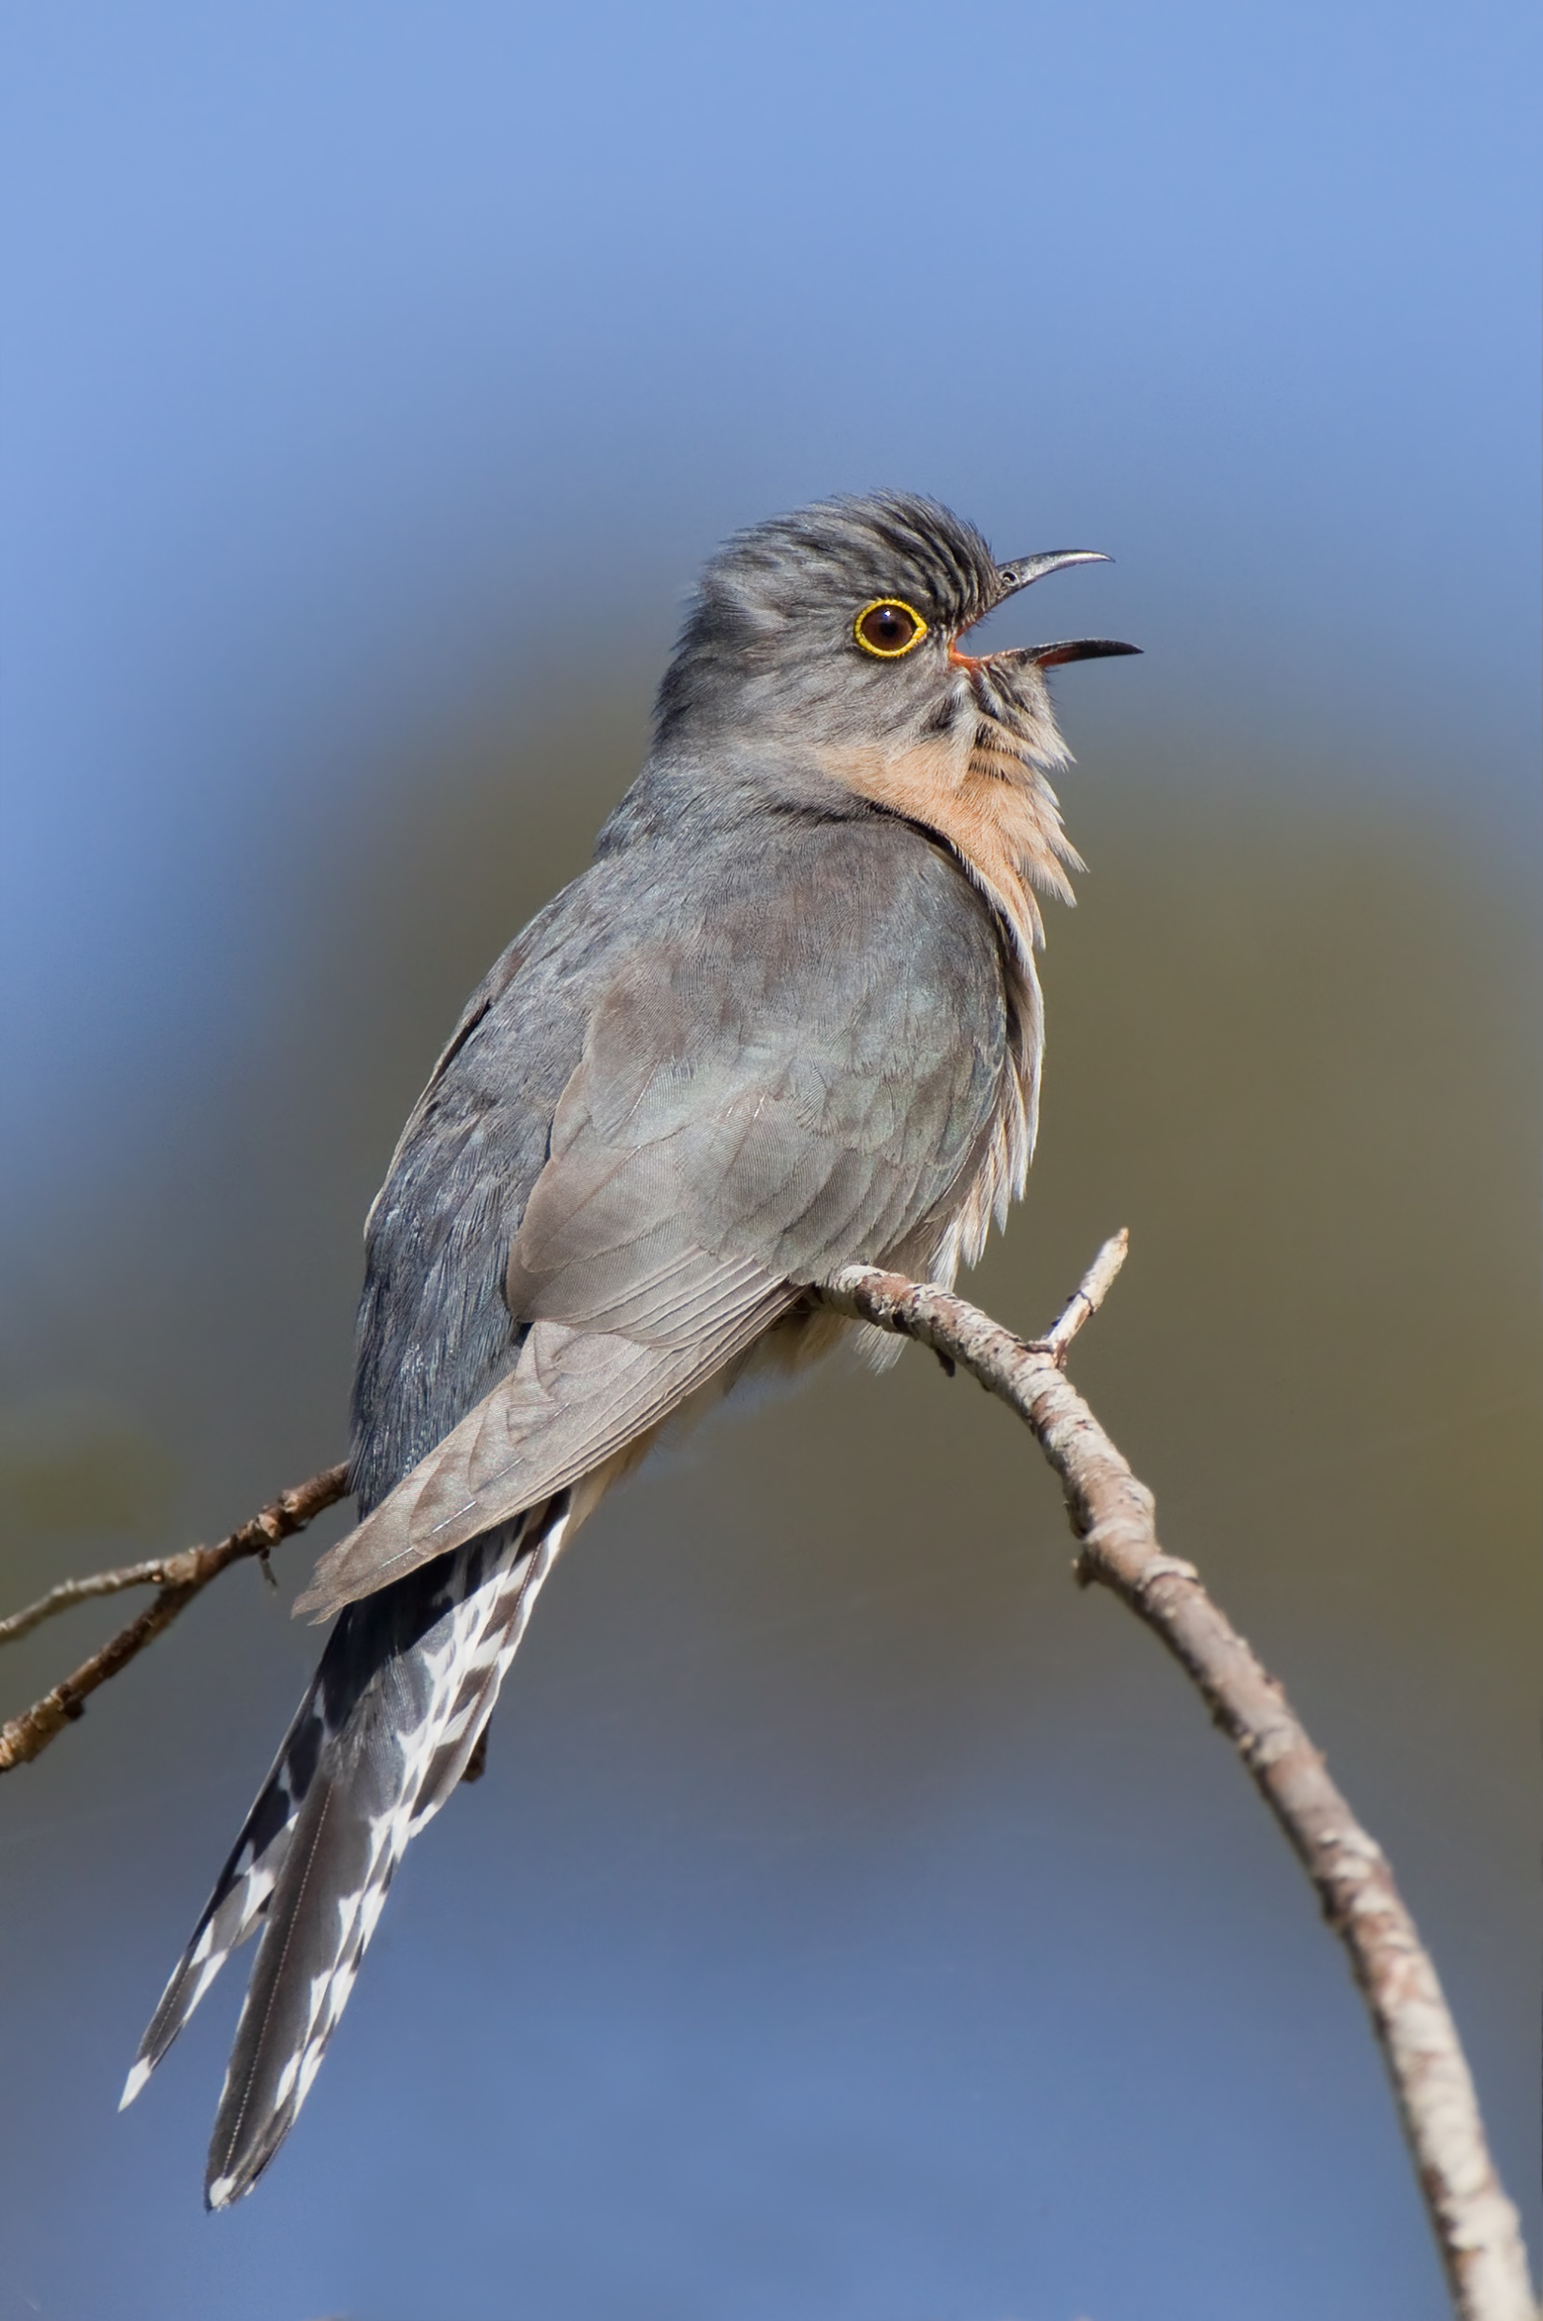
Hvala na pažnji!
Cuckoo (kukavica hrv.)

