Slide 1


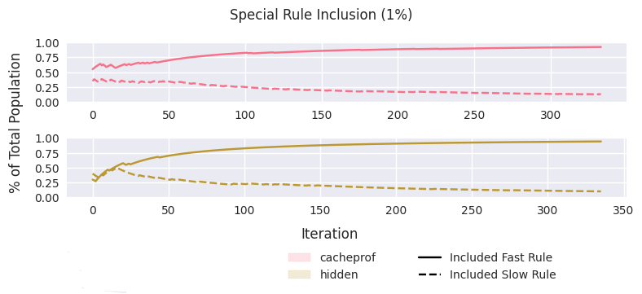
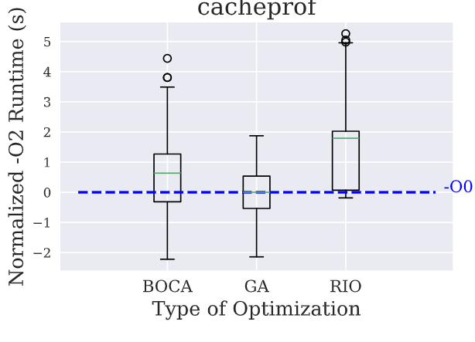
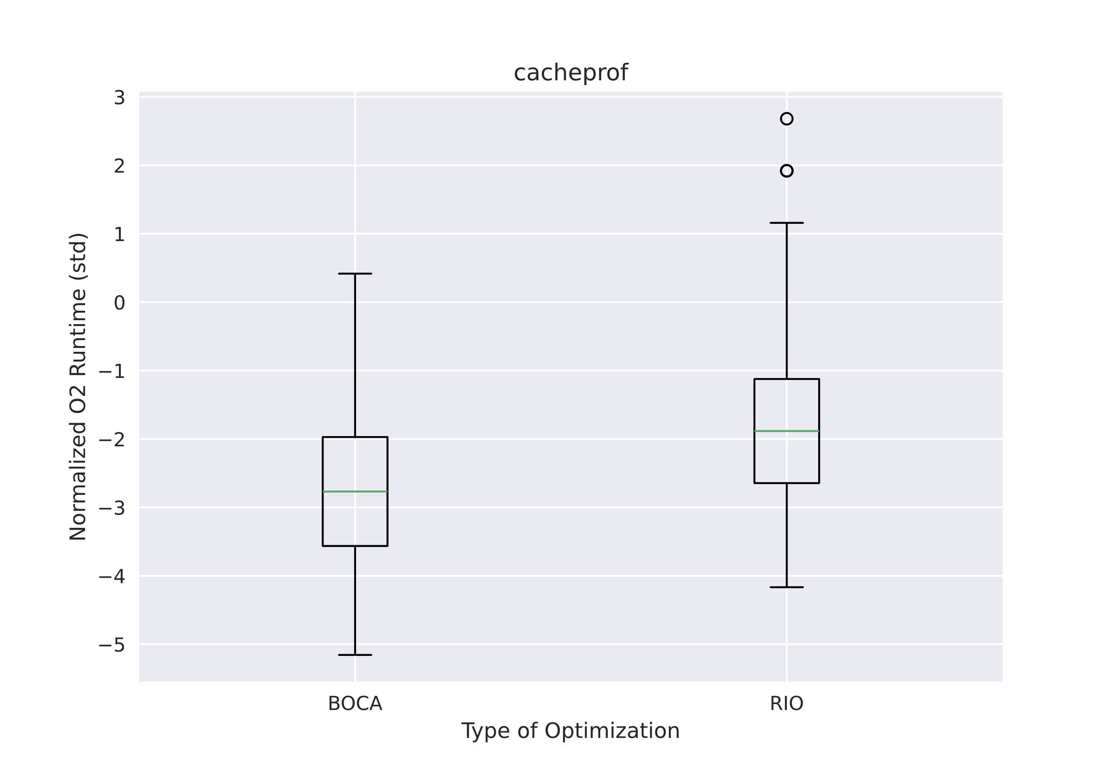
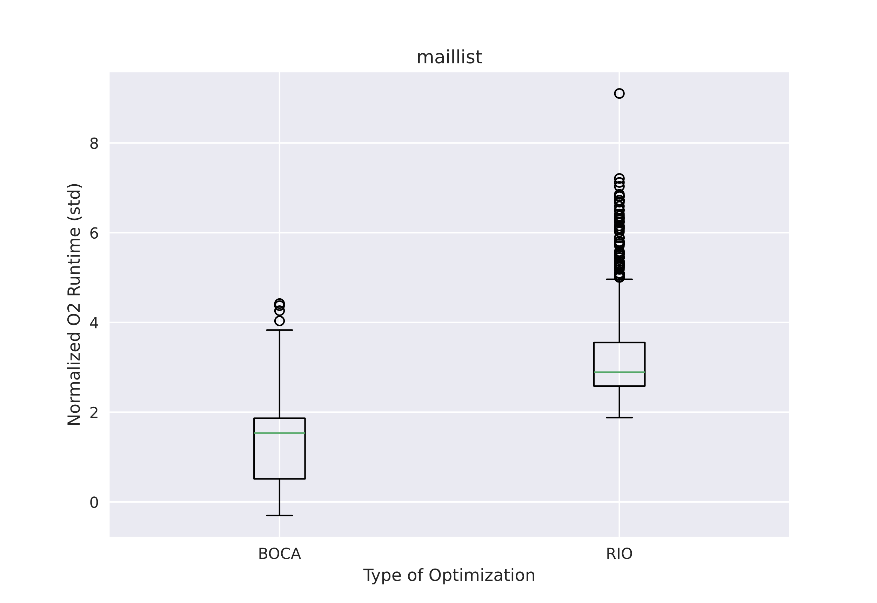
GHC Compiler Flag Optimization using Machine Learning
Connor Rhys Peper
CSSE, Rose-Hulman Institute of Technology, Terre Haute, Indiana 47803
Background
Flag Selection Optimization
Phase-Order Optimization
Compilers offer many optimizations
There are too many optimizations for developers to understand them all
The ideal set of optimizations and application order must exist
Search space is very large: 2^{n} for flag selection, n! for phase-order
Machine learning can help us explore the search space efficiently
Methodology:
Tested four Haskell programs from the nofib benchmarking suite
Compared against GHC’s –O2 preset
Measured runtime
Figure 2 – Discrimination capabilities of modified BOCA (BOCPA) on the Cacheprof and Hidden test programs. BOCPA can discriminate between permutation rules with as small as a 1% change. To test this, we used an “arbitrary optimization” that did not actually change the source code with a manufactured speed-up/speed-down.
Machine Learning Algorithms
Figure 1 – Runtime of BOCA, GA, and RIO normalized around the average –O2 runtime. All three algorithms found a more optimal set of compiler flags than –O2, but while GA and BOCA converged on a solution, RIO does not and thus has a few more outliers than BOCA or GA. Greatest speed-up achieved was over two standard deviations faster than –O2.
Random Iterative Optimization (RIO)
Generate random sets/permutations, try them all
Genetic Algorithm (GA)
Represent sets as chromosomes, product offspring and mutate
Bayesian Optimization (BOCA)
Use random forest and expected improvement to select new candidates
Current Results: Best speed-up was 3% over –O2
Figure 3 & 4 – Runtime of BOCA, and RIO normalized around the default phase-order runtime. Only BOCA was able to find a more optimal ordering than the default. Maillist demonstrates that there is more room for decreased performance than increased performance, as RIO found orderings more than eight standard deviations slower than the default.
Phase-Order Optimization
Modified BOCA:
Represent optimizations as vertices, forbidden positions as edges (rules)
Topological sort to find new candidates from impactful rules
Modify GHC optimization pipeline
Current Results: Best speed-up was 5% over the default phase-order

