Slide 1
Challenge Project: Can we infer more biological meaningful information from outlier/s identified?
Yeting Zhang
Aug 2nd 2019

Slide 2
Data Resource
Publication: “Multiomics modeling of the immunome, transcriptome, microbiome, proteome and metabolome adaptations during human pregnancy” by Ghaemi et al, Bioinformatics 2018.
Datasets was downloaded from https://nalab.stanford.edu/wp-content/uploads/pregnancymultiomics.zip.

Slide 3
Question trying to answer here
I started with looking into the microbiome dataset.
First question is that if outliers are present in the dataset.
Second question is that if there’re any, can we find a biological explanation or perhaps this may indicate some hidden fact, which might be patient health related/predictive information.

Slide 4
Planned approaches
Step1. PCA analyses performed on all four gestational stages separately (challengeQuestion_modified.html).
Step 2. Using feature selection machine learning approach to identify the causal set of bacteria that distinguishes outlier from all other patients’ samples (Problem_speciesDection.html).
Step 3. Infer meaningful biology fact based on the output from step 2 using literature search approach.

Slide 5
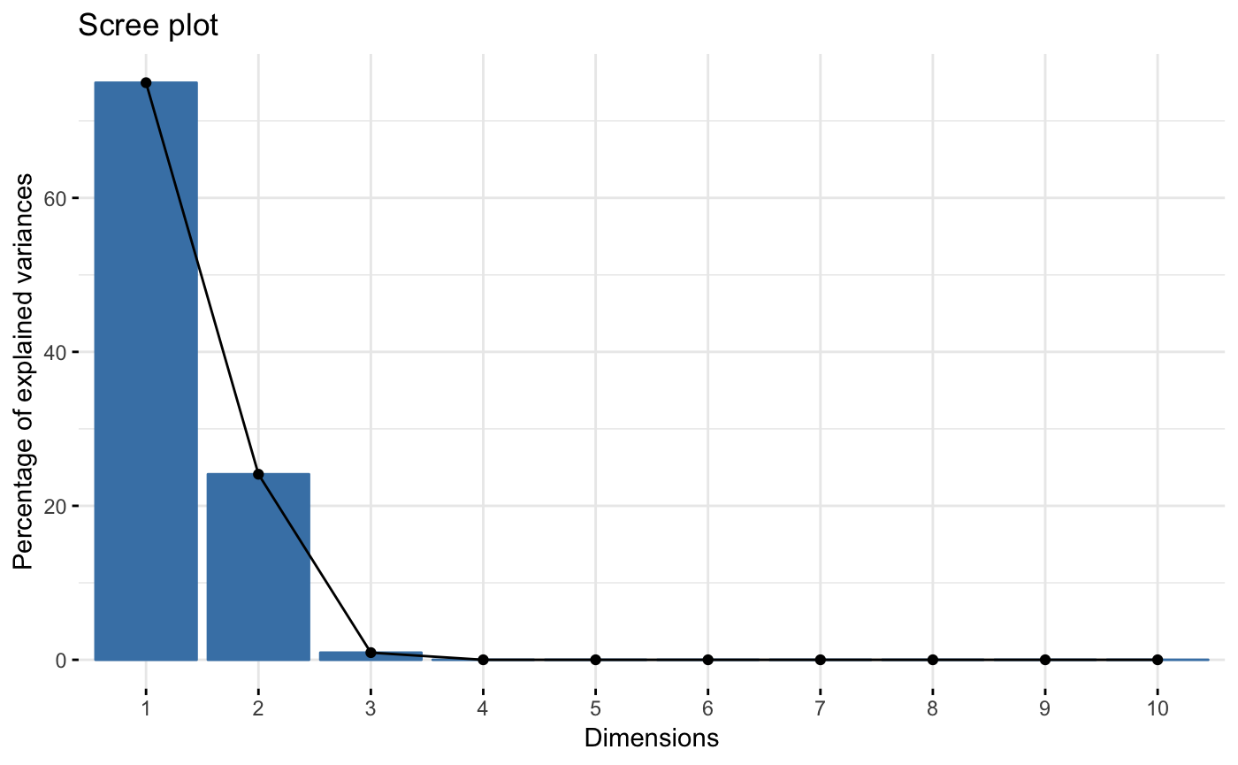
Looking into the postpartum dataset first (control dataset)
The top 2 components can already
explain the major source of variance.
Notes:
Scree plots were only shown for postpartum dataset. All other plots can be found in the HTML report.

Slide 6
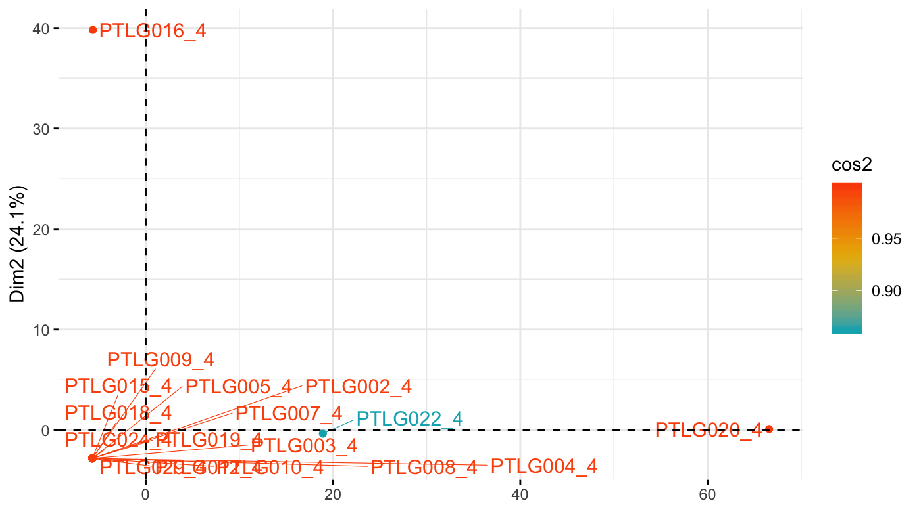
PTLG016 stands out as a potential outlier based on postpartum dataset

Slide 7
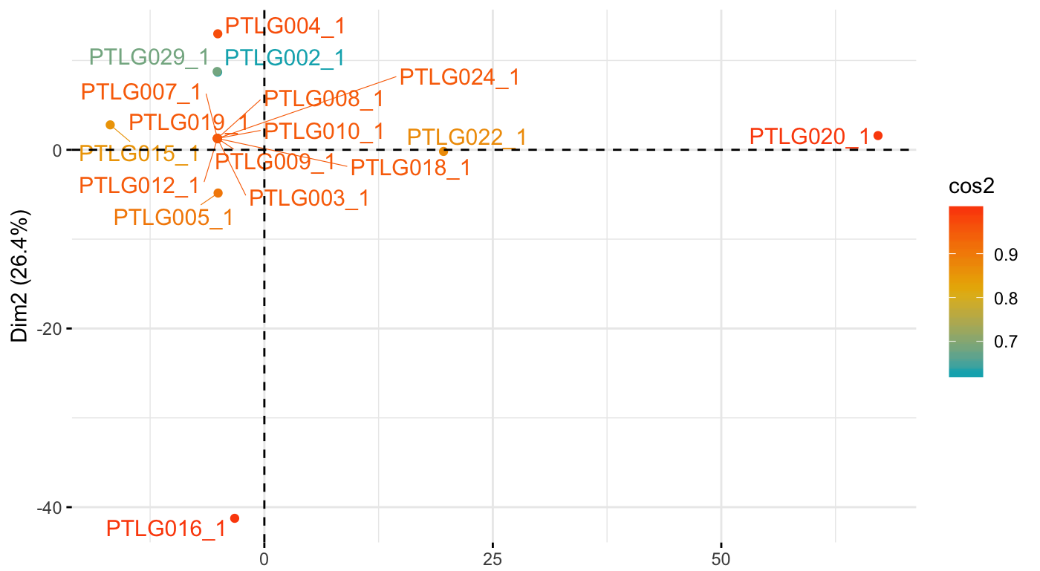
PTLG016 stands out again as a potential outlier based on 1st trimester dataset

Slide 8
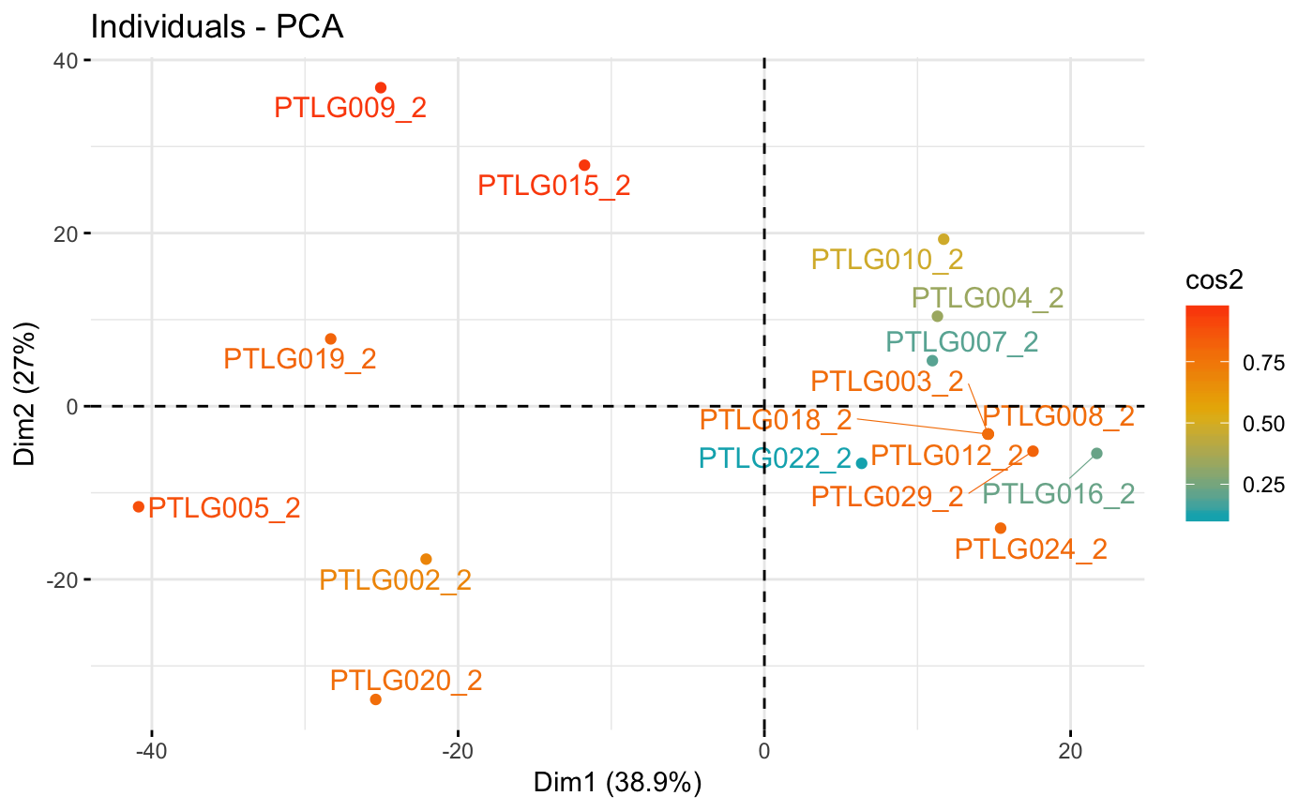
2nd Trimester look more scattered and no obvious outlier identified

Slide 9
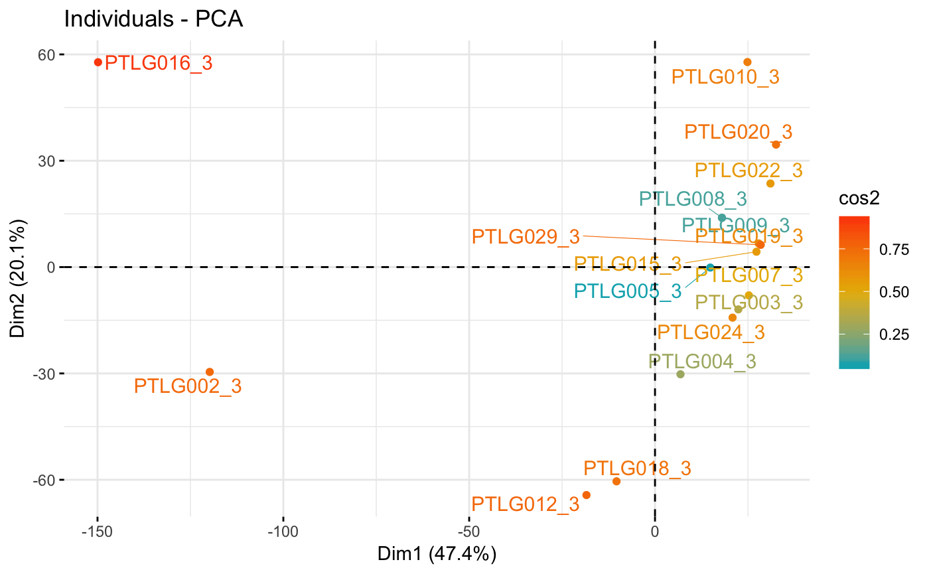
PTLG016 stands out again as a potential outlier based on 3rd trimester dataset

Slide 10
PTLG016 identified as a potential outlier Can we find out the true reason?
I applied a machine learning approach to identify a possible causal set of features, in this case, a set of bacteria, that’s making PTGL016 distinguished from the other patients.
The command and workflow is included the HTML report, named as Problem_speciesDetection.html (Rmd file is also attached)
The top ten bacteria identified is listed in next slide.

Slide 11
Are any of these bacteria pathogenic? Pathogenic species were highlighted in red color.
Model_importance | Bacteria genus
5.15E-02 | VaginalSwab_Lactobacillus
4.85E-02 | VaginalSwab_Prevotella
4.43E-02 | VaginalSwab_Campylobacter
4.43E-02 | VaginalSwab_Actinomyces
4.43E-02 | VaginalSwab_Ruminococcaceae_UCG-005
4.43E-02 | VaginalSwab_Ezakiella
3.08E-02 | VaginalSwab_Prevotella_6
3.08E-02 | VaginalSwab_Ruminococcus_1
3.08E-02 | VaginalSwab_Haemophilus
3.08E-02 | VaginalSwab_Prevotella_9

Slide 12
Potential pathogenic bacteria identified that may explain why PTLG016 as an outlier (Prevotella spp)
Prevotella species are also common vaginal commensals. Increased abundance of Prevotella in vaginal mucosa has been associated to bacterial vaginosis.
Question to link back to the health care provider: Does PTLG016 patient have vaginosis or perhaps on the edge of developing symptoms of it?
https://en.wikipedia.org/wiki/Prevotella

Slide 13
Potential pathogenic bacteria identified that may explain why PTLG016 as an outlier (Prevotella spp)
Campylobacter can cause a gastrointestinal infection called campylobacteriosis.
Question to link back to the health care provider: Does PTLG016 patient have any GI tract symptoms?
Any inflammation detected at an early stage is
vital to a healthy pregnancy.

Slide 14
Conclusion
Exploring patient related health care data, e.g., metagenomics data, we may be able to detect more subtle health related issues.
Scenario to apply to:
For each regular pregnancy check ups, a non-invasive swab can provide metagenomic information.
Comparing across patients or comparing patients themselves (in a time course) can help early detection of health related issues.

Slide 15


