Slide 1
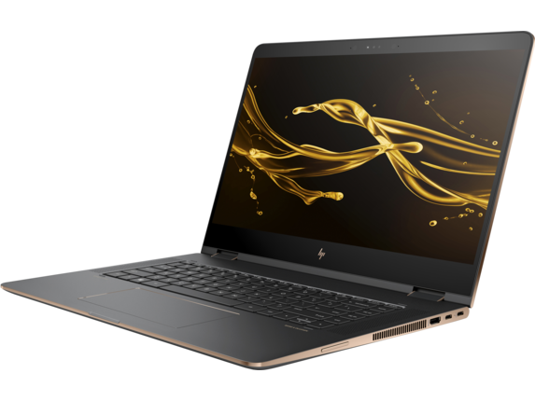
HP Spectre x360

Slide 2
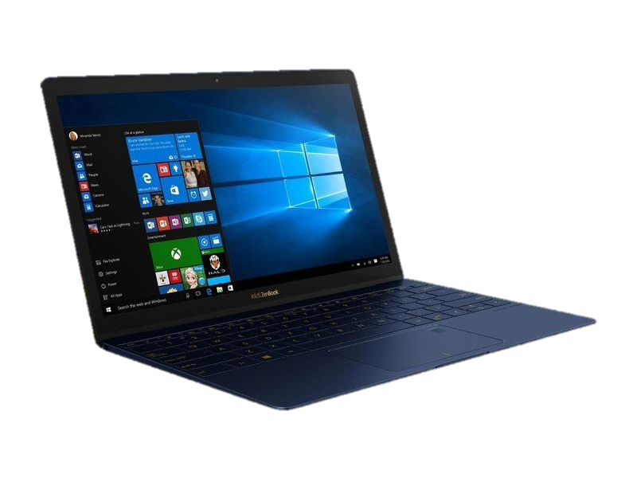
Asus Zenbook 3

Slide 3
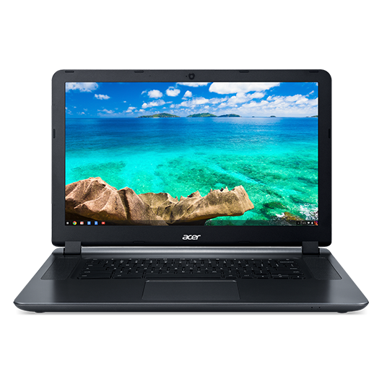
Acer Chromebook 15

Slide 4
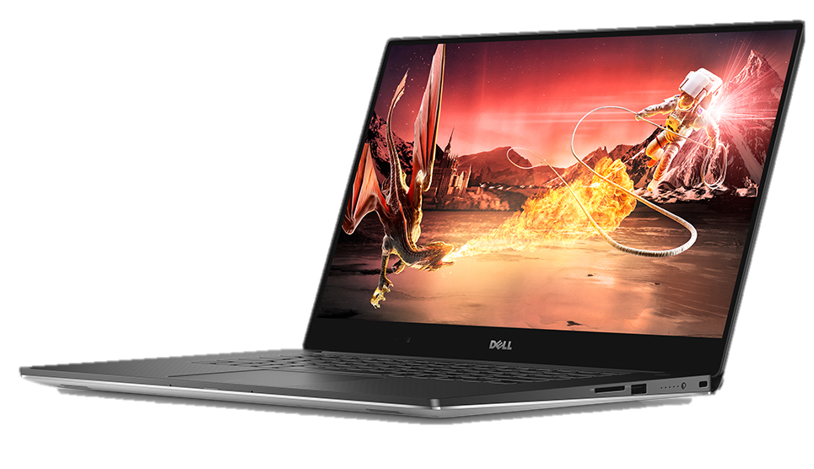
Dell XPS 15

Slide 5
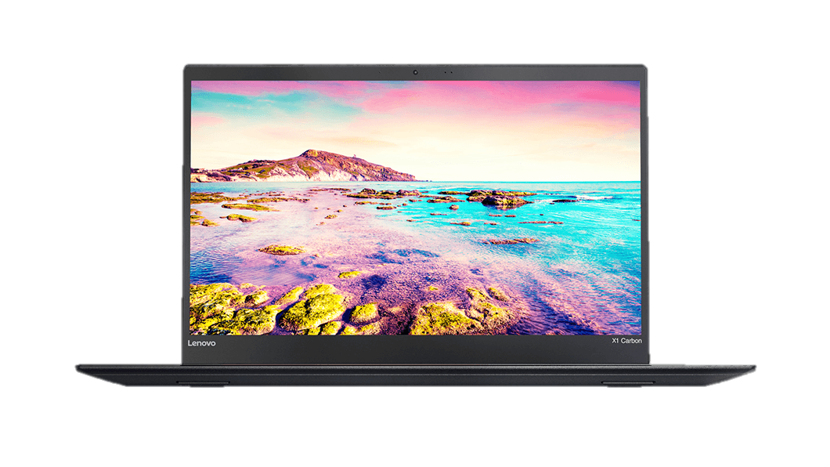
Lenovo ThinkPad X1 Carbon

Slide 6
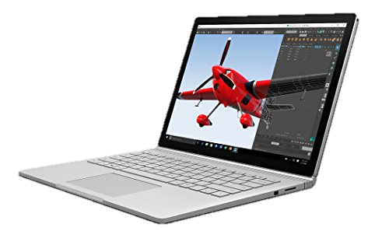
Microsoft Surface Book

Slide 7
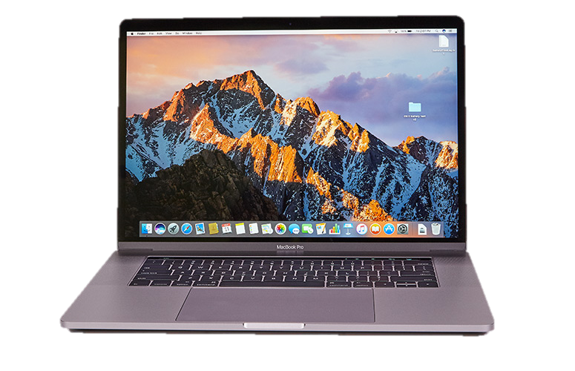
Apple MacBook Pro 15-Inch

Slide 8
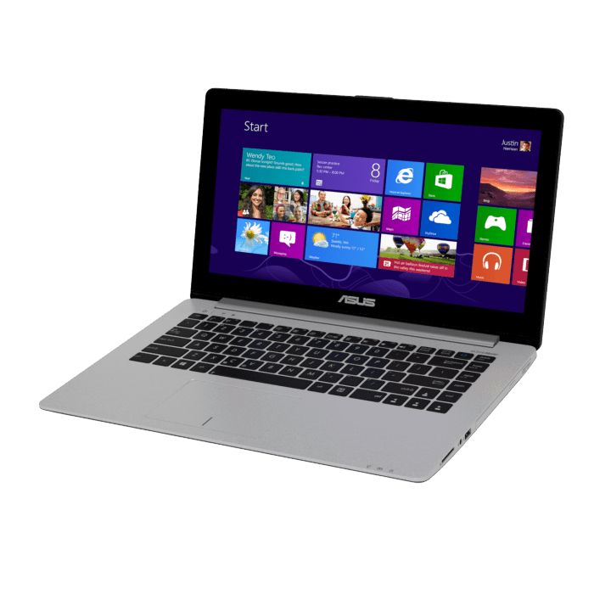
Asus VivoBook

Slide 9
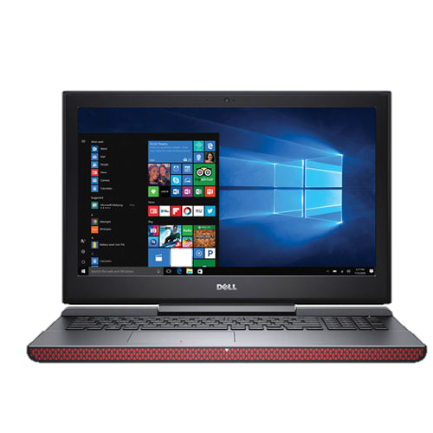
Dell i7567

