Slide 1

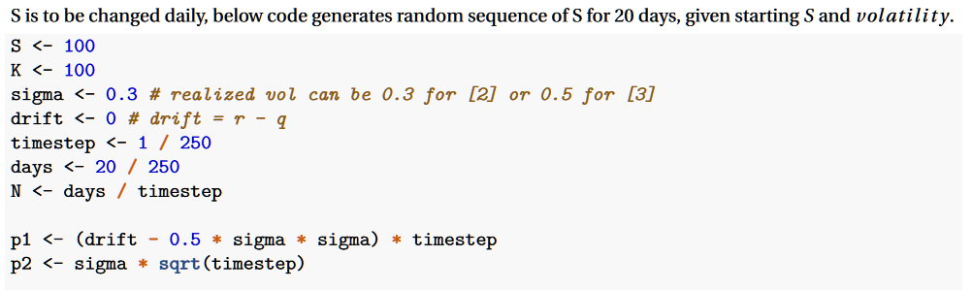
On pg. 2
On pg. 3

