Slide 1

Programming
Christopher League
30 November 2011

Slide 2

Links for later
eclipse.org/
Integrated Development Environment for Java
developer.android.com/
Complete developer’s guide and reference
slidesha.re/soQgoZ
These slides
github.com/league/android2011/
Source code for my sample apps

Slide 3
Teach Yourself Java in 21 seconds
All code is in the context of a class
Class can contain fields, methods, inner classes
Static pertains to class itself, not every object
All objects are references, and can be null
Inherit and override methods from base classes
Import classes from library packages
The rest is mostly the same as C/C++/C#
Beginners should use an IDE, such as Eclipse

Slide 4
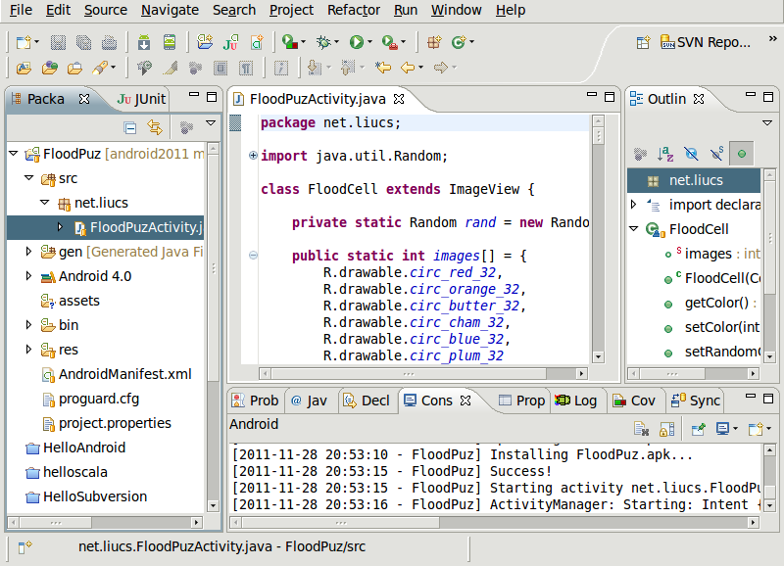
Eclipse

Slide 5
Eclipse toolbar
Run » Run (Ctrl+F11)
Android SDK Manager
Android Virtual Device Manager

Slide 6
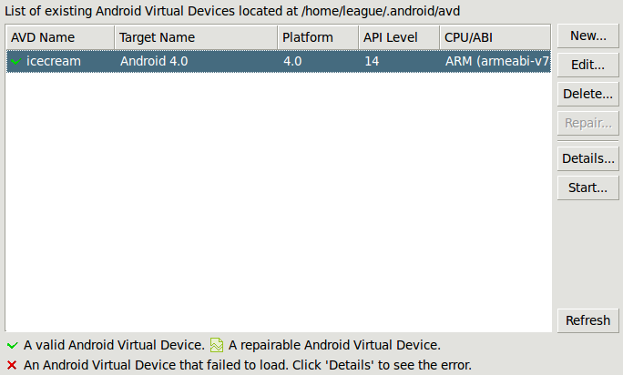
AVD, AVD, wherefore art thee?

Slide 7
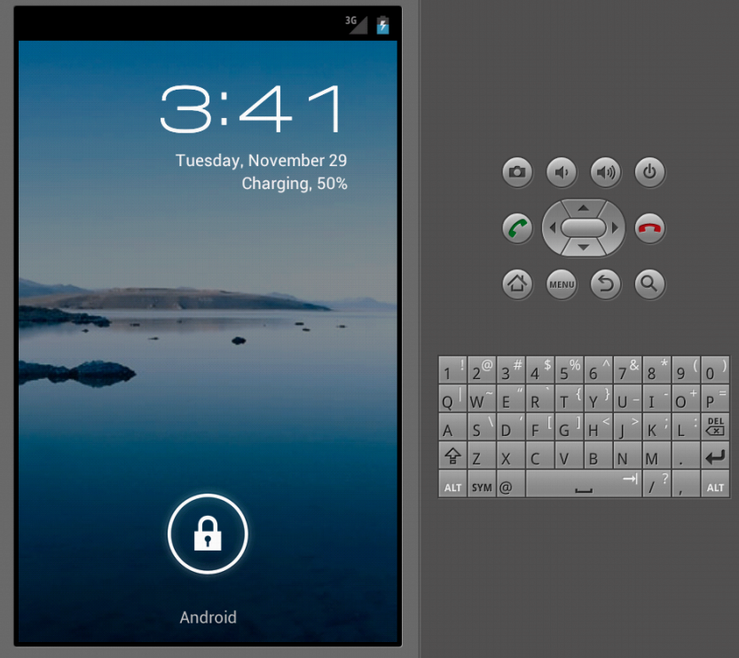

Slide 8
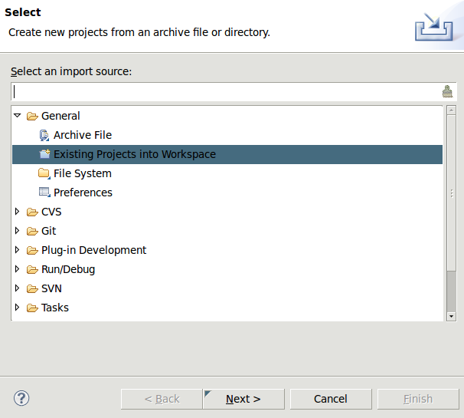
Importing an Eclipse project
Download: http://bit.ly/liu-android-zip
Eclipse menu: File » Import
Import source: General » Existing Projects

Slide 9
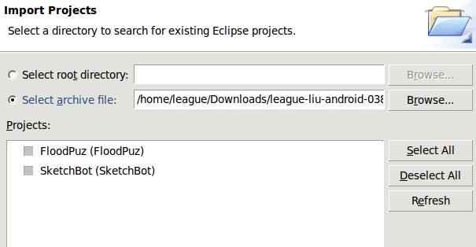
Importing an Eclipse project
Select archive file: browse to downloaded
league-liu-android-blahblah.zip
Select all; Finish

Slide 10
open FloodPuz » FloodPuzActivity

Slide 11
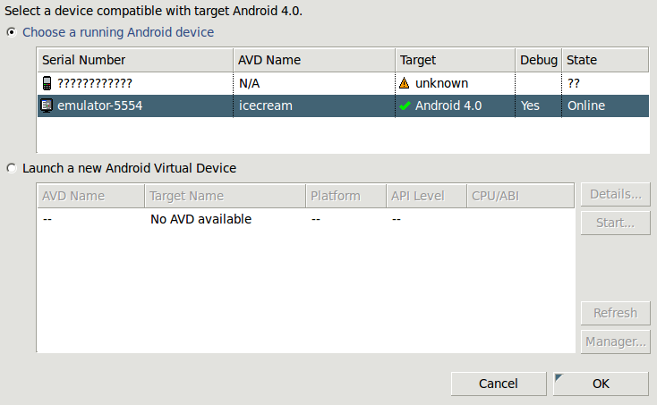
Run, select device

Slide 12
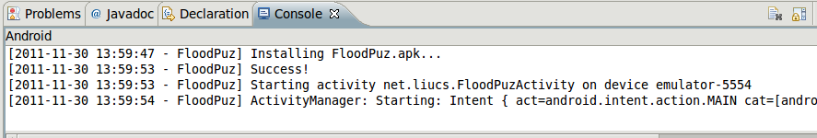
Check progress in console

Slide 13
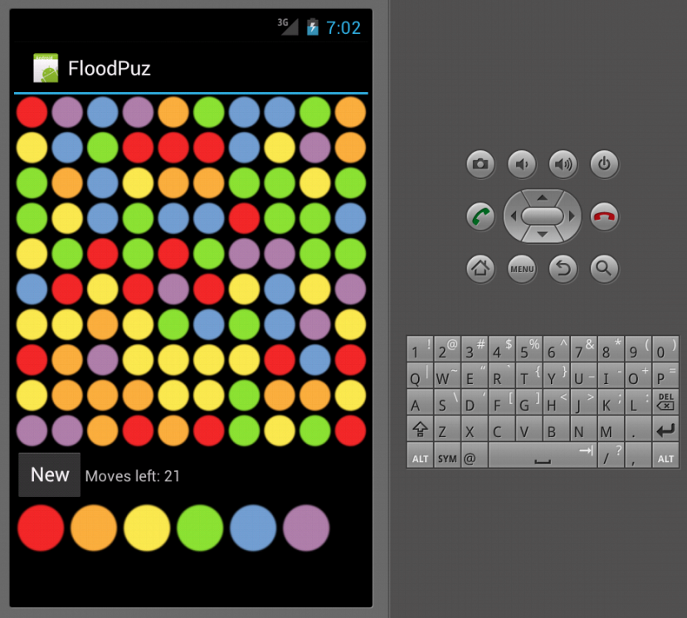
Check progress in console

Slide 14
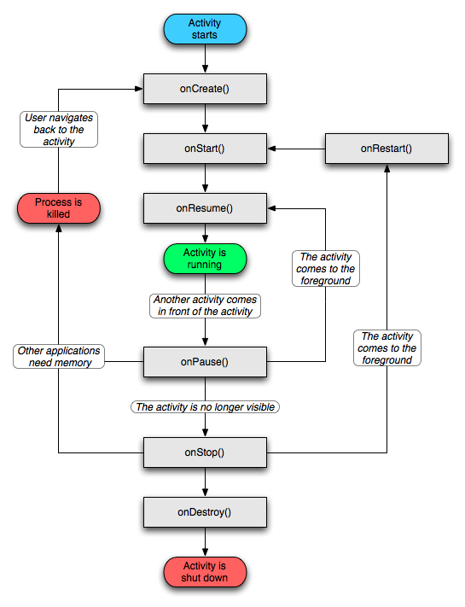
Activities
Roughly:
each UI screen
in your app
is an activity

Slide 15
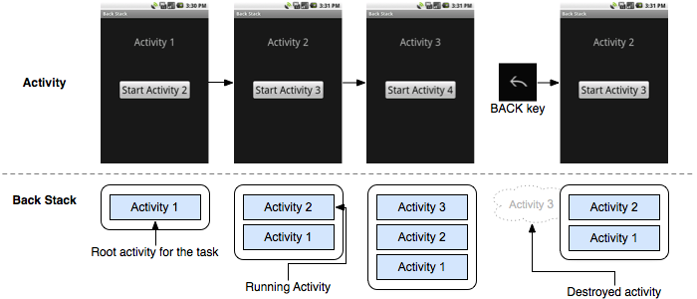
Activities
Multiple activities sequenced using back stack

Slide 16
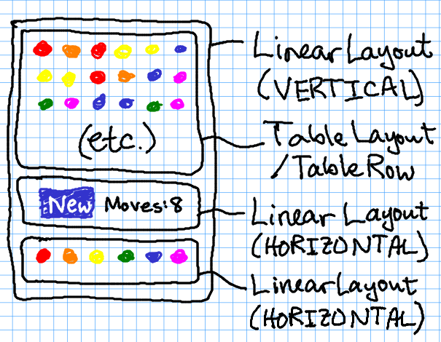
Layouts, views, & widgets

Slide 17
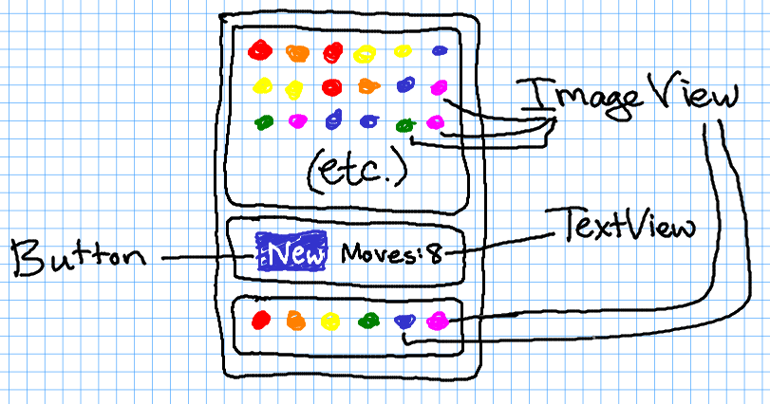
Layouts, views, & widgets

Slide 18

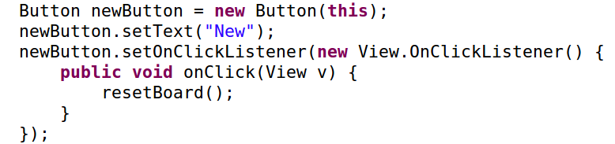
Event-based programming
:
:

Slide 19
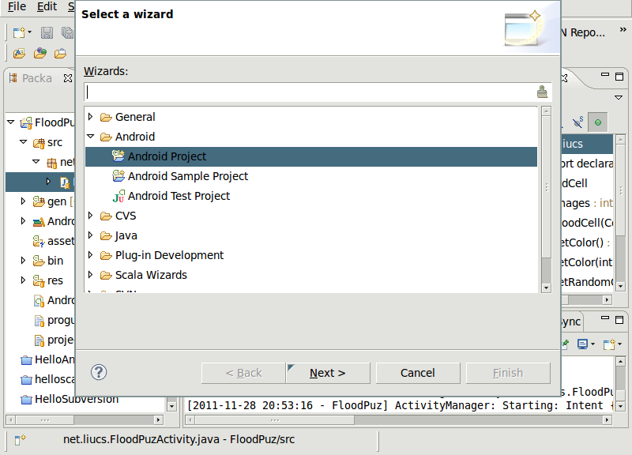
Starting a new project
File » New » Project
Android » Android Project (Next)
Project name: MyApp (Next)
Target: Android 4.0 (Next)
Package name: net.liucs (Next)
Finish

Slide 20
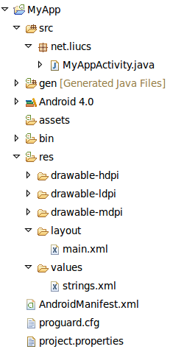
Initial files

Slide 21
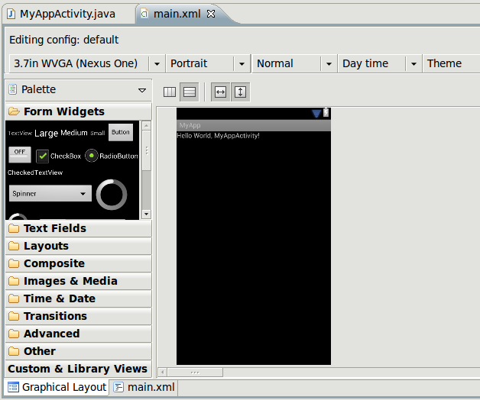
XML Layout editor

Slide 22
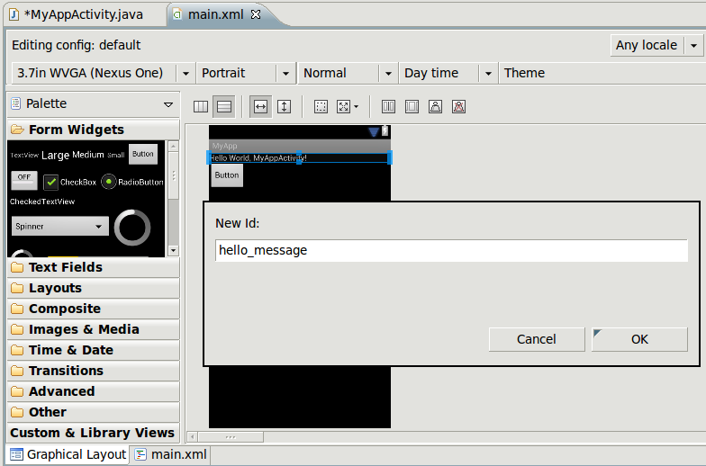
XML Layout editor
Drag a button onto the layout
Right-click “hello” text, edit ID

Slide 23
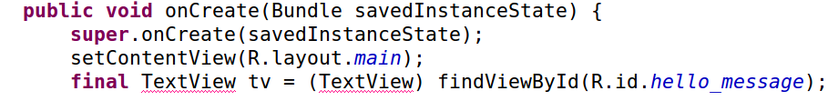
Access widgets in Java code
Source » Organize Imports (Ctrl+Shift+O) to fix

Slide 24
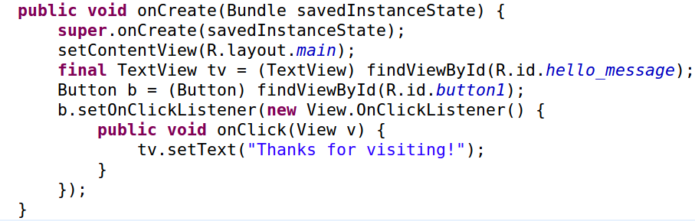

Access widgets in Java code
Or, get this code at https://gist.github.com/1410641

Slide 25
Next steps
Try to extend my projects, especially SketchBot
Additional colors
Draw shapes instead of just lines
Save drawing across application switch

Slide 26
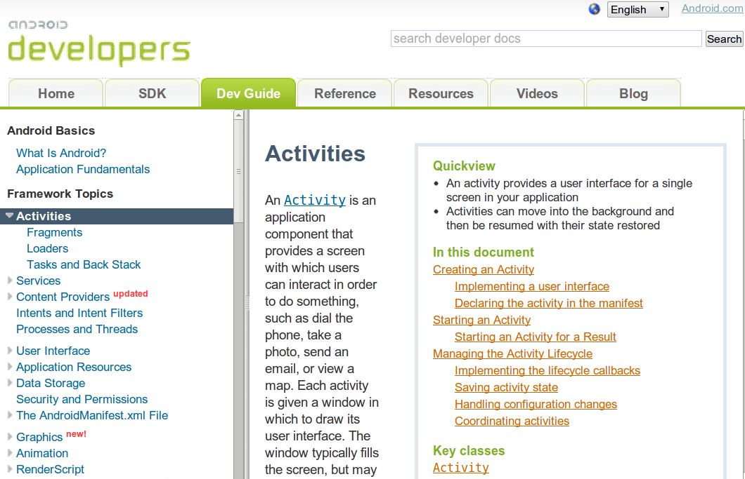
Docs are your friends

