Slide 1
Dataset on Suicide Attacks
Leah Shiferaw

Slide 2
Overview of the data
The Database on Suicide Attacks (DSAT) was created by researchers at the University of Chicago’s Project on Security and Threats (CPOST) and examines worldwide suicide attacks from 1982 to 2019. The data were collected through database searches, Google alerts, search engine and social media searches.
The goal of this analysis is to understand what trends exist in the weapons, countries, years, and groups that conducted suicide attacks.

Slide 3
Overview of variables
Top groups conducting suicide attacks
Top Five Groups
group_name | attack_count
Unknown Group | 3753
Taliban (IEA) | 993
Islamic State | 851
Al-Shabaab | 211
Tehrik-i-Taliban Pakistan | 204

Slide 4
Overview of variables
Top countries in which suicide attacks occurred
Top Five Countries
admin0_txt | attack_location
None | 8170
Iraq | 2999
Afghanistan | 1634
Syria | 692
Pakistan | 680

Slide 5
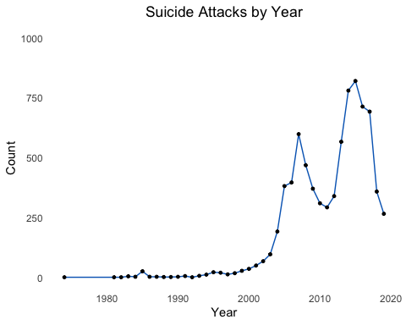
Analysis 1: Suicide attacks by year
date_year | attack_year
2015 | 821
2014 | 781
2016 | 714
2017 | 693
2007 | 599

Slide 6
Analysis 2: Most common types of weapons
The researchers have identified 17 types of weapons used to carry out suicide attacks. The top five most frequently used weapons were:
weapon_txt | n
Car bomb | 3556
Belt bomb | 2615
Truck bomb | 489
Unspecified | 379
Motorcycle bomb | 362

Slide 7
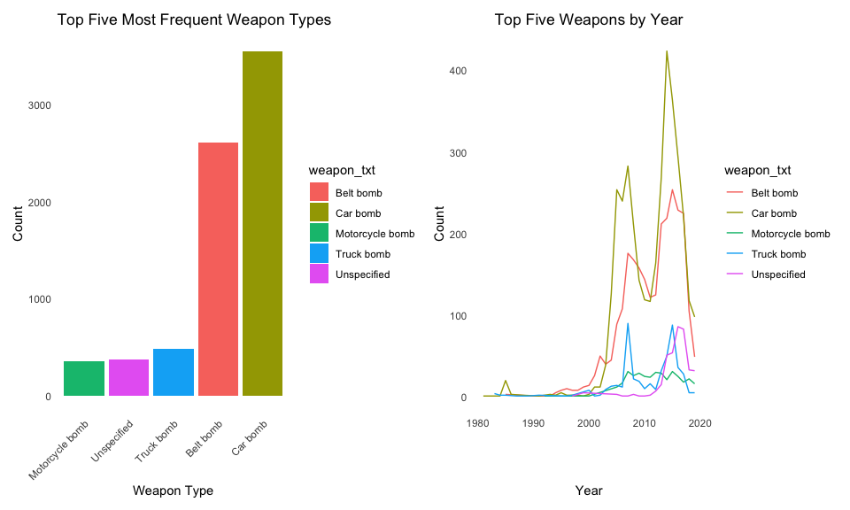
Weapon Types by Year

