Slide 1
Dataset on Suicide Attacks
Leah Shiferaw
Citation: Chicago Project on Security and Threats (CPOST). 2020. Database on Suicide Attacks (October 02, 2020 Release)

Slide 2
Overview of the data
The Database on Suicide Attacks (DSAT) was created by researchers at the University of Chicago’s Project on Security and Threats (CPOST). The data set examines worldwide suicide attacks from 1982 to 2019.
In this project, a suicide attack is defined as “an attack in which an attacker kills himself in a deliberate attack to kill others.” Only suicide attacks committed by non-state actors are included in the data set.
This presentation will focus on the following variables:
Group
Country
Year
Weapon

Slide 3
Overview of the data (cont.)
Top five groups:
Unknown (3,753)
Taliban (993)
Islamic State (851)
Al-Shabab (211)
Tehrik-i-Taliban Pakistan (204)
Top five countries:
None (8,170)
Iraq (2,999)
Afghanistan (1,634)
Syria (692)
Pakistan (680)

Slide 4
Analysis 1: Suicide attacks by year

Slide 5
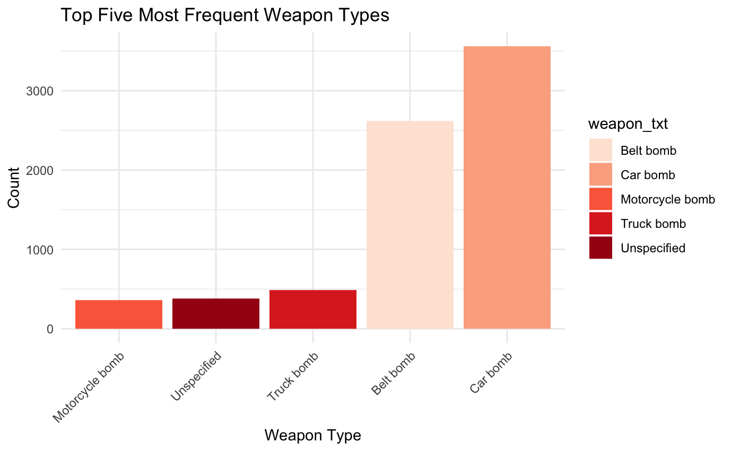
Analysis 2: Most common types of weapons
The researchers have identified 17 types of weapons used to carry out suicide attacks.
This presentation will focus on the top five weapons that appeared in the data set.

Slide 6
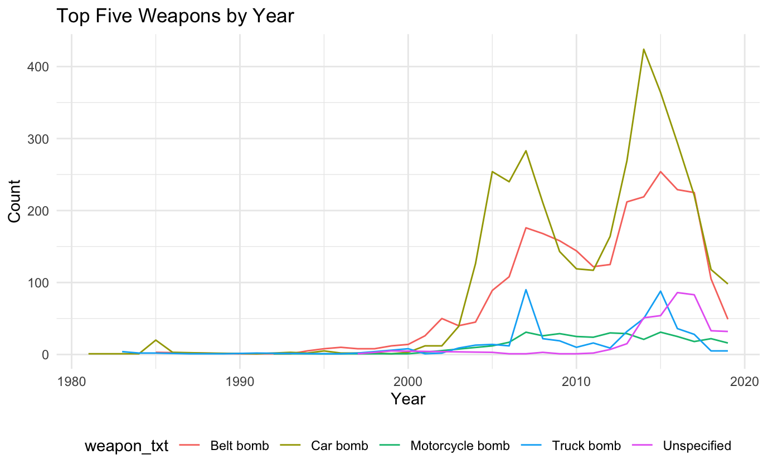
Analysis 2: Top weapons used by year

