Slide 1

Exploring the Hong Kong Districts
Leah Lu

Slide 2
Introduction
Hong Kong is one of the most populous cities in Asia. It is diverse and is the financial capital of China. It is multicultural with business opportunities provided and a business-friendly environment. It has attracted many different players into the market as a global hub of business and commerce. The city is a major center for banking and finance, retailing, world trade, transportation, tourism, real estate, new media, traditional media, advertising, legal services, accountancy, insurance in Asia.

Slide 3
Project Summary
Obtain the data;
Data visualization and some simple statistical analysis;
Analysis using Cluster, specially K-Means Clustering;
Compare the District to find the best place to start up a restaurant;
Inference from these results and related conclusion.

Slide 4
Preparation for Data
Use Wikipedia and scrap the names of 18 Districts.
Process the information properly to retrieve the necessary details and create a data frame.
Use Geopy to get the coordinates of all the districts.
Data 1: The data of 18 districts of Hong Kong. https://en.wikipedia.org/wiki/Districts_of_Hong_Kong
Data 2: Foursquare API to collect information on the venues/competitors in the neighborhoods of Hong Kong.

Slide 5
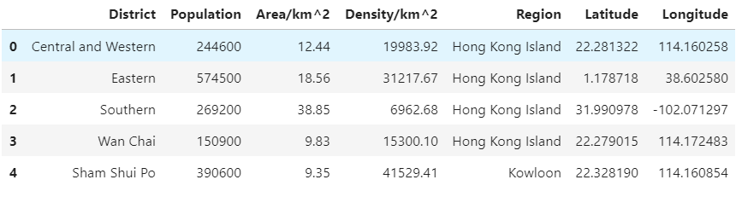
Project Step by Step
master data which has the main components District, Area, Density, Region, Longitude and Latitude.

Slide 6
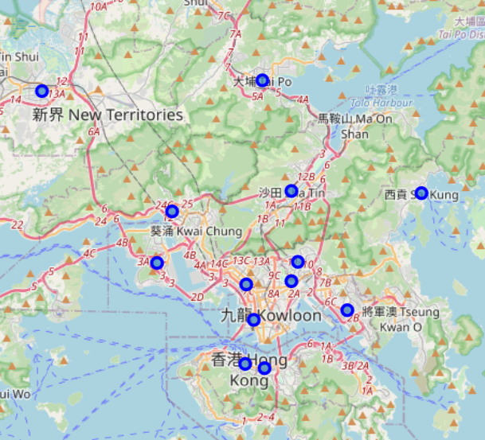
Project Step by Step
Used python folium library to visualize geographic details of Hong Kong.

Slide 7
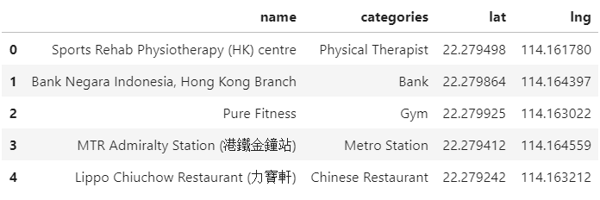
Project Step by Step
Utilized the Foursquare API to explore the regions and segment them. 679 venues were returned by Foursquare.

Slide 8
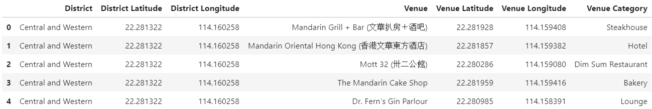
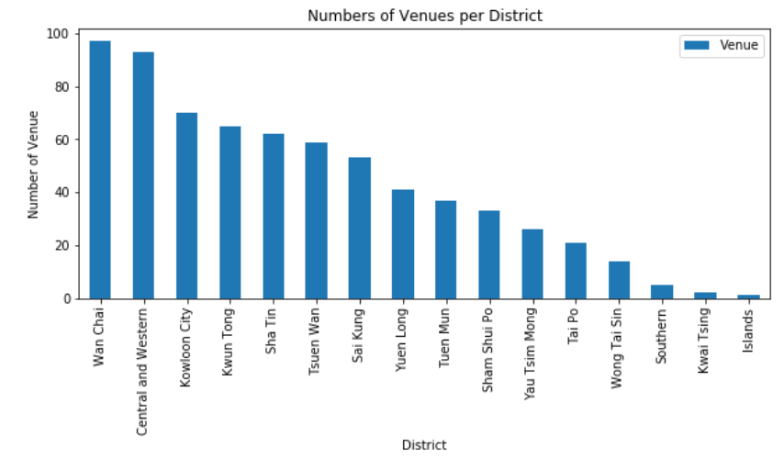
Project Step by Step
Here is a merged table of districts and venues. We can see that none of the districts reached the 100 limit of the venues., while Island, Kwai Tsing, Southern, Wong Tai Sin and Tai Po are below 20 venues in our coordinates with Latitude and Longitude, shown as in below.

Slide 9
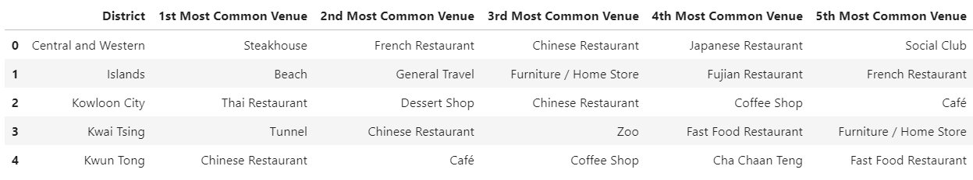
Project Step by Step
In summary of this graph 143 unique categories were returned by Foursquare, then I created a table which shows list of top 5 venue category for each borough in below table.

Slide 10
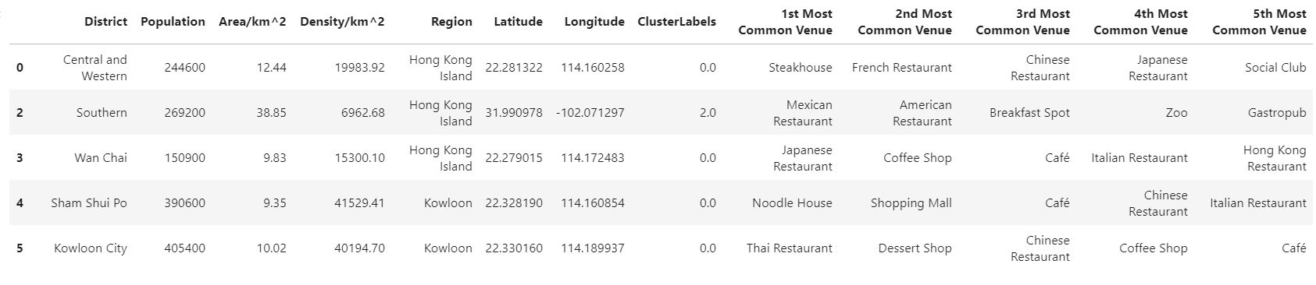
Project Step by Step
K-means algorithm to cluster the boroughs. K-Means algorithm is one of the most common cluster method of unsupervised learning. And below is my merged table with cluster labels for each District.

Slide 11
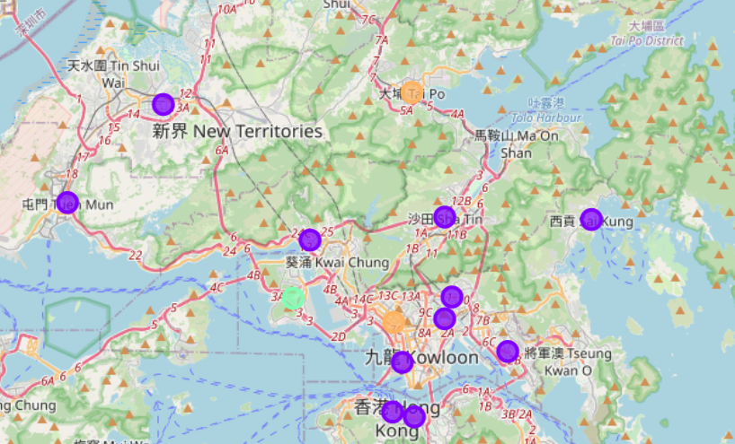
Project Step by Step
Clustered map districts of Hong Kong

Slide 12
Conclusion
I used the Kmeans algorithm as part of this clustering study. When I tested the Elbow method, I set the optimum k value to 5. However, only 18 district coordinates were used. For more detailed and accurate guidance, the data set can be expanded, and the details of the neighborhood or street can also be drilled.
I hope my project could provide some useful data analysis to people who wants to turn to Hong Kong and the city managers who manage the city.

