Slide 1
OPIM5512_A10 FOOD RECALLS
YEONGEUN RA
May 22, 2026
JRJ24004

Slide 2
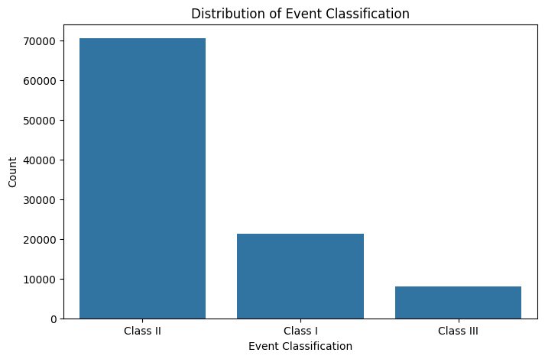
PROBLEM & DATASET
Target: Event Classification (Class 1 / 2 / 3)
Inputs: Product Description & Reason for Recall
Severe class imbalance:
Class 2 dominates the dataset
weighted F1 score
+ add class_weight='balanced'

Slide 3
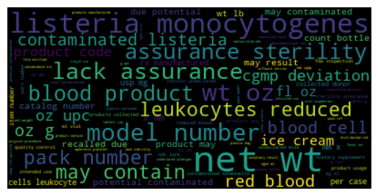
2. DATA PREPARTATION
[NLP preprocessing]
lowercase
↓
remove symbols
↓
remove stopwords
↓
tokenization
↓
stemming
[Data Preparation]
Traditional NLP preparation
Bag of Words : Convert token frequency into numerical vectors
TF-IDF: Weight important recall terminology
Transformer preparation
sequence generation: tokenizer, padded sequences , truncation
Train/Test Split
- 90/10 split - random_state=42 - stratify=y

Slide 4
3. MODELS
Model | Approach | Purpose
Naive Majority Baseline | Majority prediction | Benchmark
Bag of Words + Decision Tree | Traditional NLP | Frequency-based learning
TF-IDF + Decision Tree | Weighted text importance | Improved token relevance
Hugging Face Zero-shot | Pretrained transformer | Semantic language understanding

Slide 5
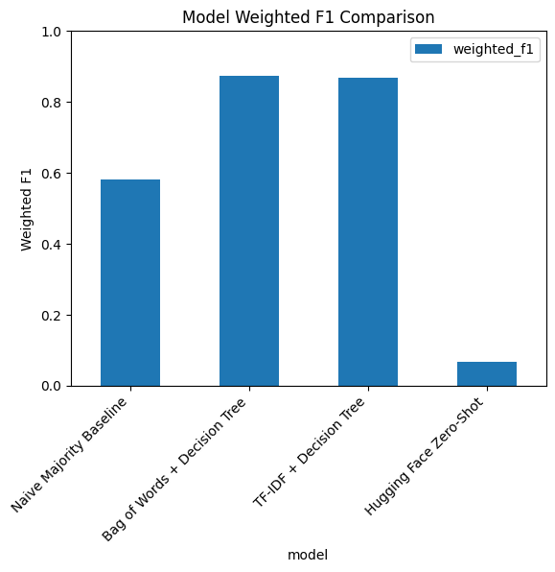
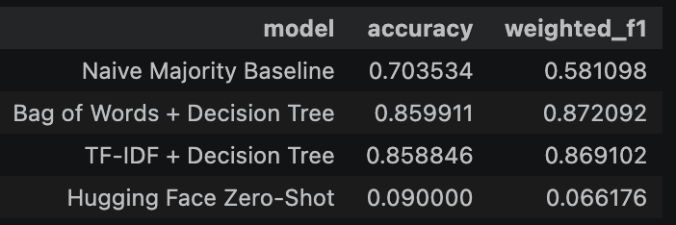
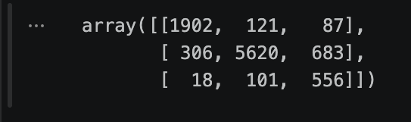
4. RESULTS

Slide 6
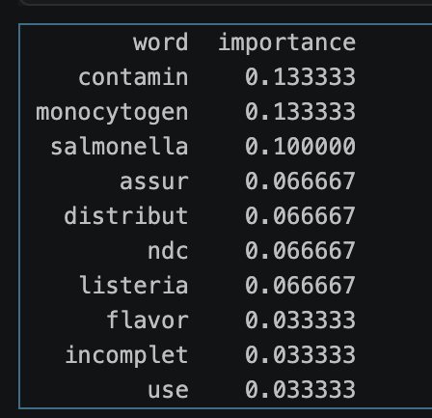
5. INTERPRETABILITY : XAI + PERMUTATION IMPORTANCE
Notes:
The xAI layer confirmed that the model focused on biologically meaningful contamination terminology associated with severe food recalls

Slide 7
Thank You

