Slide 1




DRIVE-SHARE WEBSITE
TEAM ALPHA
SOUAD OMAR
ZAYNAB MOURTADA
LEAH MIRCH
FIRAS ABUEIDA
TEAM ALPHA

Slide 2

TABLE OF
Contents
01.
INTRODUCTION
02.
WEBSITE DEMO
03.
UML DIAGRAMS
04.
DATABASE SCHEMA
TEAM ALPHA
05.
TEAM CONTRIBUTION

Slide 3


INTRODUCTION
01.
A peer-to-peer car rental website to connect car owners with renters.
Designed with HTML, CSS, Javascript, Python Flask, and SQLite
Some features include: user authentication, car listing and browsing, booking functionality, messaging, and a central dashboard
TEAM ALPHA

Slide 4

WEBSITE DEMO TIME!
02.
TEAM ALPHA

Slide 5

UML DIAGRAMS
03.
TEAM ALPHA

Slide 6
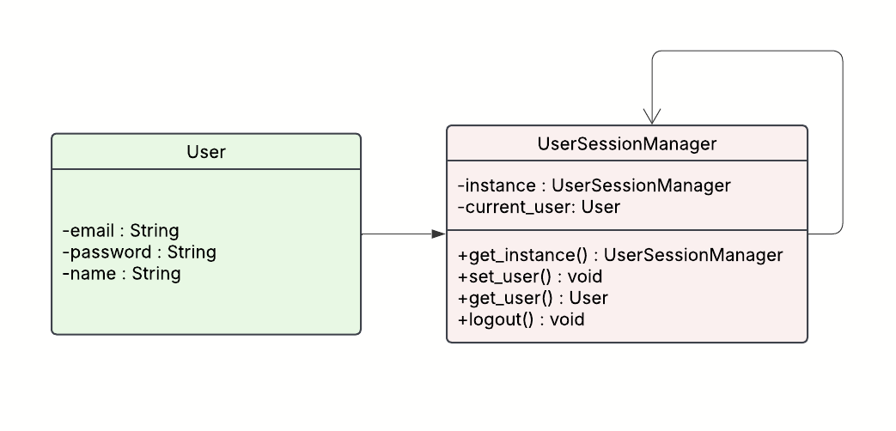
SINGLETON FOR USER SESSION MANAGEMENT
Singleton Pattern used via UserSessionManager to ensure a single, consistent session instance across the app.
Manages session-related data like the currently logged-in user.
Provides methods to set, retrieve, and clear the active user session.
TEAM ALPHA

Slide 7
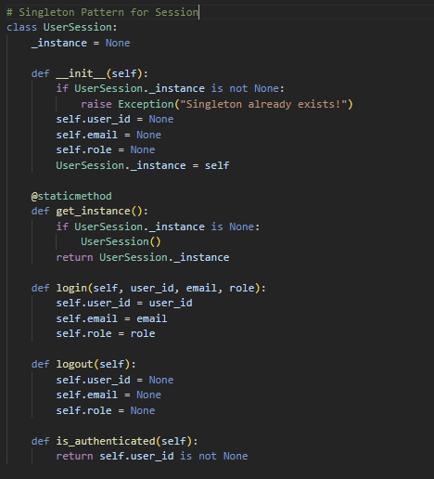
SINGLETON FOR USER SESSION MANAGEMENT
TEAM ALPHA

Slide 8
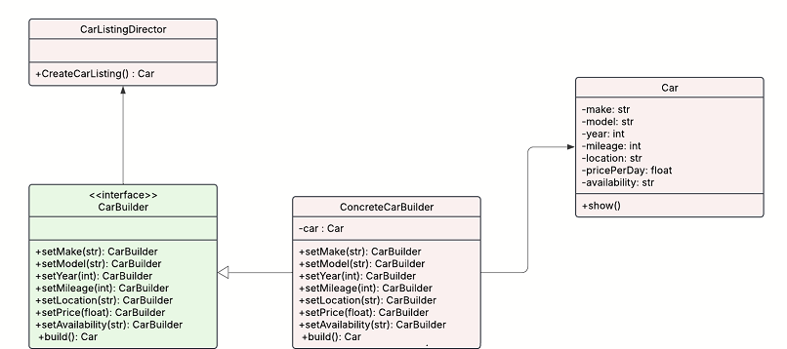
BUILDER FOR CAR CREATION
Builder Pattern allows step-by-step creation of flexible, modular car listings.
Avoids long constructors by setting attributes like make, model, year, price, etc., individually.
CarBuilder defines methods to set each field, with build() returning the complete Car.
ConcreteCarBuilder constructs the car instance internally.
TEAM ALPHA
Notes:
LEAH
Now let’s talk about how we handled modular car creation in our platform using the Builder Pattern.
This pattern gave us a clean way to create car listings without using a long, error-prone constructor. Instead, we let the user set fields like make, model, year, mileage, price, and location step-by-step.
Our CarBuilder class provides methods for each individual attribute, and once all fields are set, we call build() to generate the final Car object.
This made our code easier to maintain and extend — especially when more optional fields were added during development.
The diagram here outlines how our Builder, ConcreteBuilder, and Product (in this case, Car) interact in a structured and reusable way.

Slide 9
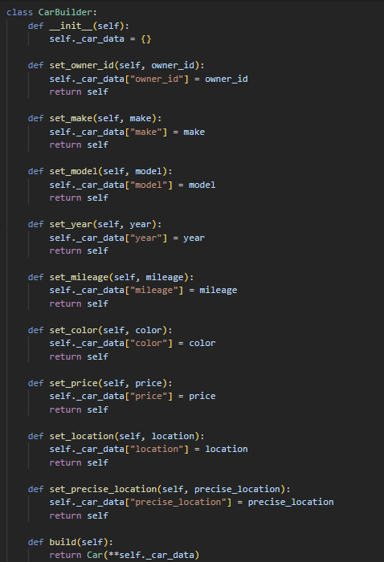
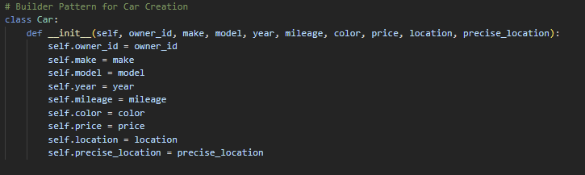
BUILDER FOR CAR CREATION
TEAM ALPHA
Notes:
LEAH
Here’s the implementation of our Builder in code.
On the left, we have the CarBuilder class with each method returning self, enabling method chaining. This improves readability and lets us construct a complete Car object in a fluid and intuitive way.
On the right is the Car class that holds the final attributes passed in during the build process.
You can see how this avoids hardcoding or passing large parameter lists, especially as more fields like color, image URLs, or precise location were added.
Overall, this pattern helped us keep our car listing flow clean and scalable.

Slide 10
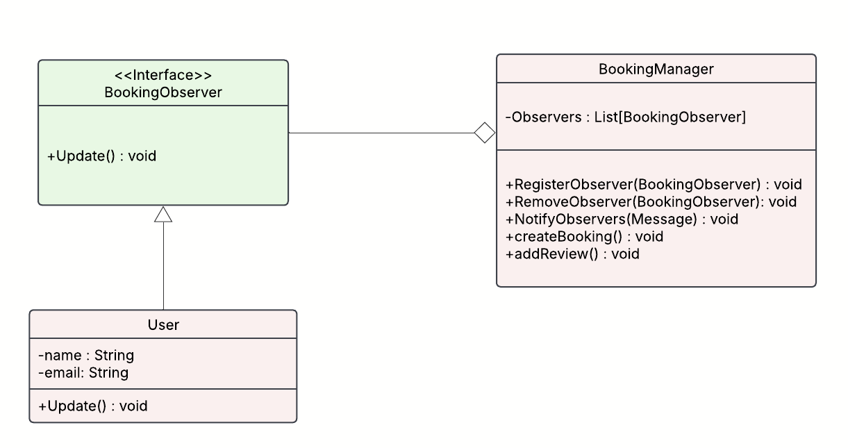
OBSERVER FOR NOTIFICATIONS
BookingManager acts as the subject, managing a list of observers.
Observers are notified via NotifyObservers() during actions like createBooking() or addReview().
Promotes a clean separation between booking logic and notifications.
TEAM ALPHA

Slide 11
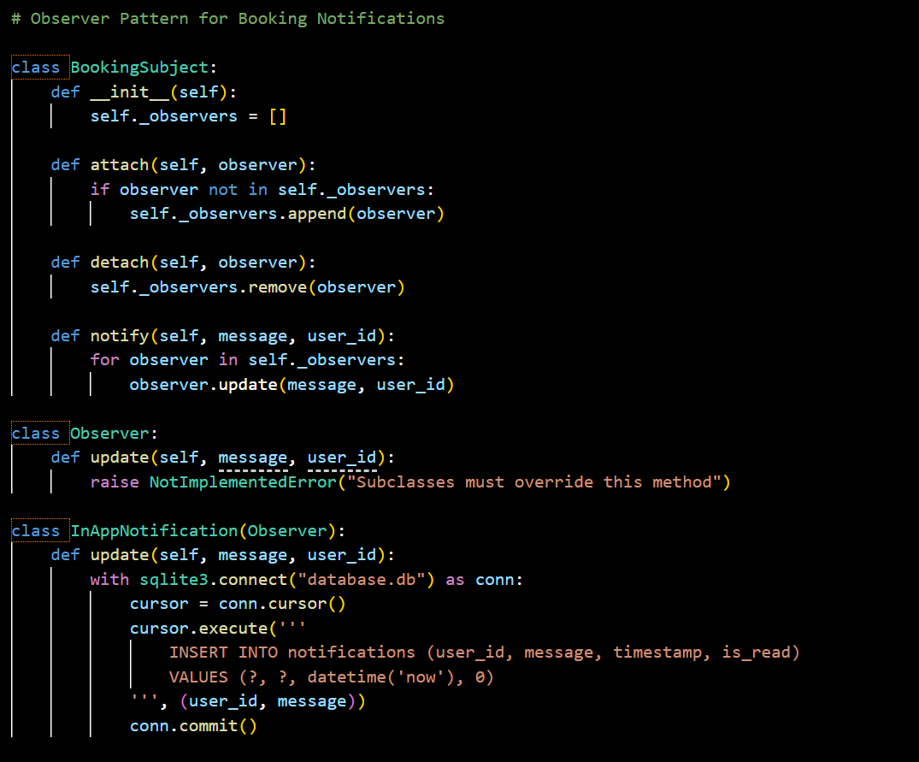
OBSERVER FOR NOTIFICATIONS
TEAM ALPHA

Slide 12
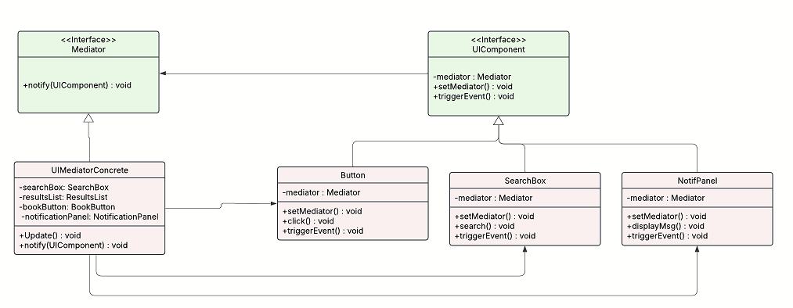
MEDIATOR FOR UI COMPONENTS
UI elements interact through a central mediator instead of directly with each other.
UIMediatorConcrete coordinates actions between components like SearchBox, Button, and NotificationPanel.
All components implement a shared UIComponent interface with setMediator() and triggerEvent().
Makes the UI easier to maintain and extend without introducing tight coupling.
TEAM ALPHA

Slide 13
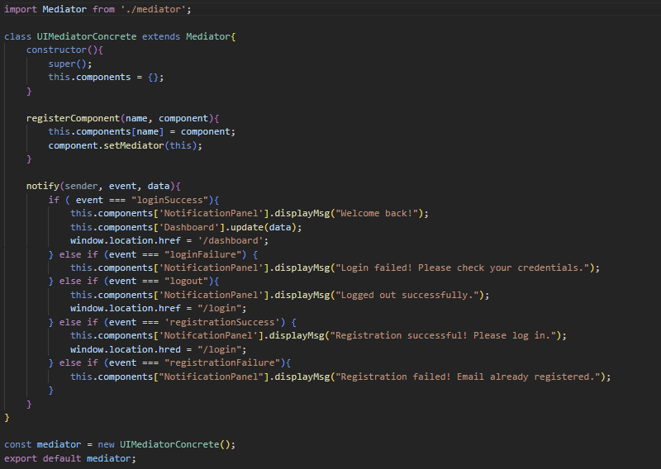
MEDIATOR FOR UI COMPONENTS
TEAM ALPHA

Slide 14
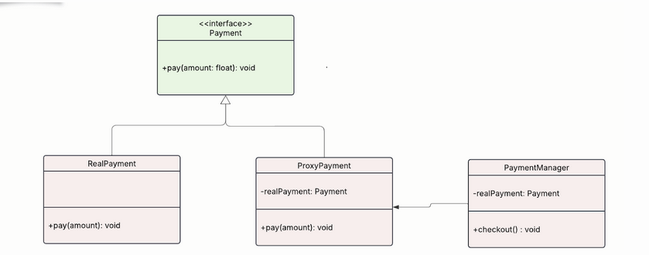
PROXY FOR PAYMENT PROCESSING
Proxy Pattern adds a secure layer between DriveShare and the real payment system.
ProxyPayment controls access to RealPayment, allowing for validation, logging, or simulation.
Both implement the Payment interface with a common pay() method.
PaymentManager uses only the interface, calling checkout() to handle transactions.
TEAM ALPHA
Notes:
LEAH Next, let’s look at how we used the Proxy Pattern to handle payment processing securely and flexibly.
In DriveShare, we didn’t want direct access to our real payment handler exposed everywhere in the code. So, we introduced a ProxyPayment class that sits between the application and the actual RealPayment logic.
The proxy acts as a gatekeeper — allowing us to log, validate, or simulate transactions before any real money is moved.
Both the proxy and the real payment class implement the same Payment interface, so they share the same pay() method. This keeps things interchangeable and loosely coupled.
Our PaymentManager is responsible for initiating payments, but it doesn’t need to know whether it’s using the proxy or the real payment system — just that it calls checkout() on an object that conforms to the interface.
This separation of concerns improved both security and testability in our payment system.

Slide 15
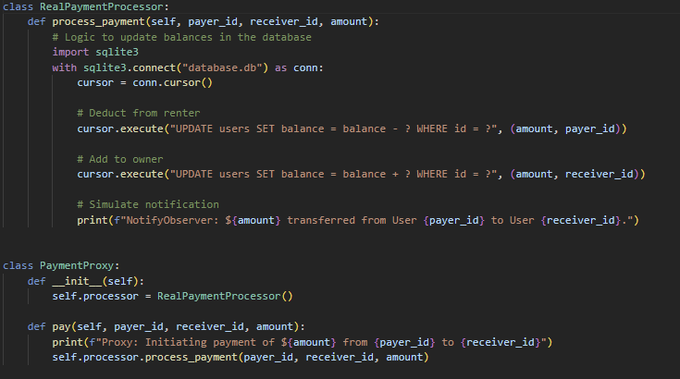
PROXY FOR PAYMENT PROCESSING
TEAM ALPHA
Notes:
LEAH Here’s the actual code showing how the proxy and real payment system work together.
On the top, you can see the Payment interface, which defines the standard pay() method. The RealPayment class handles the actual transaction logic — in production, this could tie into an API like Stripe or PayPal.
On the bottom, the ProxyPayment class wraps around RealPayment, adding any pre-processing we need. In our case, that includes logging the transaction and ensuring the payer has sufficient funds before delegating to the real system.
The final call comes from PaymentManager, which only deals with the abstract interface, not the implementation details.
Overall, this pattern gave us a flexible way to manage payments while maintaining separation of concerns.

Slide 16
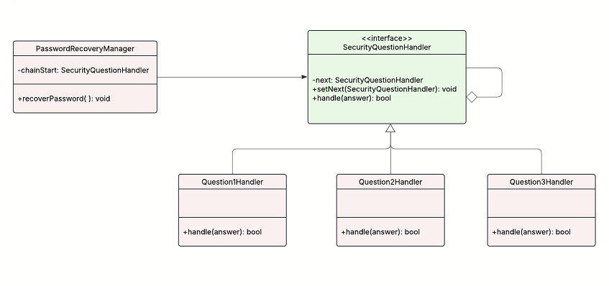
CHAIN OF RESPONSIBILITY FOR PASSWORD RECOVERY
Each security question is a handler in the chain—if answered correctly, the chain continues.
Handlers implement SecurityQuestionHandler with handle() and setNext() methods.
Question1Handler, Question2Handler, Question3Handler each verify specific questions.
PasswordRecoveryManager triggers the chain via recoverPassword().
TEAM ALPHA

Slide 17
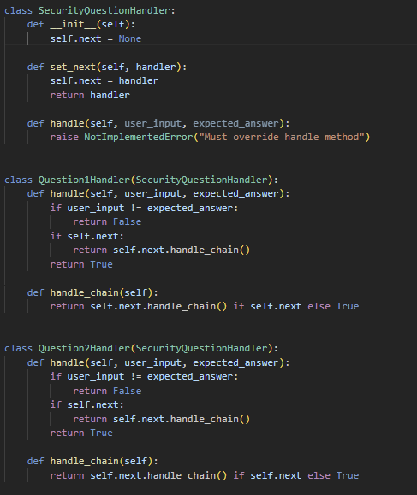
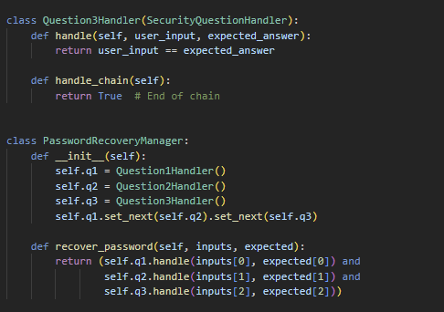
CHAIN OF RESPONSIBILITY FOR PASSWORD RECOVERY
TEAM ALPHA

Slide 18

DATABASE SCHEMA
04.
COMPANY NAME
Notes:
LEAH

Slide 19
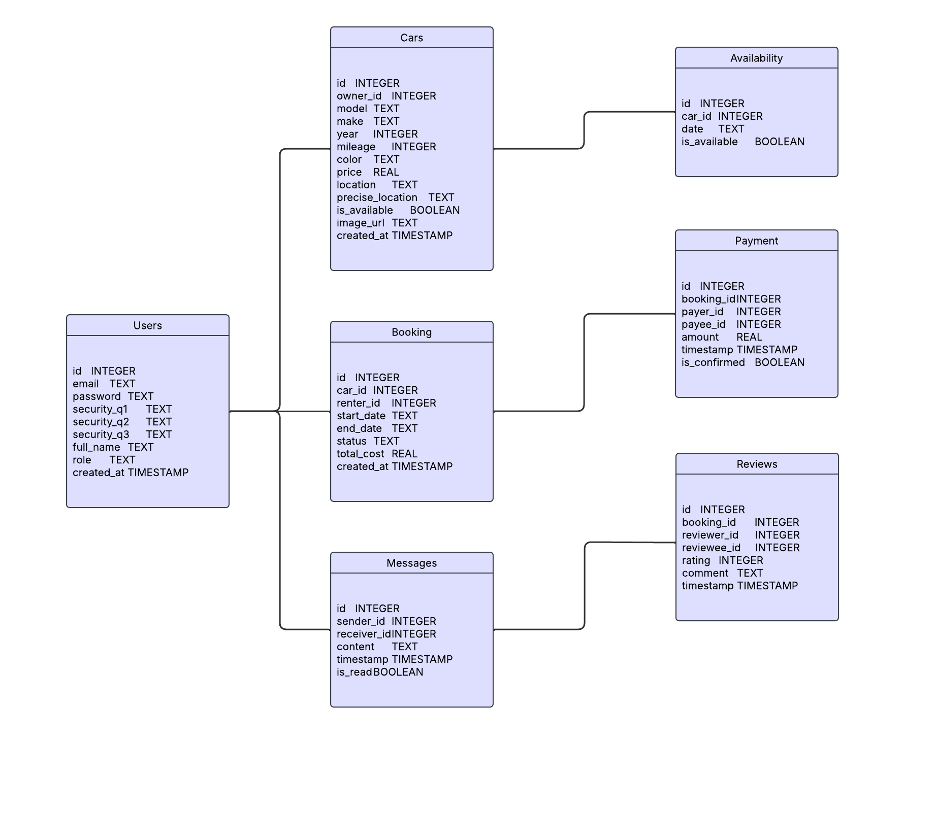
DATABASE SCHEMA
TEAM ALPHA
Notes:
LEAH To tie everything together, here’s a look at our DriveShare database schema.
Our database is designed to support all the core features of the platform — user management, car listings, bookings, availability, messaging, payments, and reviews.
You can see the main entities like Users, Cars, and Booking, each with their appropriate fields. Foreign keys are used to define relationships between tables. For example, each car has an owner_id that links back to a user, and each booking ties a car_id to a renter_id.
We also track availability at the day level through the Availability table, letting owners block off specific dates.
The Payments table ensures we log every transaction, along with who paid whom, how much, and whether it was confirmed.
We added Messages to support in-platform communication between renters and owners, and Reviews to support feedback and reputation.
This relational design makes it easy to query things like 'all future bookings for a car', or 'messages between two users'.
All of this supports the features of Drive Share that weve seen. And this will just about conclude our presentation.

Slide 20

TEAM CONTRIBUTIONS
05.
COMPANY NAME

Slide 21
Team Contributions
Leah Mirch
Database, Payment, Car listing and Management, Searching and Booking, Rental History, Payment
Zaynab Mourtada
Front End Design, Messaging, Notification system
Souad Omar
Documentation/Slides/Diagrams, User Registration & Authentication, User/Owner Reviews
TEAM ALPHA
Firas Abueida
Documentation, Slides,Testing, Worked with Souad via DAS

Slide 22
THANK
YOU
TEAM ALPHA

