Slide 1
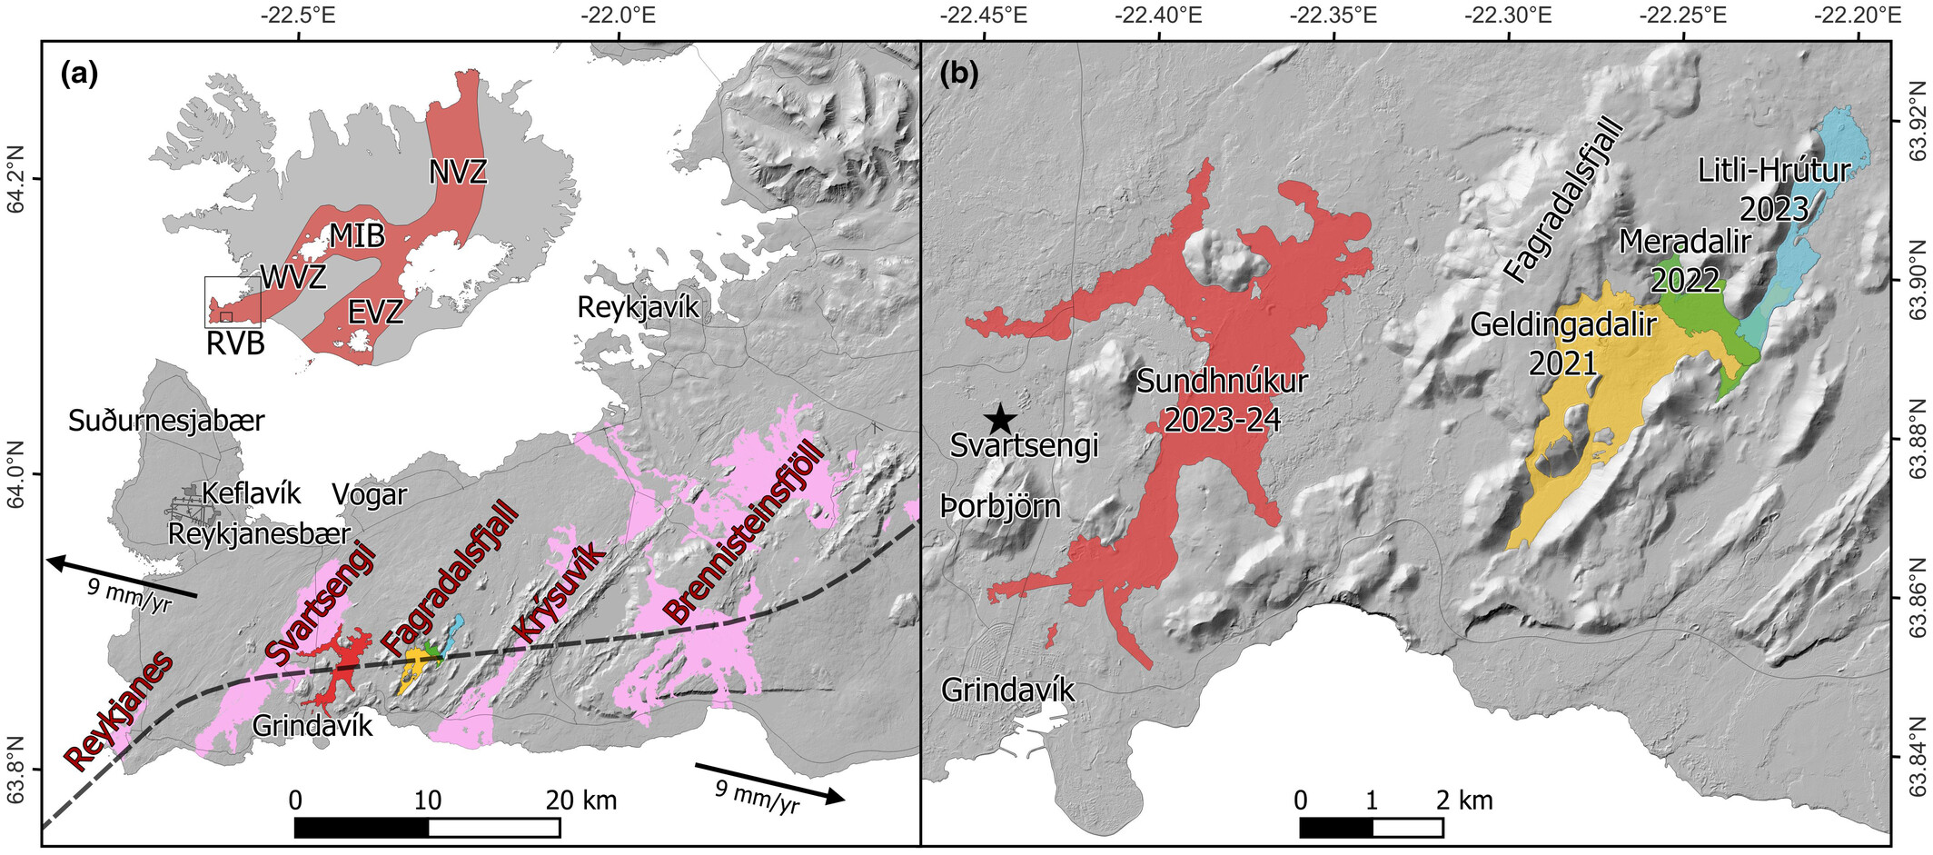
The Fagradalsfjall and Sundhnúkur Fires of 2021–2024: A single magma reservoir under the Reykjanes Peninsula, Iceland?
Terra Nova, First published: 26 June 2024, DOI: (10.1111/ter.12733)
Notes:
The Reykjanes Peninsula and recent eruption sites. (a) Map of Iceland showing the main rift zones (inset) and a close‐up of the Reykjanes Peninsula (RP), with the major volcanic lineaments and recent lava fields highlighted. EVZ, Eastern Volcanic Zone; MIB, Mid‐Iceland Belt; NVZ, Northern Volcanic Zone; RVB, Reykjanes Volcanic Belt; WVZ, Western Volcanic Zone. (b) Close‐up of part of the RP showing the three successive lava flows of the Fagradalsfjall Fires that have now joined to create a single larger lava field (Geldingadalir, yellow; Meradalir, green; and Litli‐Hrútur, blue) as well as the latest lava field at Sundhnúkur (red). Star shows the location of the Blue Lagoon.
IF THIS IMAGE HAS BEEN PROVIDED BY OR IS OWNED BY A THIRD PARTY, AS INDICATED IN THE CAPTION LINE, THEN FURTHER PERMISSION MAY BE NEEDED BEFORE ANY FURTHER USE. PLEASE CONTACT WILEY'S PERMISSIONS DEPARTMENT ON PERMISSIONS@WILEY.COM OR USE THE RIGHTSLINK SERVICE BY CLICKING ON THE 'REQUEST PERMISSIONS' LINK ACCOMPANYING THIS ARTICLE. WILEY OR AUTHOR OWNED IMAGES MAY BE USED FOR NON-COMMERCIAL PURPOSES, SUBJECT TO PROPER CITATION OF THE ARTICLE, AUTHOR, AND PUBLISHER.

