Slide 1
Activize: A Wearable Corporate Wellness Application
Bridget Davis, Amna Hashmi, and Leah Xu
August 13, 2014

Slide 2

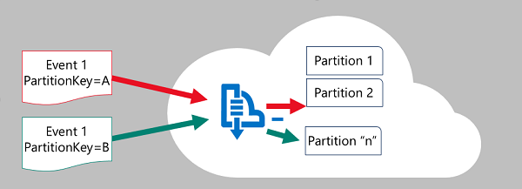
Our Imperative: Showcase Event Hubs
Event Hubs support the following scenarios:
Collecting event streams at high throughput from devices for use in real-time processing.
Connecting millions of devices from diverse platforms for sending data (with individual authentication and flow control).
Process event streams per device "in order" using several backend services (publish/subscribe.)

Slide 3
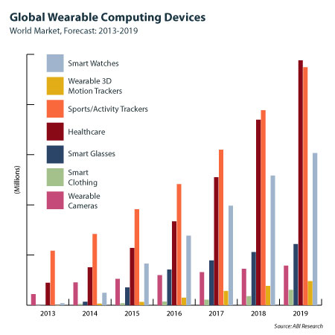
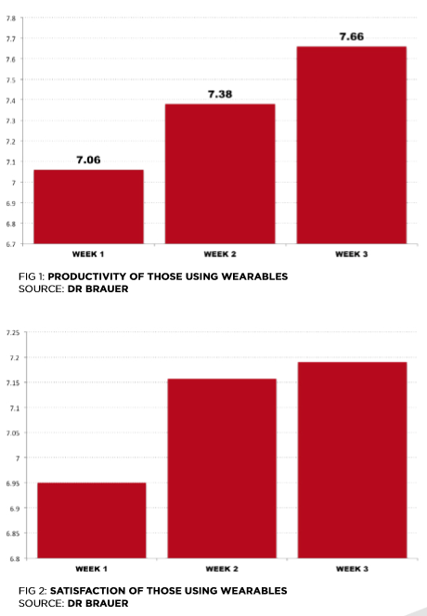
Why Wearables? Why In Enterprise?
Estimate that up to 485 million annual wearable devices will be shipped by 2018 (conservative estimates are around 50 million units annually) → expansive IoT market.
Could boost employee productivity and satisfaction. Wearing just three devices, each employee generated about 30 GB of data a week; when scaling to only 1000 employees, generates over 1.5 petabytes/year→ necessitates a cloud solution to process the big data.

Slide 4
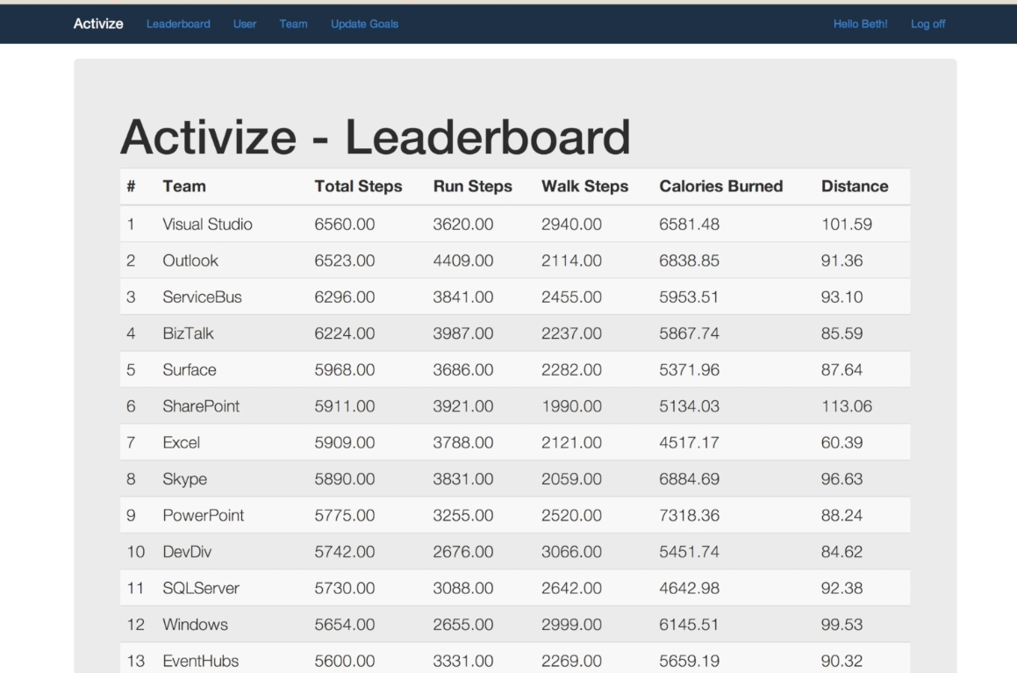
Activize: Hyperscale. Wearable. Real-Time.
Activize is a web application that fitness team members can log into to see their real-time as well as historical values for each pedometer statistic. In addition, a leaderboard feature highlights the most active teams based off of the aggregate information collected across all members within a team. Through gamification, Activize motivates those who are walking below the average, resulting in higher averages.

Slide 5
Technology Deep Dive
Data Flow in the Internet of Things

Slide 6
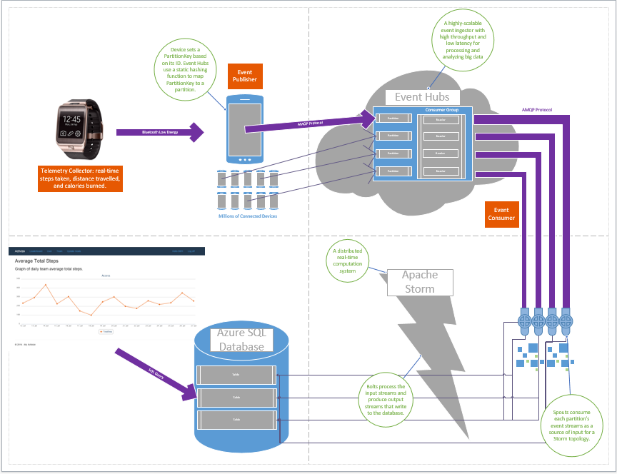

Slide 7
Samsung Gear 2 to Event Hubs
Samsung Gear 2 pushes pedometer metrics to Android host via Bluetooth
Android Host serializes the pedometer metrics as a JSON string to send to Event Hubs

Slide 8
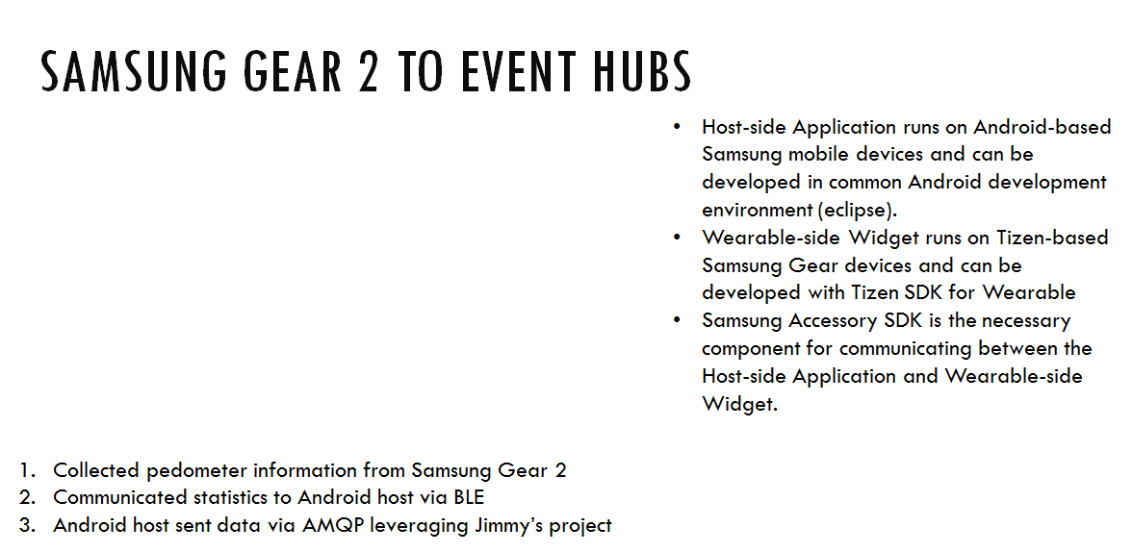
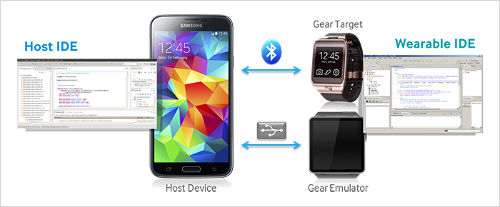

Slide 9
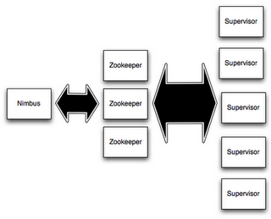
Real-Time Computing with Apache Storm
Storm is a distributed realtime computation system that makes it easy to reliably process unbounded streams of data
Node: each machine on a cluster
Nimbus Node - master, uploads computations, distributes code, launches workers, load-balancing, receives and distributes messages to workers
ZooKeeper Nodes - coordiates the storm cluster, state information
Supervisor Nodes - daemon run by worker nodes, computes with nimbus through ZooKeeper
Tuple: named list of values
Field in a tuple can be an object of any time
Storm supports all primitives, strings, and byte arrays by defaut

Slide 10
Activize Topology (x8)
EventHubSpout
MessageReceiverBolt
RawDBWriterBolt
UserAggregatorBolt (deviceId)
CompanyAggregatorBolt (companyId)
DBWriterBolt
DBWriterBolt

Slide 11
Bolts
MessageReceiverBolt
cleans the header of the JSON string received from Event Hubs
RawDBWriterBolt
UserAggregatorBolt
CompanyAggregatorBolt
Uses a HashTable to store all the team information
DBWriterBolt
writes to RTCompany, Daily Company, RTUser, DailyUser, and Leaderboard

Slide 12
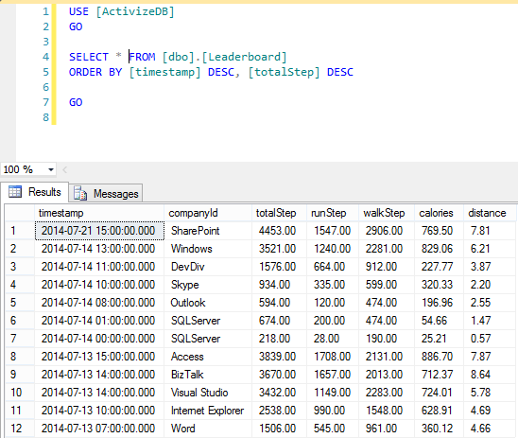
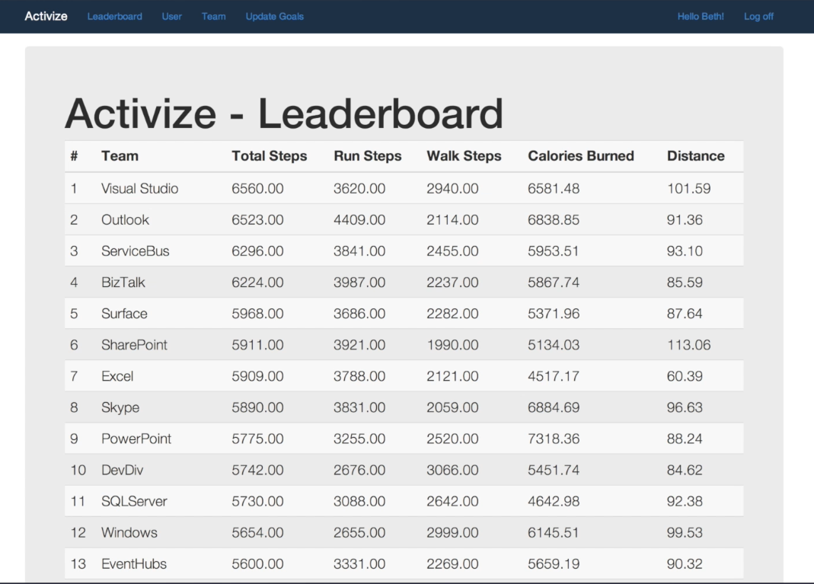
Leaderboard

Slide 13
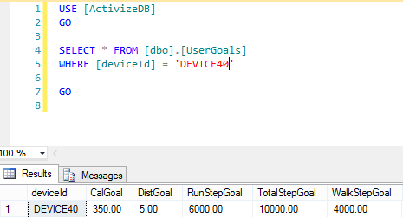
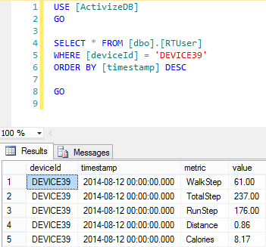
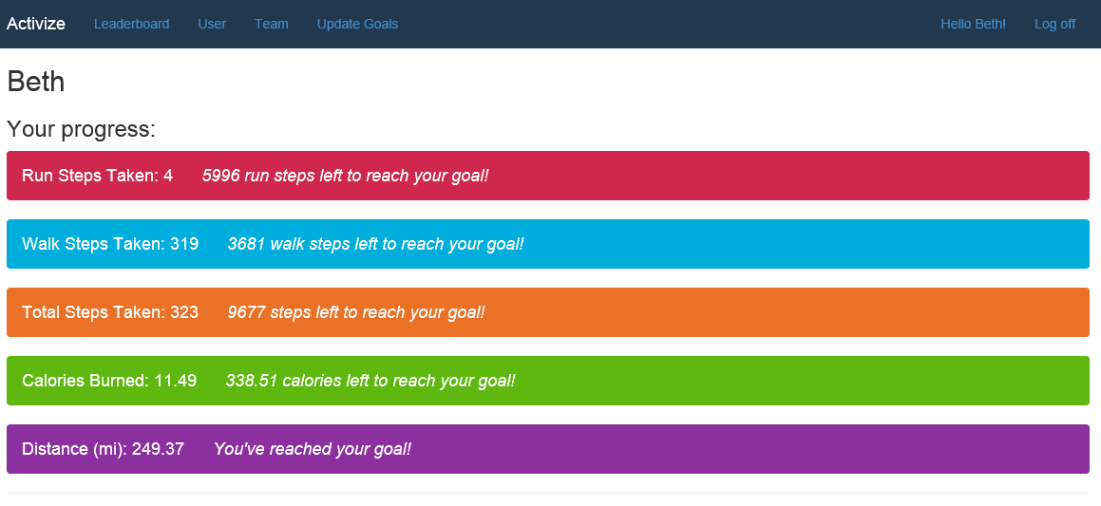
USER

Slide 14
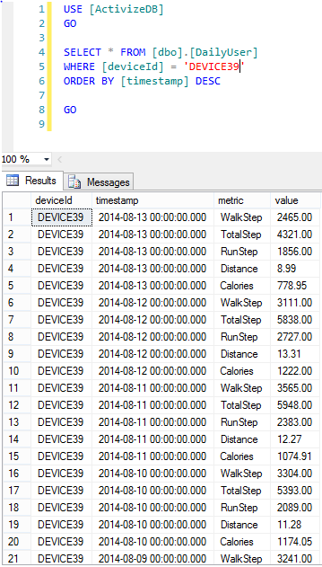
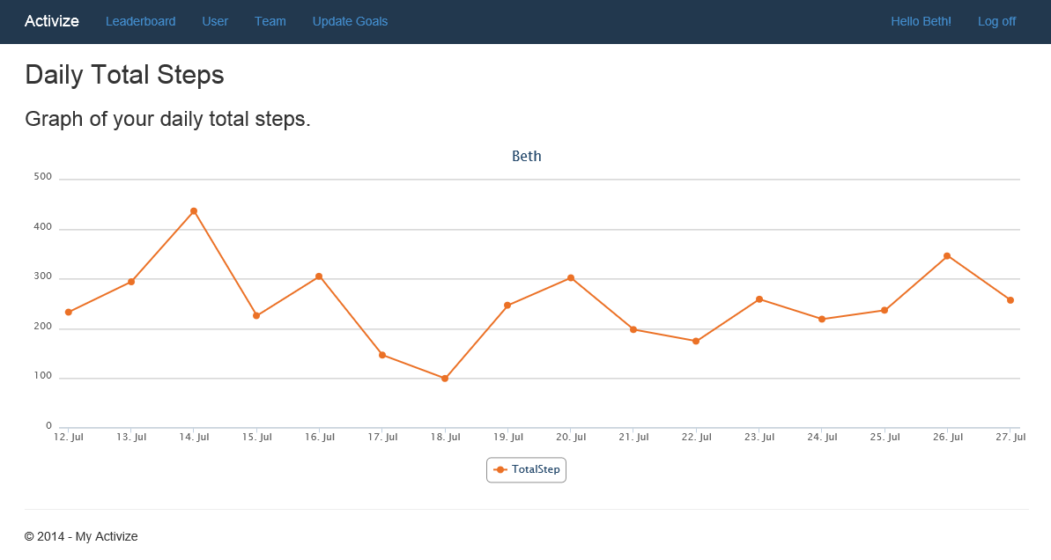
USER HISTORY

Slide 15
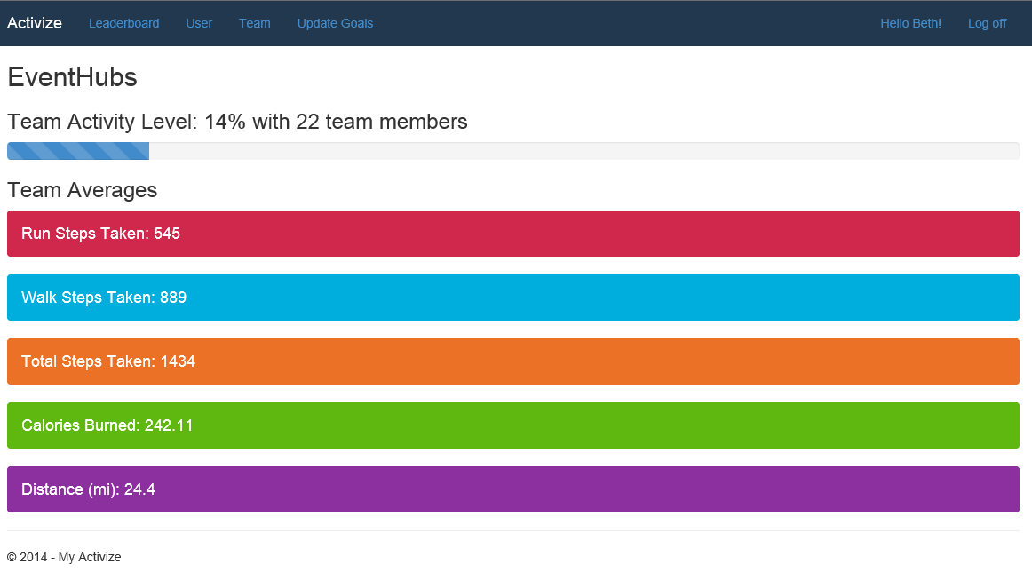
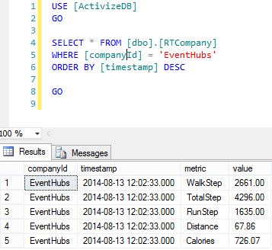
TEAM

Slide 16
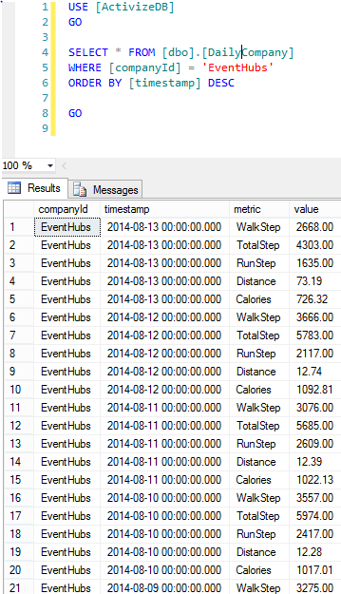
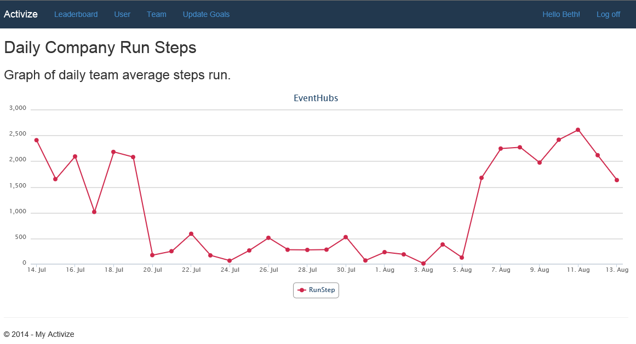
TEAM HISTORY

Slide 17
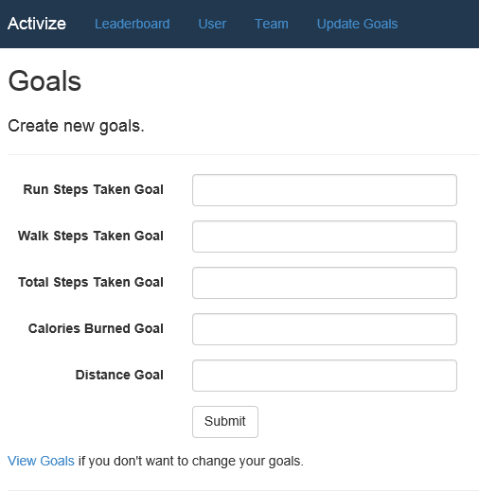
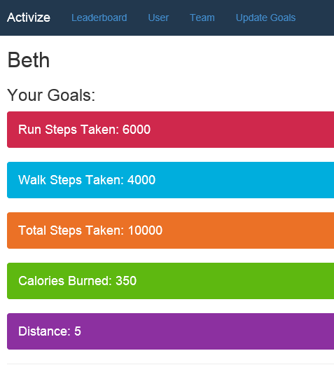
UPDATE GOALS

Slide 18
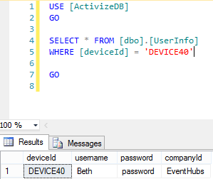
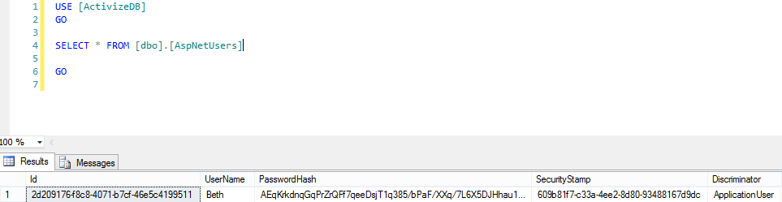
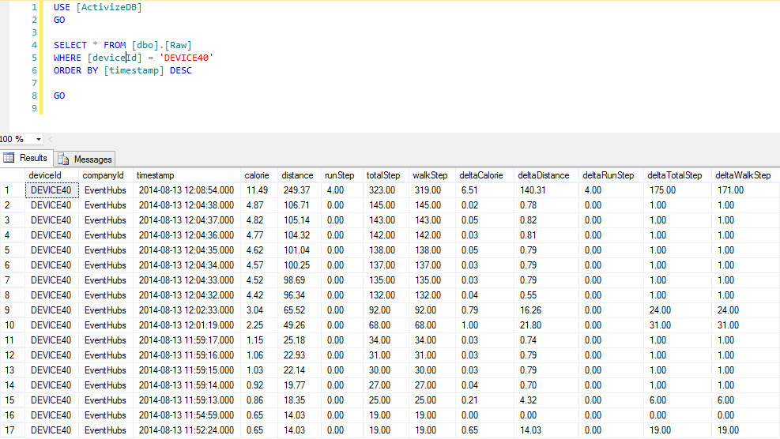
OTHER DATA TABLES

