Slide 1
Practical Course on Graph Learning
Exercise Sheet 5 presented by
Peihong Shi
Lea Marxen
Haron Shaker

Slide 2
Work flow
One person responsible per dataset, but working together on models
Manual parameter search to get optimal results

Slide 3
Implementation of HOLU
Similar to GNN implementation of exercise 3
GNN
Custom dataset, Collate function
Layer
Sparse Sum Pooling
(Virtual node)
Residual connection, (Dropout)
Mean Absolute Error
node distances as further edge attributes
Train-test split: 80%-20%

Slide 4
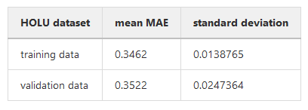
Results for HOLU
hidden dimension: 64
Type of aggregation: sum
Number of layers: 5
Dropout: 0.0
Virtual Node: False
Epochs: 100
Batch size: 100
Learning rate: 0.004

Slide 5
Implementation of CITE
Similar to GCN implementation of exercise 2
GCN
load_data
GCN_Layer
GCN
train_GCN
Node classification, masked cross entropy
Train-test split: 80%-20%

Slide 6
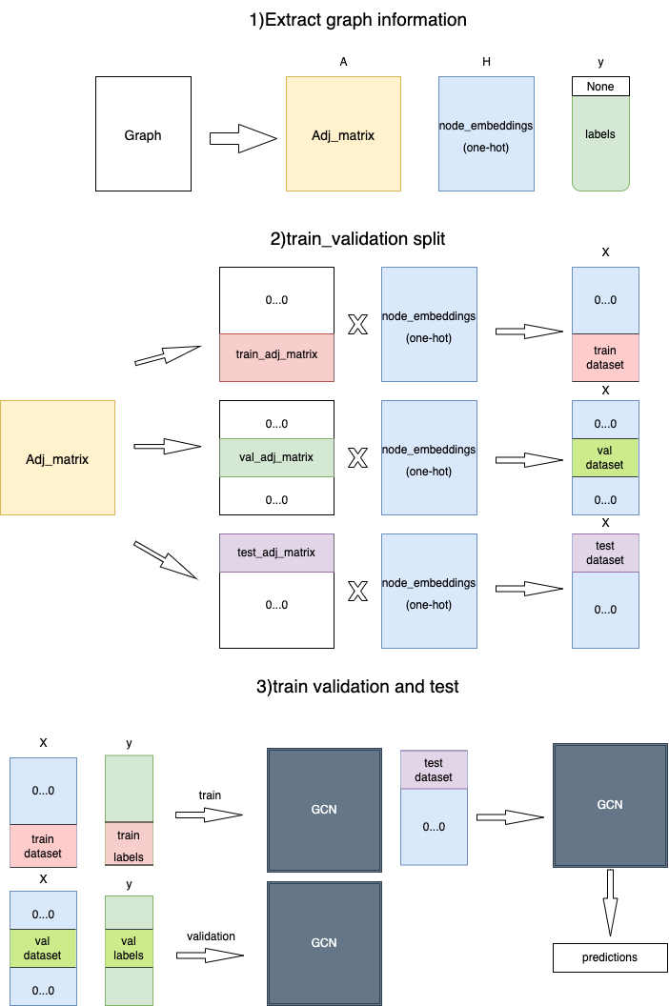

Slide 7
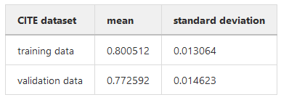
Results for CITE
hidden dimension: 64
Number of layers: 3
Dropout: 0.2
Epochs: 100
Learning rate: 0.001
Validation set percentage: 0.2

Slide 8
Implementation of LINK
First part similar to Node2Vec implementation of exercise 4
Node2Vec
Random walks (Iterable Dataset)
Node2Vec
train_node2vec
Second part: MLP
MLP module, training and validation loop
Input-train-validation-test split

Slide 9
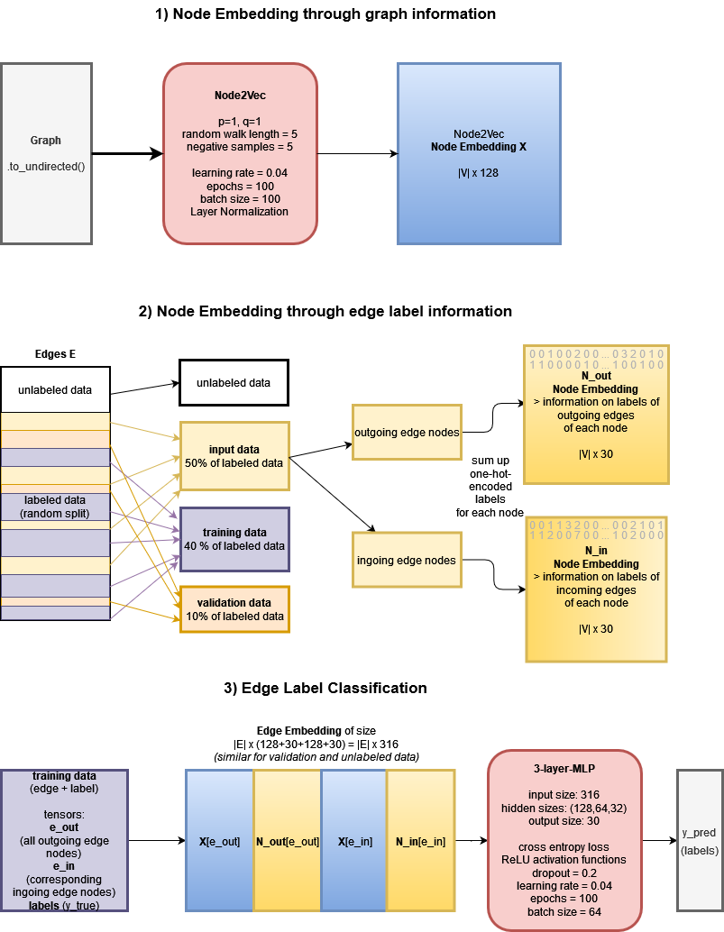

Slide 11
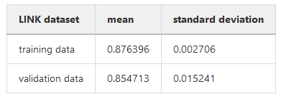
Results for LINK

Slide 12
Thank you ☺

