Slide 1
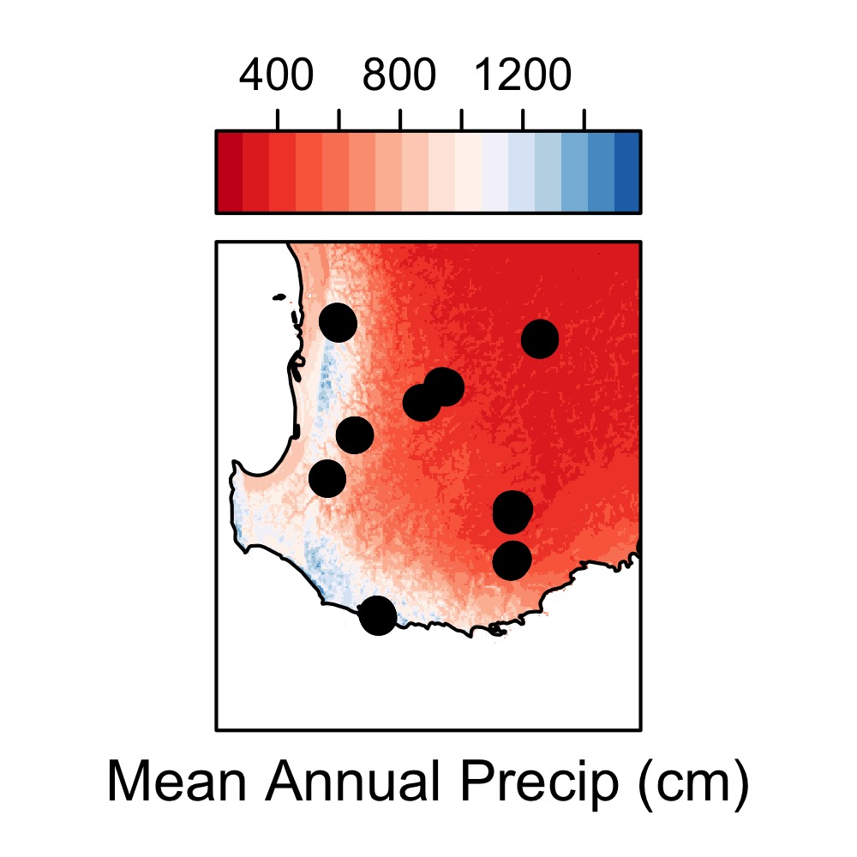
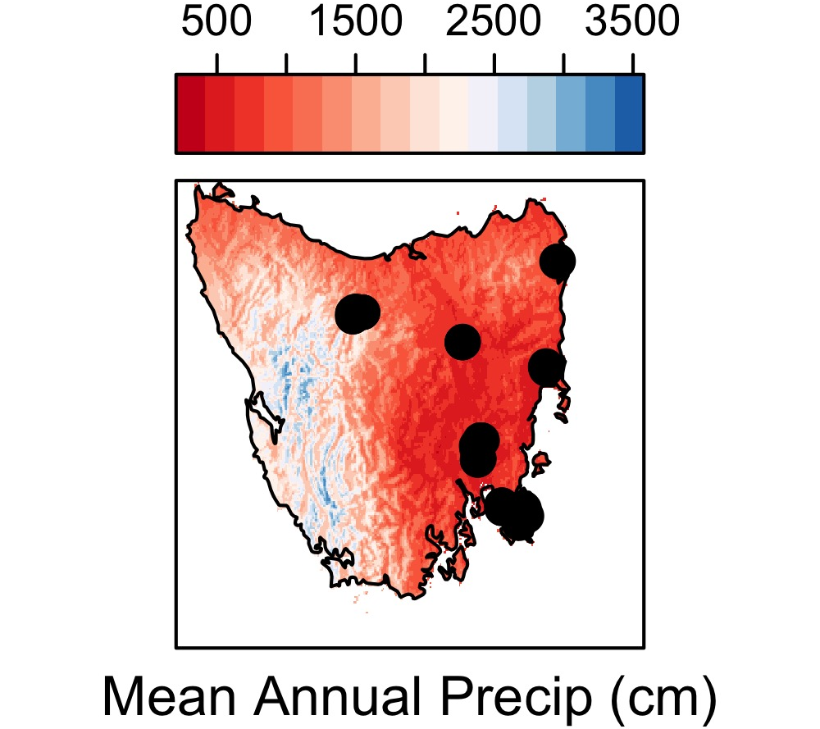
4-5 Sites
per species
8 Species
in Tasmania
and WA
3 Plots
per site
5 Individuals
per plot
3 Branches
per Individual

