Slide 1
SHIFT Sampling
Indra

Slide 2
#SHIFT

Slide 3
Leaf water content:
## Warning: Removed 2123 rows containing missing values (geom_point).

Slide 4
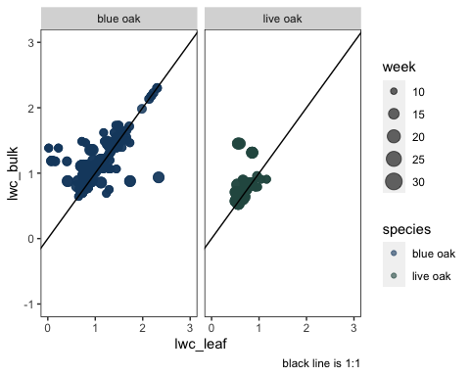

Slide 5
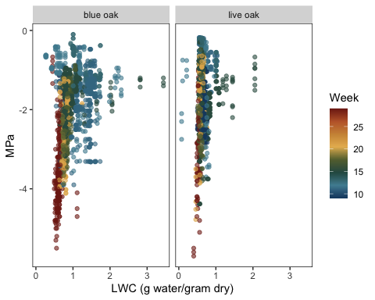

Slide 6
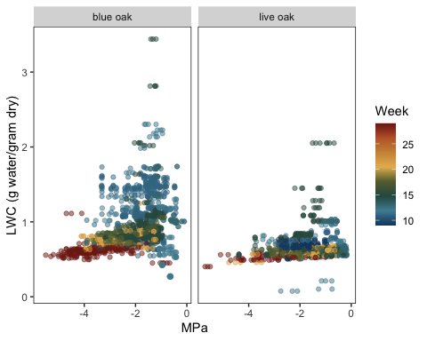

Slide 7
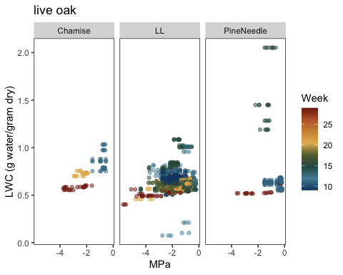

Slide 8
Relative water content:
Reminder: RWC is combination of LWC and SWC, where:
SWC = g water/g dry after 2 hour rehydration (mean per tree/time of day/week) LWC = g water/g dry (mean per tree/time of day/week)
RWC x LWC:

Slide 9
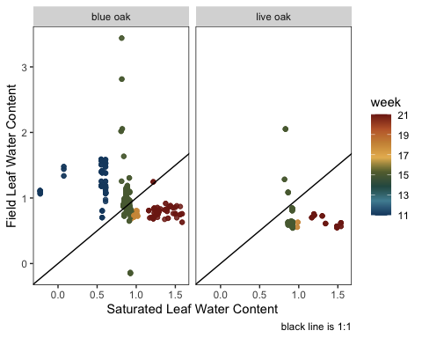

Slide 11
RWC vs. MPa

Slide 12
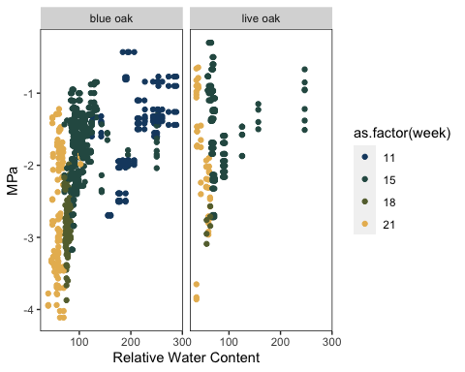

Slide 13
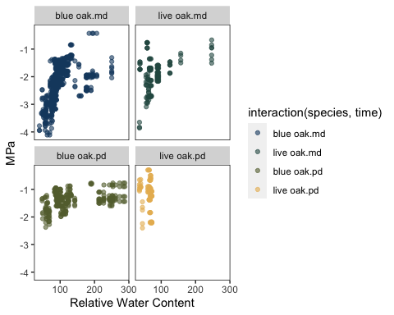

Slide 14
LFM x MPa, year 0

Slide 15
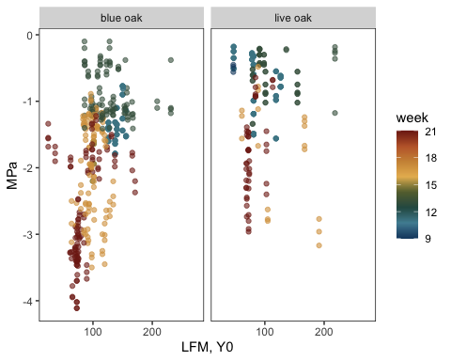

Slide 16
LFM x MPa, year 1

Slide 17
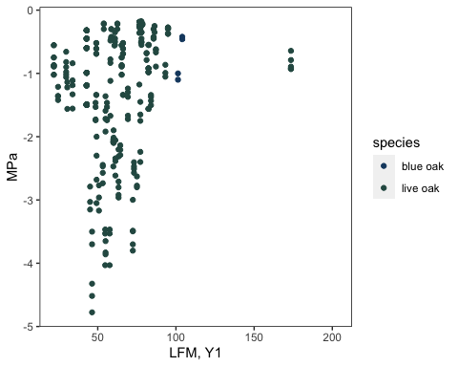

Slide 18
LFM year 1 vs. year 0

Slide 19
