Slide 1
Reminder
Want to constrain neutrino mass sum from galaxy redshift survey
Particular emphasis on information from voids
Rely on FastPM simulations populated w/ HOD
Restrict to CMASS NGC for now

Slide 2
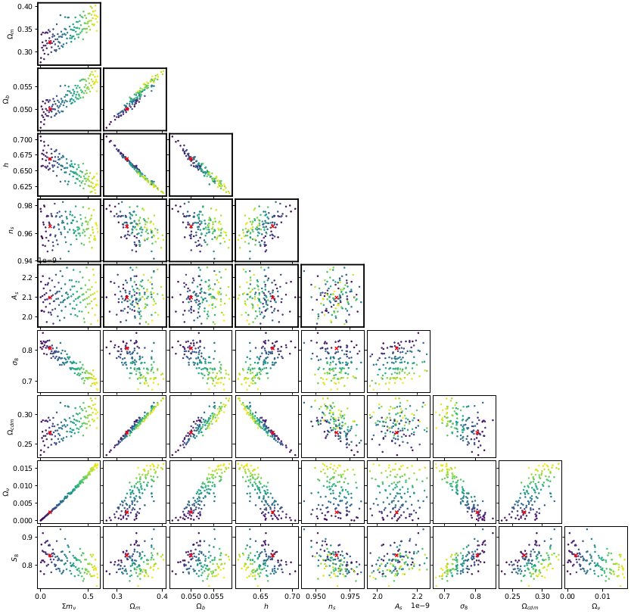
Simulations
Adopt 2xPlanck prior on CMB parameters.
Sample this prior with an open quasi-random sequence.
Red = fiducial point, color code = Mnu
127 cosmo-varied, 69 cosmo-fiducial simulations successful
Populate with 11-dimensional HOD, priors wide
Specific HOD chosen after optimization runs over a larger space
Survey realism implemented similar to SIMBIG. However, downsample n(z) to data – don’t trust HOD enough
Each simulation box allows 96 augmentations, distribution close to real
Have ~30kx8 varied lightcones, ~69x96 fiducial lightcones, ~1kx96 derivative lightcones

Slide 3
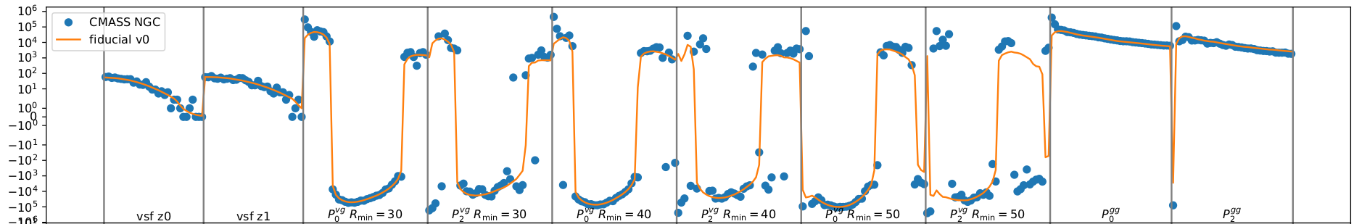
Datavector
VSF in two redshift bins (cut at z=0.53), 32 radius bins 30-80 Mpc/h
Void-galaxy power spectrum for Rmin=30, 40, 50 Mpc/h
Usual galaxy auto power spectrum
No hexadecapole as not much S/N
Power spectra measured up to k=0.2 h/Mpc, but we’ll probably cut to lower kmax (explored below)
Note the fiducial point was chosen looking only at the VSF, so the fact that it works ok for the power spectra is encouraging

Slide 4
Compression
I first tried to emulate entire data vectors, but this became extremely cumbersome. Very little control over what is a good emulator.
Thus switch to MOPED compression (down to 17-dimensional data vector)
Approximate likelihood as Gaussian for compression (note that pure Poisson and Gaussian have the same expression for MOPED)
Have also implemented nuisance-hardened compression, in a test a compression to 5d lead to compatible but slightly wider posteriors

Slide 5
Estimating derivatives
From ~1k data points w/ linear regression.
Data points chosen such that 0<Mnu<0.2, HOD reasonably close to fiducial point (estimated from preliminary posteriors)
Linear approximation turns out to be ok in this volume, looking at average chi-squared and chi-squared(parameter) scatter plots

Slide 6
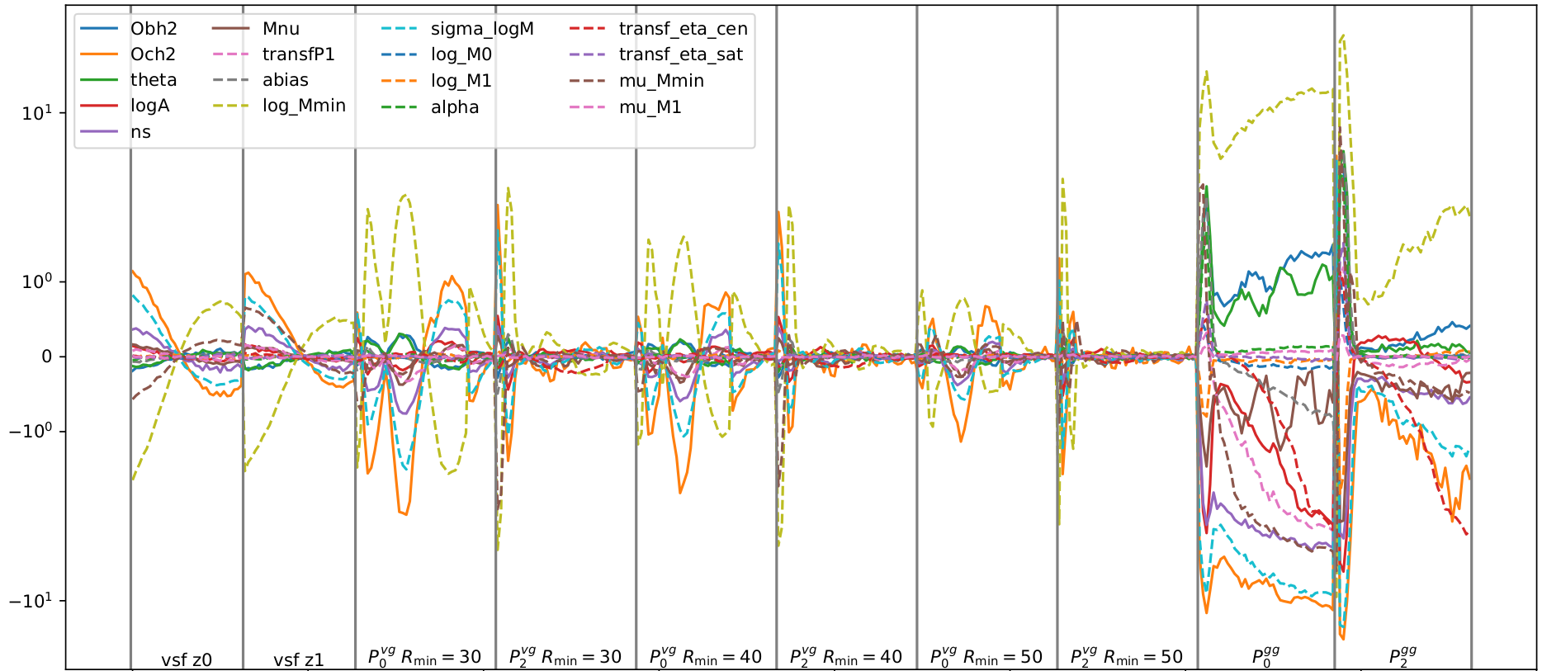
Y-axis is estimated derivative x reasonable variation / sigma

Slide 7
ILI / SBI / LFI
We are only interested in lower-dimensional marginals
The likelihood is a mixture of Poisson and Gaussian and maybe more, so difficult to deal with
Use neural ratio estimation (NRE) as implemented in SBI code, targeting lower-dimensional marginals (usually Mnu, logMmin, muMmin)
Including other parameters besides Mnu is useful because it allows additional sanity checks. The above parameters are well-constrained. Switching to different HOD parameters targeted doesn’t change Mnu posterior (as it should be).

Slide 8
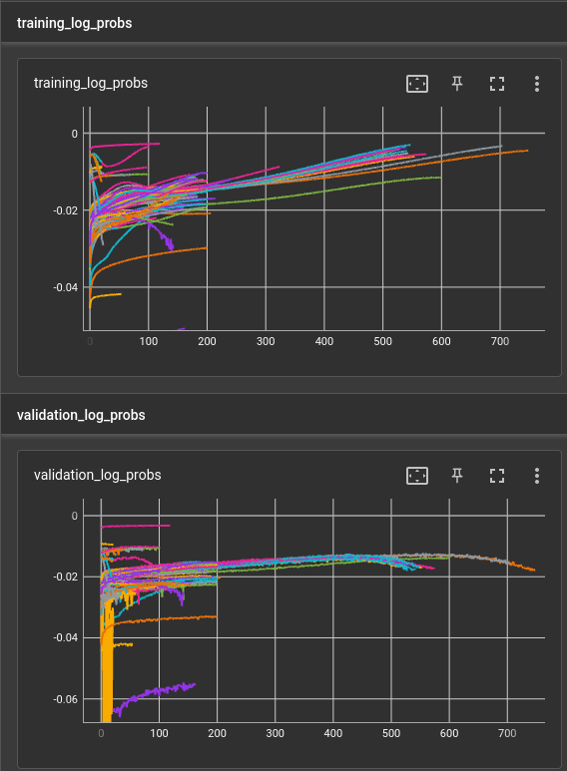
Tuning
For now, concentrate on validation loss to pick good models
Exclude samples with reduced chi-squared >1e4 (w.r.t. fiducial), will be well outside posterior and only prolong training
Changes beyond defaults (so far): deep resnet, L2 regularization, 1-cycle LR, noise on Mnu, early stopping
Overfitting is a constant problem

Slide 9
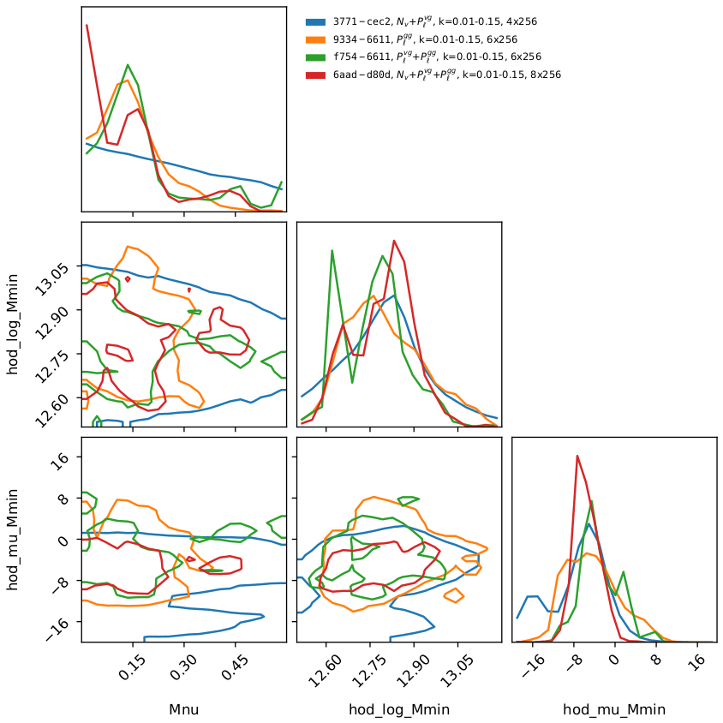
Different data choices
bump comes from P^vg I believe
HOD parameters consistent!
(checked for projection effects by looking at profile likelihood)

Slide 10
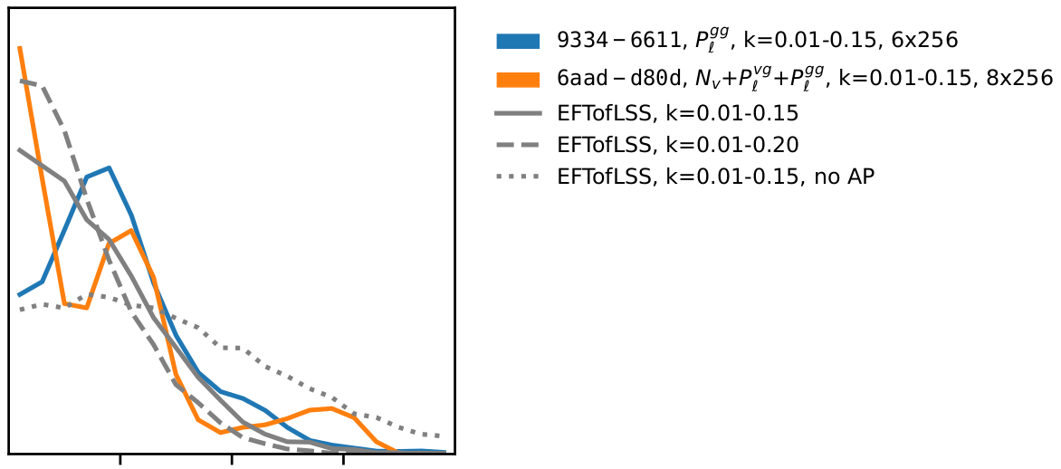
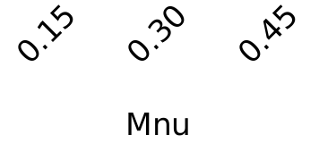
Sanity check / benchmarking
EFTofLSS posteriors come from IAS group’s code, with the same prior on LCDM as we use and pretty much the same data (not quite sure how close their high-z sample is to CMASS, but should be close). Not including SGC.
I’m including kmax=0.2, which is the maximum they claim they can go to with BOSS
Not completely sure about the AP thing, need to look at their papers. However, most likely need to include for fair comparison.

Slide 11
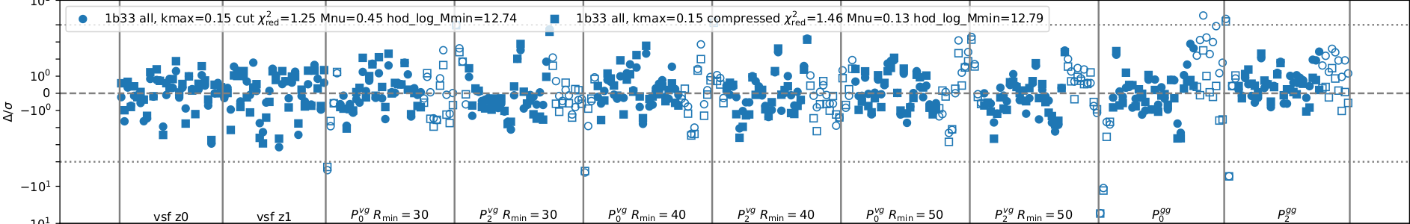
Do sims look like data?
Look at samples closest to data (avg over 8 augmentations) – note different from best-fit!
Note symlog y-scale, round is best w/out compression, square w/ compression, unfilled are unused data

Slide 12
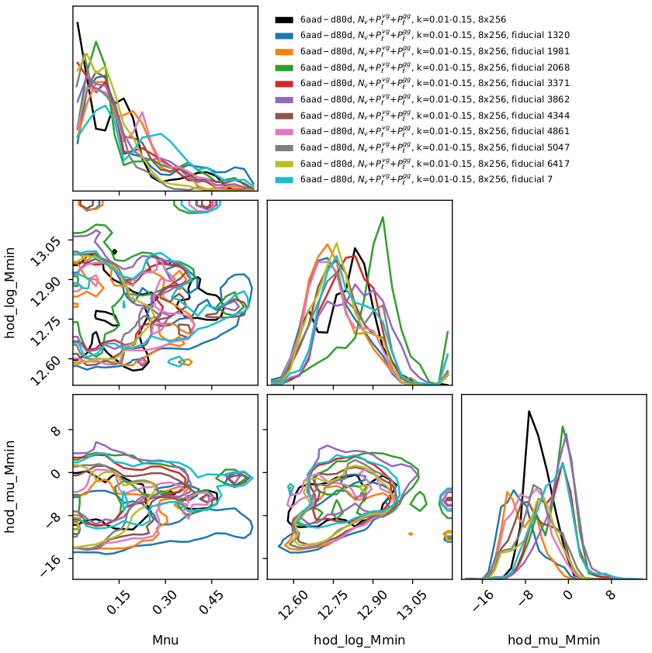
Do sims look like data?
Fiducials run w/ Mnu=0.1
Posterior shapes visually similar to what we have for real data (black).
HOD parameters consistent with inputs
(logMmin=12.9, muMmin=-5)

Slide 13
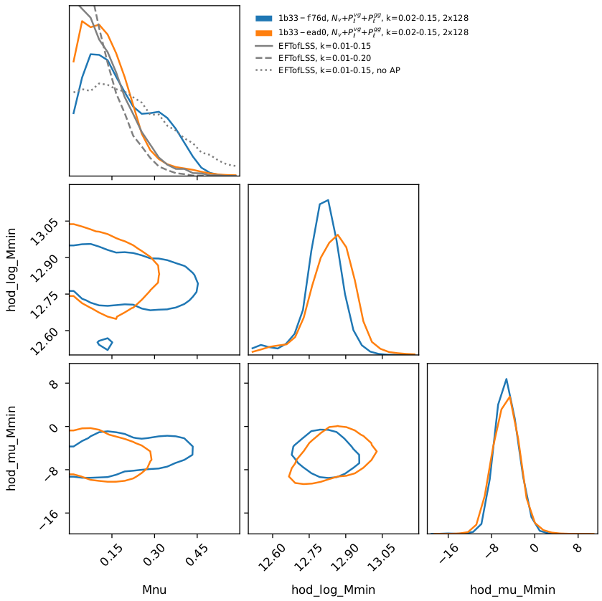
Do we have enough simulations?
Trained w/ 2/3 of the simulations (cut at cosmology level)
Note this is an older plot, orange posterior looks very nice but corresponding net has worse validation loss.
Haven’t had time yet to investigate further.

Slide 14
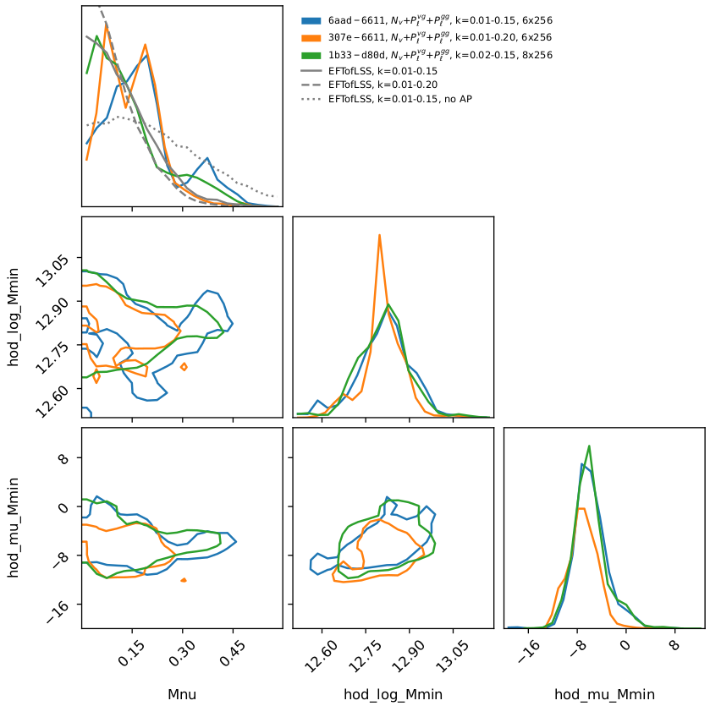
kmin, kmax issues
kmin makes a bit of a difference
kmax=0.2 surprisingly healthy!
Couldn’t get kmax=0.1 to work yet (haven’t spent much time on it though)
Haven’t yet tried different k ranges for P^vg and P^gg, could be that P^vg is more fragile and needs more cutting. Will investigate.

Slide 15
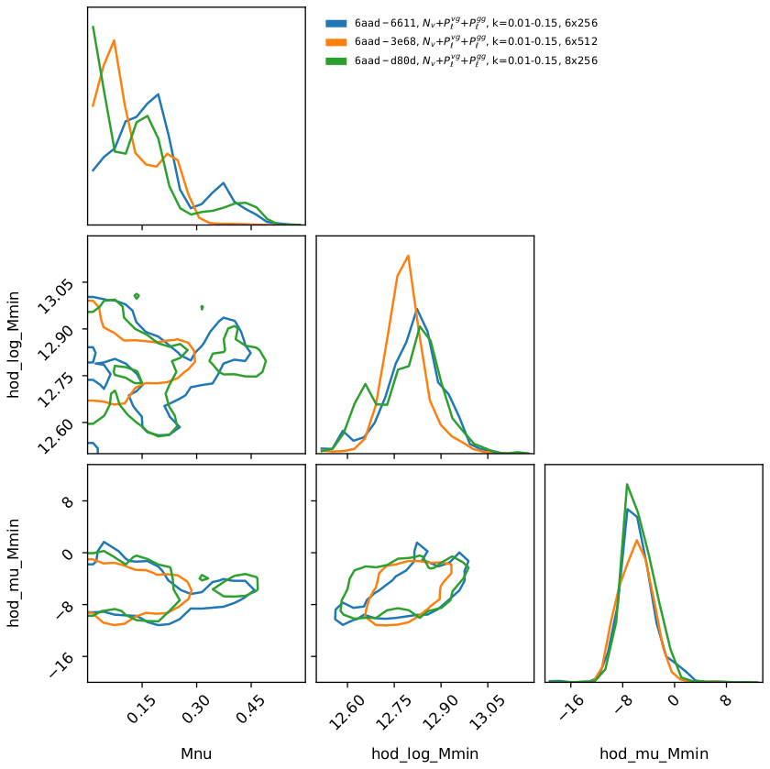
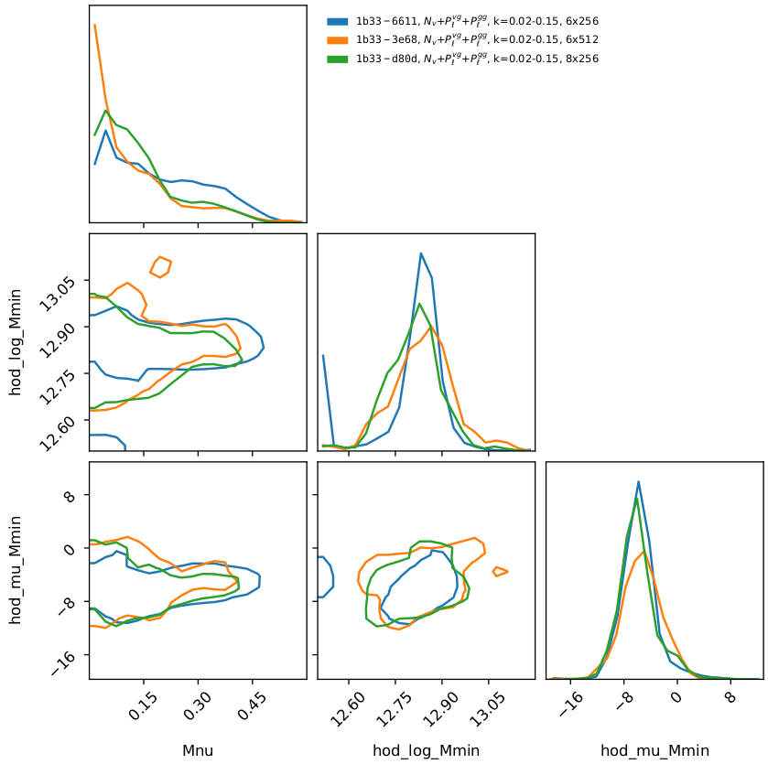
Different NREs
In both plots, compare different architectures with almost identical validation loss. Ensembling?

Slide 16
Open questions
Are we ok with the kmin, kmax issue? Can we defend kmax=0.15 (to leading order, FastPM should be conservative regarding Mnu as it lacks power, but HOD complicates matters)
Posteriors well calibrated? Test this with usual p-p plots. Q: is it ok to re-use training data there?
If calibration is an issue, ensembling?
Prior edge issues (mostly sigma_logM)

Slide 17
Preliminary interpretation
To leading order, we can do what we wanted to do! Simulations work (modulo some open issues), we get broadly reasonable posteriors
There is signal in voids, albeit small
We agree with EFTofLSS results
Combining galaxy auto power with voids leads to small but noticeable improvement in posterior (perhaps not at high confidence level though)
Both VSF and void-galaxy power contribute

Slide 18
Are we comfortable to wrap up?
Difficult to decide where to stop. Marginal improvements/clarifications definitely possible, but I wouldn’t expect them to change the main take-aways
My plan would be to do posterior calibration tests, maybe throw a bit more compute at fine-tuning the NREs, and then write the paper
Could collect more light-cone samples, perhaps with adjusted HOD prior, and/or do derivatives around a better chosen point, and/or SGC (more involved). Code is ready, but compute time non-negligible.

