Slide 1

Eat. Drink. Experience.
Lancaster's go-to for what's happening now.
tastelanc.com

Slide 2
WHAT IS TASTELANC?
TasteLanc is the hyper-local discovery platform for restaurants, happy hours, events, and nightlife — powered by AI and community voting.
• Mobile app (iOS, live on App Store) + responsive web platform
• AI concierge (“Rosie”) gives personalized recommendations from real local data
• Community voting crowns “Best Of” winners across 8 categories each month
• Restaurant owners get a full SaaS dashboard (menus, events, specials, analytics)
• Multi-market architecture live in 2 Pennsylvania markets

Slide 3
THE PROBLEM
Sound familiar?
Happy hours scattered across apps.
Events you hear about too late.
Deals buried in your feed.
No single source for what’s on right now.
By the time you find out, it’s sold out or over.
Social media algorithms hide the local spots that matter.
There is no Yelp for “what’s happening tonight.” Google Maps shows hours and reviews — not happy hour specials, live music lineups, or weekly deals. Locals piece together Instagram stories, Facebook events, and word-of-mouth. Visitors are completely lost.

Slide 4
THE SOLUTION
The single source of truth for your local food & nightlife scene.
AI Concierge (Rosie)
Happy Hours
Events Calendar
Personalized recs from real restaurant data
Real-time deals with item-level pricing
Live music, trivia, comedy, DJ nights & more
Community Voting
Rewards & Loyalty
Itinerary Builder
8 monthly categories, 4 votes/user/month
Points for check-ins, reviews, photos, referrals
AI-generated day plans with walk-time estimates
Geofence Notifications
Map Search
Weekly Specials
Neighborhood-entry alerts & check-in prompts
Clustered pins, category filters, distance sorting
Owner-managed deals updated from the dashboard

Slide 5
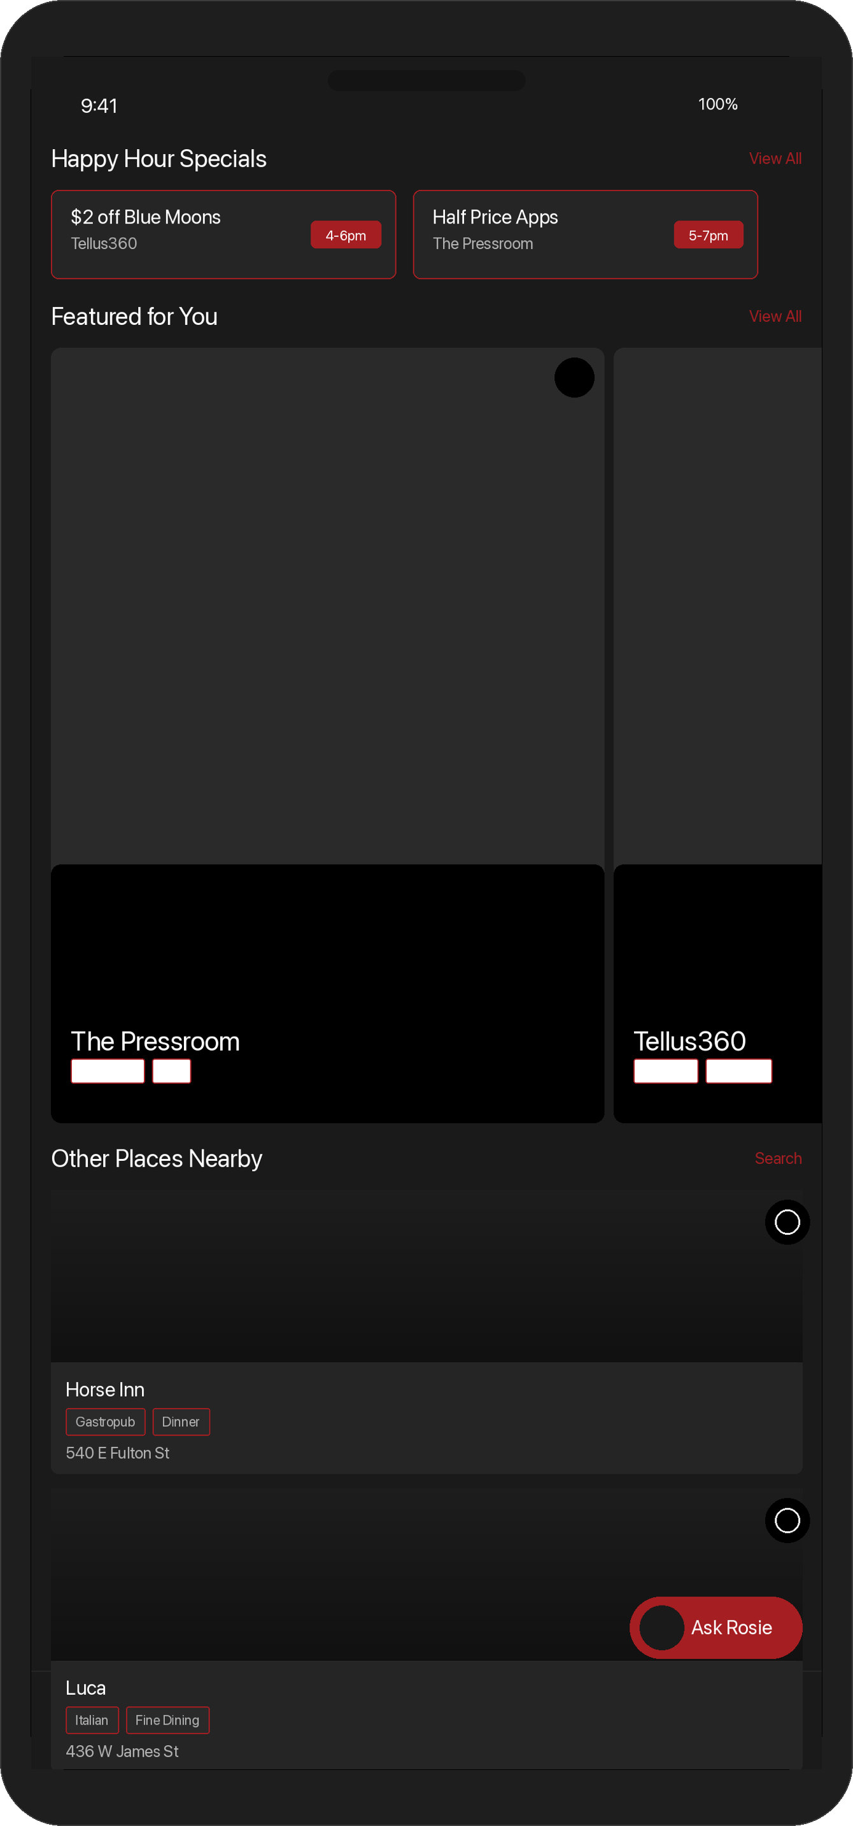
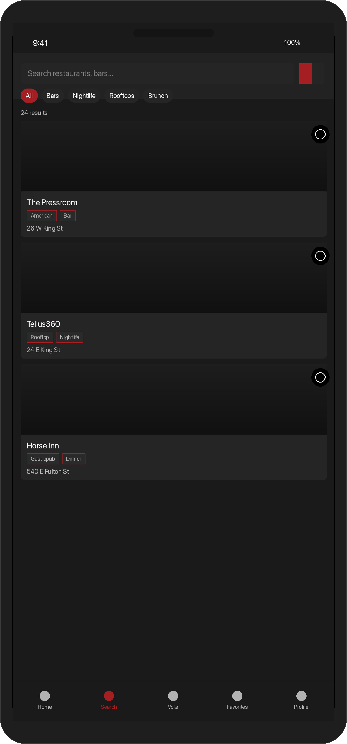
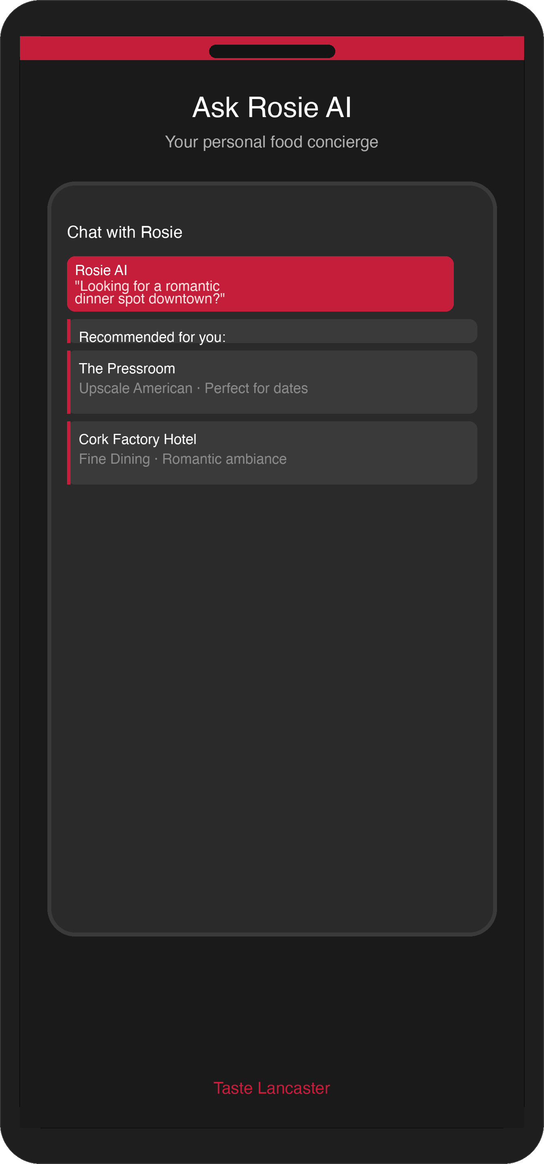
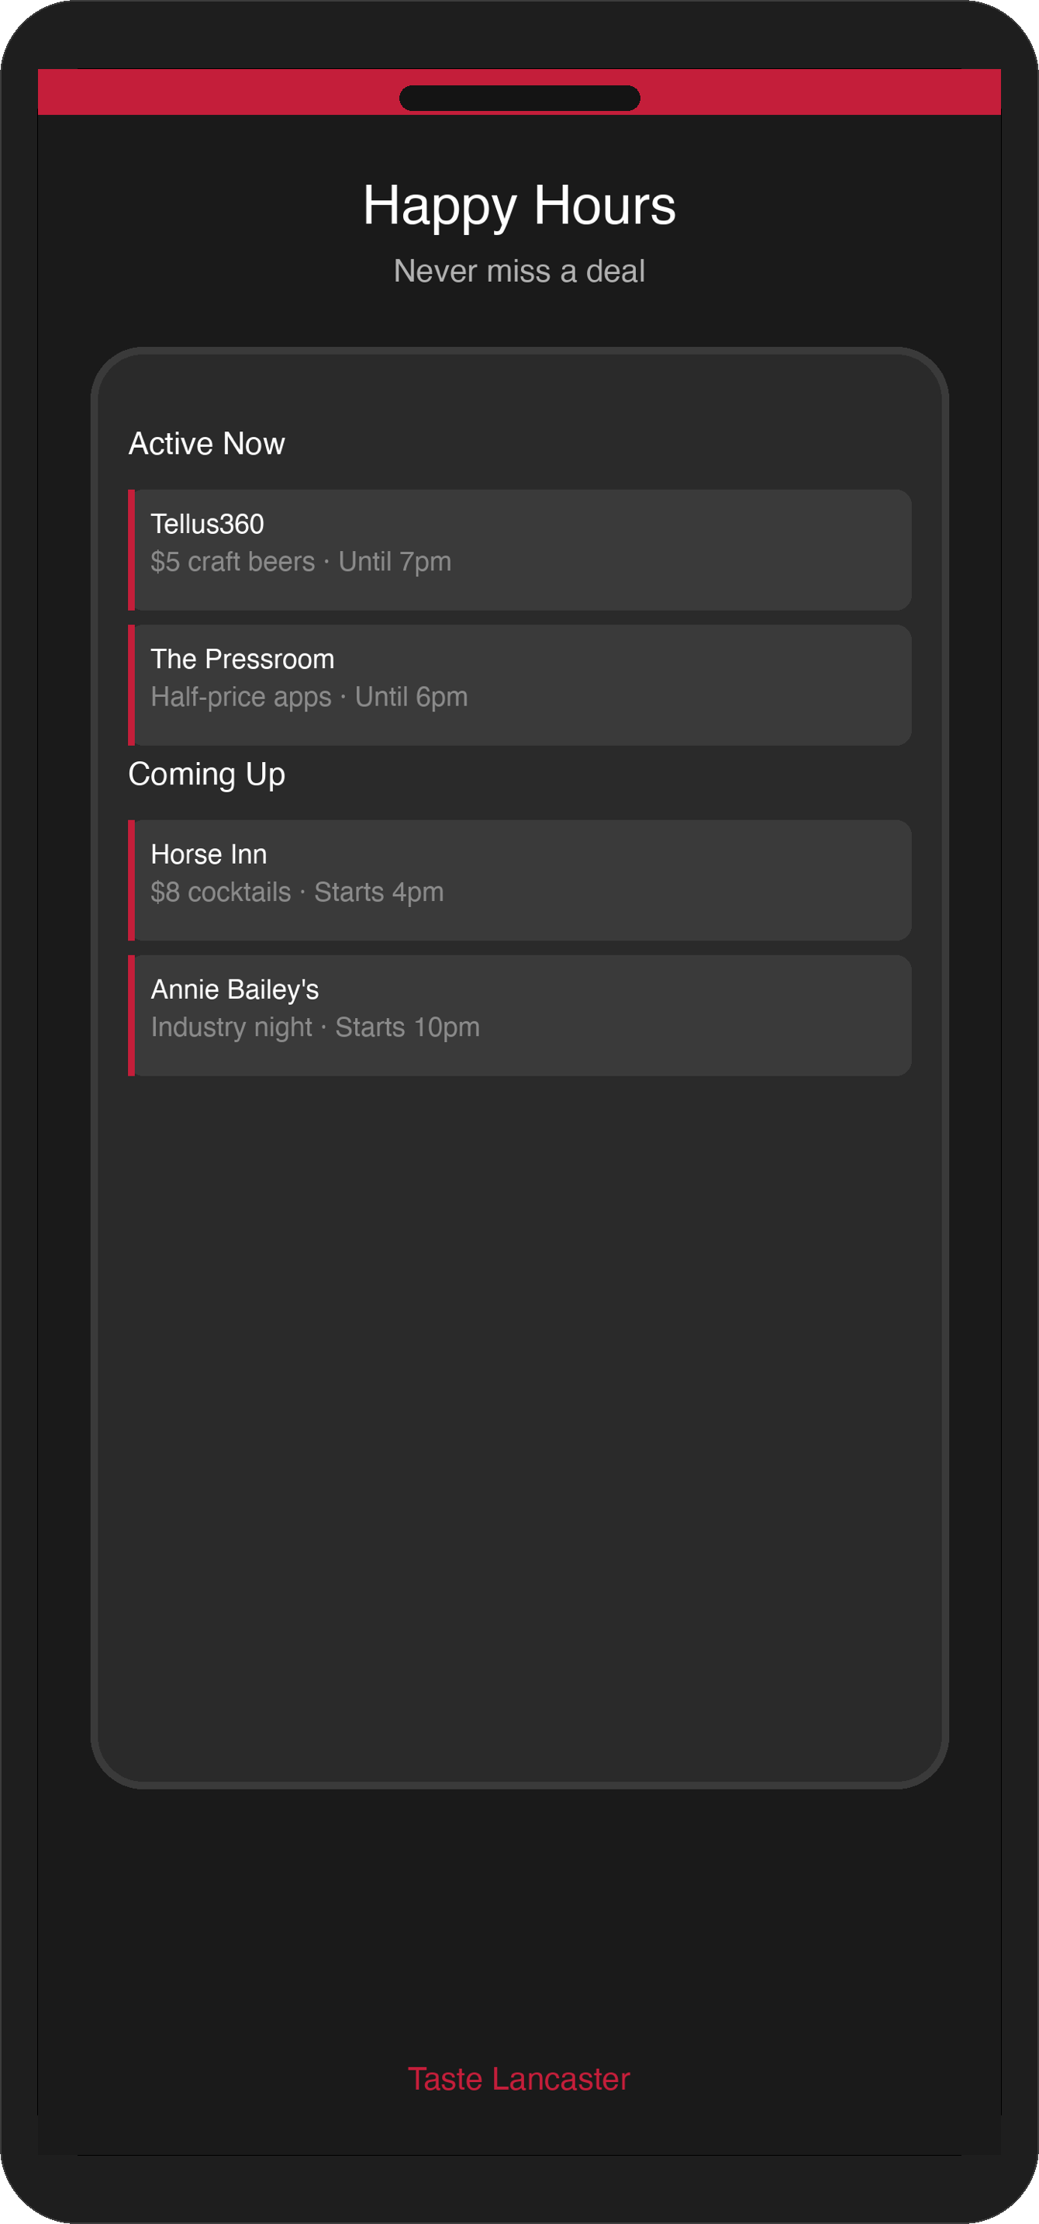
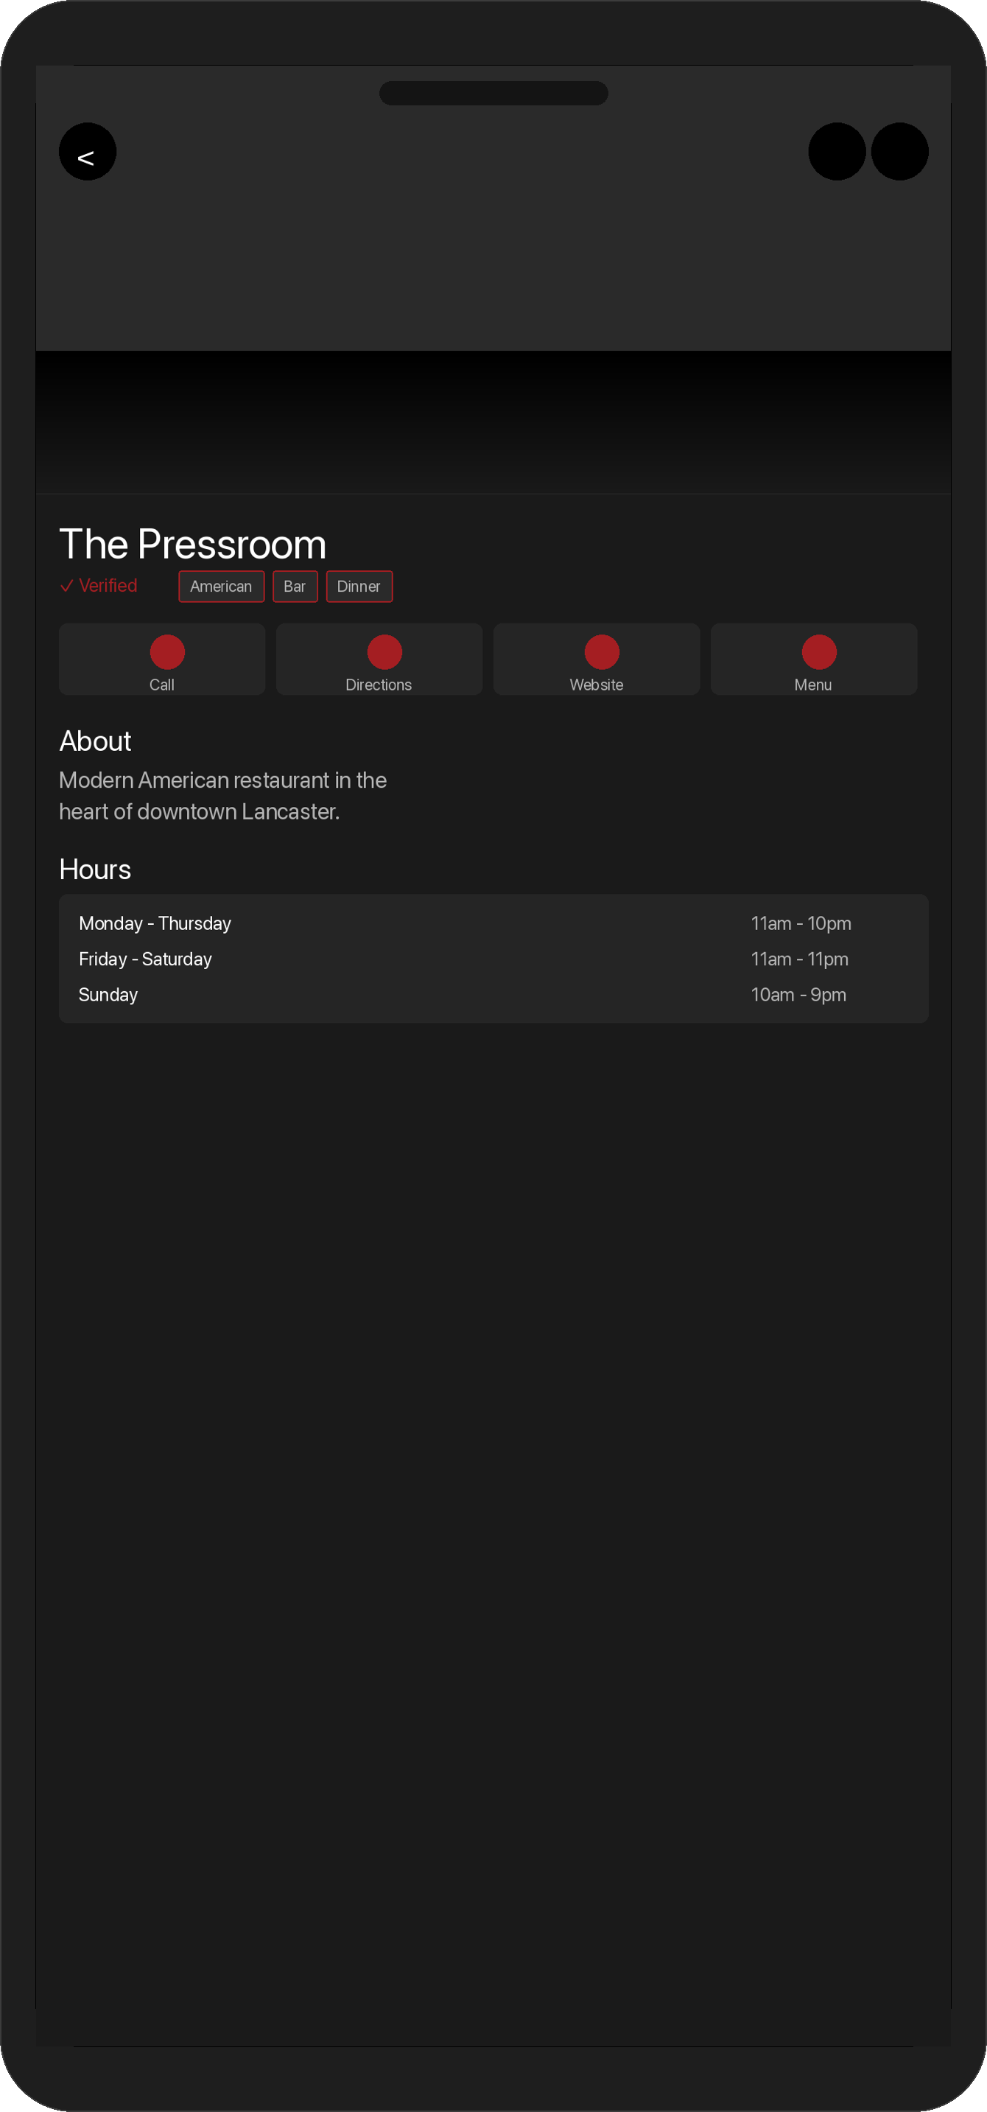
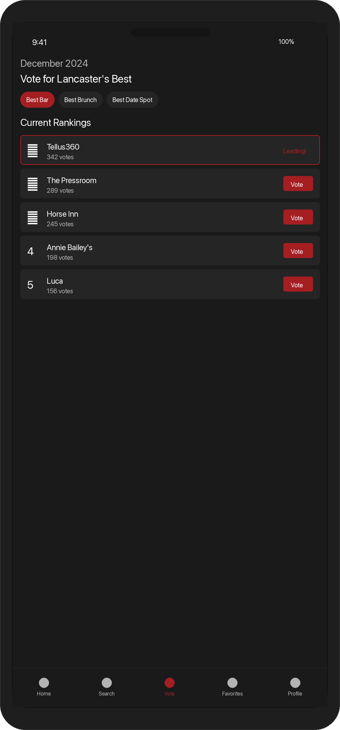
PRODUCT
Live on the iOS App Store
Home Feed
Map Search
Rosie AI
Happy Hours
Restaurant Detail
Voting

Slide 6
HOW IT WORKS
Three-Sided Platform
CONSUMERS
RESTAURANT OWNERS
SALES REPS
Free App
SaaS Dashboard
CRM + Commission
• Discover restaurants & nightlife
• Vote in 8 monthly categories
• Earn rewards via check-ins
• Chat with Rosie AI concierge
• Manage menus & photos
• Post events & entertainment
• Set happy hours & specials
• Track analytics & insights
• Full lead management CRM
• AI-generated outreach emails
• 15–20% commission structure
• Multi-restaurant cart checkout
Data Pipeline
Ingest (OutScraper CSV) → Enrich (Google Places API) → Activate (Sales Onboarding) → Engage (Push / AI Blog / Email)

Slide 7
BUSINESS MODEL
Five Revenue Streams
1
Restaurant SaaS
$250–$1,100/term
LIVE
3 tiers × 3 billing durations via Stripe
2
Consumer Premium
$1.99–$29/yr
LIVE*
2.5x rewards, ad-free, premium voting
3
Self-Promoter
$50/month
LIVE
DJs, musicians, performers
4
Sponsored Ads
TBD pricing
LIVE
Impression/click tracked, admin-managed
5
Volume Discounts
10–20% off
LIVE
Multi-location restaurant groups
* Consumer premium currently free for all users during launch phase. RevenueCat integrated but unlocked.

Slide 8
PRICING
Restaurant Plans (B2B SaaS)
BASIC
PREMIUM
ELITE
Free
Forever
$250
/3mo
$350
/3mo
✓ Hours display
✓ Location on map
✓ Cover photo
$450/6mo · $800/yr
$600/6mo · $1,100/yr
✓ Everything in Basic +
✓ Full menu management
✓ Consumer analytics
✓ Specials & happy hours
✓ Events & entertainment
✓ Push notifications (4/mo)
✓ Everything in Premium +
✓ Logo on map
✓ Daily special list
✓ Social media content
✓ Event & music spotlights
✓ Advanced analytics
Consumer: $1.99/mo early access ($4.99 standard) · Self-Promoter: $50/mo · Volume: 10–20% off for multi-location groups

Slide 9
DEFENSIBILITY
Five Layers of Moat
Local Network Effects
Community voting (8 categories, monthly leaderboards) creates engagement loops. Restaurants promote the app to improve rankings → more consumers vote → richer data.
Proprietary First-Party Data
Custom analytics on Supabase: impressions, clicks, check-ins, area visits, conversion funnels. No dependency on third-party analytics.
AI Knowledge Layer
Rosie is trained on market-specific local knowledge — neighborhood guides, food scene descriptions, local culture. Can’t be replicated by generic AI.
Geofence Infrastructure
Radar SDK geofences for restaurants and neighborhoods power automatic check-in prompts and area-entry notifications.
Operational Moat
Full sales CRM with AI email generation, commission-based field team, and multi-step lead nurturing. Expensive for competitors to replicate.

Slide 10
GO-TO-MARKET
Current (Verified in Code)
Strategy (Proposal)
• Direct sales team with built-in CRM & AI email generation
• 15–20% commission structure with tiered bonuses
• iOS App Store live (ASC ID: 6755852717)
• 15+ screen onboarding funnel feeds AI personalization
• Push notifications via Expo + geofence area alerts
• AI-generated blog (Rosie’s Blog) + email via Resend
• SEO: sitemaps for restaurants, events, happy hours, blog
• Referral rewards: 20 pts per referral (highest action value)
• Influencer partnerships with local food bloggers
• Restaurant-as-distribution: co-branded table cards & QR codes
• University campus ambassador program
• Local event sponsorships for brand visibility
⚠ Proposals — not yet implemented in code

Slide 11
EXPANSION
Multi-market architecture is live. Expansion is automated.
Live Markets
Lancaster, PA
iOS App Store + Web
LIVE
Cumberland County, PA
iOS TestFlight + Web
BETA
AI Expansion Agent (Runs Every 2 Hours)
Suggest
Proposes cities if pipeline < 20 entries
Research
Census, BEA, OpenStreetMap, College Scorecard data
Score
Weighted model: dining, population, competition, college, income, tourism
Brand
AI generates 3 proposals per city: name, colors, mascot, tagline
Jobs
Creates draft listings: sales rep, market mgr, content, community
Review
Founders vote via email; both must agree to proceed
Playbook: "Add to MARKET_CONFIG → Seed DB row → Deploy Netlify site"

Slide 12
TRACTION
What’s Live Today
Markets
2 (Lancaster PA live, Cumberland County PA beta)
iOS App
Published on App Store
Web Platform
tastelanc.com + cumberland.tastelanc.com
Restaurant Dashboard
Full owner portal: analytics, menus, events, happy hours, specials, team
Revenue Infrastructure
Stripe billing with 3 restaurant tiers, consumer subs, self-promoter plans
Ad Platform
featured_ads with impression/click tracking + CTR analytics
Sales CRM
Lead management, AI email generation, commission tracking
AI Systems
Rosie chat, expansion agent (2h cycle), blog gen, email gen, itinerary gen
Analytics
Custom Supabase: page views, impressions, clicks, check-ins, area visits
User counts, MRR, restaurant signups, and retention tracked in live dashboards. Available upon request.

Slide 13
ROADMAP
NEXT
Home Screen Personalization
IMPLEMENTATION_PLAN.md Phase 3
RecommendedSection component built, not yet rendered on HomeScreen
NEXT
Impression-Feedback Loop
IMPLEMENTATION_PLAN.md Phase 4
Auto-correct visibility imbalances across restaurant tiers
PLANNED
View All Sort/Filter Chips
IMPLEMENTATION_PLAN.md Phase 5
Enhanced browse experience with sort and filter options
PLANNED
Daily Trivia
rewards/points.ts
Reward action type exists (1 pt), marked DEFERRED in code
PLANNED
Android Play Store
brand.ts:25
App buildable, listing not yet created
PLANNED
Self-Serve Restaurant Claiming
Not in codebase
Currently sales-driven; self-service not yet built
ONGOING
Autonomous City Expansion
expansion-agent.ts
AI agent actively researching new markets

Slide 14
Partner with us to scale the hyper-local playbook to new markets.
• Strategic partners to accelerate market expansion
• Investment to scale the sales team and enter new markets
• Restaurant group partnerships for anchor tenant acquisition
tastelanc.com · info@tastelanc.com
Generated from codebase — see /pitchdeck/README.md for source map

