Slide 1


Slide 2
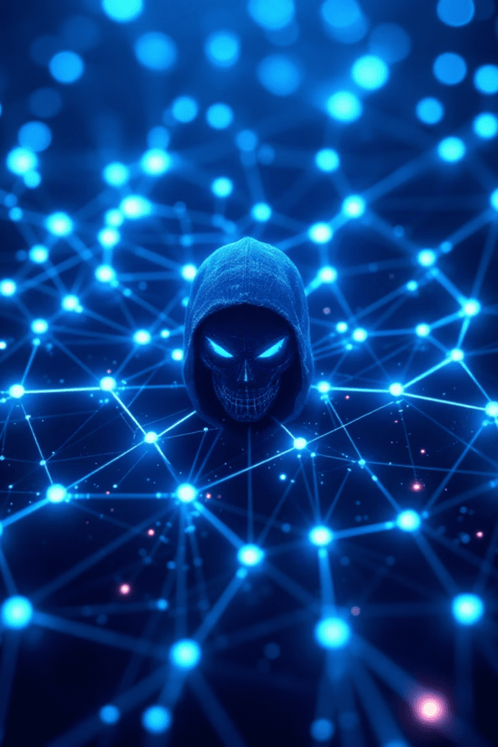
Botnets: The Hidden Army of the Internet
Rayen Khaskhoussi & Léandre Simo
IUT de béziers

Slide 3




What is a Botnet?
The "Bot" Army
Central Command
Malicious Tasks

Slide 4

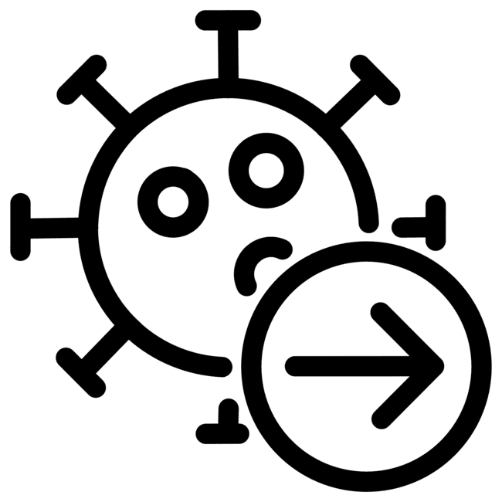


How Botnets Work and Spread
Infection
Connection
Execution

Slide 5



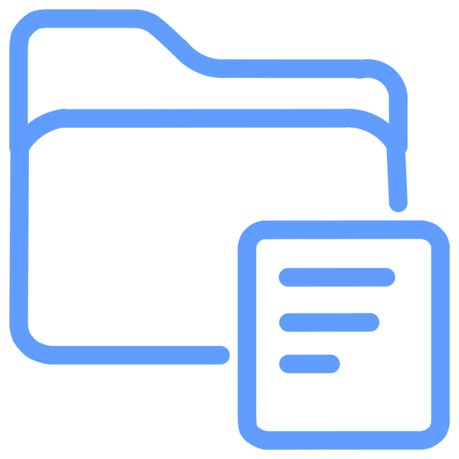
Real-World Impacts: The Damage
DDoS Attacks
Spam & Phishing
Cryptojacking
Data Theft

Slide 6
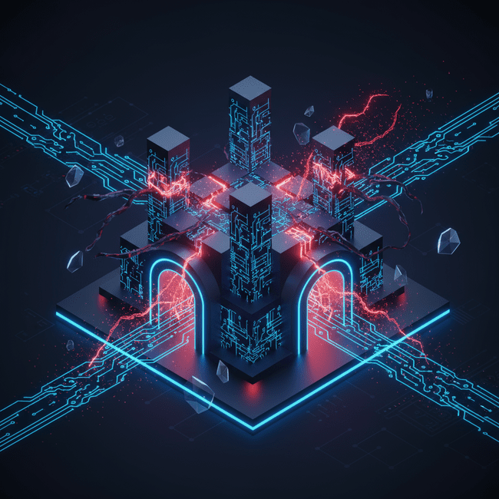
The Attackers' Levers: Vulnerabilities
Human Mistakes
Outdated Software
Weak Passwords

Slide 7




Protection: Tools and Good Practices
Antivirus/Firewall
Patch Regularly
Strong Passwords
Be Skeptical

Slide 8
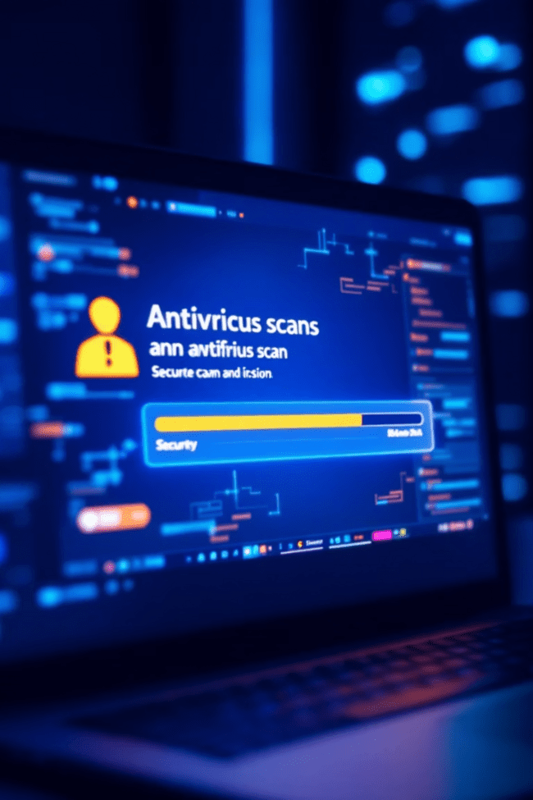



If You're Infected
Isolate Network
Scan System
Secure Accounts
Restore Data

Slide 9



Conclusion / Stay Safe Online
Strong Passwords
Enable 2FA
Spot Phishing

