Slide 1
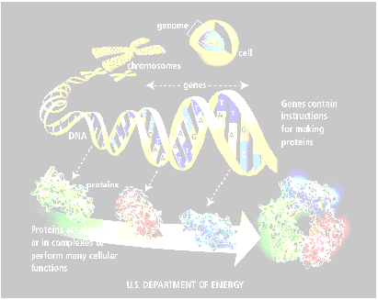
Applications to Bioinformatics:
Microarray Data Mining

Slide 2
Overview
Gene Expression Microarrays - Overview
Building Microarray Classification Models
  data preparation
  gene selection
  parameter tuning and cross-validation
Project – Data Mining Competition

Slide 3
Biology and Cells
All living organisms consist of cells.
Humans have trillions of cells. Yeast - one cell.
Cells are of many different types (blood, skin, nerve), but all arose from a single cell (the fertilized egg)
Each* cell contains a complete copy of the genome (the program for making the organism), encoded in DNA.
* there are a few exceptions

Slide 4
DNA
DNA molecules are long double-stranded chains; 4 types of bases are attached to the backbone: adenine (A) pairs with thymine (T), and guanine (G) with cytosine (C).
A gene is a segment of DNA that specifies how to make a protein.
Proteins are large molecules are essential to the structure, function, and regulation of the body. E.g. are hormones, enzymes, and antibodies.
E.g. Human DNA has about 30-35,000 genes;
Rice -- about 50-60,000, but shorter genes.

Slide 5
Exons and Introns: Data and Logic?
exons are coding DNA (translated into a protein), which are only about 2% of human genome
introns are non-coding DNA, which provide structural integrity and regulatory (control) functions
exons can be thought of program data, while introns provide the program logic
Humans have much more control structure than rice

Slide 6
Gene Expression
Cells are different because of differential gene expression.
About 40% of human genes are expressed at one time.
Gene is expressed by transcribing DNA exons into single-stranded mRNA
mRNA is later translated into a protein
Microarrays measure the level of mRNA expression

Slide 7
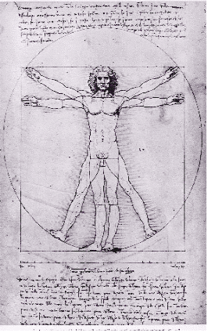
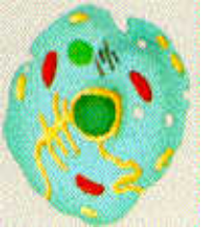
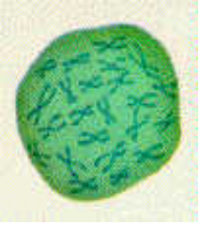
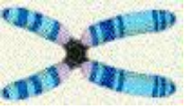
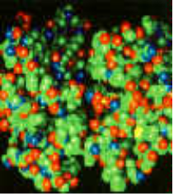
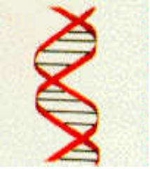
Molecular Biology Overview
Cell
Nucleus
Chromosome
Gene
expression
Protein
Gene (mRNA),
single strand
Gene (DNA)
Graphics courtesy of the National Human Genome Research Institute

Slide 8
Gene Expression Measurement
mRNA expression represents dynamic aspects of cell
mRNA expression can be measured with latest technology
mRNA is isolated and labeled with fluorescent protein
mRNA is hybridized to the target; level of hybridization corresponds to light emission which is measured with a laser

Slide 9
Gene Expression Microarrays
The main types of gene expression microarrays:
Short oligonucleotide arrays (Affymetrix) –
  11-20 probes per gene,
  probes for perfect match vs mismatch;
cDNA or spotted arrays (Brown/Botstein)
  two colors – experiment vs control.
...

Slide 10
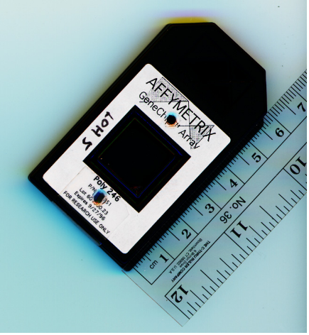
Affymetrix Microarrays
1.28cm
50um
~10⁷ oligonucleotides,
some perfectly match mRNA (PM),
some have one Mismatch (MM)
Gene expression computed from PM and MM

Slide 11
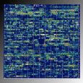
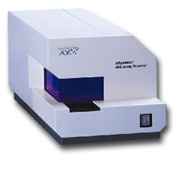
Affymetrix Microarray Raw Image
Gene Value
D26528_at 193
D26561_cds1_at -70
D26561_cds2_at 144
D26561_cds3_at 33
D26579_at 318
D26598_at 1764
D26599_at 1537
D26600_at 1204
D28114_at 707
Scanner
raw data
enlarged section of raw image

Slide 12
Microarray Potential Applications
Earlier and more accurate diagnostics
New molecular targets for therapy
Improved and individualized treatments
fundamental biological discovery (e.g. finding and refining biological pathways)
Recent examples
  molecular diagnosis of leukemia, breast cancer, ...
  discovery that genetic signature strongly predicts outcome
  a few new drugs, many new promising drug targets

Slide 13
Microarray Data Analysis Types
Gene Selection
  Find genes for therapeutic targets (new drugs)
Classification (Supervised)
  Identify disease
  Predict outcome / select best treatment
Clustering (Unsupervised)
  Find new biological classes / refine existing ones
  Exploration

Slide 14
Microarray Data Analysis Challenges
Few records (samples), usually < 100
Many columns (genes), usually > 1,000
This is very likely to result in false positives, “discoveries” due to random noise
Model needs to be explainable to biologists
Good methodology is essential for minimizing and controlling false positives

Slide 15
Microarray Classification Overview
Train data
Data Cleaning & Preparation
Class
data
Feature and Parameter Selection
Gene
data
Model Building
Test data
Evaluation

Slide 16
Data Preparation Issues
Cleaning: inherent measurement noise
Thresholding:
  min 20, max 16,000 for MAS-4
  MAS-5 does not generate negative numbers
Filtering - remove genes with low variation (for biological and efficiency reasons)
  e.g. MaxVal - MinVal < 500 and MaxVal/MinVal < 5
  or Std. Dev across samples in the bottom 1/3
  or MaxVal - MinVal < 200 and MaxVal/MinVal < 2

Slide 17
Gene Reduction improves Classification
Most learning algorithms look for non-linear combinations of features
  Can easily find spurious combinations given few records and many genes – “false positives problem”
Classification accuracy improves if we first reduce number of genes by a linear method
  e.g. T-values of mean difference
Select an equal number of genes from each class (heuristic)
Then apply favorite machine learning algorithm

Slide 18
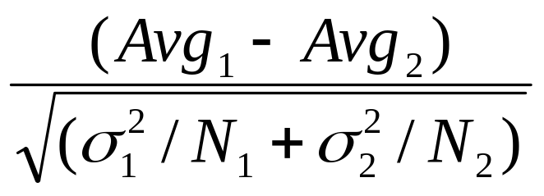
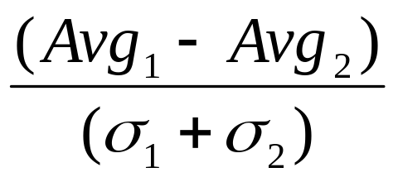
Feature selection approach
Rank genes by measure & select top 100-200
T-test for Mean Difference=
Signal to Noise (S2N) =

Slide 19
Measuring False Positives with Randomization
Randomized
Class
CD37 antigen
Class
Randomization is
Less Conservative
Preserves inner
structure of data
178
105
4174
7133
1
1
2
2
2
1
1
2
Randomize
Class
178
105
4174
7133
2
1
1
2
T-value = -1.1

Slide 20
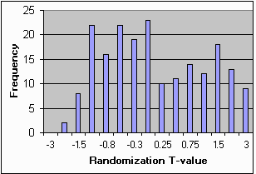
Measuring False Positives with Randomization (2)
Rand
Class
Gene
Class
178
105
4174
7133
1
1
2
2
2
1
1
2
Randomize
500 times
Gene
Class
Bottom 1% T-value = -2.08
Genes with T-value <-2.08 are significant at p=0.01
178
105
4174
7133
2
1
1
2

Slide 21
Multi-class classification
Simple: One model for all classes
Advanced: Separate model for each class

Slide 22
Iterative Wrapper approach to selecting the best gene set
Model with top 100 genes is not optimal
Test models using 1,2,3, …, 10, 20, 30, 40, ..., 100 top genes with cross-validation.
Gene selection:
  Simple: equal number of genes from each class
  advanced: best number from each class
For randomized algorithms (e.g. neural nets), average 10+ Cross-validation runs

Slide 23
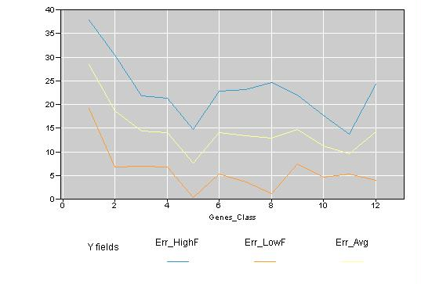
Selecting Best Gene Set
Select gene set with lowest combined Error
good, but not optimal!
Average, high and low error rate for all classes

Slide 24
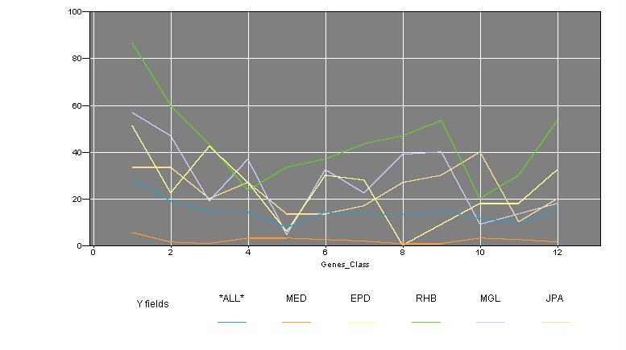
Error rates for each class
Error rate
Genes per Class

Slide 25
Popular Classification Methods
Decision Trees/Rules
  Find smallest gene sets, but not robust – poor performance
Neural Nets - work well for reduced number of genes
K-nearest neighbor – good results for small number of genes, but no model
Naïve Bayes – simple, robust, but ignores gene interactions
Support Vector Machines (SVM)
  Good accuracy, does own gene selection,
  but hard to understand
…

Slide 26
Global Feature (Gene) Selection “Leaks” Information
Gene Data
Class
data
Train data
Gene
Selection
Model Building
Evaluation
Test data
is wrong, because the information is “leaked” via gene selection.
When #Features >> # samples, leads to overly “optimistic” results.

Slide 27
Classification: External X-val
Gene Data
Train data
Feature and Parameter Selection
T r a i n
Data
class
Model Building
Evaluation
Test data
FinalTest
Final Model
Final Results

Slide 28
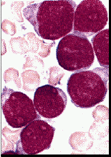
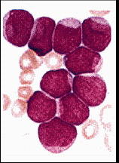
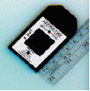
Microarrays: ALL/AML Example
Leukemia: Acute Lymphoblastic (ALL) vs Acute Myeloid (AML), Golub et al, Science, v.286, 1999
  72 examples (38 train, 34 test), about 7,000 genes
  well-studied (CAMDA-2000), good test example
ALL
AML
Visually similar, but genetically very different

Slide 29
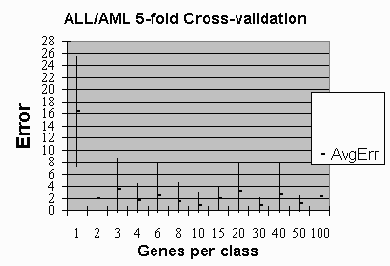
Gene subset selection: multiple cross-validation runs
For ALL/AML data, 10 genes per class had the lowest error: (<1%)
Point in the center
of each bar is the average error
from 10 cross-validation runs
Bars indicate 1 st. dev
above and below

Slide 30
ALL/AML: Results on the test data
Genes selected and model trained on Train set only
Best Net with 10 top genes per class (20 overall) was applied to the test data (34 samples):
  33 correct predictions (97% accuracy),
  1 error on sample 66
    Actual Class AML, Net prediction: ALL
    other methods consistently misclassify sample 66
    – may have been misclassified by a pathologist?

Slide 31
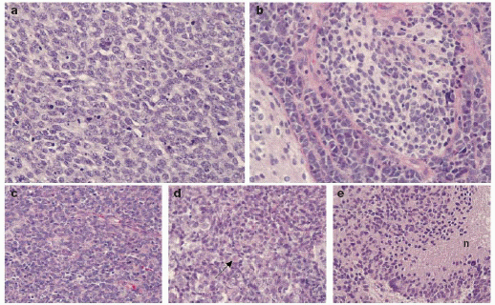
Multi-class Data Analysis
Brain data: Pomeroy et al 2002, Nature (415), Jan 2002
  42 examples, about 7,000 genes, 5 classes
Photomicrographs of tumours (400x)
a, MD (medulloblastoma) classis
b, MD desmoplastic
c, PNET
d, rhabdoid
e, glioblastoma
Analysis also used Normal tissue
(not shown)

Slide 32
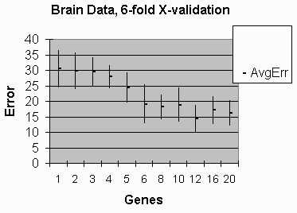
Multi-class Classification Results
Point in the center
of each bar is the average error
from 10 cross-validation runs,
using Clementine
Neural Networks
Bars indicate 1 st. dev
above and below
Best results with 12 genes per class – 15% error

Slide 33
Microarray Summary
Gene Expression Microarrays have tremendous potential in biology and medicine
Microarray Data Analysis is difficult and poses unique challenges
Capturing the entire Microarray Data Analysis Process is critical for good, reliable results

Slide 34
Final Project: Microarray Data
Analysis
92 pediatric tumor cases of 5 classes
  MED, MGL, EPD, JPA, RHB
  7,070 genes (no controls)
Train set: 69 samples, labeled
Test set: 23 samples, unlabeled, similar class distribution
Goal: Predict classes in test set

Slide 35
Final Project: Scoring the test set
Use train set to develop best model parameters (number of genes, etc) by cross-validation
Use Weka: IB1, IBk, J4.8, NaiveBayes, ?
Use the same parameters to develop the final model on the entire train set and use it to score the final test set
Write a paper describing the experiment
Random label assignment: 8-11 correct of 23
Final grade: effort, paper, correct assignment

