Slide 1




Developers Survey 2019
Leandro Bueno do Prado
Data Science & Analysis | Data Storyteller | Business Intelligence | Controlling & Finance
Report built in December 2020

Slide 2



OUTLINE
Executive Summary
Introduction
Methodology
Results
Visualization – Charts
Dashboard
Discussion
Findings & Implications
Conclusion
Appendix

Slide 3

EXECUTIVE SUMMARY
This report was built to analyze a sample dataset from a survey conducted by Stack Overflow, a popular website for developers across the world.
This report communicates findings that could help new enthusiasts and experienced professionals on their careers.
The main topis are:
Trends in languages and databases
Demographics
Tech gap between countries
Gender gap in the developer job market

Slide 4

INTRODUCTION
What are the trends in programming development?
Purpose:
What are top programming languages in demand?
What are top databases in demand?
What skills will be required in the future?
Audience: IT professionals and Human Resources

Slide 5

METHODOLOGY
Dataset sources:
StackOverflow Survey 2019
GitHub Jobs postings
Data Exploration, Cleaning and Normalizing
Removing duplicates and outliers that could misinterpret the salaries
Normalizing the salaries to year, considering amounts in US Dollars
Data Visualization
Using Python libraries and Cognos BI
Presentation

Slide 6
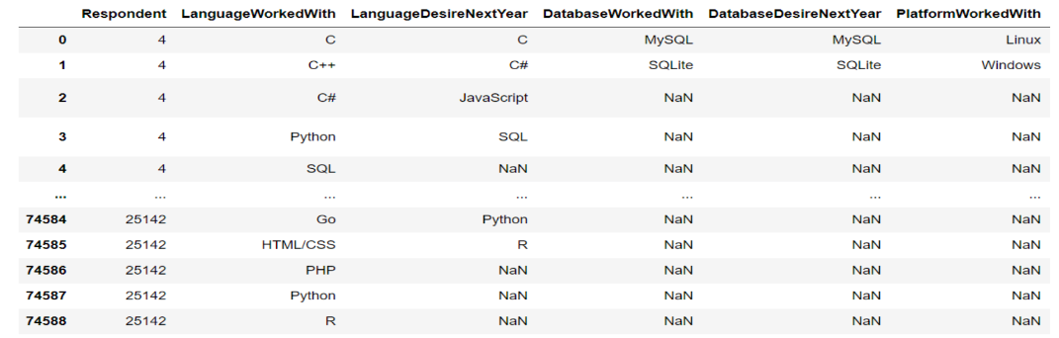
RESULTS
Results are based on the DataFrame below:

Slide 7
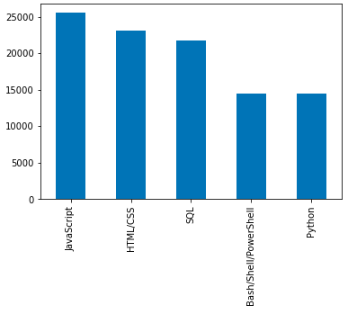
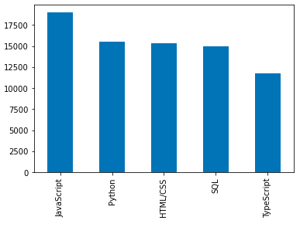
PROGRAMMING LANGUAGE TRENDS
Current Year
Next Year

Slide 8
PROGRAMMING LANGUAGE TRENDS - FINDINGS & IMPLICATIONS
Findings
Javascript, HTML/CSS, SQL are popular this year
Developers have increasing Python interests
PowerShell/Bash are not priorities for next year
Implications
Web Development still popular with Javascript and HTML/CSS
Data related languages of SQL and Python have growing interests by developers
Can Typescript replace Javascript in the future?

Slide 9
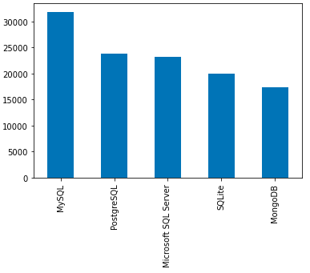
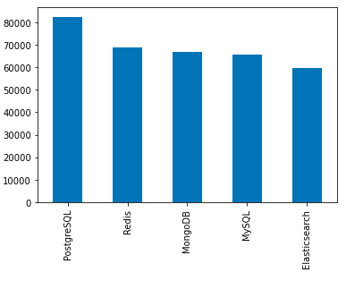
DATABASE TRENDS
Current Year
Next Year

Slide 10
DATABASE TRENDS - FINDINGS & IMPLICATIONS
Findings
MySQL and Microsoft SQL are most popular databases
PostdegreSQL and MongoDB are popular with growing desire among developers
Redis and Elasticsearch are also with growing desire among developers
Implications
Open source databases are preferred in-company
NoSQL databases will make an impact in the job market
Redis support abstract data-types

Slide 11

DASHBOARD
The link for the Cognos Dashboard on Cloud:
https://dataplatform.cloud.ibm.com/dashboards/c0006621-8a35-4d08-ad6e-d445010db678/view/4739c17921b869de4ce5c4e4079c2b077c342559e7bb830a84877b495d612397a96c1a99c8264b58da430266f0ec165fc1
The following slides have static dashboards extracted from the Cognos platform.

Slide 12
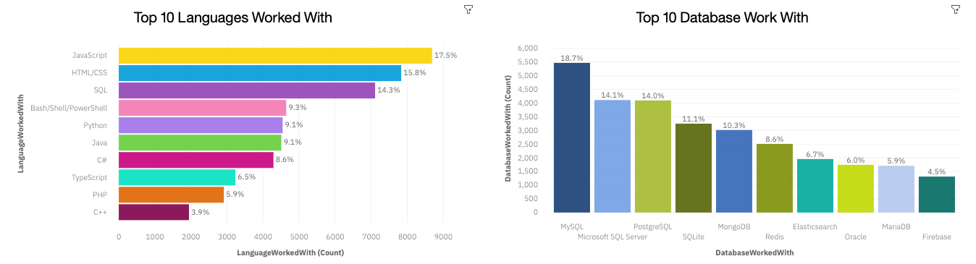
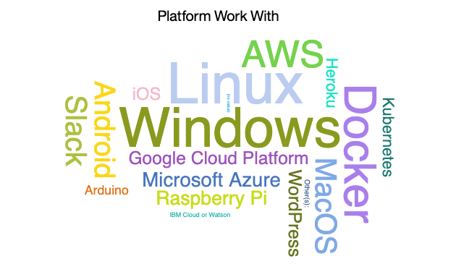
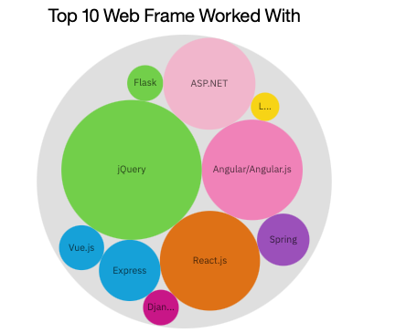
CURRENT TECHNOLOGY USAGE

Slide 13
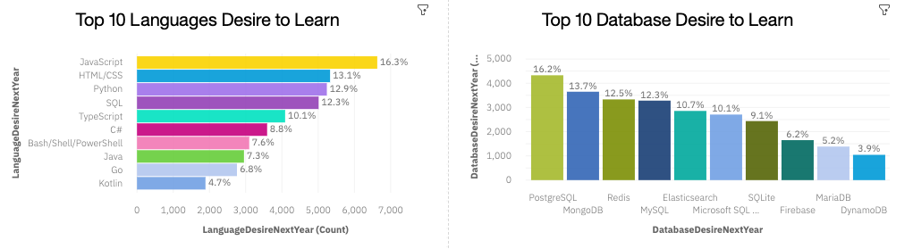
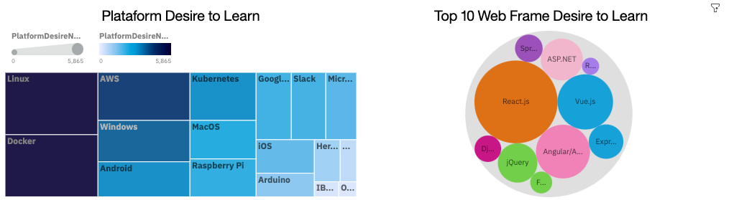
FUTURE TECHNOLOGY TREND

Slide 14
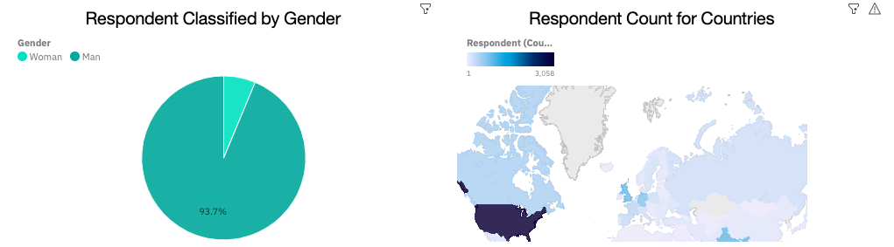
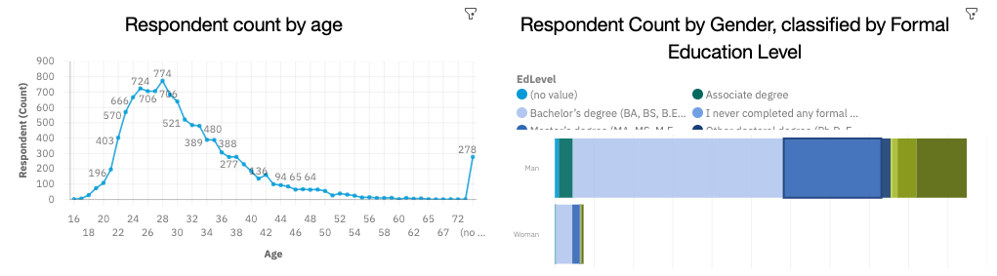
DEMOGRAPHICS

Slide 15
DISCUSSION
Topics to discuss from this report:
What are actual technologies and trends for the future?
What can be done to increase women on the developer’s job market?
Why are there large gap between countries?
How to eliminate age and education discrimination in employment?

Slide 16
OVERALL FINDINGS & IMPLICATIONS
Findings
Fast changing in technologies
Concentration on USA
Gap in gender, age and educational levels
Implications
Companies need to adapt to fast changes to keep motivation and performance
Chose wisely the changes to be made
Spread technologies to more countries

Slide 17

CONCLUSION
Comparing actual languages and desire languages can help companies chose better products
Understanding overall feelings can help professionals learn better tools
High demand for women as companies search to reduce gap
Future analysis to compare salaries of different current knowledge

Slide 18

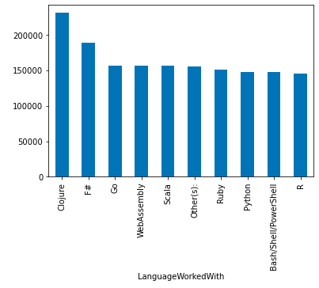
APPENDIX
Interesting to analyze the average salary per technology used, as the top 10 has little attachment to highest desire to learn.

Slide 19
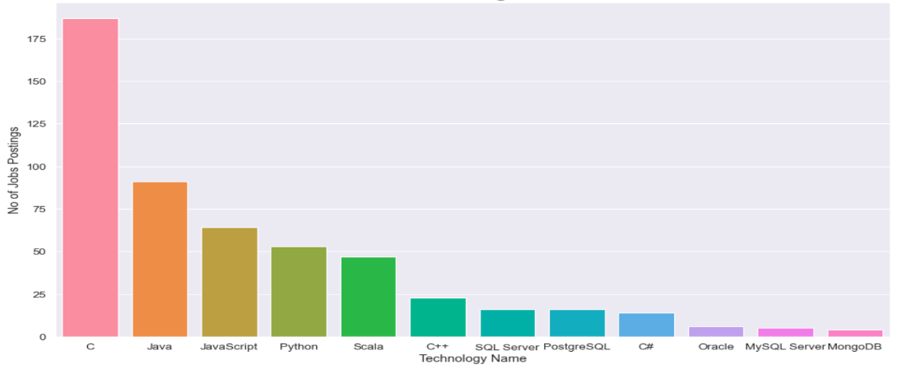
GITHUB JOB POSTINGS
In Module 1 you have collected the job postings data using GitHub API in a file named “github-job-postings.xlsx”. Present that data using a bar chart here. Order the bar chart in the descending order of number of job postings.

Slide 20
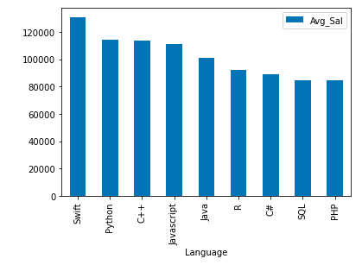
POPULAR LANGUAGES
From: “popular-languages.csv” in Module 1
Difference from Survey dataset, where first sample was from the user’s that respond the survey and from the GitHub Jos posting average hiring positions.

