Slide 1
Network control through distributed optimization: a Tutorial
Fernando Paganini
Universidad ORT Uruguay
Congresso Brasileiro de Automatica 2012

Slide 2
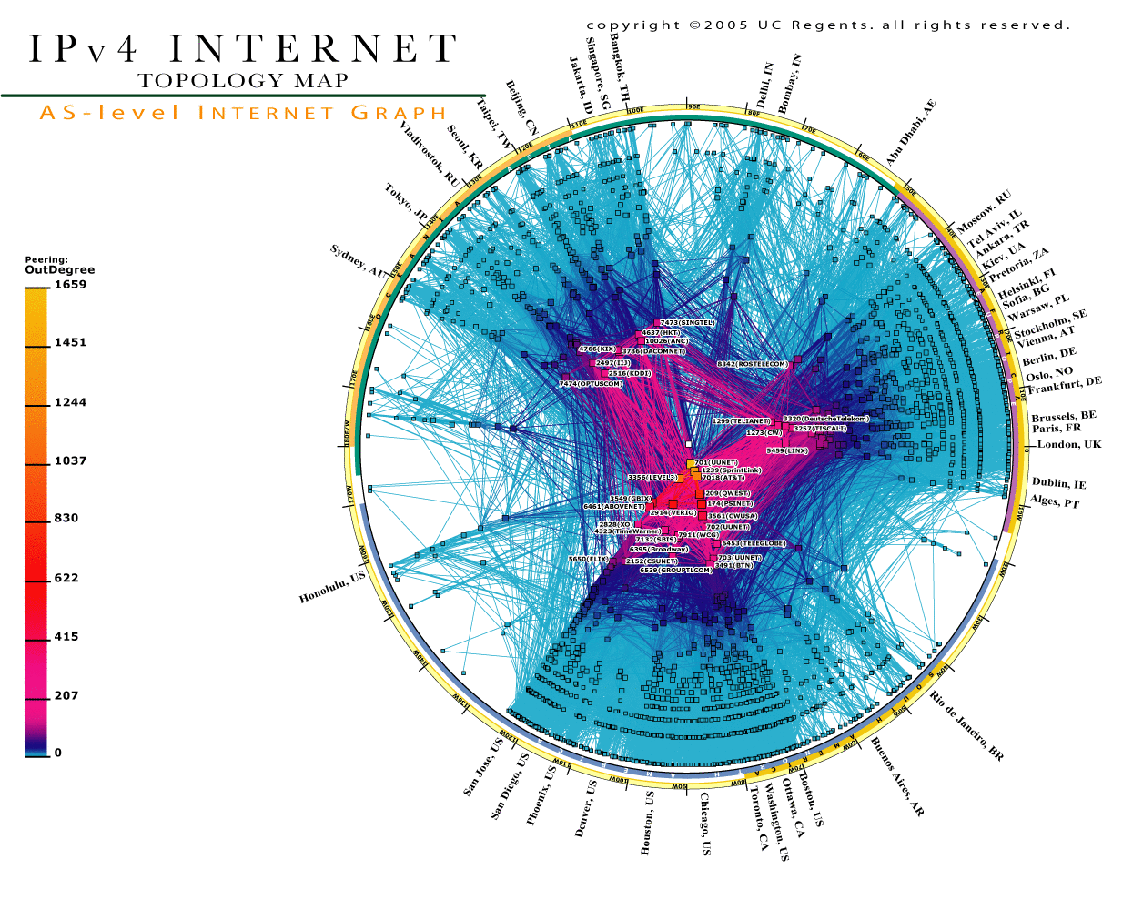
1. In a network of huge complexity…
Source: http://www.caida.org

Slide 3
…made of backbones,…
Router
Intermountain
GigaPoP
U. Memphis
Northern Lights
Indiana GigaPoP
Front Range
GigaPoP
Great Plains
U. Louisville
Merit
OARNET
WiscREN
Qwest Labs
OneNet
Arizona St.
NCSA
StarLight
U. Arizona
Iowa St.
MREN
Oregon
GigaPoP
NYSERNet
Pacific
Wave
UNM
Kansas
City
Indian-
apolis
WPI
Pacific
Northwest
GigaPoP
Denver
Northern
Crossroads
Seattle
Chicago
SINet
U. Hawaii
ESnet
New York
SURFNet
AMES NGIX
GEANT
Wash
D.C.
WIDE
Sunnyvale
Rutgers U.
CENIC
Los Angeles
MANLAN
UniNet
Houston
Atlanta
North Texas
GigaPoP
TransPAC/APAN
SOX
PSC
MAGPI
Texas Tech
SFGP/
AMPATH
DARPA
BossNet
Mid-Atlantic
Crossroads
Abilene Backbone
Physical Connectivity
(as of December 16, 2003)
Texas
GigaPoP
Miss State
GigaPoP
UMD NGIX
Drexel U.
0.1-0.5 Gbps
0.5-1.0 Gbps
1.0-5.0 Gbps
5.0-10.0 Gbps
UT Austin
LaNet
Florida A&M
U. Florida
UT-SW
Med Ctr.
U. Delaware
Tulane U.
U. So. Florida
NCNI/MCNC

Slide 4
… access networks, …
Routers
Links
Hosts

Slide 5
… different technologies,…
Fiber
Ethernet

Slide 6
…supporting end-to-end flows,…
www.inria.fr
www.ufcg.edu.br
how is bandwidth shared between users?

Slide 7


Regulating the sending rate of a server
Rate should exploit, but not exceed, network capacity.
But from outside, the network is an unknown “cloud”
of uncertain capacity.
Therefore, feedback control is required to regulate!

Slide 8


Congestion control
Conceptually: each source regulates its rate based on congestion feedback.
feedback
However:
~10⁹ hosts on the Internet!
Congestion is coupled.
Plant changes all the time.
Not your classical SISO
feedback design!
The largest artificial feedback system.
Not designed by control engineers…

Slide 9
Feedback in TCP (Transmission Control Protocol)
DATA packets
Router
Source
Receiver
ACK packets
TCP-Reno (Jacobson 1990): control rate by adjusting window.
Packet loss
SS
CA
time

Slide 10
Questions
Was this design successful? Yes and no.
Positives: Internet works, went through explosive growth without “congestion collapse”.
Limitations: full queues, unfairness, inefficiency in high speeds, oscillations.
Is there a role for model-based control?
Non standard control design: large scale plant, unknown and variable, decentralized feedback.
Analytical approach from the late 90s’: combination of economic theory, optimization and control.
Helps understand existing designs + improve them.
This talk gives an introduction to these methods.

Slide 11
Outline
Introduction: Feedback in the Internet.
Economic models: Rate allocation through Network Utility Maximization.
Dynamics in NUM, TCP congestion control: New designs for stability under delays.
Highlights from cross layer optimization:
Multipath routing and congestion control.
Controlling the number of connections.
NUM in multirate WiFi networks.
Conclusions.

Slide 12
2. Economics of bandwidth allocation
Distributing scarce network capacity among greedy applications is an economic problem.
Toy example

Slide 13
Utility functions and welfare optimization
Concave objective, linear constraints: tractable problem.

Slide 14
Choice of utility and fairness

Slide 15
Distributed solutions and prices.
“Central planning” welfare optimization is impractical
over a large network. We want a distributed solution.
As in the real economy, prices serve this purpose.
Example: single bottleneck network.

Slide 16
Convex duality

Slide 17
Social welfare in a general network
Network Utility Maximization (NUM) problem.

Slide 18
Congestion control under fixed routes
1
2
3

Slide 19
Prices through duality: the network case

Slide 20
Back to example

Slide 21
Feedback loop of congestion prices
ROUTING
LINKS
SOURCES
Decentralized control at links and sources.

Slide 22
Solution of NUM through duality

Slide 23
Does real TCP congestion control have any relation to this theory?
ACKs
Packet loss
SS
CA
time

Slide 24
Loss probability as price

Slide 25
Congestion control as NUM
Remarks:
Unintended by designer, after-the-fact interpretation.
Makes resource allocation explicit. In particular, utility shows bias against high RTTs. Alternatives?
Assumes equilibrium (as economists often do!).
Questions from a control engineer’s perspective:
Dynamics: is this equilbrium stable?
Robustness against variations in network, delay,...?

Slide 26
Outline
Introduction: Feedback in the Internet
Economic models: Rate allocation through Network Utility Maximization.
Dynamics in NUM, TCP congestion control: New designs for stability under delays.
Highlights from cross layer optimization:
Multipath routing and congestion control.
Controlling the number of connections.
NUM in multirate WiFi networks.
Conclusions.

Slide 27
Dynamics of Congestion Control
Questions:
Design decentralized control laws at links and sources to stabilize the desired equilibrium.
Robustness to unkwown R? Effect of delay,...?

Slide 28
‘Dual’ congestion control [Low-Lapsley ’99]

Slide 29
‘Primal-dual’ congestion control

Slide 30
Dealing with network delay
Previous models assume instantaneous propagation of rates and prices. In reality, delays appear:
Forward: source to link. Backward from link to source

Slide 31
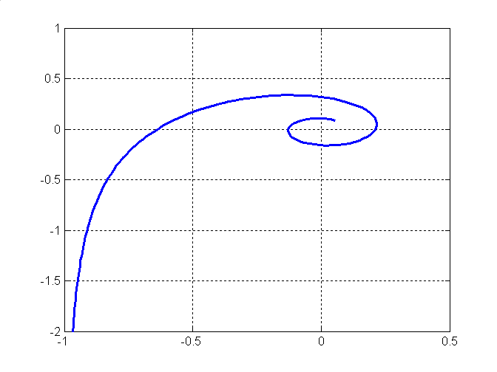
Dual control, single link and source.
SOURCE
LINK

Slide 32
Gain scheduling design [P’Doyle-Low ’01] Single link case.

Slide 33
Global nonlinear dynamics

Slide 34
Primal-dual design: local stability for any demand curve [P’-Wang-Low-Doyle, IEEE ToN ’05]
SOURCES
LINKS
Theorem.
For arbitrary network topology and link capacities:

Slide 35
Back to practice: TCP for high speeds
In the early 2000s it became clear that TCP-Reno and its variants did not scale well to high speeds.
A variety of proposals were introduced. One class (HSTCP, Scalable TCP, Cubic, HTCP,…) proposed changing the AIMD window profile (response to loss) to a more aggressive increase.
Among them, Scalable TCP is closely related to NUM theory (“primal” laws, not discussed today).
A different proposal was FAST-TCP, from the Caltech group (Jin/Wei/Low, ’04), later in FastSoft, Inc.
Here the congestion signal is queueing delay instead of loss. We see it is closely related to primal-dual laws.

Slide 36
FAST TCP as primal-dual control

Slide 37
Outline
Introduction: Feedback in the Internet.
Economic models: Rate allocation through Network Utility Maximization.
Dynamics in NUM, TCP congestion control: New designs for stability under delays.
Highlights from cross layer optimization:
Multipath routing and congestion control.
Controlling the number of connections.
NUM in multirate WiFi networks.
Conclusions.

Slide 38
Multiple layers in
Internet protocols.
Files
Files
HTTP, FTP,…
TCP,UDP
IP
packets
packets
packets
Links
packets
packets
packets
802.11
Sources

Slide 39
4. Highlights on cross-layer optimization
Dynamic control mechanisms exist in multiple layers.
Do they work in unison or against each other?
Can we use NUM to jointly optimize them? Large research area, e.g [Chiang-Low-Calderbank-Doyle ’07].
We will briefly discuss our contributions to:
HTTP, FTP,…
TCP
IP

Slide 40
4.1 Joint congestion control and
multipath routing [P’Mallada, IEEE ToN ’09]
Source s(k)
Destination
d(k)
Router i
j

Slide 41
Congestion prices
Multipath routing control.

Slide 42
Dual congestion control under gradient control of routing fractions
Traffic splitting
LINKS
SOURCES
Node price
recursion

Slide 43
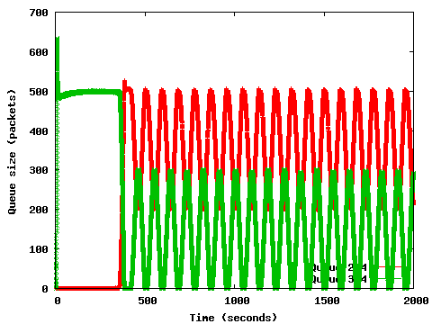
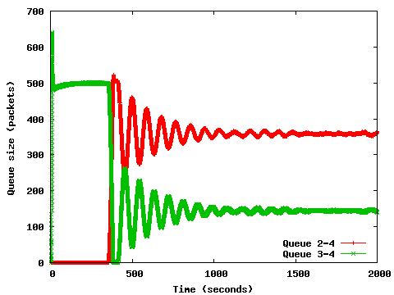
Solving the problem: PD control!

Slide 44
4. Highlights on cross-layer optimization
HTTP, FTP,…
TCP

Slide 45
NUM models and user-centric fairness.

Slide 46
CONNECTION CONTROL
NWK

Slide 47
Utility-Based Admission Control

Slide 48
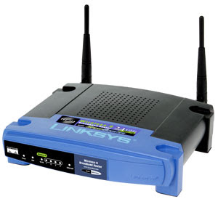
4. Highlights on cross-layer optimization
TCP
IP
802.11
AP

Slide 49
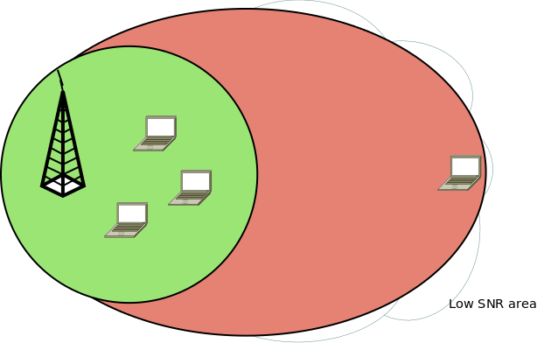

Allocation in rate-diverse WiFi Network
c₁(Mbps) | c₂(Mbps) | x(Mbps)
54 | 54 | 27
54 | 6 | 5.4

Slide 50
Proportionally fair rate allocation
c₁(Mbps) | c₂(Mbps) | x₁(Mbps) | x₂(Mbps)
54 | 54 | 27 | 27
54 | 6 | 27 | 3

Slide 51
Outline
Introduction: Feedback in the Internet.
Economic models: Rate allocation through Network Utility Maximization.
Dynamics in NUM, TCP congestion control: New designs for stability under delays.
Highlights from cross layer optimization:
Multipath routing and congestion control.
Controlling the number of connections.
NUM in multirate WiFi networks.
Conclusions.

Slide 52
Conclusion: an interdisciplinary field of research
Dynamics
Centralized
decisions
Equilibrium
Decentralized
decisions
Feedback Control Theory
Network
resource
allocation
Economic
Theory
Convex
Optimization

Slide 53
Obrigado!

