Slide 1




Average Time Spent By A User On Social Media
Linguagem de Programação Aplicada à Automação (LPAA)
Prof. Dr. Emmanuel Andrade
PROJETO FINAL
Leandro Dantas Lima – ldl@poli.br
Universidade de Pernambuco – POLI/UPE
ENGENHARIA DE CONTROLE E AUTOMAÇÃO

Slide 2

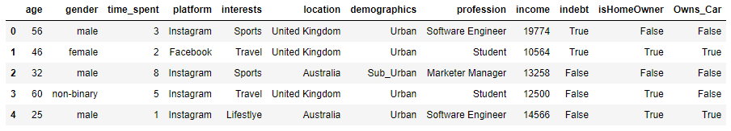
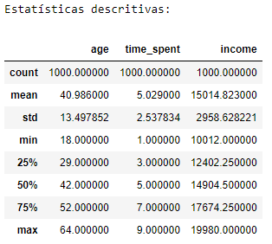
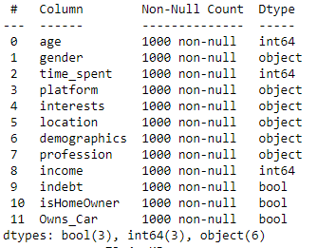
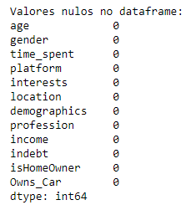
Análise dos dados
AVERAGE TIME SPENT BY A USER ON SOCIAL MEDIA

Slide 3
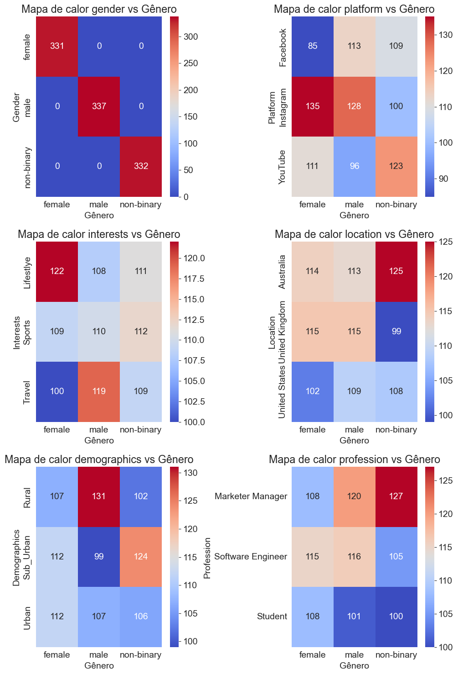
Análise dos dados
AVERAGE TIME SPENT BY A USER ON SOCIAL MEDIA

Slide 4
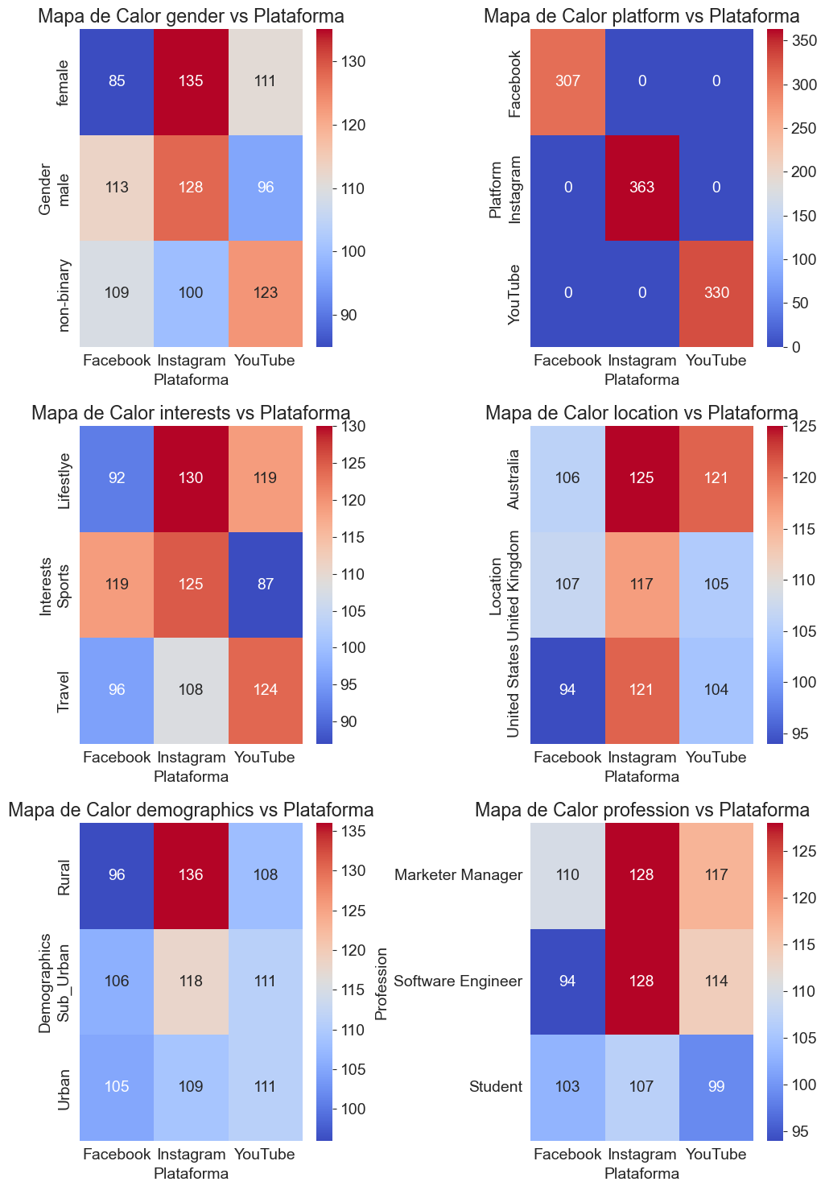
Análise de dados
AVERAGE TIME SPENT BY A USER ON SOCIAL MEDIA

Slide 5
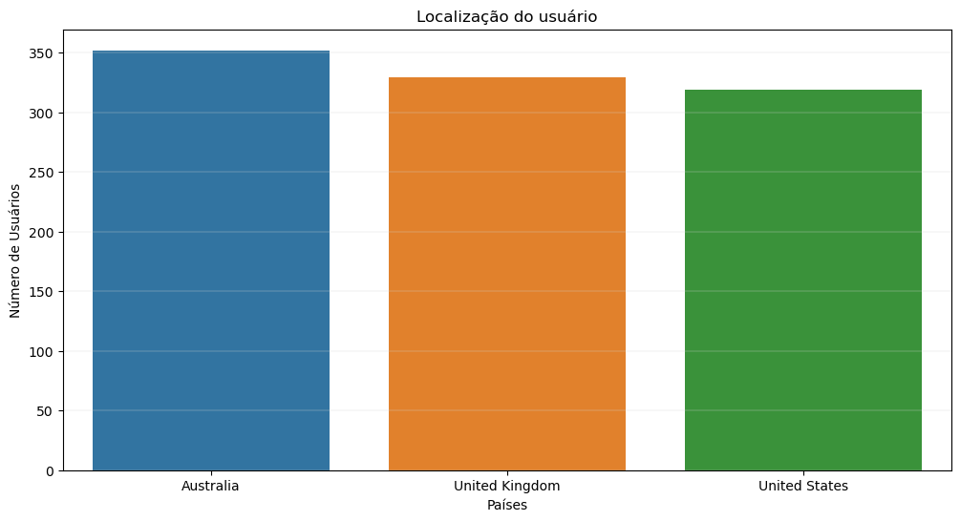
Análise dos dados
AVERAGE TIME SPENT BY A USER ON SOCIAL MEDIA

Slide 6
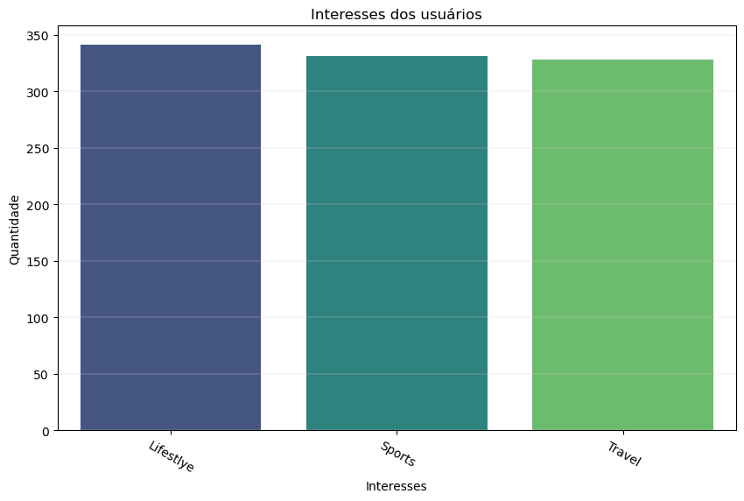
Análise dos dados
AVERAGE TIME SPENT BY A USER ON SOCIAL MEDIA

Slide 7
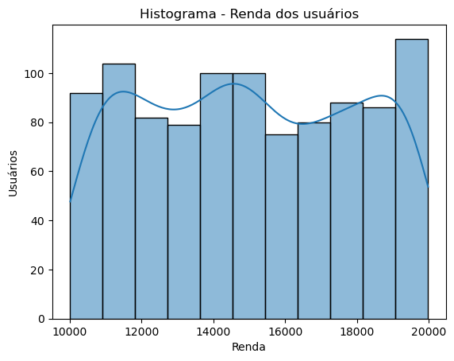
Análise de dados
AVERAGE TIME SPENT BY A USER ON SOCIAL MEDIA

Slide 8
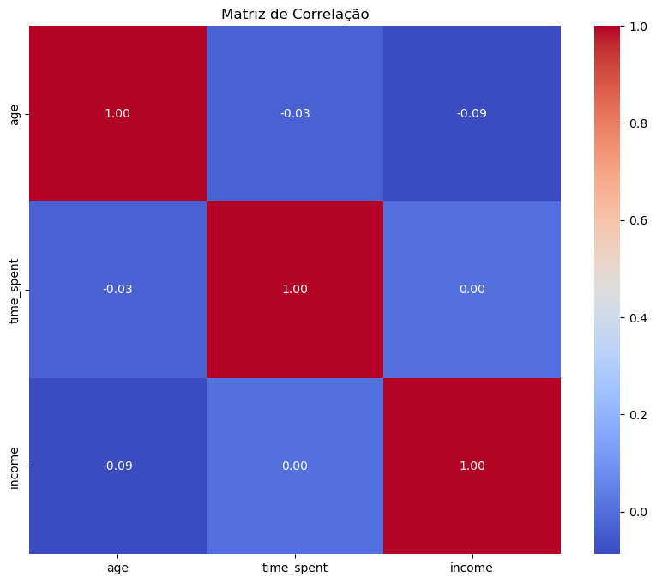
Análise de dados
AVERAGE TIME SPENT BY A USER ON SOCIAL MEDIA

Slide 9
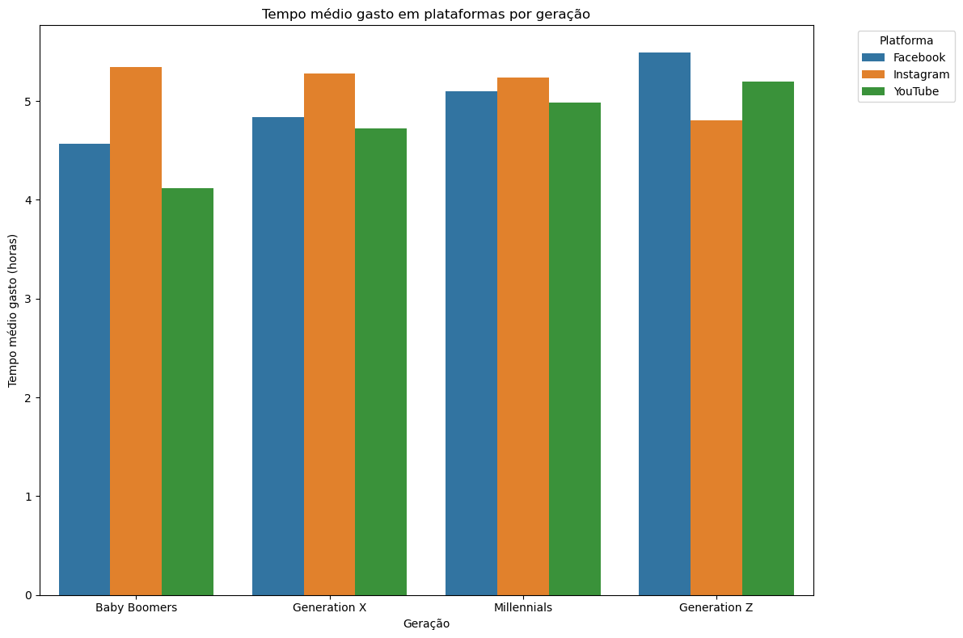
Análise de dados
AVERAGE TIME SPENT BY A USER ON SOCIAL MEDIA

Slide 10
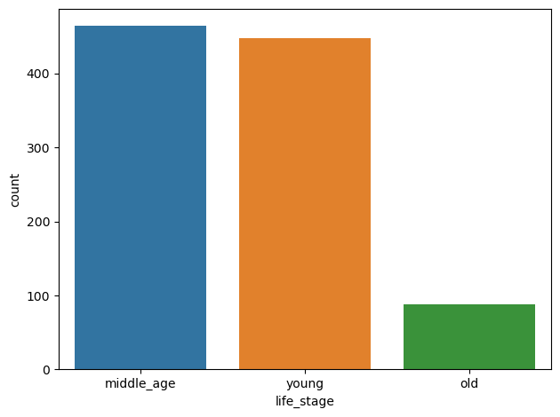
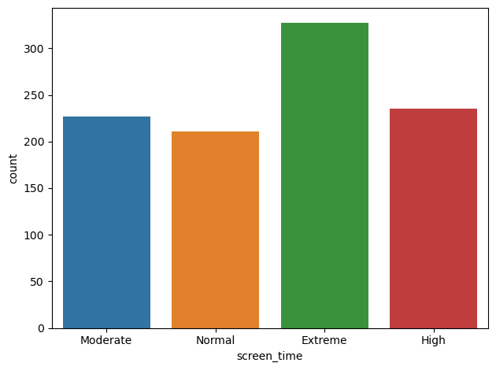
Análise de dados
AVERAGE TIME SPENT BY A USER ON SOCIAL MEDIA

Slide 11
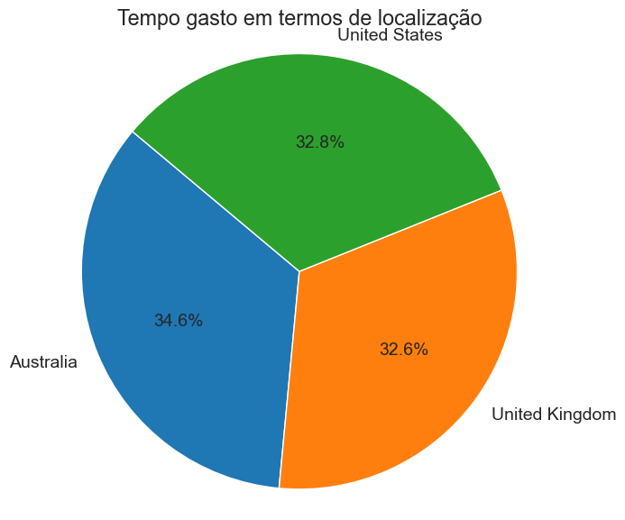
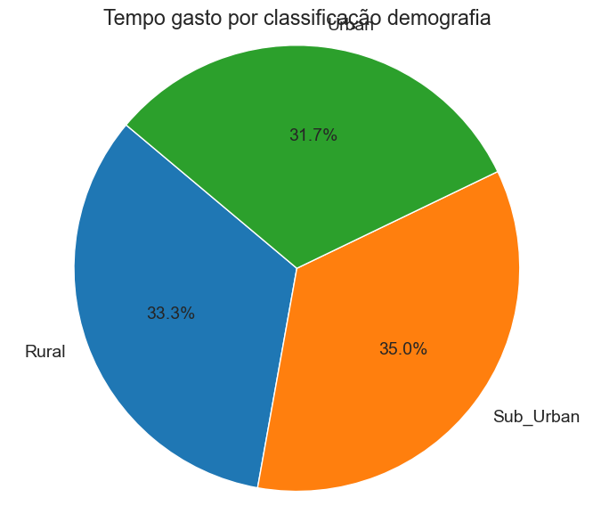
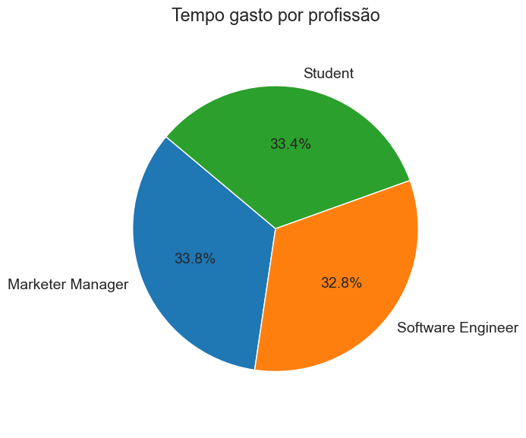
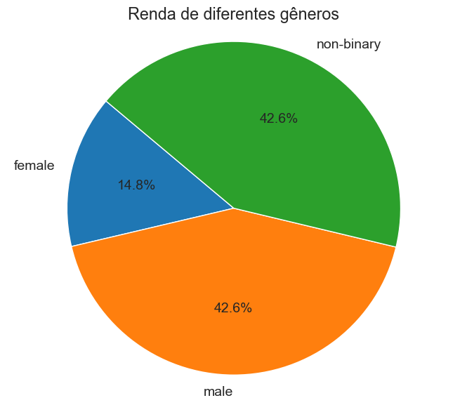
Análise de dados
AVERAGE TIME SPENT BY A USER ON SOCIAL MEDIA

Slide 12
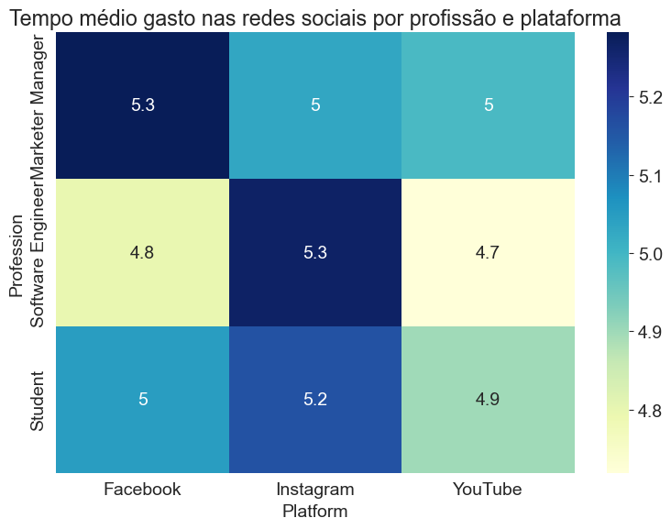
Análise de dados
AVERAGE TIME SPENT BY A USER ON SOCIAL MEDIA

Slide 13
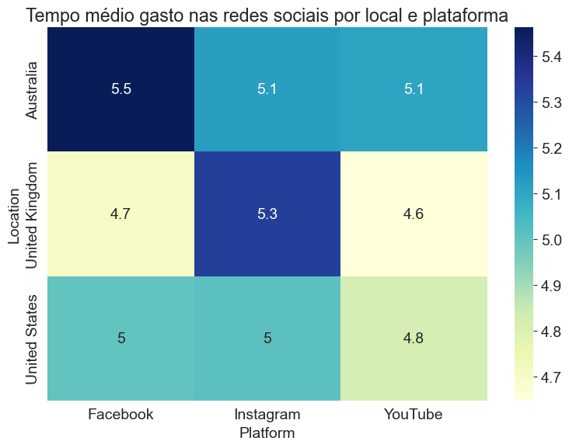
Análise de dados
AVERAGE TIME SPENT BY A USER ON SOCIAL MEDIA

Slide 14
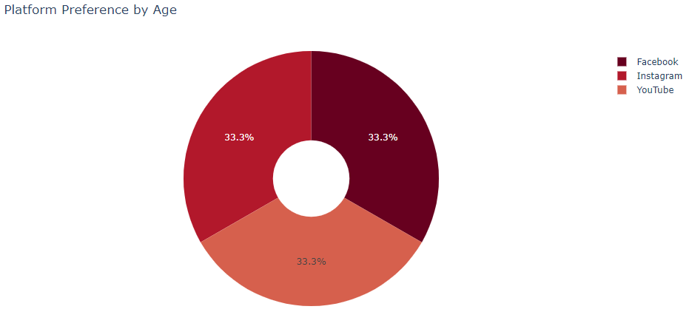
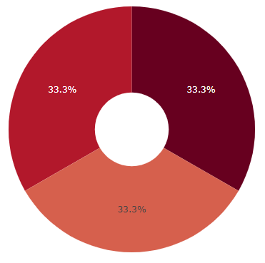

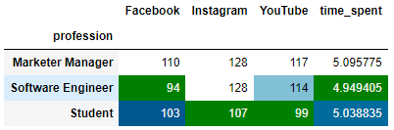
Análise de dados
Plataforma x Idade
Plataforma x Profissão
Plataforma x Gênero
AVERAGE TIME SPENT BY A USER ON SOCIAL MEDIA

Slide 15
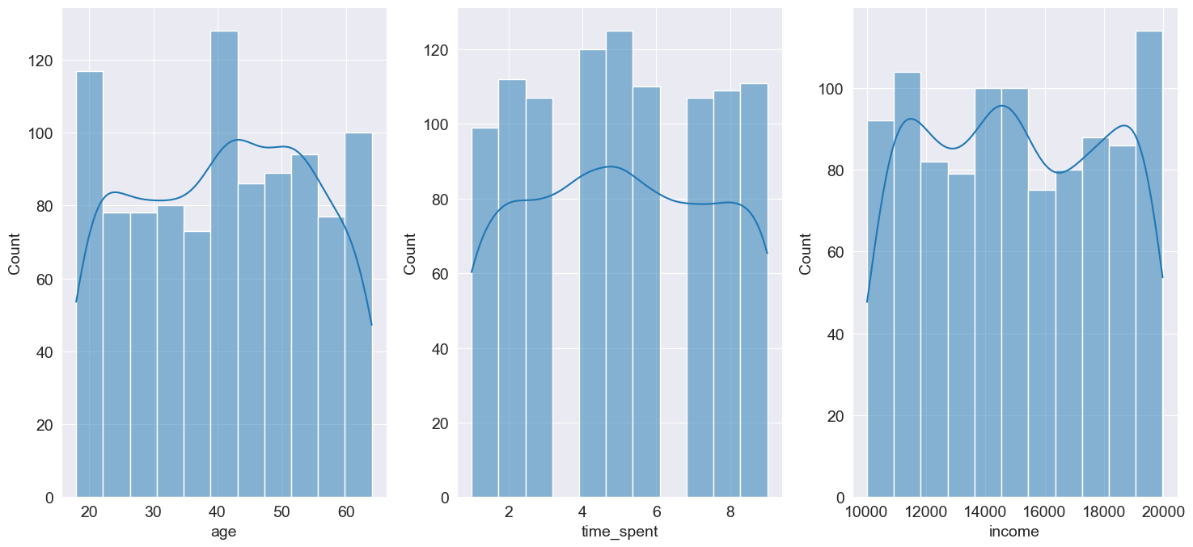
ANÁLISE DE DADOS
AVERAGE TIME SPENT BY A USER ON SOCIAL MEDIA

Slide 16
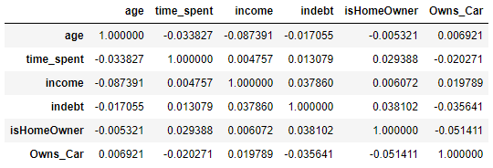
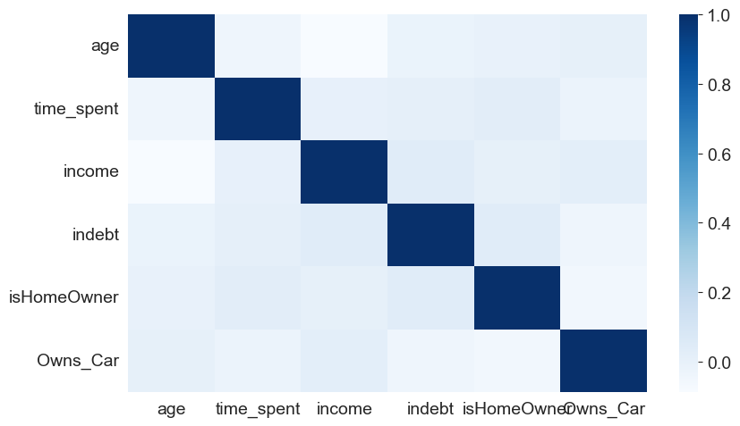
ANÁLISE DE DADOS
AVERAGE TIME SPENT BY A USER ON SOCIAL MEDIA

Slide 17
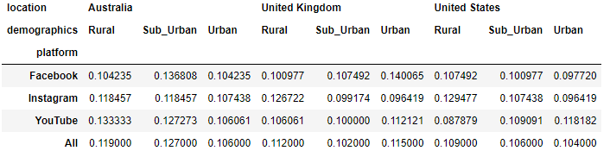
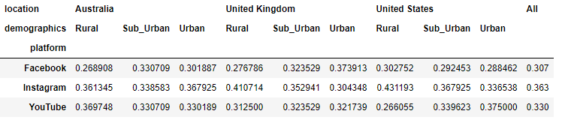
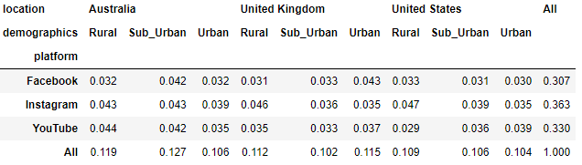
Análise de dados
AVERAGE TIME SPENT BY A USER ON SOCIAL MEDIA

Slide 18
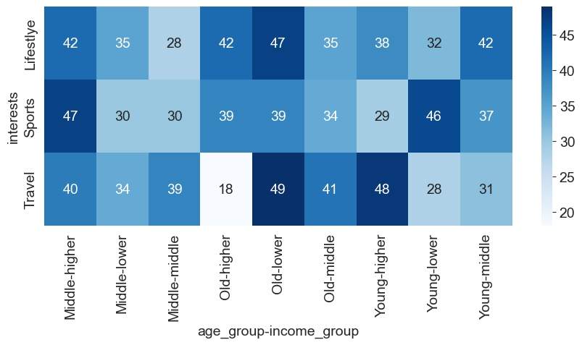
ANÁLISE DE DADOS
AVERAGE TIME SPENT BY A USER ON SOCIAL MEDIA

Slide 19
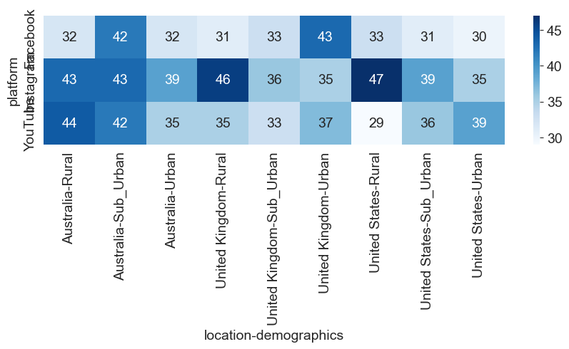
ANÁLISE DE DADOS
AVERAGE TIME SPENT BY A USER ON SOCIAL MEDIA

Slide 20
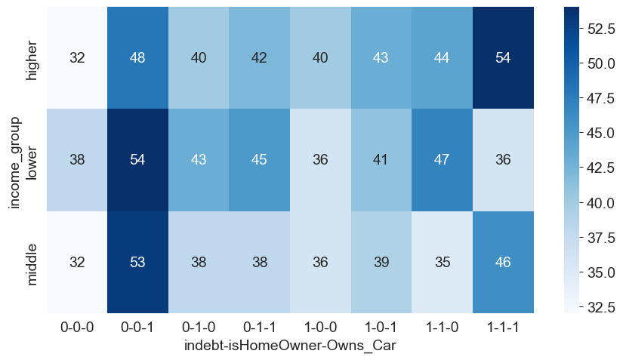
ANÁLISE DE DADOS
AVERAGE TIME SPENT BY A USER ON SOCIAL MEDIA

Slide 21
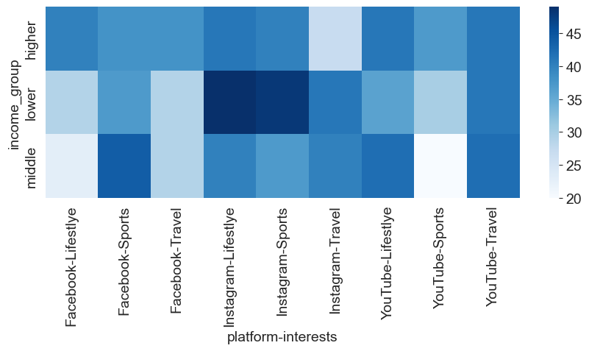
ANÁLISE DE DADOS
AVERAGE TIME SPENT BY A USER ON SOCIAL MEDIA

Slide 22
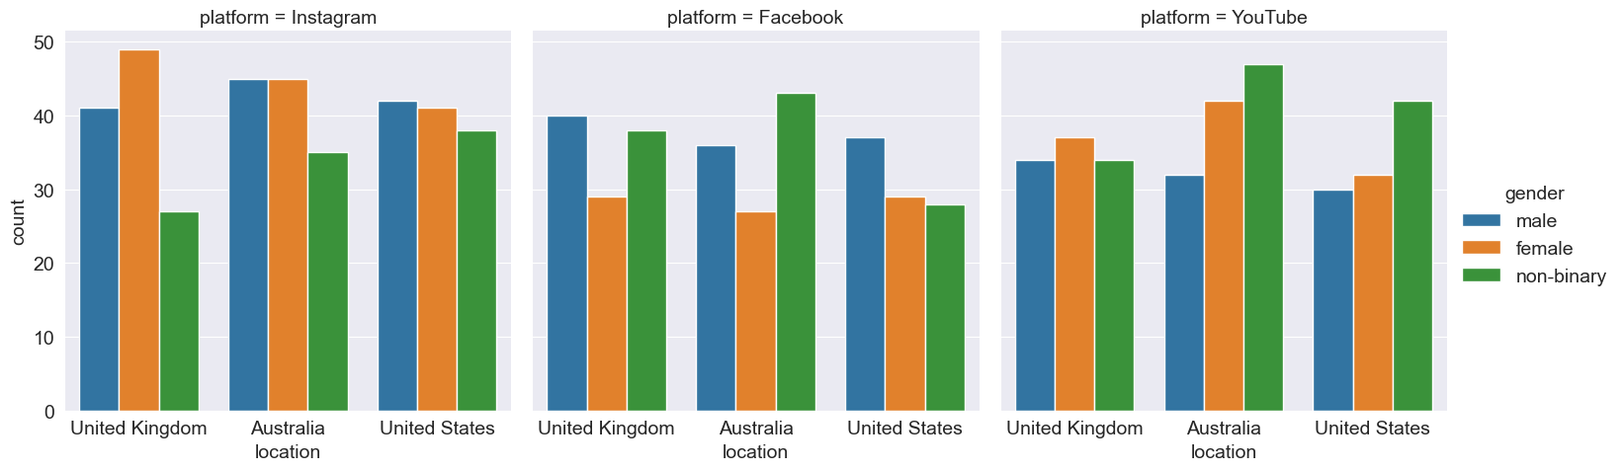
ANÁLISE DE DADOS
AVERAGE TIME SPENT BY A USER ON SOCIAL MEDIA

Slide 23
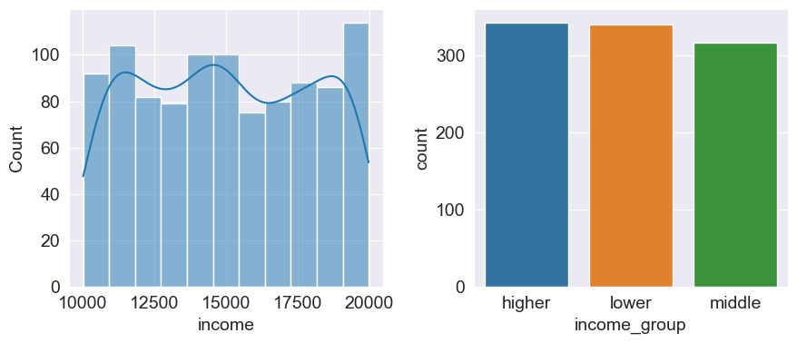
Análise de dados
AVERAGE TIME SPENT BY A USER ON SOCIAL MEDIA

Slide 24
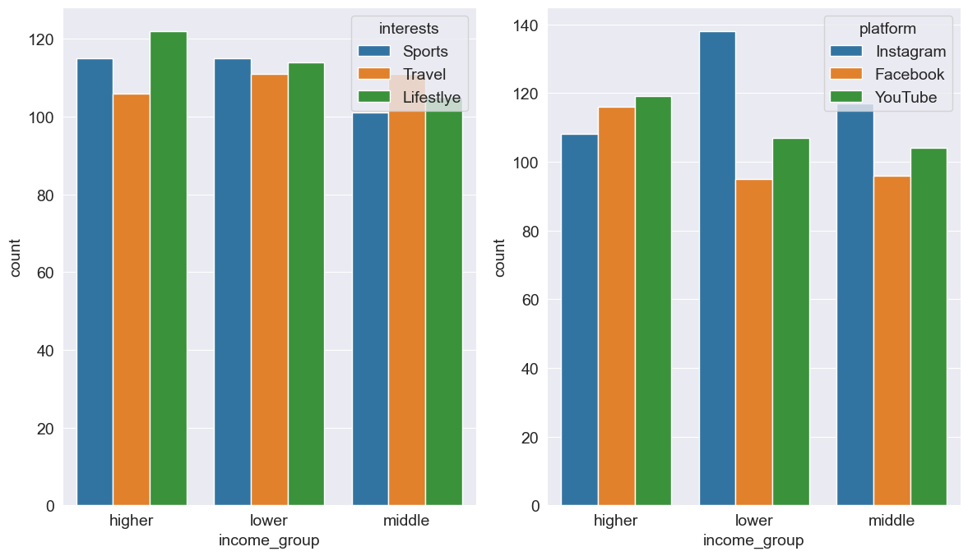
ANÁLISE DE DADOS
AVERAGE TIME SPENT BY A USER ON SOCIAL MEDIA

Slide 25
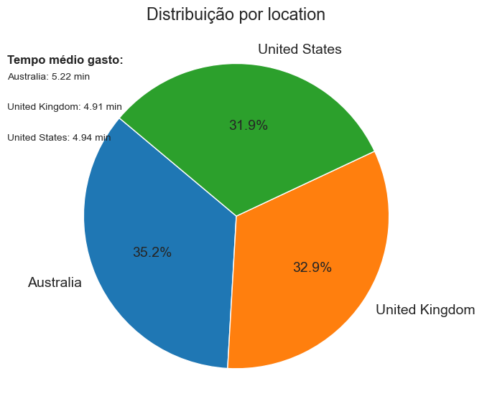
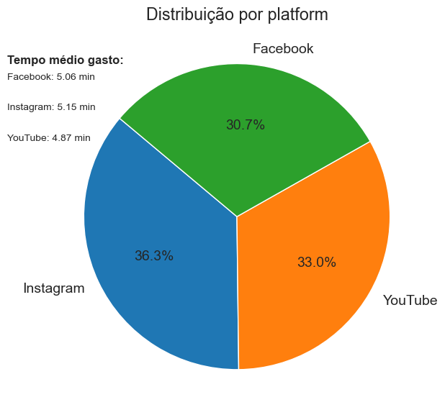
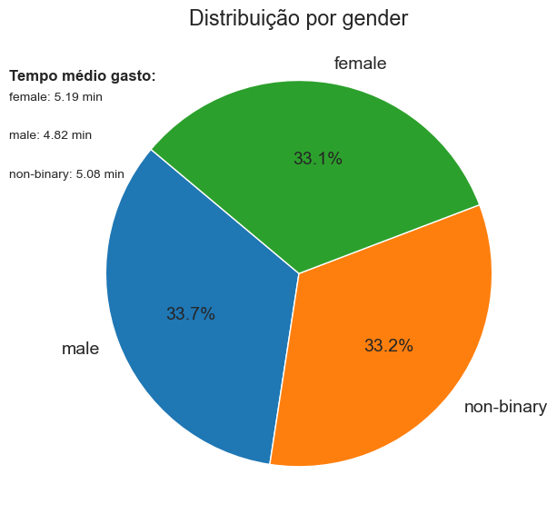
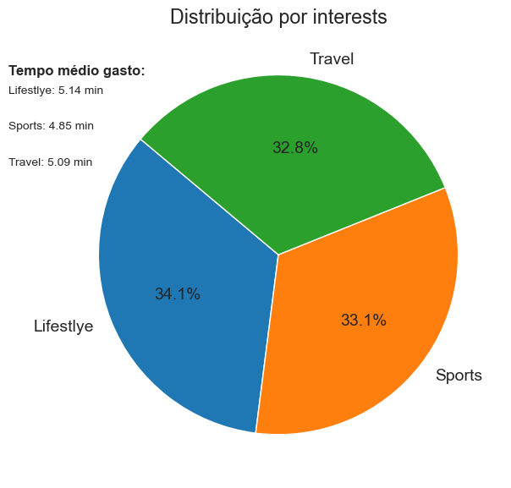
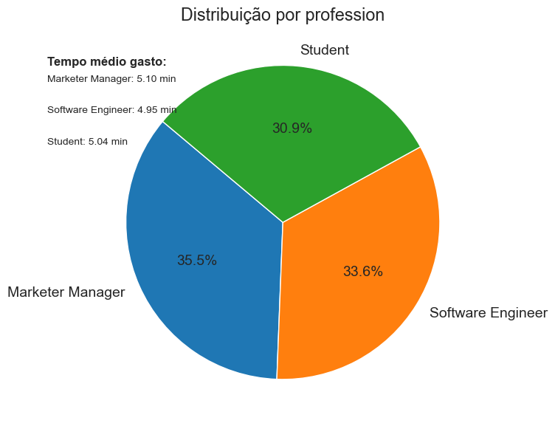
Análise de dados
AVERAGE TIME SPENT BY A USER ON SOCIAL MEDIA

Slide 26
ANÁLISE DOS ALGORITMOS E AVALIAÇÃO DOS RESULTADOS
AVERAGE TIME SPENT BY A USER ON SOCIAL MEDIA

Slide 27
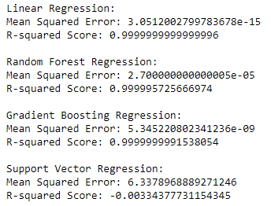
RESULTADOS
AVERAGE TIME SPENT BY A USER ON SOCIAL MEDIA

Slide 28

RE
FE
RÊN
CIAS
[1] KAGGLE. Average Time Spent By A User On Social Media
Disponível em: https://www.kaggle.com/datasets/imyjoshua/average-time-spent-by-a-user-on-social-media
Acesso em 19/03/2024

