Slide 1

Web Development & Design Foundations with H T M L 5
Ninth Edition
Chapter 1
Introduction to the Internet and World Wide Web
Slides in this presentation contain hyperlinks. JAWS users should be able to get a list of links by using INSERT+F7
Copyright © 2019, 2017, 2015 Pearson Education, Inc. All Rights Reserved
Notes:
If this PowerPoint presentation contains mathematical equations, you may need to check that your computer has the following installed:
1) MathType Plugin
2) Math Player (free versions available)
3) NVDA Reader (free versions available)

Slide 2
Learning Objectives (1 of 2)
1.1 Describe the evolution of the Internet and the Web
1.2 Explain the need for web standards
1.3 Describe Universal Design
1.4 Identify benefits of accessible web design
1.5 Identify reliable resources of information on the Web
1.6 Identify ethical use of the Web

Slide 3
Learning Objectives (2 of 2)
1.7 Describe the purpose of web browsers and web servers
1.8 Identify networking protocols
1.9 Define U R I s and domain names
1.10 Describe H T M L, X H T M L, and H T M L5
1.11 Describe popular trends in the use of the Web

Slide 4
Internet
The interconnected network of computer networks that spans the globe.

Slide 5
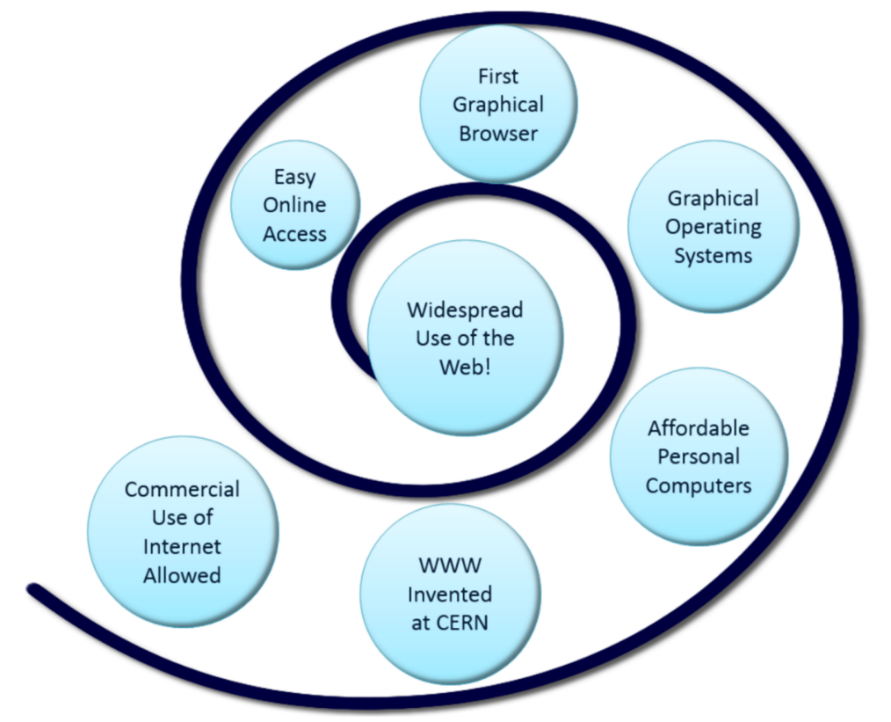
Reasons for Internet Growth in the 1990s
Removal of the ban on commercial activity
Development of the World Wide Web by Tim Berners-Lee at C E R N
Development of Mosaic, the first graphics-based web browser at N C S A
Personal computers were increasingly available and affordable
Online service providers offered low-cost connections to the Internet

Slide 6
The World Wide Web
The graphical user interface to information stored on computers running web servers connected to the Internet.

Slide 7
Internet Standards & Coordination (1 of 2)
I E T F – Internet Engineering Task Force
The principal body engaged in the development of new Internet protocol standard specifications.
R F C – Requests for Comments
A formal document from the I E T F that is drafted by a committee and subsequently reviewed by interested parties
I A B – Internet Architecture Board
Provides guidance and broad direction to the I E T F. Responsible for publications for R F Cs.

Slide 8
Internet Standards & Coordination (2 of 2)
I C A N N - The Internet Corporation for Assigned Numbers & Names
Non-profit organization
Main function is to coordinate the assignment of:
Internet domain names
I P address numbers
Protocol parameters
Protocol port numbers.

Slide 9
Growth of the Internet
Year | Percentage of Global Population Using the Internet
1995 | 0.4%
2000 | 5.8%
2005 | 15.7%
2010 | 28.10%
2015 | 42.4%
Source: http://www.internetworldstats.com/emarketing.htm

Slide 10
Intranet & Extranets
Intranet
A private network contained within an organization or business used to share information and resources among coworkers.
Extranet
A private network that securely shares part of an organization’s information or operations with external partners

Slide 11
Web Standards and the W3C Consortium
W3C – World Wide Web Consortium
Develops recommendations and prototype technologies related to the Web
Produces specifications, called Recommendations, in an effort to standardize web technologies
W A I – Web Accessibility Initiative

Slide 12
Web Accessibility
Accessible Website
provides accommodations for individuals with visual, auditory, physical, and neurological disabilities
W A I
W3C’s Web Accessibility Initiative http://www.w3.org/WAI/
W C A G
Web Content Accessibility Guidelines http://www.w3.org/WAI/WCAG20/quickref/

Slide 13
Web Accessibility & the Law
Americans with Disabilities Act (A D A)
Prohibits discrimination against people with disabilities
Section 508 of the Rehabilitation Act
Requires that government agencies must give individuals with disabilities access to information technology that is comparable to the access available to others
http://www.section508.gov

Slide 14
Universal Design for the Web
Universal Design
the design of products and environments to be usable by all people, to the greatest extent possible, without the need for adaptation or specialized design
http://www.ncsu.edu/www/ncsu/design/sod5/cud/about_ud/about_ud.htm

Slide 15
Reliability & Information on the Web
Questions to Ask:
Is the organization credible?
How recent is the information?
Are there links to additional resources?
Is it Wikipedia?

Slide 16
Checkpoint 1.1
Describe the difference between the Internet and the Web.
Explain three events that contributed to the commercialization and exponential growth of the Internet.
Is the concept of universal design important to web developers? Explain your answer.

Slide 17
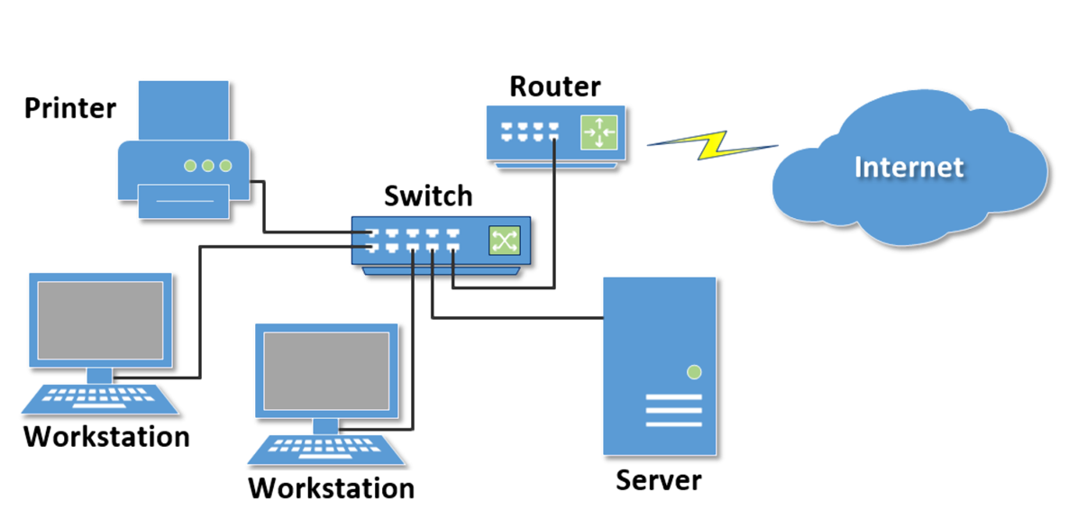
Network Overview
Network
two or more computers connected together for the purpose of communicating and sharing resources

Slide 18
Networks
L A N – Local Area Network
Usually confined to a single building or group of buildings
W A N – Wide Area Network
Usually uses some form of public or commercial communications network to connect computers
is widely dispersed geographical areas.

Slide 19
Internet Infrastructure
Internet Backbone
A high capacity communication link that carries data gathered from smaller links that interconnect with it.
Maps of the Internet Backbone
http://www.google.com/search?q=global+internet+backbone+map+images

Slide 20
The Client/Server Model
Client/Server can describe a relationship between two computer programs – the “client” and the “server”.
Client
requests some type of service (such as a file or database access) from the server.
Server
fulfills the request and transmits the results to the client over a network

Slide 21
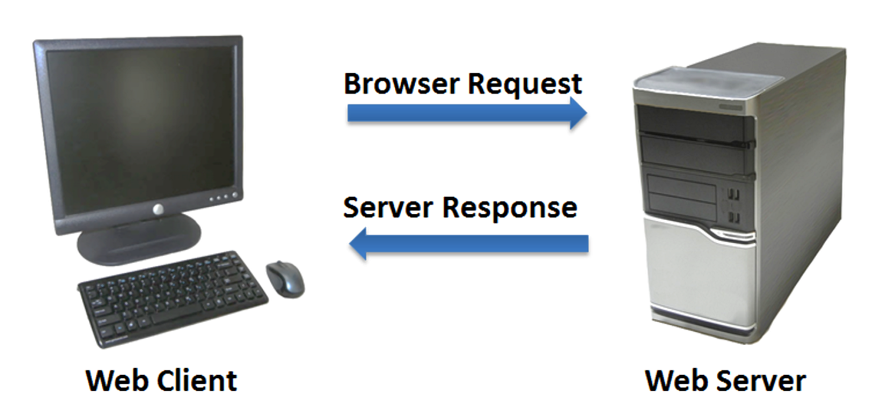
The Internet Client/Server Model
Client – Web Browser
Server – Web Server

Slide 22
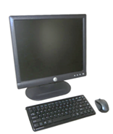
Web Client
Connected to the Internet when needed
Usually runs web browser (client) software (such as Internet Explorer or Firefox)
Uses H T T P (Hypertext Transfer Protocol)
Requests web pages from server
Receives web pages and files from server

Slide 23
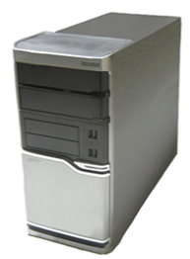
Web Server
Continually connected to the Internet
Runs web server software (such as Apache or Internet Information Server)
Uses H T T P (Hypertext Transfer Protocol)
Receives request for the web page
Responds to request and transmits status code, web page, and associated files

Slide 24
M I M E Type
Multi-Purpose Internet Mail Extension
a set of rules that allow multimedia documents to be exchanged among many different computer systems

Slide 25
Internet Protocols
Protocols
Rules that describe the methods used for clients and servers to communicate with each other over a network.
There is no single protocol that makes the Internet and Web work.
A number of protocols with specific functions are needed.

Slide 26
F T P File Transfer Protocol
A set of rules that allow files to be exchanged between computers on the Internet.
Web developers commonly use F T P to transfer web page files from their computers to web servers.
F T P is also used to download programs and files from other servers to individual computers.

Slide 27
E-Mail Protocols
Sending E-mail
S M T P Simple Mail Transfer Protocol
Receiving E-mail
P O P (P O P3) Post Office Protocol
I M A P Internet Mail Access Protocol

Slide 28
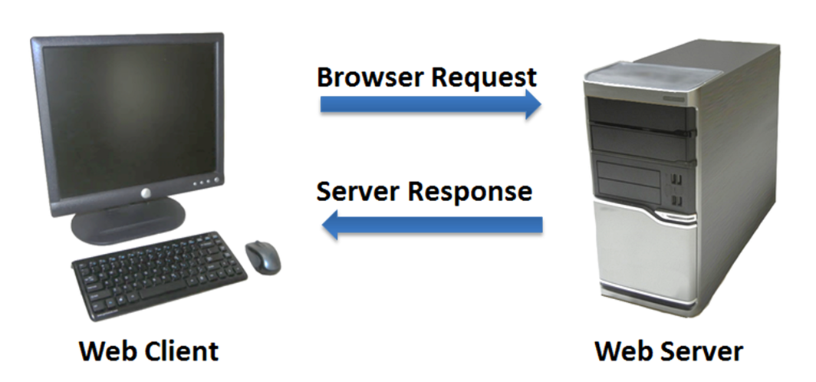
H T T P - Hypertext Transfer Protocol
A set of rules for exchanging files such as text, graphic images, sound, video, and other multimedia files on the Web.
Web browsers send H T T P requests for web pages and their associated files.
Web servers send H T T P responses back to the web browsers.

Slide 29
T C P / I P Transmission Control Protocol/ Internet Protocol
T C P / I P has been adopted as the official communication protocol of the Internet.
T C P and I P have different functions that work together to ensure reliable communication over the Internet.

Slide 30
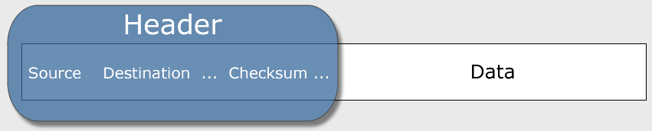
T C P Transmission Control Protocol
Purpose is to ensure the integrity of communication
Breaks files and messages into individual units called packets

Slide 31
I P Internet Protocol
A set of rules that controls how data is sent between computers on the Internet.
I P routes a packet to the correct destination address.
The packet gets successively forwarded to the next closest router (a hardware device designed to move network traffic) until it reaches its destination.
http://www.tracert.com/cgi-bin/trace.pl

Slide 32
I P Address
Each device connected to the Internet has a unique numeric I P address.
These addresses consist of a set of four groups of numbers, called octets.
216.58.194.46 will get you Google!
An I P address may correspond to a domain name.

Slide 33
Domain Name
Locates an organization or other entity on the Internet
Domain Name System
Divides the Internet into logical groups and understandable names
Associates unique computer I P Addresses with the text-based domain names you type into a web browser
Browser: http://google.com
I P Address: 173.194.116.72

Slide 34
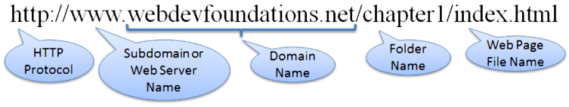
Uniform Resource Identifier
U R I – Uniform Resource Identifier
Identifies a resource on the Internet
U R L – Uniform Resource Locator
A type of U R I which represents the network location of a resource such as a web page, a graphic file, or an M P3 file.

Slide 35
T L D Top-Level Domain Name
A top-level domain (T L D) identifies the right-most part of the domain name.
Examples of generic T L Ds: .com, .org, .net, .mil, .gov, .edu, .int, .aero, .asia, .cat, .jobs, .name, .biz, .mobi, .museum, .info, .coop, .post, .pro, .tel, .travel

Slide 36
County Code T L Ds
Two character codes originally intended to indicate the geographical location (country) of the web site.
In practice, it is fairly easy to obtain a domain name with a country code T L D that is not local to the registrant.
Examples:
.t v, .w s, .a u, .j p, .u k
See http://www.iana.org/cctld/cctld-whois.htm

Slide 37
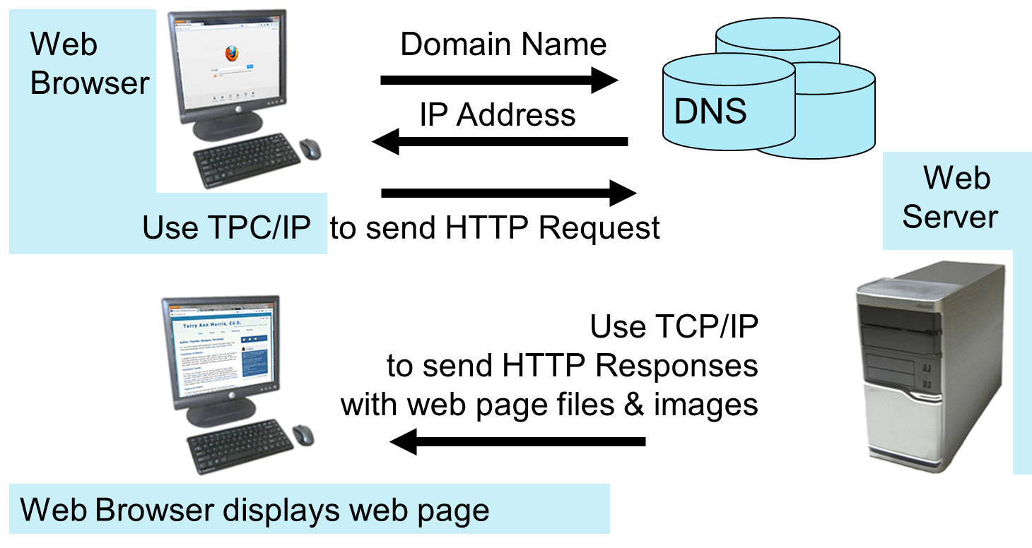
Domain Name System
The Domain Name System (D N S) associates Domain Names with I P addresses.

Slide 38
Markup Languages (1 of 4)
S G M L – Standard Generalized Markup Language
A standard for specifying a markup language or tag set
H T M L – Hypertext Markup Language
The set of markup symbols or codes placed in a file intended for display on a web browser.

Slide 39
Markup Languages (2 of 4)
X M L – eXtensible Markup Language
A text-based language designed to describe, deliver, and exchange structured information.
It is not intended to replace H T M L – it is intended to extend the power of H T M L by separating data from presentation.

Slide 40
Markup Languages (3 of 4)
X H T M L – eXtensible Hypertext Markup Language
Developed by the W3C as the reformulation of H T M L 4.0 as an application of X M L.
It combines the formatting strengths of H T M L 4.0 and the data structure and extensibility strengths of X M L.

Slide 41
Markup Languages (4 of 4)
H T M L 5
The next version of H T M L4 and X H T M L
https://www.w3.org/TR/html5/
It’s already been updated!
H T M L 5.1
https://www.w3.org/TR/html51/
The W3C is working on H T M L 5.2!
https://www.w3.org/TR/html52/

Slide 42
Checkpoint 1.2
Describe the components of the client/server model as applied to the Internet.
Identify two protocols used on the Internet to convey information that use the Internet but do not use the Web.
Explain the similarities and differences between a U R L and a domain name.

Slide 43
Popular Uses of the Internet
E-Commerce
Mobile Access
Blogs
Wikis
Social Networking
R S S
Podcasts
Web 2.0
Cloud Computing

Slide 44
Summary
This chapter provided a brief overview of Internet, Web, and introductory networking concepts.

Slide 45

Copyright

