Slide 1
Java Programming, 9e Chapter 3
Using Methods, Classes, and Objects

Slide 2
Objectives
Describe method calls and placement
Identify the parts of a method
Add parameters to methods
Create methods that return values
Learn about classes and objects
Create a class
Create instance methods in a class
Declare objects and use their methods
Create constructors
Appreciate classes as data types
Install Eclipse from Eclipse.org

Slide 3
Understanding Method Calls and Placement (1 of 4)
Method
A program module
Contains a series of statements
Carries out a task
Execute a method
Invoke or call from another method
Calling method (client method)
Makes a method call
Called method
Invoked by a calling method

Slide 4
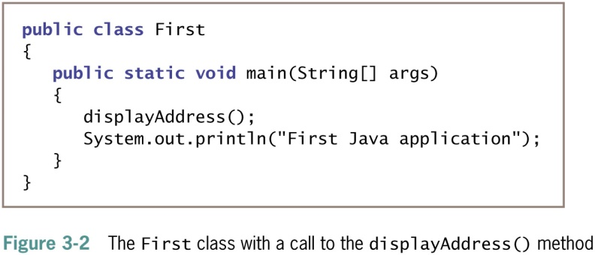
Understanding Method Calls and Placement (2 of 4)

Slide 5
Understanding Method Calls and Placement (3 of 4)
main() method executes automatically
Other methods are called as needed

Slide 6
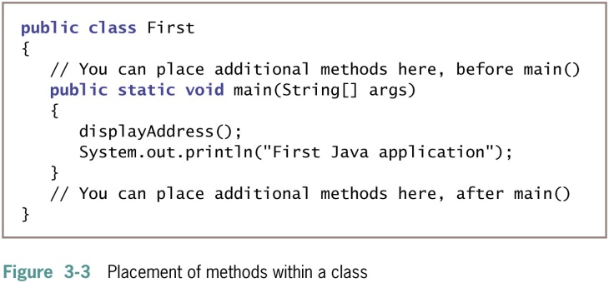
Understanding Method Calls and Placement (4 of 4)

Slide 7
Understanding Method Construction (1 of 3)
A method must include:
Method header
Also called a declaration
Method body
Between a pair of curly braces
Contains the statements that carry out the work
Also called implementation

Slide 8
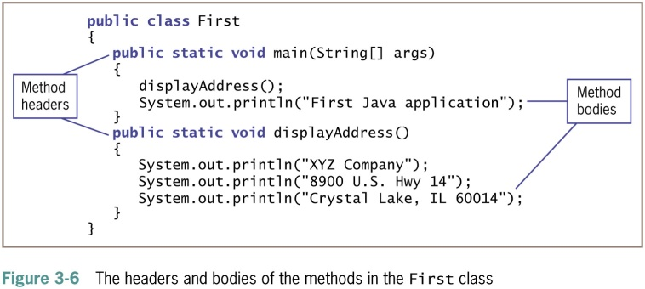
Understanding Method Construction (2 of 3)

Slide 9
Understanding Method Construction (3 of 3)
The method header contains:
Optional access specifiers
A return type
An identifier
Parentheses
Might contain data to be sent to the method
Place the entire method within the class that will use it
Not within any other method

Slide 10
Access Specifiers (1 of 2)
Can be public, private, protected , or package
public access allows use by any other class
Also called access modifiers
Methods most commonly use public access

Slide 11
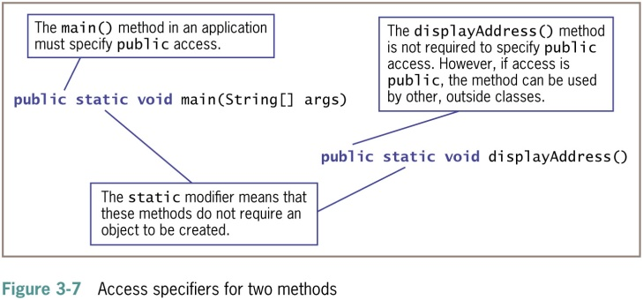
Access Specifiers (2 of 2)

Slide 12
Return Type (1 of 2)
Describes the type of data the method sends back to the calling method
If no data is returned to the method, the return value is void

Slide 13
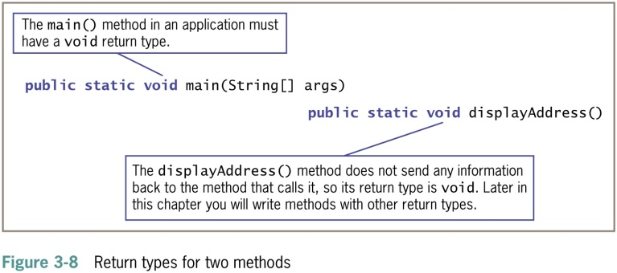
Return Type (2 of 2)

Slide 14
Method Name (1 of 2)
Can be any legal identifier
Must be one word
No embedded spaces
Cannot be a Java keyword

Slide 15
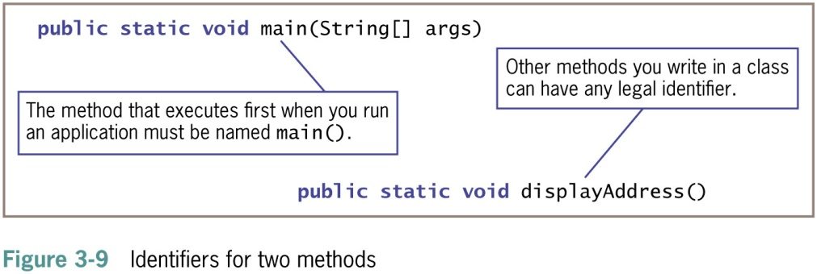
Method Name (2 of 2)

Slide 16
Parentheses (1 of 2)
Every method header contains a set of parentheses that follow the identifier
May contain data to be sent to the method
Fully qualified identifier
A complete name that includes the class

Slide 17
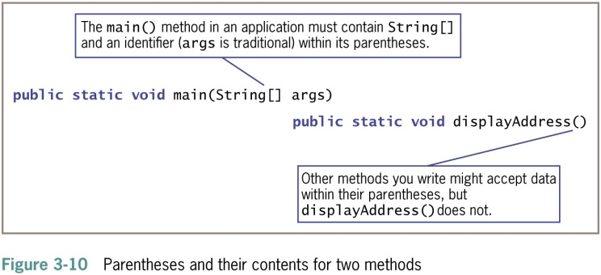
Parentheses (2 of 2)

Slide 18
Adding Parameters to Methods
Arguments
Data items you use in a call to a method
Parameters
Data items received by the method
Implementation hiding
Encapsulation of method details within a class
The calling method needs to understand only the interface to the called method
Interface
The only part of a method that the client sees or with which it interacts

Slide 19
Creating a Method That Receives a Single Parameter (1 of 4)
Define the following:
Optional access specifiers
Return type for the method
Method name
Parameter type
Local name for the parameter

Slide 20
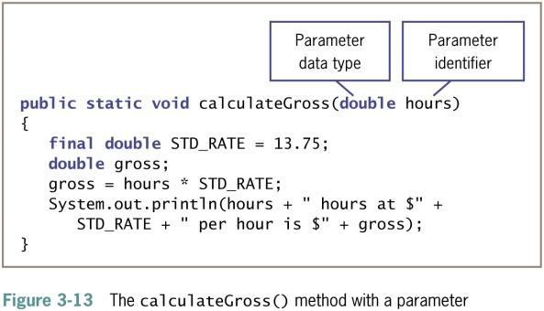
Creating a Method That Receives a Single Parameter (2 of 4)

Slide 21
Creating a Method That Receives a Single Parameter (3 of 4)
Local variable
Known only within the boundaries of the method
Each time the method executes:
The variable is redeclared
A new memory location large enough to hold the type is set up and named

Slide 22
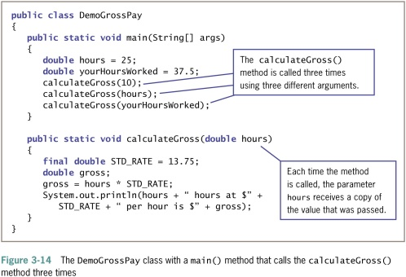
Creating a Method That Receives a Single Parameter (4 of 4)

Slide 23
Creating a Method That Requires Multiple Parameters (1 of 2)
A method can require more than one parameter
List the arguments within the call to the method
Separate with commas
Call a method
Arguments sent to the method must match the parameters listed in the method declaration by:
Number
Type
Method signature
Method name
Number, types, and order of the arguments

Slide 24
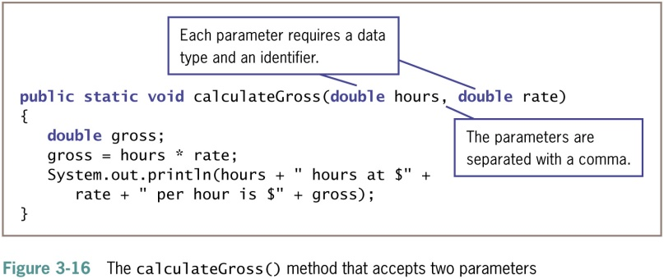
Creating a Method That Requires Multiple Parameters (2 of 2)

Slide 25
Creating Methods That Return Values (1 of 3)
return statement
Causes a value to be sent from the called method back to the calling method
The return type can be any type used in Java
Primitive types
Class types
void
Returns nothing
Method’s type
A method’s return type

Slide 26
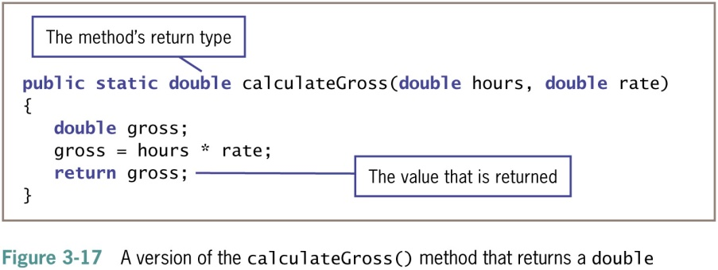
Creating Methods That Return Values (2 of 3)

Slide 27
Creating Methods That Return Values (3 of 3)
Unreachable statements (dead code)
Logical flow leaves the method at the return statement
Can never execute
Causes a compiler error

Slide 28
Chaining Method Calls (1 of 2)
Any method might call any number of other methods
Method acts as a black box
Do not need to know how it works
Just call and use the result

Slide 29
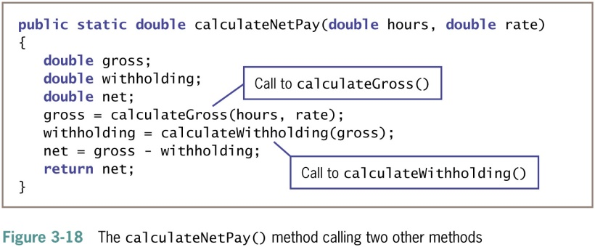
Chaining Method Calls (2 of 2)

Slide 30
Learning About Classes and Objects
Every object is a member of a class
Is-a relationships
An object “is a” concrete example of the class
The zoo’s shark “is a” Fish
Instantiation
Shark is an instantiation of the Fish class
Reusability
Methods are often called upon to return a piece of information to the source of the request
Class client or class user
An application or a class that instantiates objects of another prewritten class

Slide 31
Creating a Class (1 of 4)
Assign a name to the class
Determine what data and methods will be part of the class
Create a class header with three parts:
An optional access modifier
The keyword class
Any legal identifier for the name of the class
public class
Accessible by all objects

Slide 32
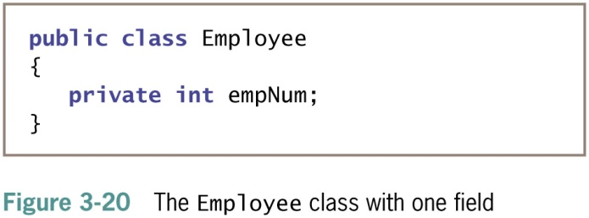
Creating a Class (2 of 4)

Slide 33
Creating a Class (3 of 4)
Extended
To be used as a basis for any other class
Data fields
Variables declared within a class but outside of any method
Instance variables
Nonstatic fields given to each object

Slide 34
Creating a Class (4 of 4)
Private access for fields
No other classes can access the field’s values
Only methods of the same class are allowed to use private variables
Information hiding
Most class methods are public

Slide 35
Visibility Modifiers
public
private
public
private
Violate
encapsulation
Enforce
encapsulation
Variables
Support other
methods in the
class
Provide services
to clients
Methods

Slide 36
Method Control Flow
The called method is often part of another class or object
main
doIt
helpMe
obj.doIt();
helpMe();

Slide 37
Creating Instance Methods in a Class (1 of 4)
Classes contain methods
Mutator methods
Set or change field values
Accessor methods
Retrieve values
Nonstatic methods
Instance methods
“Belong” to objects
Typically declare nonstatic data fields
static class variables are not instance variables

Slide 38
Creating Instance Methods in a Class (2 of 4)
Table 3-1 Comparison of static and nonstatic
Static | Nonstatic
In Java, static is a keyword. It also can be used as an adjective. | There is no keyword for nonstatic items. When you do not explicitly declare a field or method to be static, it is nonstatic by default.
Static fields in a class are called class fields. | Nonstatic fields in a class are called instance variables.
Static methods in a class are called class methods. | Nonstatic methods in a class are called instance methods.
When you use a static field or method, you do not need to use an object; for example: JOptionPane.showDialog(); | When you use a nonstatic field or method, you must use an object; for example: System.out.println();
When you create a class with a static field and instantiate 100 objects, only one copy of that field exists in memory. | When you create a class with a nonstatic field and instantiate 100 objects, then 100 copies of that field exist in memory.
When you create a static method in a class and instantiate 100 objects, only one copy of the method exists in memory and the method does not receive a this reference. | When you create a nonstatic method in a class and instantiate 100 objects, only one copy of the method exists in memory, but the method receives a this reference that contains the address of the object currently using it.
Static class variables are not instance variables. The system allocates memory to hold class variables once per class, no matter how many instances of the class you instantiate. The system allocates memory for class variables the first time it encounters a class, and every instance of a class shares the same copy of any static class variables. | Instance fields and methods are nonstatic. The system allocates a separate memory location for each nonstatic field in each instance.

Slide 39
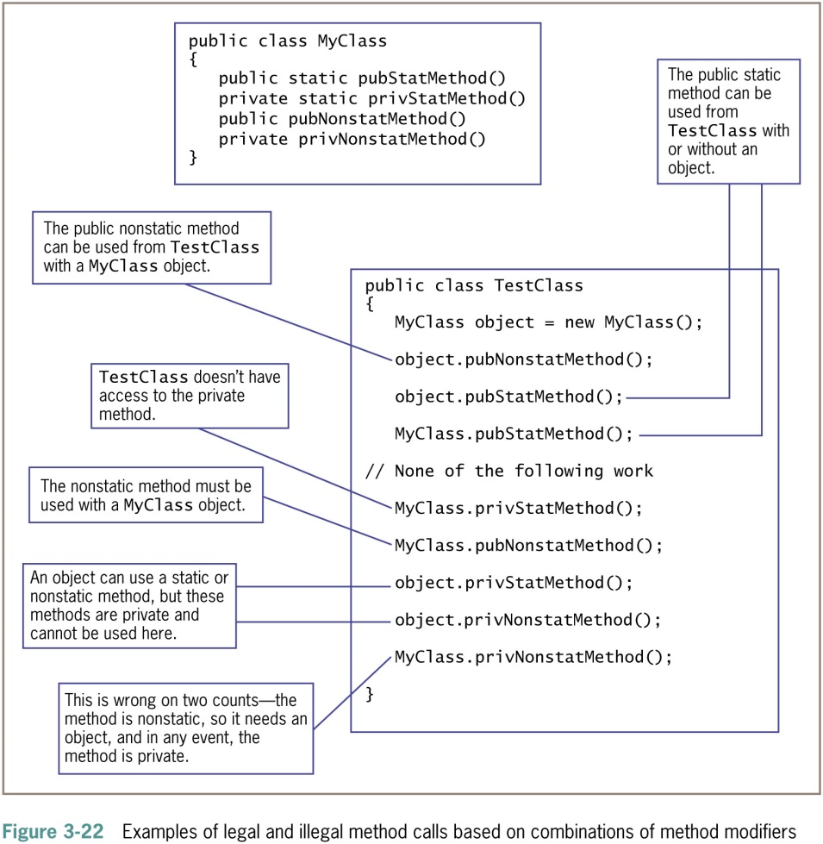
Creating Instance Methods in a Class (3 of 4)

Slide 40
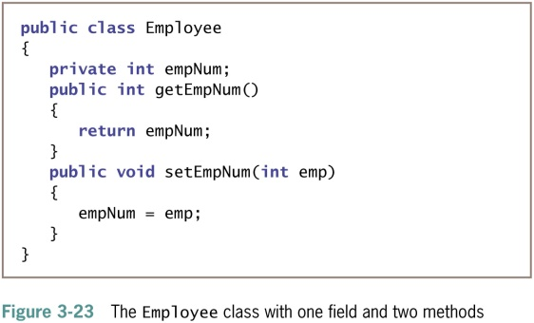
Creating Instance Methods in a Class (4 of 4)

Slide 41
Organizing Classes (1 of 4)
Place data fields in logical order
At the beginning of a class
List the fields vertically
Data fields and methods may be placed in any order within a class
It’s common to list all data fields first
Names and data types can be seen before reading the methods that use the data fields

Slide 42
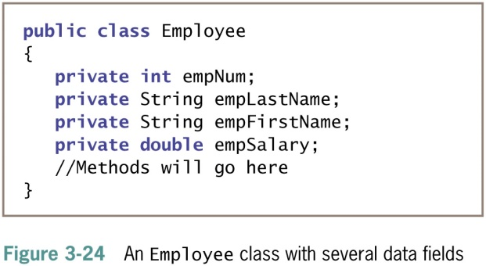
Organizing Classes (2 of 4)

Slide 43
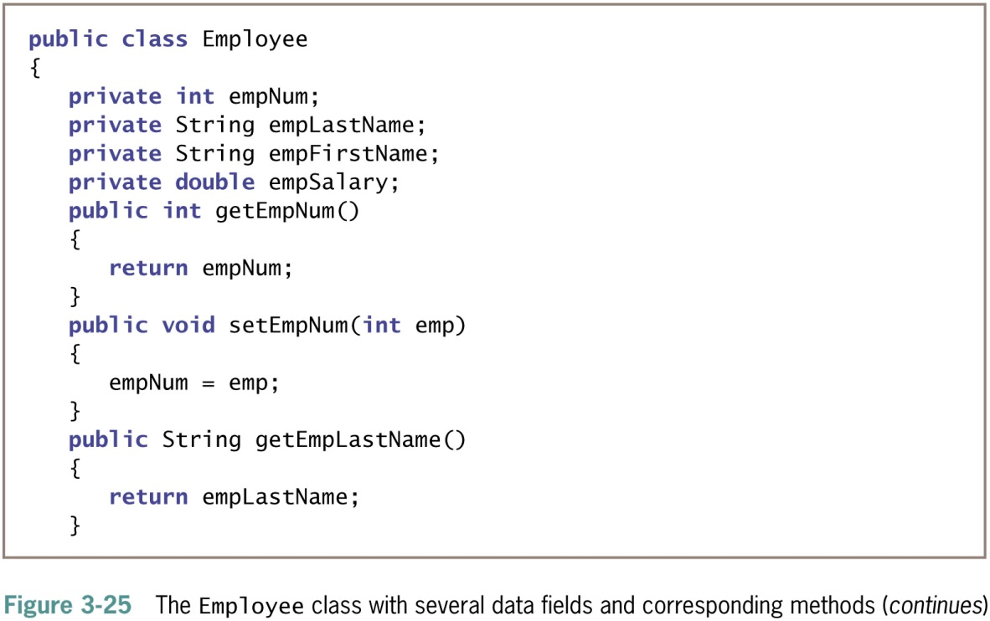
Organizing Classes (3 of 4)

Slide 44
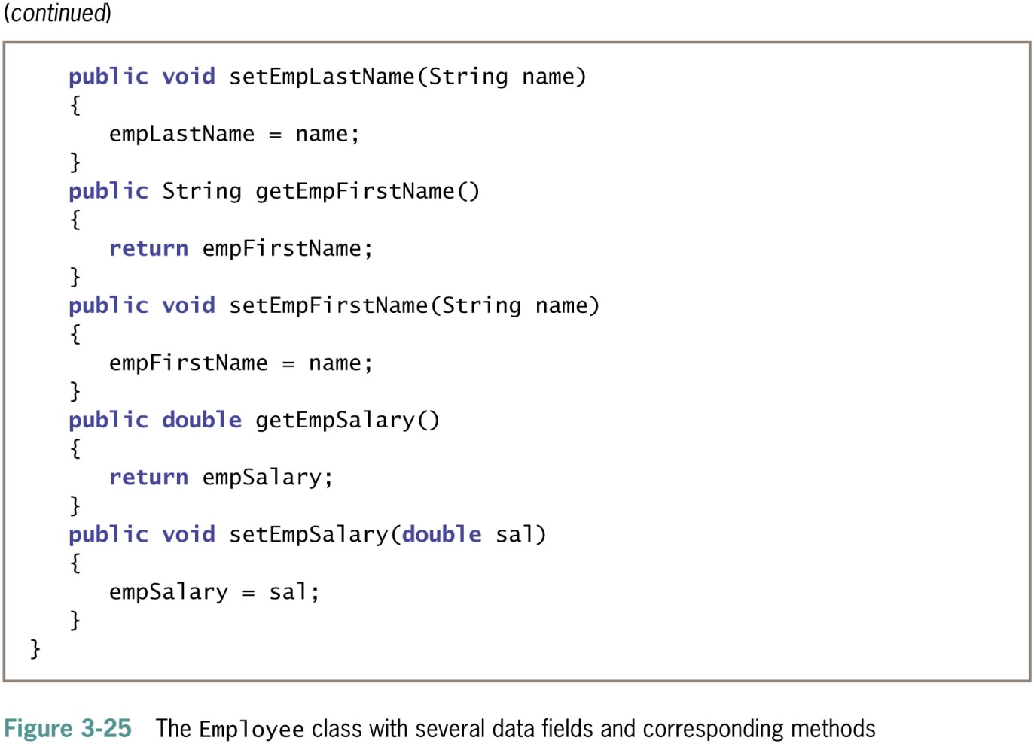
Organizing Classes (4 of 4)

Slide 45
Declaring Objects and Using Their Methods (1 of 4)
Declaring a class does not create any actual objects
To create an instance of a class:
Supply a type and an identifier
Allocate computer memory for the object
Use the new operator
Employee someEmployee;
someEmployee = new Employee();
or
Employee someEmployee = new Employee();

Slide 46
Declaring Objects and Using Their Methods (2 of 4)
Reference to the object
The name for a memory address where the object is held
Constructor method
A method that creates and initializes class objects
You can write your own constructor methods
Java writes a constructor when you don’t write one
The name of the constructor is always the same as the name of the class whose objects it constructs

Slide 47
Declaring Objects and Using Their Methods (3 of 4)
After an object is instantiated, its methods can be accessed using:
The object’s identifier
A dot
A method call

Slide 48
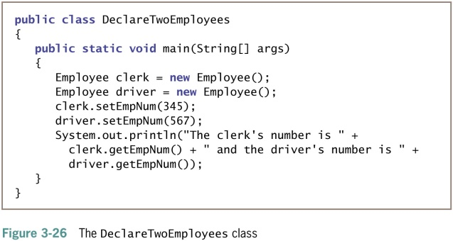
Declaring Objects and Using Their Methods (4 of 4

Slide 49
Understanding Data Hiding
Data hiding using encapsulation
Data fields are usually private
The client application accesses them only through public interfaces
set method
Controls the data values used to set a variable
get method
Controls how a value is retrieved

Slide 50
An Introduction to Using Constructors (1 of 4)
Employee chauffeur = new Employee();
Actually a calling method named Employee()
Default constructors
Require no arguments
Created automatically by a Java compiler
For any class
Whenever you do not write a constructor

Slide 51
An Introduction to Using Constructors (2 of 4)
The default constructor provides specific initial values to an object’s data fields
Numeric fields
Set to 0 (zero)
Character fields
Set to Unicode ‘\u0000’
Boolean fields
Set to false
Nonprimitive object fields
Set to null

Slide 52
An Introduction to Using Constructors (3 of 4)
A constructor method:
Must have the same name as the class it constructs
Cannot have a return type
public access modifier

Slide 53
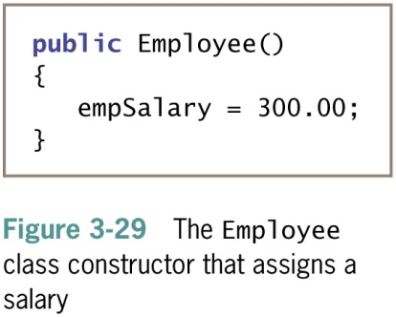
An Introduction to Using Constructors (4 of 4)

Slide 54
Understanding That Classes Are Data Types
Classes you create become data types
Often referred to as abstract data types (ADTs)
Implementation is hidden and accessed through public methods
Programmer-defined data type
Not built into the language
Declare an object from one of your classes
Provide the type and identifier

Slide 55
Don’t Do It
Don’t place a semicolon at the end of a method header
Don’t think “default constructor” means only the automatically supplied constructor
Don’t think that a class’s methods must:
Accept its own fields’ values as parameters
Return values to its own fields
Don’t create a class method that has a parameter with the same identifier as a class field

Slide 56
Summary (1 of 2)
Method
A series of statements that carry out a task
A declaration includes the parameter type and local name for a parameter
You can pass multiple arguments to methods
Has a return type
Class objects
Have attributes and methods associated with them
Instantiate objects that are members of a class

Slide 57
Summary (2 of 2)
Constructor
A method establishes an object and provides specific initial values for an object’s data fields
Everything is an object
Every object is a member of a more general class
Implementation hiding, or encapsulation
private data fields
public access methods

