Slide 1
JUNIT

Slide 2
Unit Testing
Testing small chunk of code
Helps in early detection of error

Slide 3
JUnit
JUnit is a framework for writing unit tests
A unit test is a test of a single class
A test case is a single test of a single method
A test suite is a collection of test cases
Unit testing is particularly important when software requirements change frequently
Whenever code is changed, rerun the tests

Slide 4
Test suites
In practice, you want to run a group of related tests (e.g. all the tests for a class)
To do so, group your test methods in a class which extends TestCase
Running suites we will see in examples

Slide 5
assertX methods
static void assertTrue(boolean test)
static void assertFalse(boolean test)
assertEquals(expected, actual)
This method is heavily overloaded: arg1 and arg2 must be both objects or both of the same primitive type
For objects, uses your equals method, if you have defined it properly, as public boolean equals(Object o) --otherwise it uses ==.
assertSame(Object expected, Object actual)
Asserts that two objects refer to the same object (using ==)
assertNotSame(Object expected, Object actual)
assertNull(Object object)

Slide 6
assertX methods
assertNotNull(Object object)
fail()
Causes the test to fail and throw an AssertionFailedError
Useful as a result of a complex test, when the other assert methods aren’t quite what you want .
All the above may take an optional String message as the first argument, for example, static void assertTrue(String message, boolean test)

Slide 7
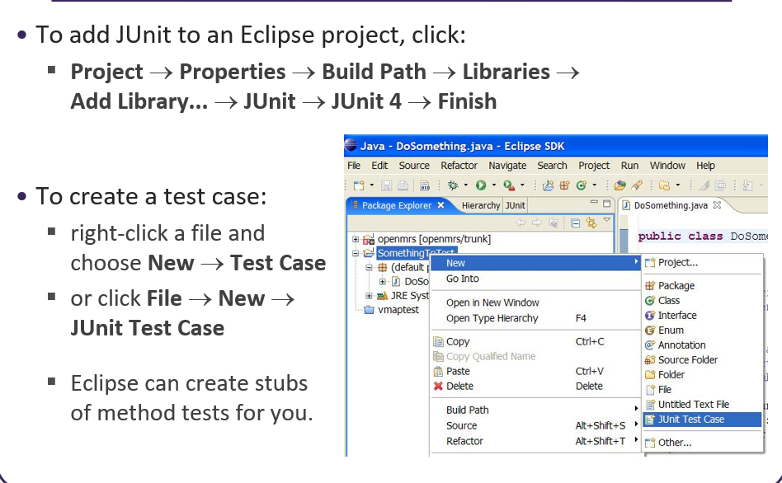

Slide 8
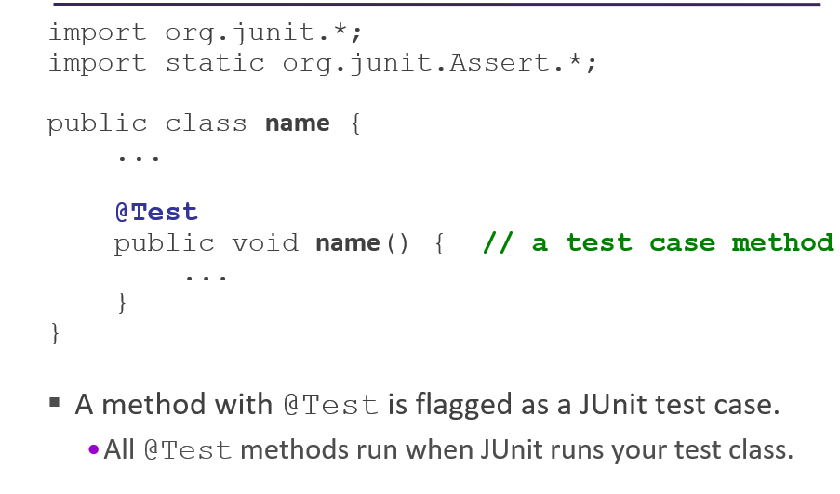
JUnit test case

Slide 9
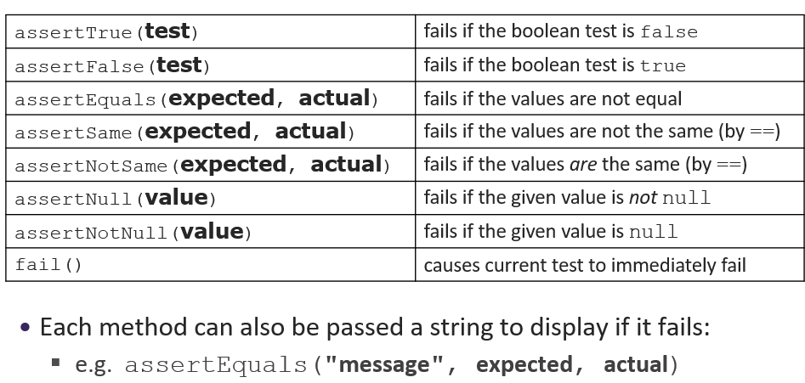
Junit Assertion methods

Slide 10
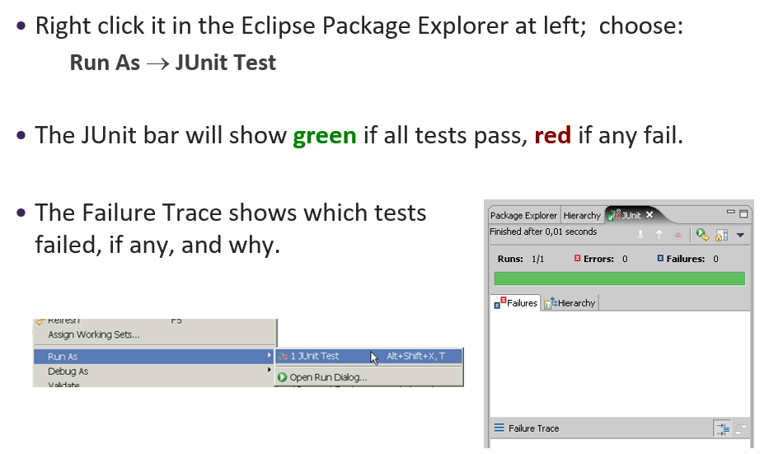
Run a test

Slide 11
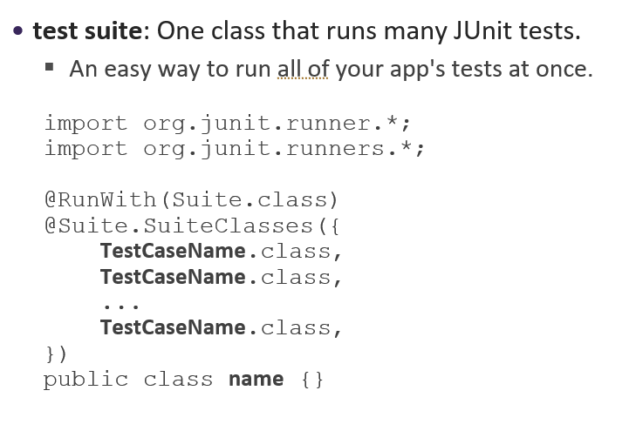
Test suit

Slide 12
The @BeforeClass and @AfterClass annotated methods will be run exactly once during your test run - at the very beginning and end of the test as a whole, before anything else is run. In fact, they're run before the test class is even constructed, which is why they must be declared static.
The @Before and @After methods will be run before and after every test case, so will probably be run multiple times during a test run.
So let's assume you had three tests in your class, the order of method calls would be:
setUpBeforeClass() (Test class first instance constructed and the following methods called on it) setUp() test1() tearDown() (Test class second instance constructed and the following methods called on it) setUp() test2() tearDown() (Test class third instance constructed and the following methods called on it) setUp() test3() tearDown() tearDownAfterClass()

Slide 13
More Reading
http://www.junit.org/index.htm
http://open.ncsu.edu/se/tutorials/junit/
http://www.cs.umanitoba.ca/~eclipse/10-JUnit.pdf
http://supportweb.cs.bham.ac.uk/documentation/tutorials/docsystem/build/tutorials/junit/junit.pdf
http://junit.sourceforge.net/javadoc/junit/framework/

