Slide 1
Chapter 12
Network Security

Slide 2
Chapter Outline
12-1 Introduction
12-2 Intrusion (How an Attacker Gains Control of a Network
12-3 Denial of Service
12-4 Security Software and Hardware
12-5 Managing Network Access
12-6 Wireless Security

Slide 3
Objectives
Examine how an attacker gains control of a network
Understand how denial of service attacks are initiated
Examine the security software and hardware used to
protect the network
Understand wireless security issues

Slide 4
Introduction
An enterprise network is vulnerable to many types of network attacks.
While network attacks can’t be prevented, there are some steps that can be taken to minimize the impact an attack has on the network.

Slide 5
Introduction
The first type of attack examined in this chapter is intrusion, where an attacker gains access to a remote network system.
There are many ways by which an attacker can gain access to the network. These are social engineering, password cracking, packet sniffing, vulnerable software, and viruses. These issues are examined in section 12-2.

Slide 6
Introduction
Denial of service and distributed denial of service attacks are examined in section 12-3.
Techniques for using security software and hardware like firewalls to protect a network are examined in section12-4.
Section 12-5 examines managing network access
Section 12-6 examines wireless security

Slide 7
Introduction
There are many techniques used by a hacker to gain control of a network. The network administrator needs to be aware of the different ways an intruder can use to gain access or even control of a network.
The information presented in this chapter is an example of what the hacker already knows and what the network administrator needs to know to protect the network.

Slide 8
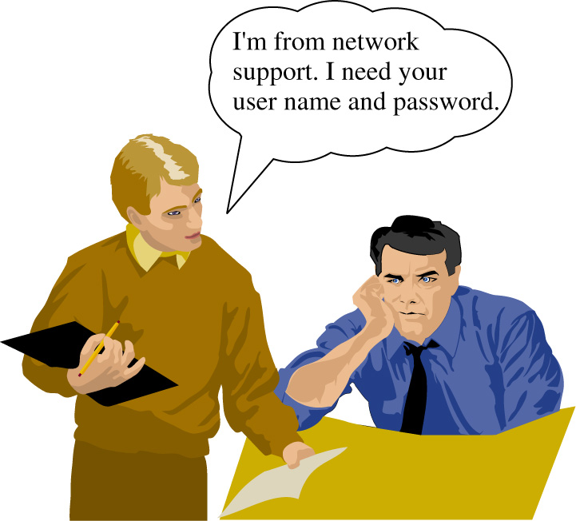
Social Engineering
The first issue of intrusion is social engineering.
This is a way of for an intruder to gain enough information that enables the unauthorized user to gain access to the network.

Slide 9
Social Engineering
An attacker tells a user that they are having trouble with their account and then ask for the user’s name and password.
Often a user will blindly provide the information not realizing that the person calling is not associated with the network and is in fact an attacker

Slide 10
Social Engineering
This gives the attacker an account (username and password) to attack the network. This is just one example of social engineering.
This problem is not completely solvable because as the number of users increases, so does the possible ways to attack the network.

Slide 11
Social Engineering
The solution is educating the users to not share information about the way they access the network and to always require identification from support staff.

Slide 12
Password Cracking
If the attacker can’t get the password from the user, the attacker can use password cracking. This can be done via brute force or via checking for “weak” passwords. Most networks require the users to use strong passwords
In password cracking, the attacker can try to guess the user’s password. A way is to do this is to use a dictionary attack. The dictionary attack uses known passwords and many variations (upper and lower case and combinations) to try to login to your account.
A brute force attack means the attackers uses every possible combination of characters for the password.

Slide 13
Preventing Password Cracking
Don’t use passwords that are dictionary words
Don’t use your user name
Don’t use your user name backwards
Limit the number of log in attempts
Make you password sufficiently long (6 or more characters) with an alpha numeric combination (e.g. A b 1 & G 2 5 h).
Change passwords often

Slide 14
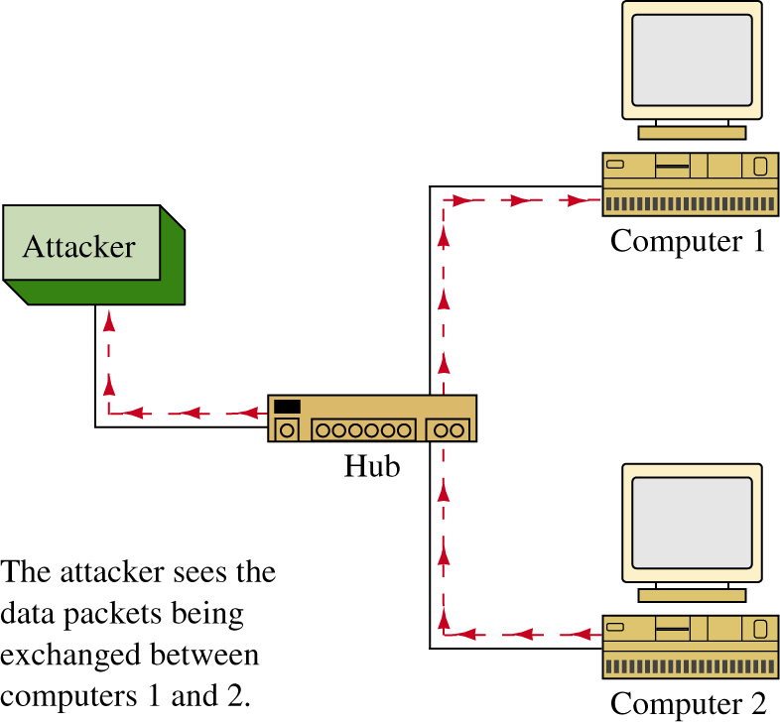
Packet Sniffing
Another way attackers can obtain a password is by sniffing the network’s data packets.
This is easy in a network that uses hubs but not in a network that uses switches to interconnect the computing devices. The attacker will have to insert a device on the network that allows the user to see the data packets.

Slide 15
Packet Sniffing
The attacker will watch the data packets until a telnet or FTP data packet passes or many of the other applications that have unencrypted logins.
Many of these applications pass the user name and password over the network in plain text.

Slide 16
Packet Sniffing
Plain text means that the information is in a human readable form.
If the attacker captures all data packets from a user’s computer then the chances are good that the attacker can obtain the users login name and password on one of the network’s computers.

Slide 17
Packet Sniffing
The way to prevent this is by encrypting the users name and password. An encrypted alternative to telnet is SSH (Secure Shell).
The packets that pass across this SSH connection are encrypted.
SSL (Secure Socket Layer) is an encryption used by web servers. For example, the packet transmission is encrypted when a credit card number is entered.

Slide 18
Packet Sniffing
There is also a secured version of FTP. In these examples, the security is implemented at the application layer. Security can also be implemented at layer three using IPSec (IP Security).
In IPSec each packet is encrypted prior to transmission across the network link. IPSec is also a method used to encrypt VPN tunnels.

Slide 19
Vulnerable Software
In the process of writing large amounts of code, errors happen that can open the access to the code and to a network. The basic attack that capitalizes of these errors is the buffer overflow.
The buffer overflow happens when a program attempts to put more data into a buffer than it was configured to hold. The computer program stack contains data plus instructions that it will run.

Slide 20
Vulnerable Software
For example, a web application could have a vulnerability with long URLs assigned to a variable within the web application.
If the attacker makes the URL long enough then the buffer overflow could allow the attacker’s code to be placed in the stack. When the program counter gets to the inserted code, the inserted code is run and the attacker then has remote access to the machine.

Slide 21
Vulnerable Software
Sometimes buffer overflows don’t allow instructions to be run but rather the application will crash. A common code that gets run in buffer overflow applications is setting up a backdoor to gain entry into the computer.
What the attacker is doing is creating an application on a port and then the attacker can connect to the port. The attacker can also use this to place viruses in the computer.
For example, the attacker finds a vulnerability in the source code for an operating system, e.g. the SSL code on a web server. The attacker downloads malicious code onto the web server and then connects to the machine and instructs the code to begin attacking other machines.

Slide 22
Preventing Vulnerable Software Attacks
Keep the software patches and service packs for the operating system current.
Turn off all services and ports that are not needed on a machine. For example, if your machine does not use web service then turn this service off. Leaving these services on is like leaving the windows and doors open to your house. You are just inviting an attacker to come in. If you aren’t using a service, shut the access.
The command netstat –a can be used to display the ports currently open on the windows operating system. This command shows who is connected to your machine and the port number.

Slide 23
netstat -a
c: netstat -a
Active Connections
Proto Local Address Foreign Address State
TCP pc-salsa2:1087 PC-SALSA2:0 LISTENING
TCP pc- salsa2:1088 PC-SALSA2:0 LISTENING
TCP pc- salsa2:135 PC-SALSA2:0 LISTENING
TCP pc- salsa2:137 PC- SALSA2:0 LISTENING
TCP pc- salsa2:138 PC- SALSA2:0 LISTENING
UDP pc- salsa2:nbname *:*
UDP pc- salsa2:nbdatagram *:*
The ports that are listening are just waiting for a connection. For example, ports 135 and 137 are the NETBIOS and file sharing ports for Microsoft. Every port that is established, shows listening and that port can accept a connection. For example if your application is vulnerable and it is listening then the machine is vulnerable to an attack. It is good idea to check to see what applications are running on your machine. It is also a good idea to turn off ports that are not needed. The steps for turning off ports depends on the application. For example, if port 80 is running (WEB – IIS) then go to the Windows services and turn off web the web applications.

Slide 24
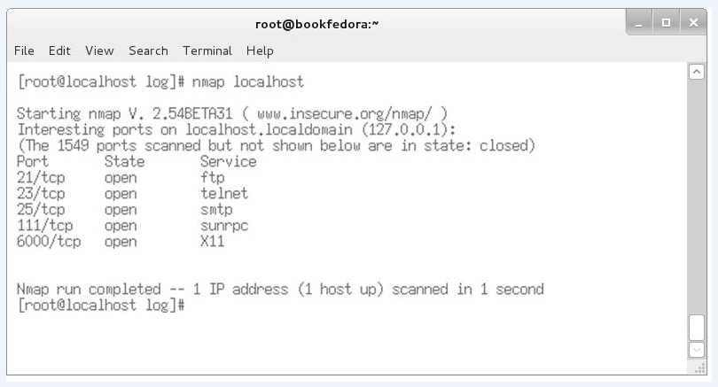
nmap port scanner
This is a port scanner that is used by the network administrator to scan a local computer or other computers internal to the network to determine what network ports and services are being made available to users. An example is provided below.

Slide 25
penetration testing
A penetration test is a way to evaluate the security of the user’s network.
This is accomplished by trying to exploit vulnerabilities in the network. This includes identifying any potential problems with the operating systems, service and applications as well as verifying user adherence to policies.
The penetration test will also validate any protection mechanisms currently in place.

Slide 26
Viruses
A virus is a piece of malicious piece of code that when run on your machine will open a backdoor to the machine, might start a program that attacks other applications. Problems caused by viruses include:
annoyance
clogging up the mail server
denial of service
data loss
open holes for others to access your machine
attack other machines or networks on demand
Worms are a type of computer virus that typically proliferate by themselves.

Slide 27
Viruses
Today, most viruses are exchanged via attachments via email.
For example, a user receives an email that says “Look at this!” trying to coax the user into opening the attachment. If the attachment is opened the user’s computer could possibly become infected.

Slide 28
Steps for Preventing Viruses
Only open attachments that come from known sources. Even this can be a problem because email addresses can be spoofed or the message can come from a known person whose computer has been infected.
Always run a virus check software on the client machines. The virus checker will catch most viruses.
Include e-mail server filters
Keep the virus software up to date

Slide 29
Malware
Nowadays, malware is the term that is being used to encompass all malicious programs intended to harm, disrupt, deny, or gain unauthorized access to a computing system.
Malware is short for malicious software. Viruses and worms are considered a type infectious malware.

Slide 30
Malware
It is important to understand that an intruder can gain network access or even control of your network.
Remember, the information presented in this chapter is an example of what the hacker already knows and what the network administrator needs to know to protect the network.

Slide 31
Denial of Service
Denial of Service (DoS) means that a service is being denied to a computer, network, or network server.
Denial of Service attacks can be on individual machines or the attack can be on the network that connects the machines, or the attack can be on both machines.
You can have denial of service attacks by exploiting software vulnerabilities. For example, a vulnerability in the software can permit a buffer overflow causing the machine to crash. This effects all applications even secure applications.

Slide 32
Prevention
To prevent your network from becoming a host for an attacker, use access lists to only allow specific sources for the network on each of the router’s interfaces.
For example, network B connects to a router. Only packets from Network B are allowed to pass through the router.
The downside of this is it does become a maintenance problem, keeping track of the access lists, and processing access lists is processor intensive and can slow down the throughput of the packets.

Slide 33
Prevention
This does help eliminate spoofed packets. Spoof means the attacker doesn’t use his IP address but will insert an IP address from the victim’s network as the source IP. There is a lot of software on the Internet that enables someone to spoof an IP address.
To prevent yourself from becoming a victim, well … there isn’t a way unless you aren’t connected to any network or any other users.

Slide 34
Distributed Denial of Service
Attackers now use worms to distribute an attack. The attacker will do a port scan and look for an open port that is vulnerable to an attack.
The machine is attacked and distribute their malicious software from the hacked machine. The attacker will repeat this for many victim machines.
Once the software is on the victim machines, the attacker can issue a command or instruction that starts the attack on a specific site.

Slide 35
Distributed Denial of Service
The attack will come from potentially a massive amount of machines that the work has infected.
To stop DDoS attacks, stop intrusions to the network. The bottom line is PREVENT INTRUSIONS.

Slide 36
Introduction
A healthy network starts from within and the most basic component in the network is an individual computer.
An individual computer should have similar protection as its big network. Remember, the fundamental of DDoS is to take control of vulnerable machines and launch the attack.

Slide 37
Introduction
It is not cost effective to guard each computer with dedicated hardware, but there are many security software packages that can help.

Slide 38
Antivirus Software
The first line of defense against the viruses and worms is antivirus software.
It is always recommended that every computer have an antivirus installed. Even though antivirus software cannot give 100% protection, it will protect against most of the viruses out there.

Slide 39
Antivirus Software
Antivirus software uses so-called signatures or definitions to match against the viruses and worms.
Each virus or worm has its own trait and this trait is defined in a signature or a definition.

Slide 40
Antivirus Software
This is why it is important to keep the antivirus software up-to-date.
Most of the antivirus software is launched at the start up of the operating system, and it will try to update its signatures or its definitions at that time.
When a virus is found on the computer, the virus program is usually quarantined or removed.

Slide 41
Network Access Quarantine Control (NAQC)
When a virus is found on the computer, the virus program is usually quarantined or removed.
Network Access Quarantine Control (NAQC) is a Resource Kit tool in Windows Server that allows administrators to prevent remote client computers from connecting to their network with machines that aren't secure.

Slide 42
Personal Firewall
Another software protection that is readily available for a computer is a personal firewall.
Most of the operating systems (Windows, Mac OS, Linux) today are equipped with a personal firewall.
Some of them might not be enabled by default. The personal firewall software is typically based on basic packet filtering inspections where the firewall accepts or denies incoming network traffic based on information contained in the packets’ TCP or IP headers.

Slide 43
Firewalls
Firewalls are used in computer networks for protection against the “network elements” (for example, intrusions, denial of service attacks, etc.).
Access lists (ACLs) are the basic form of firewall protection, although an access list is not stateful and is not by itself a firewall.
Access lists can be configured on a router, on a true dedicated firewall, or on the host computer.

Slide 44
Firewalls
Firewalls allow traffic from inside the network to exit but don’t allow general traffic from the outside to enter the network.
The firewall monitors the data traffic and recognizes where packets are coming from. The firewall will allow packets from the outside to enter the network if they match a request from within the network.
Firewalls are based on three technologies:
• Packet filtering
• Proxy server
• Stateful packet filtering

Slide 45
Packet Filtering
In packet filtering, a limit is placed on the packets that can enter the network.
Packet filtering can also limit information moving from one segment to another. ACLs are used to enable the firewall to accept or deny data packets.
The disadvantages of packet filtering are
• Packets can still enter the network by fragmenting the data packets.
• It is difficult to implement complex ACLs.
• Not all network services can be filtered.

Slide 46
Firewalls
A general rule of thumb is to place the firewall close to the machines you want to protect (for example, the network servers).
Do not assume that the clients on the network will never attack your system. Clients can and will get viruses on their machines.
Create demilitarized zones (DMZ)for the outside servers, which mean that they are moved to a place on the network so that they are isolated. If the machines are compromised, the intruder will have limited access to the inside of the network.

Slide 47
Proxy Server
A proxy server is used by clients to communicate with secure systems using a proxy. The client gets access to the network via the proxy server.
This step is used to authenticate the user, establish the session, and set policies. The client must connect to the proxy server to connect to resources outside the network.
The disadvantages of the proxy server are
• The proxy server can run very slow.
• Adding services can be difficult.
• There can be a potential problem with network failure if the proxy server fails or is corrupted.

Slide 48
Stateful Firewall
In a stateful firewall the inbound and outbound data packets are compared to determine if a connection should be allowed.
This technique is used to protect the inside of the network from the outside world but still allow traffic to go from the inside to the outside and back.
The firewall needs to be stateful to accomplish this.

Slide 49
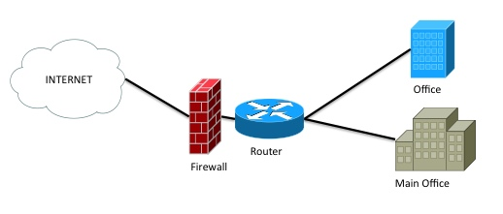
Perimeter Firewall Deployment
A firewall is usually placed in-line between a trusted (internal) network and an untrusted (external) network.
Its primary function is to protect its trusted network.
An example of how a perimeter firewall is often deployed is provided

Slide 50
Firewalls
A big problem with firewalls is that users assume a firewall catches all possible problems.
This is a wrong assumption. The user may be slow to update the patches and fixes to the software.
A firewall is not the end-to-end solution.

Slide 51
Other Security Appliances
There are more security appliances in the market today that help protect the network.
IPS (Intrustion Prevention System) monitors and analyzes the network traffic. In real time, it identifies misuse and anomaly on the network.
The IPS detects a misuse intrusion by matching the network packets with its IPS signatures for known attacks or activities that are classified as bad.
The IPS has an ability to stop or prevent malicious attacks that it detects by interacting with the firewall.

Slide 52
Computer Forensics
A final comment related to security has to do with computer forensics.
Computers are subject to attacks from the “bad guys” and in some cases a crime may have been committed.
In this case the network technician and network administrators must know the proper steps to take to preserve the evidence.
The following are some basic guidelines for the first responders.

Slide 53
Computer Forensics
No action should change data held on a computer or storage media which may be subsequently relied upon in court.
In circumstances where a person finds it necessary to access original data held on a computer or storage media, that person must be competent to do so and be able to give evidence explaining the relevance and the implications of their actions.
An audit trail or other record of all processes applied to computer-based electronic evidence should be created and preserved. An independent third-party should be able to examine those processes and achieve the same result.

Slide 54
Six Stages of
Forensics Examination
Readiness: This includes appropriate training, regular testing and verification of their software and equipment, familiarity with legislation, and ensuring that the on-site acquisition (data extraction) kit is complete and in working order.
Evaluation: The evaluation process includes receiving instructions, clarify the instructions, complete risk analysis and allocate resources.

Slide 55
Six Stages of
Forensics Examination
Collection: This step involves the collection of evidence, interviewing relevant personnel and as the IT administration responsible for the affected system.
Analysis: This step involves the use of the appropriate tools needed to provide thorough and repeatable analysis of the compromised system.

Slide 56
Six Stages of
Forensics Examination
Presentation: In this step the examiner will provide a structured report on the findings of the examination. This will also include addressing key points and any additional information relevant to the investigation.
Review: At this point the examiner should review what went wrong, what was done properly, and what and be learned and improved on based on this incident.

Slide 57
Network Security – Trusted Source
This section examines the concept of a trusted source more closely and explores the concepts and techniques used to identify a trusted source, grant access to a trusted source, and manage accessibility for a trusted source.
Authentication, authorization, and accounting (AAA, pronounced "triple-A") is a framework developed to control access to computing resources, enforce policies, and audit usage.
AAA defines fundamental security building blocks that are the core of network management and security, as its name implies

Slide 58
Authentication
Authentication defines who and what you are. It has to happen first.
Without successful authentication, there will not be authorization and accounting. This process provides a mechanism to identify a valid user.
The most common practice is for a user to supply a username and password. The AAA server checks and verifies the authentication credentials. If the credentials are valid, the user is granted access to the network.
If not, the authentication fails, and the access is denied. A password is a common authentication factor based on something you know. Other authentication factors are what you have (for example, a smart card), what you are like (for example, biometric), and what you do (for example, your handwriting).

Slide 59
Authorization
Authorization defines what are you allowed to do.
As the process after authentication, it governs the privileges and tasks a user can perform after gaining access to a network or system.
Authorization determines whether the user has the authority to perform such tasks or to access certain resources.
As with authentication, authorization is negotiated at the AAA server, which enforces all the user access policies.

Slide 60
Accounting
Accounting defines and keeps track of what you do.
Simply put, this process keeps track and records all the activities by all users.
While these activities can be logged by the AAA server, in most cases, they are carried out as part of the system log (syslog), which records and stores all the events related to the system.

Slide 61
Accounting
It is best practice to send all the accounting activities to a centralized syslog for keeping track of auditing and logging so that the events from all network devices can be monitored, analyzed, and correlated.
The analytics can be used for resource planning, capacity planning, network trend monitoring, and security analysis.

Slide 62
Managing Network Devices
An organization must have a good policy for change management for network device configuration and standard procedures for network maintenance.
To prepare for disaster recovery, an organization must have a backup plan that covers backing up network equipment configurations and archiving for recovery process.

Slide 63
Documentation
Documentation can consist of network drawings and diagrams, asset management, and even vendor documentation.
Having network diagrams helps engineers to visualize and understand how things are connected.
Asset management gives engineers details of their network equipment, from model numbers to software versions and locations.

Slide 64
Unified Threat Management (UTM)
Another security device is UTM (unified threat management), which is an all-in-one solution that integrates a wide range of security features into one appliance.
A UTM appliance may consist of a firewall, a network IDS/IPS, a VPN, a gateway antivirus, gateway anti-spam, load balancing, and content filtering.
This type of appliance is popular in small to medium business where the network is too big and complicated. It helps reduce overhead administrative time and cost.

Slide 65
Wireless Security Issues
The network administrator must be aware of the security issues when configuring a wireless LAN. The fact is, RF (Radio Frequencies) will pass through walls, ceilings, and floors of a building even with low signal power.
Therefore, the assumption should never be made that the wireless data is confined to only the user’s area.
The network administrator must assume that the wireless data can be received by an unintended user. In other words, the use of an unsecured wireless LAN is opening a potential threat to network security.

Slide 66
Wireless Security Issues
A threat to wireless devices includes war driving.
War driving is a term that applies to driving with an antenna out the door connected to a mobile device running Windows or Linux. A wireless card in a PC and a software application are used to detect management packets that come from the wireless access points.
Software is used to determine if wireless security is turned on, the type of access points, and so on. If wireless security is not enabled, then the attacker can attempt to break into the network.
If the wireless security features are not enabled, the packets that come from the access points can be viewed.

Slide 67
WPA
An improvement with wireless security is provided with WPA and WPA2. WPA stands for WiFi Protected Access and it supports the user authentication provided by 802.1x and it replaces WEP as the primary way for securing wireless transfers.
WPA2 is an improved version of WPA. The 802.1x standard enhances wireless security by incorporating authentication of the user.
Cisco Systems uses an 802.1x authentication system called LEAP. In Cisco LEAP, the user must enter a password to access the network. This means that even if the wireless client is being used by an unauthorized user, the password requirement will keep the unauthorized user out of the network.

Slide 68
Some basic guidelines for wireless security are:
make sure the wireless security features are turned on
use firewalls and intrusion detection on your WLAN
improve authentication of the WLAN by incorporating 802.1x features
consider using a third party end-to-end encryption software to protect the data that is intercepted by an unauthorized user
whenever possible, use encrypted services such as SSH and SecureFTP.

Slide 69
Summary
The bottom line is the choice of the level of security will be
based upon multiple factors within the network.
what is the cost-benefit ratio of
increased security
how will incorporating or not incorporating increased
wireless security affect users.
The network administrator and the overall management
will have to make the final decision regarding wireless
security before it is installed and after the network
becomes operational.

