Slide 1
1. Understanding Virtualization

Slide 2
Objectives
Describe virtualization
Understand the three properties of VM
Understand the key trends that drove virtualization
Understand why virtualization is a key technology in the datacenter

Slide 3
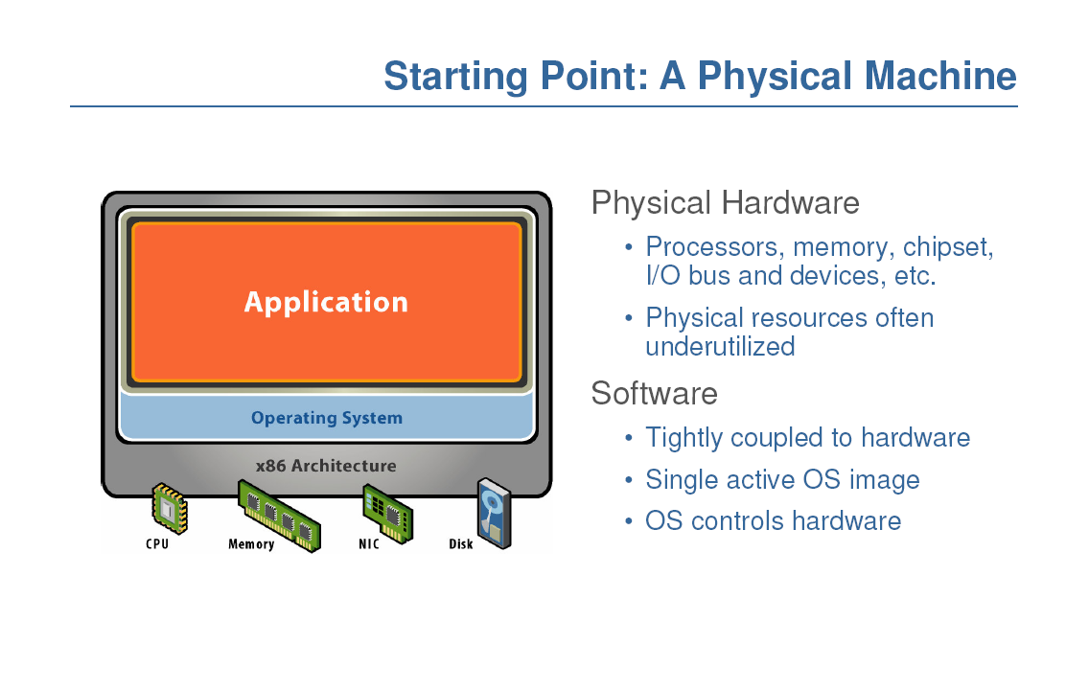

Slide 4
What is Virtualization?
Virtualization is an abstraction layer that decouples the physical hardware from the operating system to deliver greater IT resource utilization and flexibility.
It allows multiple virtual machines (VMs), with heterogeneous operating systems to run in isolation, side-by-side on the same physical machine.
A Virtual Machine Monitor (VMM) is a software that creates a virtualized environment between the computer platform and the VMs.

Slide 5
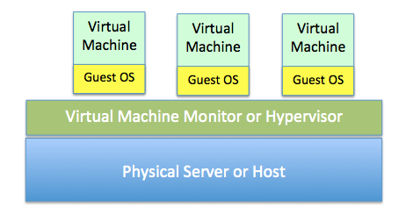

A Virtual Machine Monitor
VMM is called Hypervisor today
A bare-metal hypervisor system does not require an operating system. The hypervisor is the operating system.

Slide 6
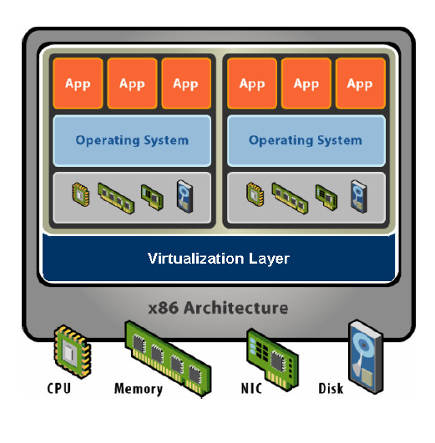

Slide 7
VMM
Decouples hardware and OS
Multiplexes physical hardware across multiple guest VMs
Strong isolation between VMs
Manage physical resources, improves utilization
A Virtual Machine provides the hardware-level abstraction
Virtual hardware: processors, memory, chipset, I/O devices, etc.
Encapsulates all OS and application states

Slide 8
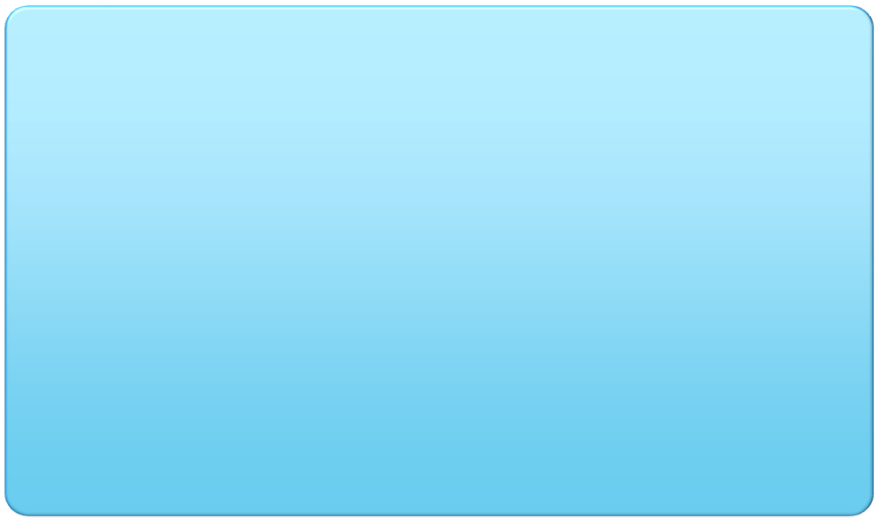
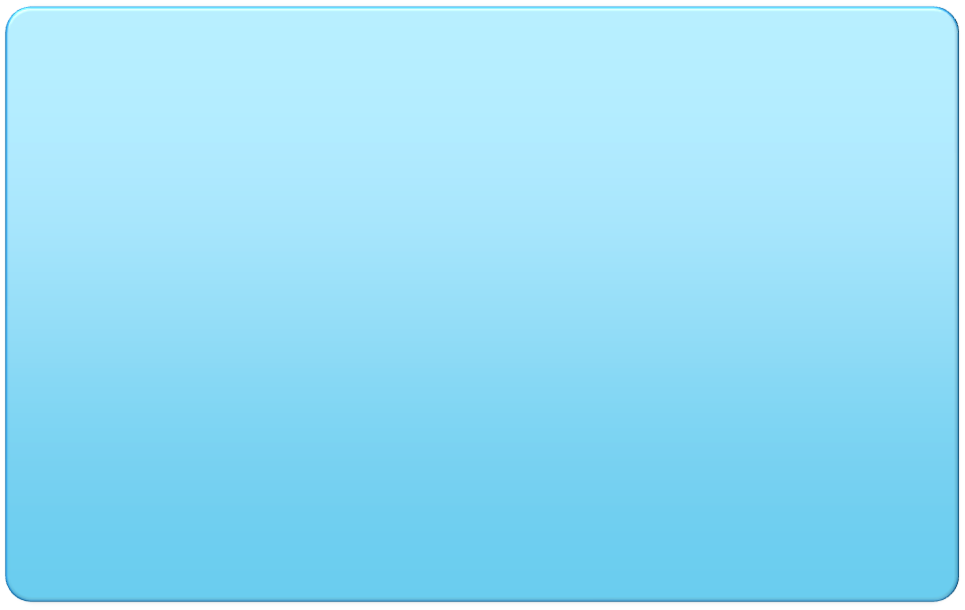
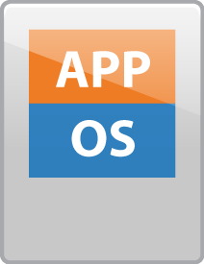




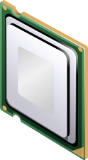
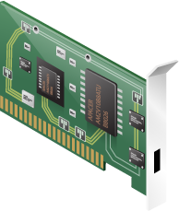
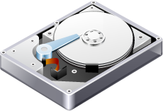
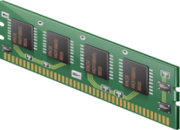
Physical Versus Virtual Architecture
physical architecture
virtual architecture
application
operating system
hypervisor
x86 architecture
x86 architecture

Slide 9
Features
Each virtual machine has its own set of virtual hardware (e.g., RAM, CPU, NIC, etc.) upon which an operating system and applications are loaded.
The operating system sees a consistent, normalized set of hardware regardless of the actual physical hardware components.

Slide 10
VMM Properties
An efficient VMM has three main properties
Isolation or Safety – VMM must have control of system resources
Performance – little or no difference in performance
Fidelity – virtual environment should be identical to physical

Slide 11
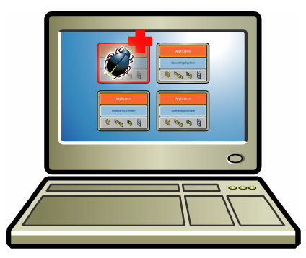
VM Isolation
Secure Multiplexing
Virtual machines are completely isolated from the host machine and other virtual machines.
Run multiple VMs on a single physical host
There is no overlap amongst memory as each Virtual Memory has its own memory space.
Strong Guarantees
Software bugs, crashes, viruses within one VM cannot affect other VMs
Data does not leak across virtual machines.
Performance Isolation
Partition system resources
E.g. VMM controls for reservation, limit, shares
Notes:
MMU – memory management unit

Slide 12
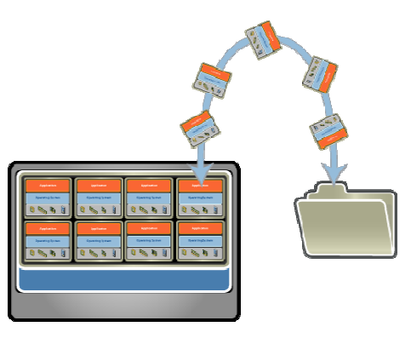
VM Encapsulation
Entire VM is a File
OS, applications, data
Memory and device state
Snapshots and Clones
Capture VM state on the fly and restore to point-in-time
Rapid system provisioning, backup, remote mirroring
Easy Content Distribution
Pre-configured apps, demos

Slide 13
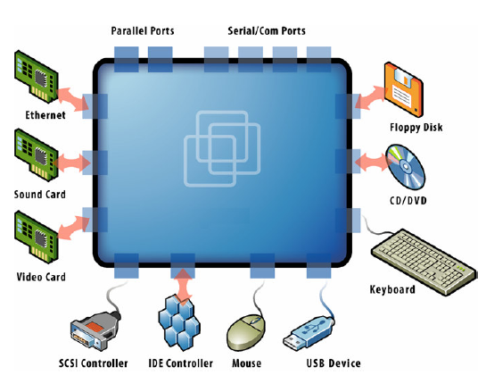
VM Compatibility
Hardware independent
Physical hardware hidden by virtualization layer
Standard virtual hardware exposed to VM
Create once, Run anywhere
No configuration issues
Migrate VMs between hosts
Legacy VM
Run ancient OS on new platform
E.g. DOS VM drives virtual IDE devices, mapped to modern SAN hardware
Notes:
Hardware and low-level systems software change quickly
High-level software (middleware, applications) changes more slowly

Slide 14
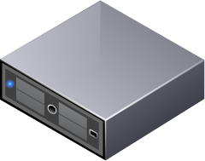
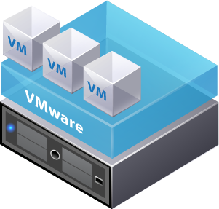
Summary - Why Use Virtual Machines?
Physical machine
Virtual machine
OS is installed on physical machines - difficult to move or copy
Bound to a specific set of hardware components
Often has a short life cycle
Requires personal contact to upgrade hardware
Easy to move and copy:
VMs are encapsulated into files
Independent of physical hardware
Easy to manage:
Isolated from other virtual machines
Insulated from hardware changes
Provides the ability to support legacy applications
Allows servers to be consolidated

Slide 15
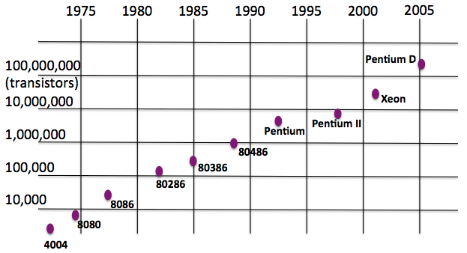
History
Virtualization was first introduced in the 1960s to allow partitioning of large, mainframe hardware.
Rapid growth of PCs
Moore’s Law
Processing power doubles roughly every eighteen months.
Originally, was coined around processing power.
Today applies to many technologies

Slide 16
The Rise of Windows
Companies began using technology to achieve competitive advantages and save money (1970s)
Windows provided commodity platforms that drove down costs and defeated platform lock-in (1980s)
Windows limitations often forced a ‘one server, one application’ policy.

Slide 17
Rapid Datacenter Growth
Windows server growth drove datacenter growth
Datacenter growth drove resource utilization
Power, cooling, cables, square footage, staff, security
Moore’s Law made servers more powerful, but less efficient due to application deployment practices

Slide 18

Non-virtualized Data Centers
Too many servers for too little work
Many servers are running at only 10% or 15% of total processing capacity
High costs and infrastructure needs
Maintenance
Networking
Floor space
Cooling
Power
Disaster Recovery

Slide 19
Challenges in Running Many Physical Servers
When 10-15% of physical server capacity is used, the 1:1 arrangement leaves most computers vastly underused.
The cost of the space and power required to house, run and keep these systems cool can be expensive.
Provisioning physical servers is a time consuming process.
time must be allotted to procure new hardware, place it in the datacenter, install and patch the operating system, and install and configure the required applications.
includes other tasks to integrate the system into the infrastructure. For example, configuring firewall rules, enabling switch ports and provisioning storage.

Slide 20

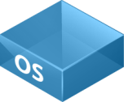
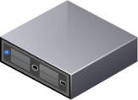
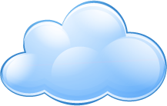
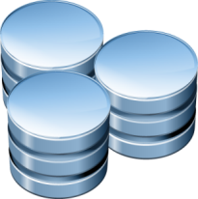
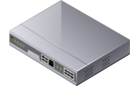
Physical Infrastructure
applications operating system physical host
Fibre Channel
Ethernet
iSCSI storage
NFS storage
Network
Fibre Channel storage

Slide 21
Virtualization
In the 1990s, researchers began to see how virtualization could solve some of the problems associated with the proliferation of less expensive hardware, including underutilization, escalating management costs and vulnerability.

Slide 22
Dynamic Data Center
Virtualization helps us break the “one service per server” model
Consolidate many services into a fewer number of machines when workload is low, reducing costs
Conversely, as demand for a particular service increases, we can shift more virtual machines to run that service
We can build a data center with fewer total resources, since resources are used as needed instead of being dedicated to single services
Notes:
Or sitting and waiting until the next spike in demand

Slide 23
VM workload multiplexing
Separate VM sizing
VM multiplexing
s₃
s₂
s₁
We expect s₃ < s₁ + s_{2.} Benefit of multiplexing !
Multiplex VMs’ workload on same physical server
Aggregate multiple workload. Estimate total capacity need based on aggregated workload
Performance level of each VM be preserved

Slide 24
Why Virtualization Matters
Hypervisors allow multiple virtual servers to run on a single host. In this way fewer servers are used and resources are consumed more efficiently.
Virtualization provides large ROIs by removing cost from the infrastructure.
Not just servers, but desktops and applications can be virtualized.
First commercial x86 hypervisor developed by VMware in 2001. Others soon followed.

Slide 25
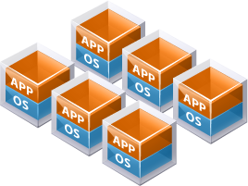
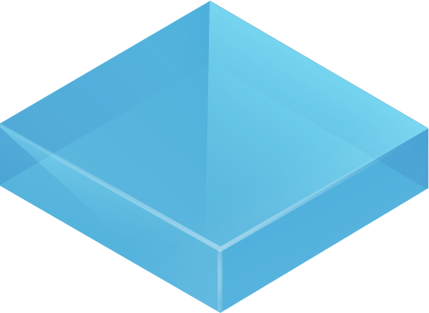
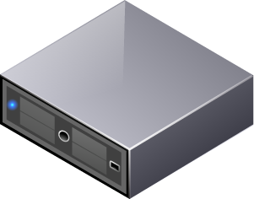
Virtual Infrastructure
virtual machines
hypervisor
VMware ESXi™ host
VMware vSphere
VMware vSphere
VMware vSphere
VMware vSphere
Fibre Channel
Ethernet
iSCSI storage
NFS storage
Network
Fibre Channel storage

Slide 26
Trends that Accelerate Virtualization
Consolidation
Running multiple workloads on a single host
Consolidation Ratio
Number of VMs on 1 physical machine
Increase cost savings and reduce cabling complexity
Reduce datacenter square footage, rack space, power, cooling, cabling, etc.
Containment
Deploying new applications in a virtual infrastructure
New virtual machines can be deployed in very short time
Virtualization first policy
Move from an infrastructure enhancer to business enabler

Slide 27
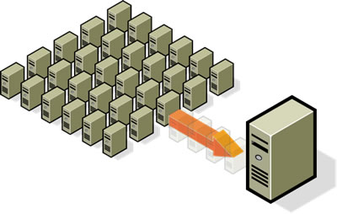
Common Virtualization Uses Today
Reduce costs by consolidating services onto the fewest number of physical machines

Slide 28
Common Virtualization Uses Today
Test and Development
Rapidly provision test and development servers; store libraries of pre-configured test machines
Business Continuity
Reduce cost and complexity by encapsulating entire systems into single files that can be replicated and restored onto any target server
Enterprise Desktop
Secure unmanaged PCs without compromising end-user autonomy by layering a security policy in software around desktop virtual machines.

Slide 29
Common Virtualization Uses Today
Run legacy software on non-legacy hardware
Run multiple operating systems on the same hardware
Create a manageable upgrade path
Manage outages (expected and unexpected) dynamically

Slide 30
Summary
Virtualization optimizes resource usage
Three properties for effective virtualization:
Fidelity, Isolation, Performance
Moore’s Law and the spread of Microsoft Windows
Datacenter virtualization drives down costs, drives better resource efficiencies, and is the platform for the cloud.

