Slide 1
1. Networks and the OSI Model

Slide 2
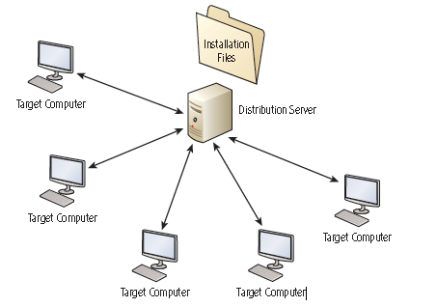
Benefits of Networks
Resource Sharing
Reduced Cost and Easier Installation of Software
Improved Communications
More Workplace Flexibility
Reduced Cost of Peripherals

Slide 3
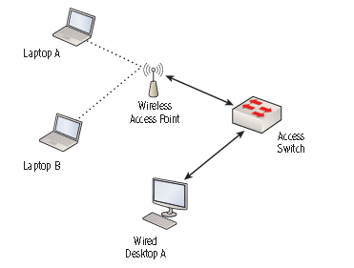
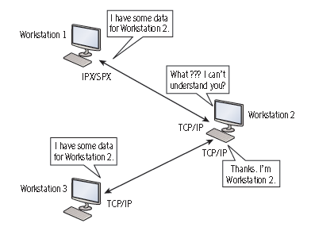
Requirements for a Network
At least two computers
A transmission medium
A communications agreement (protocol)

Slide 4
Classifying Networks
Local Area Networks, LANs
high-speed (~100Mbps to 10 Gbps)
All nodes are located within a small geographical area
Home, office, airport, school campus
A single physical location
Wifi and Ethernet usually

Slide 5
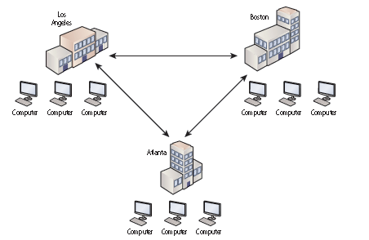
Classifying Networks
Wide Area Network, WAN
network that uses the telecommunications network to interconnect sites that are geographically distributed throughout a region, a country, or the world
Multiprotocol Label Switching (MPLS), Frame Relay, Integrated Services Digital Network (ISDN)

Slide 6
Organizing Network Functions - Protocol “layers”
Networks are complex,
with many “pieces”:
hosts
routers
links of various media
applications
protocols
hardware, software
Question:
Is there any hope of organizing structure of network?

Slide 7
Example: Sending a letter
The letter is written
Put into an envelope
Dropped in mailbox
Letter is carried from mailbox to a local office
Letters are sorted local office and determine which regional offices will use to deliver the letters
Letter is picked up
Remove from envelope
and read
Letter is delivered from post office to home
Destination post office receives the letter and assigns the postman
Letters are carried from source to destination thru’ regional offices
a series of steps

Slide 8
Layering of Letter Sending functionality
Put in envelope
Post letter
Letters collection
Letters sorting
Letter forwarding
Open envelope
Pick up letter
Letters delivery
Letters sorting
Letter forwarding
Envelope
Send/receive
Collect/deliver
Letters sorting
Letter forwarding
l
Letter forwarding
Letter forwarding
departure
local post office
intermediate regional offices
arrive destination post office
layers: each layer implements a service
via its own internal-layer actions
relying on services provided by layer below

Slide 9
Why layering?
dealing with complex systems:
explicit structure allows identification, relationship of complex system’s pieces
layered reference model for discussion
modularization eases maintenance, updating of system
change of implementation of layer’s service transparent to rest of system
e.g., change in collect/deliver procedure doesn’t affect rest of system

Slide 10
Open Systems Interconnection (OSI)
The Open Systems Interconnection (OSI) reference model is used to define how data communication occurs on computer networks.
Developed by the International Organization for Standardization (ISO) in 1984
This model is divided into layers, each of which provides services to the layers above.
These layers are associated with protocols and devices.

Slide 11
Reference Models
Benefits
Encourages standardization
Modularizes the communication process
Standardized communication process
Encourages vendors to build on each other’s developments through use of a common framework
Speeds development

Slide 12
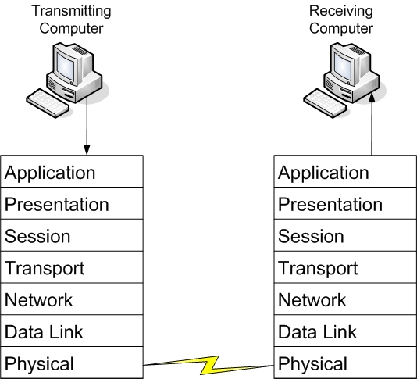
OSI Model Layers

Slide 13
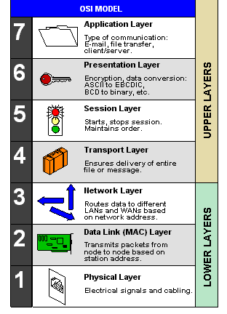
OSI Reference Model

Slide 14
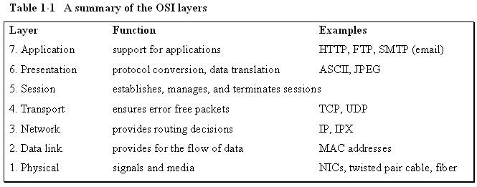
A summary of the OSI Layers

Slide 15
Layer 1 – Physical Layer
This is the physical and electrical medium for data transfer.
Provides the electrical and mechanical connection to the network
It includes but is not limited to cables (e.g. UTP, fiber), connectors (RJ45), patch panels, and network interface cards (NIC).
Concepts related to the physical layer include topologies, analog versus digital encoding, bit synchronization, baseband versus broadband, multiplexing, etc.
The unit of measurement used on this layer is bits.

Slide 16
Networking Standards
Networking standards such as 100BASE-T are based on the physical layer.
The 100 in 100BASE-T stands for 100 Mbps,
The BASE means baseband
The T stands for twisted-pair cabling.
Baseband refers to the fact that all computers on the LAN share the same channel or frequency to transmit data, in this case 100 MHz.
Conversely, broadband means that there are multiple channels that can be utilized by the communications system.

Slide 17
Layer 2 – Data Link Layer (DLL)
DLL is usually implemented on network interface cards and network devices such as switches.
Data transfer between neighboring network elements
Ethernet, 802.11 (WiFi),
This layer establishes, maintains, and decides how transfer is accomplished over the physical layer.
It provides the Media Access Control (MAC) service; hence it is also known as the MAC layer
Which device is allowed to transmit at a given moment, e.g. CSMA/CD (Carrier Sense Multiple Access with Collision Detection) for Ethernet
It also provides error checking service and flow control for transmission over the physical layer.

Slide 18
Layer 2 – Data Link Layer (DLL)
To transmit data to a neighboring device, it does so through the use of physical addresses
the address that is burned into the ROM of the NIC
also known as the MAC address
The unit of measurement used on this layer is frames.

Slide 19
Media Access Control Address
In an Ethernet network, every network adapter must have a unique Media Access Control (MAC) address.
The MAC address is a unique identifier assigned to network adapters by the manufacturer.
The MAC address for LAN is 6 bytes (48 bits) in length.
The address is displayed in 12 hexadecimal codes (e.g. 00:10:A4:13:99:2E)
The first 6 hexadecimal codes are used to indicate the vendor of the network interface, also called the Organizationally Unique Identifier (OUI)
the last 6 hexadecimal values are unique numbers assigned by the vendor.

Slide 20
Layer 2 Switches
A layer 2 switch is the most common type of switch used on a LAN.
Used to connect all devices within a network
These switches use the MAC address of each host computer’s network adapter when deciding where to direct frames of data
Every port on the switch is mapped to the MAC address(es) of the computer(s) that physically connects to it.

Slide 21
Layer 3 – Network Layer
This layer is dedicated to routing data from source to destination between different networks.
Devices that exist on the network layer are routers.
Routers provide connection between networks
Routing protocols are used to determine the best path from source to destination: e.g. RIP, OSPF, BGP
Protocols used for this layers include IP and IPX
Here, we are getting into the logical addressing of hosts.
The address changes according to the network that the device is presently connected to
The unit of measurement used on this layer is packets.
Notes:
IPX was used in Novell network.

Slide 22
Layer 3 Switches
Devices on layer 3 are known as Routers; however, recent technology has implemented the routers use for intranet in a similar way as layer 2 switch, and those routers are referred to as layer 3 switch
A layer 3 switch differs from a layer 2 switch in that it determines paths for data using logical addressing (IP addresses) instead of physical addressing (MAC addresses).
Layer 3 switches forward packets, whereas layer 2 switches forward frames.

Slide 23
Communications Subnetwork
Layers 1 through 3 of OSI model form the basis of the communication subnetwork
Data are sent between neighboring devices (node-to-node)
Regardless of what type of data transmission occurs in a computer network, the communication subnetwork will be employed.

Slide 24
Layer 4 – Transport Layer
This layer concerns with the end-to-end (host-to-host) data transmission
transmits messages between hosts through logical addressing.
Shields the upper layers from transport implementation details.
The protocols provide services such as break up messages, and send them through the subnet
Handles end-to-end flow control, error checking and recovery
When reliable service is provided, the protocols will ensure correct reassembly at the receiving end, making sure there are no duplicates or lost messages.

Slide 25
TCP and UDP
Two main transport protocols on Internet are the Transmission Control Protocol (TCP), which is a connection-oriented protocol providing reliable service, and the User Datagram Protocol (UDP), which is connectionless.
An example of an application that uses TCP is a web browser, and an example of an application that uses UDP is streaming media.
The unit of measurement used on this layer is sometimes referred to as segments or messages. All layers above this one use the terms “data” and “messages.”

Slide 26
Connection Oriented Communications
Connection-oriented (also known as CO mode) communications require that both end devices involved in the communication establish an end-to-end logical connection before data can be sent between the two.
These connection-oriented systems are often considered reliable network services.
If an individual packet is not delivered in a timely manner, it is resent
i.e. Sending device needs to buffer up any data sent until an acknowledgement is received from the receiving device

Slide 27
Connectionless Communications
In connectionless communications (CL mode), no end-to-end connection is necessary before data is sent.
Every packet that is sent has the destination address located in its header.
This is sufficient to move independent packets, such as in the previously mentioned streaming media.
But if a packet is lost, it will not be resent.

Slide 28
Transport Layer
Port numbers are used to identify the applications on the computer

Slide 29
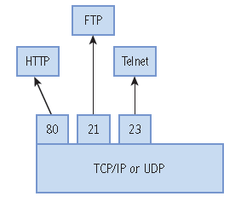
TCP and UDP

Slide 30
Ports
Ports act as logical communications endpoints for computers.
There are a total of 65,536 (2¹⁶)ports, numbering between 0 and 65,535.
They are defined by the Internet Assigned Numbers Authority or IANA and divided into categories

Slide 31
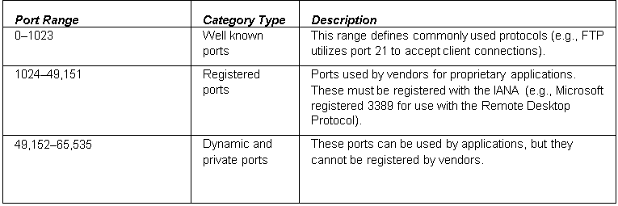
Ports

Slide 32
Ports
Inbound ports
Used by servers to accept incoming service requests
Outbound ports
Used by client computers and are assigned dynamically by the operating system

Slide 33
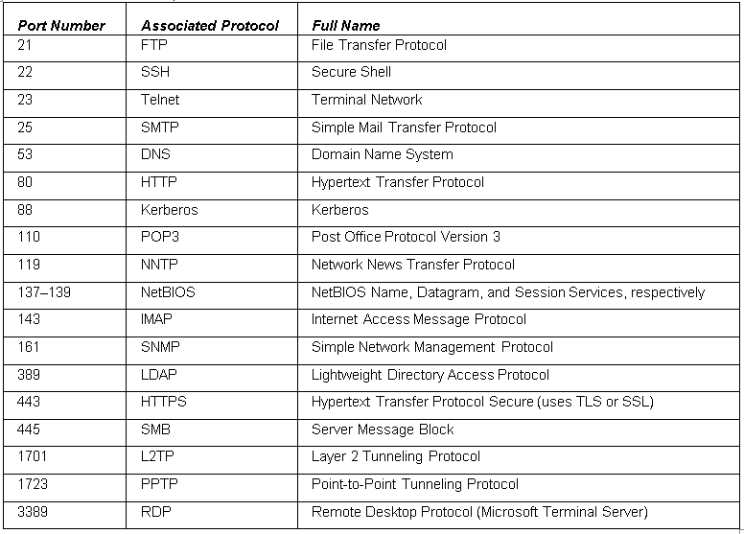
Ports

Slide 34
Layer 5 – Session Layer
This layer establishes, maintains, and terminates communications sessions between upper layer applications — for example, when you log on and log off.

Slide 35
Layer 6 – Presentation Layer
This layer translates the data format from sender to receiver that may be used.
Concepts include code conversion, data compression, and file encryption.
E.g. translate between
ASCII and EBCDIC (text)
Jpeg, Gif and TIFF (image)
Mpeg and QuickTime (sound/video)

Slide 36
Layer 7 – Application Layer
This layer provides network services to user applications and is where message begins.
End-user protocols such as FTP, SMTP,HTTP, Telnet, and RAS work at this layer.
This layer is not the application itself, but the protocols that are initiated by this layer.
Notes:
RAS – remote access service

Slide 37
TCP Model
The TCP/IP (or TCP) model is similar to the OSI model.
Most widely used nowadays.
It is often used by software manufacturers who are not as concerned with how information is sent over physical media, or how the data link is actually made.
This model is composed of only four layers.

Slide 38
TCP Model
Layer 1: Data link layer (also simply known as the link or network access layer)
Layer 2: Network layer (also known as the Internet layer)
Layer 3: Transport layer
Layer 4: Application layer
The OSI physical layer is skipped altogether, and the application layer comprises the OSI application, presentation, and session layers.

Slide 39
OSI Model vs. TCP/IP Protocol Suite
OSI Model Layer Number | OSI Model Layer | TCP/IP Protocol Suite Layer | Protocol Data Unit | Network Device
7 | Application | Application | Data
6 | Presentation
5 | Session
4 | Transport | Transport | Segment
3 | Network | Internet | Packet (or Datagram) | Multilayer Switch or Router
2 | Data Link | Link* (or Network Access) | Frame | Layer 2 Switch or Bridge
1 | Physical |  | Bits | Hub

Slide 40

Encapsulation
source
message
M
application
transport
network
link
physical
segment
H_{t}
M
H_{t}
datagram
H_{n}
H_{n}
H_{t}
M
frame
H_{l}
H_{n}
H_{t}
M
link
physical
switch
destination
H_{n}
H_{t}
M
network
link
physical
M
application
transport
network
link
physical
H_{l}
H_{n}
H_{t}
M
H_{n}
H_{t}
M
H_{t}
M
H_{n}
H_{t}
M
H_{l}
H_{n}
H_{t}
M
router

Slide 41
Summary
To understand the OSI model by defining each of the layers from a theory perspective and with hands-on labs.
To be able to separate the functions of the lower levels of the OSI, or the communications subnetwork, from the upper levels where message creation begins.
To understand the differences between layer 2 and layer 3 switches, and to gain a basic understanding of how they operate.
To differentiate between the OSI model and the TCP model.

