Slide 1
2. Understanding Local Area Networking

Slide 2
Protocol and Topology
Local area networks are defined in terms of the protocol and the topology used for accessing the network.
The networking protocol is the set of rules established for the users to gain control of the network to exchange information.
The topology is the network architecture used to interconnect the networking equipment.
It defines the physical connections of hosts in a computer network.

Slide 3
Network Topology
There are several types of physical topologies including:
Bus
Ring
Star
Mesh
Tree

Slide 4
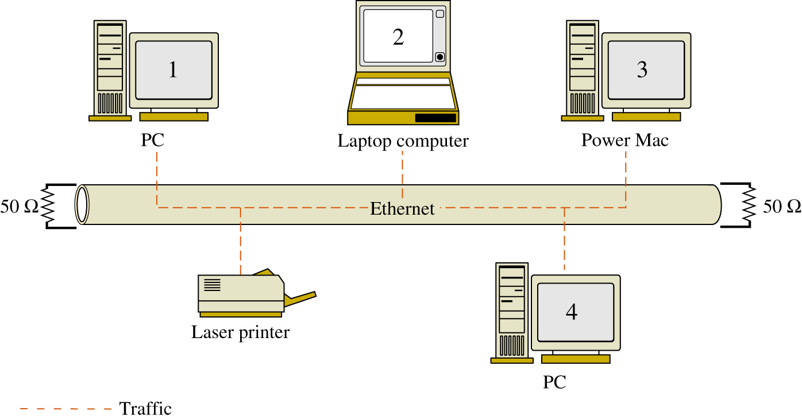
Bus Topology
network data traffic is carried over a common data link

Slide 5
Bus Topology
Advantages
Easy to implement and design
Requires less cable than other topologies
Inexpensive
Disadvantages
If the cable is broken at any point, the entire network is down
Terminators are required at both ends.
Locating breaks is difficult.
Limits on cable length and number of nodes.
Performance degradation occurs under traffic load.
Introducing or connecting new devices takes the network down.

Slide 6
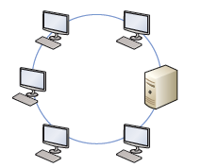
Ring Topology
In a LAN environment, each computer is connected to the network using a closed loop.
Packets move in the same direction.
Used by Token Ring and FDDI.
Advantages
Performs better than a bus under load
Prevents collisions
Can be larger than a bus
Disadvantages
Any break brings the entire network is down.
Locating breaks is difficult.
Introducing or connecting new devices takes the network down.

Slide 7
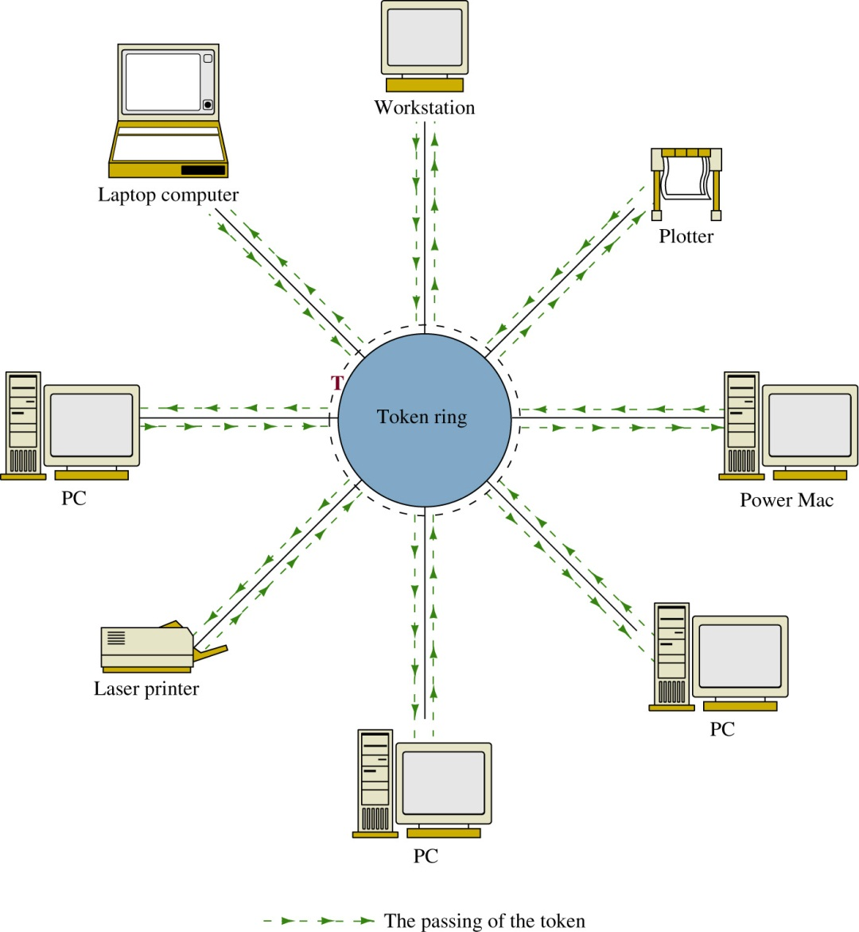
Token-Ring (IEEE 802.5)
Advantage:
Deterministic – meaning that the networking devices gain control of the network within a fixed time interval.

Slide 8
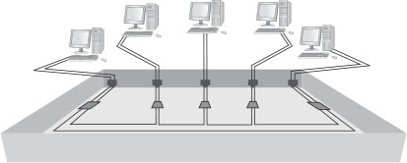
Note: For Token Ring, a physical star implements the logical ring inside the central device’s electronics
Notes:
Logical Topologies
A logical ring using a physical star implements the ring inside the central device’s electronics, which is a MAU in the token ring technology

Slide 9
Star Topology
Most widely used topology nowadays
Each computer is individually wired to a central connecting device (hub, switch or SOHO router) with twisted-pair cabling.
The networking devices do not share data connections to/from the central hub or switch
A hub broadcasts all data traffic to all networking devices connected to its data ports.

Slide 10
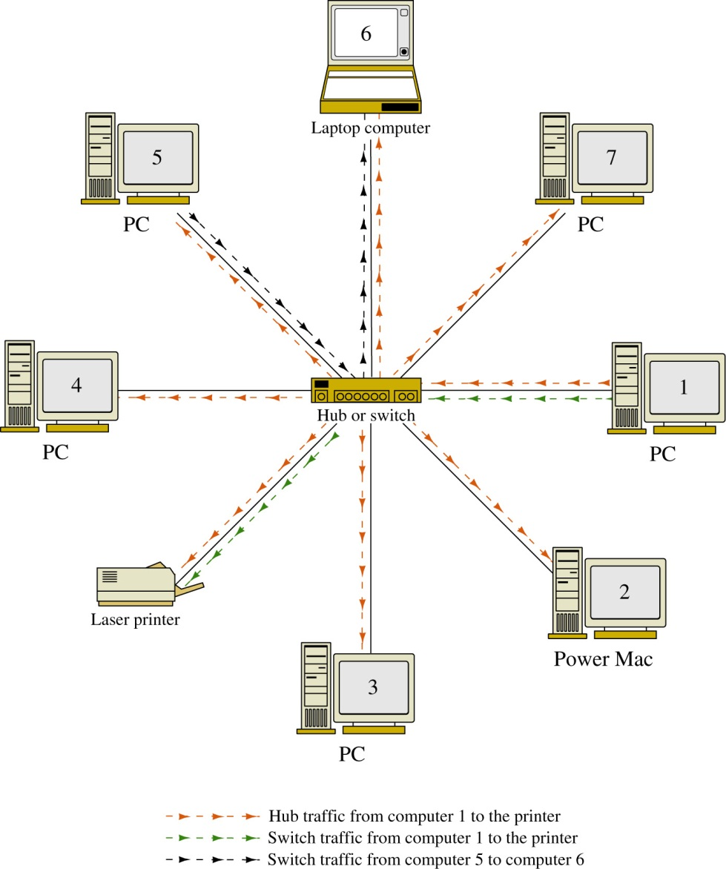
Star Topology
Switch (or Hub)
Multi-port Repeater
Twisted Pair Cable

Slide 11
Star Topology
Advantages
Better performance than bus or ring
If a cable goes bad, only the device connected to it is affected.
Can support larger numbers than the bus.
Easy to troubleshoot.
No network disruption when adding or removing devices.
Disadvantages
Single point of failure at the hub or switch
Performance dependent on central device
Size limited by connections on the hub or switch

Slide 12
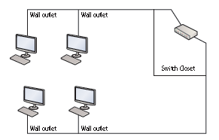
Star implementation

Slide 13
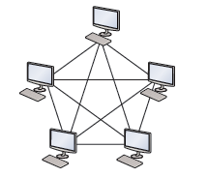
Mesh Topology
Every computer connects to every other computer
No central connecting device is needed
Redundant data traffic paths
Advantages
Best fault tolerance
No disruption when adding or removing devices
Disadvantages
Expensive to implement
High maintenance cost
Limitation on number of devices in each mesh

Slide 14
Local Area Network (LAN)
A local area network (LAN) is a group of devices that are confined to a small geographic area, usually one building.
LAN requires computers with network adapters, central connecting devices, and some type of medium to tie it all together, be it cabled or wireless connections
Networks are used to exchange data.

Slide 15
Token Ring (IEEE 802.5)
A Token Ring network sends data logically in a ring fashion, meaning that a token goes to each computer, one at a time, and continues on in cycles.
However, Token Ring computers are physically connected in a star fashion.
Namely, all computers in a Token Ring network are connected to a central connecting device known as a Multistation Access Unit (MAU or MSAU).

Slide 16
Ethernet (IEEE 802.3)
Ethernet is a set of rules that govern the transmission of data between network adapters hubs, switches, and other devices.
All network adapters and central connecting devices must be compatible with Ethernet in order to communicate with each other.
Ethernet is the de facto standard and has the largest share of networks in place today.
Ethernet is standardized by the Institute of Electrical and Electronics Engineers (IEEE) as 802.3.

Slide 17
Ethernet
It specifies the Medium Access Control protocol – CSMA/CD (Carrier Sense Multiple Access with Collision Detection)
Note that WiFi uses CSMA/CA (collision avoidance) instead
All stations ready to transmit will sense the carrier before transmission
If the carrier is idle, i.e. the station believes that no other is transmitting, it will start its transmission
The station will keep sensing the carrier while transmitting. If collision is detected, it will stop its transmission immediately.

Slide 18
Frames
Computers on Ethernet networks communicate by sending Ethernet frames.
A frame is a group of bytes packaged by a network adapter for transmission across the network
These frames are created and reside on Layer 2 of the OSI model
By default, computers on Ethernet networks all share a single channel. Because of this, only one computer can transmit at a time.
However, newer networks with more advanced switches transcend this limitation.

Slide 19
The Ethernet Frame
Preamble – an alternating pattern of 1’s and 0’s used for synchronization

Slide 20
The Ethernet Frame
Start Frame Delimiter – a binary 8-bit sequence of
1 0 1 0 1 0 1 1 that indicates the start of the frame

Slide 21
The Ethernet Frame
Destination MAC Address and Source MAC Address - - Each computer has an Ethernet network interface card (NIC) that has a unique media access control (MAC) address associated with it.
- The MAC address is 6 bytes (12 hex characters) in length.

Slide 22
The Ethernet Frame
Length / Type - an indication of the number of bytes in the data field if this value is less than 1500.
If this number is greater than 1500, it indicates the type of data format, for example IP or IPX.

Slide 23
The Ethernet Frame
This is the data being transferred from the source to the destination and destination to the source.

Slide 24
The Ethernet Frame
This is the data being transferred from the source to the destination and destination to the source.

Slide 25
The Ethernet Frame
A field used to bring the total number of bytes up to the minimum of 64 if the data field is less than 64 bytes.

Slide 26
The Ethernet Frame
A 4-byte CRC (cyclic redundancy check) value used for error detection. The CRC is performed on the characters from the destination MAC address through the Pad fields. If an error is detected, the receiver will discard the frame.

Slide 27
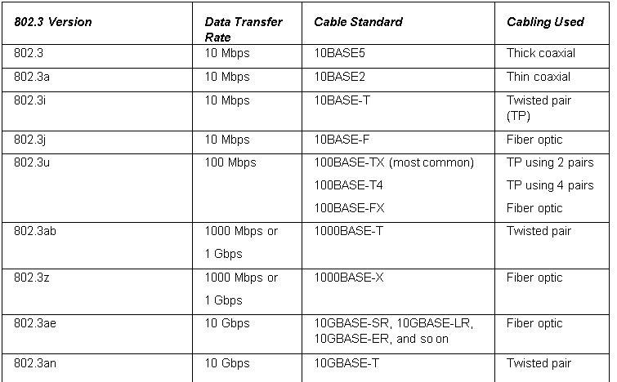
802.3 Ethernet Standards
multiple access with collision avoidance (CSMA/CA)

Slide 28
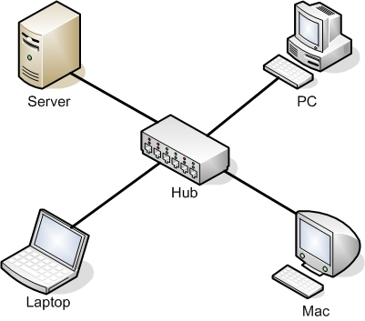
Hub
A hub is the most basic of central connecting devices.
It connects each of the networked computers, known as hosts, to one another by way of copper-based cables.
Any host that sends data must first send that data to the hub, where it is amplified and broadcast to the rest of the network.
When two more stations transmit at the same time, their data frames will collide.

Slide 29
Bridge
A bridge is used in computer networks to interconnect two LAN segments.
A segment is a section of a network separated by bridges, switches, and routers.
Computers on a LAN segment are interconnected using a centralized device such as hub.
Bridge is usually used to interconnect two LANs running the same type of protocol (e.g. Ethernet) and is called a transparent bridge.
Bridges are also used to interconnect two LANs that are operating two different networking protocols. For example LAN A could be an Ethernet LAN and LAN B could be a token-ring.

Slide 30
Bridge is a layer 2 device, i.e. it uses the MAC address information to make decisions regarding forwarding data packets.
Only the data that needs to be sent to across the bridge to the adjacent network segment is forwarded.
E.g. LAN A connects to port 1 of the bridge and LAN B connects to port 2 on the bridge. This creates two segments.
Port1
Bridge
Port 2
Segment
LAN A
Computer 1
Computer 2
Computer 3
Computer 4
LAN B
Computer 5
Computer 6
Computer 7

Slide 31
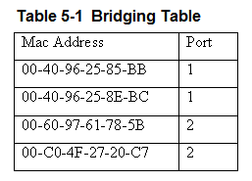
The bridges use the MAC addresses to build a bridging table of MAC addresses and port locations for hosts connected to the bridge ports.
The source MAC address is stored into the bridge table as soon as a host transmits a data packet on the LAN.
An association indicates that the destination MAC address is connected to one of the ports on the bridge.
A bridge only forwards data packets when there is an association - used to isolate data traffic in each segment.

Slide 32
Bridge Table – Expiration Counter
The MAC address entries stored in a bridge table are temporary. Each MAC address entry to the bridge table remains active as long as there is periodic data traffic activity from that host on its port.
However, an entry into the table is deleted if the port becomes inactive. In other words, the entries stored into the table will have a limited lifetime.
An expiration timer will commence once the MAC address is entered into the bridge table. The lifetime for the entry is renewed by new data traffic by the computer and the MAC address is reentered.
Note: Hubs and bridges are in general replaced by switches nowadays

Slide 33
Switch
A layer 2 switch is the most common type of central connecting devices used on a LAN.
An improved network technology that minimizing data collisions, and maximizing the use of a LAN’s bandwidth
improves the efficiency of the data transfer in the network.
Connect all devices on the same LAN segment
use the MAC address of each host computer’s network adapter when deciding where to direct frames of data
Every port on the switch is mapped to the MAC address(es) of the computer(s) that physically connects to it.
Operates in a similar way as bridge

Slide 34
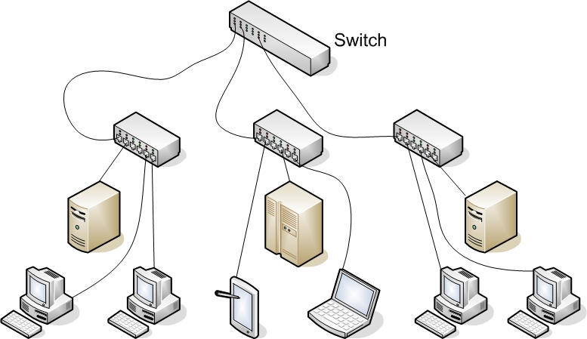
Switch

Slide 35
Switch
The switch monitors data traffic on its ports and extracts the MAC address from the headers of Ethernet packets in the same way the bridge does to build a table of MAC addresses for the devices connected to its ports.
This information is stored in CAM – Content Addressable Memory.
The switch has multiple ports similar to the hub and can switch in a data connection from any port to any other port similar to the bridge.
This is why the switch is sometimes called a multiport bridge. The switch minimizes traffic congestion and isolates data traffic in the LAN.
The use of the switch enables simultaneous direct data connections for multiple pairs of hosts connected to the network.
Each switch connection provides a link with minimal collisions and therefore maximum use of the LAN’s bandwidth.

Slide 36
CAM – Content Addressable Memory
The extracted MAC addresses are then used by the switch to map a direct communication between two network devices connected to its ports.
The MAC address and port information remain in CAM as long as the device connected to the switch port remains active.
A time-stamp establishes the time when the mapping of the MAC address to a switch port is established.
switches limit the amount of time address and port information are stored in CAM. This is called aging time.

Slide 37
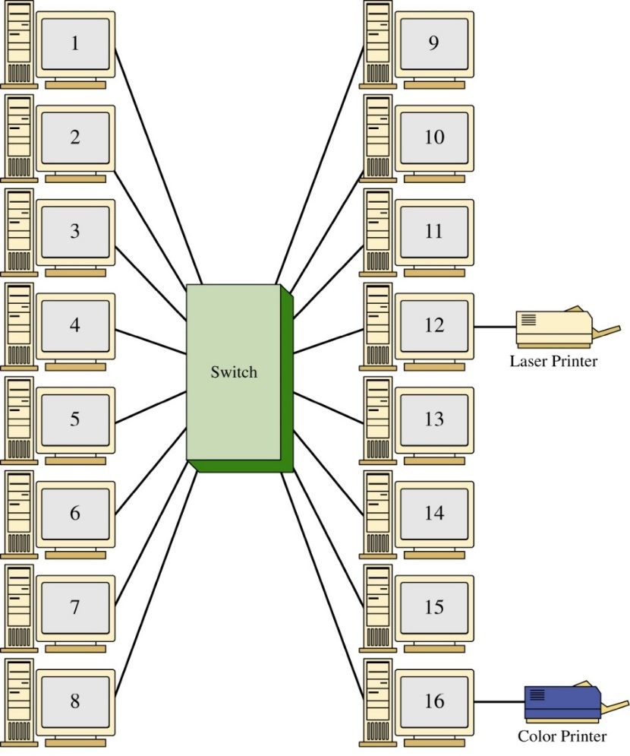
Each host has a direct connection to the switch
when a link is established between the two hosts, their link is isolated from any other data traffic.
However, the exception to this is when broadcast or multicast messages are sent in the LAN
the message is sent to all devices connected to the LAN.
In a broadcast domain, any network broadcast sent over the network will be seen by all devices in the same network.
Broadcasts within a LAN will be passed by switches

Slide 38
Switches
The benefits of a using a network switch include
less network congestion, faster data transfers, and excellent manageability.
Main advantage: data traffic within a LAN is isolated.
The term for this is isolating the collision domains where the data traffic from one part of the network is isolated from the other networking devices.
A direct benefit is there will be an increase in the data transfer speed and throughput.
This is due to the fact that the LAN bandwidth is not being shared and chances of data collisions are minimized.
As a result, the LAN will exhibit faster data transfers and latency within the LAN will be significantly reduced. Reduced latency means that the data packets will arrive at the destination more quickly.

Slide 39
Router
Router is used to interconnect computer networks
Forward packets based on the destination network address
The router is a layer 3 device in the OSI model, which means the router uses the network address (layer 3 addressing such as IP address) to make routing decisions regarding forwarding the data packets.
The network address is also called a logical address rather than a physical address such as the MAC address.
The logical address describes the IP address location of the network and the address location of the host in the network.

Slide 40
Router
Route data packets entering or exiting the LAN.
differs from the layer 2 switch which use the Ethernet address for making decisions regarding forwarding data packets and only know how to forward data to hosts physically connected to their ports.
Routers are used to interconnect LANs (subnets) in a campus network.
Routers also interconnect networks around the country and the world.

Slide 41
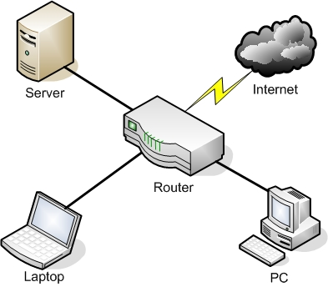
SOHO/Home Router
A SOHO router combines the functions of a switch and a router
it also has a link to the Internet, thereby allowing the hosts to send data to and receive data from computers on the Internet.
This communications link between the router and the Internet is where the LAN ends.

Slide 42
Network Adapter and RJ45 Patch Cable
A network adapter, also known as a network interface card or NIC, is the device that enables you to send and receive data to and from your computer.
An adapter can connect to the network by cable (wired) or by air (wireless).
RJ45 port (or an 8P8C) is the most common type of network adapter port, allowing the adapter to connect to most of today’s wired networks.
Notes:
This adapter might be integrated into the motherboard or act as a separate device that connects to a PCI slot or perhaps a PC card slot or USB port.

Slide 43
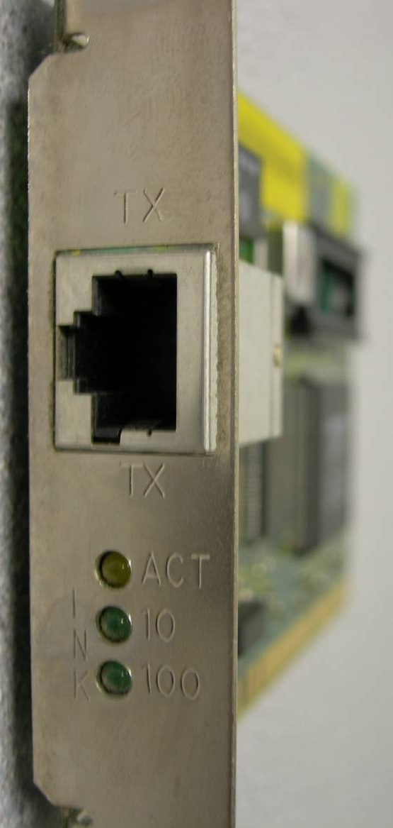
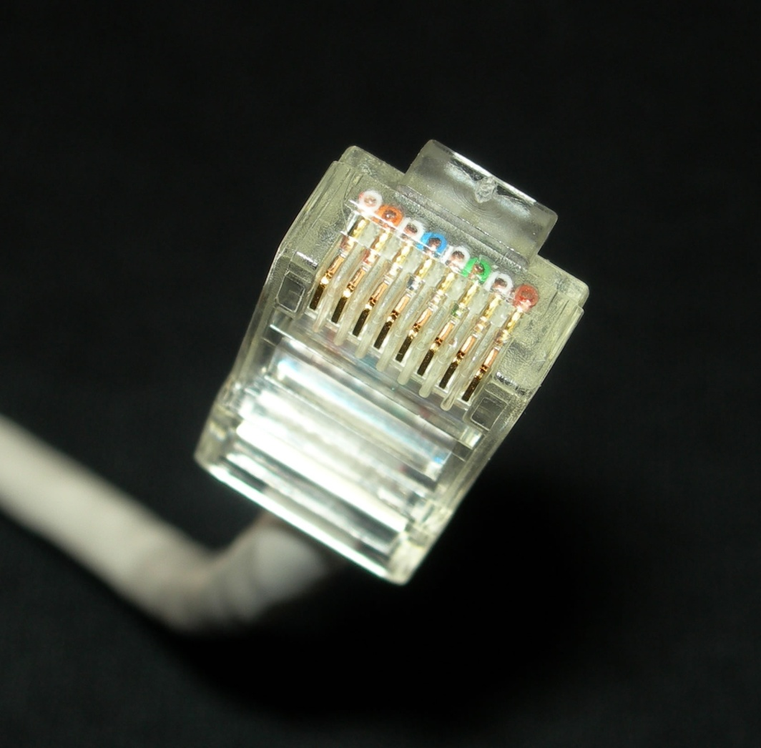
Network Adapter and RJ45 Patch Cable

Slide 44
Serial Data Transfer
Generally, when data is transferred on a LAN, it is sent in a serial fashion over twisted-pair cabling.
Serial data transfer means the transfer of one bit at a time—in other words, transfer in a single-bit stream.

Slide 45
Data Transfer Rate
Data transfer rate, otherwise known as bit rate defines the maximum bits per second (bps) that can be transmitted over a network.
As mentioned, this value is rated in bits, and it is signified with a lowercase b (for example, 10 Mbps).
The lowercase b helps differentiate this amount from data that is stored on a hard drive, which uses an upper case B that stands for bytes (for example 10 MB).

Slide 46
Types of Transfers
Broadcast has data sent to every other host on the network.
Unicast has data sent to one host only.
Multicast has data sent to everyone in a group.
Anycast has data sent to any one of the members in a group.

Slide 47
IP Address
Today, every computer and many other devices have such an address.
An IP address allows each computer to send and receive information back and forth in an orderly and efficient manner.
An IP address is an logical address that identifies a computer and the network it lives on.
A typical example of an IPv4 address would be 192.168.1.1.

Slide 48
IP Address
Every IP address is broken down into two parts: the network portion (in this example 192.168.1), which is the network that your computer is a member of, and the host portion, which is the individual number of your computer that differentiates your computer from any others on the network.
In this case, the host portion is .1.

Slide 49
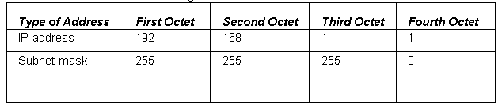
Subnet Mask
The subnet mask is a group of four numbers that identifies the network portion of an IP address.
All of the 255s in a subnet mask collectively refer to the network portion, whereas the 0s refer to the host portion.

Slide 50
Host
IP addresses are usually applied to your network adapter, but they can also be applied to other devices like routers, and so on.
The fact that a device or computer has an IP address is what makes it a host.

Slide 51
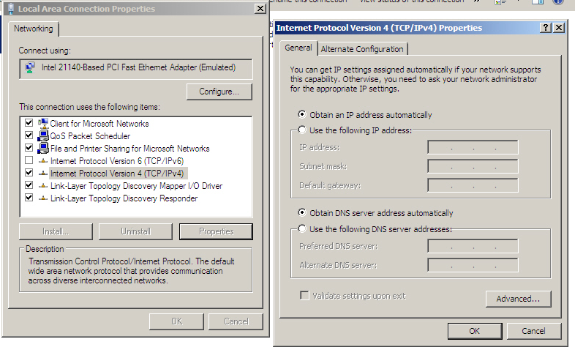
IP Address

Slide 52
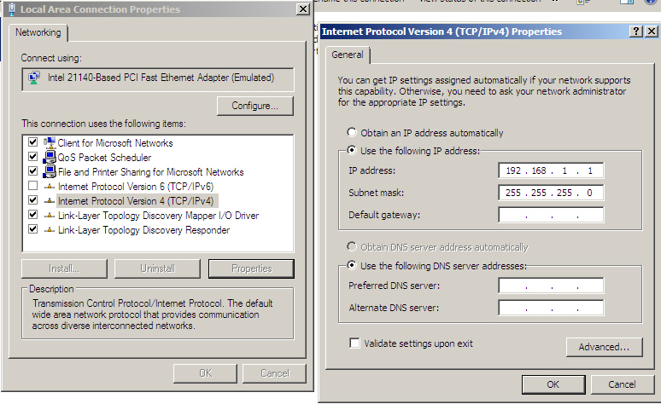
IP Address

Slide 53
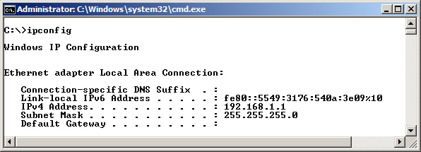
IPConfig Command
IPConfig command shows IP configuration information.

Slide 54
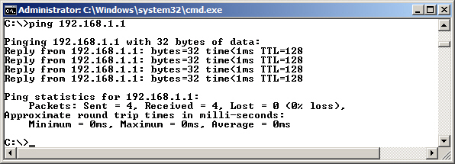
Ping Command
Ping command is used to test network connectivity between two hosts.

Slide 55
Ping Command
ping loopback
ping localhost
ping 127.0.0.1

Slide 56
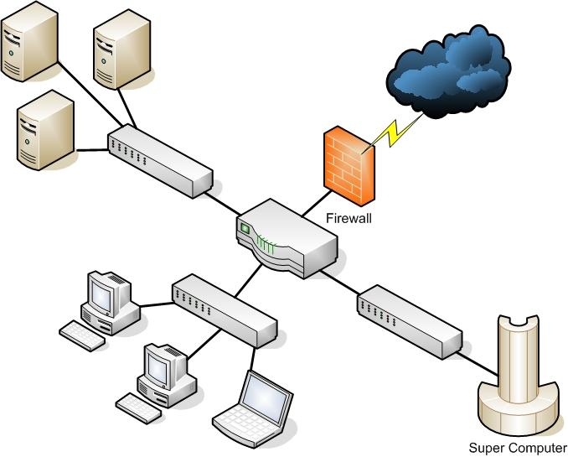
Wired LAN
Computers and other devices are wired using copper-based twisted-pair cables.

Slide 57
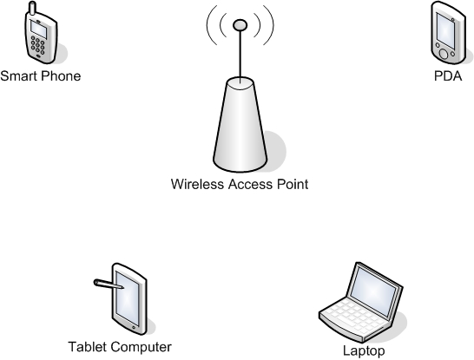
Wireless Local Area Network (WLAN)
A wireless local area network (WLAN) has many advantages, the most obvious of which is the ability to roam.

Slide 58
Wireless Access Point
The wireless access point (WAP) acts as the central connecting device for the network.
Today, such networks can consist of many types of devices other than traditional PCs, including smart phones, PDAs, tablet computers, and micro computers.
Not to mention the fact that PCs and laptops equipped with wireless network adapters can connect to these networks as well.

Slide 59
Perimeter network
A perimeter network (also known as a demilitarized zone or DMZ) is a small network that is set up separately from a company’s private LAN and the Internet.
It is called a perimeter network because it is usually on the edge of the LAN, but DMZ has become a much more popular term

Slide 60
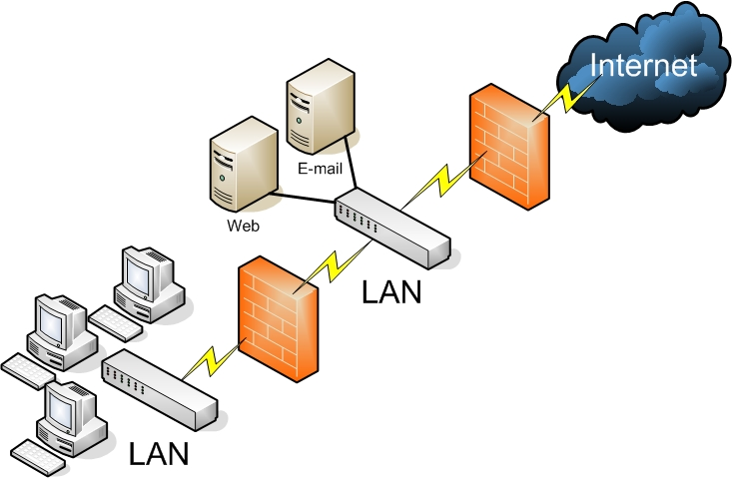
Back-to-Back Configuration

Slide 61
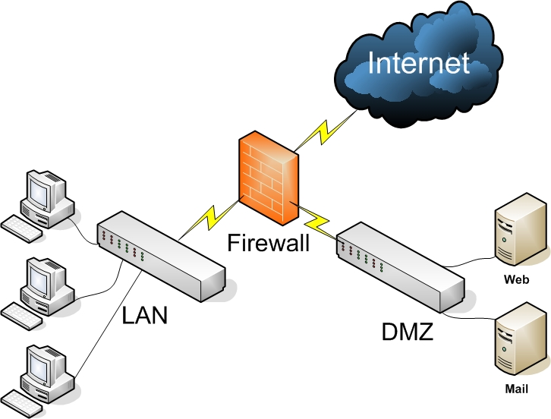
3-Leg Perimeter Configuration

Slide 62
Summary
To understand local area networks (LANs), including but not limited to LAN elements, design, perimeter networks, IP addressing, and LAN types.
To understand network topologies and access methods, including topologies such as star, mesh, and ring; Ethernet architecture; and the client-server and peer-to-peer networking models.
To understand the functions of switches and routers

