Slide 1
3. Understanding Wired and Wireless Networks

Slide 2
Throughput and Bandwidth
Throughput
Amount of data transmitted during given time period
Also called payload rate or effective data rate
Expressed as bits transmitted per second
Bandwidth (strict definition)
Difference between highest and lowest frequencies medium can transmit
Range of frequencies
Both are commonly expressed as bits transmitted per second, called bit rate
Notes:
Throughput and Bandwidth
Throughput
Amount of data transmitted during given time period
Also called payload rate or effective data rate
Expressed as bits transmitted per second
Bandwidth (strict definition)
Difference between highest and lowest frequencies medium can transmit
Range of frequencies
Both are commonly expressed as bits transmitted per second, called bit rate

Slide 3
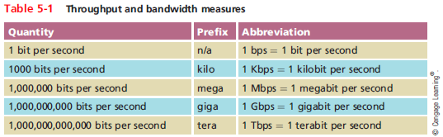
Throughput and Bandwidth
Notes:
Throughput and Bandwidth

Slide 4
Simplex, Half-Duplex, and Duplex
Methods of transmission:
Full-duplex, also called duplex - signals are free to travel in both directions over a medium simultaneously
Half-duplex - signals may travel in both directions over a medium but in only one direction at a time
Simplex - signals may travel in only one direction
Sometimes called one-way or unidirectional
Many network devices allow you to specify whether the device should use half- or full-duplex
Modern NICs use full-duplex by default
Notes:
Simplex, Half-Duplex, and Duplex
Methods of transmission:
Full-duplex, also called duplex - signals are free to travel in both directions over a medium simultaneously
Half-duplex - signals may travel in both directions over a medium but in only one direction at a time
Simplex - signals may travel in only one direction
Sometimes called one-way or unidirectional
Many network devices allow you to specify whether the device should use half- or full-duplex
Modern NICs use full-duplex by default

Slide 5
Twisted-Pair Cable
Wired networks are still the most common type of physical connection that computers make.
Twisted-pair cable is the cable most commonly used in local area networks.
It’s relatively easy to work with, flexible, efficient, and fast.
A single twisted-pair cable has eight wires; they are copper conductors that transmit electric signals.

Slide 6
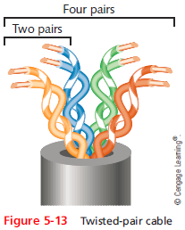
Twisted-Pair Cable
These eight wires are grouped into four pairs: blue, orange, green, and brown.
Each pair of wires is twisted along the entire length of the cable, and all of the pairs are twisted together as well.
The reason the wires are twisted is to reduce crosstalk and interference.

Slide 7
Twisted-Pair Cable
More wire pair twists per foot
More resistance to cross talk
Higher-quality
More expensive
Twist ratio
Twists per meter or foot
However, high twist ratio can result in greater attenuation
Must balance between minimizing cross-talk and reducing attenuation
Notes:
Twisted-Pair Cable
More wire pair twists per foot
More resistance to cross talk
Higher-quality
More expensive
Twist ratio
Twists per meter or foot
High twist ratio
Greater attenuation

Slide 8
Twisted-Pair Cable
Hundreds of different designs
Twist ratio, number of wire pairs, copper grade, shielding type, shielding materials
1 to 4200 wire pairs possible
Wiring standard specification
TIA/EIA 568
Most common twisted pair types
Category (cat) 3, 5, 5e, 6, 6a, 7
CAT 5e or higher used in modern LANs
Notes:
Twisted-Pair Cable
Hundreds of different designs
Twist ratio, number of wire pairs, copper grade, shielding type, shielding materials
1 to 4200 wire pairs possible
Wiring standard specification
TIA/EIA 568
Most common twisted pair types
Category (cat) 3, 5, 5e, 6, 6a, 7
CAT 5e or higher used in modern LANs

Slide 9
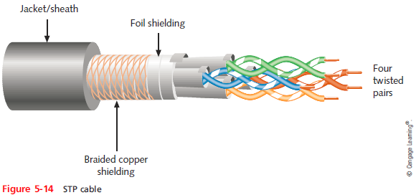
STP (Shielded Twisted Pair)
Individually insulated
Surrounded by metallic substance shielding (foil)
Barrier to external electromagnetic forces
Contains electrical energy of signals inside
The shield must be grounded
Expensive
Notes:
STP (Shielded Twisted Pair)
Individually insulated
Surrounded by metallic substance shielding (foil)
Barrier to external electromagnetic forces
Contains electrical energy of signals inside
May be grounded

Slide 10
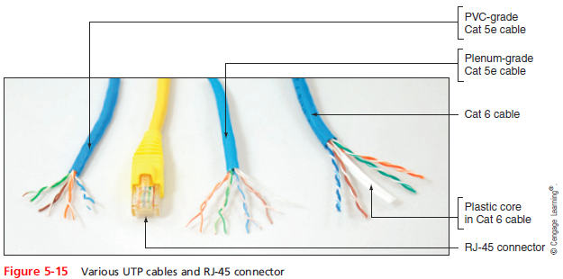
UTP (Unshielded Twisted Pair)
One or more insulated wire pairs
Encased in plastic sheath
No additional shielding
Less expensive, less noise resistance
Notes:
UTP (Unshielded Twisted Pair)
One or more insulated wire pairs
Encased in plastic sheath
No additional shielding
Less expensive, less noise resistance

Slide 11
Comparing STP and UTP
Throughput
STP and UTP can transmit the same rates
Cost
STP and UTP vary in cost
Connector
STP and UTP use Registered Jack 45 (RJ-45)
Noise immunity
STP more noise resistant
Size and scalability
Maximum segment length for both: 100 meters
Notes:
Comparing STP and UTP
Throughput
STP and UTP can transmit the same rates
Cost
STP and UTP vary in cost
Connector
STP and UTP use Registered Jack 45
Noise immunity
STP more noise resistant
Size and scalability
Maximum segment length for both: 100 meters

Slide 12
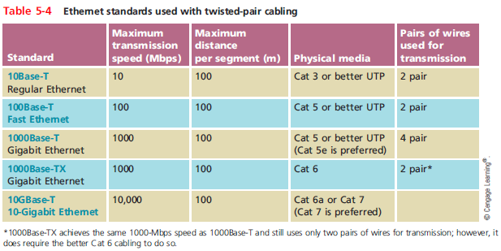
Ethernet Standards for Twisted-Pair Cabling
Notes:
Ethernet Standards for Twisted-Pair Cabling

Slide 13
Cable Pinouts
Proper cable termination is a requirement for two nodes on a network to communicate
TIA/EIA specifies two methods of inserting wires into RJ-45 plugs
TIA/EIA 568A
TIA/EIA 568B
No functional difference between the two standards
Just make sure you use the same standard on every RJ-45 plug and jack
Notes:
Cable Pinouts
Proper cable termination is a requirement for two nodes on a network to communicate
TIA/EIA specifies two methods of inserting wires into RJ-45 plugs
TIA/EIA 568A
TIA/EIA 568B
No functional difference between the two standards
Just make sure you use the same standard on every RJ-45 plug and jack

Slide 14
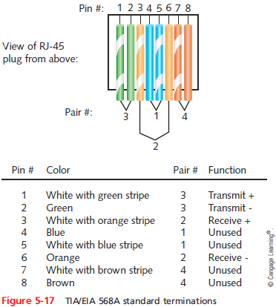
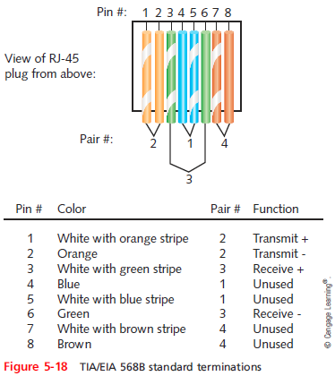
Cable Pinouts
Notes:
Cable Pinouts

Slide 15
Cable Pinouts
Straight-through cable
Terminate RJ-45 plugs at both ends identically
Crossover cable
Transmit and receive wires on one end reversed
Rollover cable
All wires are reversed
Terminations are a mirror image of each other
Also called console cables
Used to connect a computer to the console port of a router/switch
Notes:
Cable Pinouts
Straight-through cable
Terminate RJ-45 plugs at both ends identically
Crossover cable
Transmit and receive wires on one end reversed
Rollover cable
All wires are reversed
Terminations are a mirror image of each other
Also called Yost cables or Cisco console cables
Used to connect a computer to the console port of a router

Slide 16
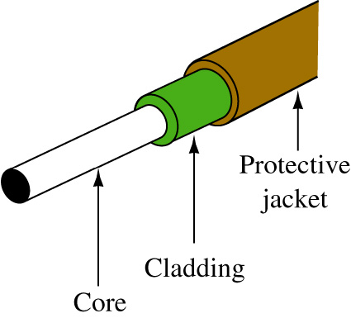
Fiber-Optic Cable
Fiber-optic cable (fiber)
The core is the portion of the glass fiber strand at the center that carries the transmitted light.
Cladding
Layer of glass or plastic surrounding fibers
Different density from glass or plastic in strands
Reflects light back to core
Allows fiber to bend
Data transmission
Pulsing light sent from laser or light-emitting diode (LED) through central fibers
Notes:
Fiber-Optic Cable
Fiber-optic cable (fiber)
One or more glass or plastic fibers at its center (core)
Data transmission
Pulsing light sent from laser or light-emitting diode (LED) through central fibers
Cladding
Layer of glass or plastic surrounding fibers
Different density from glass or plastic in strands
Reflects light back to core
Allows fiber to bend

Slide 17
Fiber-Optic Cable
Benefits over copper cabling
Extremely high throughput
Very high noise resistance
Excellent security
Able to carry signals for longer distances
Industry standard for high-speed networking
Drawbacks
More expensive than twisted pair cable
Requires special equipment to splice
Notes:
Fiber-Optic Cable
Benefits over copper cabling
Extremely high throughput
Very high noise resistance
Excellent security
Able to carry signals for longer distances
Industry standard for high-speed networking
Drawbacks
More expensive than twisted pair cable
Requires special equipment to splice

Slide 18
Fiber-Optic Cable
Throughput
Proven reliable in transmitting data at rates that can reach 100 gigabits per second per channel
Cost
Most expensive transmission medium
Noise immunity
Unaffected by EMI
Size and scalability
Segment lengths vary from 150 to 40,000 meters
Depends on the light’s wavelength and type of cable
Notes:
Fiber-Optic Cable
Throughput
Proven reliable in transmitting data at rates that can reach 100 gigabits per second per channel
Cost
Most expensive transmission medium
Noise immunity
Unaffected by EMI
Size and scalability
Segment lengths vary from 150 to 40,000 meters
Depends on the light’s wavelength and type of cable

Slide 19
SMF (Single Mode Fiber)
Consists of narrow core (8-10 microns in diameter)
Laser-generated light travels over one path
Little reflection
Light does not disperse as signal travels
Can carry signals many miles:
Before repeating is required
Rarely used for shorter connections
Due to cost
The Internet backbone depends on SMF
Notes:
SMF (Single Mode Fiber)
Consists of narrow core (8-10 microns in diameter)
Laser-generated light travels over one path
Little reflection
Light does not disperse as signal travels
Can carry signals many miles:
Before repeating is required
Rarely used for shorter connections
Due to cost
The Internet backbone depends on SMF

Slide 20
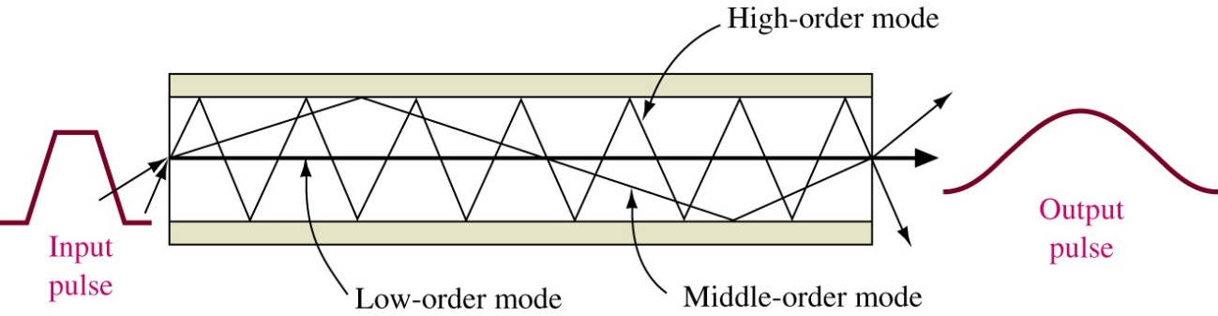
MMF (Multimode Fiber)
Contains a core with a larger diameter than single mode fiber
Common sizes: 50 or 62.5 microns
Laser or LED generated light pulses travel at different angles
Greater attenuation than single-mode fiber
Common uses
Cables connecting router to a switch
Cables connecting server on network backbone
Notes:
MMF (Multimode Fiber)
Contains a core with a larger diameter than single mode fiber
Common sizes: 50 or 62.5 microns
Laser or LED generated light pulses travel at different angles
Greater attenuation than single-mode fiber
Common uses
Cables connecting router to a switch
Cables connecting server on network backbone

Slide 21
Transmission Flaws
Noise
Any undesirable influence degrading or distorting signal
Types of noise
EMI (electromagnetic interference)
Example: radio frequency interference
Cross-talk
Signal on one wire infringes on adjacent wire signal
Alien cross-talk occurs between two cables
Near end cross-talk (NEXT) occurs near source
Far end cross-talk (FEXT) occurs at the far end
Notes:
Transmission Flaws
Noise
Any undesirable influence degrading or distorting signal
Types of noise
EMI (electromagnetic interference)
Example: radio frequency interference
Cross-talk
Signal on one wire infringes on adjacent wire signal
Alien cross-talk occurs between two cables
Near end cross-talk (NEXT) occurs near source
Far end cross-talk (FEXT) occurs at the far end

Slide 22
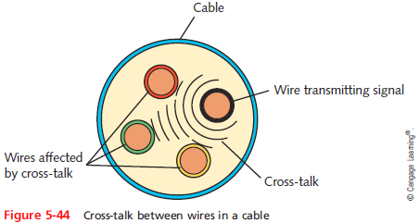
Transmission Flaws
Notes:
Transmission Flaws

Slide 23
Transmission Flaws
Attenuation
Loss of signal’s strength as it travels away from source
Two ways analog and digital signals are boosted:
Amplifier - increases the voltage, or strength, of signals
Can also boot the noise that has accumulated in the signal
Repeater - regenerates a digital signal in its original form
Without noise previously accumulated
Notes:
Transmission Flaws
Attenuation
Loss of signal’s strength as it travels away from source
Two ways analog and digital signals are boosted:
Amplifier - increases the voltage, or strength, of signals
Can also boot the noise that has accumulated in the signal
Repeater - regenerates a digital signal in its original form
Without noise previously accumulated
End-to-end delay for voice < 150ms (i.e. 0.15s)

Slide 24
Transmission Flaws
Latency
Delay between signal transmission and receipt
May cause network transmission errors
Latency causes
Cable length
connectivity devices such as routers and switches
Round trip time (RTT)
Time for packet to go from sender to receiver, then back from receiver to sender
Notes:
Transmission Flaws
Latency
Delay between signal transmission and receipt
May cause network transmission errors
Latency causes
Cable length
Intervening connectivity device
Round trip time (RTT)
Time for packet to go from sender to receiver, then back from receiver to sender

Slide 25
Structured Cabling - Network Equipment in Commercial Buildings
TIA/EIA’s joint 568 Commercial Building Wiring Standard
Also known as structured cabling
Describes the best way to install networking media to maximize performance and minimize upkeep
Apply no matter what type of media, transmission technology, or networking speeds are involved
Based on hierarchical design and assumes a network is based on the start topology
(TIA: Telecommunications Industry Association, EIA: Electronic Industries Alliance)
Notes:
Network Equipment in Commercial Buildings
TIA/EIA’s joint 568 Commercial Building Wiring Standard
Also known as structured cabling
Describes the best way to install networking media to maximize performance and minimize upkeep
Apply no matter what type of media, transmission technology, or networking speeds are involved
Based on hierarchical design and assumes a network is based on the start topology

Slide 26
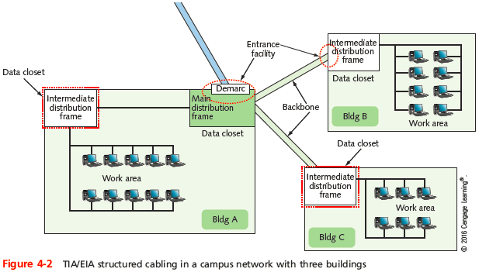
Network Equipment in Commercial Buildings
Notes:
Network Equipment in Commercial Buildings

Slide 27
Structured Cabling System
Six Subsystems
Entrance facilities: the point where the external cabling interconnect with the internal building cabling in the equipment room (ER).
Also known as Building entrance
Equipment Room (ER): a room set aside for complex electronic equipment such as network servers and telephone equipment
Telecommunications closet (TC): the location for cabling termination points. The connection of the horizontal cabling to the backbone wiring is made at this point.
Backbone wiring: cabling interconnects telecommunications closets in the same building and between buildings
Notes:
Network Equipment in Commercial Buildings
Components
Entrance facilities
MDF (main distribution frame)
IDF (intermediate distribution frame)
Horizontal wiring
Backbone wiring
Work area

Slide 28
Structured Cabling System
Horizontal wiring: cabling extends out from the telecommunications closet into the LAN work area
Typically, it is structured in a star configuration running to each TCO or telecommunications outlet, which is the wall plate where the twisted-pair cable terminates in the room.
Work area: the location of the computers and printers, patch cables, jacks, etc.
MDF (main distribution frame): the central telecommunications connect point for a campus or building. Usually connects two or more buildings.
IDF (intermediate distribution frame): a building’s connection point to the campus backbone
At least one per floor
Notes:
Network Equipment in Commercial Buildings
Components
Entrance facilities
MDF (main distribution frame)
IDF (intermediate distribution frame)
Horizontal wiring
Backbone wiring
Work area

Slide 29
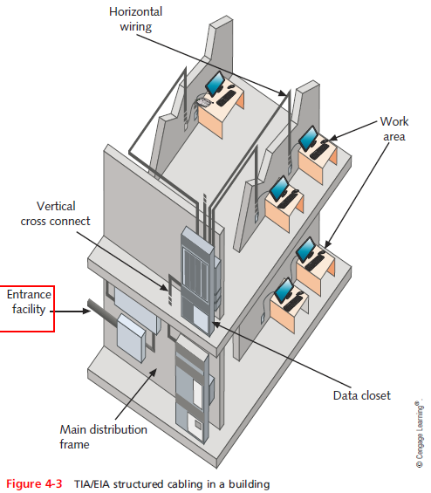
Network Equipment in Commercial Buildings
Notes:
Network Equipment in Commercial Buildings

Slide 30
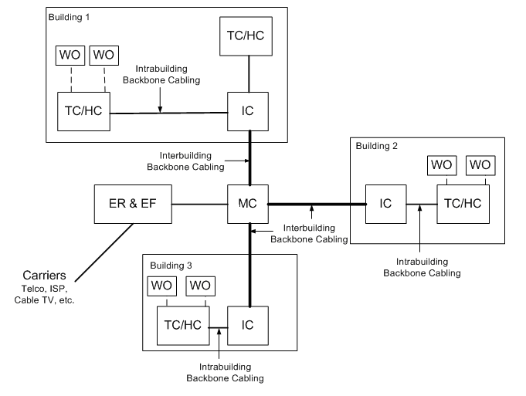
The Telecommunications Cabling System Architecture

Slide 31
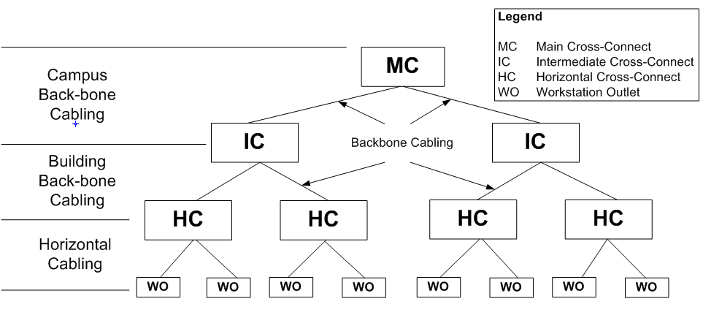
The Campus Network Hierarchical topology
The MC (main cross-connect) usually connects two or more buildings and it is typically the central telecommunications connection point for a campus or building. It is also called the Main Distribution Frame (MDF) or Main Equipment Room.

Slide 32
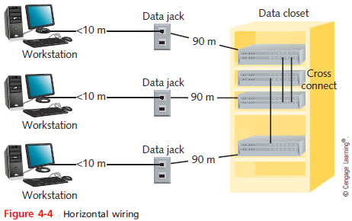
Network Equipment in Commercial Buildings
Notes:
Network Equipment in Commercial Buildings

Slide 33
Horizontal Cabling
This is where your network interfaces with the users.
Basic Components
Backbone cabling interconnecting between closets
Switch
Patch panel
Patch cables
Cabling to the LAN (horizontal cabling)
Wall plate
Patch cable connecting the computer to the wall plate
Notes:
Network Equipment in Commercial Buildings
Components
Entrance facilities
MDF (main distribution frame)
IDF (intermediate distribution frame)
Horizontal wiring
Backbone wiring
Work area

Slide 34
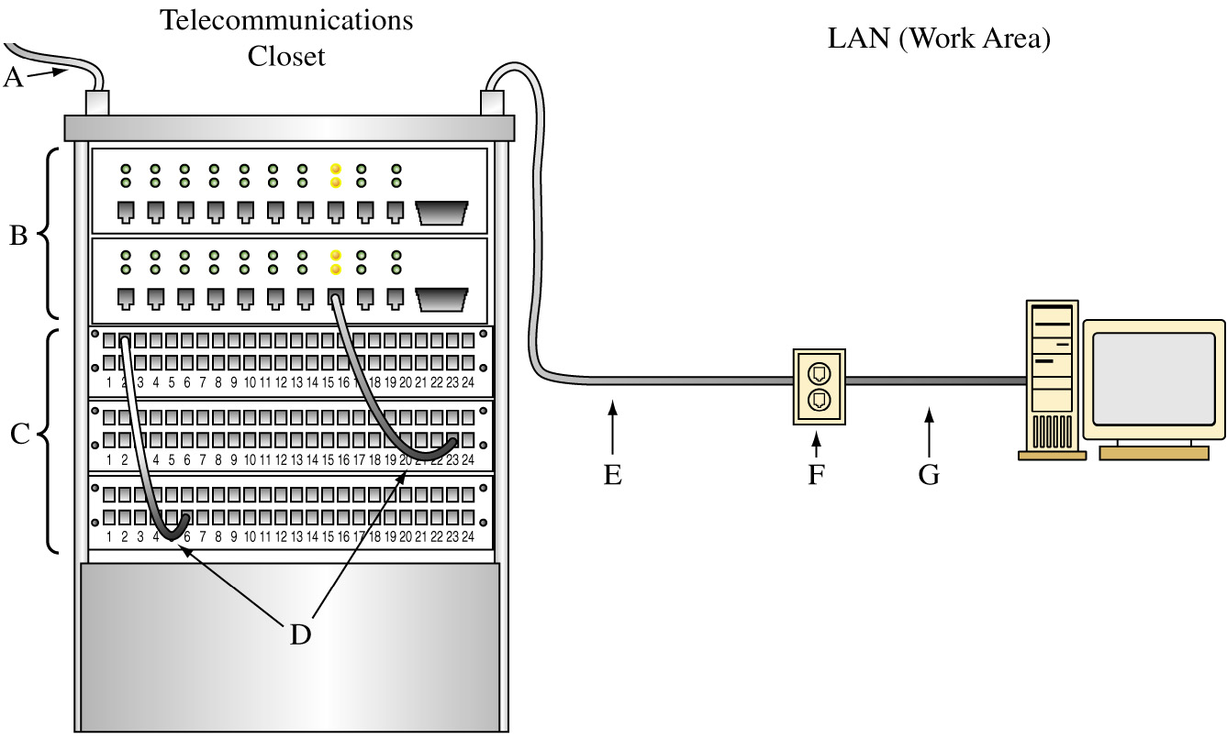
The Basic Blocks of Horizontal Cabling

Slide 35
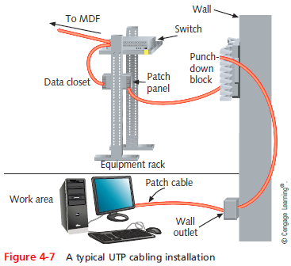
Network Equipment in Commercial Buildings
Notes:
Network Equipment in Commercial Buildings

Slide 36
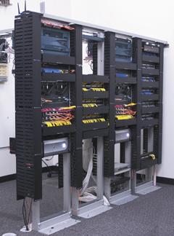
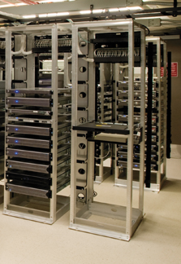
Rack Systems
Two-post and four-post racks
Notes:
Rack Systems

Slide 37
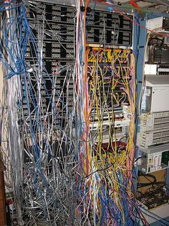
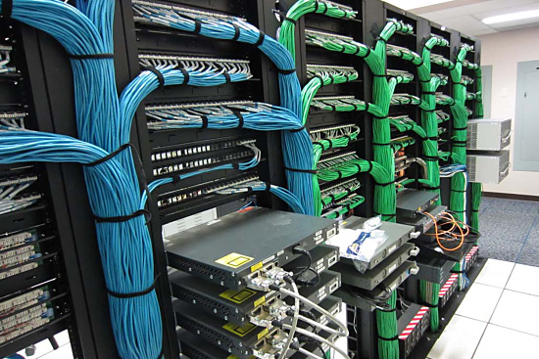
Network Equipment in Commercial Buildings
Notes:
Network Equipment in Commercial Buildings

Slide 38
Building and Maintaining Network Documentation
Having up-to-date and detailed documentation of your network is essential to good troubleshooting
Network diagrams - graphical representations of a network’s devices and connections
May show physical layout, logical topology, IP address reserves, names of major network devices, and types of transmission media
Network mapping - the process of discovering and identifying the devices on a network
Notes:
Building and Maintaining Network Documentation
Having up-to-date and detailed documentation of your network is essential to good troubleshooting
Network diagrams - graphical representations of a network’s devices and connections
May show physical layout, logical topology, IP address reserves, names of major network devices, and types of transmission media
Network mapping - the process of discovering and identifying the devices on a network

Slide 39
Building and Maintaining Network Documentation
To adequately manage a network, record the following:
Network diagrams
Physical topology
Access methods
Protocols
Devices
Operating systems
Applications
Configurations
Notes:
Building and Maintaining Network Documentation
To adequately manage a network, record the following:
Network diagrams
Physical topology
Access methods
Protocols
Devices
Operating systems
Applications
Configurations

Slide 40
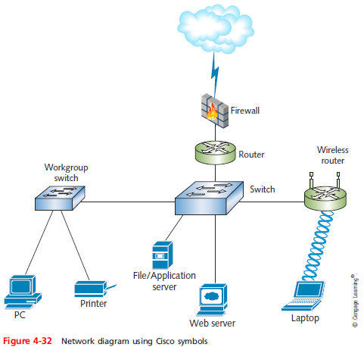
Building and Maintaining Network Documentation
Notes:
Building and Maintaining Network Documentation

Slide 41
Building and Maintaining Network Documentation
Network diagrams provide broad snapshots of a network’s physical or logical topology
Useful for planning where to insert a new switch or determining how a particular router, gateway, or firewall interact
Wiring schematic - a graphical representation of a network’s wired infrastructure
In detailed form, it shows every wire necessary to interconnect network devices
Notes:
Building and Maintaining Network Documentation
Network diagrams provide broad snapshots of a network’s physical or logical topology
Useful for planning where to insert a new switch or determining how a particular router, gateway, or firewall interact
Wiring schematic - a graphical representation of a network’s wired infrastructure
In detailed form, it shows every wire necessary to interconnect network devices

Slide 42
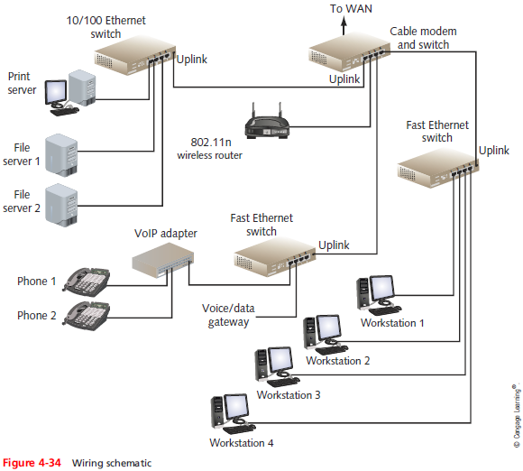
Building and Maintaining Network Documentation
Notes:
Building and Maintaining Network Documentation

Slide 43
Wireless Networks
Wireless devices might allow for central connectivity of client computers and handheld devices.
Or, they might offer an extension of connectivity to a pre-existing wireless network and could be used to connect entire local area networks to the Internet.
In addition, some wireless devices can be connected directly to each other in a point-to-point fashion, known as ad-hoc mode.

Slide 44
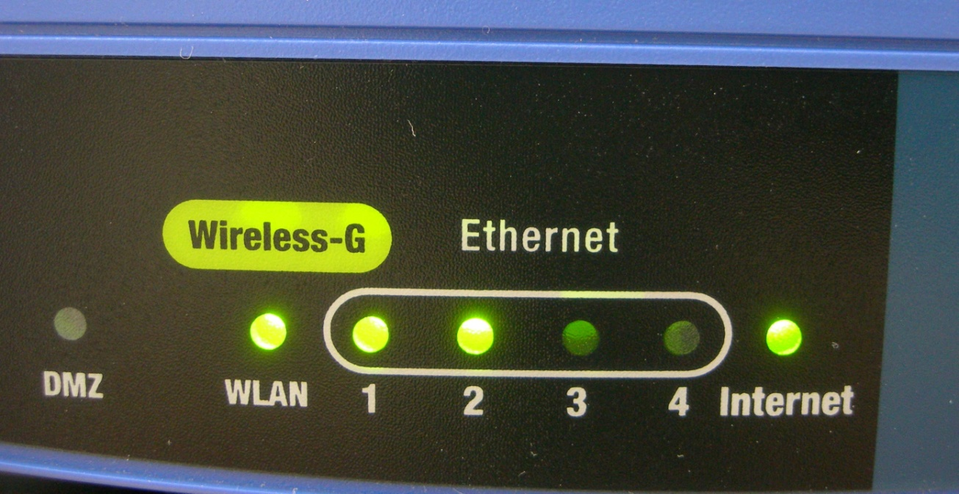
Wireless Access Point
By far the most well-known wireless device is the wireless access point or WAP.
This device quite often also acts as a router, firewall, and IP proxy.

Slide 45
Wireless Network Adapters
Wireless network adapters allow for connectivity between a desktop computer or laptop and the wireless access point.
They come in many shapes and sizes, including USB, PC Card, ExpressCard, and of course, as an internal PCI or PCI Express adapter card for a personal computer.

Slide 46
Wireless LAN (WLAN)
Wireless LAN or WLAN is a network composed of at least one WAP and at least one computer or handheld device that can connect to the WAP.
In order to ensure compatibility, the WAP and other wireless devices must all use the same IEEE 802.11 WLAN standard.

Slide 47
WLAN Standards
802.11a: 5.0 GHZ, up to 54 Mbps
802.11b: 2.4 GHZ, up to 11 Mbps
802.11g: 2.4 GHZ, up to 54 Mbps
802.11n: 2.4 and 5.0 GHZ, Multiple-Input Multiple-Output (MIMO), up to 600 Mbps depending on number of antennas
802.11ac: 5.0 GHZ, Multi-user MIMO (MU-MIMO), up to 1300 Mbps

Slide 48
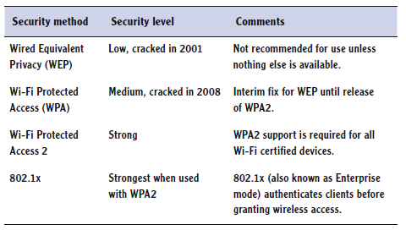
Wireless Encryption Options

Slide 49
Wireless Encryption Options
WPA and WPA2 both support
Personal mode
Uses preshared key
Enterprise mode
Uses 802.1x server for authentication

Slide 50
Wireless Encryption Options
Notes:
NPAS : Network Policy and Access Services

Slide 51
Wireless Modes
There several different ways to connect to a wireless network
Infrastructure mode - It occurs when wireless clients connect to a wireless access point,
Ad-hoc mode - All of the clients communicate directly with each other.

Slide 52
Service Set Identifier (SSI)
When utilizing infrastructure mode, the base unit (normally a WAP) will be configured with a service set identifier (SSID).
This then becomes the name of the wireless network, and it is broadcast over the airwaves.
Thus, when clients want to connect to the WAP, they can identify it by the SSID.
SSID
Disabling SID broadcast doesn’t enhance security
Disabling SSID broadcast does not truly hide the SSID

