Slide 1
5. TCP/IP and Packet Delivery Processes
Ref:
The Packet Delivery Process: Locally Connected Hosts
The Packet Delivery Process: Remotely Connected Hosts

Slide 2
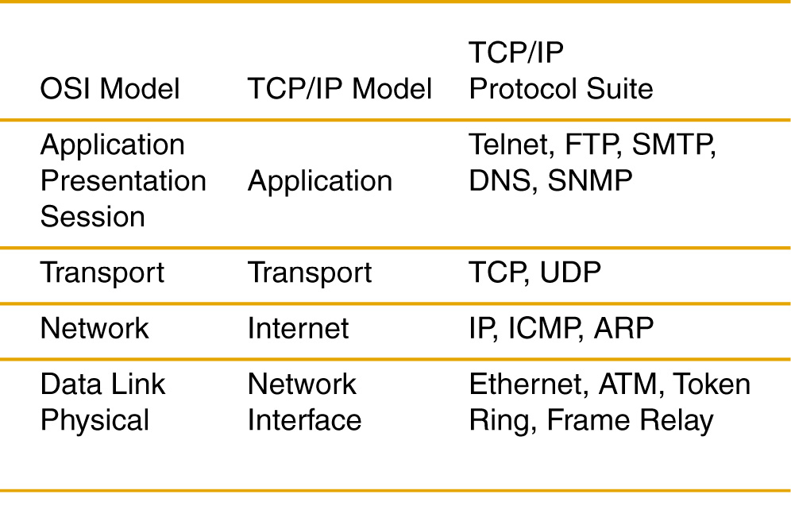
OSI and TCP/IP Models

Slide 3
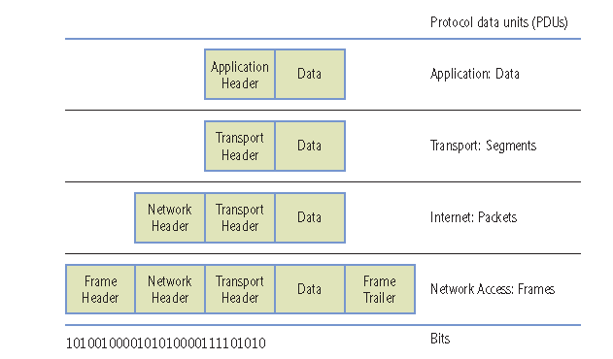
Understanding Data and PDUs

Slide 4
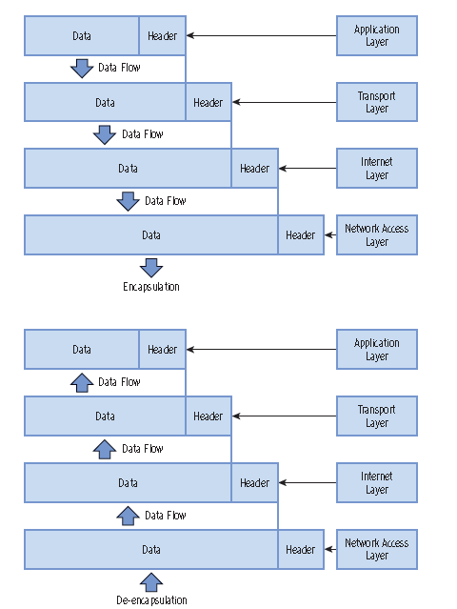
TCP/IP Encapsulation Process

Slide 5
Transport Layer
Manage the delivery of data between a source and destination host
TCP
Connection-Oriented
Guaranteed Delivery (reliable service)
Stateful
Email, file transfer, web browsing
UDP
Connection-less
Nonguaranteed Delivery (unreliable service)
Uses best-effort delivery
Stateless
Video streaming, voice call (skype)

Slide 6
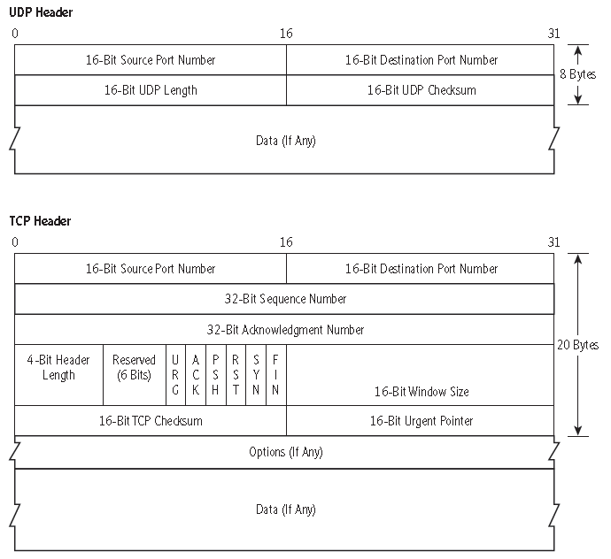
TCP and UDP

Slide 7
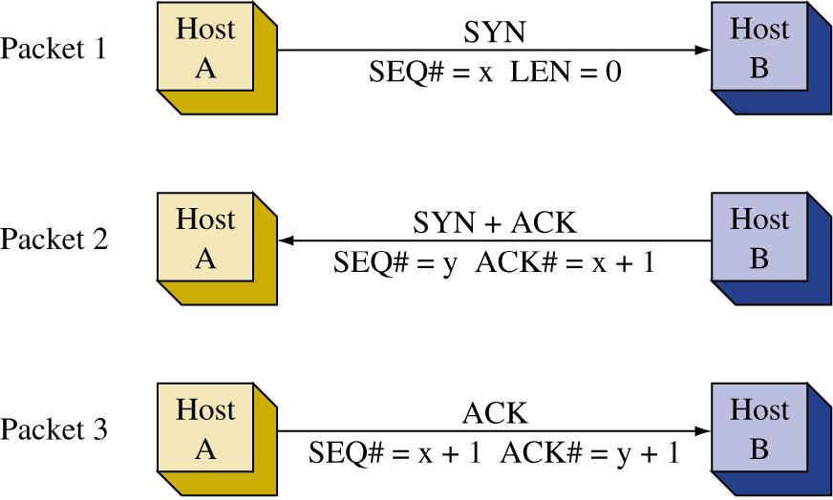
TCP 3 Way Handshake
TCP connection setup
Before data is exchanged between two machines, a connection is needed to be setup
Syn: Synchronizing, Ack: Acknowledgement
The connection also needs to be closed when data transmission is completed by using FIN/ACK

Slide 8
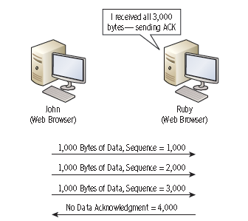
Transport Protocols
TCP provides
Sequencing
Acknowledgments
Windowing
Flow Control

Slide 9
Understanding Ports
TCP and UDP use port numbers to identify applications
Computes listen on specific ports for requests to applications

Slide 10
Understanding Ports
Controlling port traffic with a firewall

Slide 11
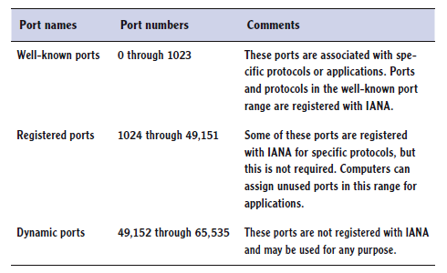
Understanding Ports
Assigned by IANA

Slide 12
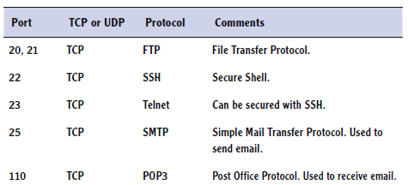
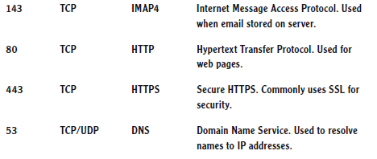
Common ports

Slide 13
Internet Layer
Internet Layer defines the protocols used for address and routing the data packets
Logical Addressing
Routing
Packet Forwarding
Protocols, examples:
IP
ARP
ICMP
IGMP

Slide 14
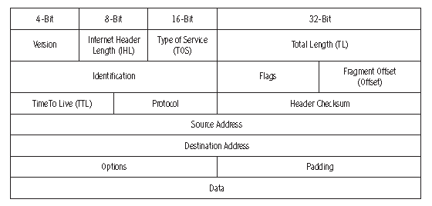
Internet Layer Protocols

Slide 15
ARP (Address Resolution Protocol)
ARP is used to resolve an IP address to a hardware address (MAC address) for final delivery of data packets to the destination.
ARP broadcasts a query in a network called an ARP request, asking which network interface has this IP address.
The host having the IP address replies with an ARP reply that contains the hardware address for the destination host.

Slide 16
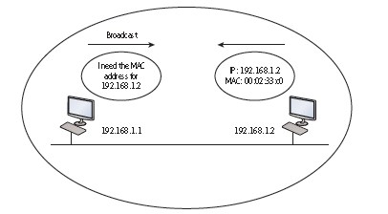
When an ARP request is issued on the LAN,
the destination address is BROADCAST, i.e. this message is being sent to all computers in the local area network.
The ARP Request message also contains the source IP address, source MAC address, and the destination IP address

Slide 17
ARP
(IP address, MAC address) pairs are stored in the arp cache of the local machine for future use if the destination IP address is referenced again
To show contents of ARP cache on your PC
arp –a
arp –d use to delete the arp cache

Slide 18
Packet Delivery Process for Locally Connected Hosts
Step 1

Slide 19
Step 2

Slide 20
Step 3

Slide 21
Step 4

Slide 22
Step 5

Slide 23
Step 6

Slide 24
Step 7

Slide 25
Step 8

Slide 26
Packet Delivery Process for Remotely Connected Hosts
Step 1

Slide 27
Step 2

Slide 28
Step 3

Slide 29
Step 4

Slide 30
Step 5

Slide 31
Step 6

Slide 32
Step 7

Slide 33
Step 8

Slide 34
Step 9

Slide 35
Internet Layer Protocols
ICMP (Internet Control Message Protocol)
Used by devices to send messages to one another to control the flow of data in the network , reporting errors, and for performing diagnostics.
E.g. a router sends an ICMP source-quench packet to a host that requests a slowdown in the data transfer.
Used by ping command
used to verify connectivity with another host in the network

Slide 36
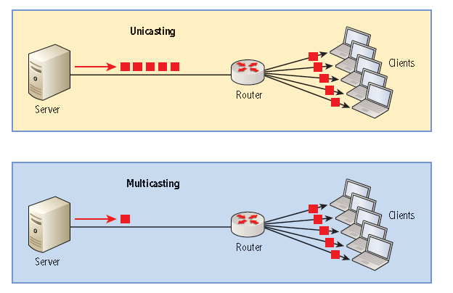
Internet Layer Protocols IGMP (Internet Group Management Protocol)
IGMP is used when one host needs to send data to many destination hosts - multicasting.
The addresses used are called multicast addresses. These are reserved addresses that are not assigned to hosts in a network.

Slide 37
IGMP Protocol
An example of an application that uses IGMP packets is when a router uses multicasting to share routing tables.
Another application to use IGMP packets is when a hosts wants to stream data to multiple hosts.
Streaming means the data are sent without waiting for any acknowledgement that the data packets were delivered. In fact, in the IGMP protocol, the source doesn’t care if the destination receives a packet.
Streaming is an important application in the transfer of audio and video files over the Internet.

Slide 38
ipconfig and ping Command
ipconfig and ping can be used to analyze, test, troubleshoot, and configure IPv4 and IPv6 connections.
ipconfig
displays info. about the network adapter
ipconfig /all - provides more info.
ipconfig /release
Release the ip configuration, such as ip address, received from a DHCP server
ipconfig /renew
Request for an ip address or renew a lease from a DHCP server

Slide 39
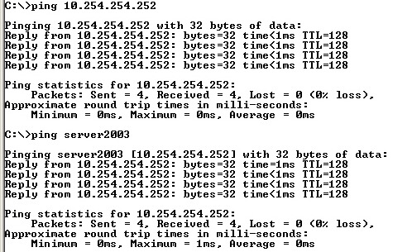
ping Command
Used to test network connectivity
Uses ICMP

Slide 40
ping Command
ping /? - displays help file
Examples:
ping localhost
ping loopback
ping 127.0.0.1
ping –l 1500 10.254.20.1
ping with a packet size of 1500
ping –n 10 10.254.20.1
ping the ip address 10 times
ping –t 10.254.20.1
Keep sending the ping commands until ctrl-c is entered
Notes:
When troubleshooting a problem, you need to use a systematic approach, such as: use IPConfig to look at current configuration. Then use the Ping command to ping localhost, local host, default gateway, remote router link, remote host. Of course, you can also use the tracert and pathping commands.

Slide 41
tracert and pathping Commands
Show the network path to remote destination
pathping also provides statistics on packet loss
Example
tracert google.com
pathping google.com
Notes:
W

Slide 42
netstat Command
The netstat command is used to display active TCP (or UDP) connections, as well as a host of other statistics
netstat –e
Display Ethernet statistics such as the number of packets and bytes sent and received

Slide 43
nslookup
nslookup displays information about DNS names and their corresponding IP addresses, and it can be used to diagnose DNS servers.
Example
nslookup google.com

Slide 44
FTP (File Transfer Protocol)
It is an application layer protocol as well as an application for transferring files
Uses TCP as the transport protocol
ftp ipaddress or name of the server, example
ftp ftp6.ipswitch.com
Some basic commands
dir list the files and folders
cd change directory/folder
get download a file
put upload a file from the current folder
quit

Slide 45
Telnet Command
Telnet provides a text-based terminal connection to a remote computer.
Basically, a network administrator connects to a remote computer, server, router, or switch by typing
telnet ipaddress
Telnet is an older, out-of-date protocol, and as such, it should be replaced with a more secure program such as SSH.
Need to turn on telnet service before using it in Windows system
Control panel > Programs and features > Turn Windows features on or off

Slide 46
Terminal Services
Terminal Services, also known as Remote Desktop Services, is a type of thin-client terminal server computing.
It allows client computers to access and use applications loaded on the server, as well as to connect to and take control of a server.
A Windows system can permit remote connection by
right click on Computer > Properties > Remote setting
Connection is done using Remote Desktop Connection
Notes:
Before Windows Server 2008 R2, it was known as Terminal services. Starting with Windows Server 2008 R2, it is called Remote Desktop Services.

Slide 47
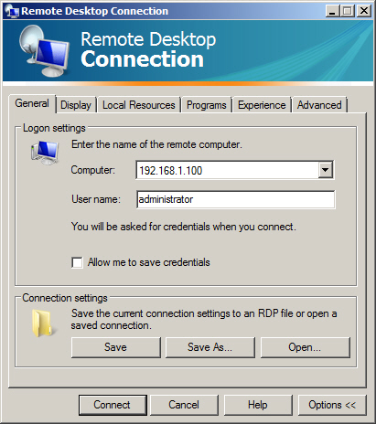
Remote Desktop Connection

Slide 48
DNS
The Domain Name System (DNS) is a worldwide service that resolves host names to IP addresses.
This facilitates proper communication between computers. DNS servers communicate with each other in a hierarchy in an effort to teach each other their name resolutions.
DNS servers use inbound port 53 to accept name resolution requests.

Slide 49
IPSec
Internet Protocol Security (IPSec) is a protocol within the TCP/IP suite that encrypts and authenticates IP packets.
It is designed to secure any application traffic because it resides on the network layer, i.e. at IP layer.
This protocol is used in conjunction with virtual private networks and is an integral part of IPv6.

Slide 50
IPSec
There are three main protocols that IPSec uses to perform its necessary functions:
Security association (SA): This generates the encryption and authentication keys that are used by IPsec.
Authentication header (AH): This provides connectionless integrity and the authentication of data. It also provides protection against replay attacks.
Encapsulating security payload (ESP): This provides the same services as AH but also provides confidentiality when sending data.

