Slide 1
6. Understanding Wide Area Networks

Slide 2
Routing
Routing is the process of moving data across networks or internetworks between hosts or between routers themselves.
Information is transmitted according to the IP networks and individual IP addresses of the hosts in question.
A router is in charge of maintaining tables of information about other routers on the network or internetwork.

Slide 3
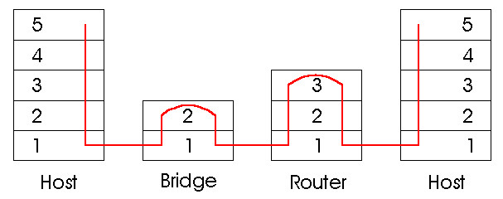
Routers
Routers: network layer devices
Bridges/switches are link layer devices
A large group of users in a department are usually interconnected using switches within a subnetwork
Subnetworks are interconnected using routers so that a user can access other subnetworks or to the external network via the backbone network

Slide 4
Campus Network
Servers have redundant connectivity to backbone
To Internet or wide area network
Organization Servers
High-speed campus backbone net connects dept routers
s
s
Gateway
Backbone
R
R
R
S
S
S
Departmental Server
R
R
R
s
s
Only outgoing packets leave LAN through router
s
s
s
s
s
s
s

Slide 5
Routers
Each host in the Internet is identified by a globally unique IP address
In Internet Protocol (IP) v4, an address is composed of two parts:
network id and host id
Hosts within the same network will have the same network id
A router is used to interconnect multiple networks
Routers in the campus network are interconnected to form the campus backbone

Slide 6
Routers (cont.)
Routers in a campus network form a domain or autonomous system (AS)
Domain: indicates that the routers run the same routing protocol
AS: one or more domains under a single administration
All routing and policy decisions inside an AS are independent of other networks
Campus network may be connected to external networks via Internet Service Provider (ISP) through border routers
Border router communicates on an inter-domain level
Routers within a campus network operate at the intra-domain level

Slide 7
Connecting to Internet Service Provider
Internet service provider
Border routers
Campus
Network
Border routers
Interdomain level
Autonomous
system or
domain
Intradomain level
LAN
s
network administered
by single organization
s
s

Slide 8
Routers (cont.)
Main function is routing of packets
Determining feasible paths (routes) for packets to follow from source to destination
3 paths from node 1 to 6
Selecting the “best” path to use
Least no. of hops
Shortest delay
Max. throughput
Lowest cost
Max. reliability
Routing algorithms are used to determine the set of best paths between any two nodes
A routing table is hence created for routing of packets
1
3
6
4
2
5
Node
(switch or router)

Slide 9
Routing Tables in Datagram Packet Networks
Node 3
Node 1
Destination Next node
Node 6
Destination Next node
1 1
Destination Next node
2 2
2 4
1 3
3 3
4 4
2 5
4 4
5 6
3 3
5 2
6 6
4 3
6 3
5 5
Node 4
Destination Next node
1 1
Node 2
2 2
Node 5
Destination Next node
3 3
Destination Next node
1 1
5 5
6 3
1 4
3 1
2 2
4 4
3 4
5 5
4 4
6 5
6 6
Example: Communication between nodes 1 and 5

Slide 10
Creating the Routing Tables
Need information on state of links
Link up/down; congested; delay or other metrics
Need to distribute link state information using a routing protocol
State information/routing tables exchanged by routers
Adapts to topology and other changes
Routing protocols for internet: RIP, OSPF, BGP, etc.
Each router needs to compute routes based on received updated network state information

Slide 11
Routing
A static route is one that has been manually configured.
A dynamic route is one that has been implemented dynamically with special routing protocols.
Routing Information Protocol (RIP)
Open Shortest Path First (OSPF)
Interior Gateway Routing Protocol (IGRP)
Border Gateway Protocol (BGP)

Slide 12
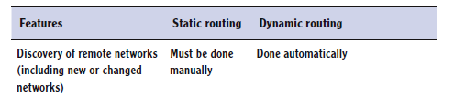
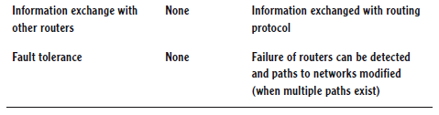
Routing
Comparing static and dynamic routing

Slide 13
Routing
Interior Routing Protocols
routing protocols which pass routing information between routers within an AS
RIP, OSPF, IGRP
Exterior Routing Protocols
Protocols used to pass routing information between routers in different ASs
BGP

Slide 14
Routing Information Protocol (RIP)
A dynamic protocol that uses distance-vector routing algorithms to determine which route to send data packets.
“Distance”: uses hop count as metric
The protocol calculates the direction or interface that packets should be forwarded to, as well as the distance from the destination.
RIPv1 and RIPv2 are common among today’s networks.

Slide 15
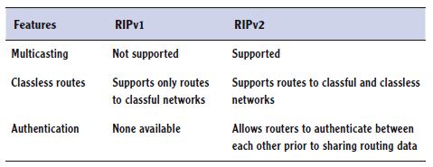
RIP
RIPv1 and RIPv2

Slide 16
Open Shortest Path First (OSPF)
A link-state protocol that monitors the network for routers that have a change in their link state, on or off.
This is perhaps the most commonly used interior gateway protocol in large networks.

Slide 17
Routing Protocols
Interior Gateway Routing Protocol (IGRP): A distance-vector proprietary protocol (by Cisco) used in large networks to overcome the limitations of RIP.
Border Gateway Protocol (BGP): The most popular exterior routing protocol.

Slide 18
WAN Technology
Wide area networks connect multiple local area networks together.
If an organization wishes to have a wide area connection to another office, it needs to decide on a networking service and the speed at which it wishes to connect.

Slide 19
Circuit Switching
Uses a dedicated path between two stations
Can be inefficient
Channel capacity dedicated for duration of connection
If no data, capacity is wasted
Set up (connection) takes time
Once connected, transfer is transparent
Driven by applications that handle voice traffic
Efficient for analog transmission of voice signals
Inefficient for digital transmission
Notes:
Communication via circuit switching implies that there is a dedicated communication
path between two stations. That path is a connected sequence of links between
network nodes. On each physical link, a logical channel is dedicated to the connection.
Communication via circuit switching involves three phases, which can be
explained with reference to Figure 9.1.
1. Circuit establishment . Before any signals can be transmitted, an end-to-end
(station-to-station) circuit must be established. For example, station A sends a
request to node 4 requesting a connection to station E. Typically, the link from
A to 4 is a dedicated line, so that part of the connection already exists. Node
4 must find the next leg in a route leading to E. Based on routing information
and measures of availability and perhaps cost, node 4 selects the link to node
5, allocates a free channel (using FDM or TDM) on that link, and sends a
message requesting connection to E. So far, a dedicated path has been established
from A through 4 to 5. Because a number of stations may attach to 4,
it must be able to establish internal paths from multiple stations to multiple
nodes. How this is done is discussed later in this section. The remainder of the
process proceeds similarly. Node 5 allocates a channel to node 6 and internally
ties that channel to the channel from node 4. Node 6 completes the connection
to E. In completing the connection, a test is made to determine if E is busy or
is prepared to accept the connection.
2. Data transfer . Data can now be transmitted from A through the network to E.
The transmission may be analog or digital, depending on the nature of the
network. As the carriers evolve to fully integrated digital networks, the use of
digital (binary) transmission for both voice and data is becoming the dominant
method. The path is A-4 link, internal switching through 4, 4-5 channel, internal
switching through 5, 5-6 channel, internal switching through 6, 6-E link.
Generally, the connection is full duplex.
3. Circuit disconnect . After some period of data transfer, the connection is
terminated, usually by the action of one of the two stations. Signals must be
propagated to nodes 4, 5, and 6 to deallocate the dedicated resources.
Note that the connection path is established before data transmission begins.
Thus, channel capacity must be reserved between each pair of nodes in the path, and
each node must have available internal switching capacity to handle the requested
connection. The switches must have the intelligence to make these allocations and
to devise a route through the network.
Circuit switching can be rather inefficient. Channel capacity is dedicated for
the duration of a connection, even if no data are being transferred. For a voice connection,
utilization may be rather high, but it still does not approach 100%. For a
client/server or terminal-to-computer connection, the capacity may be idle during
most of the time of the connection. In terms of performance, there is a delay prior
to signal transfer for call establishment. However, once the circuit is established, the
network is effectively transparent to the users. Information is transmitted at a fixed
data rate with no delay other than the propagation delay through the transmission
links. The delay at each node is negligible.

Slide 20
Notes:
Circuit switching was developed to handle voice traffic but is now also used
for data traffic. The best-known example of a circuit-switching network is the public
telephone network (Figure 9.2). This is actually a collection of national networks
interconnected to form the international service. Although originally designed and
implemented to service analog telephone subscribers, it handles substantial data
traffic via modem and is gradually being converted to a digital network. Another
well-known application of circuit switching is the private branch exchange (PBX),
used to interconnect telephones within a building or office. Circuit switching is
also used in private networks. Typically, such a network is set up by a corporation
or other large organization to interconnect its various sites. Such a network usually
consists of PBX systems at each site interconnected by dedicated, leased lines
obtained from one of the carriers, such as AT&T. A final common example of the
application of circuit switching is the data switch. The data switch is similar to the
PBX but is designed to interconnect digital data processing devices, such as terminals
and computers.
A public telecommunications network can be described using four generic
architectural components:
• Subscribers : The devices that attach to the network. It is still the case that most
subscriber devices to public telecommunications networks are telephones, but
the percentage of data traffic increases year by year.
• Subscriber line : The link between the subscriber and the network, also referred
to as the subscriber loop or local loop . Almost all local loop connections use
twisted-pair wire. The length of a local loop is typically in a range from a few
kilometers to a few tens of kilometers.
• Exchanges : The switching centers in the network. A switching center that
directly supports subscribers is known as an end office. Typically, an end office
will support many thousands of subscribers in a localized area. There are over
19,000 end offices in the United States, so it is clearly impractical for each end
office to have a direct link to each of the other end offices; this would require
on the order of 2 * 10⁸ links. Rather, intermediate switching nodes are used.
• Trunks : The branches between exchanges. Trunks carry multiple voice-frequency
circuits using either FDM or synchronous TDM. We referred to
these as carrier systems in Chapter 8.

Slide 21
Packet Switching
Circuit switching was designed for voice
Packet switching was designed for data
Transmitted in small packets
Packets contain user data and control info
User data may be part of a larger message
Control information includes routing (addressing)
Packets are received, stored briefly (buffered) and passed on to the next node
Examples: X.25, Frame Relay, Multiprotocol Label Switching (MPLS), Ethernet WAN
Notes:
The long-haul circuit-switching telecommunications network was originally designed
to handle voice traffic, and the majority of traffic on these networks continues to
be voice. A key characteristic of circuit-switching networks is that resources within
the network are dedicated to a particular call. For voice connections, the resulting
circuit
will enjoy a high percentage of utilization because, most of the time, one
party or the other is talking. However, as the circuit-switching network began to be
used increasingly for data connections, two shortcomings became apparent:
• In a typical user/host data connection (e.g., personal computer user logged on
to a database server), much of the time the line is idle. Thus, with data connections,
a circuit-switching approach is inefficient.
• In a circuit-switching network, the connection provides for transmission at
a constant data rate. Thus, each of the two devices that are connected must
transmit and receive at the same data rate as the other. This limits the utility of
the network in interconnecting a variety of host computers and workstations.

Slide 22
Advantages
Single link shared by many packets over time
Higher line efficiency
lower cost
Packets queued and transmitted as fast as possible
Packets accepted even when network is busy
Priorities can be used
Disadvantages
Higher delays (latency)
Higher jitter (variation of delays)
Notes:
Let us return to Figure 9.1, but now assume that it depicts a simple packet switching
network. Consider a packet to be sent from station A to station E. The
packet includes control information that indicates that the intended destination
is E. The packet is sent from A to node 4. Node 4 stores the packet, determines the
next leg of the route (say 5), and queues the packet to go out on that link (the 4-5
link). When the link is available, the packet is transmitted to node 5, which forwards
the packet to node 6, and finally to E. This approach has a number of advantages
over circuit switching:
• Line efficiency is greater, because a single node-to-node link can be dynamically
shared by many packets over time. The packets are queued up and
transmitted as rapidly as possible over the link. By contrast, with circuit
switching, time on a node-to-node link is preallocated using synchronous
time-division multiplexing. Much of the time, such a link may be idle because
a portion of its time is dedicated to a connection that is idle.
• A packet-switching network can perform data-rate conversion. Two stations
of different data rates can exchange packets because each connects to its node
at its proper data rate.
• When traffic becomes heavy on a circuit-switching network, some calls are
blocked; that is, the network refuses to accept additional connection requests
until the load on the network decreases. On a packet-switching network, packets
are still accepted, but delivery delay increases.
• Priorities can be used. If a node has a number of packets queued for transmission,
it can transmit the higher-priority packets first. These packets will
therefore experience less delay than lower-priority packets.

Slide 23
Switching Techniques
Station breaks long message into packets
Packets sent one at a time to the network
It is necessary to determine the links that packets are sent based on the addressing information.
The links can be determined in two ways:
Datagram
Each packet is treated independently with no reference to previous packets
Virtual circuit
A preplanned route is established before any packets are sent
Notes:
If a station has a message to send through a packet-switching network that is of length greater than the maximum packet size, it breaks the message up into packets and sends these packets, one at a time, to the network. A question arises as to how the network will handle this stream of packets as it attempts to route them through the network and deliver them to the intended destination. Two approaches are used in contemporary networks: datagram and virtual circuit.

Slide 24
Datagram (Connectionless systems):
Full addressing information must be carried in each packet.
Network nodes determine where to send the packet next
Virtual Circuit (Connection-oriented systems):
Network predetermines the route for a packet, and each packet only carries an identifier
A network node determines the onward route by looking up the identifier in tables held in memory
As the circuit is set up temporarily, it is called a Virtual Circuit (VC)

Slide 25
WAN Link Connection Options
An Enterprise can get WAN access in two ways:
Private WAN infrastructure: Service providers may offer dedicated point-to-point leased lines, circuit-switched links, such as PSTN or ISDN, and packet-switched links, such as Ethernet WAN, ATM, or Frame Relay.
Public WAN infrastructure: Service providers provide Internet access using broadband services such as DSL, cable, and satellite access.
Broadband connections are typically used to connect small offices and telecommuting employees to a corporate site over the Internet. Data traveling between corporate sites over the public WAN infrastructure should be protected using VPNs.

Slide 26
WAN Link Connection Options

Slide 27
Leased Lines
When permanent dedicated connections are required, a point-to-point link is used to provide a pre-established WAN communications path between customer premises or from the customer premises to the provider network.
Point-to-point lines are usually leased from a service provider and are called leased lines.

Slide 28
Data Channels
Leased lines are available in different capacities and are generally priced based on the bandwidth required and the distance between the two connected points.
The most common communications data rates for end users are DS-0 to DS-3, and T1 to T3.
A T-carrier or telecommunications carrier system is a cabling and interface system designed to carry data at high speeds.
DS0 designates the base rate of the digital signal lines.
Designation Data Rate
DS0 64 kbps
T1 (DS-1) 1.544 Mbps
T2 (DS-2) 6.312 Mbps
T3 (DS-3) 44.736 Mbps
T4 (DS-4) 274.176 Mbps

Slide 29
T-Carriers
The two most common T-carrier systems are as follows:
T1: It is considered 1.544 Mbps, but only 1.536 Mbps of that is for data.
The 1.536 Mbps is broken into 24 equal 64 Kbps channels and can be used with a multiplexor.
T3: Stands for trunk Carrier 3.
Equivalent of 28 T1s. It is considered 44.736 Mbps, using 672 64 Kbps B channels.

Slide 30
The T1 Line
The T1 line is capable of carrying 24 DS0 transmissions or 24 voice channels.
Each DS-0 line uses 64 kbps of data for digitized voice
the data rate of 56 kbps indicates the data rate actually available to the user
When a 56 kbps connection is used, the other part of the data is for the overhead (synchronization and framing) required for the digital transmission.
The data lines are leased from a communications carrier for carrying any type of data, including voice, data, and video.

Slide 31
The T1 Line
When leasing a T1 (DS-1) line from the communications carrier for providing a data connection from point A to point B, the communications carrier does not provide you with a point-to-point private physical connection.
It provides you with sufficient data bandwidth and a switched connection in their system to carry your data traffic to the destination.
Your data will be multiplexed with hundreds of other T1/DS-1 data channels.

Slide 32
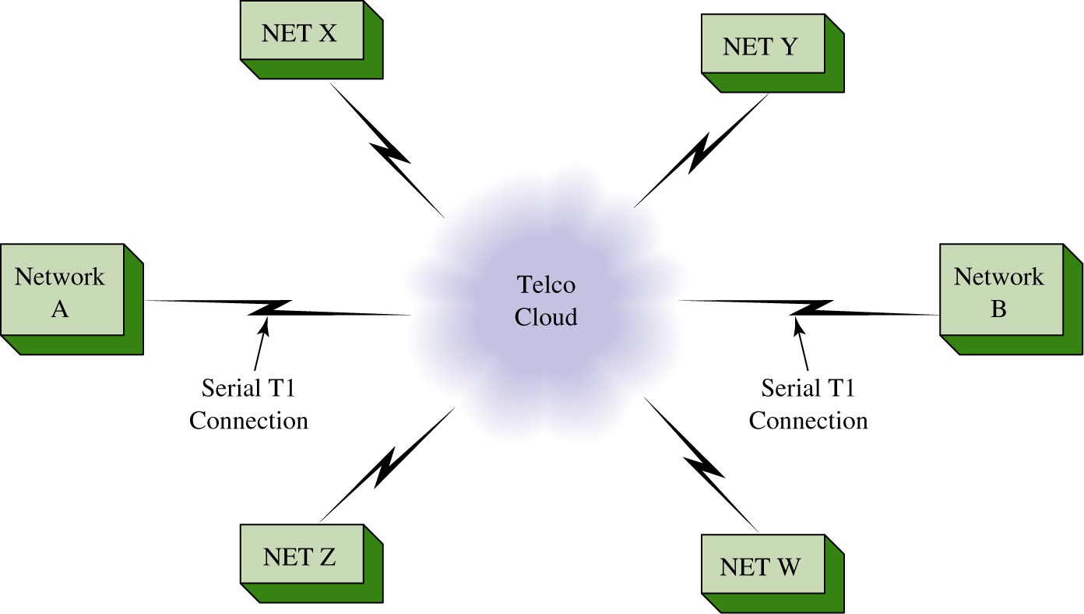
The Telco Cloud
Networks A and B each have established and configured a T1 data connection to the Telco cloud. The Telco cloud is the switched network the telecommunications carrier used to get the data to its destination.

Slide 33
The data from Network A enters the Telco cloud and is routed to the destination which is network B. The term cloud is often used to describe the interconnection of networks via the Internet.

Slide 34
Sample Leased-Line Topology

Slide 35
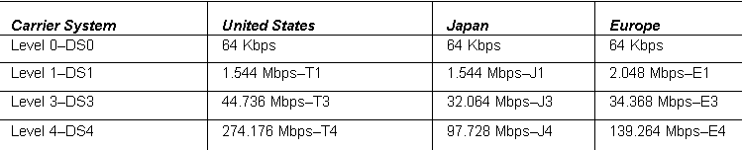
T-Carriers
T1 and T3 are the names used in the United States. In Japan, they are also known as J1/J3, and in Europe, they are denoted E1/E3.

Slide 36
Dialup
Usually used when no other WAN technology is available.
E.g. A remote location uses modems and analog dialed telephone lines to provide low capacity and dedicated switched connections.
Suitable when intermittent, low-volume daa transfers are needed.
Notes:
PSTN – public switched telephone network

Slide 37
ISDN
The Integrated Services Digital Network (ISDN) is a digital technology developed to combat the limitations of PSTN.
Users that have ISDN can send data, fax, or talk on the phone, all simultaneously from one line.
A common application of ISDN is to provide additional capacity as needed on a leased-line connection.
The leased line is sized to carry average traffic loads while ISDN is added during peak demand periods.
ISDN is also used as a backup if the leased line fails.
Notes:
PSTN – public switched telephone network

Slide 38
ISDN
ISDN can be broken down into two major categories:
Basic rate ISDN (BRI):
This is 128 Kbps with two equal B channels at 64 Kbps each for data, and one 16 Kbps D channel for timing/signaling.
Generally, devices that connect to BRI lines can handle eight simultaneous connections to the Internet.

Slide 39
ISDN
Primary rate ISDN (PRI):
This is 1.536 Mbps, and it runs on a T-1 circuit.
PRI has 23 equal 64 Kbps B channels for data, along with one 64 Kbps D channel for timing.

Slide 40
Frame Relay
Frame Relay is the advancement of X.25 packet switching.
No error correction at intermediate nodes
faster than X.25 and less overhead
It has a higher data rate at 44.473 Mbps (it was originally at 1.544 Mbps)
X.25 has a rate of only 64 kbps
It also uses a virtual circuit
Frame Relay created the “virtual network” that resides in the cloud.
Many customers use the same groups of wires or circuits (known as shared circuits).

Slide 41
Permanent Virtual Circuits
With Frame Relay, multiple sessions can run simultaneously on the same link.
These connections to the cloud are known as permanent logical links or permanent virtual circuits (PVCs) which are identified by a data-link connection identifier (DLCI).
The PVC links the sites together in the cloud.

Slide 42
ATM
Asynchronous transfer mode (ATM) is a cell-based switching technology as opposed to a packet switching technology.
It is capable of transferring voice, video, and data.
The cells involved in ATM are a fixed length, normally 53 octets (or 53 8-bit bytes).

Slide 43
Ethernet WAN
Originally designed for LAN as the max cable length was 1 km.
Newer Ethernet standards using fiber-optic cables support cable length up to 70 km.
It is also known as Metropolitan Ethernet (MetroE), Ethernet over MPLS (EoMPLS), and Virtual Private LAN Service (VPLS).

Slide 44
Multiprotocol Label Switching (MPLS)
Routing is based on short path labels rather than IP addresses
Labels identify paths between routers
It is Multiprotocol, i.e. it can carry any payload including IPv4, IPv6, Ethernet, ATM, DSL, and Frame Relay.
MPLS is a service provider technology
It encapsulate packets of various network protocols

Slide 45
Digital Subscriber Line (DSL)
DSL is a family of technologies that provides high-bandwidth data transmissions over telephone lines.
A DSL modem converts a Ethernet signal from user device to a DSL signal, which is transmitted to the ISP.
xDSL is the standard for the various digital subscriber lines.
ADSL (asymmetrical digital subscriber lines) can run on your home telephone line so that you can talk on the phone and access the Internet at the same time.
SDSL (symmetrical digital subscriber line) is installed (usually to companies) as a separate line and is more expensive. The upload and download speed are the same or symmetrical.

Slide 46
Digital Subscriber Line (DSL)

Slide 47
Broadband Cable
Broadband cable is used for cable Internet and cable TV.
It operates at a higher speed than DSL
Cable modem converts the digital signals into broadband frequencies used for transmitting on a cable TV network.

Slide 48
POTS/PSTN
POTS/PSTN stands for plain old telephone system/public switched telephone network.
This is what we use now for “regular” phone lines, and it has been around since the 1940s.
POTS/PSTN is now digital at the switching office and some central offices, but there analog lines run to people’s homes.

Slide 49
Summary
The differences between static and dynamic routing.
The differences between circuit switching and packet switching.
The differences between datagram and virtual circuit.
What T-carrier lines are, the different types of lines, and their Japanese and European counterparts.
The basics about various other wide area networking technologies, such as Frame Relay, ISDN, ATM, MPLS and MetroE.
An introduction to different personal and small business Internet connectivity types.

