Slide 1

Oracle: SQL
Subqueries

Slide 2
Objectives
Determine when using a subquery is appropriate
Identify which clauses can contain subqueries
Distinguish between an outer query and a subquery
Use a single-row subquery in a WHERE clause
Use a single-row subquery in a HAVING clause
Use a single-row subquery in a SELECT clause
Oracle 11g: SQL

Slide 3
Objectives (continued)
Distinguish between single-row and multiple-row comparison operators
Use a multiple-row subquery in a WHERE clause
Use a multiple-row subquery in a HAVING clause
Use a multiple-column subquery in a WHERE clause
Oracle 11g: SQL

Slide 4
Objectives (continued)
Create an inline view using a multiple-column subquery in a FROM clause
Compensate for NULL values in subqueries
Distinguish between correlated and uncorrelated subqueries
Nest a subquery inside another subquery
Use a subquery in a DML action
Process multiple DML actions with a MERGE statement
Oracle 11g: SQL

Slide 5
Subqueries and Their Uses
Subquery – a query nested inside another query
Used when a query is based on an unknown value
Requires SELECT and FROM clauses
Must be enclosed in parentheses
Place on right side of comparison operator
Oracle 11g: SQL

Slide 6
Single-Row Subqueries
Can only return one result to the outer query
Operators include =, >, <, >=, <=, < >
Oracle 11g: SQL

Slide 7
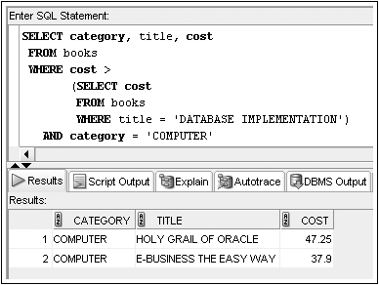
Single-Row Subquery in a WHERE Clause
Used for comparison against individual data
Oracle 11g: SQL

Slide 8
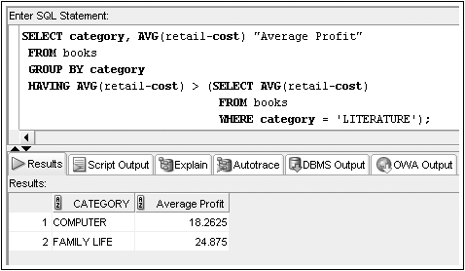
Single-Row Subquery in a HAVING Clause
Required when returned value is compared to grouped data
Oracle 11g: SQL

Slide 9
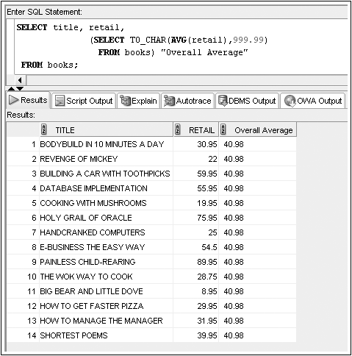
Single-Row Subquery in a SELECT Clause
Replicates subquery value for each row displayed
Oracle 11g: SQL

Slide 10
Multiple-Row Subqueries
Return more than one row of results
Require use of IN, ANY, ALL, or EXISTS operators
Oracle 11g: SQL

Slide 11
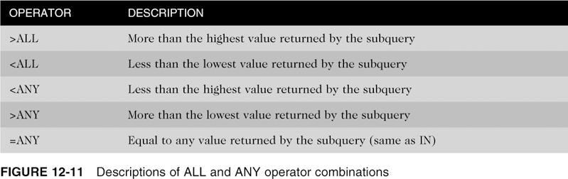
ANY and ALL Operators
Combine with arithmetic operators
Oracle 11g: SQL

Slide 12
Difference between Any and All
Id | Age | Salary
A | 25 | 2000
B | 33 | 4000
C | 23 | 8500
D | 27 | 6000
E | 24 | 4150
Select * from customers where age > ANY(Select age from customers where salary > 5000)
Any will be true if any of the subquery values meet the conditions
The inner query returned 23, 27
The outer query is then compared to the results if any of them either greater than 23 or 27
What records it will return?
Notes:
It will retrieve records with the 25, 33, 27, 24 ages.

Slide 13
Difference between Any and All
Id | Age | Salary
A | 25 | 2000
B | 33 | 4000
C | 23 | 8500
D | 27 | 6000
E | 24 | 4150
Select * from customers where age > ALL(Select age from customers where salary > 5000)
All will be true if all of the subquery values meet the conditions
The inner query returned 23, 27
The outer query is then compared to the results if they are greater than 23 and 27
What records it will return?
Notes:
The query will return only the record with the age of 33

Slide 14
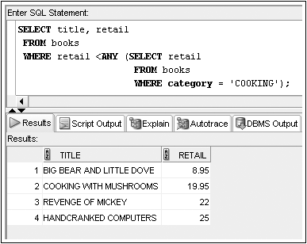
Multiple-Row Subquery in a WHERE Clause (continued)
Oracle 11g: SQL

Slide 15
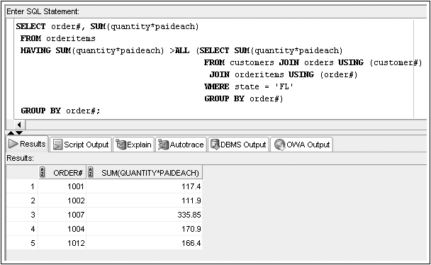
Multiple-Row Subquery in a HAVING Clause
Oracle 11g: SQL

Slide 16
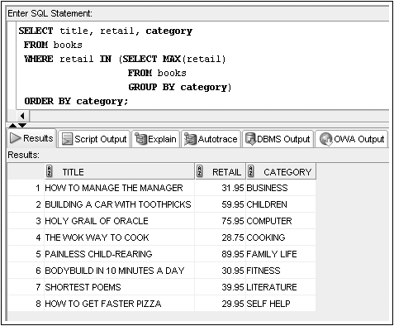
Multiple-Row Subquery in a WHERE Clause
Note: Could use IN operator or =ANY
Oracle 11g: SQL

Slide 17
Multiple-Column Subqueries
Return more than one column in results
Can return more than one row
Column list on the left side of operator must be in parentheses
Use the IN operator for WHERE and HAVING clauses
Oracle 11g: SQL

Slide 18
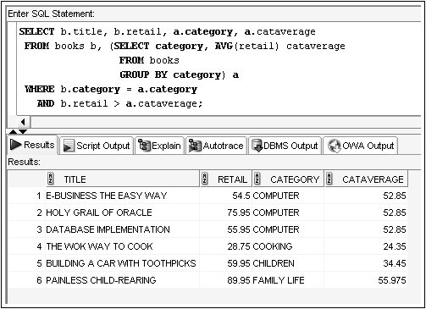
Multiple-Column Subquery in a FROM Clause
Creates a temporary table
Oracle 11g: SQL

Slide 19
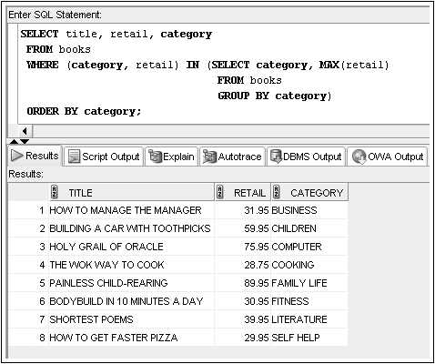
Multiple-Column Subquery in a WHERE Clause
Returns multiple columns for evaluation
Oracle 11g: SQL

Slide 20
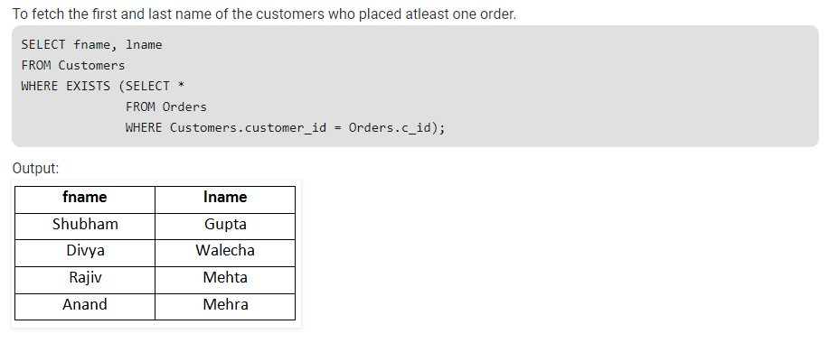
Using the exist condition

Slide 21
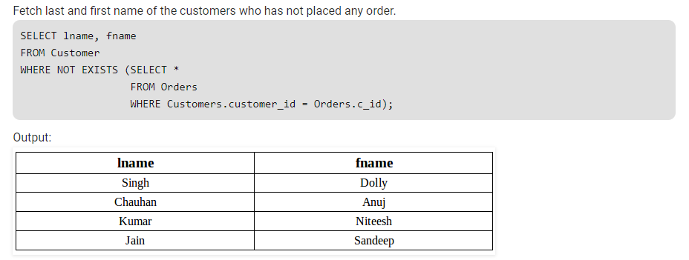
Using the Not Exists condition

Slide 22
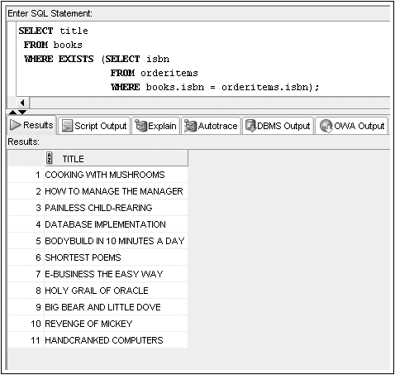
The Exist Condition
Oracle 11g: SQL

Slide 23
Nested Subqueries
Maximum of 255 subqueries if nested in the WHERE clause
No limit if nested in the FROM clause
Innermost subquery is resolved first, then the next level, etc.
Oracle 11g: SQL

Slide 24
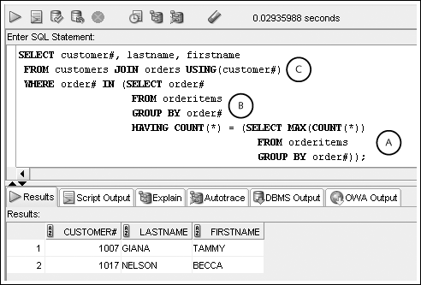
Nested Subqueries (continued)
Innermost is resolved first (A), then the second level (B), then the outer query (C)
Oracle 11g: SQL

Slide 25
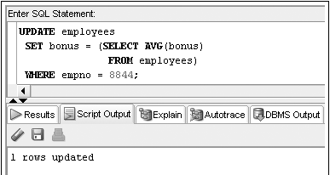
Subquery in a DML action
Oracle 11g: SQL

Slide 26
Summary
A subquery is a complete query nested in the SELECT, FROM, HAVING, or WHERE clause of another query
  The subquery must be enclosed in parentheses and have a SELECT and a FROM clause, at a minimum
Subqueries are completed first; the result of the subquery is used as input for the outer query
A single-row subquery can return a maximum of one value
Single-row operators include =, >, <, >=, <=, and <>
Multiple-row subqueries return more than one row of results
Oracle 11g: SQL

Slide 27
Summary (continued)
Operators that can be used with multiple-row subqueries include IN, ALL, ANY, and EXISTS
Multiple-column subqueries return more than one column to the outer query
NULL values returned by a multiple-row or multiple-column subquery will not present a problem if the IN or =ANY operator is used
Correlated subqueries reference a column contained in the outer query
Subqueries can be nested to a maximum depth of 255 subqueries in the WHERE clause of the parent query
Oracle 11g: SQL

Slide 28
Summary (continued)
With nested subqueries, the innermost subquery is executed first, then the next highest level subquery is executed, and so on, until the outermost query is reached
Oracle 11g: SQL

