Slide 1
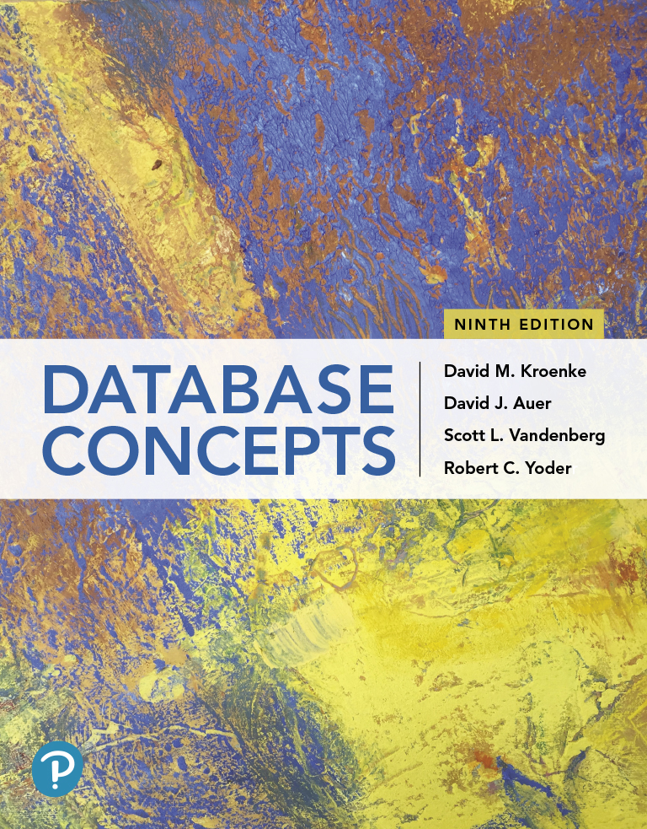
Database Concepts
Ninth Edition
Chapter 4
Data Modeling and the Entity-Relationship Model
Copyright © 2020, 2017, 2015 Pearson Education, Inc. All Rights Reserved
Notes:
If this PowerPoint presentation contains mathematical equations, you may need to check that your computer has the following installed:
1) Math Type Plugin
2) Math Player (free versions available)
3) NVDA Reader (free versions available)

Slide 2
Learning Objectives (1 of 2)
Learn the basic steps of systems analysis and design
Learn the basic stages of database development
Understand the purpose and role of a data model
Know the principle components of the E-R data model
Understand how to interpret traditional E-R diagrams
Understand how to interpret the Information Engineering (I E) model’s Crow’s Foot E-R diagrams
Learn to construct E-R diagrams
Learn the purpose of a database management system (DBMS)
Know how to represent 1:1, 1:N, N:M, and binary relationships with the E-R model

Slide 3
Learning Objectives (2 of 2)
Understand two types of weak entities and how to use them
Understand nonidentifying and identifying relationships and know how to use them
Know how to represent subtype entities with the E-R model
Know how to represent recursive relationships with the E-R model
Learn how to create an E-R diagram from source documents

Slide 4
Data and Information
Learn the basic steps of system analysis and design
Data is defined as recorded facts and numbers
Information is defined as:
Knowledge derived from data
Data presented in a meaningful context
Data processed by summing, ordering, averaging, grouping, comparing, or other similar operations

Slide 5
What is an Information System?
Learn the basic steps of system analysis and design
A System is defined as a set of components that interact to achieve some purpose or goal
An information system is a system that has the goal of producing information and is composed of the following components:
Hardware
Software
Data
Procedures
People

Slide 6
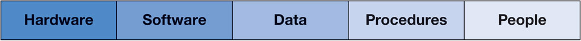
Figure 4.1 The Five-Component Information System Framework

Slide 7
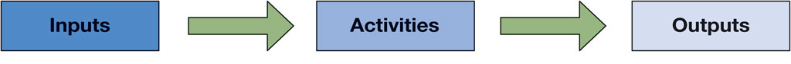
Figure 4.2 A Generalized Business Process
A business process is a set of activities that transform input into outputs

Slide 8
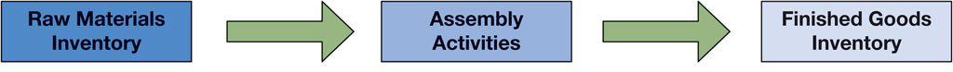
Figure 4.3 The Manufacturing Process

Slide 9
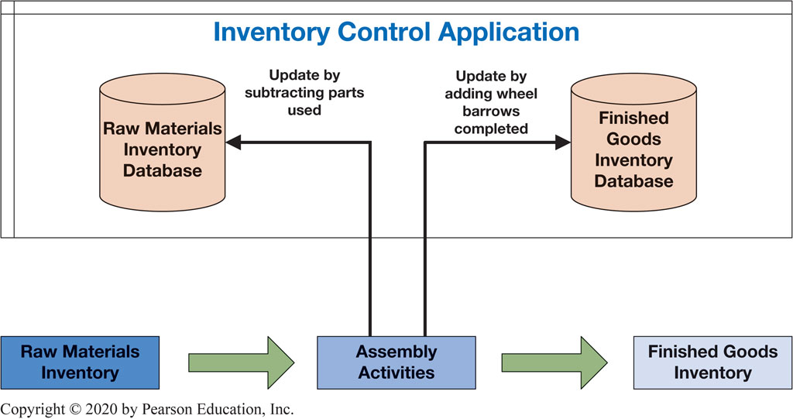
Figure 4.4 The Manufacturing Process with Supporting Information System

Slide 10
Systems Analysis and Design
Learn the basic steps of system analysis and design
Systems analysis and design is the process of creating and maintaining information systems.
The classic methodology used in systems analysis and design to developed information systems is called the systems development life cycle (S D L C) and is composed of the following steps:
Systems definition
Requirements analysis
Component design
Implementation
System maintenance

Slide 11
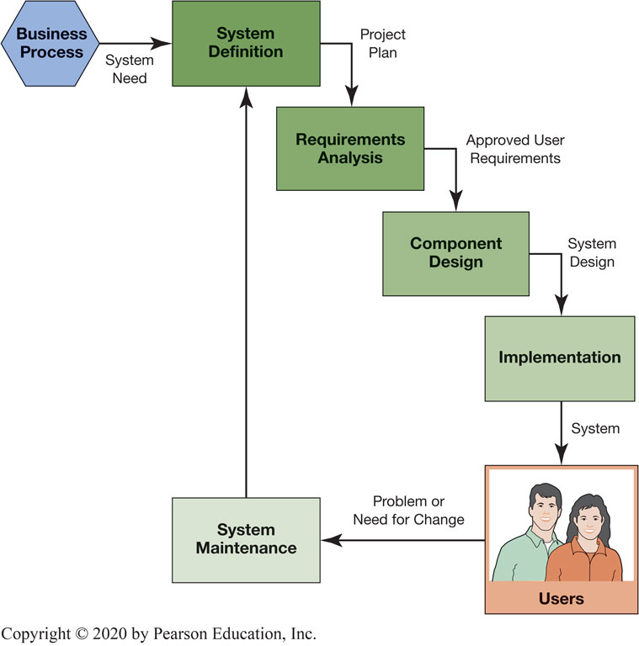
Figure 4.5 The S D L C in Use

Slide 12
The System Definition Step
Learn the basic steps of system analysis and design
The system definition step is a process that starts with the need for an information system to support a business process as its input and produces a plan as its output.
This step includes:
Define the information system project goals and scope
Assess the feasibility of the project (cost, schedule, technical, organizational)
Form the project team
Plan the project (specify tasks, assign personnel, determine task dependencies, set schedules)
The deliverable is the project plan

Slide 13
The Requirements Analysis Step
Learn the basic steps of system analysis and design
The requirements analysis step is a process that starts with the project plan as its input and produces a set of approved user requirements as its output
This step includes:
Conduct user interviews
Evaluate existing systems
Determine needed new forms/reports/queries
Identify needed new applications features and functions
Consider security
Consider the five components of an information system – hardware, software, data, procedures, people
The deliverable is the approved user requirements

Slide 14
The Component Design Step
Learn the basic steps of system analysis and design
The component design step is a process that starts with the approved user requirements as its input and produces a final system design as its output.
This step includes:
Determine hardware specifications
Determine program (software) specifications
Create the database design
Design business procedures
Create job descriptions for business personnel
The deliverable is the documented system design

Slide 15
The Implementation Step
Learn the basic steps of system analysis and design
The Implementation step is a process that starts with the final system design as its input and produces a final system as its output.
This step includes:
Build system components
Conduct component tests
Integrate the components
Conduct integrated component tests
Convert to the new system
The deliverable is the installed and functioning information system.

Slide 16
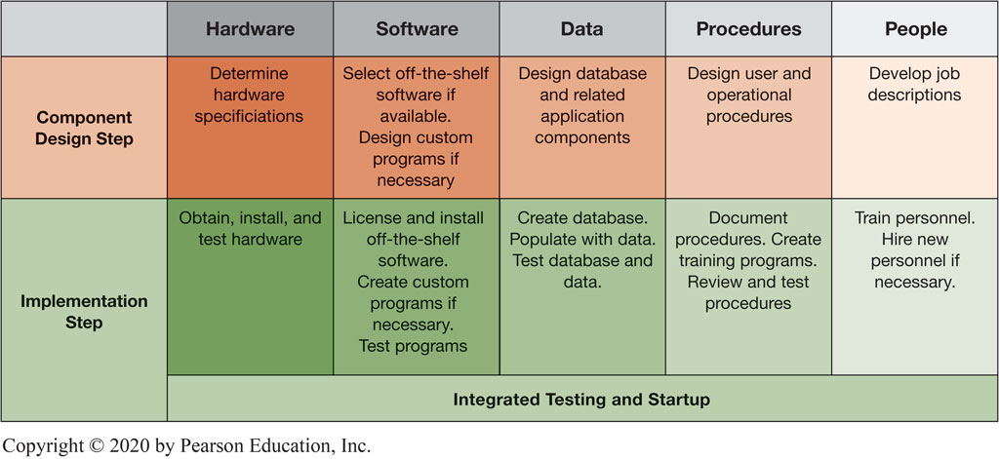
Figure 4.6 The S D L C Design and Implementation Steps for the Five Information System Components

Slide 17
The System Maintenance Step
Learn the basic steps of system analysis and design
The system maintenance step is a process that starts with the implemented system as its input and produces an updated system or a request of system modification using the S D L C as its output.
This step includes:
Update the system with patches, service packs, and new software releases
Record and prioritize requests for system changes of enhancements
The deliverable is an updated system and the start of a new S D L C cycle to enhance the information system.

Slide 18
What are the Steps in the Database Development Process?
Learn the basic stages of database development
The database development process is a subset of the S D L C that consists of three major stages:
Requirements analysis
Component design
Implementation

Slide 19
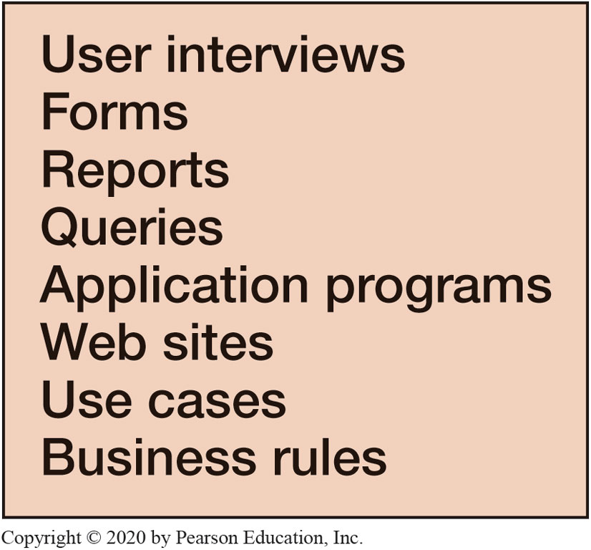
Figure 4.7 Sources of Requirements for a Database Applications

Slide 20
The Entity-Relationship Data Model
Know the principle components of the E-R model
When you create a database, data requirements must first be documented in a data model
A number of techniques can be used to create data models
The most popular is the entity-relationship model created by Peter Chen in 1976 (now interpreted as the extended entity-relationship model)
The most important elements of the E-R model are entities, attributes, identifiers, and relationships.

Slide 21
Entities
Know the principle components of the E-R model
An entity is something that users want to track. Examples include customers, purchases, products, etc.
Entities of a given type are grouped into an entity class such as EMPLOYEE (a collection of all EMPLOYEE entities) which are shown in all caps.
An entity instance of an entity class is the occurrence of a particular entity, such as CUSTOMER 12345.

Slide 22
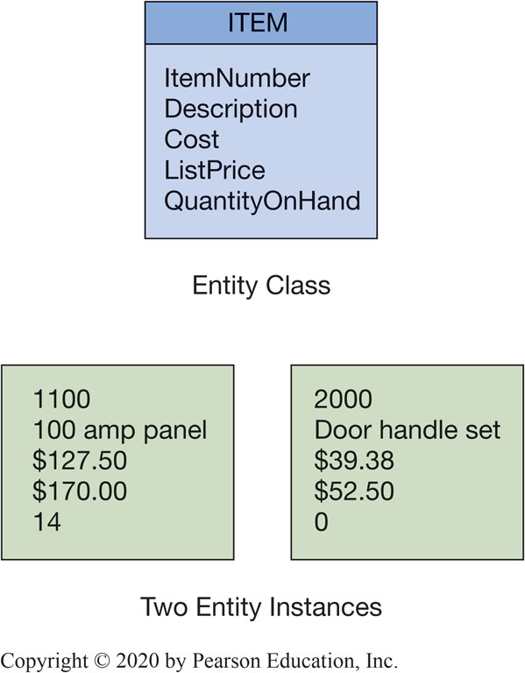
Figure 4.8 The ITEM Entity and Two Entity Instances

Slide 23
Attributes
Know the principle components of the E-R model
Entities have attributes, which describe the entity’s characteristics.
Examples include EmployeeName, DateOfHire, and JobSkillCode.
Attributes are shown with the first letter of each word capitalized as shown above.
An attribute has a data type (character, numeric, date, currency, etc.)

Slide 24
Identifiers
Know the principle components of the E-R model
Entity instances have identifiers, which are attributes that name, or identify, entity instances.
Examples include ItemNumber identifying an instance of ITEM and SocialSecurityNumber identifying an instance of EMPLOYEE.
Identifiers may be unique or nonunique
Unique identifiers identifies one, and only one, entity instance
Nonunique identifiers identifies a set in instances
An example is EmployeeName is an example as there may be more than one person with that name

Slide 25
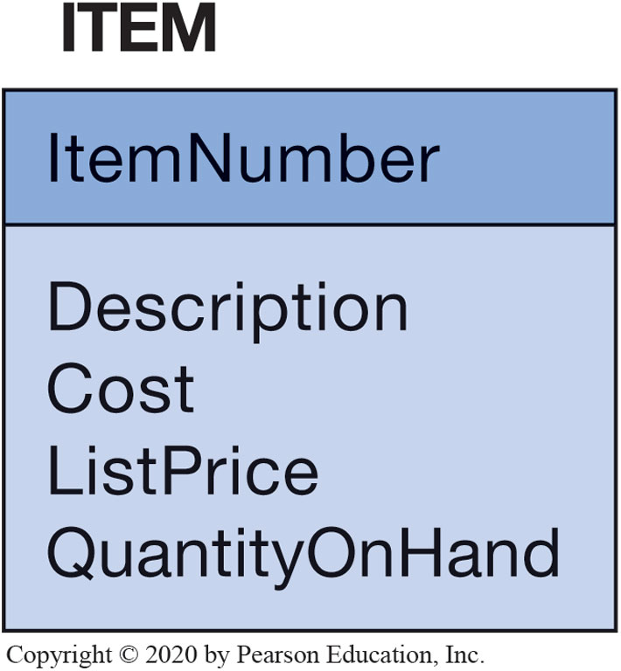
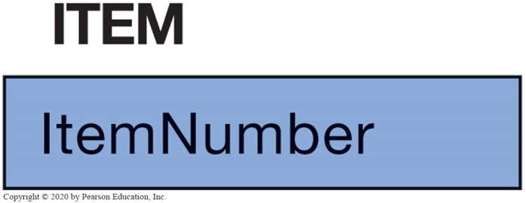
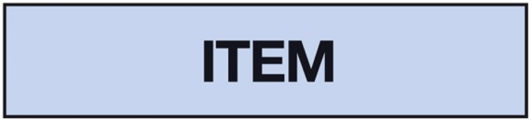
Figure 4.9 Levels of Entity Attribute Display

Slide 26
Relationships
Know the principle components of the E-R model
Entities can be associated with one another in relationships.
The number of entity classes in the relationship is known as the degree of the relationship as follows:
degree 2 is a binary relationship
degree 3 is a ternary relationship

Slide 27
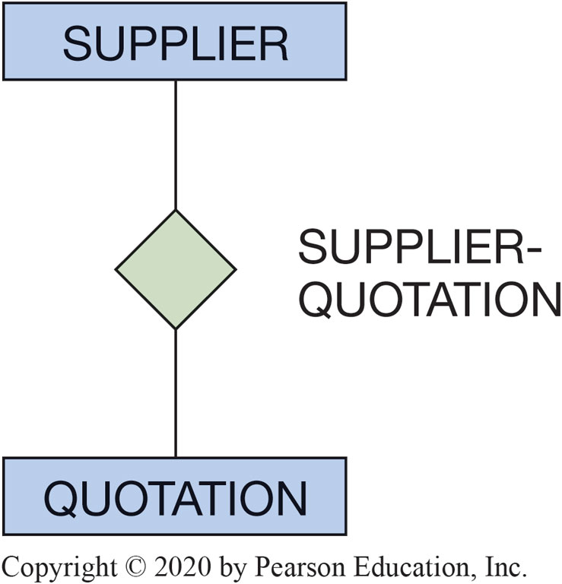
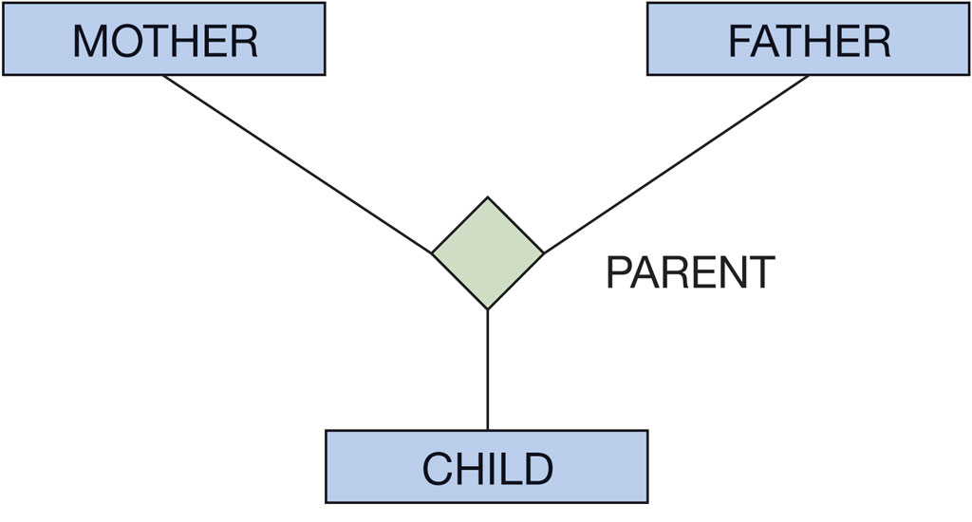
Figure 4.10 Example Relationships

Slide 28
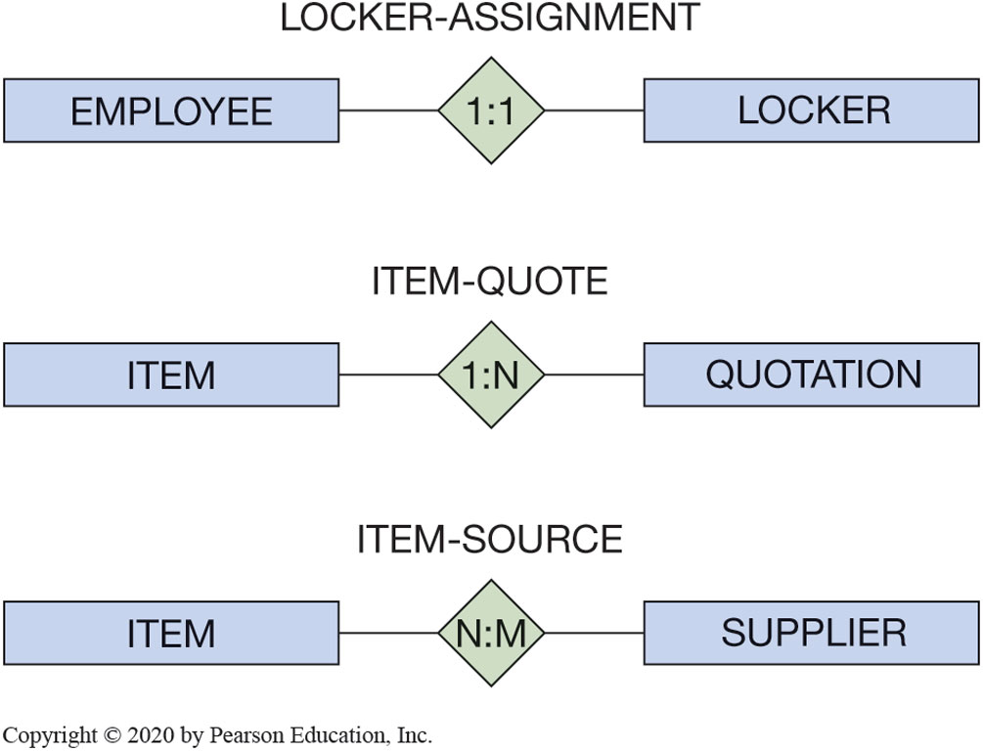
Figure 4.11 Three Types of Binary Relationships

Slide 29
Maximum Cardinality (1 of 2)
Know the principle components of the E-R model
Relationships are named and classified by their cardinality, which is a word that means count.
Each of the three types of binary relationships shown in the previous slide have different maximum cardinalities.
Maximum cardinality is the maximum number of entity instances that may participate in a relationship instance.

Slide 30
Maximum Cardinality (2 of 2)
Know the principle components of the E-R model
Minimum cardinality is the minimum number of entity instances that must participate in a relationship instance.
These values typically assume a value of zero (optional) or one (mandatory).

Slide 31
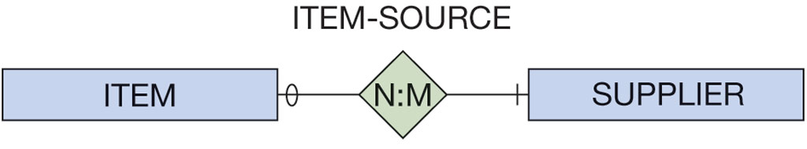
Figure 4.12 A Relationship with Minimum Cardinalities

Slide 32
H A S - A Relationships
Understand how to interpret traditional E-R diagrams
The relationships in the previous slides are called H A S - A relationships.
The term is used because each entity instance has a relationship to a second entity instance:
an employee has a badge
a badge has an employee

Slide 33
Variations of the E-R Model
Understand how to interpret the Information Engineering (I E) model’s Crow’s Foot E-R Diagrams
Information Engineering (I E) [James Martin 1990] It uses “crow’s feet” to show the many sides of a relationship, and is sometimes called the crow’s foot model.
Integrated Definition 1, Extended (I D E F I X) is a version of the E-R model that is a national standard.
Unified Modeling Language (UML) is a set of structures and techniques for modeling and designing object-oriented programs (O O P) and applications.

Slide 34
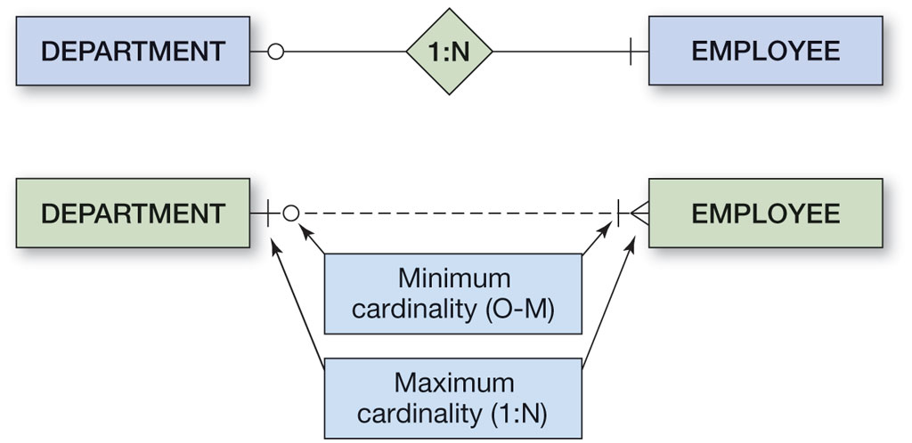
Figure 4.13 Two Versions of a 1:N O-M Relationship

Slide 35
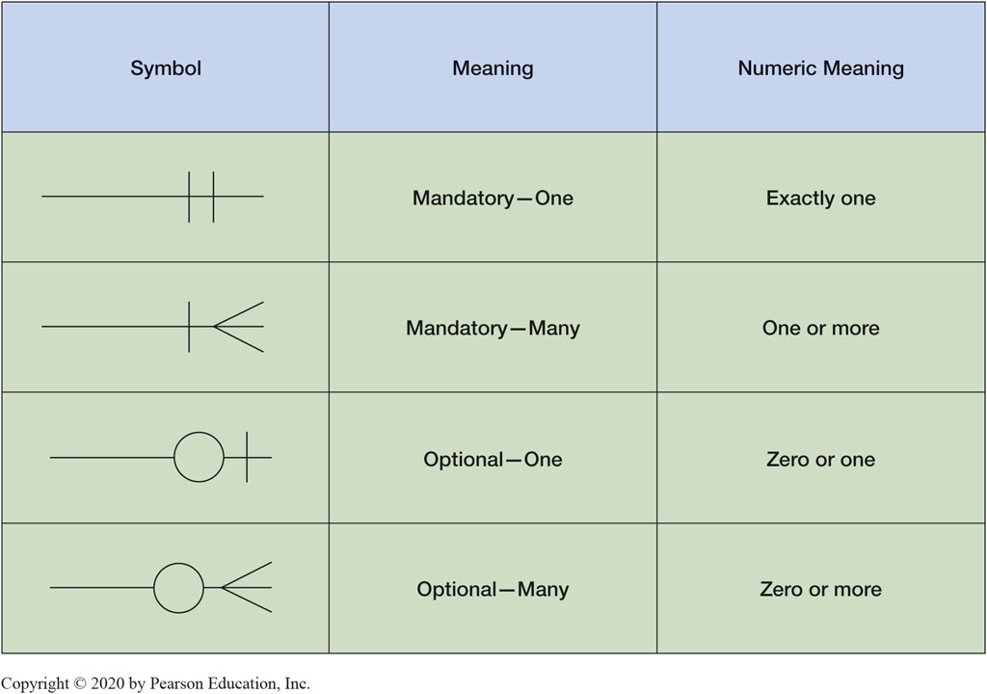
Figure 4.14 Crow’s Foot Notation

Slide 36
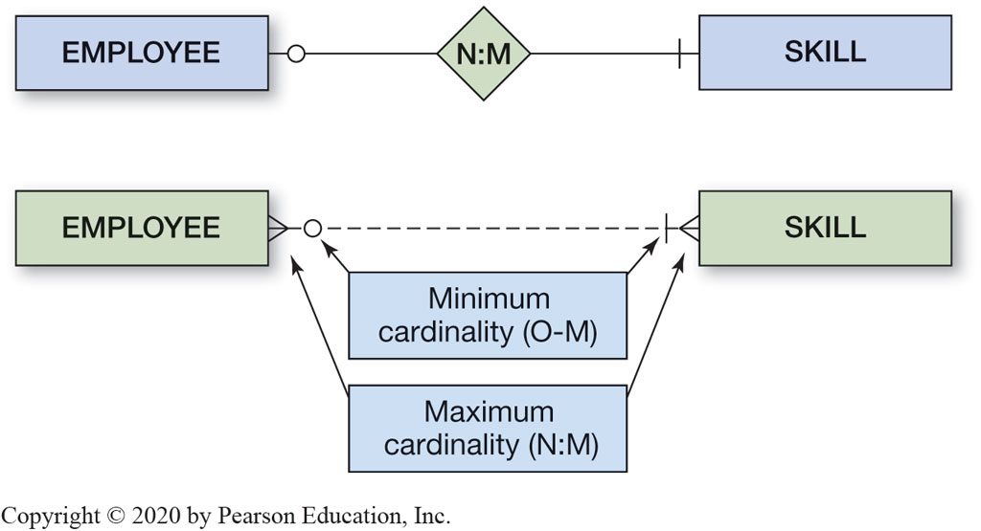
Figure 4.15 Two Versions of a N:M O-M Relationship

Slide 37
Weak Entities
Understand two types of weak entities and know how to use them
A weak entity is an entity that cannot exist in the database without the existence of another entity.
Any entity that is not a weak entity is called a strong entity.

Slide 38
ID-Dependent Weak Entities
Understand two types of weak entities and know how to use them
An ID-dependent weak entity is a weak entity that cannot exist without its parent entity.
An ID-dependent weak entity has a composite identifier:
the first part of the identifier is the identifier for the strong entity
the second part of the identifier is the identifier for the weak entity itself

Slide 39
Weak Entity Relationships
Understand nonidentifying and identifying relationships and how to use them
The relationship between a strong and weak entity is termed an identifying relationship if the weak entity is ID-dependent:
represented by a solid line
The relationship between a strong and weak entity is termed a nonidentifying relationship if the weak entity is non-ID-dependent:
represented by a dashed line
also used between strong entities

Slide 40
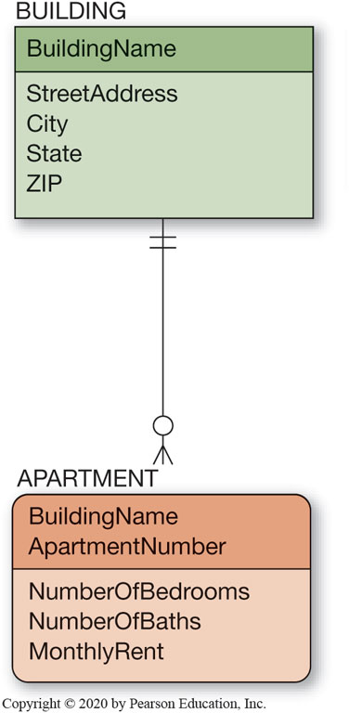
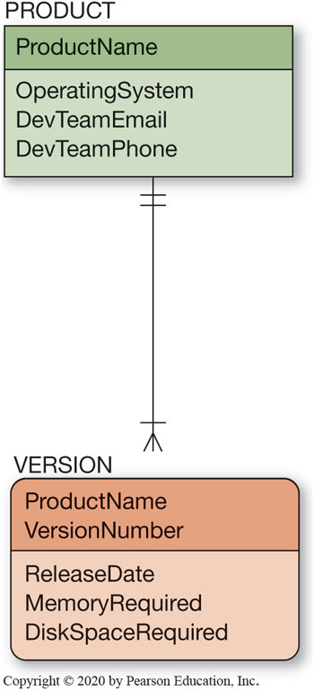
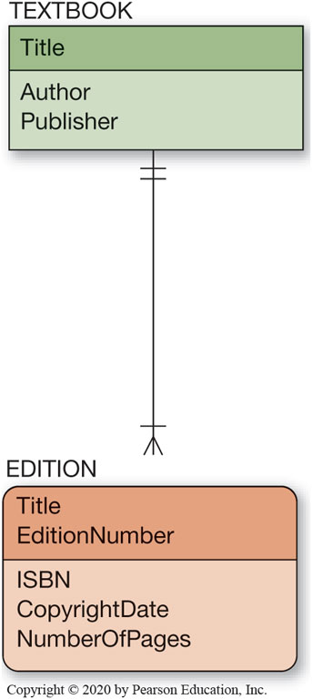
Figure 4.16 Example ID-Dependent Entities

Slide 41
Non-ID-Dependent Weak Entities
Understand nonidentifying and identifying relationships and how to use them
All ID-dependent entities are weak entities, but there are other entities that are weak but not ID-dependent.
A non-ID-dependent weak entity may have a single or composite identifier, but the identifier of the parent entity will be a foreign key.

Slide 42
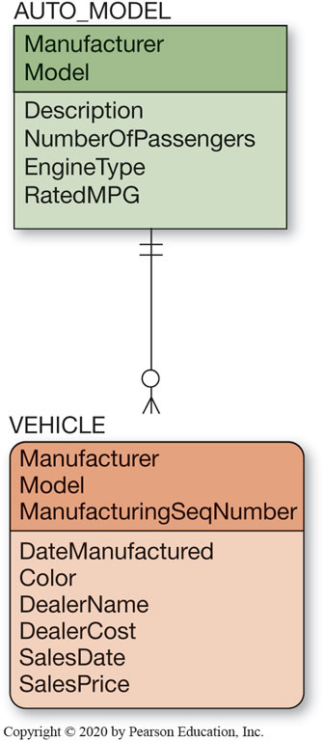
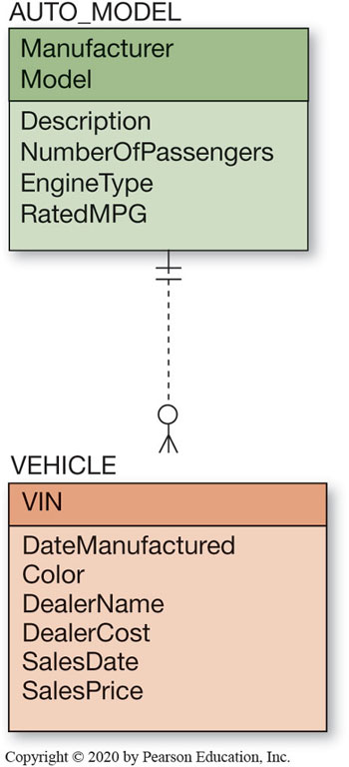
Figure 4.17 Weak Entity Examples

Slide 43
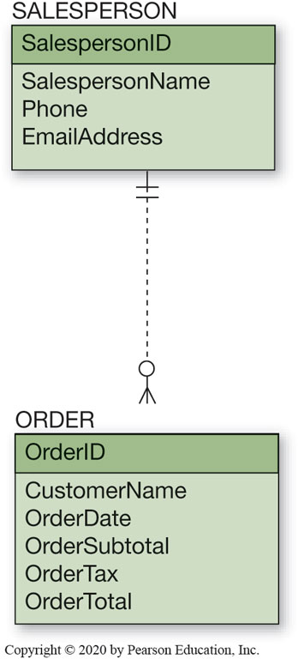
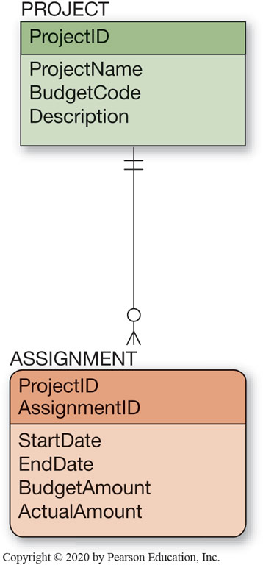
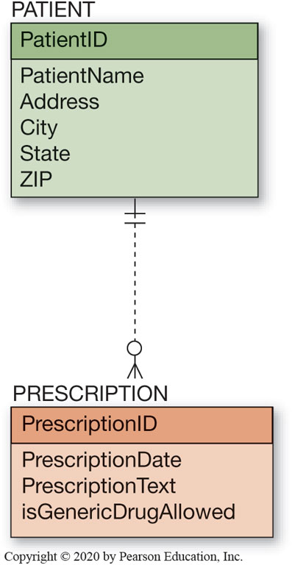
Figure 4.18 Examples of Required Entities

Slide 44
Associative Entities
Understand nonidentifying and identifying relationships and how to use them
An associative entity (also called an association entity) is used whenever a pure N:M relationship cannot properly hold attributes that are describing aspects of the relationship between two entities.
A new entity is then created to:
link the two original entities
hold the attributes

Slide 45
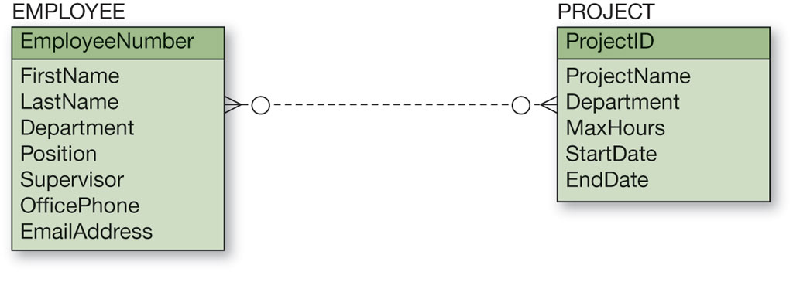
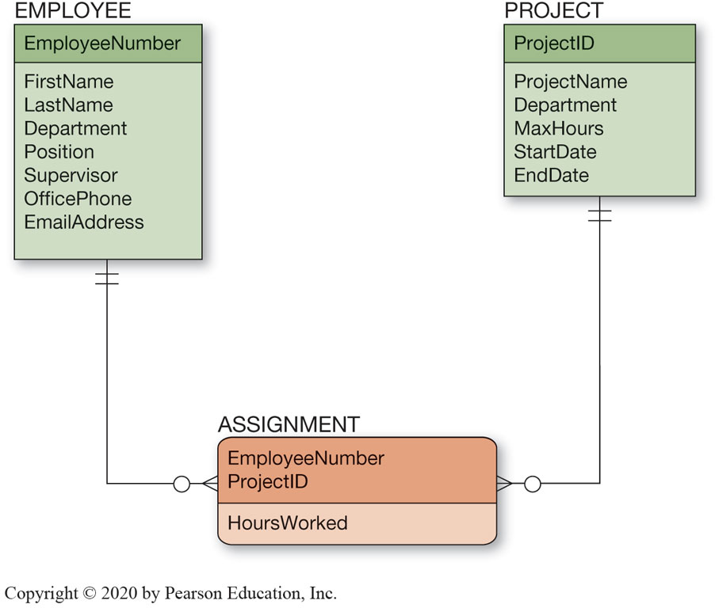
Figure 4.19 The Associative Entity

Slide 46
Subtype Entities
Know how to represent subtype entities with the E-R model
A subtype entity is a special case of another entity called supertype.
An attribute of the supertype indicates which of the subtypes is appropriate for a given instance and is called a discriminator.
Subtypes can be exclusive or inclusive:
if exclusive, the supertype relates to at most one subtype
if inclusive, the supertype can relate to one or more subtypes

Slide 47
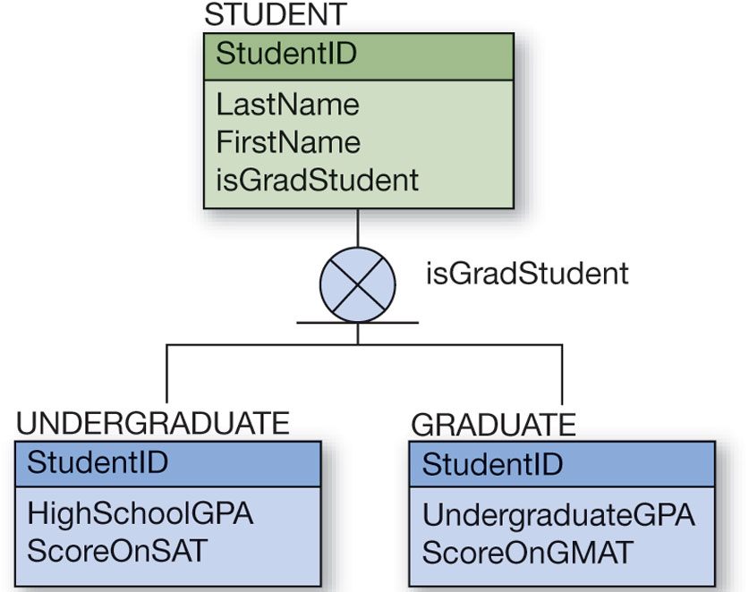
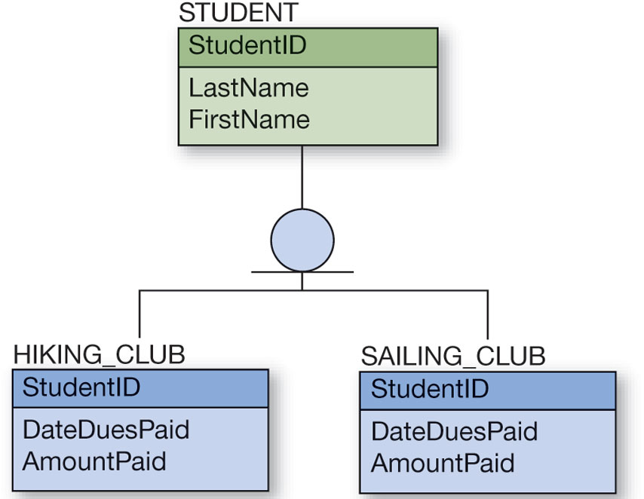
Figure 4.20 Example Subtype Entities

Slide 48
Subtype Entity Identifiers
Know how to represent subtype entities with the E-R model
The relationships that connect supertypes and subtypes are called I S - A relationship because a subtype is the same entity as the supertype.
The identifier of a supertype and all of its subtypes is the same attribute

Slide 49
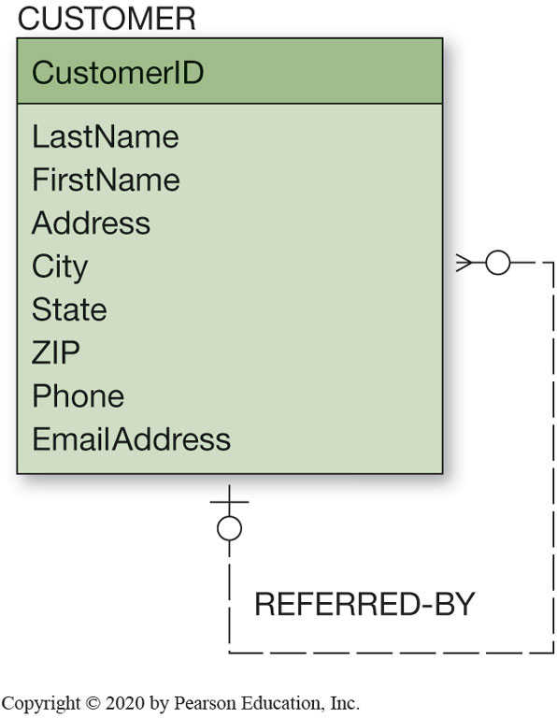
Figure 4.21 Example Recursive Relationship
Know how to represent recursive relationships with the E-R model
It is possible for an entity to have a relationship to itself—this is called a recursive relationship (also known as a unary relationship)

Slide 50
Developing an Example E-R Diagram
Learn how to create an E-R Diagram from source documents
Heather Sweeney Designs will be used as an on-going example throughout Chapters 4, 5, 6, and 7:
Heather Sweeney is an interior designer who specializes in home kitchen design
offers a variety of free seminars at home shows, kitchen and appliance stores, and other public locations
earns revenue by selling books and videos that instruct people on kitchen design
offers custom-design consulting services

Slide 51
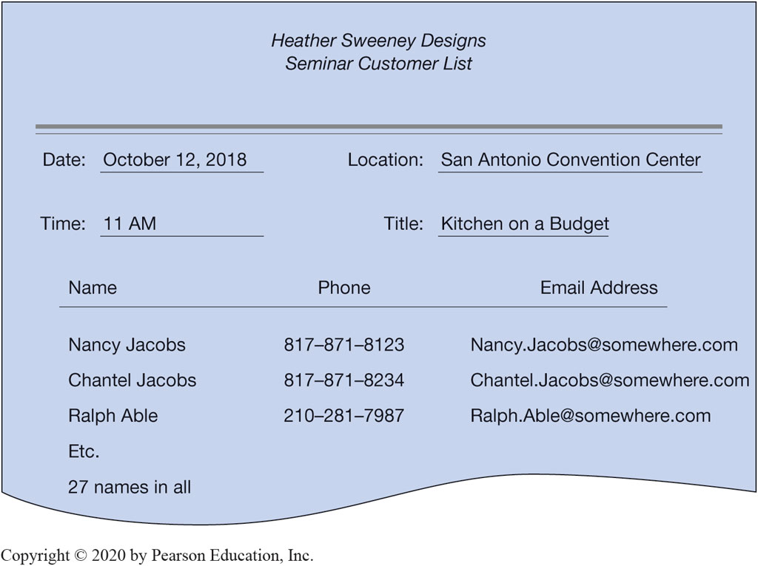
Figure 4.22 Example Seminar Customer List

Slide 52
Heather Sweeney Design Fact
Learn how to create an E-R diagram from source documents
Having missing facts is typical during the data modeling process as there are a number of undetermined facts from the Heather Sweeney design.
It is not certain about the 1:N cardinality
Neither is it know what to use for the identifier for each entity
Once all information is know, the initial E-R Diagram can be created.

Slide 53
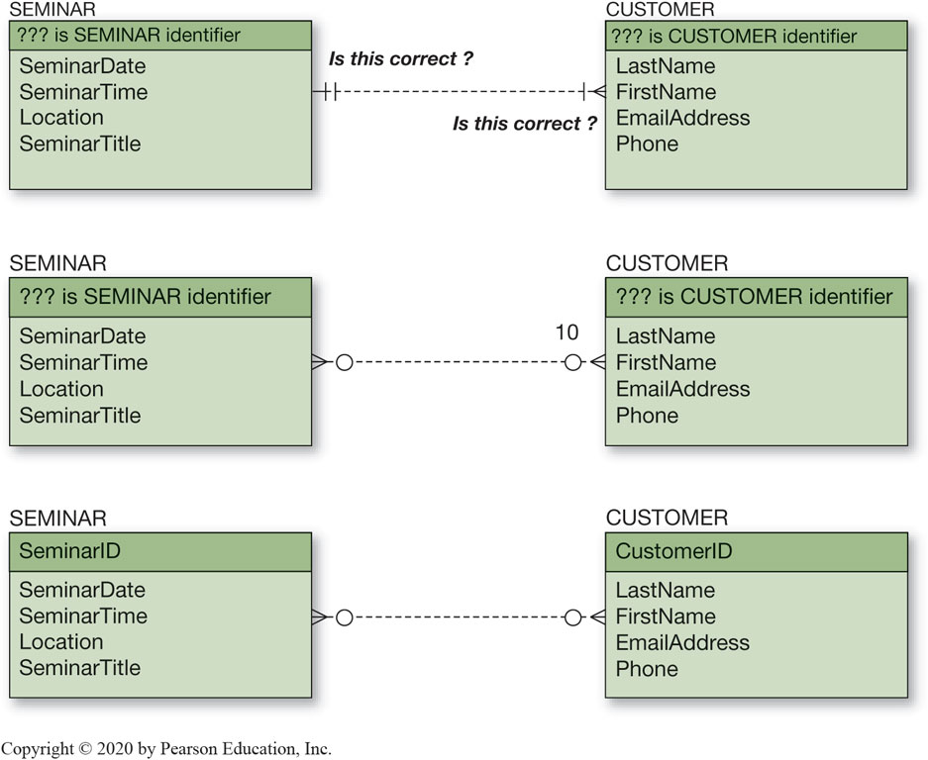
Figure 4.23 Initial E-R Diagram for Heather Sweeney Designs

Slide 54

Figure 4.24 Heather Sweeney Designs Customer Form Letter

Slide 55
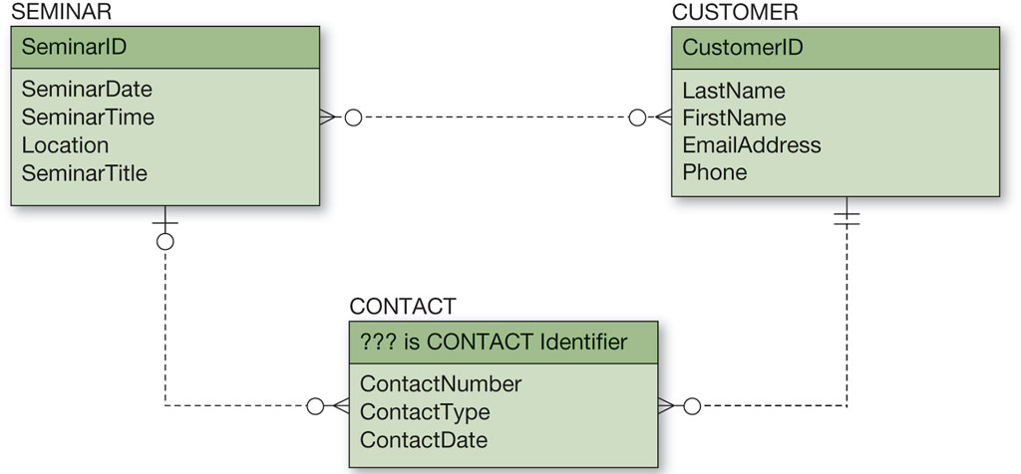
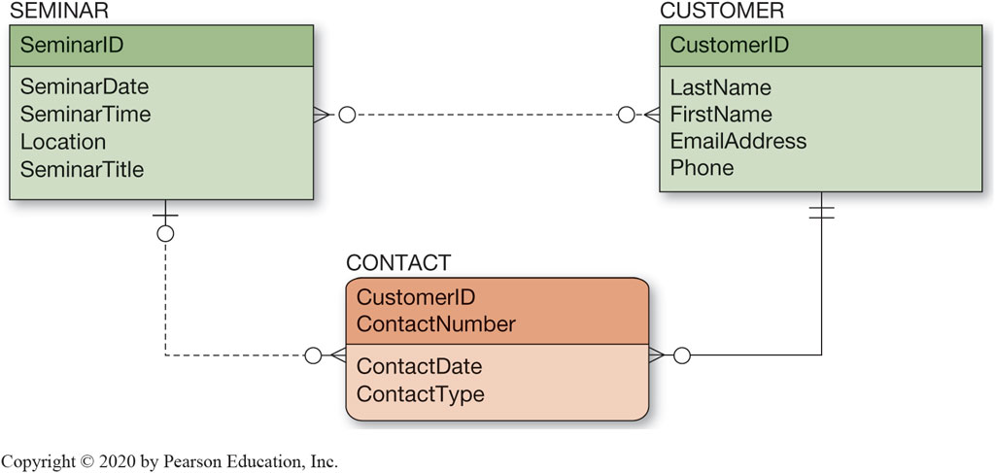
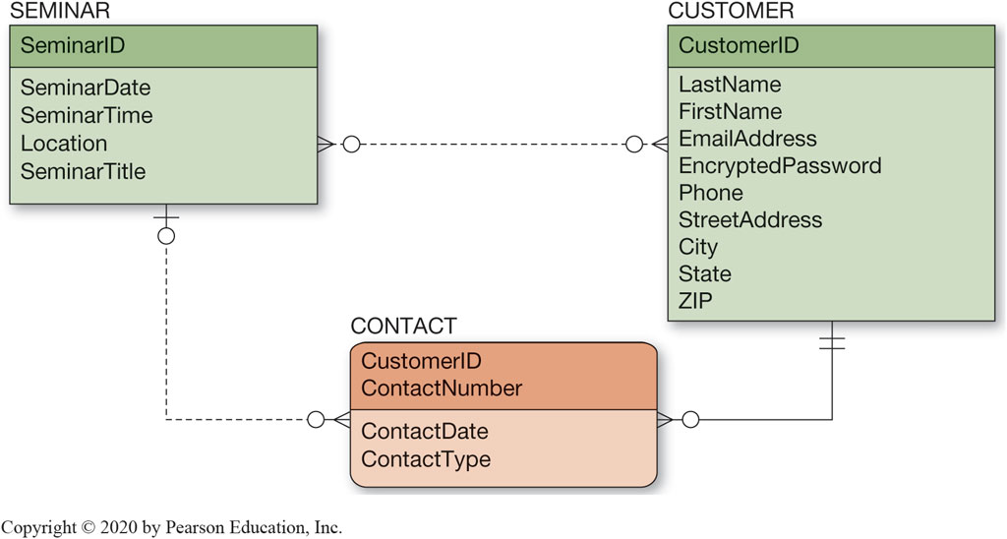
Figure 4.25 Heather Sweeney Designs Data Model with CONTACT

Slide 56
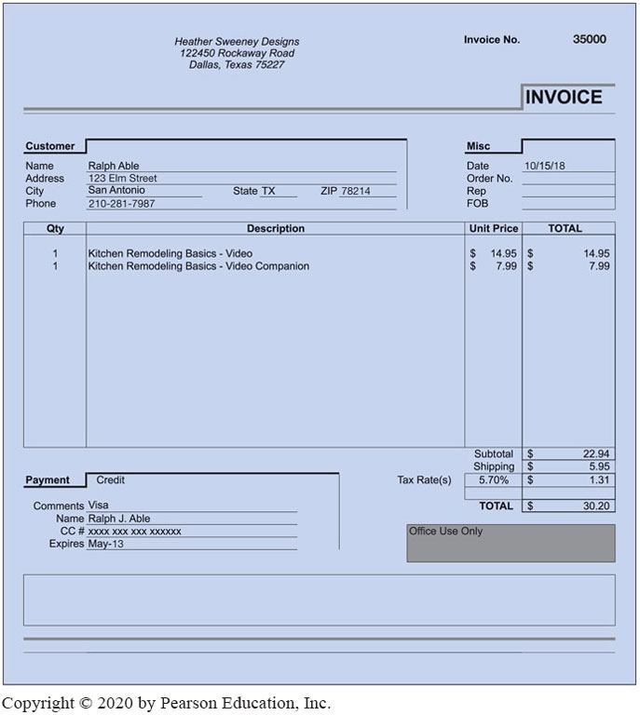
Figure 4.26 Heather Sweeney Designs Sales Invoice

Slide 57
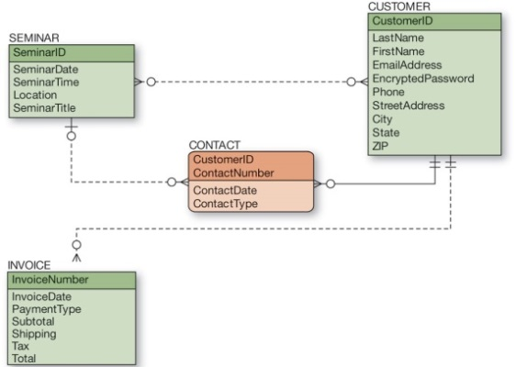
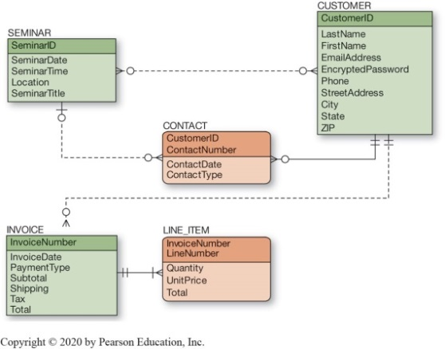
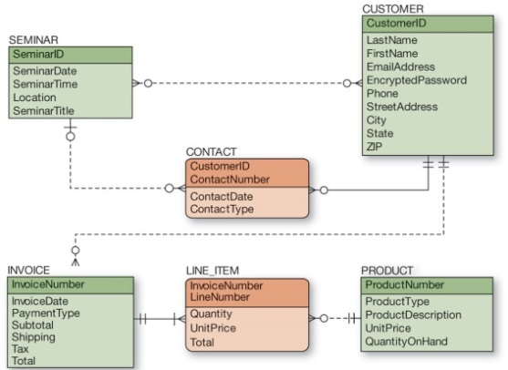
Figure 4.27 The Final Data Model for Heather Sweeney Designs

Slide 58
Validating the Data Model
Learn how to create an E-R diagram from source documents
After the data model has been completed, it needs to be validated:
The most common way is to show it to the users and obtain their feedback
prototyping is commonly use to validate forms and reports
A data model needs to be evaluated against all use cases

Slide 59
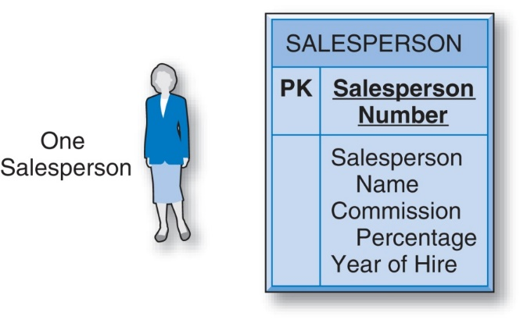
E-R Model Entity (and its attributes)
Rectangular shape
Salesperson = a type of entity
Name of entity is in caps above the separator line.

Slide 60

E-R Model Entity (and its attributes)
The attribute(s) which is the entity’s unique identifier is shown with a PK ( Primary Key )
All other Entity attributes are shown below the separator line.

Slide 61
E-R Model (Relationship between Entities)
Relationship – is the link between entities (relates to primary key-foreign key relationship in related tables)
A relationship is always between entities, not attributes.

Slide 62
E-R Model (Relationship between Entities)
Cardinality - represents the maximum number of entities that can be involved in a particular relationship.
Many-to-Many Relationships
One-to-Many Relationships
One-to-One Relationships

Slide 63
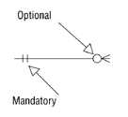
E-R Model (Relationship between Entities)
Modality (Optionality)
The minimum number of entity occurrences that can be involved in a relationship.
“inner” symbol on E-R diagram (“outer” symbol is cardinality)

Slide 64
Cardinality
Represents the maximum number of entities that can be involved in a particular relationship.
One-to-One Binary Relationship
One-to-Many Binary Relationship
Many-to-Many Binary Relationship

Slide 65
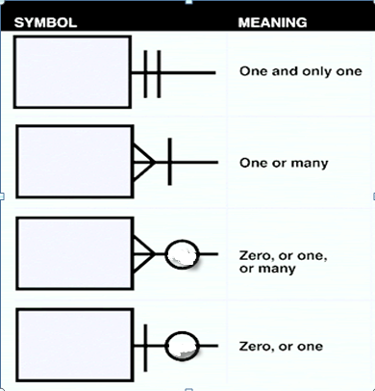
Crow’s Foot Notations (Drawing Symbols)

Slide 66
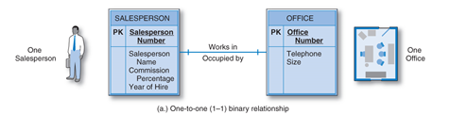
One-to-One Binary Relationship
1-1
A single occurrence of one entity type can be associated with a single occurrence of the other entity type and vice versa.

Slide 67
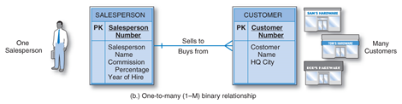
One-to-Many Binary Relationship
1-M
Use “crow’s foot” to represent the multiple association.
“many” = the maximum number of occurrences that can be involved, means a number that can be 1, 2, 3, ... n.

Slide 68
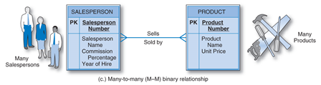
Many-to-Many Binary Relationship
M-M
“many” can be either an exact number or have a known maximum.

Slide 69
Modality (Optionality)
The minimum number of entity occurrences that can be involved in a relationship.
“inner” symbol on E-R diagram (“outer” symbol is cardinality)

Slide 70
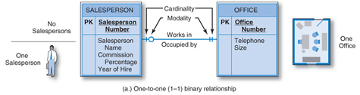
Cardinality & Modality

Slide 71
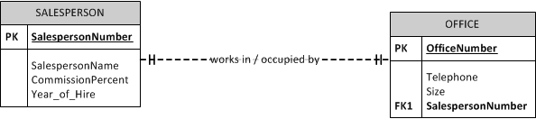
Foreign Key

Slide 72

Copyright
This work is protected by United States copyright laws and is provided solely for the use of instructors in teaching their courses and assessing student learning. Dissemination or sale of any part of this work (including on the World Wide Web) will destroy the integrity of the work and is not permitted. The work and materials from it should never be made available to students except by instructors using the accompanying text in their classes. All recipients of this work are expected to abide by these restrictions and to honor the intended pedagogical purposes and the needs of other instructors who rely on these materials.
Notes:
If this slide was not included in the original PPT, it should be added.

