Slide 1
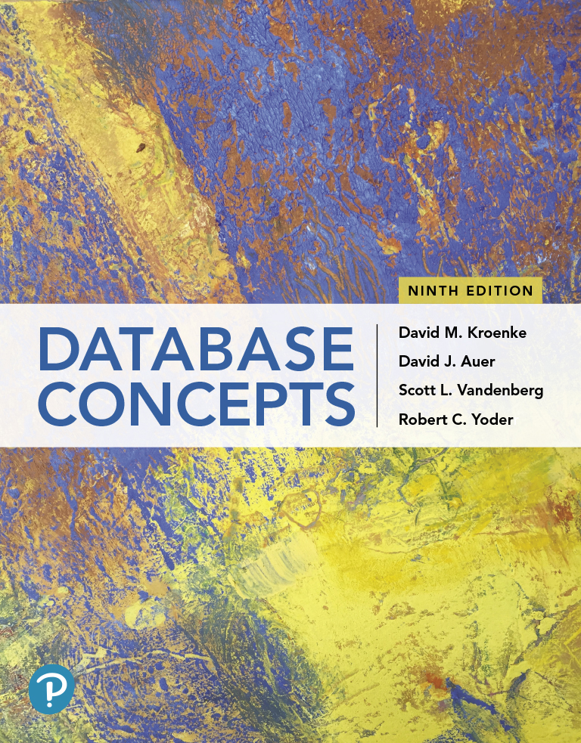
Database Concepts
Ninth Edition
Chapter 5
Database Design
Copyright © 2020, 2017, 2015 Pearson Education, Inc. All Rights Reserved
Notes:
If this PowerPoint presentation contains mathematical equations, you may need to check that your computer has the following installed:
1) Math Type Plugin
2) Math Player (free versions available)
3) NVDA Reader (free versions available)

Slide 2
Learning Objectives
Learn how to transform E-R data models into relational designs
Practice applying the normalization process
Understand the need for denormalization
Learn how to represent weak entities with the relational Model
Know how to represent 1:1, 1:N, and N:M binary relationships
Know how to represent 1:1, 1:N, and N:M recursive relationships
Learn SQL statements for creating joins over binary and recursive relationships

Slide 3
The Purpose of a Database Design
Learn how to transform E-R data models into relational designs
A database design is a set of database specifications that can actually be implemented as a database in a DBMS.
The three designs are:
conceptual design (conceptual schema)
logical design (logical schema)
physical design (physical schema)
The design studied in this chapter is equivalent to the logical design.

Slide 4
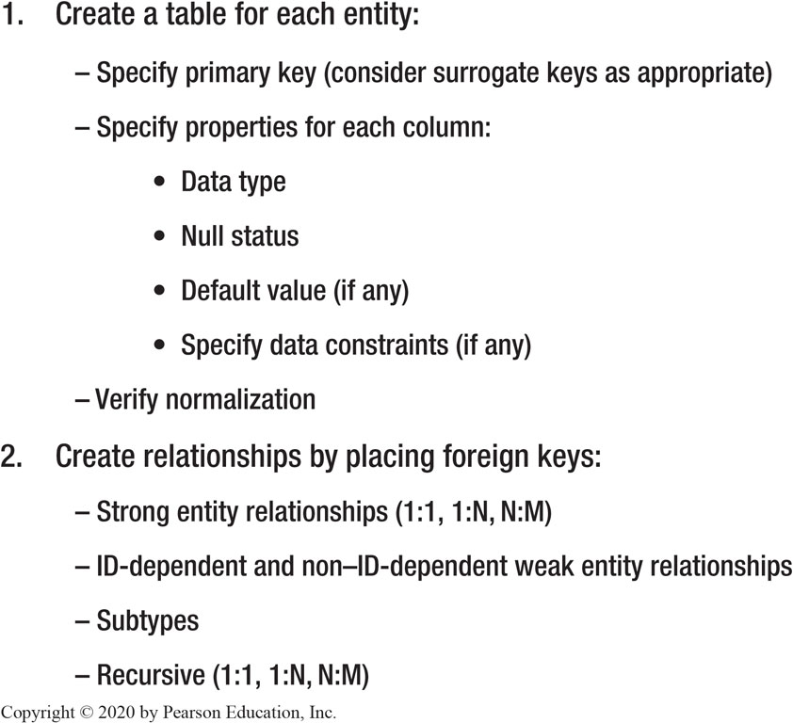
Figure 5.1 The Steps for Transforming a Data Model into a Database Design

Slide 5
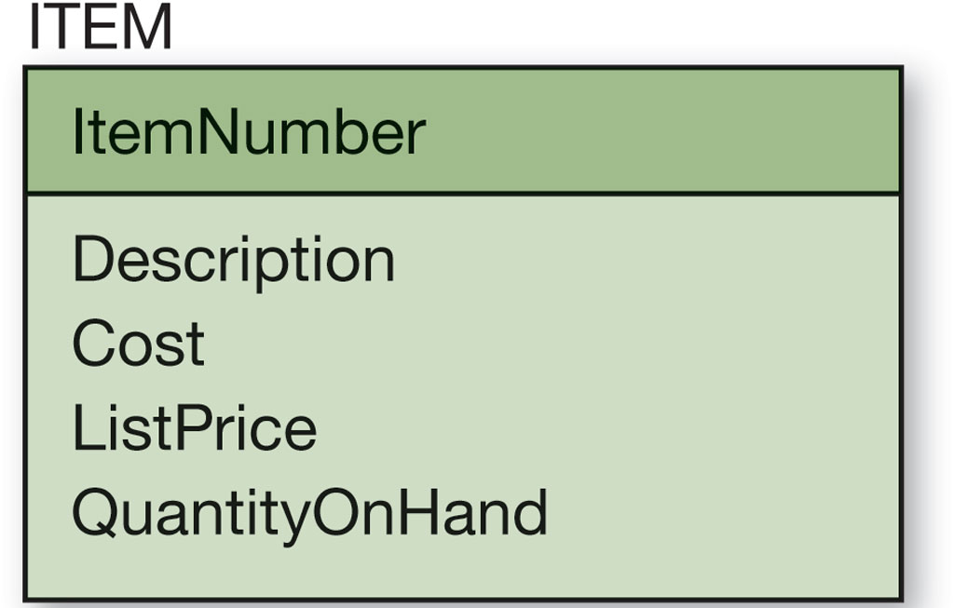
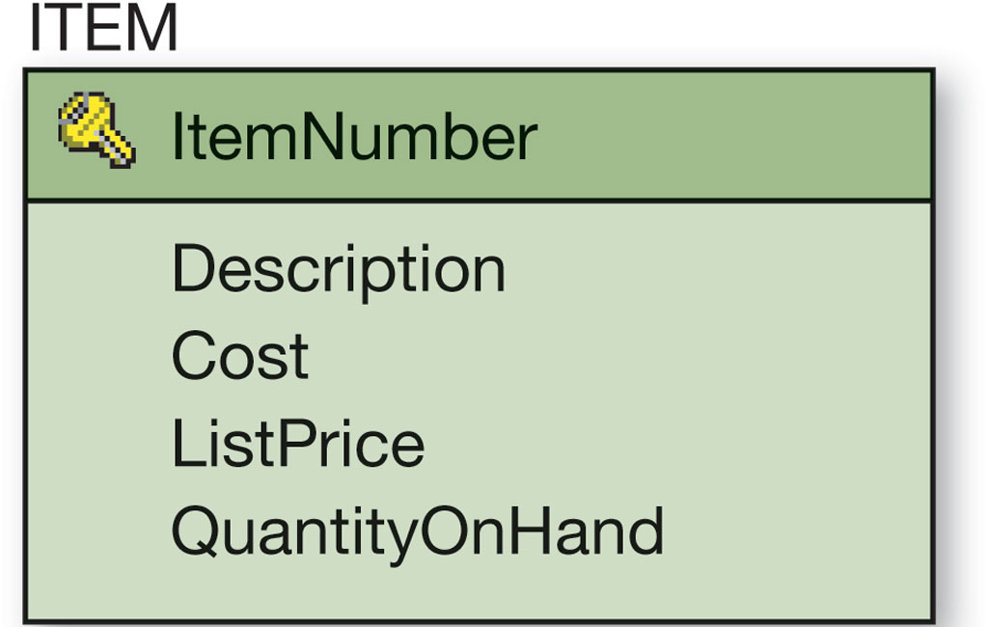
Figure 5.2 The ITEM Entity and Table

Slide 6
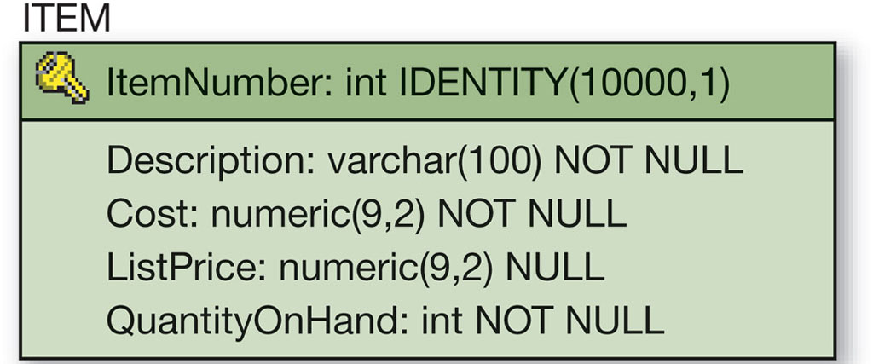
Figure 5.3 The Final ITEM Table

Slide 7
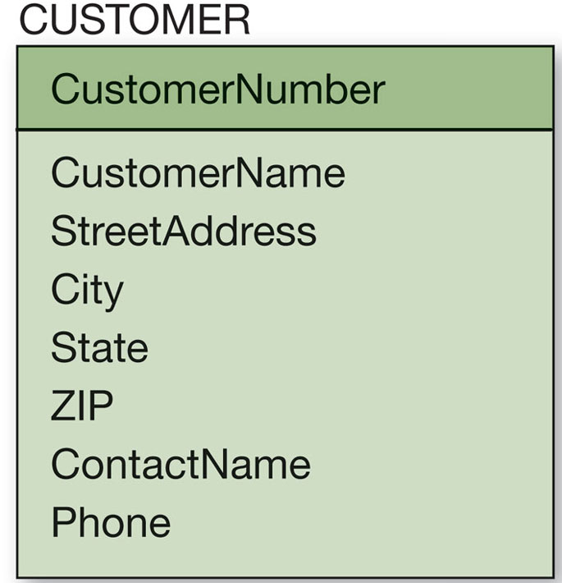
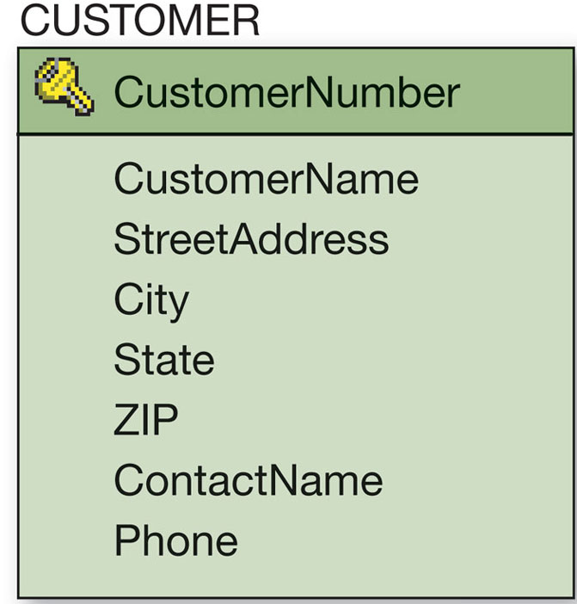
Figure 5.4 The CUSTOMER Entity and Table
CUSTOMER (CustomerNumber, CustomerName, StreetAddress, City, State, ZIP, ContactName, Phone)

Slide 8
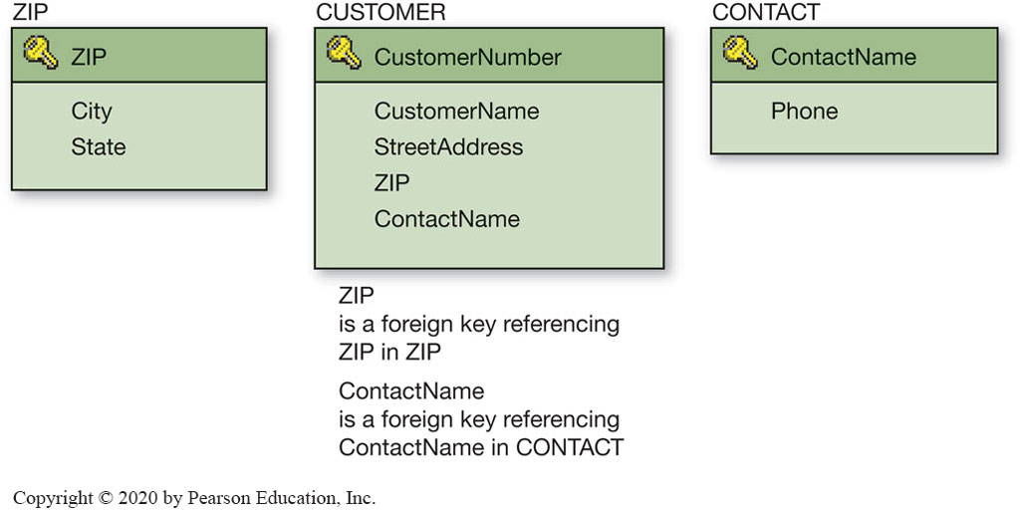
Figure 5.5 The Normalized CUSTOMER and Associated Tables

Slide 9
Denormalization
Understand the need for denormalization
Normalizing relations (or breaking them apart into many component relations) may significantly increase the complexity of the data structure.
The question is one of balance:
trading complexity for modification problems
There are situations where denormalized relations are preferred.

Slide 10
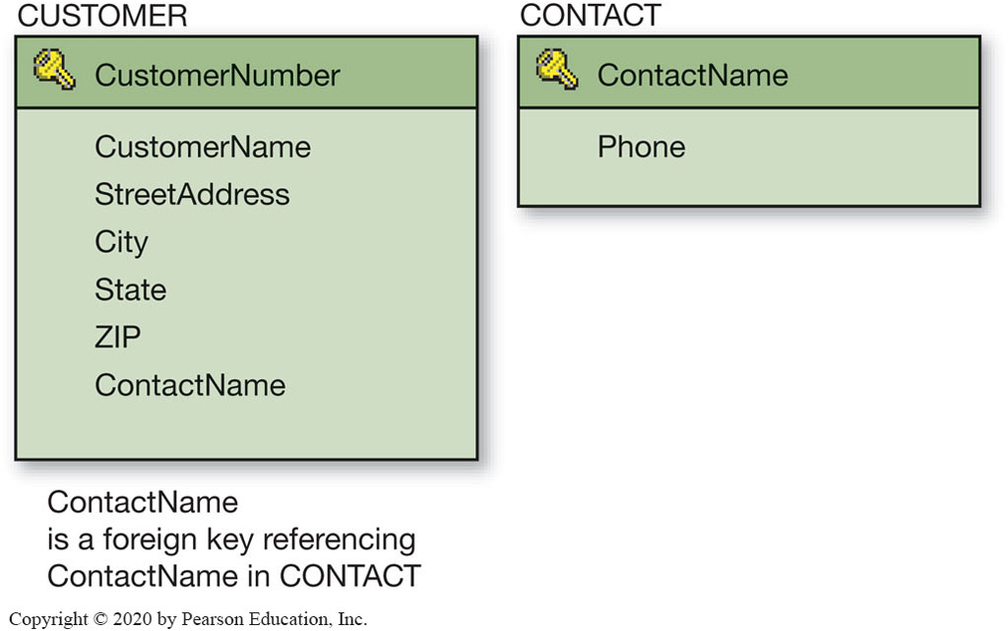

Figure 5.6 The Denormalized CUSTOMER and Associated CONTACT Tables

Slide 11
Represent Weak Entities
Learn how to represent weak entities with the relational model
If not ID-dependent, use the same techniques as for strong entities
If ID-dependent, then must add primary key of the parent entity

Slide 12
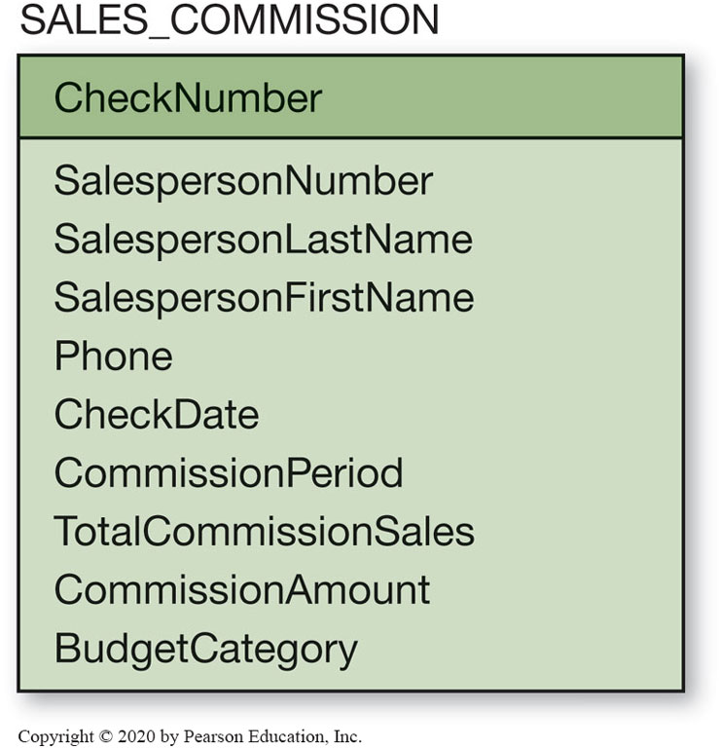
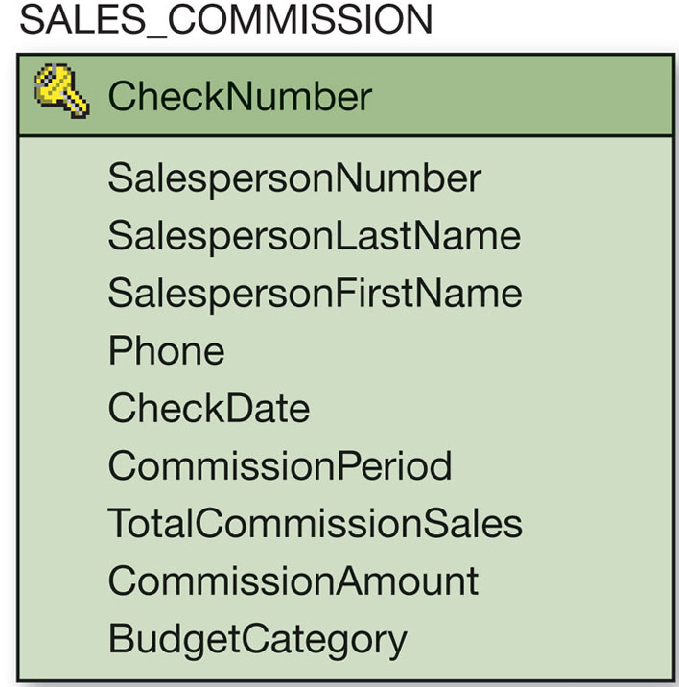
Figure 5.7 The SALES_COMMISSION Entity and Table

Slide 13
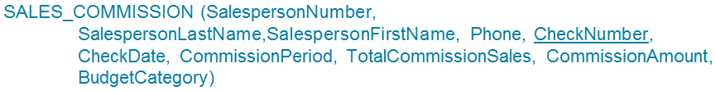
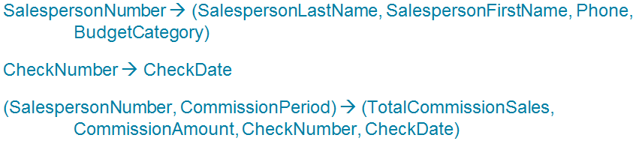
A Relational Design for the SALES_COMMISSION Entity (1 of 2)
Understand the need for denormalization
Consider the original attributes of the SALES_COMMISSION entity on the previous slide
Three additional functional dependencies are:

Slide 14
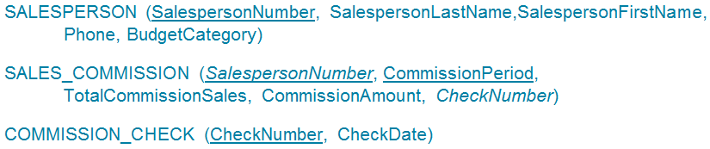
A Relational Design for the SALES_COMMISSION Entity (2 of 2)
Understand the need for denormalization
One look at the previous functional dependencies reveals that the original table, given the primary key CheckNumber, should actually be called COMMISSION_CHECK.
Once normalized properly you have…
This is now shown in Figure 5.8 on the next slide.

Slide 15
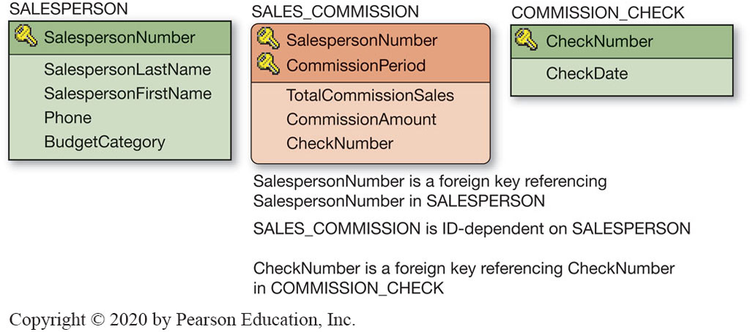
Figure 5.8 The Normalized SALES_ COMMISSION And Associated Tables

Slide 16
Representing 1:1 Relationships
Know how to represent 1:1, 1:N, and N:M binary relationships
The maximum cardinality determines how a relationship is represented.
1:1 Relationship:
the key from one relation is placed in the other as a foreign key
it does not matter which table receives the foreign key

Slide 17
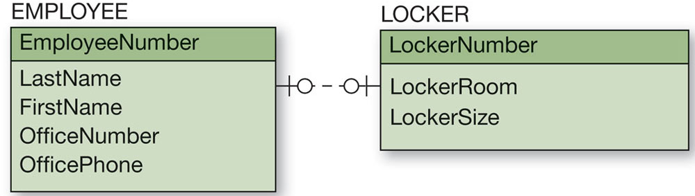
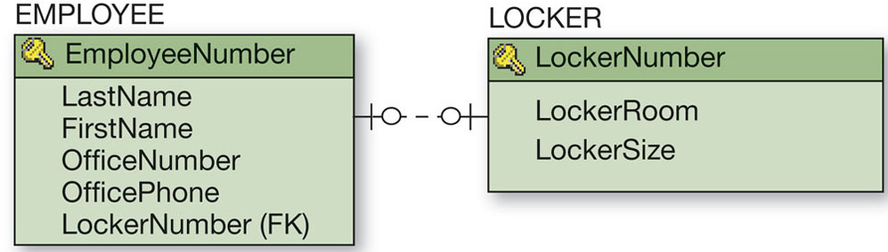
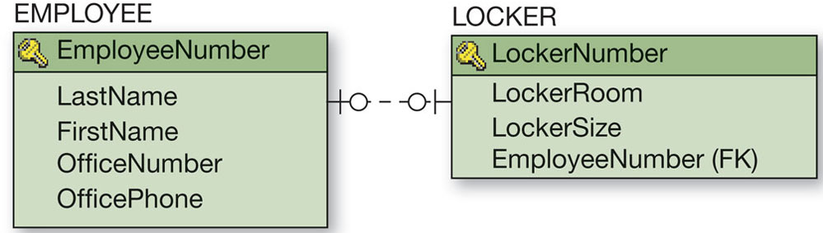
Figure 5.10 1:1 Strong Entity Relationships

Slide 18
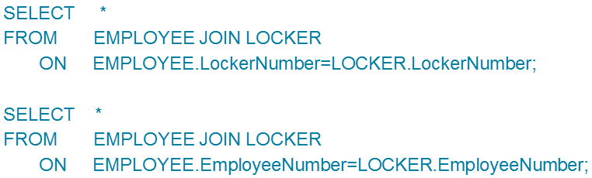
Results of a 1:1 Relationship
Know how to represent 1:1, 1:N, and N:M binary relationships
Because of a 1:1 relationship both of the following examples would not produce any unassigned employees.

Slide 19
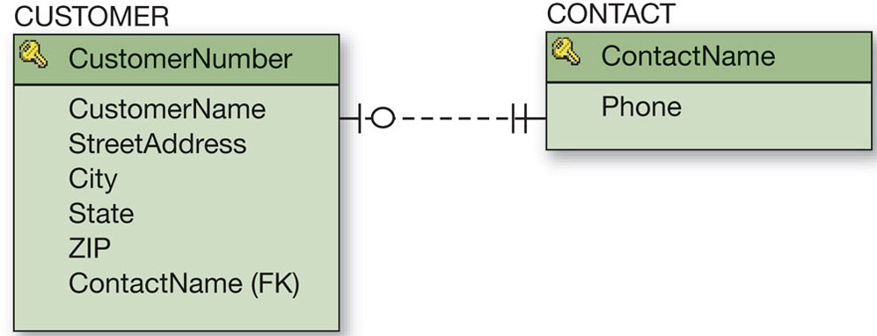
Figure 5.11 1:1 Strong Entity Relationship Between CUSTOMER and CONTACT

Slide 20
Representing 1:N Strong Entity Relationships
Know how to represent 1:1, 1:N, and N:M binary relationships
Like a 1:1 relationship, a 1:N relationship is saved by placing the key from one table into another as a foreign key.
However, in a 1:N the foreign key always goes into the many-side of the relationship:
the 1 side is called the parent
the N side is called the child

Slide 21
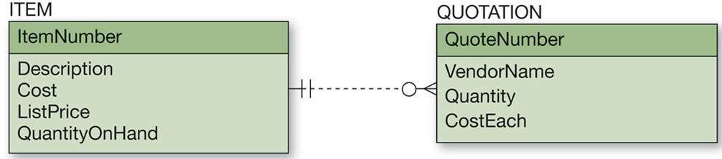
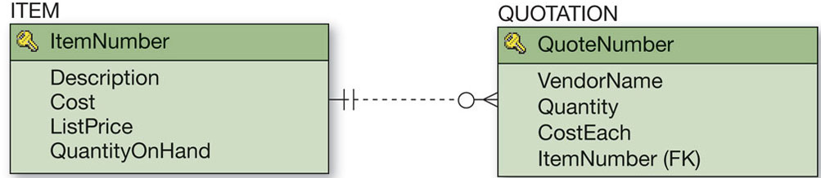
Figure 5.12 1:N Strong Entity Relationships

Slide 22
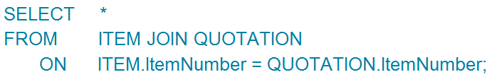
Results of a 1:N Relationship
Know how to represent 1:1, 1:N, and N:M binary relationships
In a 1:N relationship, the key of the parent must be placed in the child relation

Slide 23
Representing N:M Strong Entity Relationships
Know how to represent 1:1, 1:N, and N:M binary relationships
To create an N:M relationship, a new table is created. This table is called an intersection table.
An intersection table has a composite key consisting of the keys from each of the tables that it connects.

Slide 24
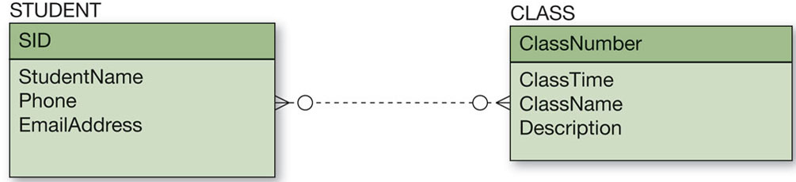
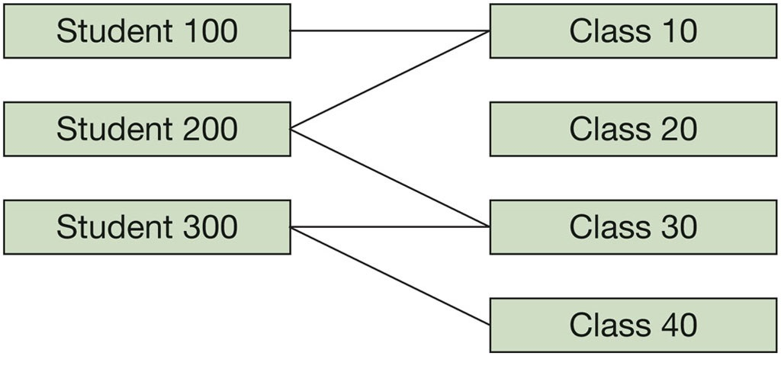
Figure 5.13 N:M Strong Entity Relationships

Slide 25
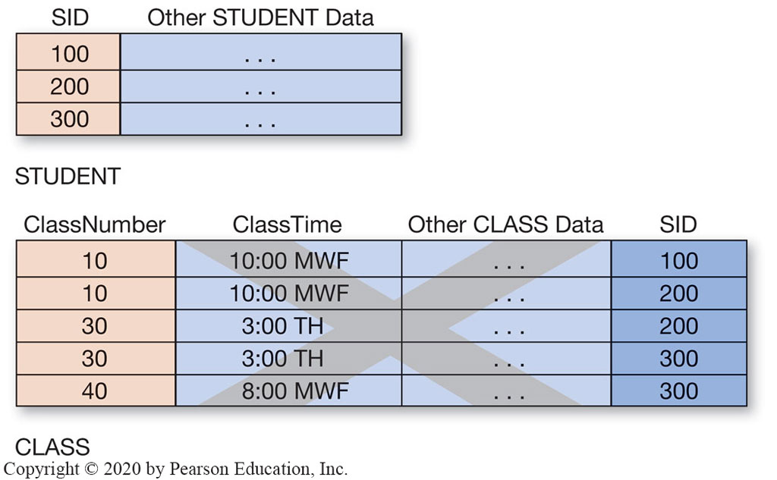
Figure 5.14 Incorrect Representation of an N:M Relationship

Slide 26
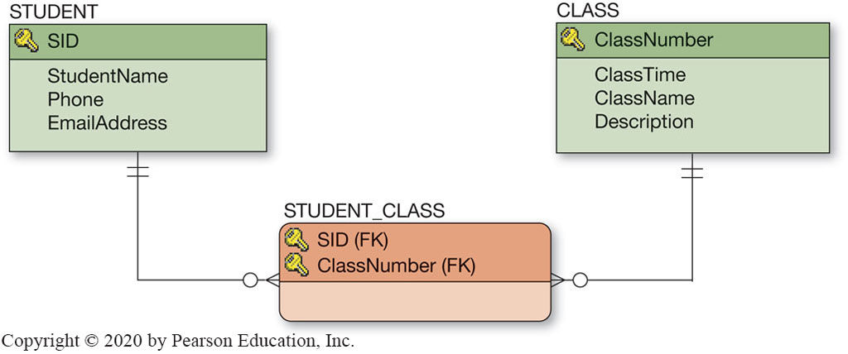
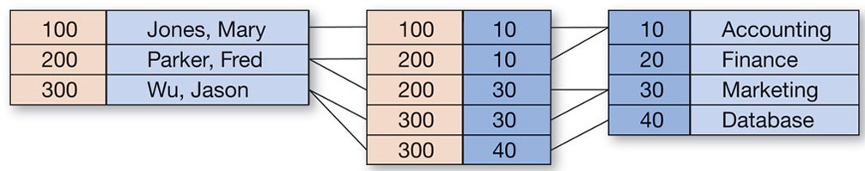
Figure 5.15 Representing a N:M Strong Entity Relationship

Slide 27
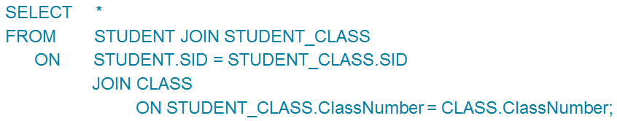
Results of a N:M Relationships
Learn SQL Statements for creating joins over binary and recursive relationships
In a N:M relationship, an intersection table must be created that will contain the primary keys of each of the other two tables as a composite primary key.

Slide 28
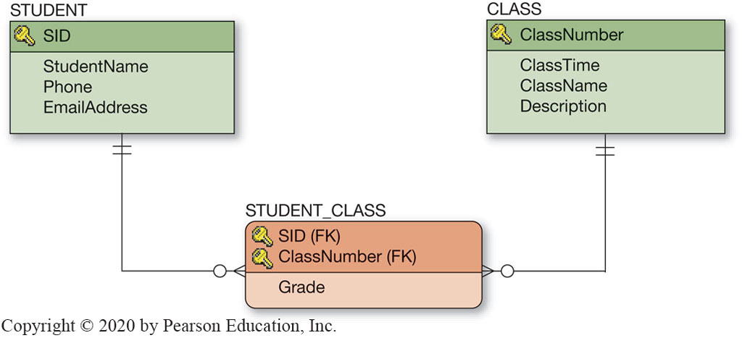
Figure 5.18 The Association Relationship

Slide 29
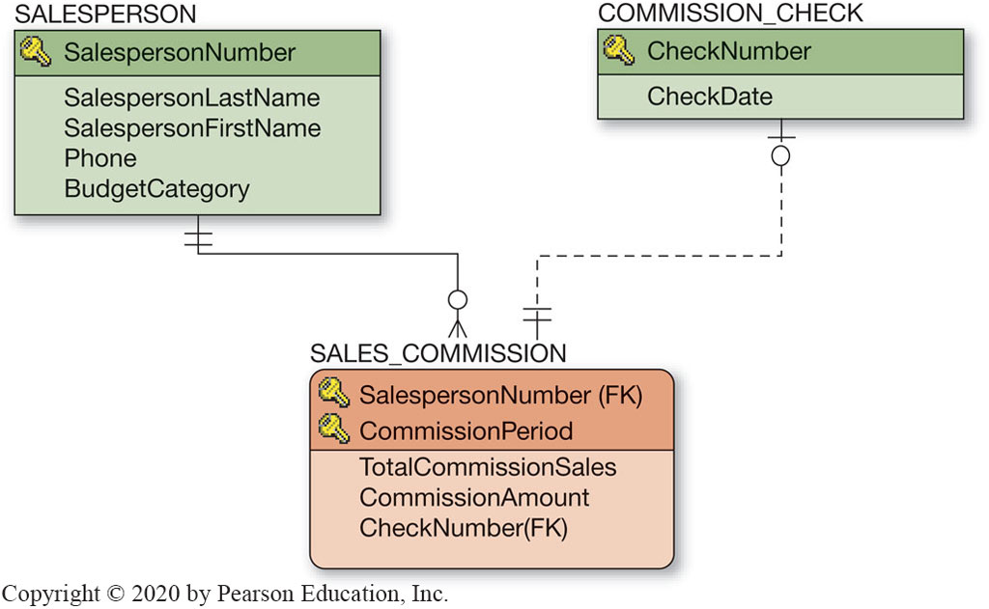
Figure 5.19 Mixed Entity Relationship Example

Slide 30
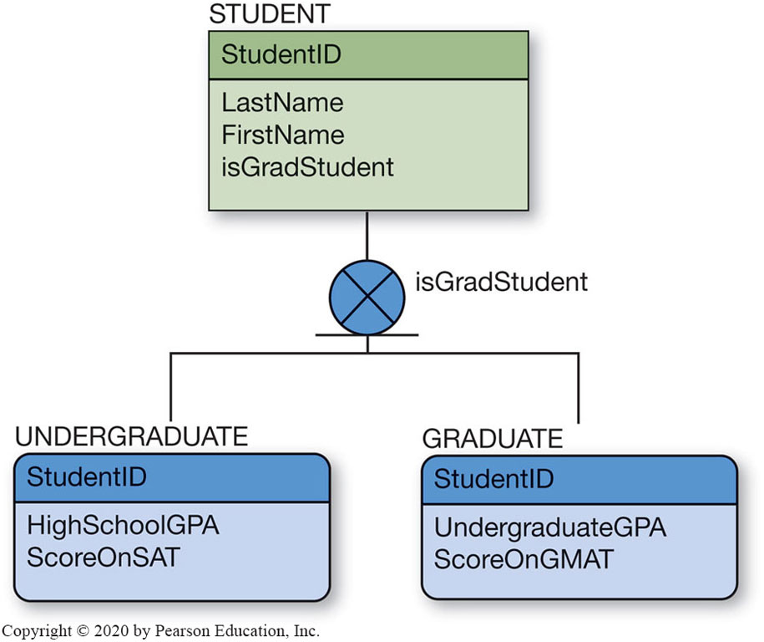
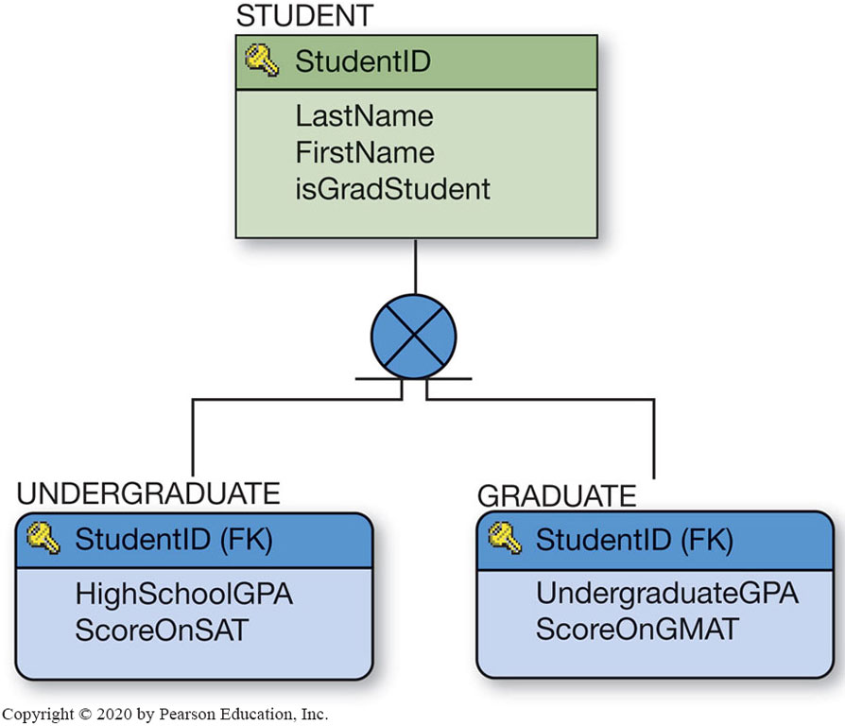
Figure 5.20 Representing Subtypes

Slide 31
Representing Recursive Relationships
Know how to represent 1:1, 1:N, and N:M recursive relationships
A recursive relationship is a relationship among entities of the same class (a relationship with itself).
There are three types of recursive relationships:
1:1 and 1:M relationships are saved using foreign keys
M:M relationships are saved by creating an intersecting relation

Slide 32
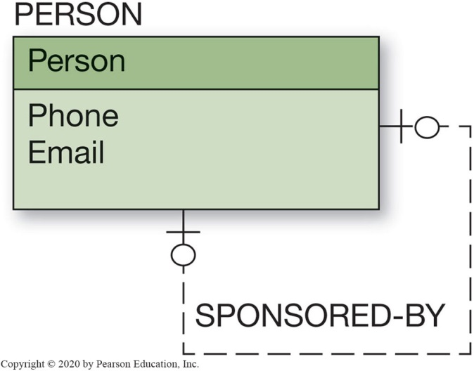
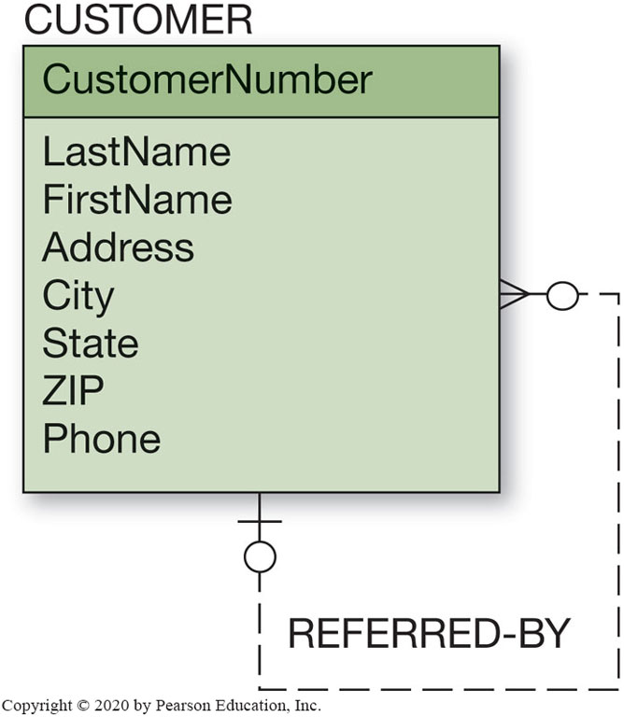
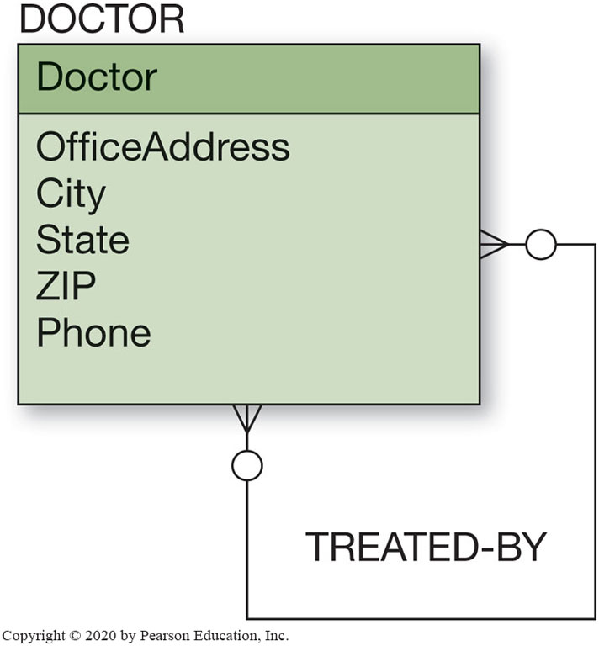
Figure 5.21 Example Recursive Relationships

Slide 33
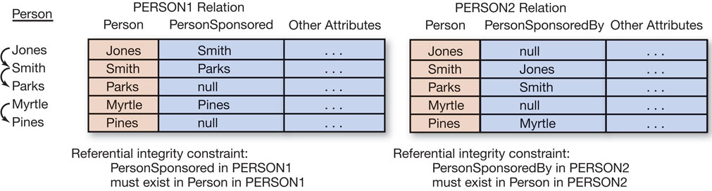
Figure 5.22 Example 1:1 Recursive Relationship

Slide 34
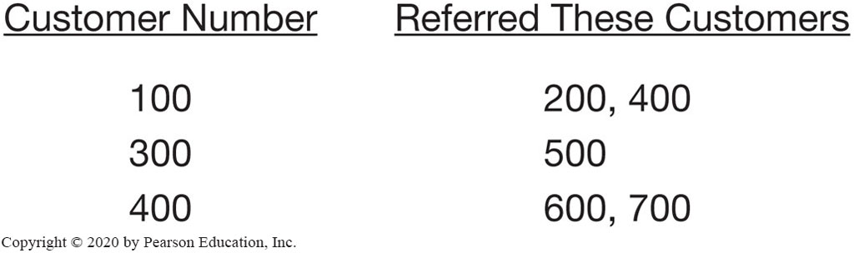
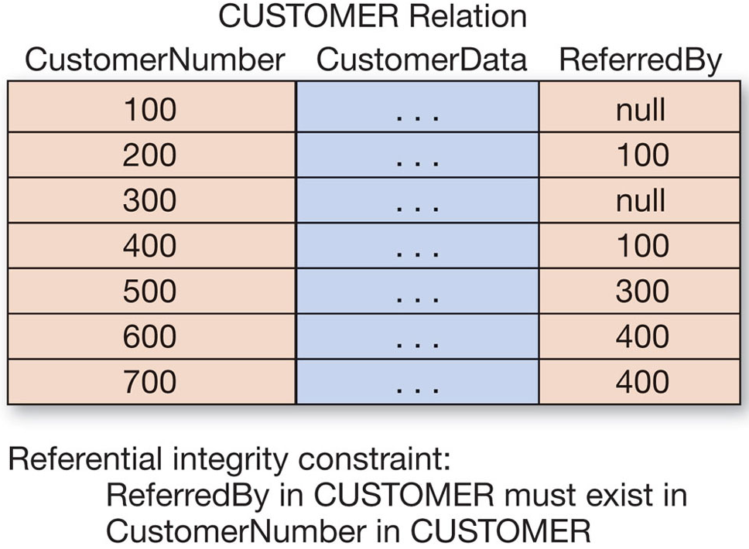

Figure 5.23 Example 1:N Recursive Relationship

Slide 35
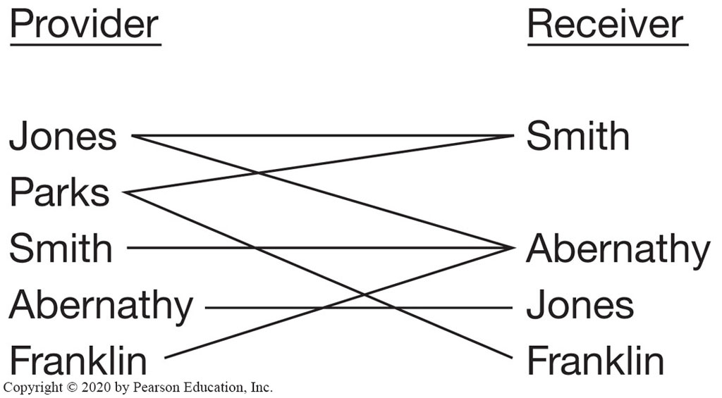
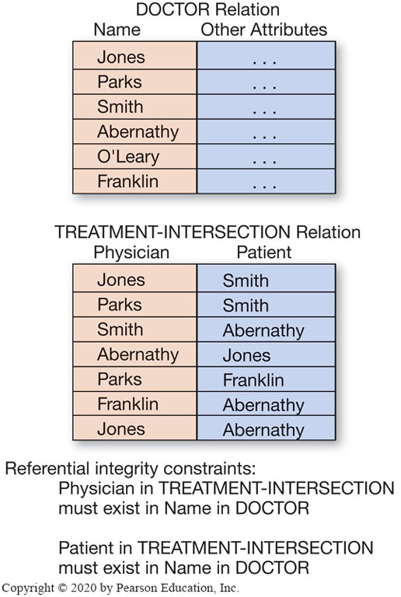
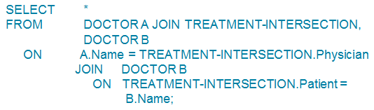
Figure 5.24 Example N:M Recursive Relationship

Slide 36
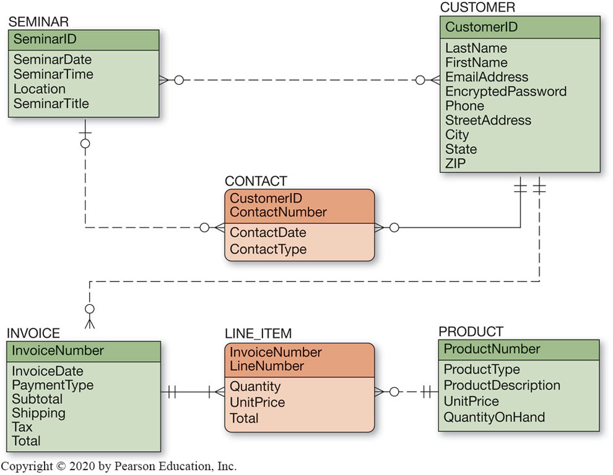
Figure 5.25 The Final Data Model for Heather Sweeney Designs

Slide 37
Specifying Column Properties
Learn how to transform E-R data models into relational designs
Column properties must be specified for each table.
The finalized column properties for the H S D tables are on the next set of slides – these are the column characteristics after additional needed foreign keys have been added. This includes any new intersection tables.

Slide 38
Figure 5.26 Heather Sweeney Designs H S D Database Column Specifications (1 of 3)
Column Name | Data Type (Length) | Key | Required | Default Value | Remarks
SeminarID | Integer | Primary Key | Yes | DBMS supplied | Surrogate Key: Initial value=1 Increment=1
SeminarDate | Date | No | Yes | None | Format: yyyy-mm- dd
SeminarTime | Time | No | Yes | None | Format: 00:00:00.000
Location | VarChar (100) | No | Yes | None | Blank
SeminarTitle | VarChar (100) | No | Yes | None | Blank
Column Name | Data Type (Length) | Key | Required | Default Value | Remarks
CustomerID | Integer | Primary Key | Yes |  | DBMS Supplied Surrogate Key: Initial Value=1 Increment=1
LastName | Char (25) | No | Yes | None | Blank
FirstName | Char (25) | No | Yes | None | Blank
EmailAddress | VarChar (100) | Primary Key | Yes | None | Blank
EncryptedPassword | VarChar(50) | No | No | None | Blank
Phone | Char (12) | No | Yes | None | Format: ###-###-####
StreetAddress | Char (35) | No | No | None | Blank
City | Char (35) | No | No | Dallas | Blank
State | Char (2) | No | No | TX | Format: AA
ZIP | Char (10) | No | No | 75201 | Format: #####-####

Slide 39
Figure 5.26 Heather Sweeney Designs H S D Database Column Specifications (2 of 3)
Column Name | Data Type (Length) | Key | Required | Default Value | Remarks
CustomerID | Integer | Primary Key, Foreign Key | Yes | None | REF: CUSTOMER
ContactNumber | Integer | Primary Key | Yes | None | Blank
ContactDate | Date | No | Yes | None | Format: yyyy-mm-dd
ContactType | Char (15) | No | Yes | None | Blank
Column Name | Data Type (Length) | Key | Required | Default Value | Remarks
InvoiceNumber | Integer | Primary Key | Yes | DBMS supplied | Surrogate Key: Initial value=35000 Increment=1
InvoiceDate | Date | No | Yes | None | Format: yyyy-mm-dd
PaymentType | Char (25) | No | Yes | Cash | Blank
Subtotal | Numeric (9,2) | No | No | None | Blank
Shipping | Numeric (9,2) | No | No | None | Blank
Tax | Numeric (9,2) | No | No | None | Blank
Total | Numeric (9,2) | No | No | None | Blank

Slide 40
Figure 5.26 Heather Sweeney Designs H S D Database Column Specifications (3 of 3)
Column Name | Data Type (Length) | Key | Required | Default Value | Remarks
InvoiceNumber | Integer | Primary Key, Foreign Key | Yes | None | REF: INVOICE
LineNumber | Integer | Primary Key | Yes | None | This is not quite a Surrogate Key—for each InvoiceNumber: Increment=1 Application logic will be needed to supply the correct value
Quantity | Integer | No | No | None | Blank
UnitPrice | Numeric (9,2) | No | No | None | Blank
Total | Numeric (9,2) | No | No | None | Blank
Column Name | Data Type (Length) | Key | Required | Default Value | Remarks
ProductNumber | Char (35) | Primary Key | Yes | None | Blank
ProductType | Char (24) | No | Yes | None | Blank
ProductDescription | VarChar (100) | No | Yes | None | Blank
UnitPrice | Numeric (9, 2) | No | Yes | None | Blank
QuantityOnHand | Integer | No | Yes | 0 | Blank

Slide 41
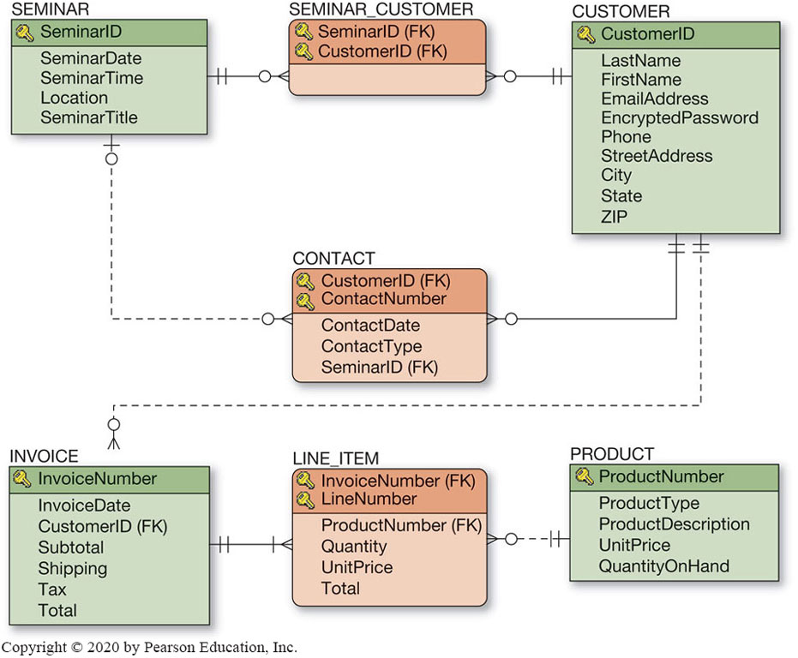
Figure 5.27 Database Design for Heather Sweeney

Slide 42
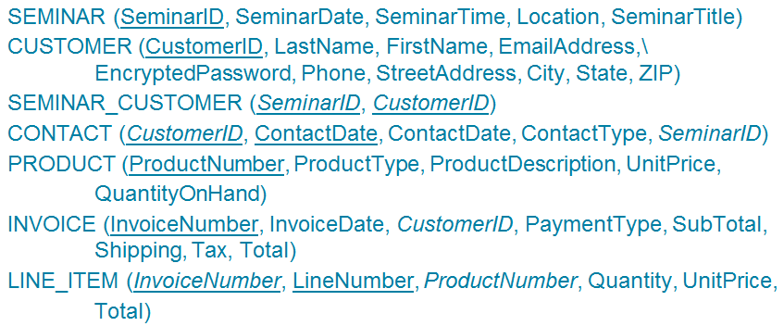
Heather Sweeney’s Database Design Schema
Learn how to transform E-R data models into relational designs

Slide 43
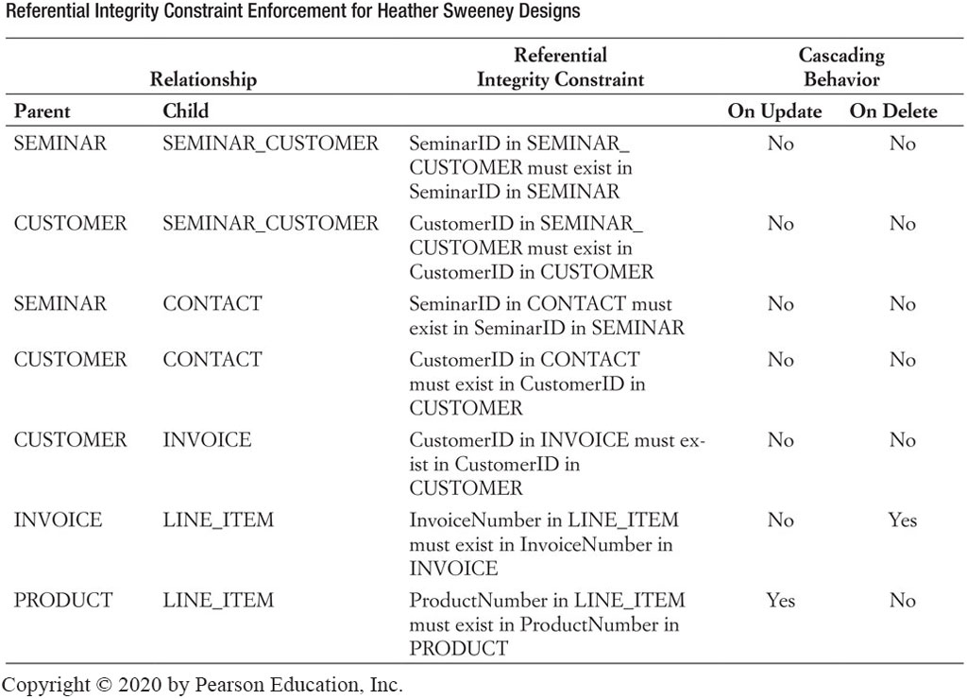
Figure 5.29 Referential Integrity Constraint Enforcement for Heather Sweeney Designs

Slide 44

Copyright
This work is protected by United States copyright laws and is provided solely for the use of instructors in teaching their courses and assessing student learning. Dissemination or sale of any part of this work (including on the World Wide Web) will destroy the integrity of the work and is not permitted. The work and materials from it should never be made available to students except by instructors using the accompanying text in their classes. All recipients of this work are expected to abide by these restrictions and to honor the intended pedagogical purposes and the needs of other instructors who rely on these materials.
Notes:
If this slide was not included in the original PPT, it should be added.

