Slide 1



Gaussian Mixture ESMDA
Preliminary conclusions
www.ltrace.com.br
Leandro P. de Figueiredo
www.ltrace.com.br
leandro@ltrace.com.br

Slide 2
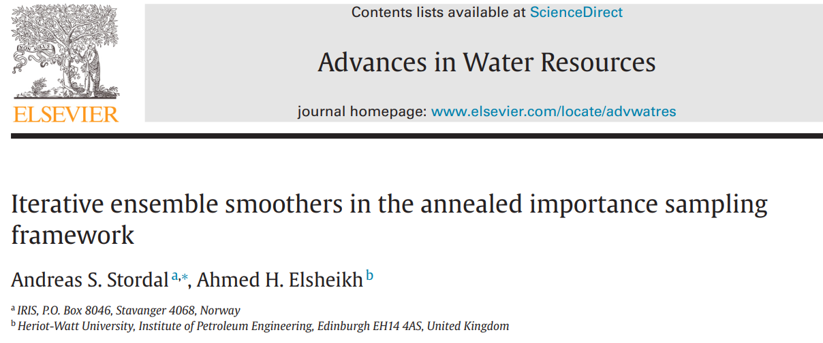
Summary
The idea of generalizing ESMDA for a Gaussian Mixture prior models
Advantages:
Partly overcome the Gaussian unimodal assumption
In the particular case where the modes are interpreted as different facies, the facies estimation becomes an integral part of the solution
It might be useful to test different assumptions of the reservoir, e.g. depositional trends
However, it may rise numerical and computation issues such as
Evaluation of PDF with high dimension
The number of models in the ensemble is probably higher

Slide 3
Literature
Only one reference was found in the literature by searching for keywords in google scholar
However, the context of the use of Gaussian mixture differs from our proposal

Slide 4
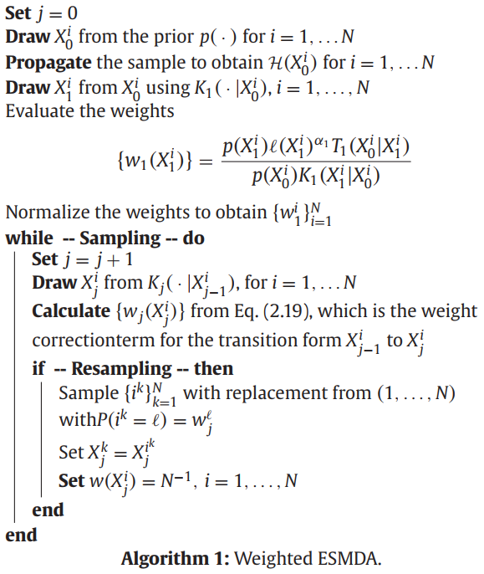
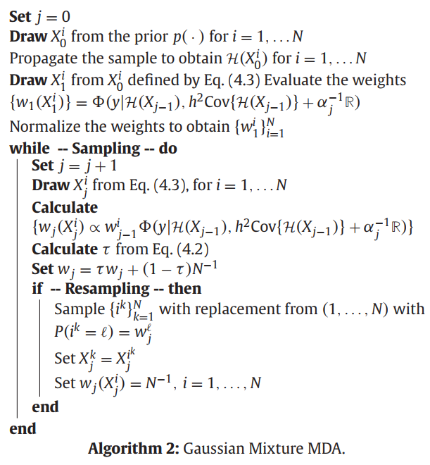
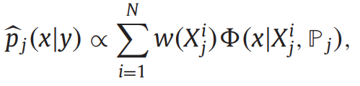
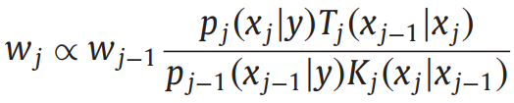
Stordal and Elsheikh, 2015
It is introduced in the context of “importance sampling”
The mixture is used to weigh each model of the ensemble
Posterior distribution:

Slide 5
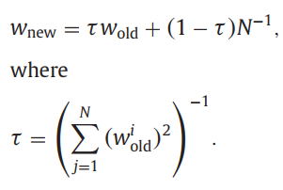
Stordal and Elsheikh, 2015
It is introduced in the context of “importance sampling”
The mixture is used to weigh each model of the ensemble
Posterior distribution:
“weights according to (2.19) an adaptive weight shrinkage is applied”

Slide 6
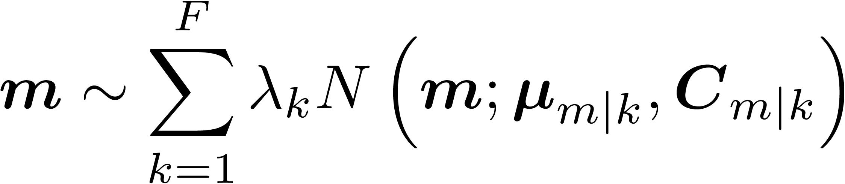
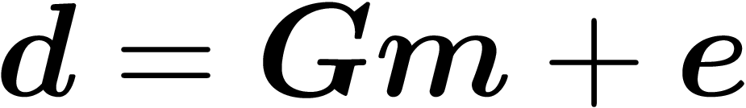
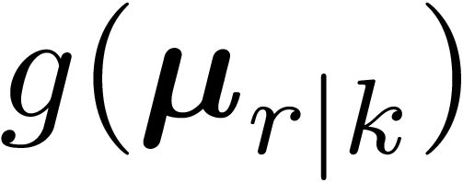

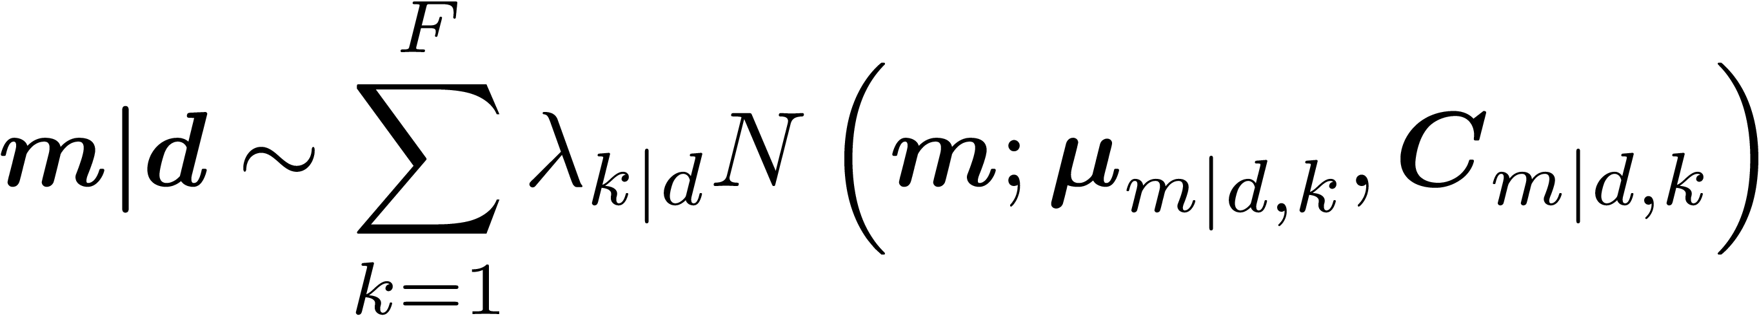

Gaussian Mixture BLI
Forward model with Gaussian error:
Gaussian mixture prior:
The posterior distribution is also a Gaussian mixture and it is analytically obtained:

Slide 7
General comments
Since the distributions in the ESMDA are indirectly given by the multiple realizations in the ensemble, in our implementation we define a Gaussian mixture prior by drawing multiple realizations from each Gaussian component
In practice, it is like we have multiple ensembles
The posterior is then computed from the ensemble after the updates

Slide 8
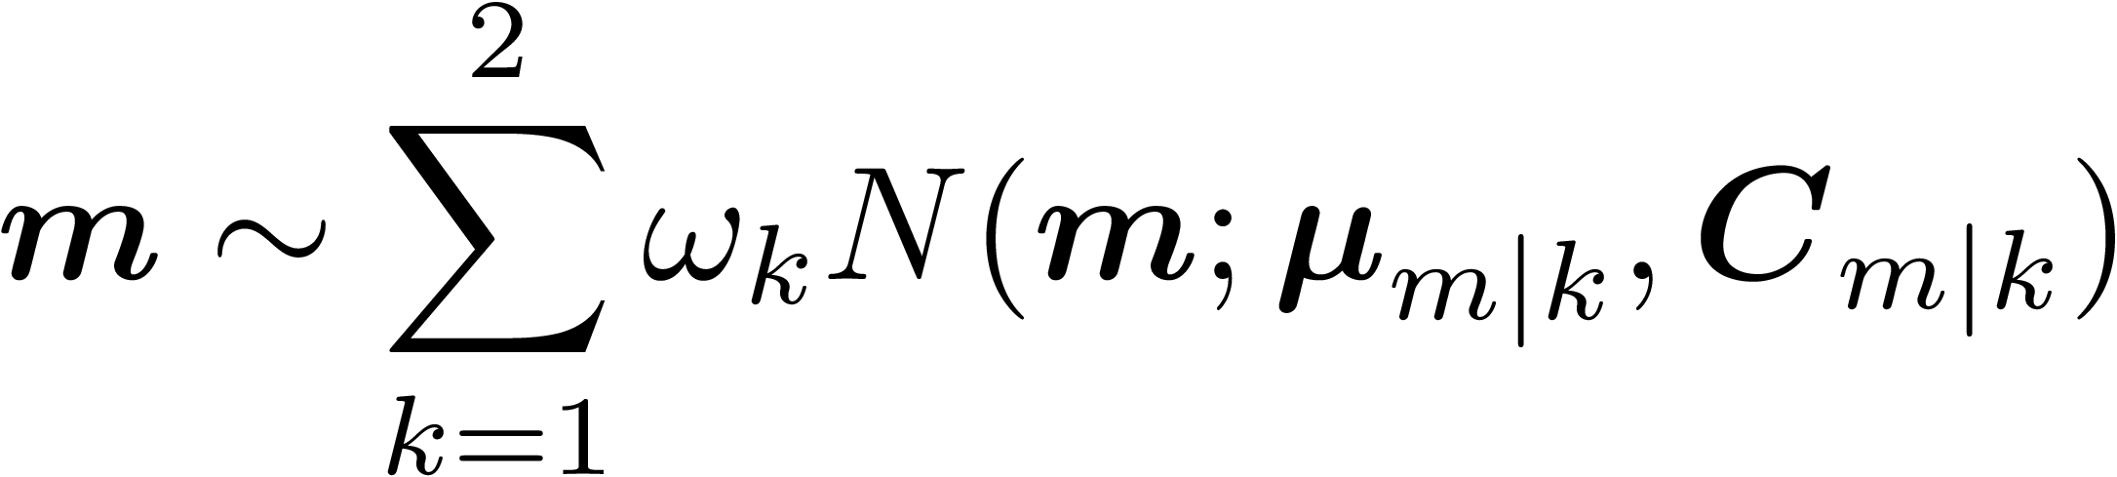
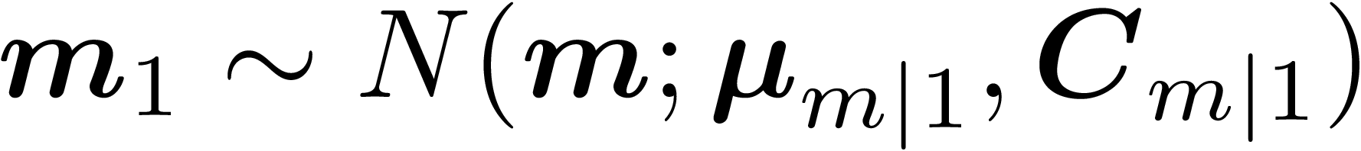
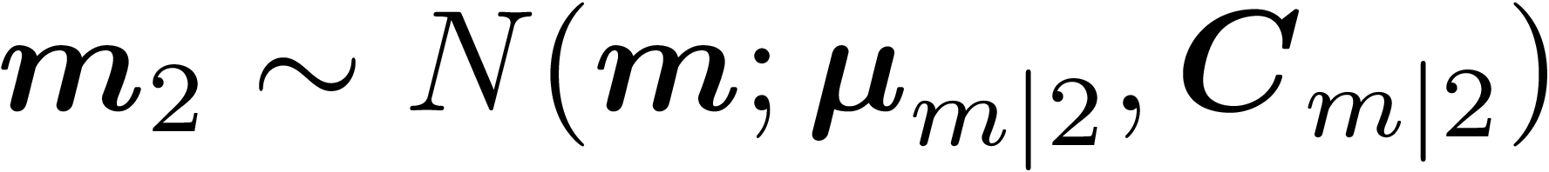
GM-ESMDA - First approach
Straightforward application of the Gaussian Mixture BLI
Prior considering 2 modes:
GM-ESMDA:

Slide 9


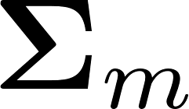
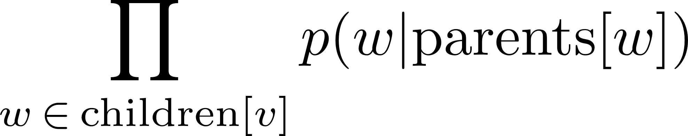


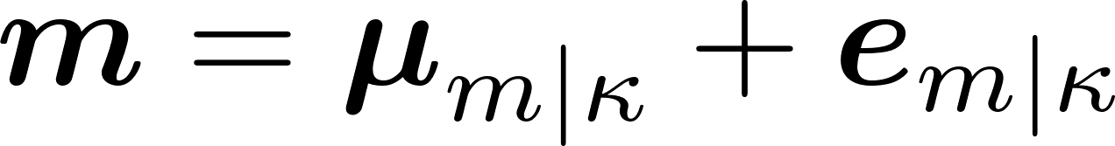



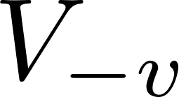

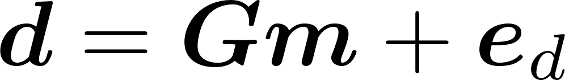
GM-ESMDA – Gibbs Algorithm approach
Gibbs Sampling
Sequential sampling from the conditional distribution following
the rule:
- All variables of the graph
- All variables removing the variable v

Slide 10
GM-ESMDA – Gibbs Algorithm approach
Gibbs sampling
Rule:
Conditional distribution of m
Conditional distribution of k

Slide 11
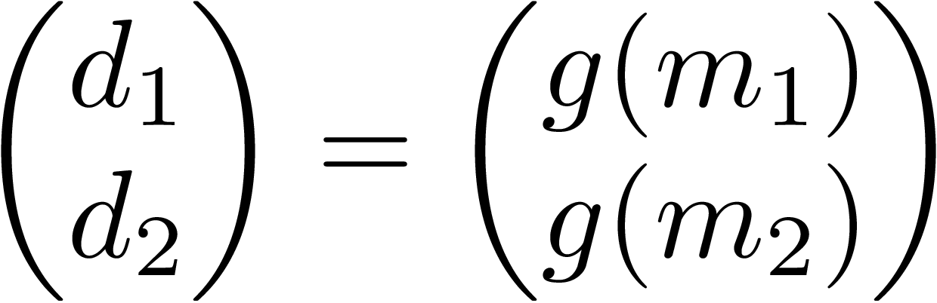
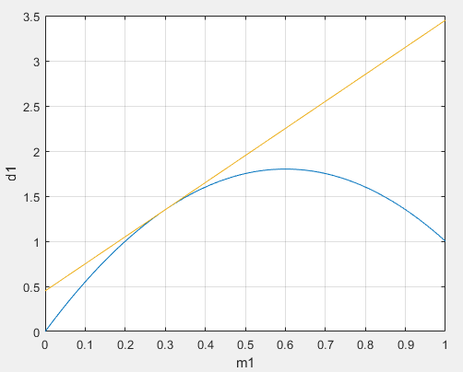
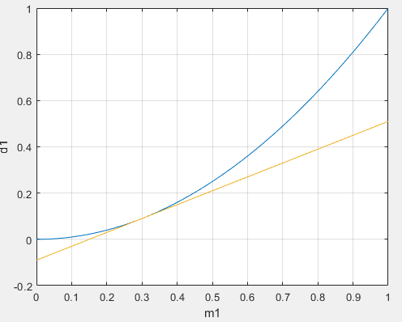
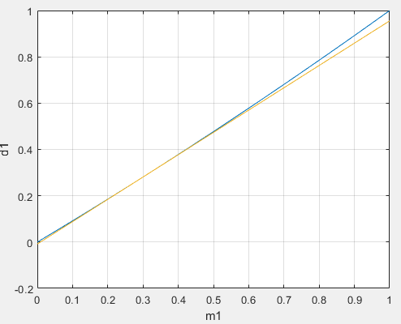
Ultra Toy Problem
Bivariate problem with a 2nd order polynomial forward model
It allows us to compare the algorithm with Gaussian Mix BLI
Additional parameter to control de non-linearity
Linear factor = - 0.6
Linear factor = 0
Linear factor = 5

Slide 12
Experiment 1
Bivariate linear case
Priors with the same mean and variance
but different correlations
Linear factor = 10

Slide 13
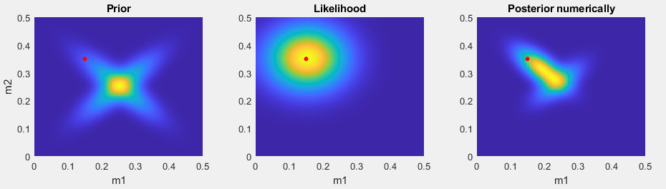
Reference solution – Linear case
Extensively numerically evaluation of the model space

Slide 14
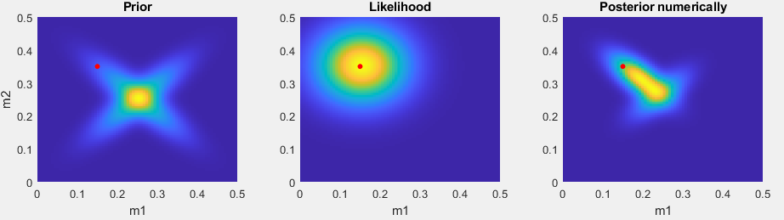
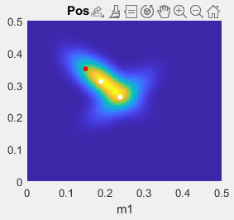
Reference solution – Linear case
Analytical Gaussian mixture BLI

Slide 15
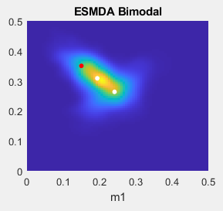
Gaussian Mix ESMDA - Linear case
First approach

Slide 16
Posterior estimates – Linear case

Slide 17
Experiment 2
Bivariate NON linear case
Priors with the same mean and variance
but different correlations
Linear factor = - 0.6

Slide 18
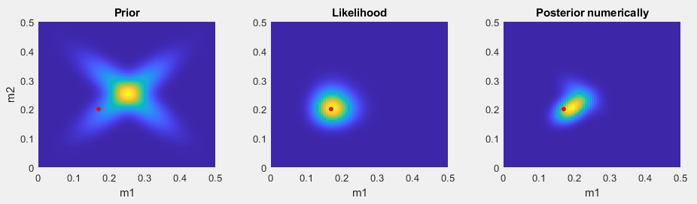
Reference solution – Non-Linear case
Extensively numerically evaluation of the model space

Slide 19
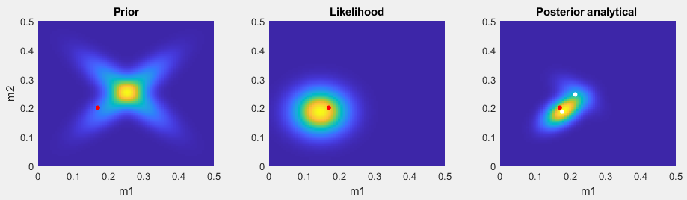
Reference solution – Non-Linear case
Analytical Gaussian mixture BLI

Slide 20
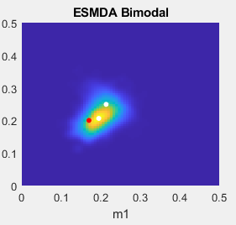
Gaussian Mix ESMDA – Non-Linear case
First approach

Slide 21
Posterior estimates – Non linear case

Slide 22
Conclusions
For the linear model, the proposed GM-ESMDA shows similar results to the GM-BLI and numerical results
For the non-linear model, the proposed GM-ESMDA shows similar results to the numerical results and it differs from the GM-BLI, which is expected since the forward model was linearized.

Slide 23
Future work
Experiments with different prior means
Compute the statistical moments of the posterior distributions for a quantitative comparison
Investigate further Gibbs algorithm approach
Compute Kullback–Leibler divergence between the reference posterior and the estimated posterior of the methods
Application in a pointwise petrophysical inversion from elastic properties and non-linear rock-physics data – Well log of Volve data set as reference petrophysical data
It is still a bi/tri-variate problem
“Easy” and fast publication
Meanwhile, we think in a way for handling the lambda evaluation for high-dimensional problems

Slide 24
Thank you
www.ltrace.com.br
Leandro P. de Figueiredo
leandro@ltrace.com.br

