Slide 1



Gaussian Mixture ESMDA
Preliminary conclusions
www.ltrace.com.br
Leandro P. de Figueiredo
www.ltrace.com.br
leandro@ltrace.com.br

Slide 2
Experiment 1
Priors with the same variances, same correlation
but different means

Slide 3
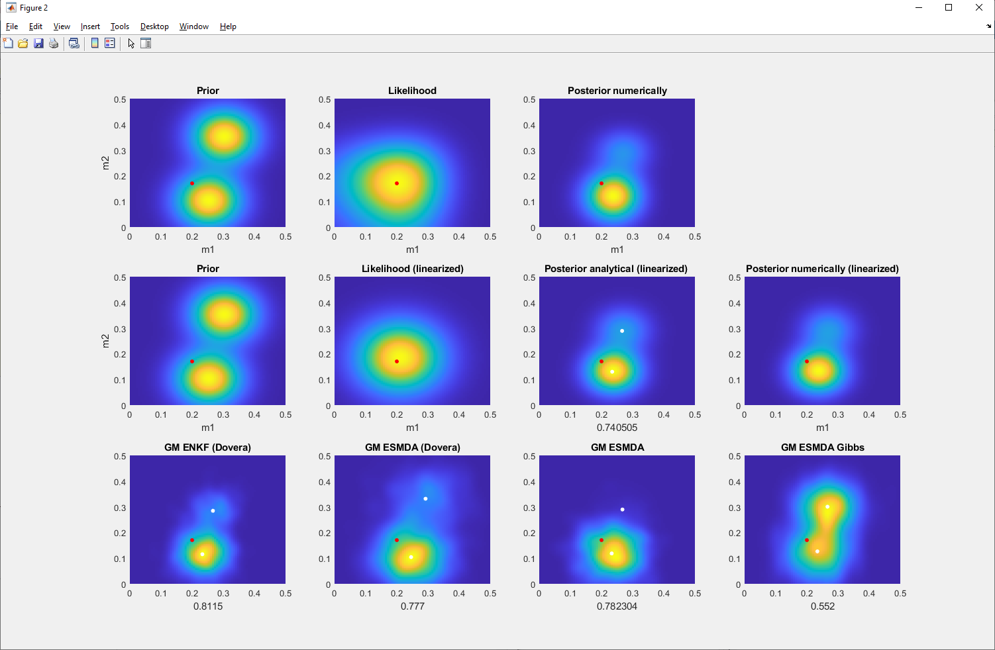
Signal to noise = 2

Slide 4
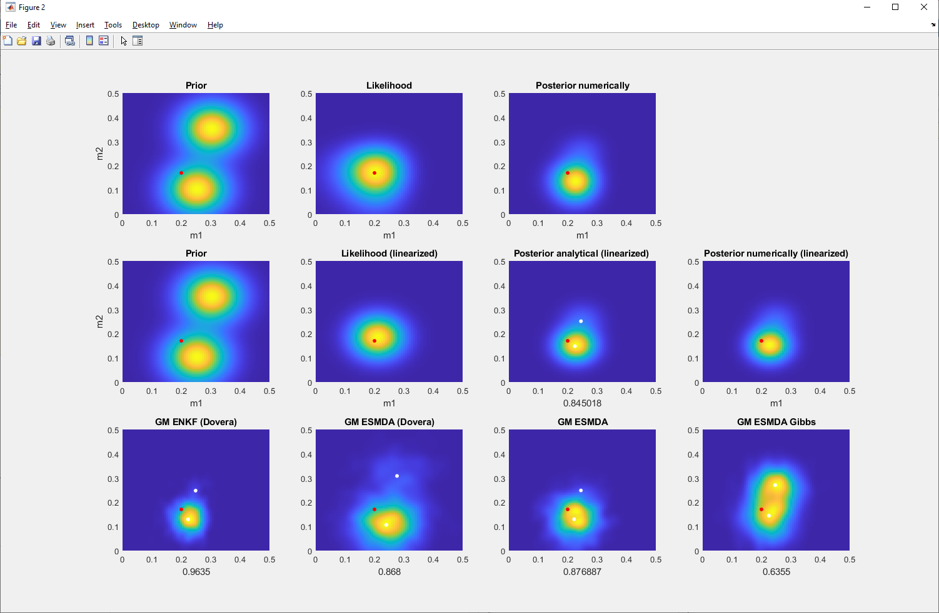
Signal to noise = 5

Slide 5
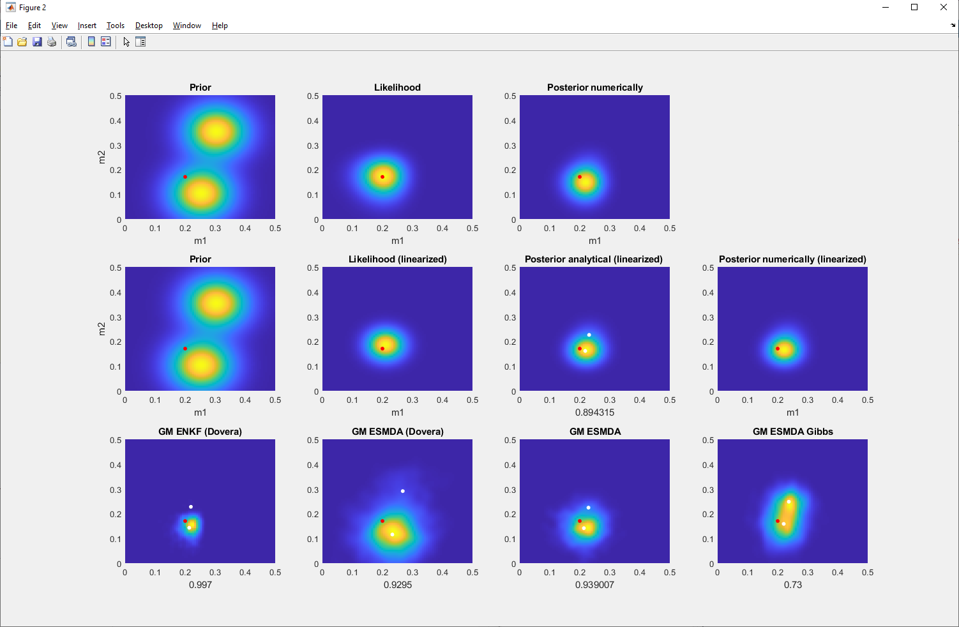
Signal to noise = 10

Slide 6
Experiment 2
Priors with the same means and variances, but opposite correlations

Slide 7
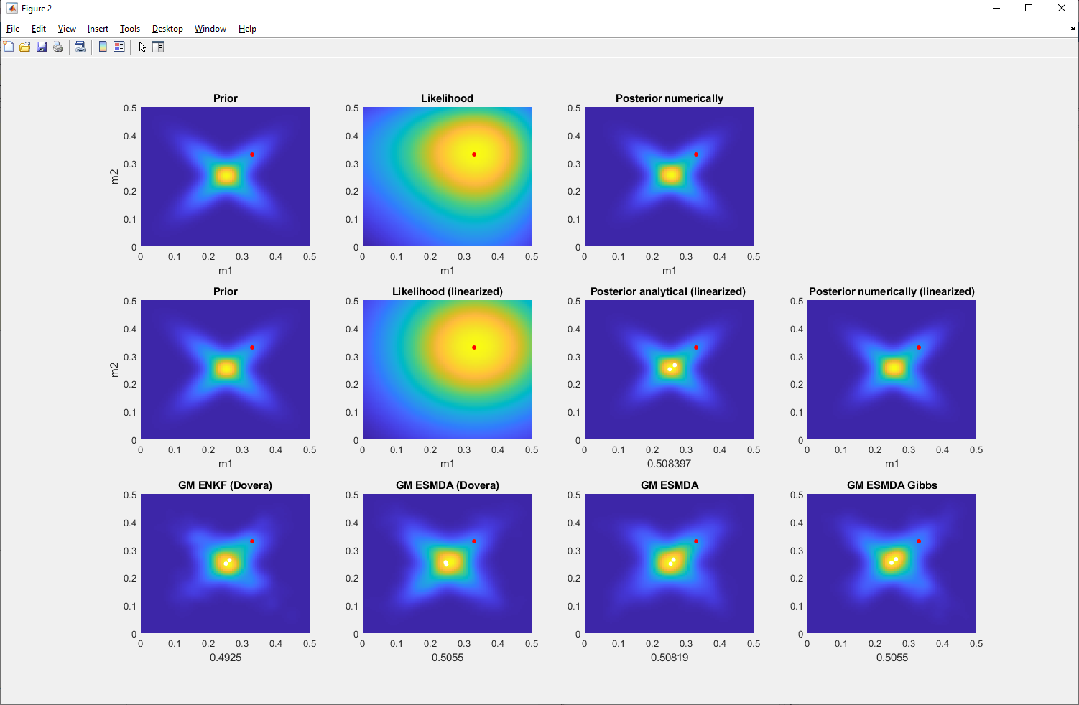
Signal to noise = 2

Slide 8
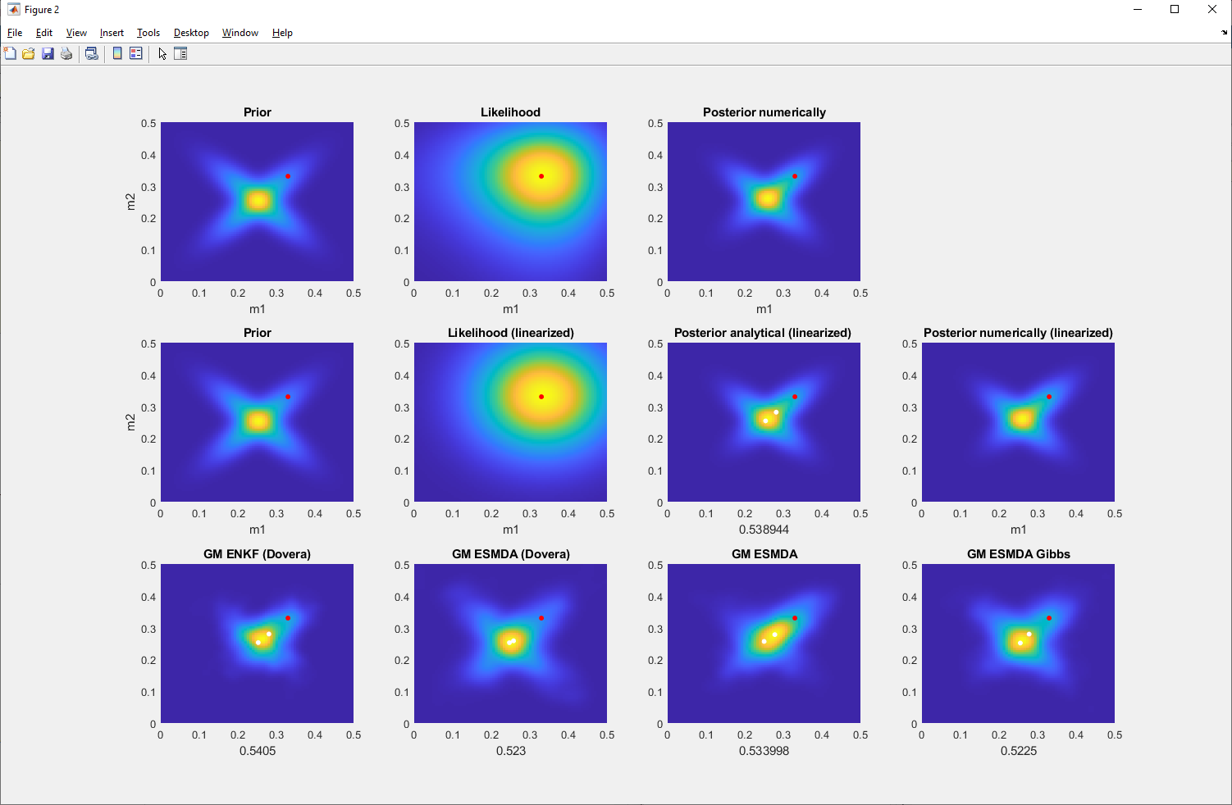
Signal to noise = 5

Slide 9
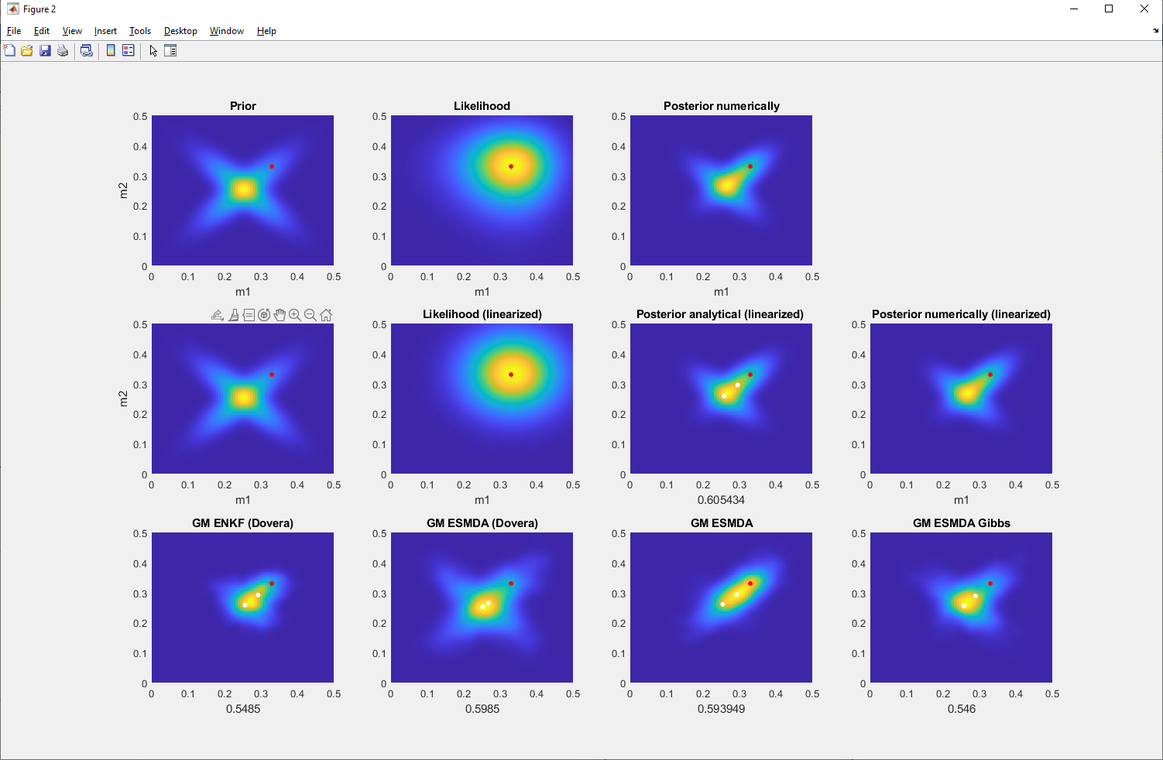
Signal to noise = 10

Slide 10
Thank you
www.ltrace.com.br
Leandro P. de Figueiredo
leandro@ltrace.com.br

