Slide 1
LLM-Judge Fake Receipt Detector
3 OpenAI Vision Judges · Majority Vote · Langfuse Observability
Python · Streamlit · OpenAI · Langfuse · MCP
February 2026

Slide 2
The Problem
Why can't classical CV catch receipt forgeries?
What forgers do
Why classical features fail
Solution: Vision LLM judges
• Change a single digit in the total
• Copy-paste amounts between receipts
• Alter font or spacing in key fields
• Substitute store names / dates
• Save at same quality — no metadata leak
• Blur & brightness: nearly identical
• File size: forgers match it
• Aspect ratio: same portrait format
• No single feature separates classes
• Dataset: 83.9% REAL → naive baseline = 83.9%
• Trained on billions of documents
• Detect font inconsistencies visually
• Spot pixel-level copy-paste artefacts
• Read layout plausibility holistically
• No labelled training data needed

Slide 3
System Architecture
End-to-end pipeline for a single receipt image
INPUT
FEATURES
JUDGE PANEL
VOTE
OUTPUT
Receipt image
(.png / .jpg)
+ OCR .txt
(optional)
CPU-only
Blur · Brightness
Contrast · Dims
OCR total
3 × OpenAI Vision
gpt-4o-mini
gpt-4.1-mini
gpt-4o
Majority Vote
FAKE ≥ 2
REAL ≥ 2
else UNCERTAIN
Verdict +
Confidence +
Reasons +
Flags
→
→
→
→
LANGFUSE (via MCP) — Full observability on every run
Trace → dataset_analysis span → judge_1/2/3 generations (prompt + tokens + latency) → vote_aggregation span → 8 scores → dataset_run_log

Slide 4
The Judge Panel
Three independent personas — deliberately different priors
"Strict / Skeptical" · temp=0.2
"Balanced / Artifact-aware" · temp=0.4
"Lenient / Benefit-of-doubt" · temp=0.7
judge_1 · gpt-4o-mini
judge_2 · gpt-4.1-mini
judge_3 · gpt-4o
• Aggressively flags any forensic inconsistency
• Temperature 0.2 → deterministic, conservative
• Tends toward UNCERTAIN when evidence is weak
• Best at catching obvious copy-paste artefacts
• Lowest cost — $0.15/$0.60 per 1M tokens
• Weighs printing/scan artefacts vs tampering
• Temperature 0.4 → moderate variability
• Most accurate in our evaluation (70%)
• Distinguishes thermal printer quirks from edits
• Mid-range cost — $0.40/$1.60 per 1M tokens
• Assumes REAL unless manipulation is clear
• Temperature 0.7 → higher variability
• Highest capability vision model (tiebreaker)
• Most decisive — rarely returns UNCERTAIN
• Premium cost — $2.50/$10.00 per 1M tokens

Slide 5
Judge Prompt Design
Same base prompt, only the persona line changes
PROMPT (verbatim)
Structured output
You are an expert forensic document examiner evaluating whether a receipt image is forged.
Persona: {persona}
Return ONLY valid JSON:
{
"label": "FAKE|REAL|UNCERTAIN",
"confidence": 0-100,
"reasons": ["short reason 1", ...],
"flags": ["optional tag", ...]
}
Guidelines:
• Base decision on visual cues (fonts, alignment, spacing,
copy-paste digits, pixel artifacts, shadows, totals)
• UNCERTAIN + lower confidence if evidence is weak
• reasons must be short, concrete, observable
• response_format: json_object (where supported)
• Fallback: salvage first {…} block
• _normalize_output() enforces schema:
• label ∈ {FAKE, REAL, UNCERTAIN}
• confidence clamped 0–100
• reasons: 1–5 strings ≤ 240 chars
Why this prompt works
• Short → fast, cheap, less hallucination
• Concrete cues → actionable reasoning
• UNCERTAIN is explicit, not a failure
• Persona injects prior → ensemble diversity
• Image sent as base64 data URL inline

Slide 6
Dataset & Distribution
findit2 test set — 218 Malaysian retail receipts
218
183
35
5.2:1
Total images
REAL (83.9%)
FAKE (16.1%)
Class imbalance
Key insight — class imbalance
What features tell us (and don't)
• Naive classifier (always REAL) = 83.9% accuracy
• Accuracy alone is a misleading metric
• Per-class recall + UNCERTAIN rate matter more
• Sampling for evaluation must be stratified
• Use 'FAKE only' filter to oversample minority class
• File size: REAL ≈ FAKE — forgers match it
• Aspect ratio: both portrait ~0.4–0.5
• Blur variance: wide spread in both classes
• Brightness: slight over-exposure in some fakes
• → No single feature cleanly separates classes
• → Validates LLM vision over classical CV

Slide 7
Evaluation Results
20-image batch · 3 judges · majority vote
55%
9
70%
$0.007
Overall accuracy
(11/20 correct)
Wrong predictions
Best single judge
(judge_2 / gpt-4.1-mini)
Total API cost
(128 traces session)
Per-judge performance
Judge
Model
Accuracy
Avg. Confidence
FAKE
REAL
UNCERTAIN
Key observation
judge_1
gpt-4o-mini
5.0%
54.5
0
3
17
Defaults to UNCERTAIN — almost useless
judge_2
gpt-4.1-mini
70.0%
79.5
14
15
1
Most decisive and accurate
judge_3
gpt-4o
65.0%
82.8
0
15
5
High confidence, never FAKE

Slide 8
Error Analysis
Three representative failure modes
Case 1 — False Negative
Case 2 — Three-way Split
Case 3 — Conservative Miss
• GT: FAKE → Predicted: REAL
• Vote: FAKE:0 · REAL:2 · UNCERTAIN:1
• Judges 2+3 read layout as authentic
• Forgery: single digit changed in total
• No copy-paste artefact visible at standard res
• → LLMs can't detect numeric-only edits
• GT: REAL → Predicted: UNCERTAIN
• Vote: FAKE:1 · REAL:1 · UNCERTAIN:1
• Judge 1 flagged thermal printer font quirk
• Judge 3 accepted as real, judge 2 undecided
• Root cause: thermal artefacts mimic forgery
• → Main source of false positives
• GT: FAKE → Predicted: UNCERTAIN
• Vote: FAKE:1 · REAL:0 · UNCERTAIN:2
• Only judge_1 correctly identified as FAKE
• Other two withheld votes → no majority
• Root cause: small/low-res image, cues invisible
• → Visual-only detection has resolution limits
Key fix: add OCR arithmetic check (do line items sum to total?) as a pre-filter — catches Case 1 class at near-zero cost

Slide 9
Langfuse Observability
Full LLM operation visibility via MCP — no credentials in app code
What is logged per receipt
MCP integration (no SDK in app)
• dataset_analysis span — image stats (free, CPU)
• judge_1 generation — full system prompt + JSON response
• → real input/output/total tokens + latency_ms
• judge_2 generation — same, different model
• judge_3 generation — same, gpt-4o
• vote_aggregation span — labels → final verdict
• 8 scores per trace:
• judge_N_confidence · judge_N_correctness (×3)
• final_correct · inter_judge_agreement
• dataset_run_log — links trace to named run
• LangfuseMCPClient sends JSON-RPC to localhost:8005/mcp/
• MCP server holds Langfuse credentials internally
• Streamlit app needs zero LANGFUSE_* env vars
• Follows redirects · session-ID optional · SSE + JSON
• All errors caught silently — batch never aborted
Dataset runs — cross-run comparison
• Each batch gets a named run (e.g. test-v1, test-v2)
• Langfuse groups traces by run automatically
• Compare accuracy / cost / scores across experiments
• Charts tab needs ≥ 2 runs to populate
• Real session cost: $0.007182 · 128 traces · 60 scores

Slide 10
Streamlit Dashboard — 3 Tabs
Interactive UI for single analysis, statistics, and batch evaluation
Tab 1 — Analyze Receipt
Tab 2 — Dataset Statistics
Tab 3 — Batch Evaluation
• Select any receipt from the dataset
• View image + extracted lightweight features
• Click 'Run judges' → 3 simultaneous API calls
• See per-judge JSON verdict side-by-side
• Majority vote + tally shown instantly
• Logs trace + generations + scores to Langfuse
• Scan entire dataset (cached after first run)
• REAL vs FAKE label distribution bar chart
• Receipt total amount histograms (with OCR)
• Image dimensions, file size, aspect ratio
• Sharpness · brightness · contrast overlays
• Summary statistics table by label
• Filter pool: All / REAL only / FAKE only
• Exact image selection with searchable multiselect
• Thumbnail grid (max 30) with REAL/FAKE badges
• Live cost estimate before any API spend
• Progress bar per image during evaluation
• Confusion matrix · box plots · per-judge table
• Download full results as JSON
• Logs comprehensive traces to Langfuse

Slide 11
Code Quality & Reproducibility
Production-ready structure from day one
Project structure
Reproducibility checklist
• streamlit_app.py — 3-tab dashboard
• src/judges.py — prompt builder + run_judge()
• src/vote.py — majority_vote(), vote_tally()
• src/features.py — blur, brightness, contrast
• src/dataset.py — label loading, OCR parsing
• src/langfuse_mcp_client.py — HTTP/MCP wrapper
• scripts/run_eval20.py — CLI batch eval
• scripts/register_dataset.py — Langfuse registration
• tests/ — 69 unit + integration tests
• ✓ All secrets in .env (.env.example provided)
• ✓ Pinned versions in requirements.txt
• ✓ random_state=42 for all sampling
• ✓ Deterministic trace IDs (seed=image_id)
• ✓ Dataset items upserted by item_id — safe to re-run
• ✓ Results cached to eval_cache.json
Testing
• 61 unit tests — no API calls, < 5 seconds
• 8 integration tests — real API, ~$0.01
• Mock OpenAI client for judge tests
• pytest tests/ -v to run all
• pytest -m integration for API tests

Slide 12
Decisions & Trade-offs
What we chose and why
Decision
Chosen
Alternative
Why
Detection method
LLM vision judges
Fine-tuned classifier
No labelled training data at scale; LLM generalises across forgery types
Ensemble size
3 judges
1 or 5+ judges
Minimum for majority vote; 5+ adds cost with marginal benefit
Aggregation
Majority vote
Weighted confidence avg
Simple, interpretable, robust to one outlier judge
Uncertainty
Explicit UNCERTAIN class
Force binary FAKE/REAL
Preserves calibration; flags hard cases for human review
Observability
Langfuse via MCP
No logging / direct SDK
MCP avoids credentials in app; adds prompt versioning + cost tracking
UI
Streamlit
CLI only or Dash
Fast to build, interactive; Dash only needed at production scale
Prompt length
Short & concrete
Long chain-of-thought
Shorter = faster, cheaper, less hallucination

Slide 13
Next Steps & Improvements
Clear path to higher accuracy and lower cost
Quick wins (no API cost)
Model improvements
Platform improvements
• OCR arithmetic check: do items sum to total?
• Catches single-digit substitutions (Case 1)
• Hash-based duplicate detection
• Image metadata check (EXIF editing traces)
• Hard rules as pre-filter before LLM judges
• Replace gpt-4o-mini (judge_1) — too uncertain
• Try gpt-4.1 for higher accuracy
• Stratified 50/50 batch for fair evaluation
• Tune temperature per judge via Langfuse runs
• Add chain-of-thought for borderline cases
• Human annotation loop (Langfuse UI)
• LLM-as-a-Judge scoring via Langfuse eval
• Prompt versioning + A/B comparison
• Export to production REST API (FastAPI)
• Add confidence threshold for auto-rejection
• Scheduled batch eval with email report

Slide 14
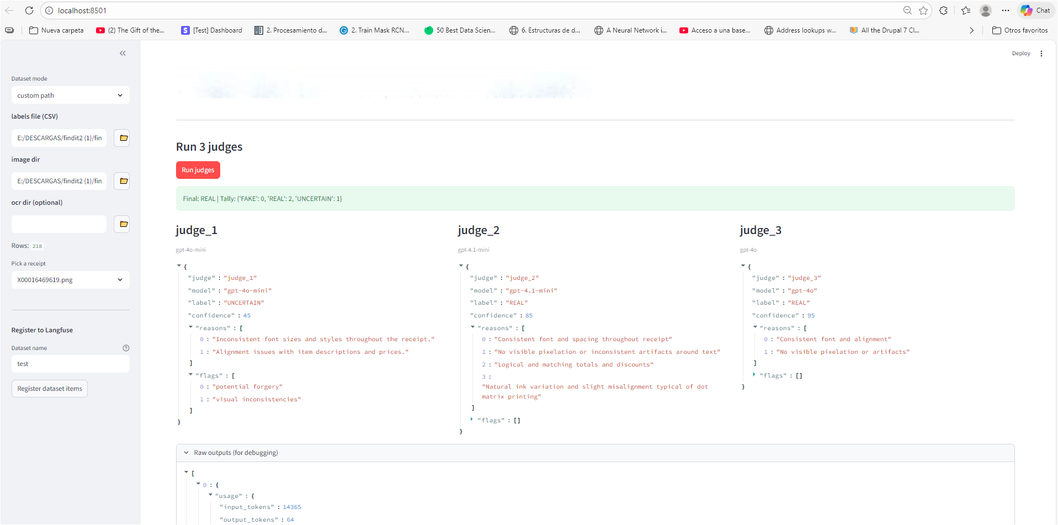

Slide 15
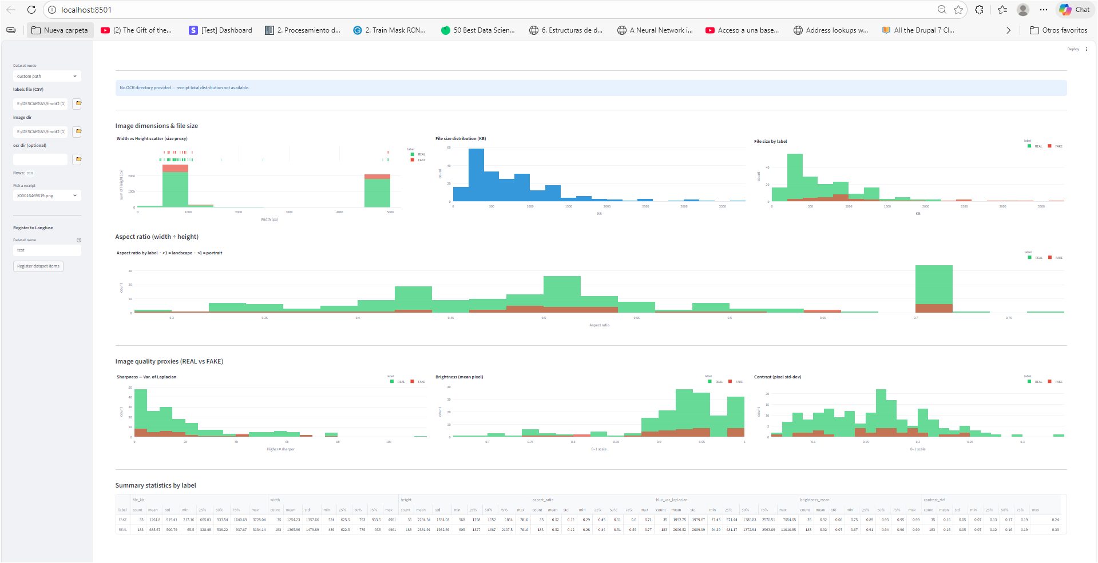

Slide 16
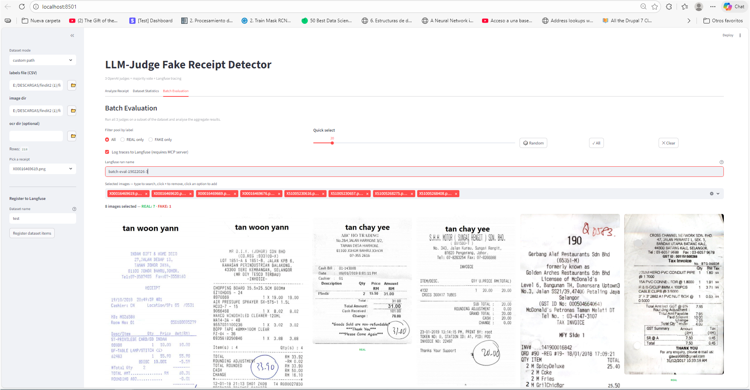

Slide 17
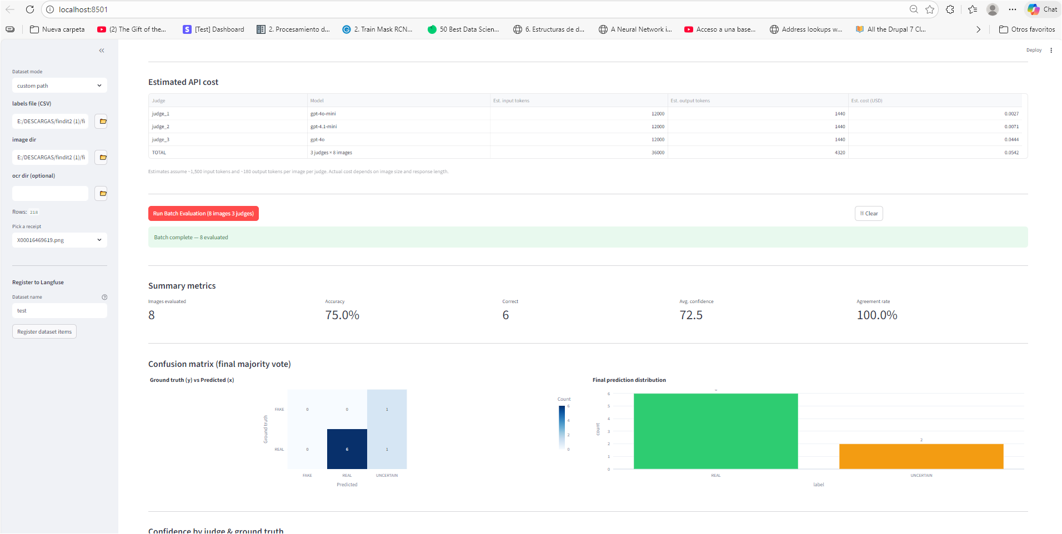

Slide 18
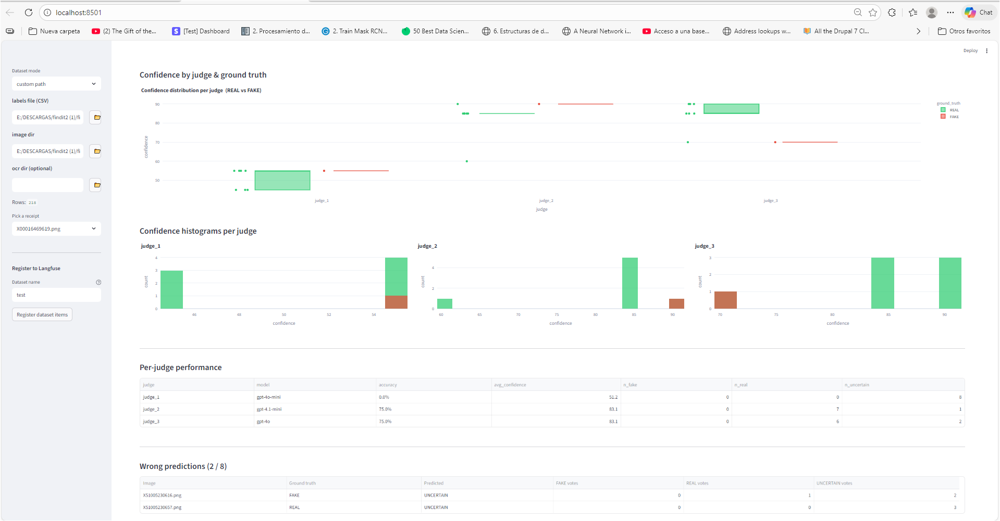

Slide 19
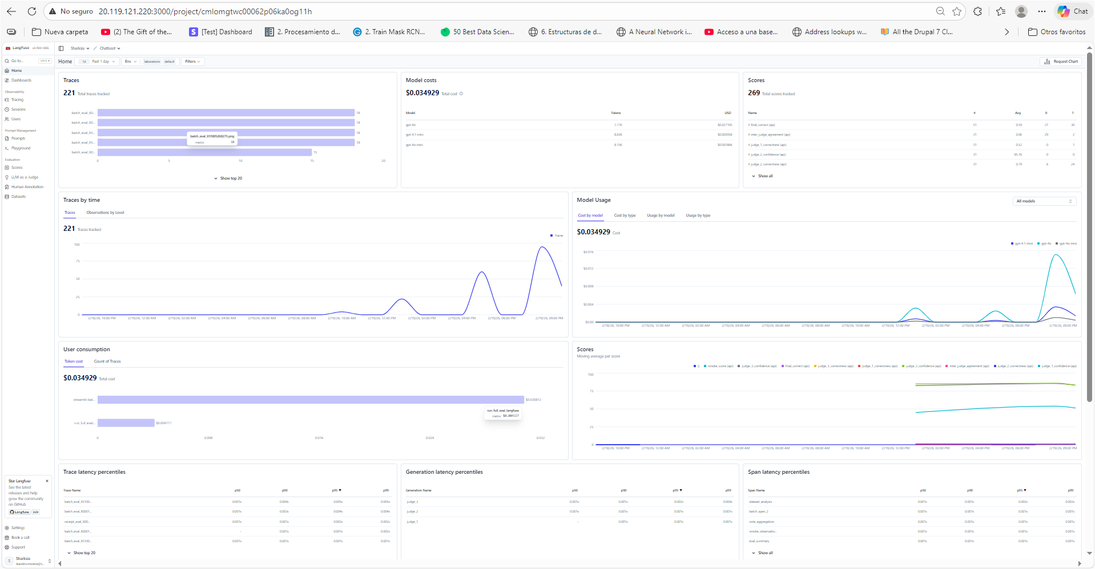

Slide 20
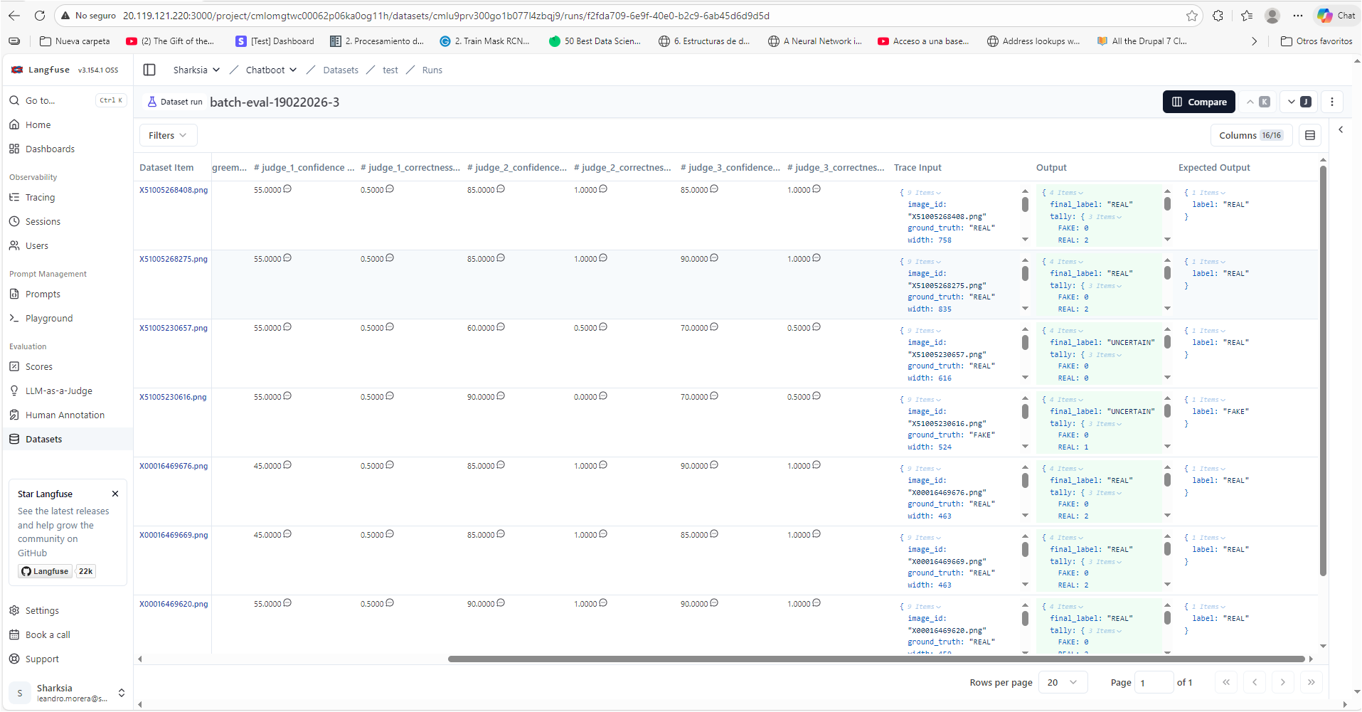

Slide 21
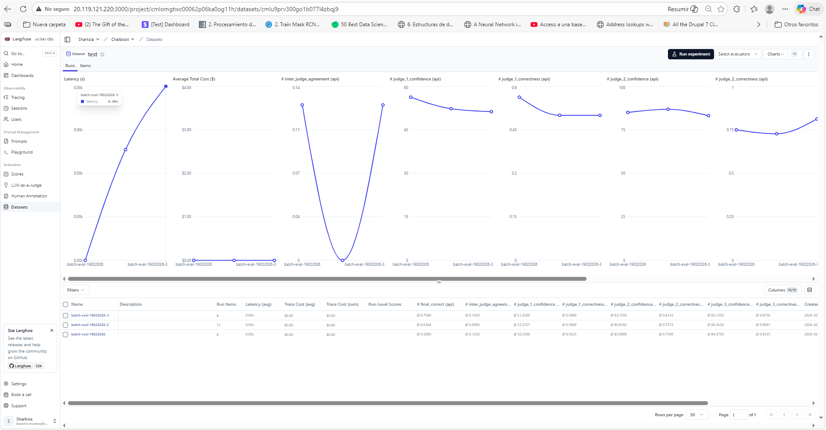

Slide 22
Thank you
LLM-Judge Fake Receipt Detector · TESTTHEKEY
Stack: Python · OpenAI Vision API · Streamlit · Langfuse · MCP · Plotly

