Slide 1

PoC assignment for developing an NFT Collateralized Lending/Borrowing Platform using Consensys Products
Leandro Melo, Sr. Software Engineer
Enablement Team

Slide 2
Objective & Key Features
Develop a decentralized platform where users can collateralize their Non-Fungible Tokens (NFTs) to borrow cryptocurrency.
NFT Collateralization: users can deposit NFTs as collateral to secure a loan
Loan Issuance: appraised value of the NFT will determine the corresponding amount of cryptocurrency (e.g. to borrow $100, NFT value >= $150)
Interest and Repayment: Smart contracts will manage interest rates and schedule repayments
Liquidation: If a borrower fails to repay, the platform automatically liquidates the NFT to cover the debt

Slide 3

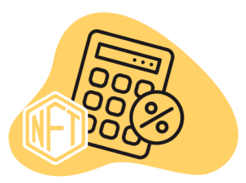

In a nutshell
NFT Price: $150
Available for borrowing: $100
Plaform fee: $1
Collateralize NFT
Borrower
Borrowed $100
Smart Contract
ATTENTION: This scenario can become more complex depending on the client requirements

Slide 4



Products
Web App + MetaMask
For wallet integration allowing users to manage their cryptocurrency and NFTs securely via authentication and transactions:
Show tokens in the wallet
Borrow cryptocurrency
List current loans
Loan terms (fees, extensions, …)
Infura + Linea
To connect the user interface with a smart contract in Linea Blockchain:
Transaction processing and storage
List user’s token
Execute liquidity

Slide 5
Smart Contract
Implement a smart contract for:
NFT Appraisal and Storage: To hold the NFTs and determine their loan-to-value ratio
Loan Management: To create, manage and close loan contracts
Interest Calculation: To calculate and accrue interest on borrowed funds
Audited smart contracts to ensure the security of collateral and loans.

Slide 6
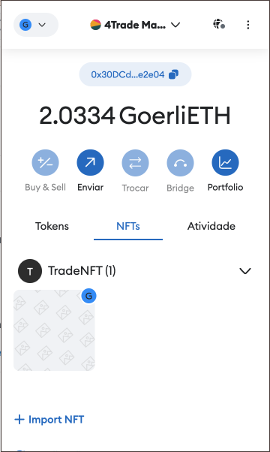
Basic workflow (web app)
A user connects their MetaMask wallet to the platform
The user selects an NFT from their wallet to use as collateral
Smart contract appraises the NFT and offers a loan amount
The user accepts the loan terms and receives crypto in wallet
1
2
3
4

Slide 7
Q&A
How should the smart contract assess the value of NFTs used as collateral? Will there be a need for integration with external appraisal services or marketplaces? (oracles, Opensea etc.)
What are the expected terms for loans? (interest rates, loan duration and default conditions)
How will the platform ensure sufficient liquidity to cover loans? (liquidity pool, external liquidator (another user), admin app for funding management)
Does the platform need to integrate with other services? (fiat onramps, or other DeFi protocols, oracles)
Do you have future plans to allow P2P lending? (necessary changes in UI/UX and implementation of a dispute tool)
What is your timeline for the project? (prepare milestones)

Slide 8
Q&A
What to do in case a loan is expired? (discussions about liquidity strategies)
Should the platform allow loan timeout extension? (if yes, what is the terms?)
Should the platform allow loan transfer? (more features to the smart contract and UI/UX changes)
Should the platform charge a fee for a loan request? (if yes, consider this in the contract)
How the platform will calculate the interest rate? (e.g. percentage based on the loan duration)
Should the platform allow the admin (contract owner) to mark the loan as paid? (The motivation for this question is related to judicial disputes)

