Slide 1
Inside the New Coolstreaming: Principles, Measurements and Performance Implications
Bo Li, Susu Xie, Yang Qu, Gabriel Y. Keung, Chuang Lin, Jiangchuan Liu and Xinyan Zhang
INFOCOM 2008

Slide 2
References
[5] X. Zhang, J. Liu, B. Li, and P. Yum, “DONet/Coolstreaming: A Data-driven Overlay Network for Live Media Streaming,” in Proc. of IEEE Infocom, March 2005.(*)
[8] Susu Xie, Bo Li, Gabriel Y. Keung, and Xinyan Zhang, “Coolstreaming: Design, Theory and Practice,” in IEEE Transactions on Multimedia, Vol. 9, Issue 8, December 2007.
*http://vc.cs.nthu.edu.tw/ezLMS/show.php?id=317

Slide 3
Outlines
Introduction
Related work
The New Coolstreaming
Log and Data Collection Results
Simulation Results
Conclusion

Slide 4
Core operations of DONet / CoolStreaming
DONet: Data-driven Overlay Network
CoolStream: Cooperative Overlay Streaming
  A practical DONet implementation
Every node periodically exchanges data availability information with a set of partners
Retrieve unavailable data from one or more partners, or supply available data to partners
The more people watching the streaming data, the better the watching quality will be
  The idea is similar to BitTorrent (BT)
*http://vc.cs.nthu.edu.tw/ezLMS/show.php?id=317

Slide 5
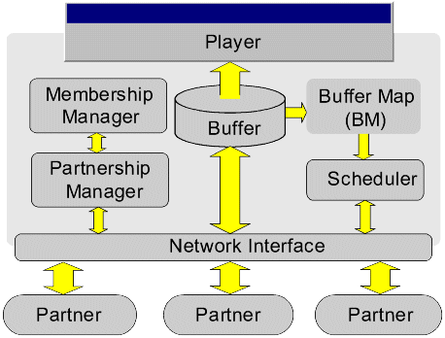
A generic system diagram for a DONet node
Membership manager
  mCache: record partial list of other active nodes
  Update by gossiping
Partnership manager
  Random select
Transmission scheduler
  Schedules transmission of video data
Buffer Map
  Record availability

Slide 6
Introduction
Data-driven overlay
  1) peers gossip with one another for content availability information
    It can independently select neighboring node(s) without any prior-structure constraint
  2) the content delivery is based on swarm-like technique using pull operation
    This essentially creates a mesh topology among overlay nodes, which is shown to be robust and very effective against node dynamics
Data-driven design
  Don’t use any tree, mesh, or any other structures
  Data flows are guided by the availability of data
Two main drawbacks in the earlier system:
  1) long initial start-up delay due to the random peer selection process and per block pulling operation
  2) high failure rate in joining a program during flash crowd

Slide 7
Introduction
Redesigned and implemented the Coolstreaming system
  1) we have now implemented a hybrid pull and push mechanism, in which the video content are pushed by a parent node to a child node except for the first block.
  2) a novel multiple sub-streams scheme is implemented, which enables multi-source and multi-path delivery of the video stream.
  3) the buffer management and scheduling schemes are completely re-designed to deal with the dissemination of multiple sub-streams.
  4) multiple servers are strategically deployed, which substantially reduce the initial start-up time to under 5 seconds.

Slide 8
Introduction
Contribution of this paper
  1) we describe the basic principles and key components in a real working system
  2) we examine the workload characteristics and the system dynamics
  3) we analyze from real traces what the key factors affect the streaming performance
  4) we investigate the sensitivity from a variety of system parameters and offer our insights in the design of future systems

Slide 9
Related Work
The existing P2P live streaming system
  tree-based overlay multicast
    Construct a multicast tree among end hosts
    single-tree approach
    multi-tree approach
      drawbacks
        multi-tree scheme is more complex to manage in that it demands the use of special multi-rate or/and multilayer encoding algorithms,
        this often requires that multiple trees are disjoint, which can be difficult in the presence of network dynamics.
      Chunkyspread[14]
    Not suitable for highly dynamic environment
    Load balancing problem
  data-driven approaches
[14] V. Venkararaman, K. Yoshida and P. Francis, “Chunkspread: Heterogeneous Unstructured End System Multicast,” in Proc. of IEEE ICNP, November 2006.

Slide 10
The New Coolstreaming
Coolstreaming was developed in Python language earlier 2004.
The first release (Coolstreaming v0.9) in March 2004 and until summer 2005.
The peak concurrent users reached 80,000 with an average bit rate of 400Kbps.
The system became the base technology for Roxbeam Inc.
Basic component
  2 basic functionalities that a P2P streaming system must have:
    1) from which node one obtains the video content
    2) how the video stream is transmitted.
  The Coolstreaming system adopted a similar technique initially used in BitTorrent (BT) for content location,
    Use a random peer selection; it then uses a hybrid pull and push mechanism in the new system for content delivery.

Slide 11
The New Coolstreaming
Advantages of the Coolstreaming:
  1) easy to deploy, as there is no need to maintain any global structure;
  2) efficient, in that data forwarding is not restricted by the overlay topology but by its availability;
  3) robust and resilient, as both the peer partnership and data availability are dynamically and periodically updated.
3 basic modules in the system:
  1) Membership manager, which maintains partial view of the overlay.
  2) Partnership manager, which establishes and maintains partnership with other peers and also exchanges the availability of video content using Buffer Map (BM) with peer nodes.
  3) Stream manager, which is responsible for data delivery.

Slide 12
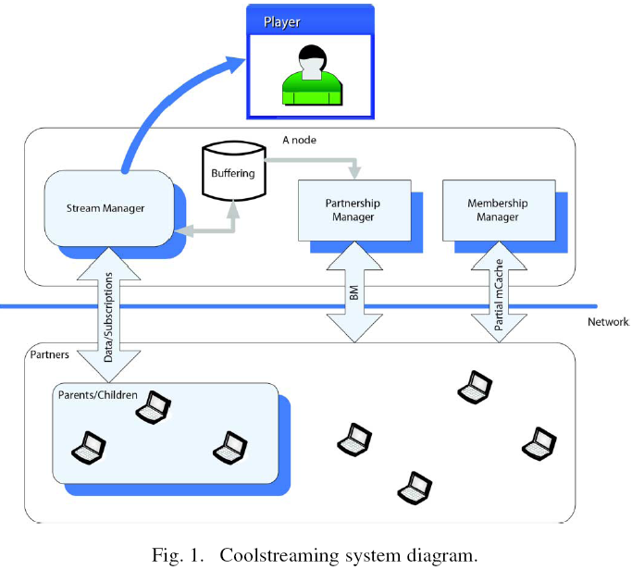

Slide 13
The New Coolstreaming (Multiple Sub-Streams)
The video stream is divided into blocks with equal size.
We divide each video stream into multiple sub-streams without any coding.
  Each node can retrieve any sub-stream independently from different parent nodes.
A video stream is decomposed into K sub-streams by grouping video blocks according to the following scheme:
  the i-th sub-stream contains blocks with sequence numbers (nK +i)
    n : a non-negative integer,
    i : a positive integer from 1 to K.
    This implies that a node can at most receive sub-streams from K parent nodes.

Slide 14
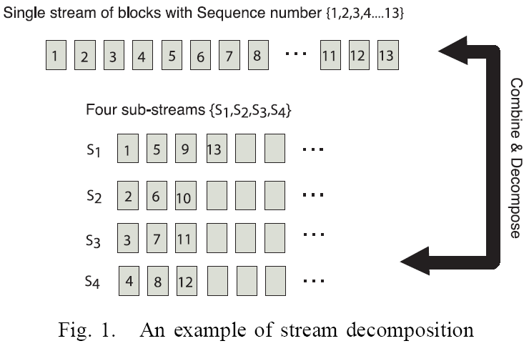

Slide 15
The New Coolstreaming (Buffer Partitioning)
Buffer Map (BM) is introduced to represent the availability of latest blocks of different sub-streams in buffer.
  This information also has to be exchanged periodically among partners in order to determine which sub-stream to subscribe to.
  The Buffer Map is represented by two vectors, each with K elements.
    The 1st vector records the sequence number of the latest received block from each sub-stream.
      The substreams are specified by {S₁, S₂, ..., S_{K}} and the corresponding sequence number of the latest received block is given by {H_{S1}, H_{S2} , ..., H_{SK}}.
    The 2nd vector specifies the subscription of sub-streams from the partner.
      Ex : {1, 1, 0, 0, ..., 0}
  In the new Coolstreaming, each node maintains an internal
    synchronization buffer
    cache buffer

Slide 16
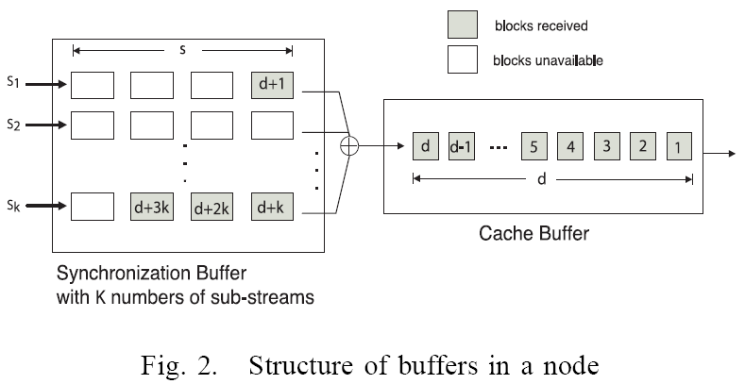
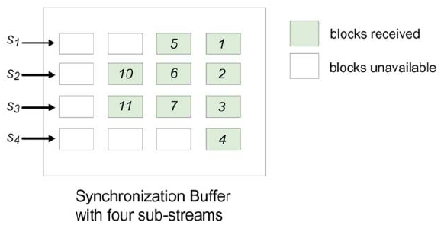

Slide 17
The New Coolstreaming (Push-Pull Content Delivering)
The old Coolstreaming system : each block has to be pulled by a peer node, which incurs at least one delay per block.
The new Coolstreaming adopts a hybrid push and pull scheme.
  When a node subscribes to a sub-stream by connecting to one of its partners via a single request (pull) in BM, the requested partner(the parent node) will continue pushing all blocks in need of the sub-stream to the requested node.
  This not only reduces the overhead associated with each video block transfer, but more importantly, significantly reduces the timing involved in retrieving video content.

Slide 18
Log and Data Collection Results
System configuration
  A live event broadcast on 27th September,2006 in Japan.
  A sport channel had a live baseball game that was broadcasted at 17:30 and we recorded real traces from 00:00 to 23:59 on that particular day.
  There is a log server in the system.
  Each user reports its activities to the log server including events and internal status periodically.
    Users and the log server communicate with each other using the HTTP protocol.
  Each video program is streamed at a bit rate of 768 Kbps.
  To provide better streaming service, the system deploys 24 servers.
    The source sends video streams to the servers, which are collectively responsible for streaming the video to peers.
      Users do not directly retrieve the video from the source.

Slide 19
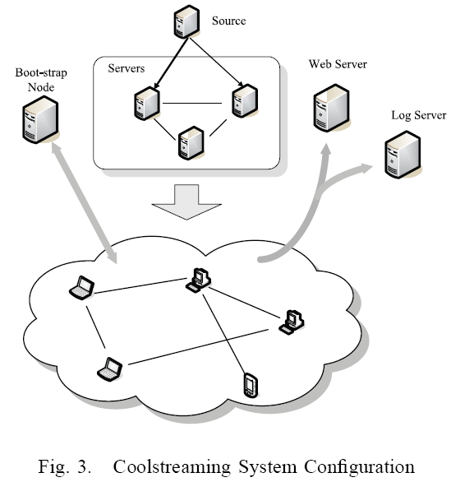

Slide 20
Log and Data Collection Results (User Types and Distribution)
The log system also records the IP address and port number for the user.
We classify users based on the IP address and TCP connections into the following 4 types:
  1) Direct-connect: peers have public addresses with both incoming and outgoing partners;
  2) UPnP: peers have private addresses with both incoming and outgoing partners.
  3) NAT: peers have private addresses with only outgoing partners;
  4) Firewall: peers have public addresses with only outgoing partners.

Slide 21
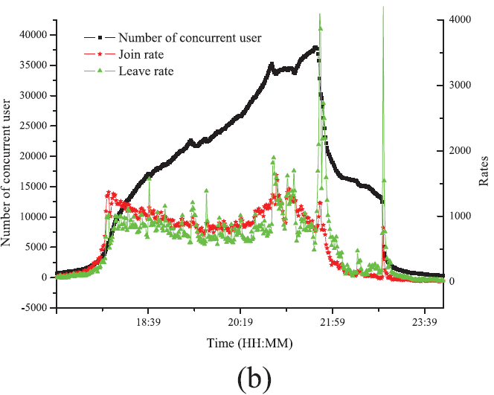
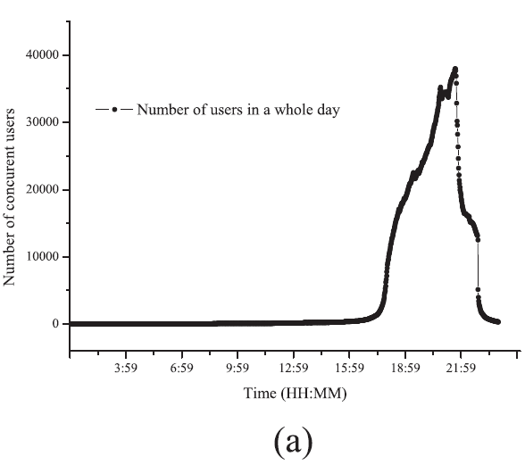
Fig. 4. (a) The evolution of the number of users in the system in a whole day; (b) The evolution of the number of users in the system from 18:00 to 23:59

Slide 22
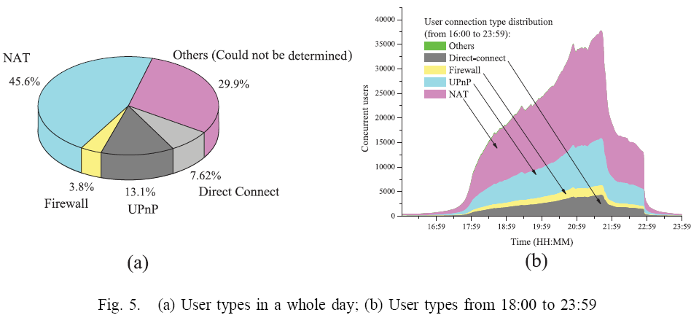

Slide 23
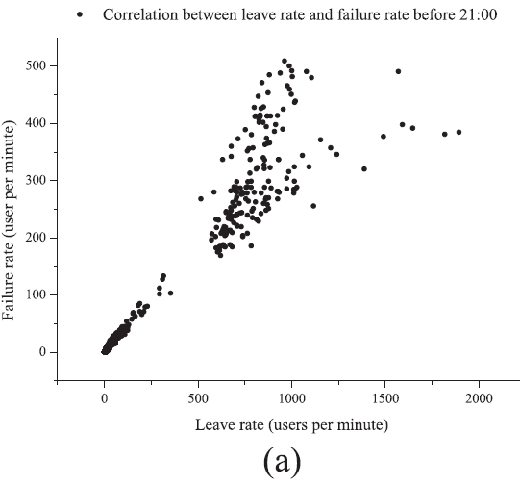
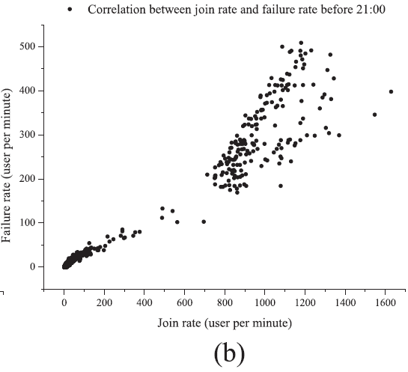
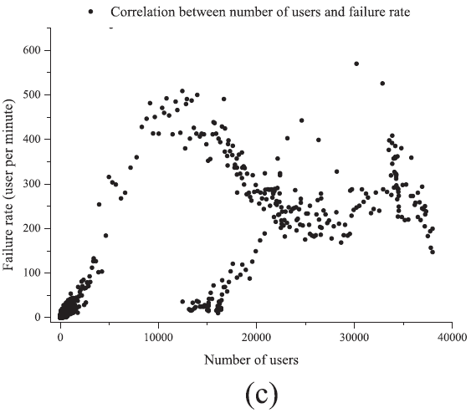
The failure is mostly caused by churn, and not affected by the size of the system.
Fig. 6. (a) The correlations between join rate and failure rate; (b) The correlations between leave rate and failure rates; (c) Correlation between failure rate and system size

Slide 24
Log and Data Collection Results
Contribution index : the aggregate upload bandwidth (bytes sent) over the aggregate download bandwidth (bytes received) for each user
  If the aggregate upload capacity from a user is zero, the contribution index is also zero.
    This implies that the user does not contribute any uploading capacity in the system.
  If the aggregate upload (bytes sent out) equals to aggregate download (bytes received) of a user, the contribution index is one.
    This indicates that the user is capable of providing full video streams to another user.
We categorize user contributions into levels by their average values of the contribution index:
  1) Level 0: contribution index is larger than one.
    The user can upload the whole video content to another user;
  2) Level 1: contribution index is between 0.5 and 1.
    The user can at least upload half video content to its children;
  3) Level 2: contribution index is between 1/6 and 0.5.
    The user can upload at least one sub-stream to its children;
  4) Level 3: contribution index is less than 1/6.
    The user cannot stably upload a single sub-stream to its children.

Slide 25
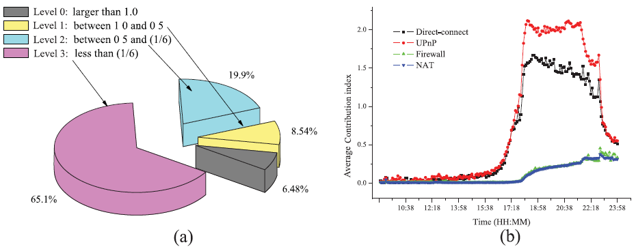
Fig. 7. (a) The distribution of contribution index from Level 0 to Level 3; (b) Average contribution index of different user connection types against time.

Slide 26
Simulation Results
Simulation Setting
  The video stream is coded with 400Kbps with 10 sub-streams and each block is 10K bits.
  There is one source node and one bootstrap node in the system initially.
  At the beginning of the simulation, 5,000 nodes join the system according to Poisson arrival with an average inter-arrival time 10 milliseconds.
  The source node has upload capacity of 9Mbps and can handle up to 15 children (partners).
  The bootstrap node can maintain a record of 500 nodes and its entry can be updated.
  Each node can maintain partnerships with at most 20 peers and can buffer up to 30 seconds’ content.
  Each node can start playing the video when the buffer is half-loaded.
  Homogeneous setting in which each node has an equivalent uploading capacity (500Kbps), and a highly heterogeneous setting in which nodes have uploading capacity at 100Kbps and 900Kbps.

Slide 27
Simulation Results
Evaluation metrics
  (i) Playback continuity (continuity index): the ratio of the number of blocks that exist in buffer at their playback due time to that of blocks that should have been played over time,
    It is the main metric for evaluating user satisfaction.
  (ii) Out-going (Uploading) bandwidth utilization: a metric for evaluating how efficient the uploading bandwidth capacity is used.
  (iii) Effective data ratio: the percentage of useful data blocks in all the received ones.
    This metric evaluates how efficient the bandwidth is utilized.
  (iv) Buffer utilization: this measures how the buffer is utilized.
  (v) Startup delay: the waiting time until a node starts playing the video after it joins the system.
  (vi) Path length: the distance between a node and the source in the overlay.
    This metric characterizes the overlay structure.
  (vii) Partner/parent/child change rate(s): The changes in partners / parents / children per second within a node
    It is a metric for evaluating overlay stability.

Slide 28
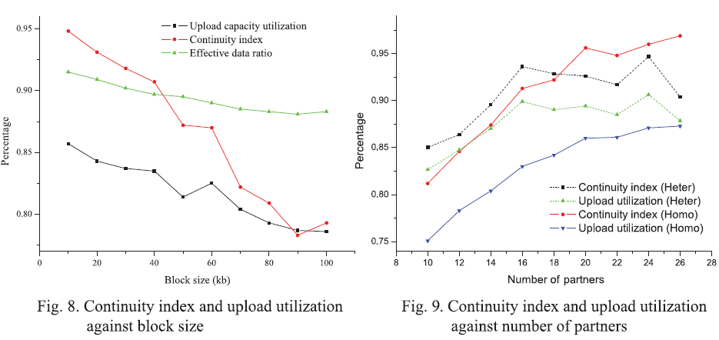

Slide 29
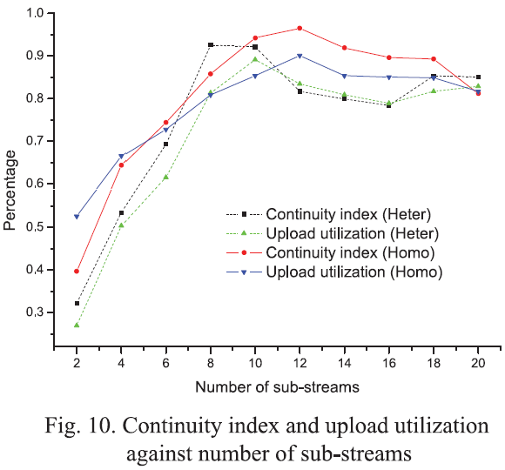
The increase of the number of sub-streams beyond 8 does not bring any further improvement due to the complication in handling multiples sub-streams in each node.

Slide 30
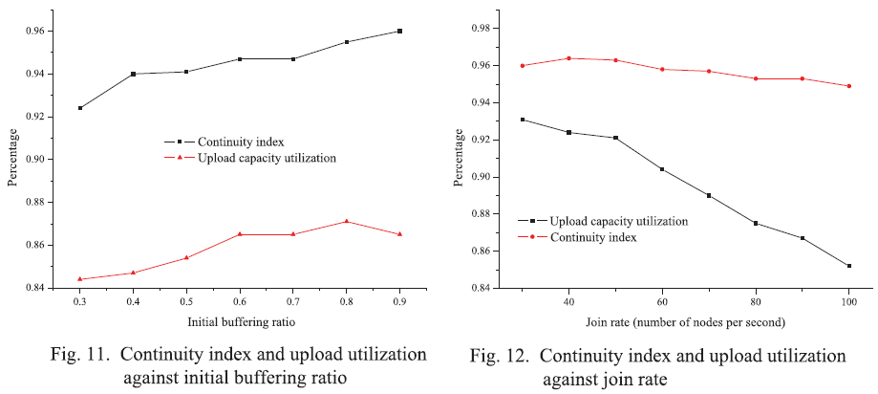

Slide 31
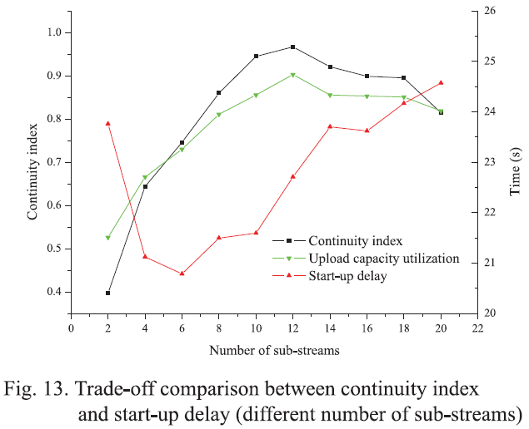
The increase of the startup time is mainly caused by the variations and synchronization in receiving sub-streams from different parents.

Slide 32
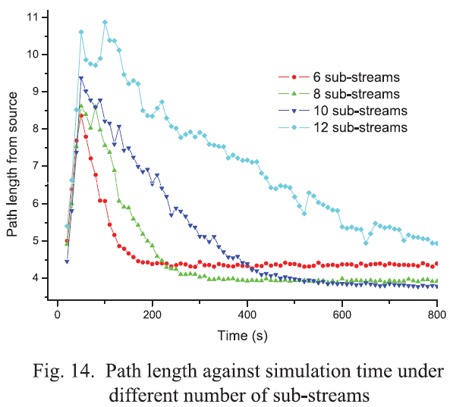
A node needs longer time to retrieve a larger number of sub-streams from different parents.

Slide 33
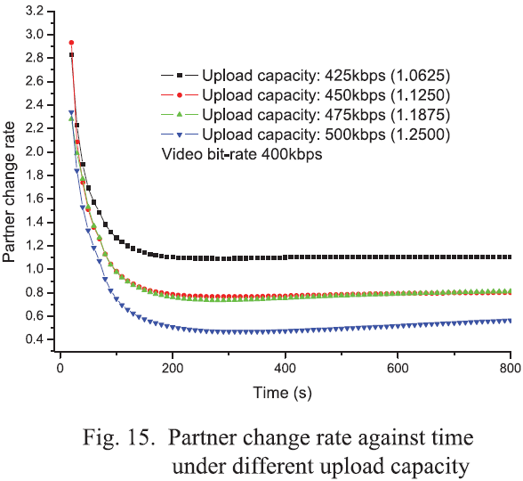
The overlay can reach a stable state within 2 minutes after the initial node joining (flash crowd phase), and higher uploading capacity can lead to more stable topology (less partner change) and better video playback quality.

Slide 34
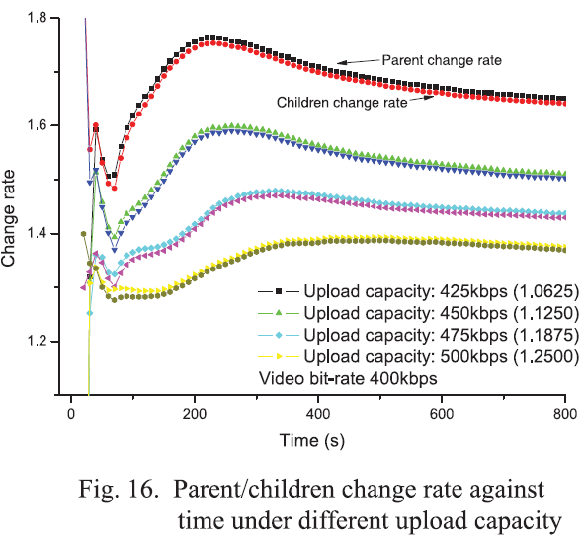
The parent/children change rates also converge to stable rates under different settings within 2-3 minutes, and the stability is sensitive to the uploading capacity.

Slide 35
Conclusion
This paper takes an inside look at the new Coolstreaming system by exposing its design options and rationale behind them.
We study the workload characteristics, system dynamics, and impact from a variety of system parameters.

Slide 36
References
[2] J. Liu, S. Rao, B. Li and H. Zhang, “Opportunities and Challenges of Peer-to-Peer Internet Video Broadcast,” (invited) Proceedings of the IEEE, Special Issue on Recent Advances in Distributed Multimedia Communications, 2007.
[5] X. Zhang, J. Liu, B. Li, and P. Yum, “DONet/Coolstreaming: A Data-driven Overlay Network for Live Media Streaming,” in Proc. of IEEE Infocom, March 2005.
[8] Susu Xie, Bo Li, Gabriel Y. Keung, and Xinyan Zhang, “Coolstreaming: Design, Theory and Practice,” in IEEE Transactions on Multimedia, Vol. 9, Issue 8, December 2007.
Bo Li, Susu Xie, Gabriel Y. Keung, Jiangchuan Liu, Ion Stoica, Hui Zhang, Xinyan Zhang : “An Empirical Study of the Coolstreaming+ System.” IEEE Journal on Selected Areas in Communications, VOL.25 NO 9, December 2007.
[14] V. Venkararaman, K. Yoshida and P. Francis, “Chunkspread: Heterogeneous Unstructured End System Multicast,” in Proc. Of IEEE ICNP, November 2006.

