Slide 1
CoolStreaming/DONet: A Data-driven Overlay Network for Peer-to-Peer Live Media Streaming
INFOCOM 2005
Xinyan Zhang, Jiangchuan Liu, Bo Li, and Tak-Shing Peter Yum
Department of Information Engineering, The Chinese University of Hong Kong
School of CS Simon Fraser University, BC, Canda
Department of CS, Hong Kong University of Science and Technology

Slide 2
Motivation
Provide peer-to-peer live streaming broadcasting
  Network heterogeneity
  No QoS guarantee
Data-driven design
  Don’t use any tree, mesh, or any other structures
  Data flows are guided by the availability of data

Slide 3
Related work
Overlay multicast system
  Proxy-assisted
    Servers or application-level proxies are strategically placed
  Peer-to-peer based
    Self-organized overlay networks
    Peer-to-Peer based multimedia distribution service (*)
      May not suitable for live streaming
*IEEE Transactions on Multimedia, April, 2004
http://vc.cs.nthu.edu.tw/ezLMS/show.php?id=112

Slide 4
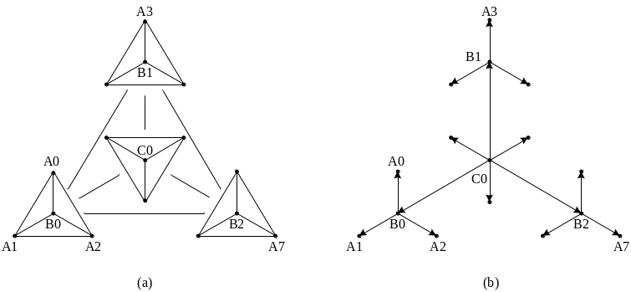
Related work
Peer-to-peer based overlay multicast system
  Tree-based protocols
    Not suitable for highly dynamic environment
    Load balancing problem
  Gossip-based protocols (*)
    Iteration
      Send messages to a random set of nodes
      Message receiving nodes do similar things in the next round
    Simple and robust
    Redundancy and delay problem
*http://vc.cs.nthu.edu.tw/ezLMS/show.php?id=121&1127891456

Slide 5
Core operations of DONet / CoolStreaming
DONet: Data-driven Overlay Network
CoolStream: Cooperative Overlay Streaming
  A practical DONet implementation
Every node periodically exchanges data availability information with a set of partners
Retrieve unavailable data from one or more partners, or supply available data to partners
The more people watching the streaming data, the better the watching quality will be
  The idea is similar to BitTorrent (BT)

Slide 6
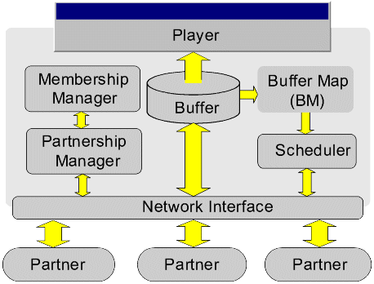
A generic system diagram for a DONet node
Membership manager
  mCache: record partial list of other active nodes
  Update by gossiping
Partnership manager
  Random select
Transmission scheduler
  Schedules transmission of video data
Buffer Map
  Record availability

Slide 7
Node join and membership management
Each node has a unique ID (eg, IP) and a membership cache (mCache)
A new node contacts the original node (server), gets a randomly selected deputy node, then gets partner candidates from the deputy node’s mCache
Use SCAM (Scalable Gossiping Membership Protocol) to distribute membership messages among nodes

Slide 8
Buffer map representation and exchange
A video length is divided into segments of uniform size
Availability of the segments in a node is represented by a Buffer Map (BM)
  In practical, a BM is recorded by 120 bits for 120 segments
Each node continuously exchanges its BM with its partners and schedules which segments to fetch from which partner

Slide 9
Scheduling algorithm
Adapt to dynamic and heterogeneous networks
  Playback deadline of each segment
    Number of segments missing deadlines should be kept minimum
  Heterogeneous streaming bandwidth from partners
This problem is a variation of the Parallel machine scheduling
  NP-hard problem
  The situation will become worse in a highly dynamic environment
  Resort a simple heuristic of fast response time

Slide 10
Heuristic scheduling algorithm
Calculate the number of potential suppliers for each segment
  Message exchange
    Window-based buffer map (BM): data availability
    Segment request (similar to BM)
  Less supplier first
  Multi-supplier: highest bandwidth within deadline first

Slide 11
Failure recovery and partnership refinement
Graceful departure
  Issue a departure message when departing
Node failure
  A partner that detects the failure will issue the departure message
Departure messages are propagated by gossip protocol
A node periodically establishes new partnership with a randomly selected node in its mCache
  In practical, establish with the nodes that have high segment send/receive throughput

Slide 12
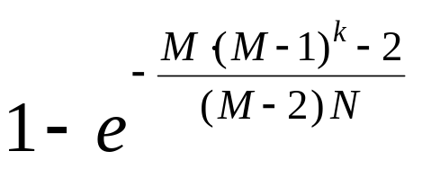
Analysis on DONet (*)
Coverage ratio for distance k (# of neighbors: M, total nodes: N)
  E.g. 95% nodes are covered in 6 hops when M=4, N=500
Average distance from source to destination is bounded by O(logN)
*DONet/CoolStreaming: A data-driven overlay network for live media streaming, Technical report, 2004

Slide 13
PlanetLab-based experiment
PlanetLab
  An open platform for developing, deploying, and accessing planetary-scale services
Involved 200~300 nodes during experiment period (May to June, 2004)
Streaming rate: 500 Kbps

Slide 14
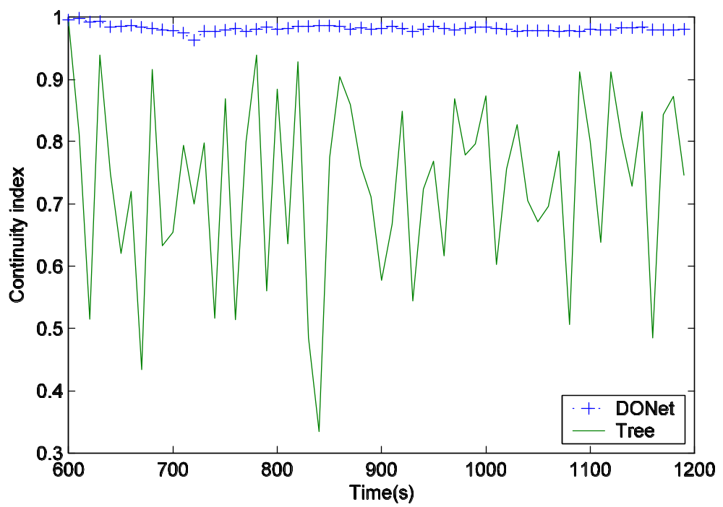
Result: data continuity
Continuity index: number of segments that arrive before or on playback deadlines over the total number segments

Slide 15
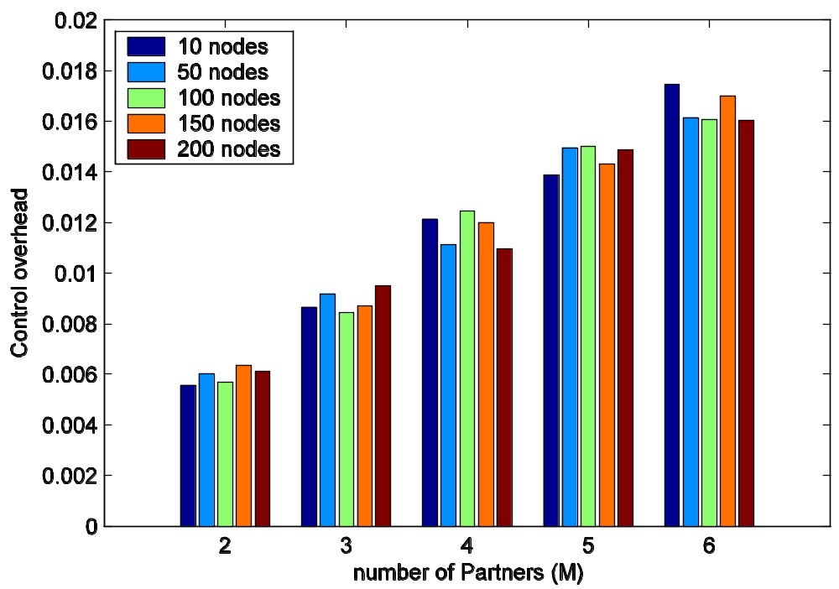
Result: control overhead vs. number of partners for different overlay sizes

Slide 16
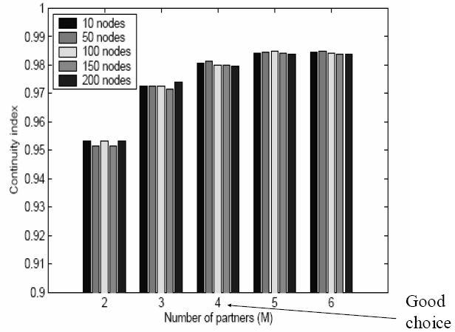
Result: continuity index as a function of the number of partners

Slide 17
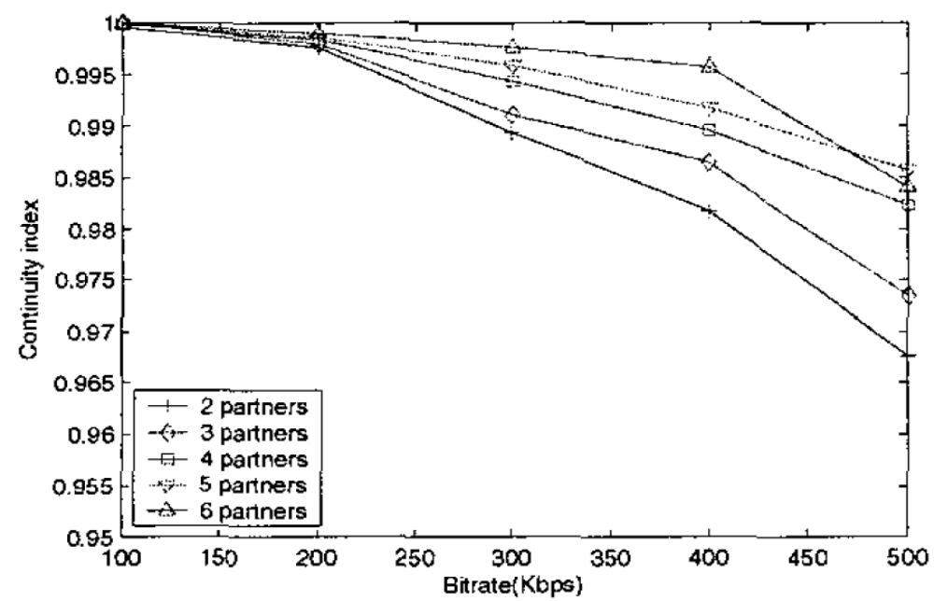
Result: Continuity index as a function of streaming rate (size = 200 nodes)

Slide 18
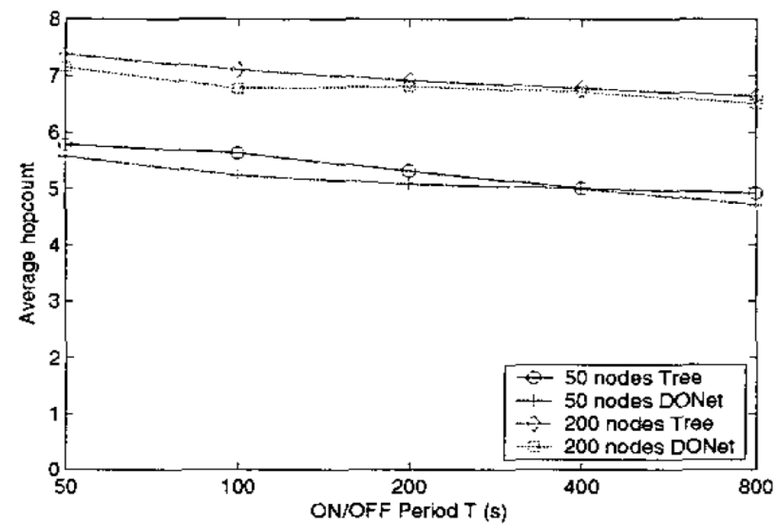
Result: average hop-count of DONet and tree-based overlay

Slide 19
CoolStream
A practical DONet implementation
First version release: May, 2004
Support Real Video and Windows Media format
Broadcast live sport programs at 450~755 Kbps
Attached 30000 users

Slide 20
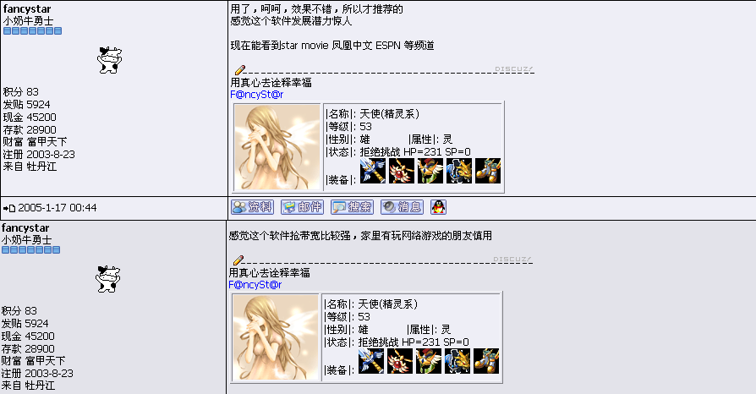
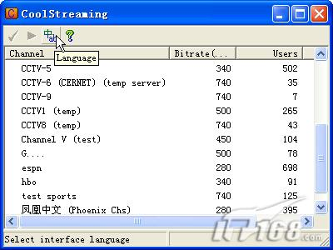
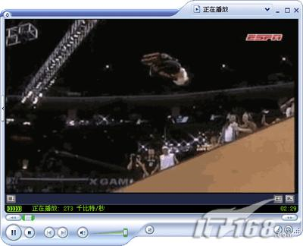
CoolStream snapshot (*)
*http://publish.it168.com/2005/0404/20050404007201.shtml

Slide 21
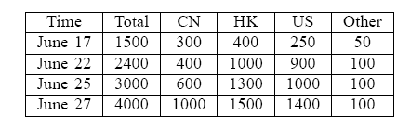
User distribution
Heterogeneous network environment
  LAN, CABLE, DSL, …

Slide 22
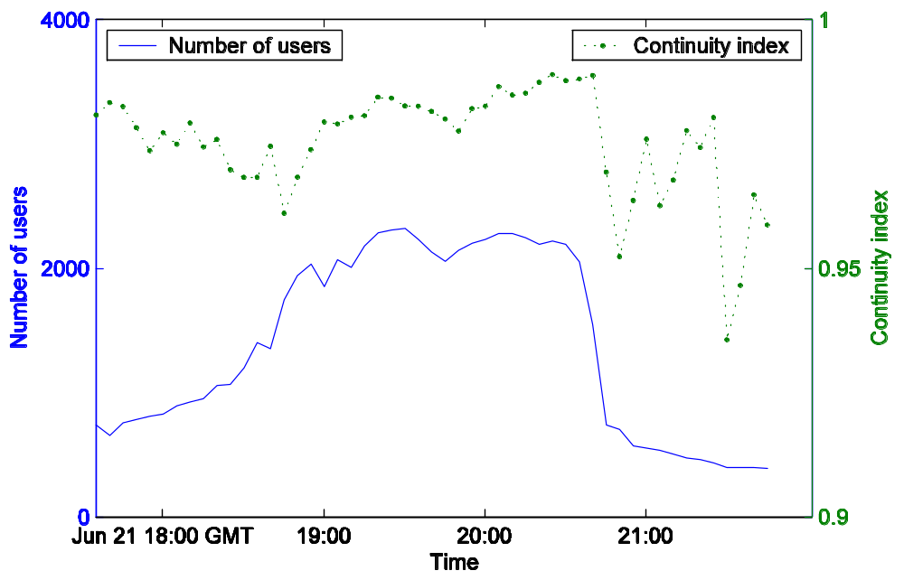
Online statistics (June 21, 2004)

Slide 23
Observations
Current Internet has enough available band to support TV-quality streaming (>450Kbps)
  Bottleneck: server, end-to-end bandwidth
Larger data-driven overlay
➔ better streaming quality
  Capacity amplification

Slide 24
Conclusion
Present the design of DONet for live media streaming
  Data-driven design
  Scalable membership and partnership management algorithm
  Heuristic scheduling algorithm
The experiment results on PlantLab demonstrate DONet delivers quite good playback quality in a highly dynamic networks
A practical implementation was also released for broadcasting live programs

Slide 25
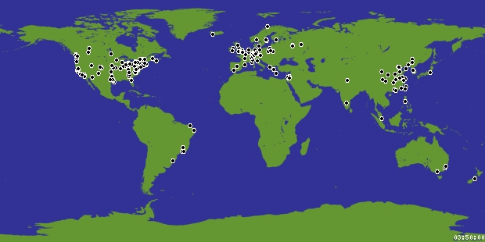
PlanetLab distribution (*)
*http://www.planet-lab.org/

Slide 26
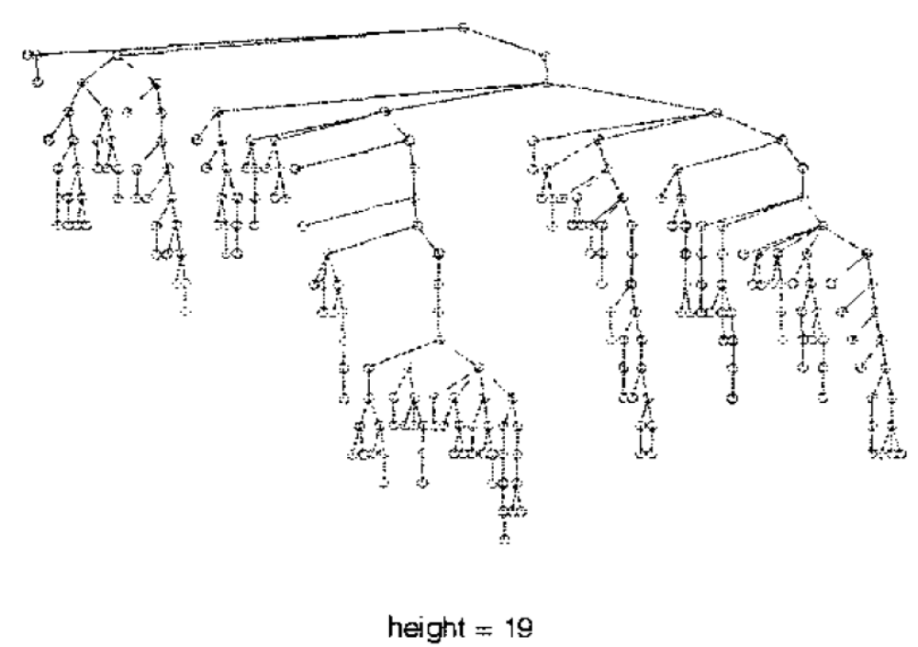
A snapshot of a tree-based overlay with 231 nodes

