Slide 1

Hootsuite
(Random Acts of Pizza: My first Text Mining project)

Slide 2
Overview:
My Goals
  Give you a data-driven advice in how to write your post and increase the chance to receive a free pizza (How can I do it?)
  Learn/Get more experience in text mining (learn on demand). Explore NLP and text mining packages (try a new thing) in R
  Test my EDA Start Kit project (GTD)
Overview
  What is RaoP?
  Data:
    Data introduction;
    Features and text engineering
    Data prep and descriptive
  First model development
    Features selection
    Model assessment
  Recommendation and next steps

Slide 3
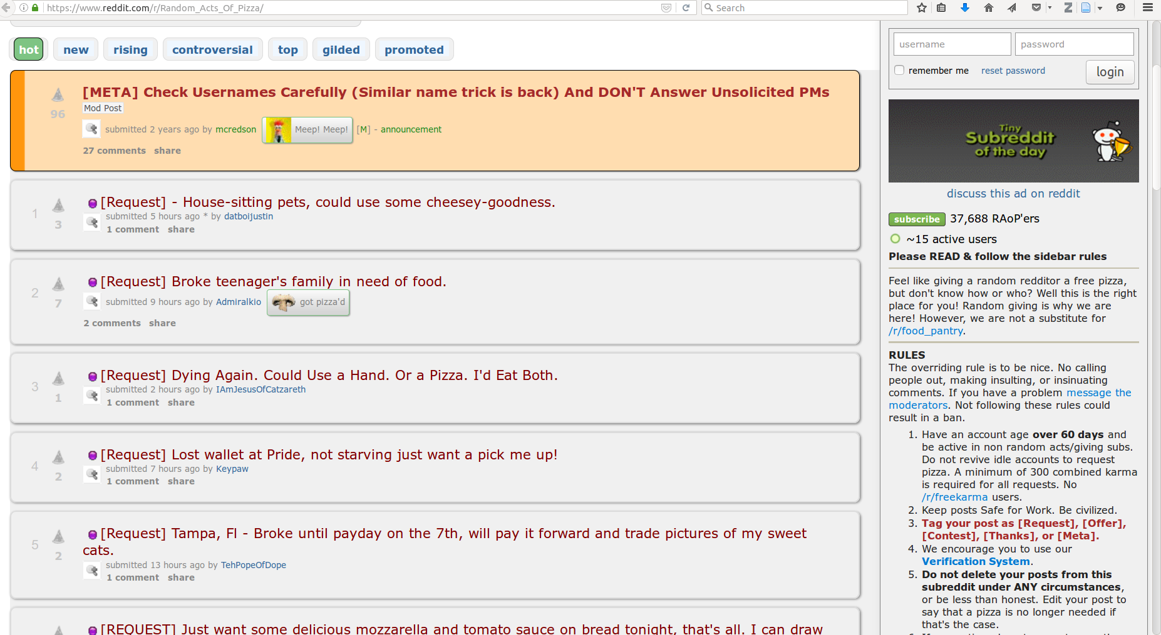

RAoP: Random Action of Pizza
If I want a free pizza. I write a compelling post on the on r/Random_Acts_Of_Pizza/ asking for a pizza with a tag: [REQUEST]
If I want to offer a pizza. I write a post with a tag [Offer] or select a [REQUEST] post
So you can help people and restore Restoring Faith in Humanity, One Slice at a Time - Reddit
https://www.reddit.com/r/Random_Acts_Of_Pizza/

Slide 4
Data

Slide 5



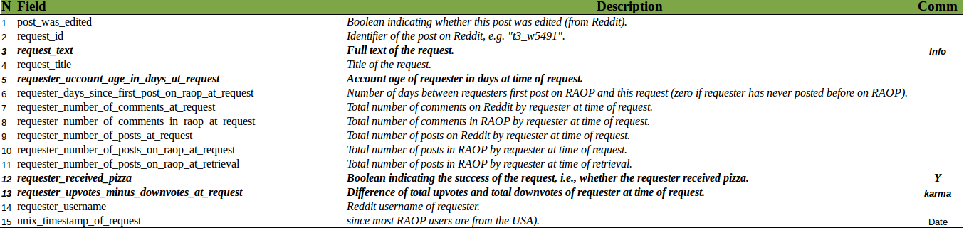
Data
Data size: 5671 (rows) x 33 (vars)
#users: 5671 (no user with 2+ post !?)
Received pizza: 1397 (25%)
Investigated actionable predictors (features)
  Available (in the moment I write the post)
  Control our partial control (I can change it)
Kept my focus on:
His/Her history was compelling?
He/She was polite?
He/She was able to prove his history?
He/She provided what was required/asked to him?
Is He/She a good/nice reddit user?
How long is he/she a reddit user?

Slide 6
Features Engineering
        Post related features (total control)
        #words in the post (compelling)
        post sentiment score: (polite and positive)
        post received 5 scores: money, job, student, family and desire narratives (kind of history) (Some narratives strategy might be more effective than others)
        Has.link (reciprocity: you gave something back)
User/requester related features (partial control)
        status or karma: requester upvote minus downvote
        Age account in days
  Community related features (No control)
        Community age (people are more excited in the begin) (WIP or TODO)
  Temporal (moment) related features (control)
        First half of the month (When was it post?)(I do not have money in the end of the month)

Slide 7
Text Engineering (80% of the time)
(Simple approach) – weekend :) --
Sentiment Score (count shared words)
  2 Dictionary: positive (+1) and negative (-1) words
  {pos words: happy, friendly,...} => high positive score
  {neg words: bad, broke,f*#$$#,...} => high negative score
  Score: #pos shared words - #neg shared words
Narrative Scores (count shared words and divide by the number of word in the dictionary)
  3 dictionaries: money, job, family, desire, student
  Scores: count shared words/(#words in the dictionary)
  Shameless stolen (Inspired) in the article: How to Ask for a Favor: A Case Study on the Success of Altruistic Requests (Stanford , Max Planck Institute)

Slide 8

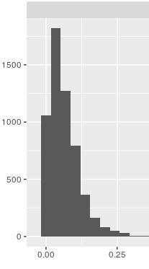
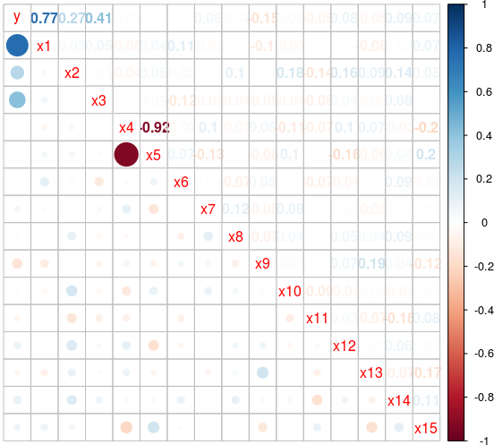
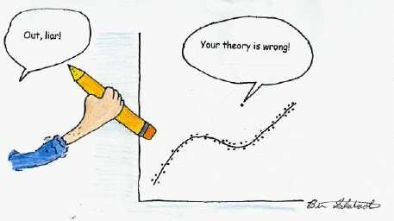
Data Preparation and issues
Issues:
        Skewness and long tails ( use median values ) :: Ignored (work with median as possible)
Concentration (You need variation to discover relation) :: removed var
Outliers :: removed points
Discrepant value ranges (X1: [0 – 10], X2: [0 – 10k]) :: scale [0 - 1]
Multi-colinearity (karma and age account):: ignored (predictive model)
Classes were Unbalanced (pizza: 1397; no pizza: 4274) :: re-balance
Text: stop words (a, by, the, in); punctuations, derived words ( work, worked, working); synonyms :: removed

Slide 9
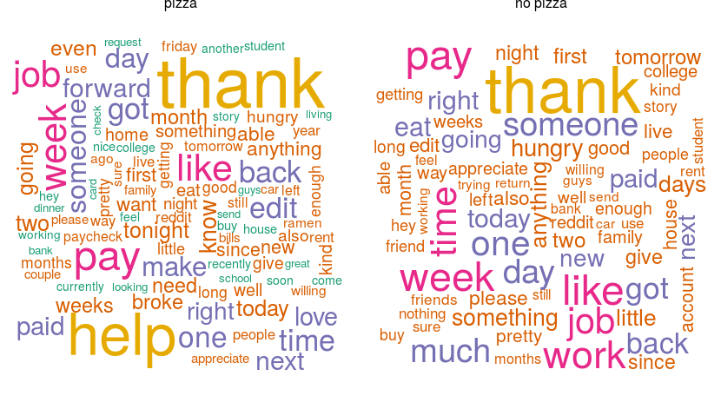
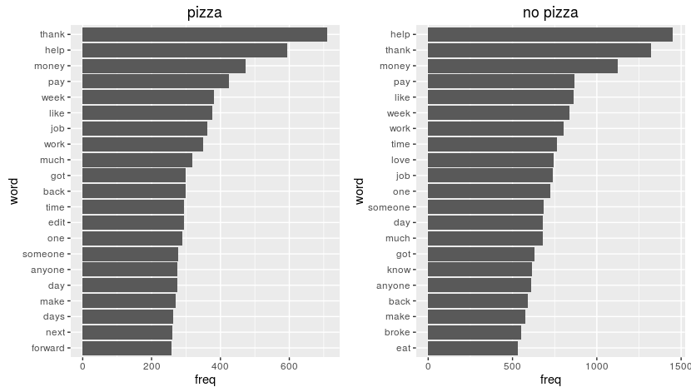
What are the most frequent words in each group?

Slide 10
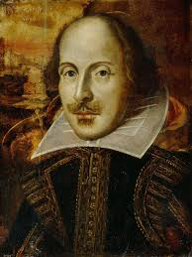
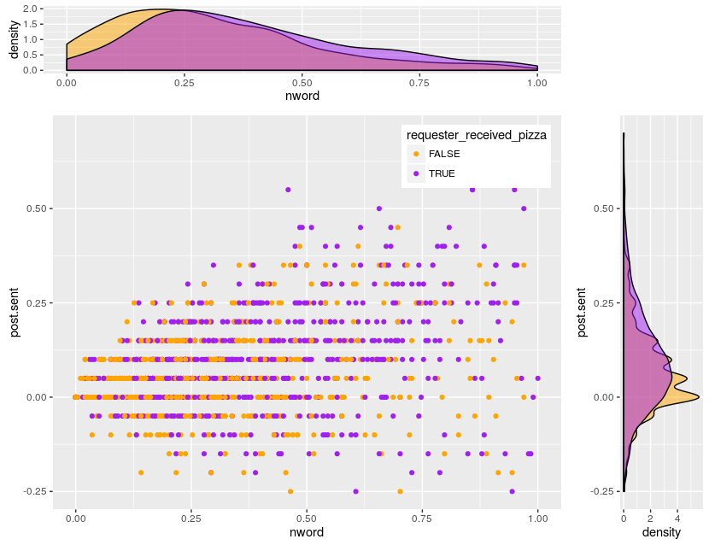

Get Pizza; #words and being positive

Slide 11
Model

Slide 12
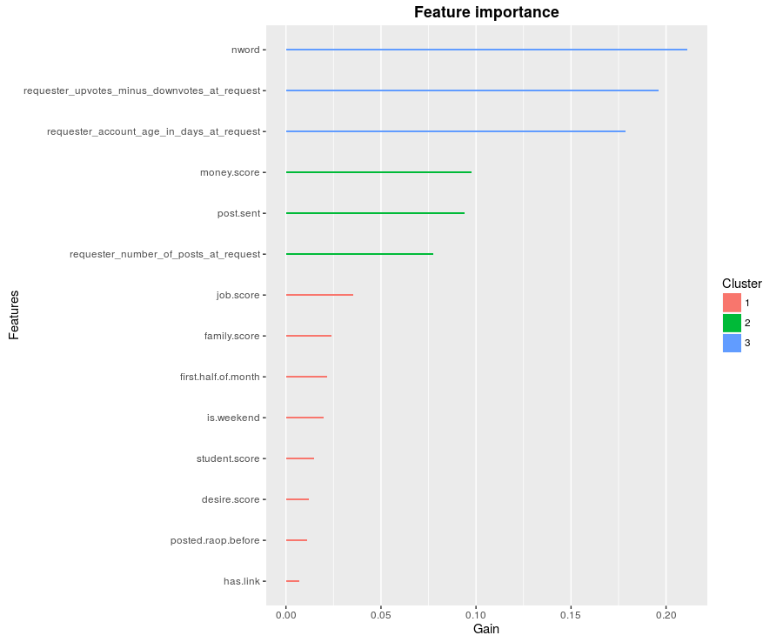
Features Selection: Xgboost relative importance
Built a ensemble of tree
What happened in Y when I change one variable and keep the rest unchanged? What is the impact in Y?
        nword (compelling)
        karma (nice user; status)
        requester account age
        money.score
        post sentiment score
        #of post at request

Slide 13
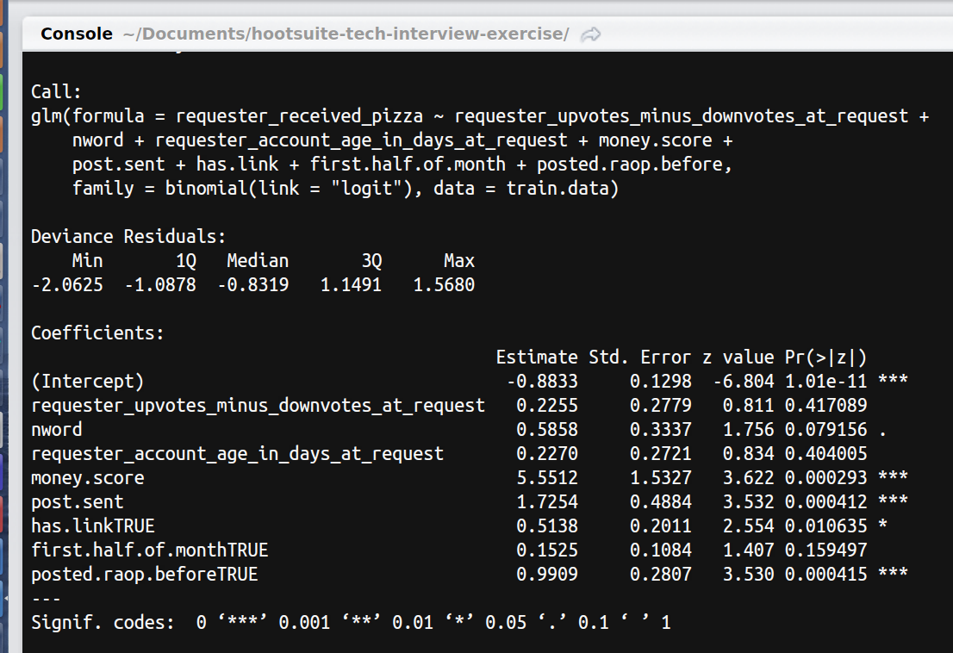
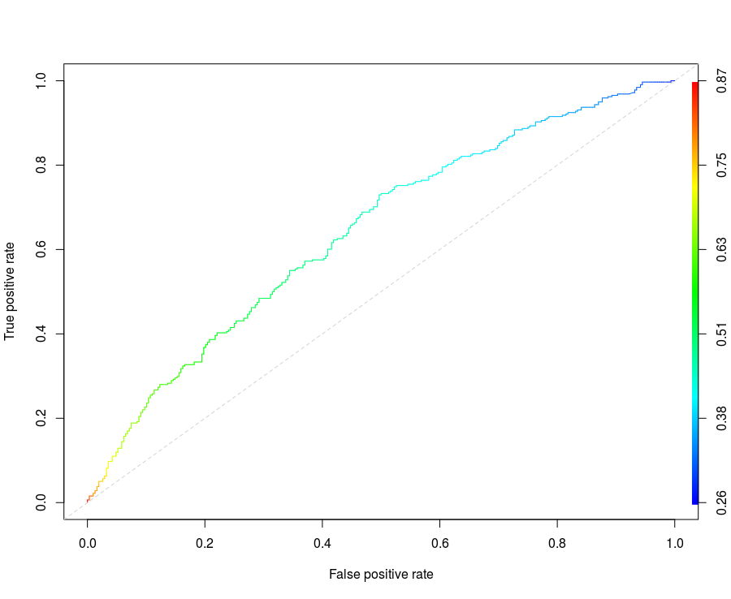
RAoP Model: Logistic Regression
AUC: 0.64 (TEST)
Accuracy: 0.59 (be right in both direction)
Sensitivity or Recall: 0.65 (hability to detect)
ROC

Slide 14
Recommendation based what I learned
        Try to be compelling (my opinion and intuition, not analysis). But write more than 100 words (pizza: median 74)
        Add a link in your post (image of a dog)
        If you are facing temporary problem with money, write about that but try to be polite and positive
        Be a nice user helps (Improve your karma)
Next Steps
        Improve variables transformations
        segment continuous variables (quantiles,deciles)
        create narrative categorical var: is.money; is.desire; ...
        Explore more variables
        Add time (trend) in the model (I forgot to include it)
        Make the model “interpretability” (make easy to understand the results)

Slide 15
Post Examples: High pos scores, nwords < 100
“My wife and I are avid pizza fans, but this month has been exceptionally tight fiscally. Having recently put together a new monthly budget (with more reasonable expenses) we've acted more responsibly, but had considerably less fun. If anyone would be so kind as to reward our new financial responsibility with dietary irresponsibility, that would be grand. I'm sure the kids would love something more than just bland-yet-wholesome Spaghetti for the third night in a row. Thanks for taking the time to read, and have a great day no matter what."

Slide 16
Like the title says I'm in a tight spot and could really use a warm pizza to lift my spirits and give me a break from KD. As it stands I won't be able to both pay bills and afford groceries when I get paid so this would be a huge boost. I'm a long time redditor and am happy to PM you from my main account to verify this as well as provide any other info you would like. EDIT: Thanks to the wonderful DEStudent I will be having pizza for supper! Thank you so much!

