Slide 1
Directory Servers
A directory server is a type of network database that stores information represented as trees of entries.
This is different from a relational database, which uses tables comprised of rows and columns, so directory servers may be considered a type of NoSQL database.
It is typically employed to store user information and passwords, simplifying account administration and centralizing credentials authentication.
It is accessed using LDAP (Lightweight Directory Access Protocol)

Slide 2
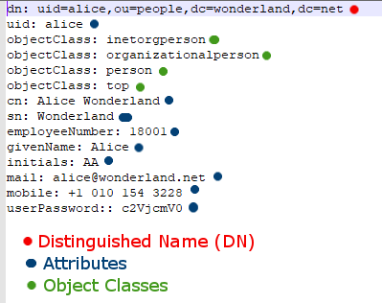

Entries
An entry (stored data) is a collection of information about an entity (i.e. person), and has three primary components:
A distinguished name (DN)
A collection of attributes (key-value pairs)
A collection of object classes

Slide 3
Distinguished Name (DN)
Uniquely identifies an entry and its position in the directory information tree (DIT) hierarchy.
It is comprised of zero or more elements called relative distinguished names (RDNs), which contain one or several key-value pairs (attributes).
For example, the DN
“uid=alice,ou=people,dc=wonderland,dc=net”
has four RDNs:
uid=alice ‘user id’
ou=people ‘organizational unit’
dc=wonderland ‘domain component’
dc=net ‘domain component’

Slide 4
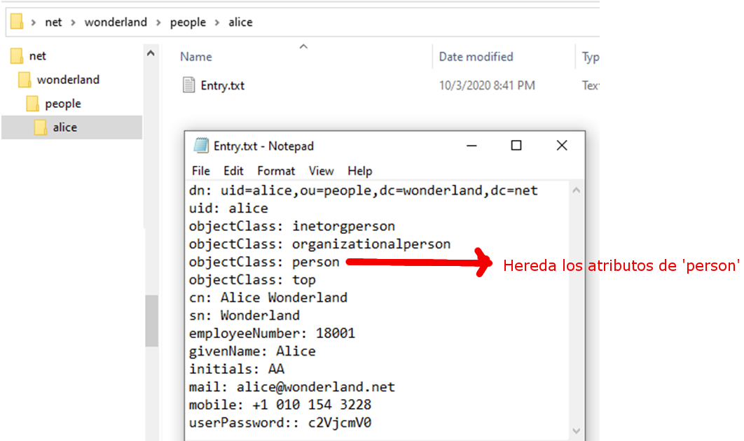
DIT vs Filesystem
<------- LOWER -------- HIERARCHY --------- HIGHER -------->
“uid=alice,ou=people,dc=wonderland,dc=net”

Slide 5
Entries
An entry has
A distinguished name (DN)
A collection of attributes
A collection of object classes

Slide 6
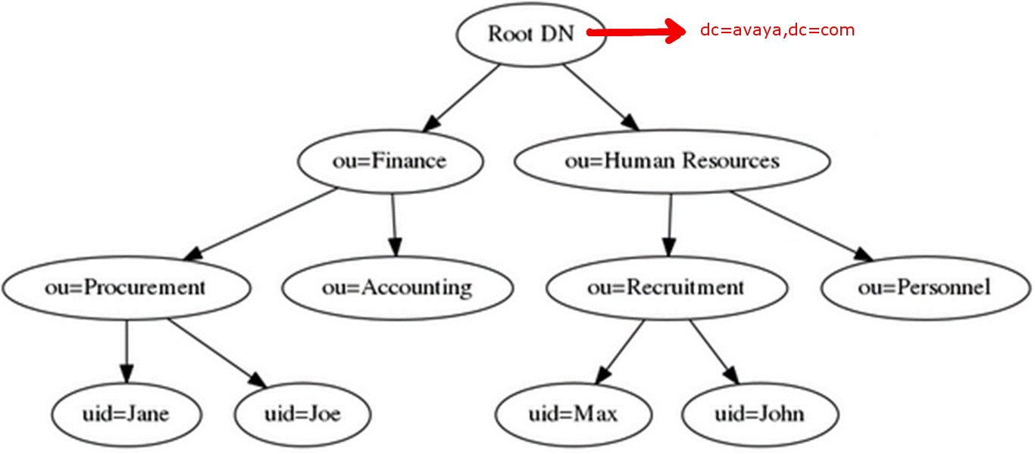
Example of DIT

Slide 7
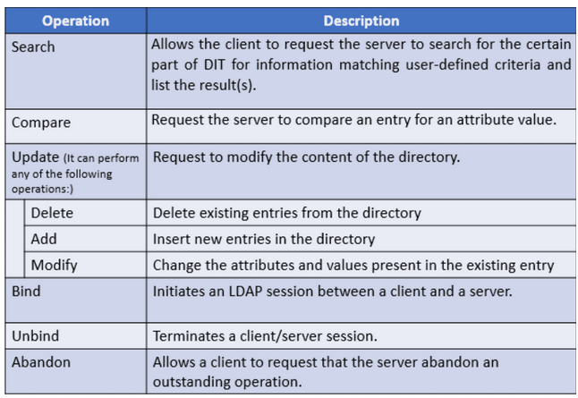
LDAP operations

Slide 8
LDAP security
Access variants:
ldap://domain.com -> basic LDAP protocol
ldaps://domain.com -> LDAP over SSL/TLS
ldapi://domain.com -> This is used to indicate LDAP over internal sockets instead of using an exposed network port.

Slide 9
LDAP authentication
There are three options for binding:
No Authentication
Basic Authentication – The LDAP client is required to provide a DN and a password for authentication (the credentials are sent over cleartext, meaning they can be easily read by an unauthorized party if one were to infiltrate their session).
SASL – Simple Authentication and Security Layer, or SASL, is a protocol that requires both the client and server to provide identifying information.

Slide 10
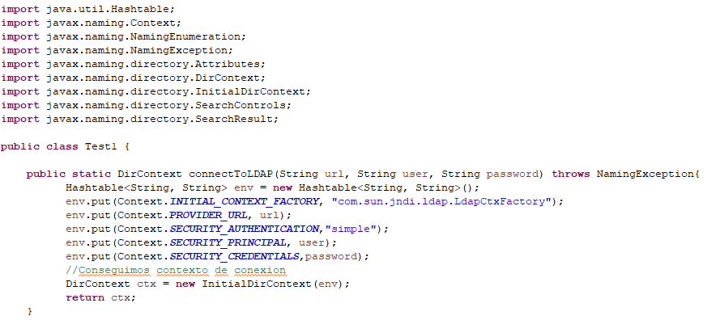
Java connect - as simple as this:
Supported directly by Java (javax)
No 3rd Party components

Slide 11
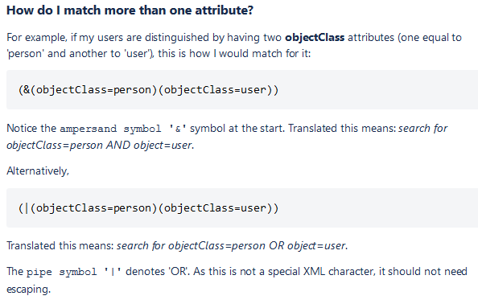
LDAP search & filters

Slide 12

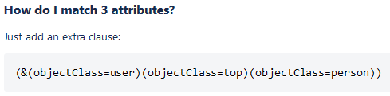
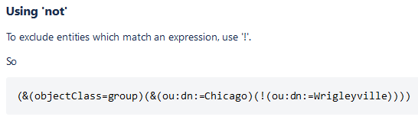
LDAP search & filters

Slide 13
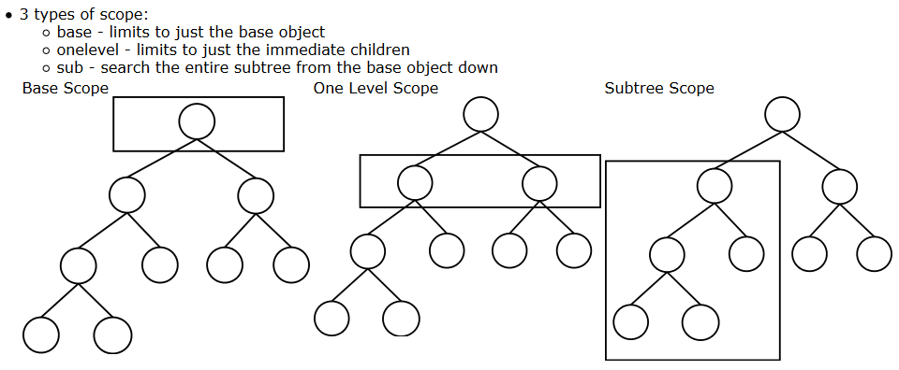
LDAP search scope

Slide 14
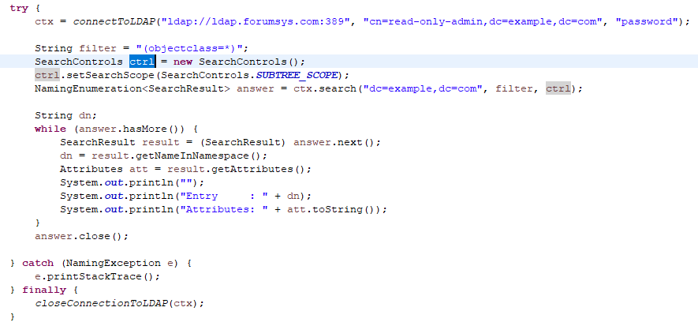
Java search - as simple as this:

Slide 15
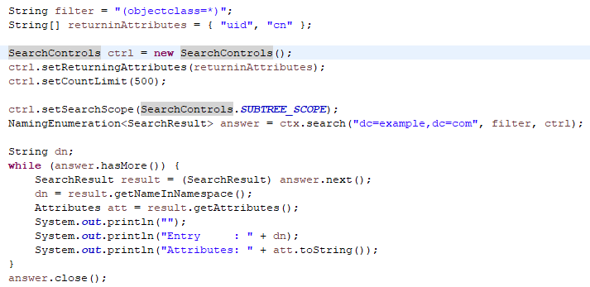
LDAP retrieve specific attributes

Slide 16

Sample Java Code

